Slide 1

Do more.
Be more.
Young Leaders’ Scheme
Scouts.org.uk
#SkillsForLife
Notes:
If you need to change the background please follow these instructions:
1. On your Windows tablet, tap the Design tab.
2. On your Windows phone, open the slide for editing (either by double-tapping it or by tapping it and then tapping Edit). Tap More at the bottom of your screen, tap Home, and then tap Design.
3. Tap Format Background.
4. You will see the background colours divided into Theme Colours and Standard Colours. Theme colours coordinate with the theme you selected previously. You can select a solid colour or colour gradient.

Slide 2
Explorer Scout Young Leader Training
Module E – Game on!

Slide 3
Do more. Be more
  Welcome
In this session, we are going to look at:
the importance of games in the section meeting
the need for different types of games and when to play them
being able to explain and run different types of games
being able to select games that suit the section’s programme
Do more.
Be more.
Young Leaders’ Scheme

Slide 4

Getting to know you...
Notes:
Icebreaker: 5- 10 mins
Key points:
Participants will be working together during the session so it's a good idea to break the ice and get to know each other first.
Activity option 1 - Speed dating:
Everyone walks around the room, finds someone they don’t know and talk for 1 minute
Ask questions: Who got you into Scouts? When did you join Scouts? What key skill do you bring to your Scout team? what they’d like to learn from workshop,
After two minutes, blow a whistle or shout and they find a new partner
Presenters can come up with other questions if they can think of better ones!
Or alternatively depending on amount or type of participants
Activity option 2 – Group discussion
Participants to discuss above questions (from option 1) within their table groups

Slide 5
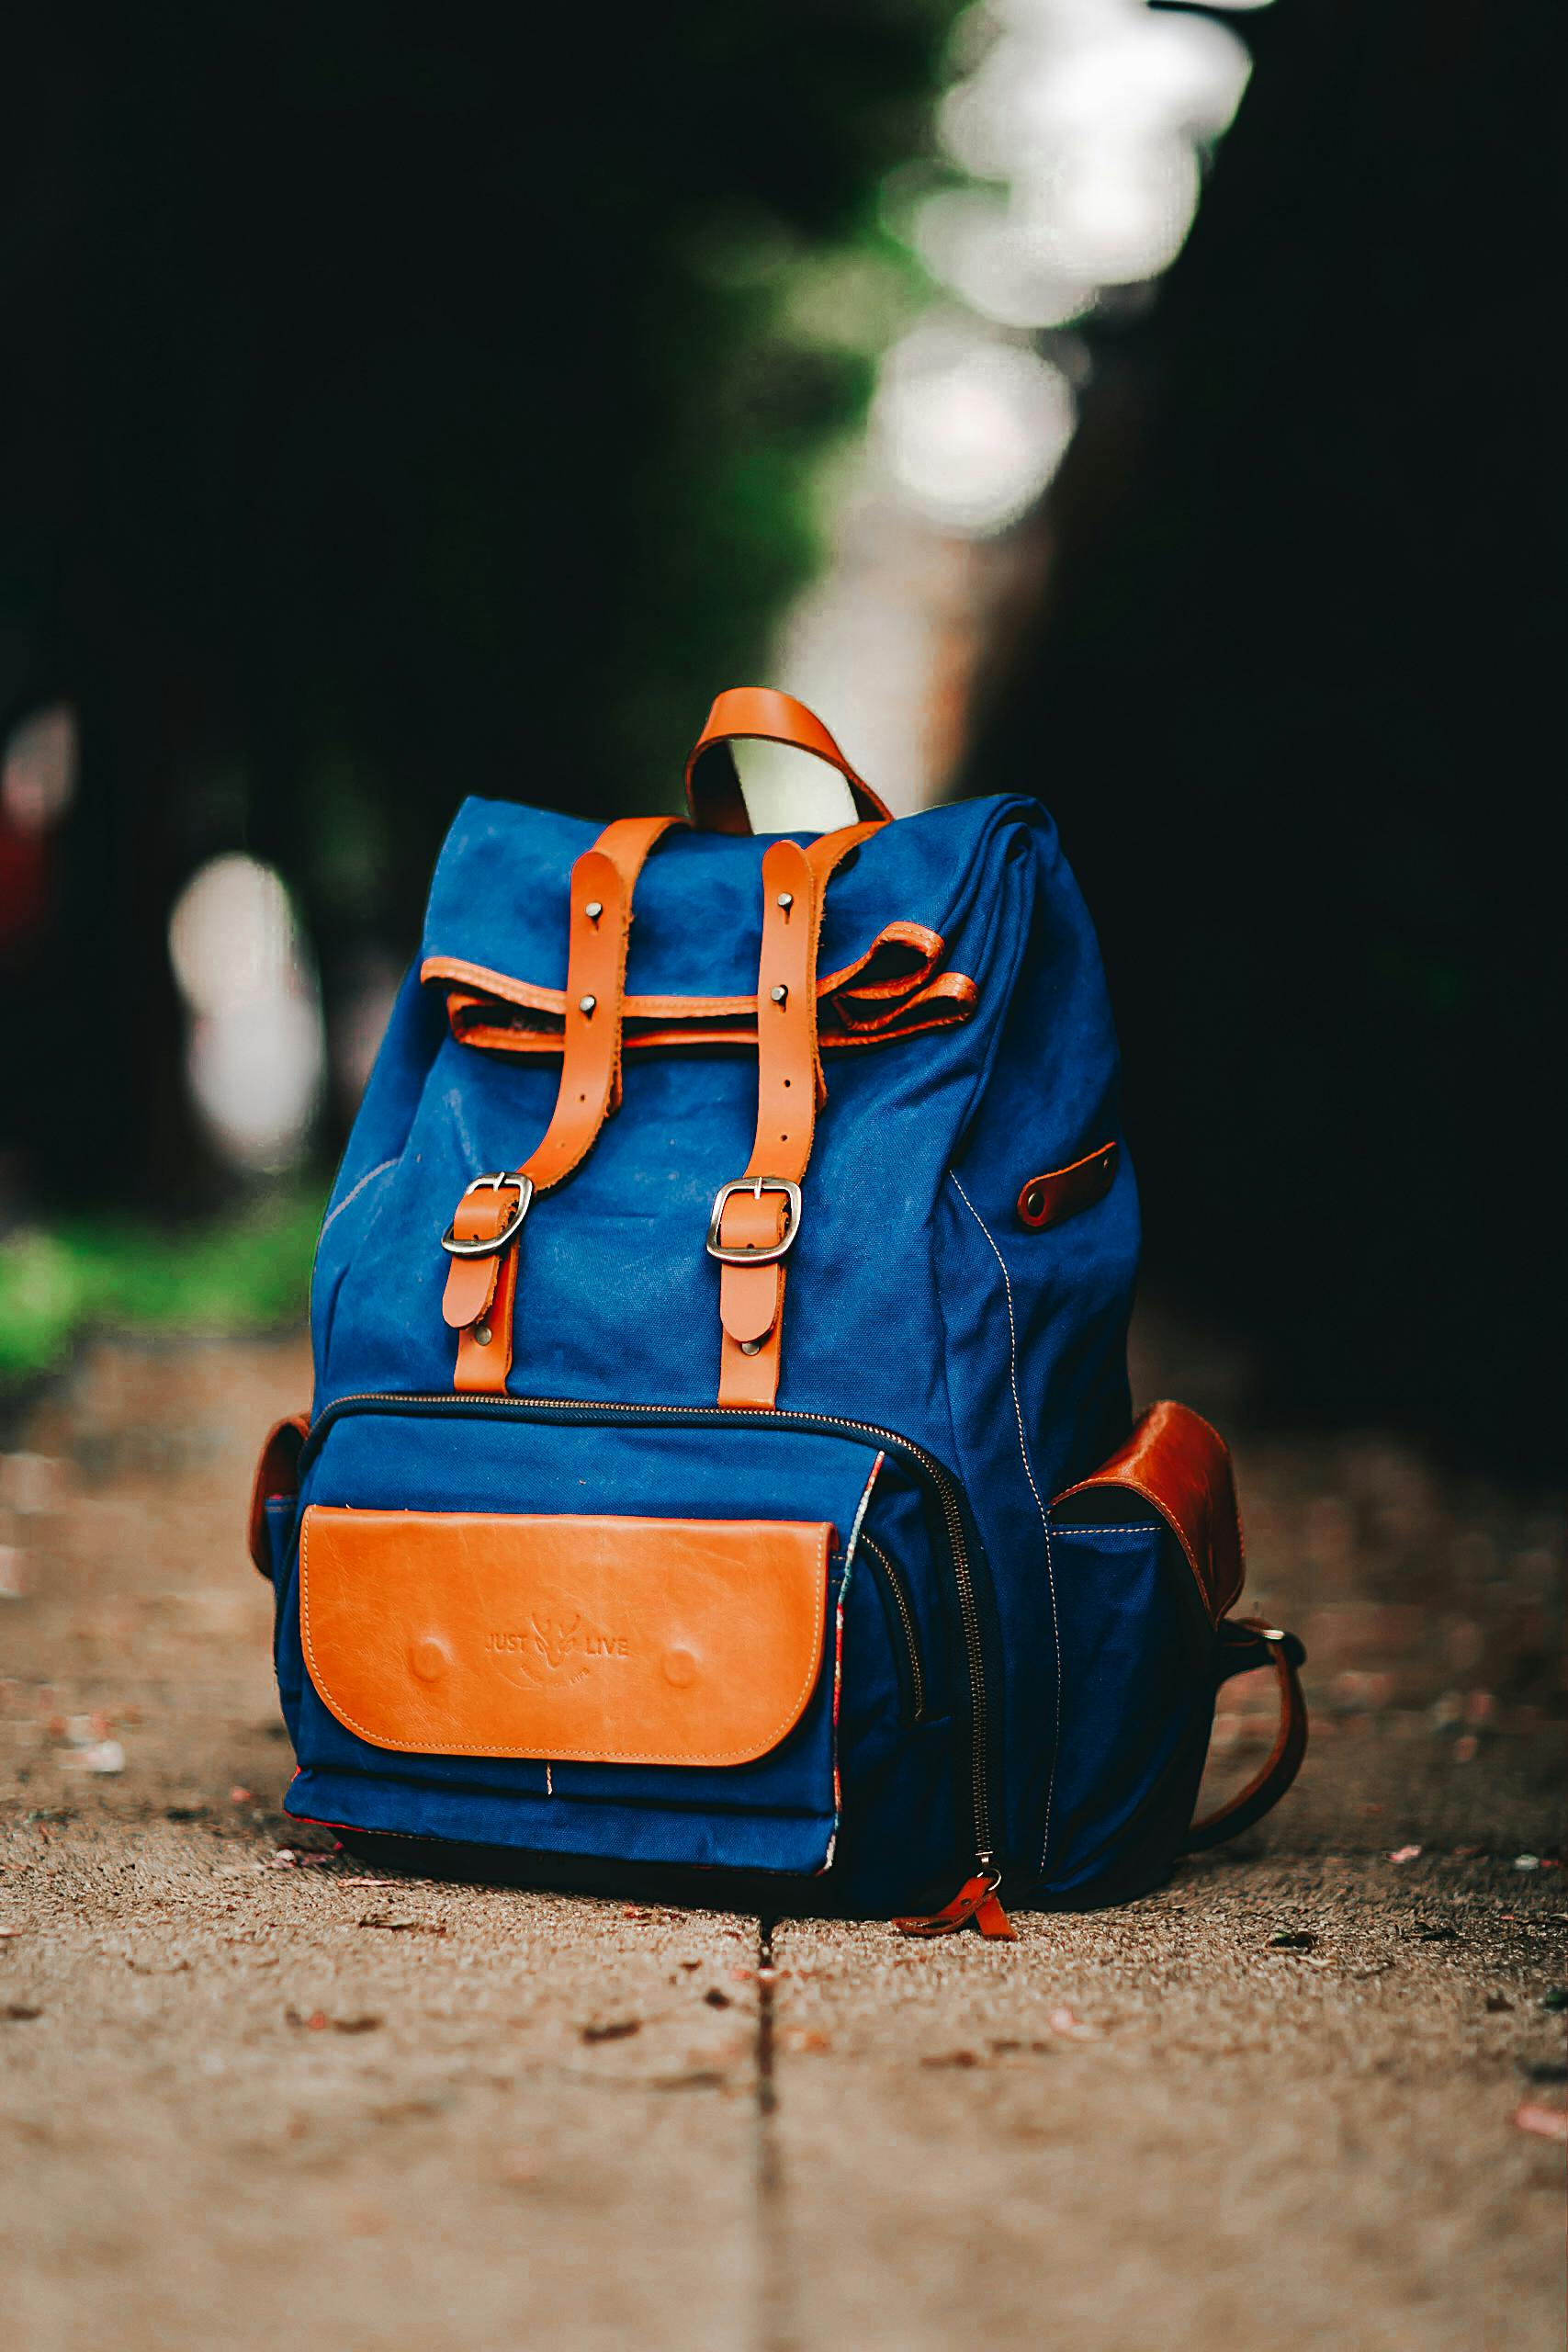
What games can you create with this equipment?
My Scouting backpack

Slide 6

What games can you create with this equipment?
A-Z

Slide 7

How can they prepare for a games session, to make sure it runs successfully?
Being prepared

Slide 8
Being prepared
Having the correct equipment
Explaining the rules clearly and simply
Maintaining discipline and sporting behaviour during the game
Timekeeping
Safety (equipment and environment)
Supervision

Slide 9
Ratios
 | Usual meeting place | Outside the meeting place | Nights away
Squirrels | 1:6 + 1 leader in charge (minimum of 3 adults) | 1:4 + 1 leader in charge (minimum of 3 adults) | 1:4 + 1 leader in charge (minimum of 3 adults)
Beavers | 2 adults | 1:6 + 1 leader in charge (minimum of 2 adults) | 1:6 + 1 leader in charge (minimum of 2 adults)
Cubs | 2 adults | 1:8 + 1 leader in charge (minimum of 2 adults) | 1:8 + 1 leader in charge (minimum of 2 adults)
Scouts | 2 adults | 1:12 (minimum of 2 adults) | 1:12 (minimum of 2 adults)

Slide 10



















Module G - What is a high quality programme?

Slide 11
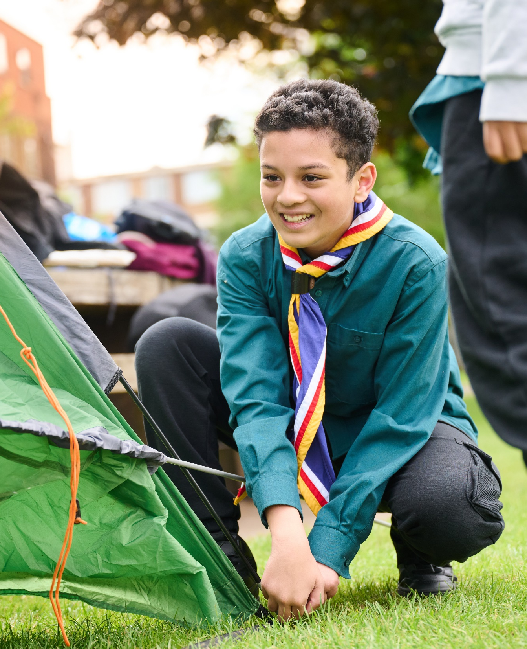
The Young Leader Scheme
Who to contact
If you have any questions, please contact the following people who will be able to help you.
Enter details of County/District contacts here

Slide 12

Thank you
Young Leaders’ Scheme
Scouts.org.uk
#SkillsForLife

