Slide 1
CLT – Safe Scouting
Head of International & Events
CST Unit Support
CST Unit Support
Health & Wellbeing:
An Inclusive Approach
Steven Maclennan
Rich Flowerdew
Rab Keddie
Scott Ideson

Slide 2
Aims of the Session
• To understand the inclusive approach that will be taken for the 2027 WSJ
Clarify expectations around care plans and information sharing
• To increase confidence in supporting Young People and their Parents/Guardians
• Engage your critical thinking of dealing with potential Scenarios

Slide 3
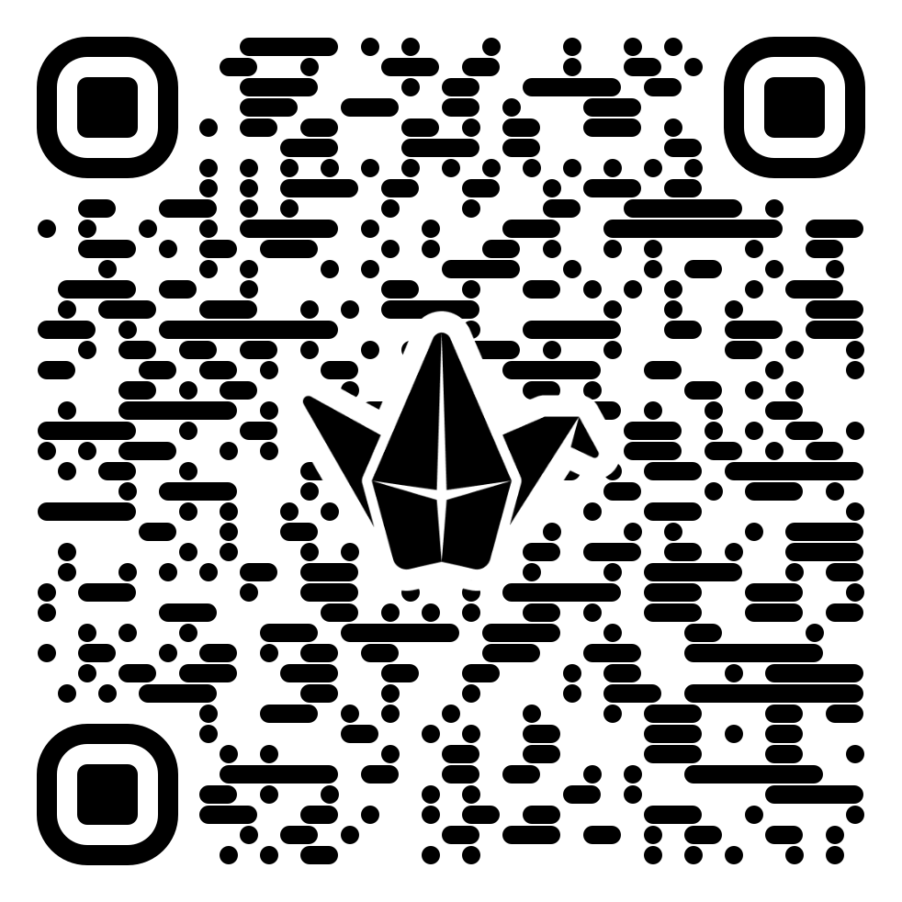
Questions – Use the Padlet

Slide 4
Recap
What has already been shared?
Map of Me - CST Unit Support
Individual Support Plans – CST Unit Support
Code of Conduct – Safe Scouting
Risk Assessment Template – UL Hub
Zendesk – UK Contingent Support

Slide 5
Coming up
Brook ‘Healthy Relationship’ Train the Trainer Session - Unit Leader Conference 2 – minimum 2 required
Further Safe Scouting sessions

Slide 6
We will support every young person to attend, as long as it’s safe to do so.
Please be honest with us. We need a realistic picture of the young people attending.

Slide 7
WSJ 2027 Approach
All Contingent Members will complete a Health and Wellbeing Questionnaire:
          Young People,
          IST,
          Unit Leaders
          Contingent Leadership and Support Team
This will be done electronically and will capture everyone’s Initial Wellbeing Data.
Including any:
          Educational, health and care plan (EHCP),
          Personal Emergency Evacuation Plan (PEEP),
          or other medical letters.

Slide 8
Terms & Conditions
It is critically important that (everyone) Parents/Careers/Guardians understand that they have singed Terms and Conditions.
You have completed the application form and provided information to the Organiser which is as accurate and complete as possible, and to the best of your knowledge.
You have provided up to date information relating to your health for us to make any reasonable adjustments and to obtain effective insurance in accordance with paragraph 8. This information will be passed to the Travel Provider and any applicable suppliers as may be required for the purposes of providing you with the travel services in connection with the Event.
You will let the Organiser know of any material changes to this information, either directly or via our registration system.
You must give us complete and accurate information about yourself and your health if we organised group insurance on your behalf. You must tell the Lead Contact if your personal health changes before and during the Event.

Slide 9
WSJ 2027 Approach
Gateways
create a
The UK Contingent will be using a Gateway model for Health and Wellbeing Support for all members of the Contingent. - You have already provided us some information and this approach will build incrementally on this.
Each Gateway will support a different level of Additional Support Need and correspond to a greater amount of information that will be required.
All H&WB questionnaires will be reviewed by the UK Contingent and supported accordingly.
The following is indicative and as an example – more information will come out shortly.
Gateway 3
Gateway 2
Gateway 1

Slide 10
WSJ 2027 Approach
Gateway 1
This will be Gateway 1 on the Health and Wellbeing Triangle.
Gateway 1 – Will be supported by the use of the “Map of Me” document. Gateway 1 will be fully supported by Units Locally – it requires little or no escalation to the UK Contingent/Organisers.
Remember to use your local Inclusion Team Leads for ongoing advice and support.
Gateway 1 may Cover:
Dietary, ADHD, Autism, Well managed & pre-existing medical conditions (CPAP, BIPAP etc), General Support and Wellbeing
create a
Gateway 1
Map of ME

Slide 11
WSJ 2027 Approach
Gateway 2
create a
Gateway 2 –Will be supported by the use of the “Individual Support Plan”.
This requires the UK Contingent to “know something” to “support” an individual appropriately or to escalate to the Jamboree Organisers to ensure appropriate supports are in place.
It will be reviewed by the Contingent and supporting teams at UKHQ
Gateway 2 may cover. Mobility Support or Aids, anyone who has been an in-patient (i.e. admitted to hospital) or emergency (in A&E or by the ambulance service) treatment for their mental health in the last 2 years?, Those being assessed, or seeking a diagnosis, for any health issues,
Gateway 2

Slide 12
WSJ 2027 Approach
Gateway 3
create a
Gateway 3 –Will be supported by the use of the “Care Plan”.
Gateway 3 requires the UK Contingent to “know something” and “DO” something for an individual, or to escalate to the Jamboree Organisers to ensure appropriate supports are in place.
It will be reviewed by the Contingent, and supporting UKHQ Teams.
Gateway 3 may cover, assistance with personal care, for example using the bathroom, washing and getting dressed? Will need a carer to enable attendance at the Jamboree, a history of self-harm within the last 2 years?
Gateway 3

Slide 13
UK Scouts – Medical Panel
UK Scouting have introduced an International Medical Panel.
Its aim is to support individuals in the Contingent to safely attend International Events.
Advise Event Leadership Team to make individual decisions about support needs, thresholds and attendance at International Events.

Slide 14
We will support every young person to attend, as long as it’s safe to do so.
Please be honest with us. We need a realistic picture of the young people attending.

Slide 15
Health & Wellbeing Form – Example

Slide 16
Working Together
We will need to work together and this may take some time:
More than four in every 10 pupils in Scotland are listed as having an additional support need
Nearly 1 in 5 pupils (19.6%) are identified as having SEN in England
9.5% of pupils (43,885) are identified as having an ALN/SEN in Wales
18.2% of pupils were identified with SEN in Northern Ireland
If we look at the UK Contingent
73 Units * 36 Young People = 2,628 Young People if we take a conservative estimate based on other International Events we will need to review 30-40% of all Submissions = ~788 - 1,051 Submissions.
We will need to work together to support Young People, Parents, Careers and Guardians complete the Health and Wellbeing Survey and any further information as it is identified or required.

Slide 17
We are now going to look at some “Scenarios” from past Events – if at any point you feel uncomfortable or need a minute there is support available in the “lid” or speak to a member of the team after.

Slide 18
Scenario
YP has exhibited serious risk taking behaviours.
You have escalated for support to your County Team, but there has been a reluctance to take action.
Behaviours are continuing to escalate.
What do you do next?

Slide 19
Scenario
Unit Leader who has coeliac and needs a special diet whilst on their Jamboree Journey.
What do you do?

Slide 20
Scenario
A Unit Member with a Mobility aid, has not been able to take a shower due to the on site facilities.
What do you do?

Slide 21
Scenario
Its February 2027, A YP breaks their leg whilst playing football. They require surgery and an external fixation device to support the repair.
What do you do?

Slide 22
Scenario
A Unit Member, with a serious bee allergy, has lost their EpiPen, during the Opening Ceremony.
What do you do?

Slide 23
Scenario
A Guardian discloses that their Unit Member, has ADHD and a medication regiment.
What do you do?

Slide 24
Scenario
During your final prep camp, a Unit Member, becomes withdrawn and self isolates.
You speak to the Parents, and they disclose a known condition for the first time.
What do you do?

Slide 25
We will support every young person to attend, as long as it’s safe to do so.
Please be honest with us. We need a realistic picture of the young people attending.

Slide 26
Questions – Use the Padlet

