Slide 1



What young people want from Scouts
Insights from the UK Youth Forum

Slide 2
Objectives
Understand the findings of the UK Youth Forum
To be able to communicate and champion these locally
Understand how this has supported Scouts' next strategy
Notes:
2

Slide 3
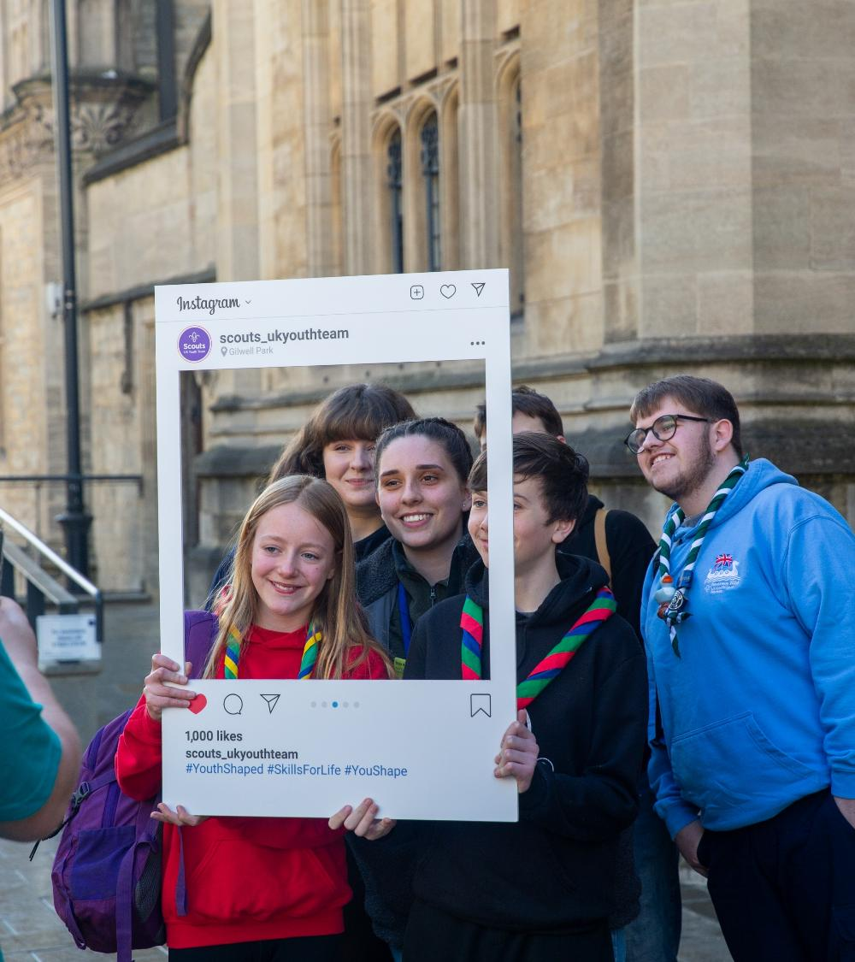
In this deck
What we did
Key findings
  Prioritising within our next strategy
  Youth Voice
  Shaping the Future
What this means for you
What’s next

Slide 4
What did we do?

Slide 5
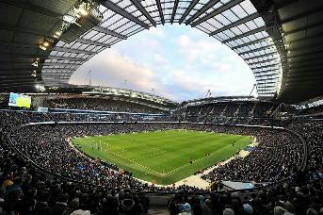
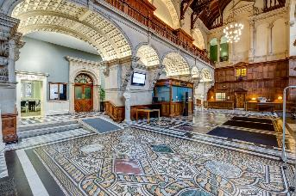

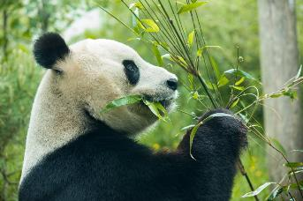
8 March - Etihad Stadium, Manchester
What we did
4 in-person events
1 day programme, ran across the UK
2 Scouts, 2 Explorers and 1 Network and 1 other volunteer from each area
All Nations and BSO represented
Strategy-focused workshops + area-specific workshops
Supported by Youth Leads
2 Self-led activities
Supplementary activities launched in January
Open to all sections with
suitable variations
15 March –Examinations School, Oxford University
29 March - Stormont, Belfast
5 April – Edinburgh Zoo, Edinburgh

Slide 6
The in-person programme
3 Strategy-focused sessions
(all participants)
Prioritising our Strategy – using prompts from Summit25 and the Youth Consultation
Youth Voice – reflecting on the meaning, impact and future of youth-shaped Scouts
Shaping the future – considering what Scouts and the world might look like in 2035
5 additional sessions
(some participants)
Sustainability
EDI
Digital
Safe Scouting
Advocacy
1 fun activity in exciting venues!

Slide 7
We spoke to...
544 Scouts across 4 events including 157 Scouts, 199 Explorers, 96 Network and 92 over-25s
1,050 young people aged 4-24 through self-led activities

Slide 8
Who we reached
2.2% of delegates attending were eligible for free school meals
The majority of delegates identified as Christian or of no faith:
  52% of No Faith
  42% Christian
  1.3% Muslim
7.6% of delegates identified as non-White:
  2.4% Mixed ethnicity
  1.8% South Asian
  1.8% Irish
* Of 64% total respondents

Slide 9
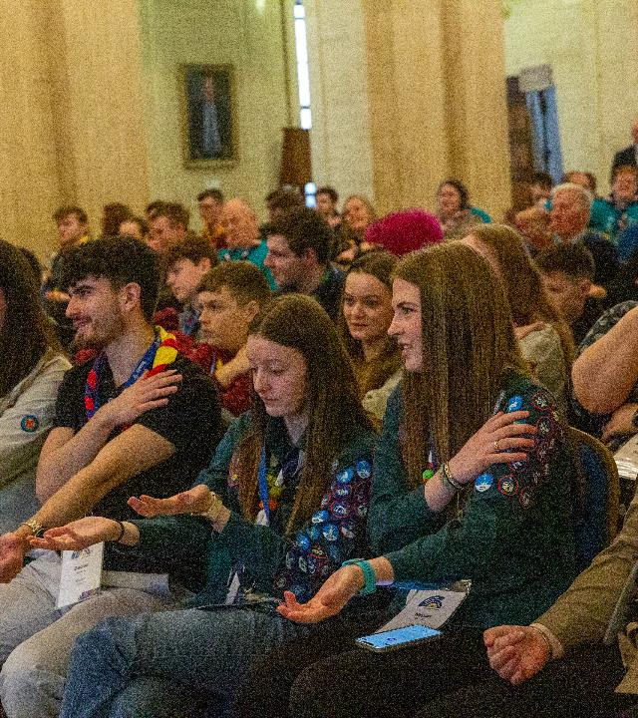
Limitations & considerations
The delegates attending provide a representative sample from across the UK.
It was up to local areas to decide how to form their delegations; some undertook fair selection processes, others were more likely to use local contacts, although efforts were made to mitigate this.
Delegates attending were likely to feel positively about Scouts; this data still needs to be considered in hand with data from the external youth consultation to provide a full picture.

Slide 10
What did we find out?

Slide 11
What are young people’s priorities for our next strategy?

Slide 12
Ranking the six youth consultation outputs
Happiest
It would make me happier if Scouts…
Provided more outdoor and adventurous activities
Gave me more opportunities to learn life skills
Became more youth led
Supported young people’s well-being more
Interacted more with the local community
Became more digital
77%
75%
68%
74% put these
in the top 3
Well-being
Community
Digital
Percentage of young people
Outdoor & adventure
Life skills
Youth-led
76% put these
in the bottom 3
Least Happy
66%
75%
98%

Slide 13
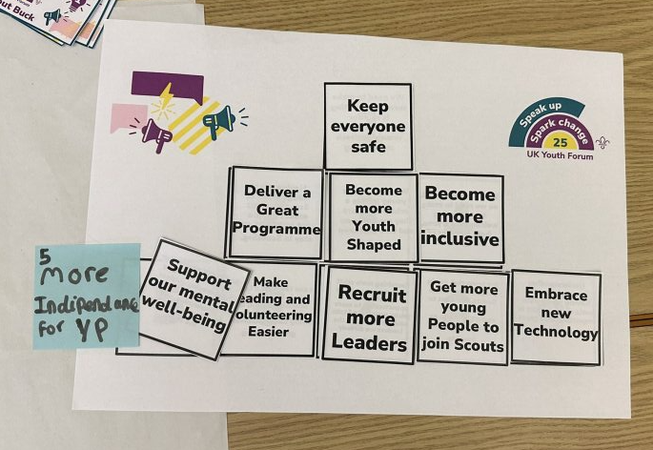
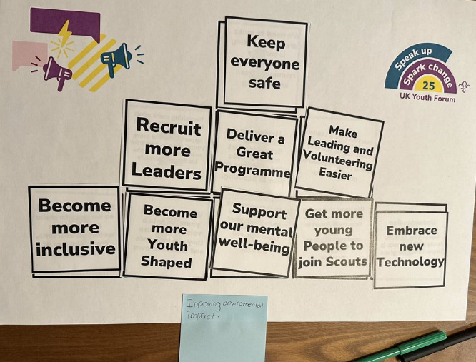
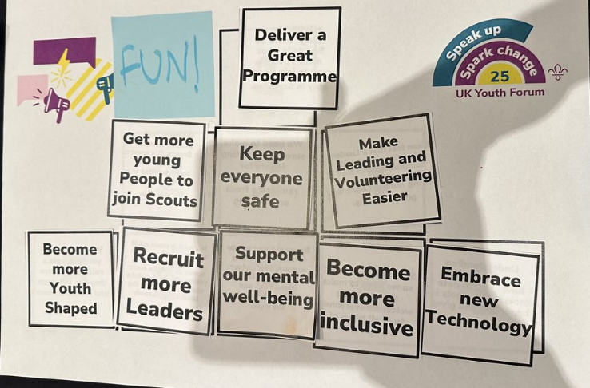
Young people ranked the nine themes from Summit based on what they felt Scouts ‘should’ be doing – then added one more priority they felt was missing.

Slide 14
* N.B. 1 indicates highest average rank, 9 indicates lowest average rank.

Slide 15
What did young people feel we haven’t discussed?
Community is the single most mentioned topic. Young people want spaces to meet other young people with similar ideals. There is a strong desire to interact with other sections and groups.
There is strong concern about a lack of physical and financial resource available to run programme. Young people sought support with funds and fundraising, as well as with resource sharing (e.g. facilities).
There is some desire to embrace the future but cherish tradition and our existing scouting model. Uniform is generally popular, but for some uniform = school.
Young people desire ‘new opportunities’ to gain skills, from financial to ‘life’. 14-24s want more active programme, and support transitioning between sections.
Leadership support for young leaders was highlighted, both for whilst being a young leader, and in the transition to adult leadership roles.
Sustainability and inclusivity were frequently mentioned as a key topics.
Lots of programme ideas were highlighted, particularly international opportunities and desire for more events at a national or county level.

Slide 16
Turning words into action…
Section Leaders
Explore how you can bring more adventure to your programme
Connect young people with their community
Continue to involve young people in decision making
Regularly adapt your programme
Supporters
Support events and moments for groups and sections to meet and mix
Help facilitate local scouting and youth shaped opportunities
Support young people’s mental wellbeing
Explore opportunities to upskill our volunteers
Lead Volunteers
Keep prioritising safety
Share youth leadership opportunities publicly
Look for ways to increase adventurous activities, and varied programmes
Drive positive change and support our volunteers

Slide 17
What did young people have to say about Youth Voice?

Slide 18
We asked everyone...
What do young people need to feel confident sharing their opinions?​
How can Scouts empower people to speak up and spark change?
How can we ensure young people have ongoing input in decision making?​
How can we get more young people into leadership roles?

Slide 19
Key themes – youth voice enablers
Feedback & action
Young people wanted to see change from their input; they asked for regular feedback loops, transparency and accountability.
Skill
development
Desire for more opportunity to develop skills such as public speaking and social skills, with external recognition.
Visibility & promotion
Felt they needed more awareness of opportunities available.
Safe spaces
Young people felt strongly about psychological safety; the need for judgement-free, welcoming and safe spaces. Many particularly referenced using smaller groups to discuss, ability to share thoughts anonymously, inclusivity and mutual respect.
Other
suggestions included anonymity, wider engagement and inclusivity.
Youth leadership opportunities
Lots of ideas for better youth representation, with a strong desire for more young people in leadership roles. They wanted more opportunities for forums, discussion and engaging activities.
Trusted leaders
& role models
Scouts could best empower them to deliver change through strong leaders. They desired role models who lead by example, mentorship opportunities and accessibility.
Support &
Community
Young people desired positive reinforcement from leaders and strong peer support. They also wanted more engagement with local communities to enact change.

Slide 20
What do they need from us?
Feedback & action
“Feedback loop so you can see the change”
“Seeing ideas happen”
“having evidence that our voice is being heard”
“You said this… and We did that…”
Skill
development
“help to build skills like social skills, confidence and independence”
“External recognition, such as UCAS points”
Safe spaces
“Dedicated safe space”
“Feeling seen and heard”
“Having someone to listen not judge”
“Someone you feel comfortable with”
“More time for listening”
“Creating inclusive and positive teams”
“respect their ideas”
“having discussions in smaller groups”
“Reassurance”
Visibility & awareness
“Publicising roles”
“show them how fun and helpful it is for them”
“not letting them feel different”
“anonymity”
Trusted leaders
& role models
“Leaders who act and listen”
“Activities for our leaders
(not just watching us)”
“Older volunteers putting faith in young people – mentorship”
“inspirational talks”
“enthusiastic leaders”
Opportunities &
Platforms
“Actually interesting activities”
“Youth forums”
“Opportunities to speak up”
“Improve young leader training”
“Younger people roles”
Support &
Community
“Support”, “Encouragement”
“To be asked the right questions”
“Ideas not being shut down”
“Feeder ideas”
“Time to think”
“friend support”
“respect”

Slide 21
“Leader perks”
“Younger people roles, making it seem fun, focusing on interests, running particular taster sessions”
“Electing patrol leaders”
“Have a forum every term”
“Actually interesting activities”
“Events like this”
“Opportunities to speak up”
“Patrol leaders and APL training”
“Different communication methods”
“teach leaders how young leaders can teach”
Young people had plenty of ideas…
“Youth forums”
“Having more young people involved in meetings”
“Youth forums - colony, pack, troop etc. - building into a programme”
“Town hall with all Scout Groups”
“Improve young leader training”
“Being allowed to sit in meetings”
“Regular small bits of information rather than all at once”
“Ideas post box”
“more forums...nationwide, online”
“Patrol leaders”
“Surveys” , “Routine inputs”

Slide 22
Turning words into action…
Section Leaders
Continue to provide a safe, judgment free space.
Provide opportunities for young people to share their ideas and give feedback
Make sure you close the loop after you’ve acted.
Remember you are a role model!
Supporters
Help develop volunteers and provide learning opportunities (especially to improve facilitation)
Provide opportunities for young people to develop their skills
Remember you are a role model!
Lead Volunteers
Support and encourage volunteers to listen and act on youth voice.
Share youth leadership opportunities publicly
Consider how young people can help shape your local area, and publicise good practice
Remember you are a role model!

Slide 23
What are young people saying about the future?

Slide 24
Excitements
Worries
Personal development opportunities
New experiences
“Moving to places with more opportunities to do hobbies”
“meeting new people”
“opportunity to make change”
International experiences
“Explorer Belt” “Travelling”
“Jamborees” “WSJ27”
“meeting Scouts from around the world”
Adventure and the outdoors
“more adrenaline inducing/adventurous activities”
“competition camps”
“hikes - pushing yourself”
Community, equality and global impact
“seeing the change we make come into action and make impact”
“the growing population of female scouts”
“Trying new things” “university”
“working towards my platinum”
“having a job that I love when I'm an adult”
Social, community and health
“changes” “the unknown” “covid kids” “loss of freedom”
“how I come across” “underperforming” “lack of mental health support”
The environment
“the intensifying affects of climate change.”
“global warming”
“animals are going extinct”
Scouting
“Scouts dying out” “loss of interest”
“Scout groups losing money”
“getting permits. They seem to be getting harder for leaders to get”
War and conflict
“More wars”
“WW3” “fascism”
“Unstable counties”
“everything going up in flames”
Politics
“Trump” “Elon Musk” “Putin”
“...a lot of my unit expresses worries about perhaps a turn to overly traditional scouting - especially with the sexism in America. Keep scouts inclusive.”
Further comments around leadership opportunities, increased responsibility and new skills and learning.
Further comments around financial challenges, education and careers, AI and reliance on tech.

Slide 25
What does success look like for you in 10 years' time?

Slide 26
“Make employers aware of how good scouting is so I can shout about my achievements with them understanding”
“More opportunities to travel”
What do you need to make your dreams a reality?
“Show me how to lead and show compassion to others”
“They believe in me. They are there when I need someone to pick me up when I’m down”
“Scouts provides a place that optimises my mental health which enables me to focus on my goals”
“Better opportunities. Many are just roles 18 to 25 which is hard”
“Finding a group of friends to support and be supported by”
“Learn from those around me in scouting and soak it all up”
“Grit and determination over talent or intelligence!!”
“win the lottery”
“Manage my time and money well”
“Climb smaller peaks to prepare for bigger ones”
“If I put my mind to it I’ll achieve my goals with respecting other people”
“Work hard in school”
What can Scouts do to help get you there?
“Have friends and family help to do some of the more challenging things”

Slide 27
Over the next ten years, what should Scouts biggest goal be?
Young people discussed a broad range of themes when considering Scouts in 2035, with ability to achieve awards and provide life skills coming out on top.
Inclusivity & accessibility interestingly came through very strongly, with reference to ethnic diversity, financial accessibility and addressing disability needs.
Youth-led and growth were also frequently referenced, with many describing desire to enable other young people to benefit from the same experiences they had. Outdoor adventure and programme was also frequently referenced.

Slide 28
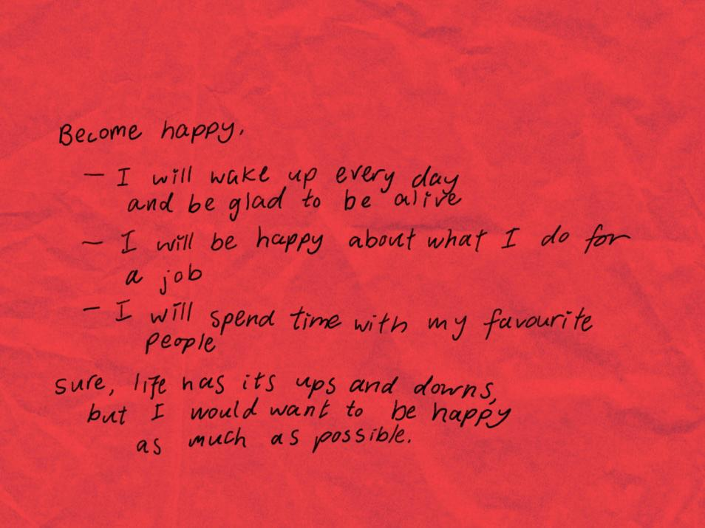
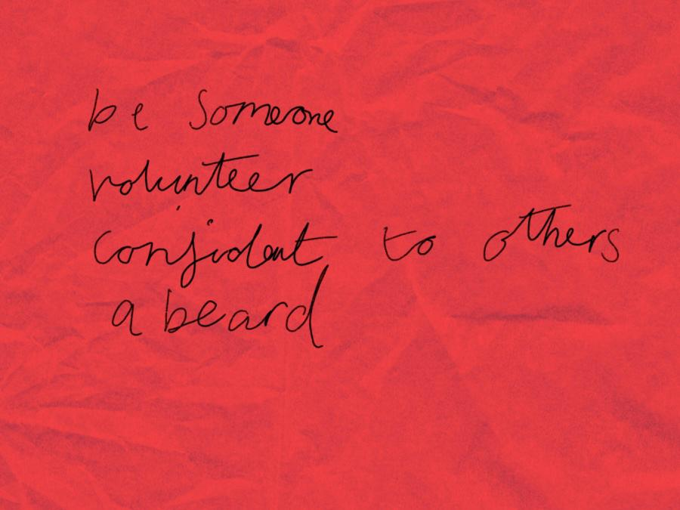
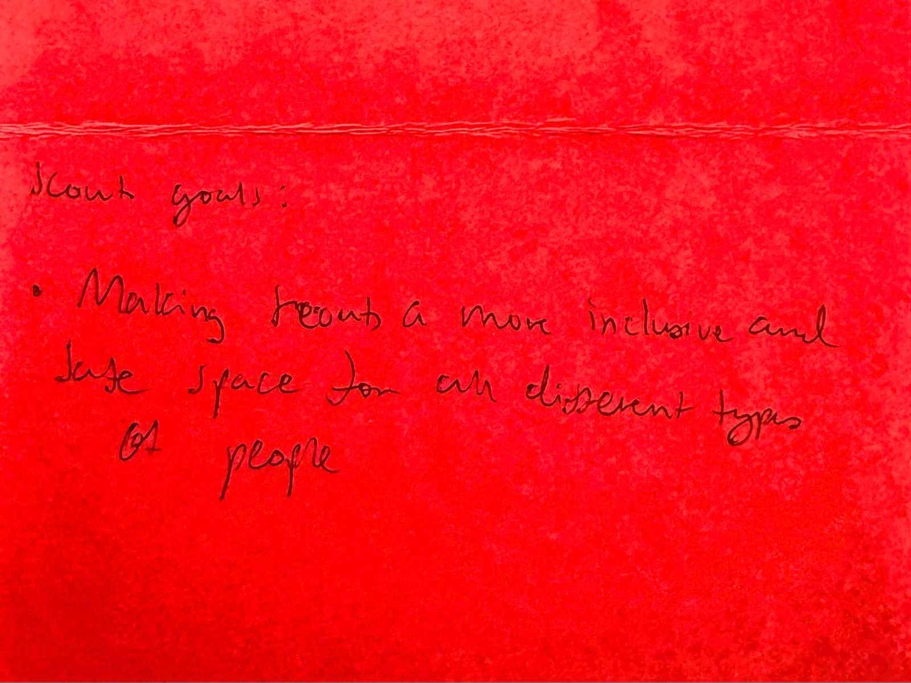
Scouts
Top 5 themes:
Awards & life skills
Growth and expansion
Inclusivity and accessibility
Youth-led initiatives
Leadership pipeline

Slide 29


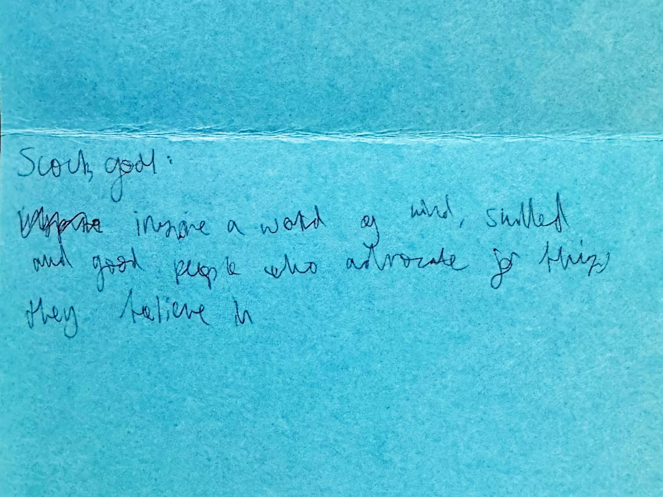
Explorers
Top 5 themes:
Awards & life skills
Inclusivity and accessibility
Youth-led initiatives
Growth and expansion
Outdoors adventure and programme

Slide 30
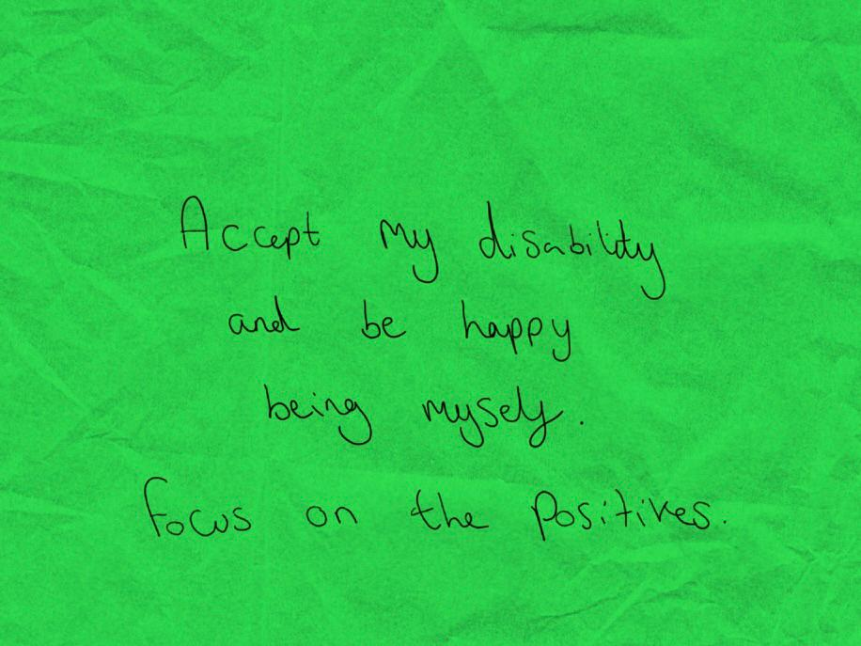
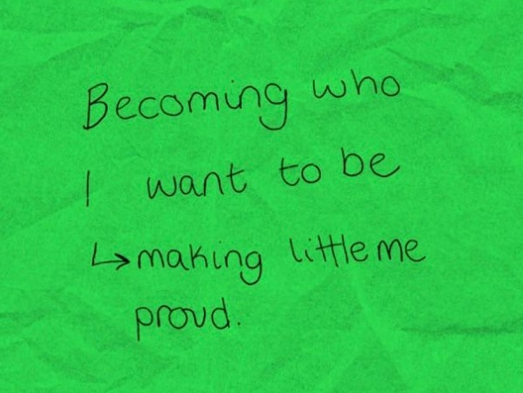
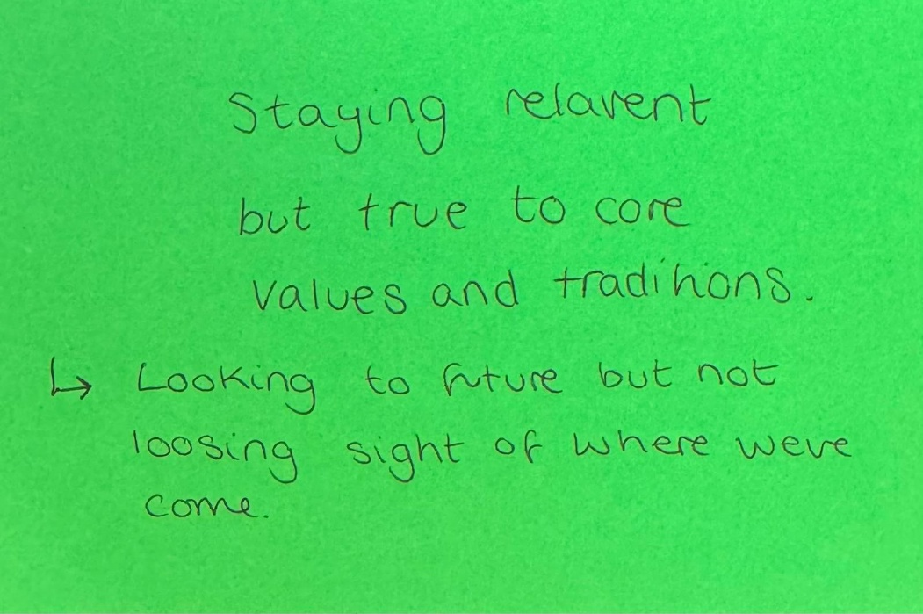
18-25
Top 5 themes:
Awards & life skills
Inclusivity and accessibility
Youth-led initiatives
Outdoors adventure and programme
Volunteer support / increasing volunteers

Slide 31
Turning words into action…
Section Leaders
Focus on achieving Top Awards
Champion the voice of young people – and consider what makes them happiest
Identify and embed life and employability skills in your programme
Share new experiences with young people
Supporters
Help us grow and share the benefits of scouting with others
Support sections to deliver exciting and new experiences
Ensure everything we do is inclusive and accessible
Lead Volunteers
Champion inclusivity and drive support for young people and volunteers
Ensure volunteers have the tools and resources to deliver a varied, quality programme
Support our volunteers and look for ways to find new ones

Slide 32
What does this mean for you?

Slide 33
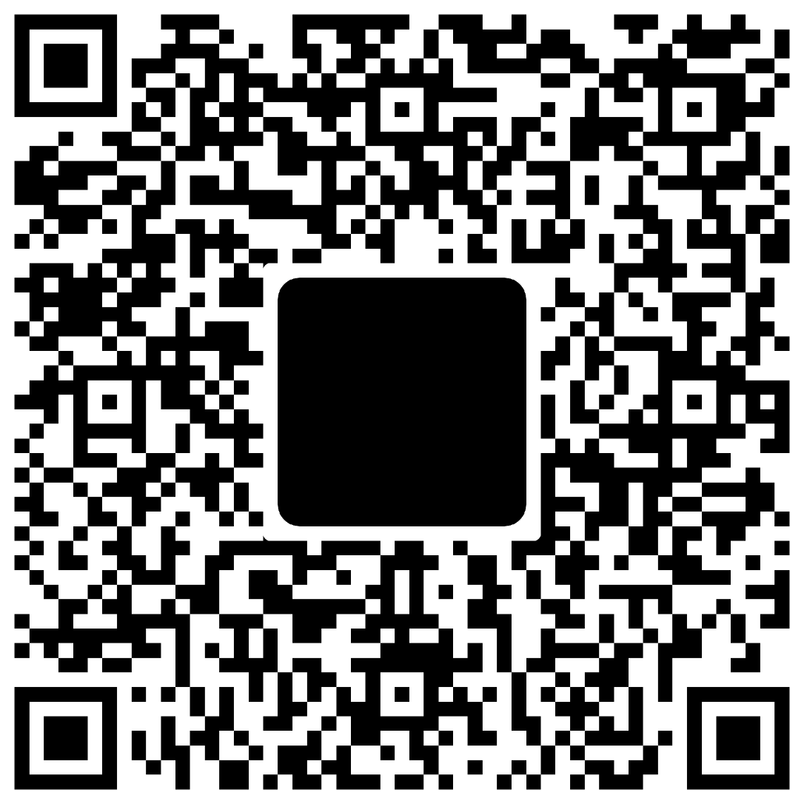
Read more about the UK Youth Forum findings here...

Slide 34
Our new strategy…
Our vision:
To empower more young people, through adventure, teamwork and shared values, to take the lead on making a positive difference in the world.
Two Pillars:
Delivering an adventurous and inclusive programme
Supporting our volunteers

Slide 35
Our new strategy…
Our vision:
To empower more young people, through adventure, teamwork and shared values, to take the lead on making a positive difference in the world.
Two Pillars:
Delivering an adventurous and inclusive programme
Supporting our volunteers

Slide 37
Thank you

