Slide 1
Notes:
As children are walking into the hall have slide 1 on display
Move onto slide 2 when ready to start……

Slide 2
Welcome
Notes:
Introduce yourself
Thank them for allowing you to spend some time during their assembly

Slide 3
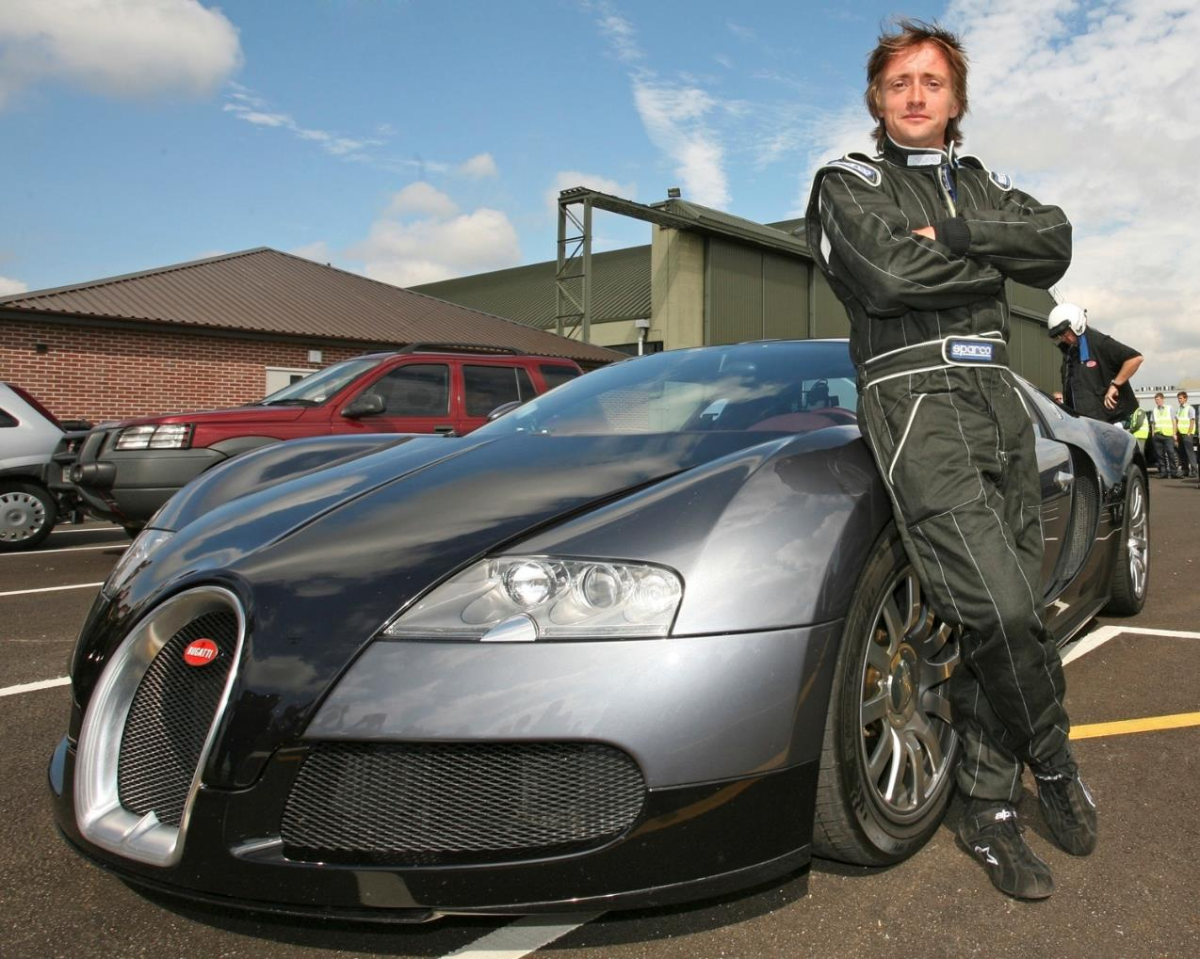
Notes:
Richard Hammond
is an English presenter, writer, and journalist, best known for co-hosting the BBC Two car programme Top Gear from 2002 until 2015 with Jeremy Clarkson and James May.

Slide 4
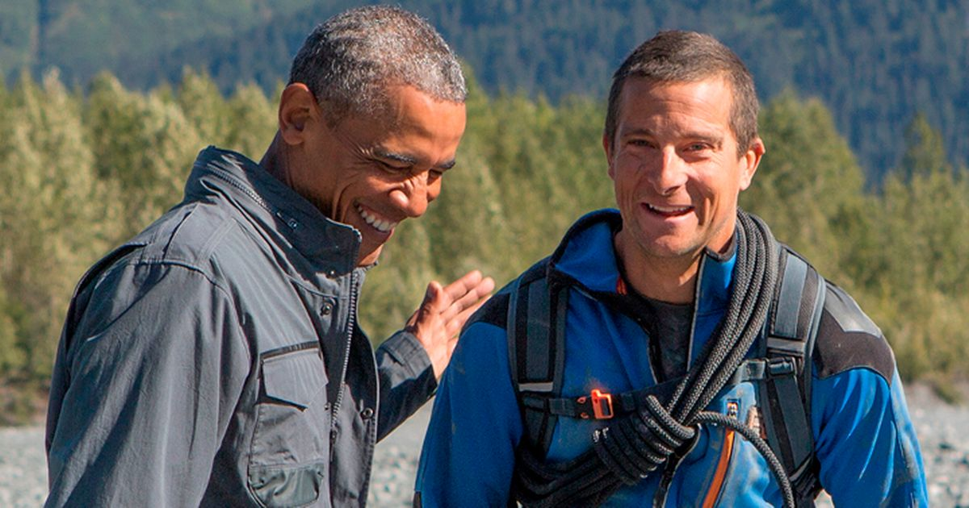
Notes:
Barack Obama and Bear Grylls
Barack Hussein Obama II (/bəˈrɑːk huːˈseɪn oʊˈbɑːmə/ (listen);^{[1]} born August 4, 1961) is an American attorney and politician who served as the 44th president of the United States from 2009 to 2017.
Bear Grylls, is a British former SAS serviceman, survival instructor, and honorary lieutenant-colonel, and, outside his military career, an adventurer, writer, television presenter and businessman.

Slide 5
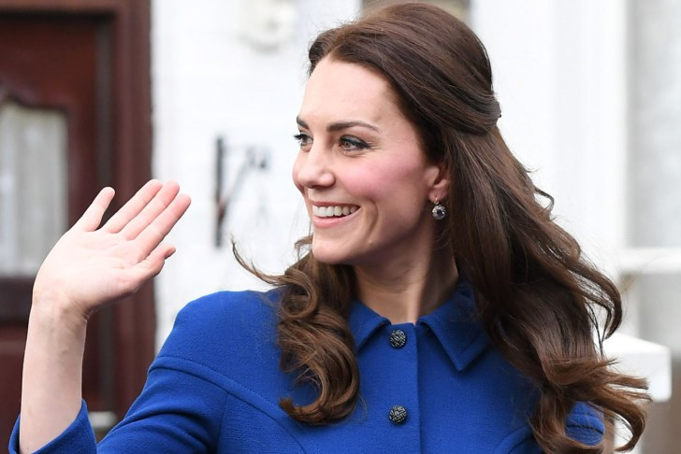
Notes:
Catherine, Princess of Wales

Slide 6
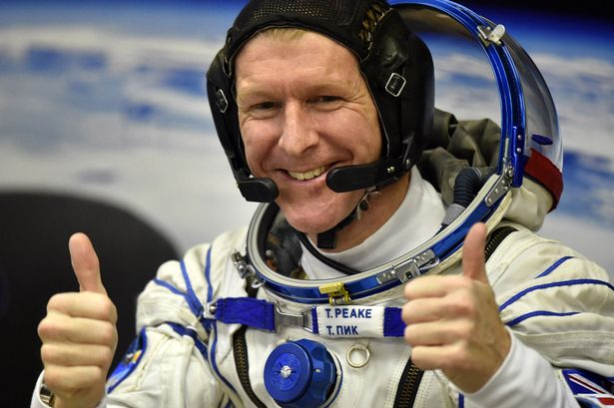
Notes:
Tim Peake is a is a British Army Air Corps officer, European Space Agency astronaut^{[3]} and a former International Space Station (ISS) crew member.

Slide 7
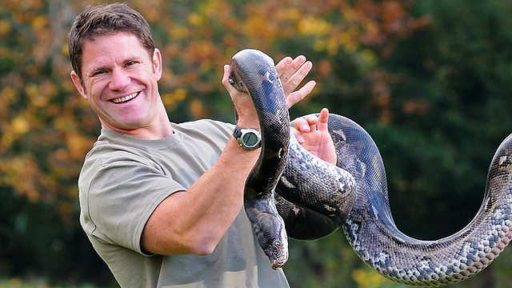
Notes:
Steve Backshall - one of TV's best-known wildlife presenters, naturalists, writers, public speakers and adventurers.

Slide 8
What do they all have
in common?
Notes:
They have all been Scouts

Slide 9
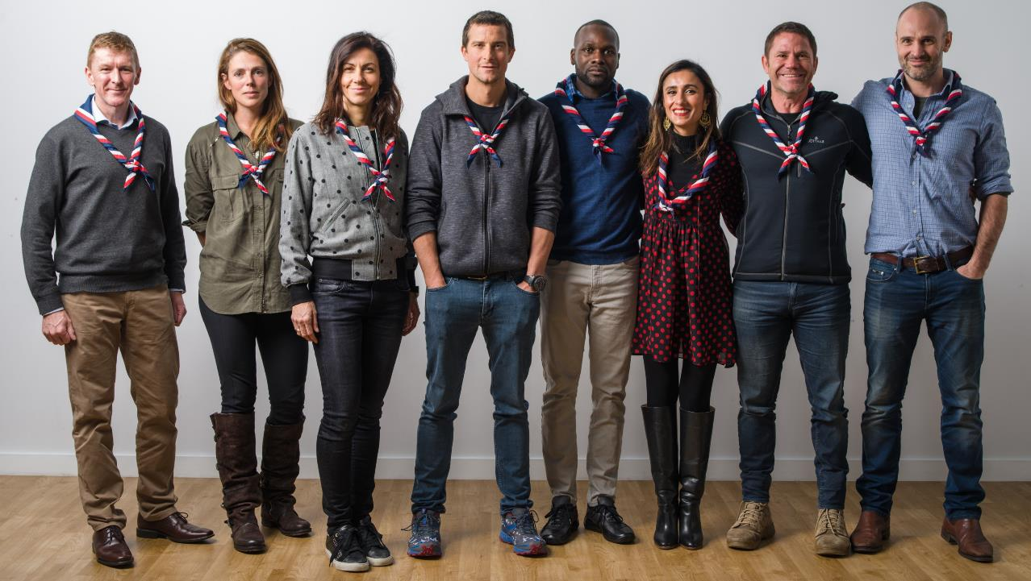
Notes:
Our Scout Ambassadors

Slide 10
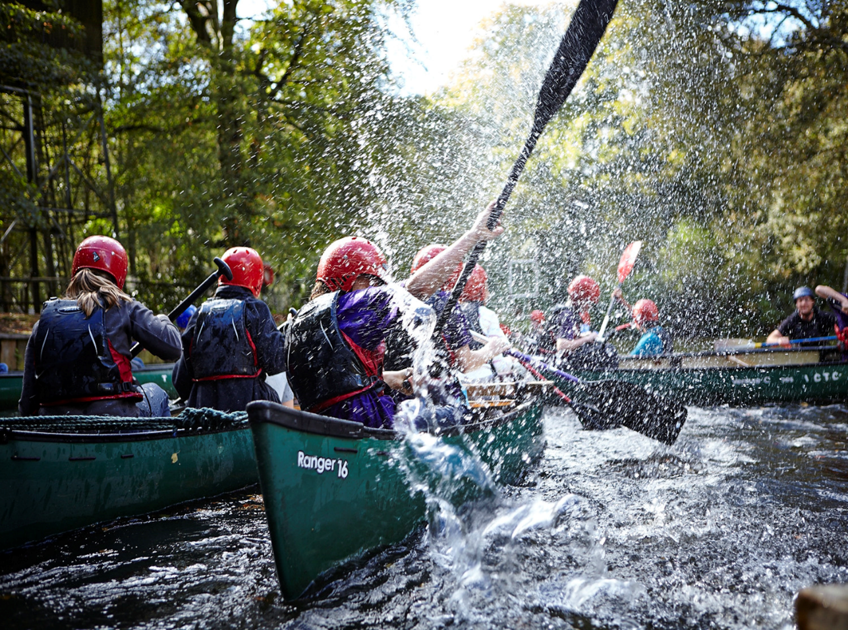
Scouts
10 - 14 yrs
Notes:
Scouts aims to build and develop young people’s confidence, sense of adventure and outdoor skills, as well as encouraging them to explore their beliefs and attitudes and be creative. It offers them the independence to put these skills into practice at camps and even on international trips.
Scouts are encouraged to work together and take the lead on all sorts of projects, from community based work to planning games and activities for their meetings.
The Scout Troop is the third section in the Scout Group, above Beavers and Cubs. The Scout Section is for young people aged between 10½ and 14 years. There is core flexibility in the age range: young people can join from age 10, and can move to Explorers between age 13½ and 14½. It may sometimes be appropriate to extend this flexibility for young people with additional needs. For further information, see our guidance on age range flexibility.

Slide 11
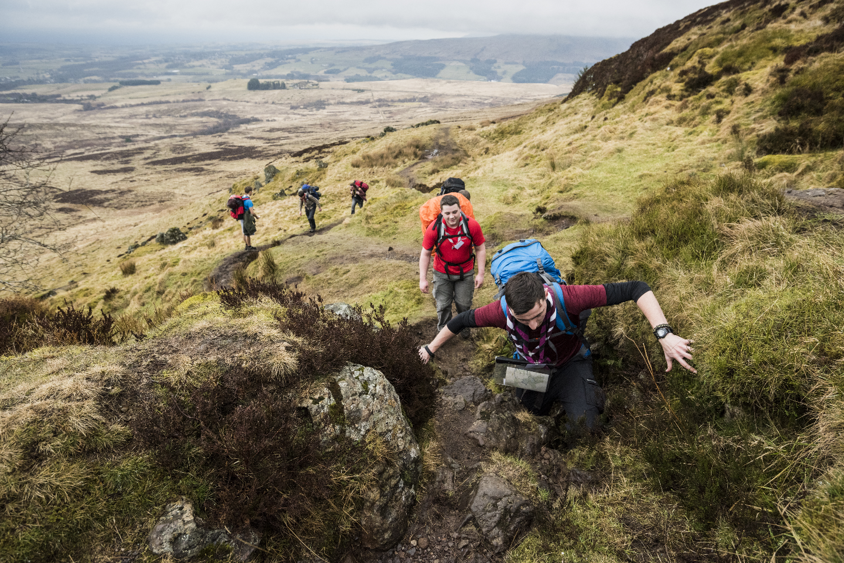
Explorers 14-18yrs
Notes:
With the support, direction and guidance of Unit leaders, Explorer Scouts are encouraged to lead themselves, design their own programme and work towards the top awards that Scouting offers. With exciting prospects like being a part of camps and expeditions both home and abroad; adventurous activities such as mountaineering, parascending and off shore sailing; Explorers offers fun and adventure for all. Explorers also have the opportunity to be a part of The Explorer Scout Young Leaders’ Scheme which develops their leadership skills and sense of responsibility, by helping to run meetings for younger sections.
Explorer Units are the fourth Section of the Scouting family after Beavers, Cubs and Scouts. Explorer Scouts are young people aged between 14 and 18 years old. There is flexibility in the age range: young people can join from age 13½ but cannot move to Scout Network until 18. Young people must have left the Explorer Scout section before the date of their 18th birthday. For further information, see our guidance on age range flexibility.

Slide 12
Myth Busting
Notes:
Ask children to raise their hands for Yes or No

Slide 13
Scouts is just for boys
  Subhead goes here
Notes:
Boys and Girls

Slide 14
All Scouts do is camp, hike and tie knots
  Subhead goes here
Notes:
Lots of activities and badges
200 different activities
he Scouting Programme provides a structure of badges and awards, which are progressive through the sections, and based on a number of objectives. The objectives are based on Scouting’s Purpose to ‘actively engage and support young people in their personal development, empowering them to make a positive contribution to society’.
The Scouting Programme for all five sections is based around three main themes: outdoor and adventure, world and skills. This programme of activities is planned by the leadership team in partnership with young people, and should incorporates elements from each theme, to offer young people the most interesting and diverse experience.
There is flexibility within Scouting which means that all young people, regardless of their abilities, can enjoy and achieve. The Programme should be flexible and have room to adapt and accommodate the needs of the individuals in the section, with the focus being on personal development. For more information, see our flexibility statement.

Slide 15
Scouts wear big hats and baggy shorts?
  Subhead goes here
Notes:
Only if they want to

Slide 16
So what are Skills for Life?
Skills for life video
Notes:
Show video

Slide 17
What activities do we do?
  https://youtu.be/-MEm8POvalA
Notes:
Show Video

Slide 18
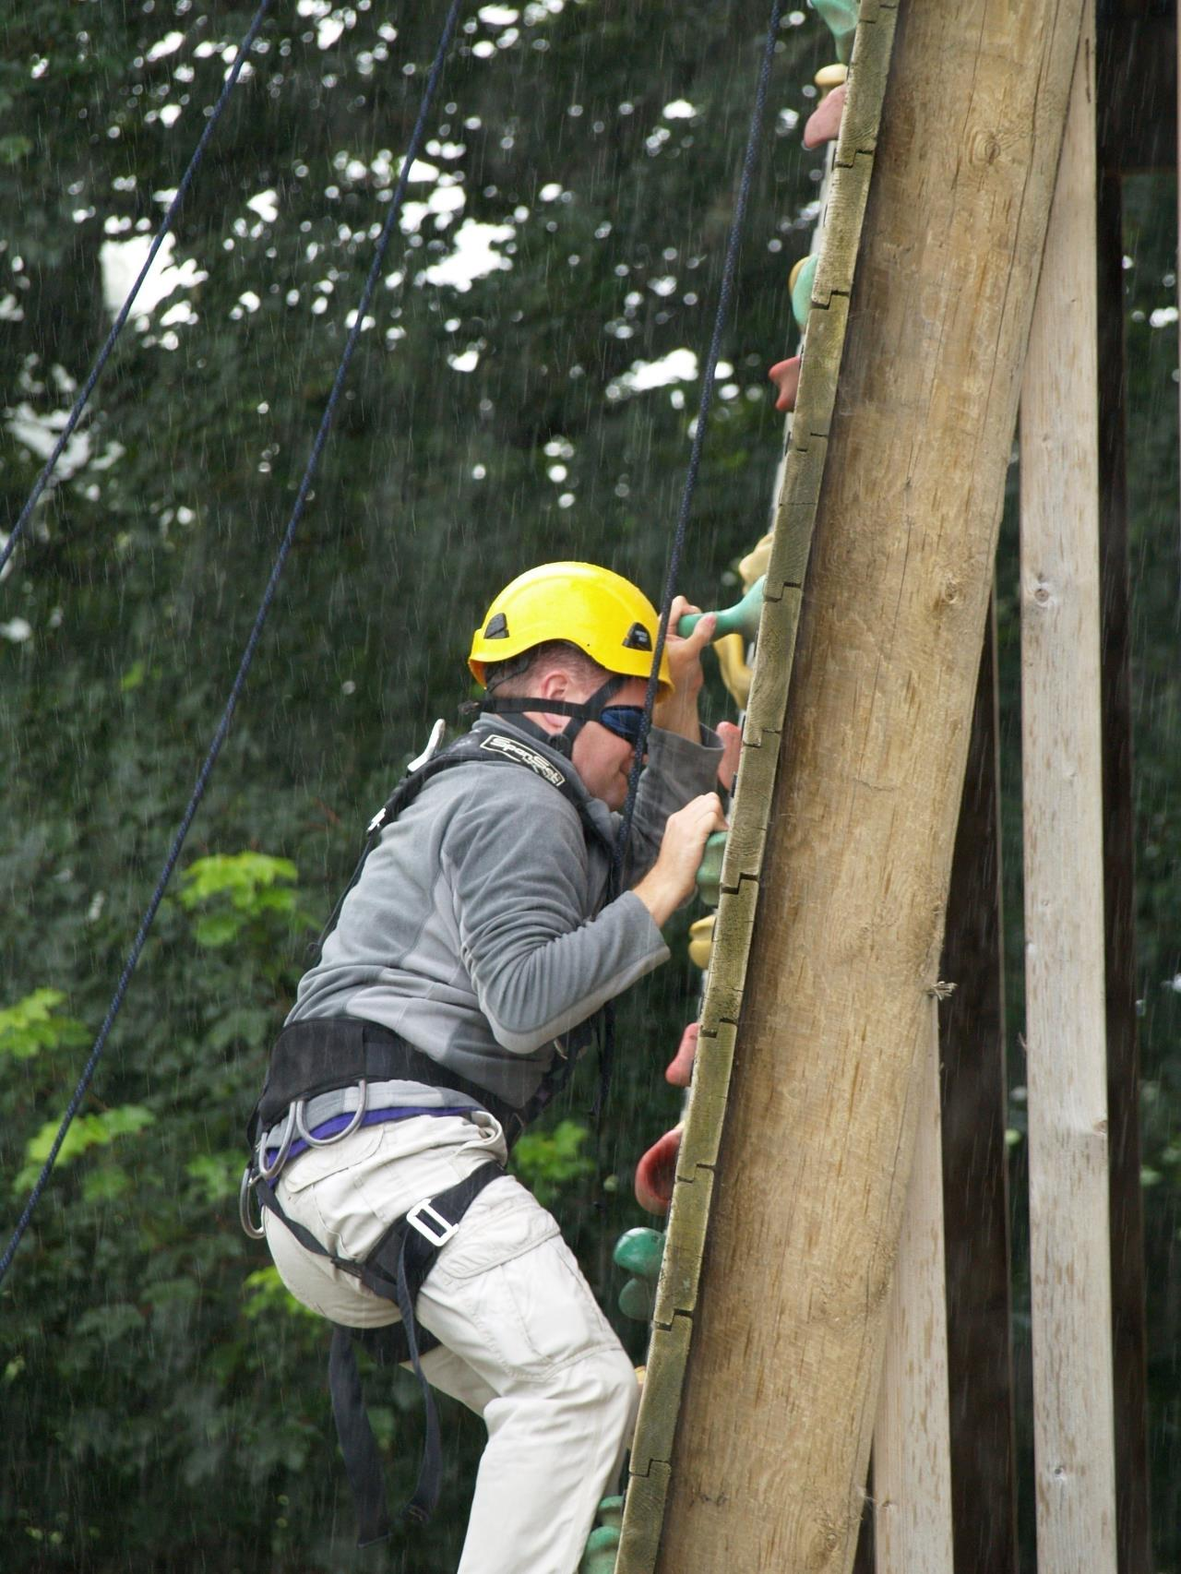
Notes:
Climbing

Slide 19
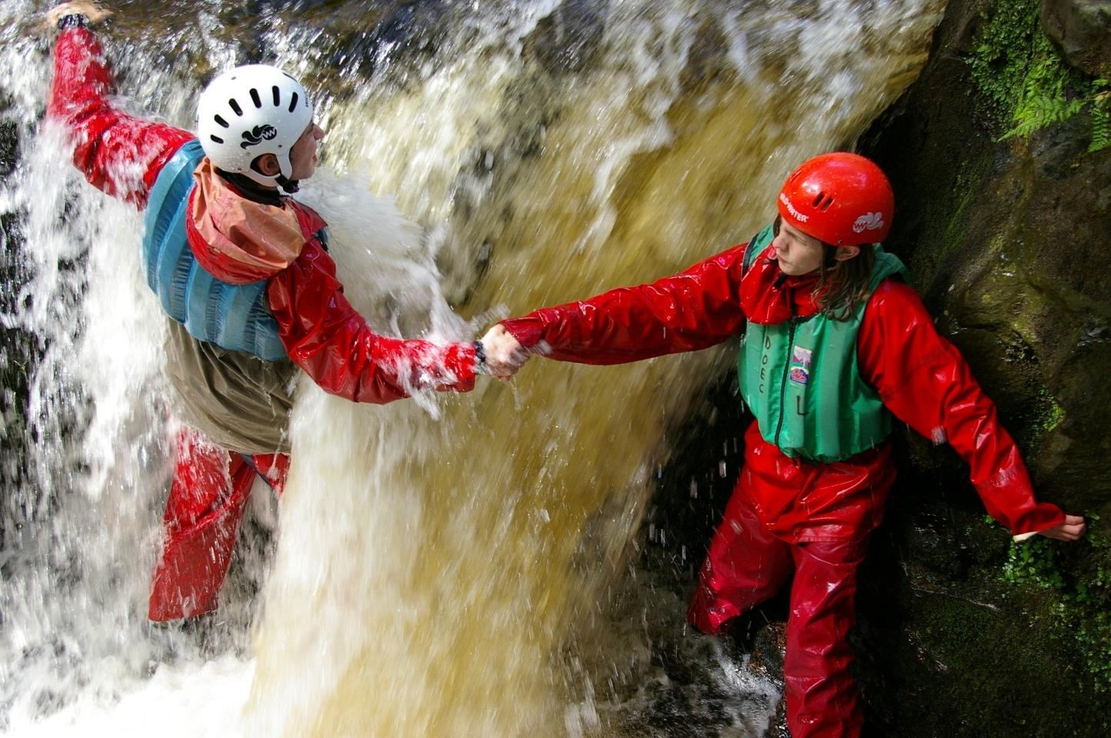
Notes:
Coasteering

Slide 20
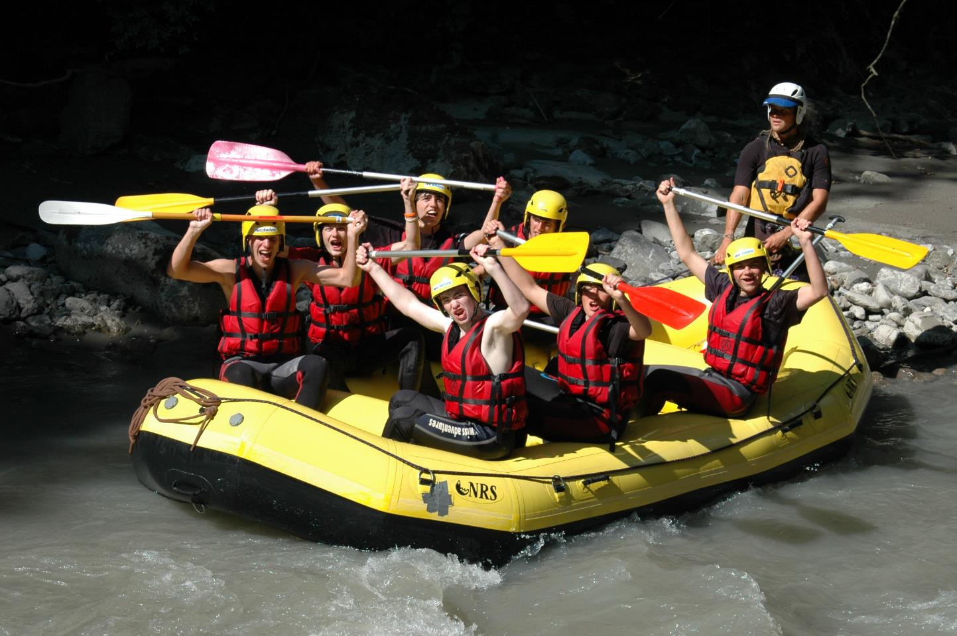
Notes:
White water Rafting

Slide 21
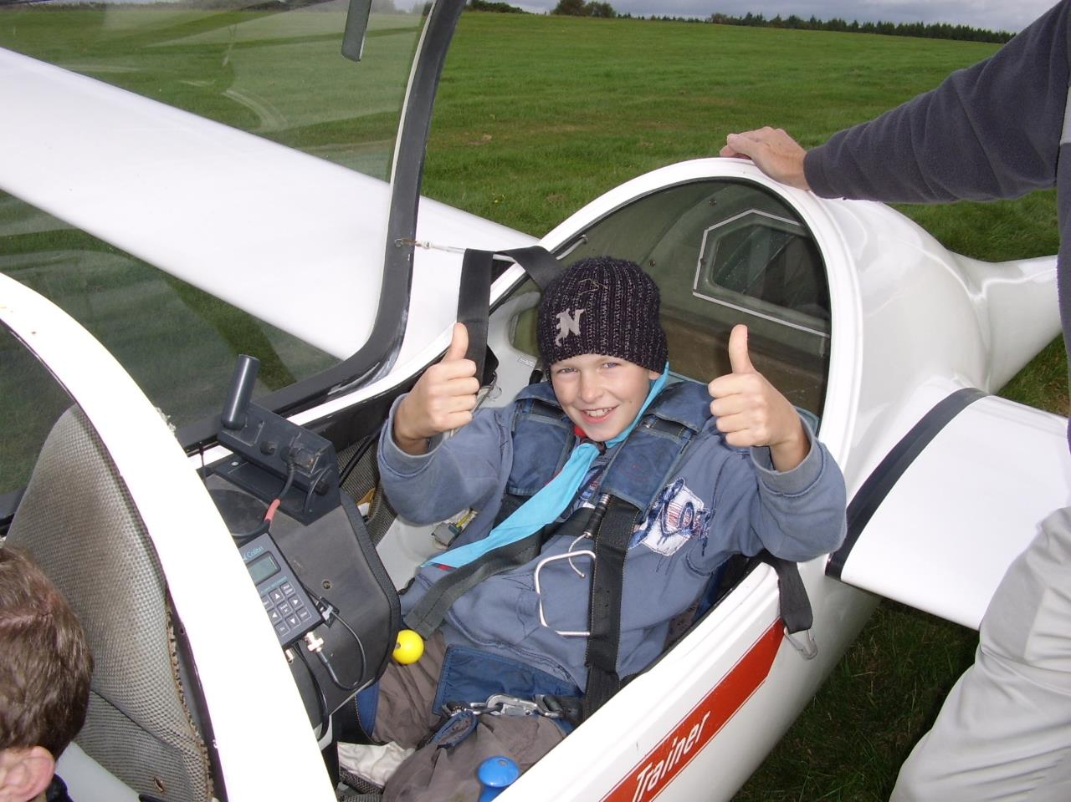
Notes:
Gliding

Slide 22
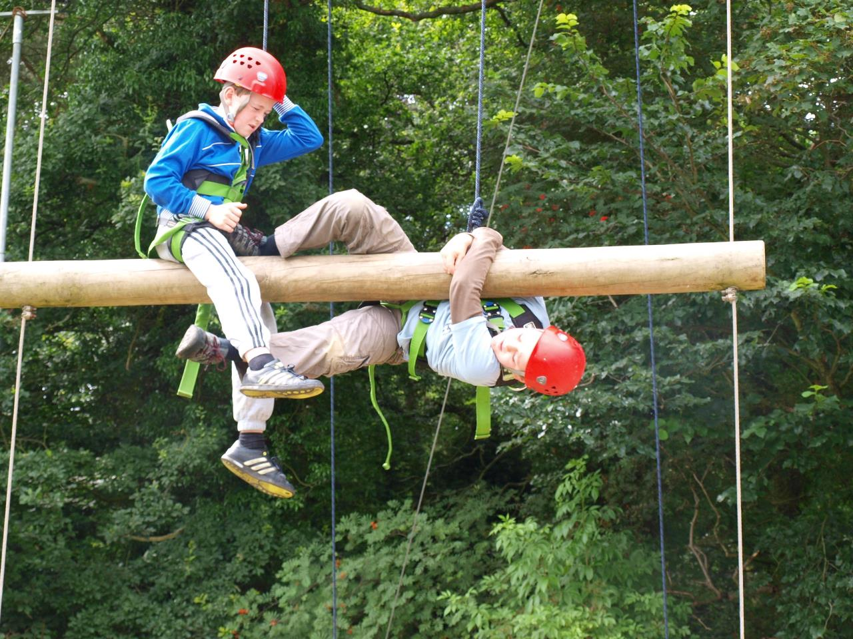
Notes:
High Ropes

Slide 23
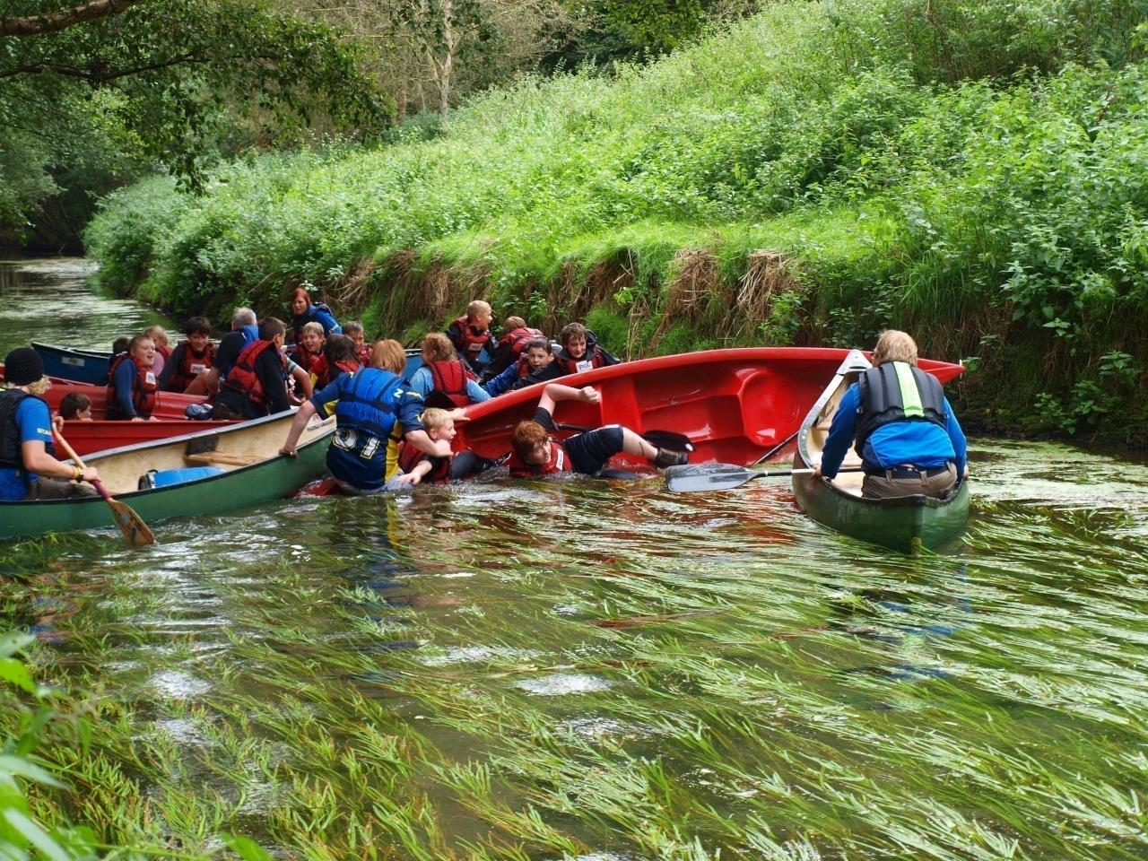
Notes:
Canoeing

Slide 24
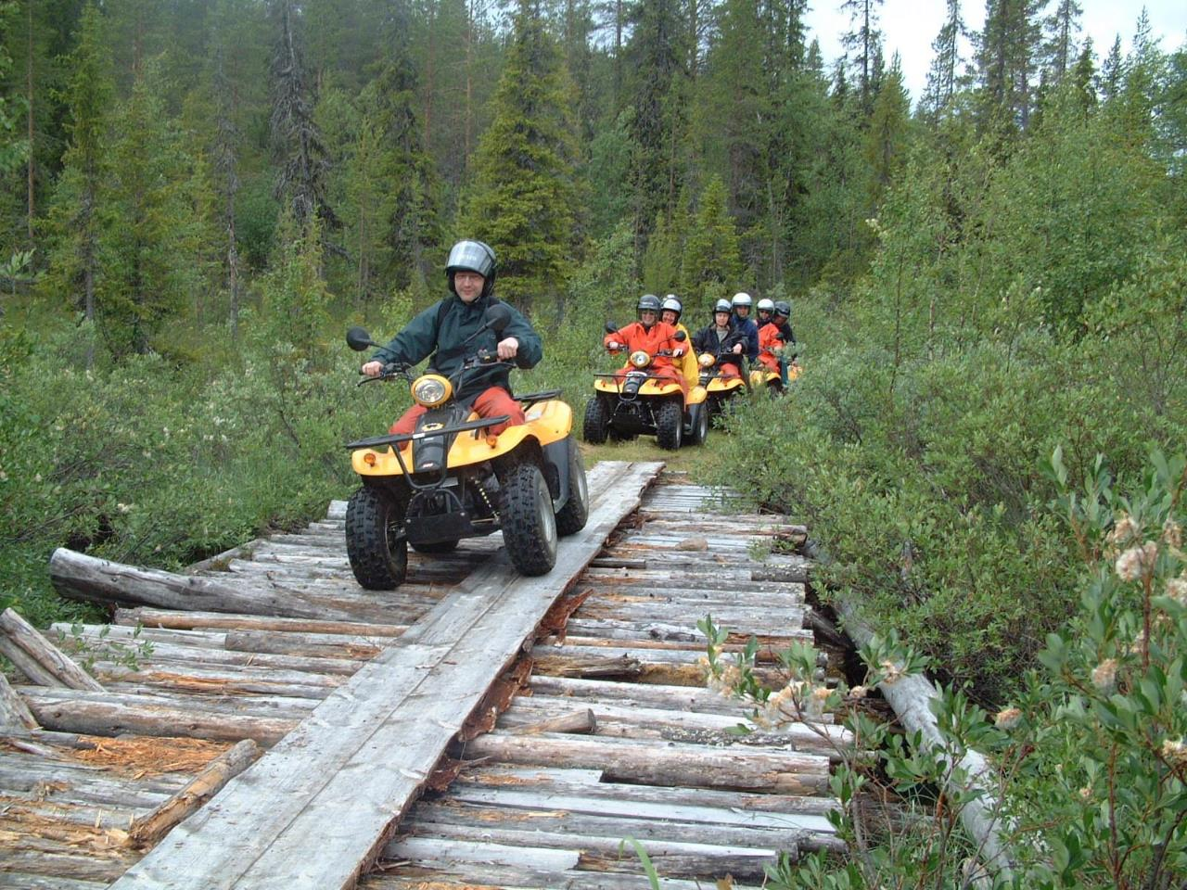
Notes:
Quad biking

Slide 25
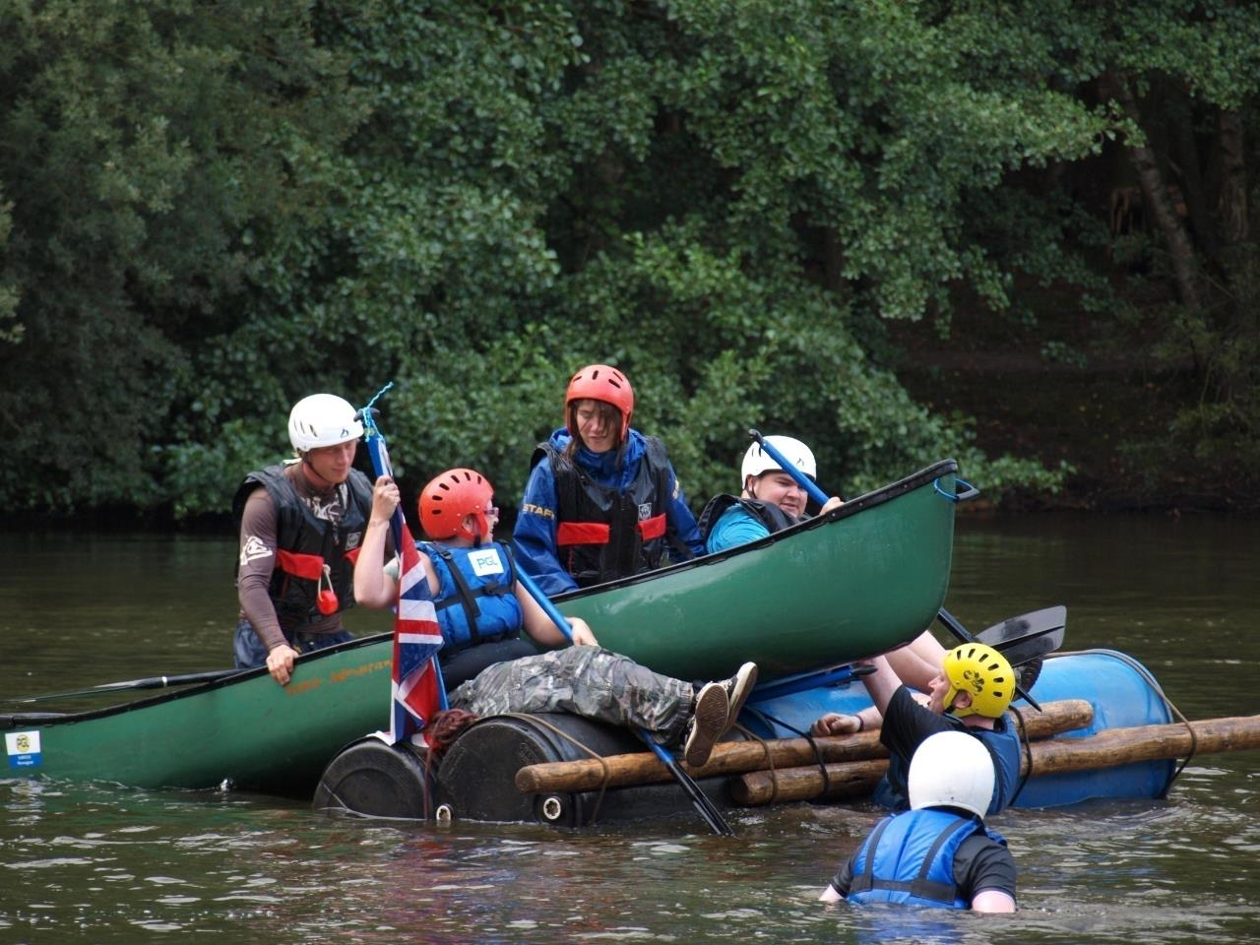
Notes:
Raft Building

Slide 26
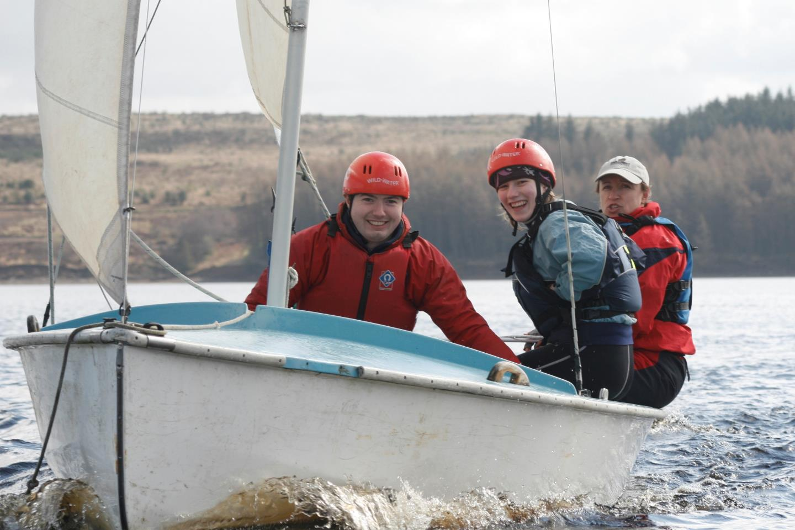
Notes:
Sailing

Slide 27
Give it a go……….!
Date
Time
Venue
Notes:
Talk about date and time of taster event

Slide 28
(Insert Group Name)

