Slide 1
How to use this slide deck:
This deck comes in two parts
1 – a presentation for use in local meetings / events.
2 – activities to help local teams familiarise themselves with the strategy.
To prepare for your session, review the deck, including the speaker notes and guidance. Feel free to include as much of the content as you like, and if you need a shorter session, you can hide / remove slides. We also recommend reading the full strategy document, for context.
In entirety, the presentation will take 40-60 minutes, plus the activities.
Notes:
The speaker notes are there to help you with what you may wish to say, to accompany the information on the slides. They are made up of both scripted information (which you can edit) as well as guidance, to help you understand the purpose of each slide, and to include your own references where appropriate.

Slide 2
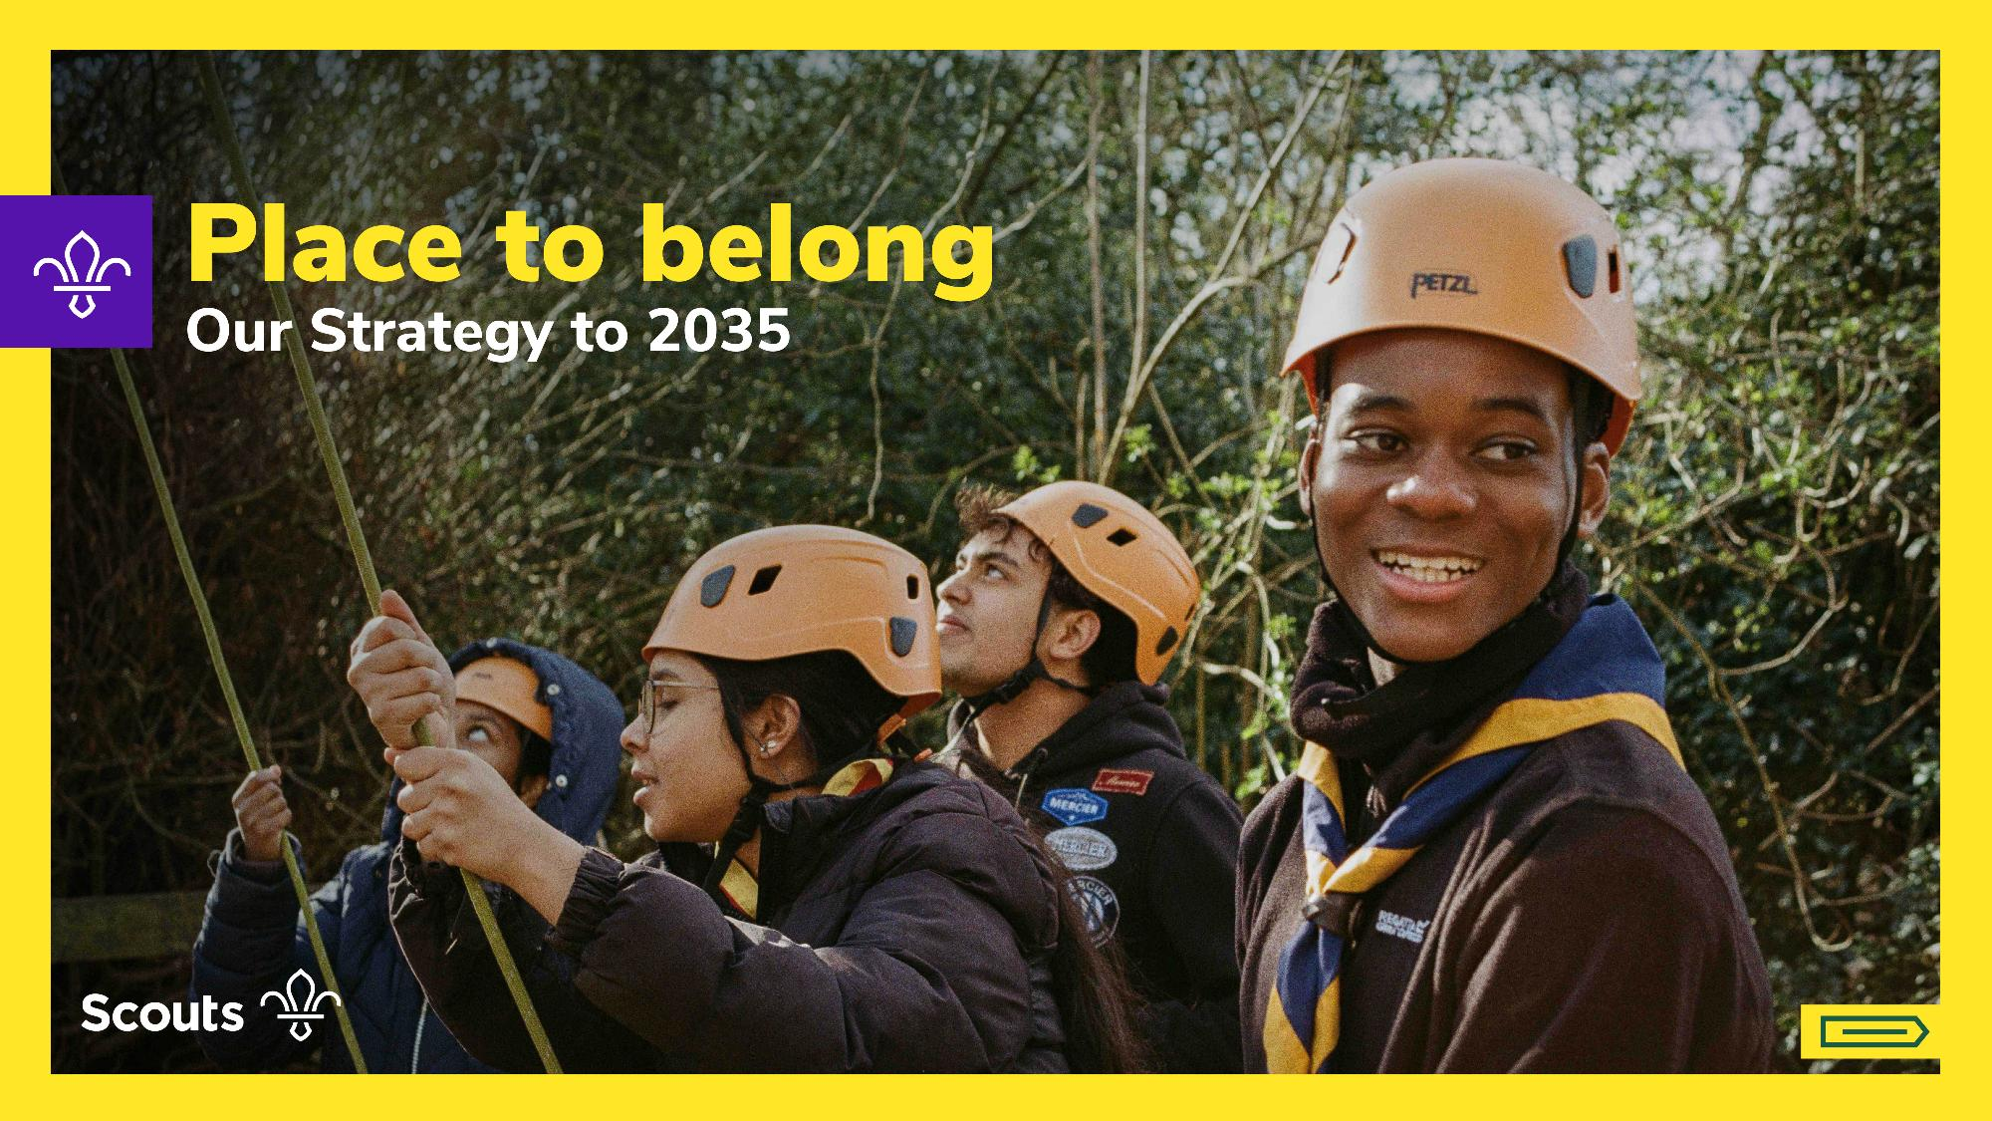

Why we looked ahead and why now?
Notes:
Welcome people to the meeting/call/session – domestics as appropriate
Introduce yourself (and if applicable, key presenters)
“Today is about focussing on our future – we’ll be talking about our new strategy, Place to belong. During this session, we’ll explore how the strategy has been formed, as well as start talking about what it means for us in [LOCATION].
When we talk about our strategy, we’re not talking about a document, we’re talking about the experience young people will have in Scouts over the next nine years. We’re also talking about the experience volunteers will have delivering this experience.
If a young person joined Scouts in [LOCATION] this year, and they stayed for the next decade, what should their experience feel like? Today we’ll start to think about what should be better than it is today.”
Guidance
Start with purpose, not process. Anchor the presentation emotionally and avoid early disengagement from ‘strategy talk’. Aim to reframe perceptions and focus the discussion around lived experience of young people – our beneficiaries.

Slide 3
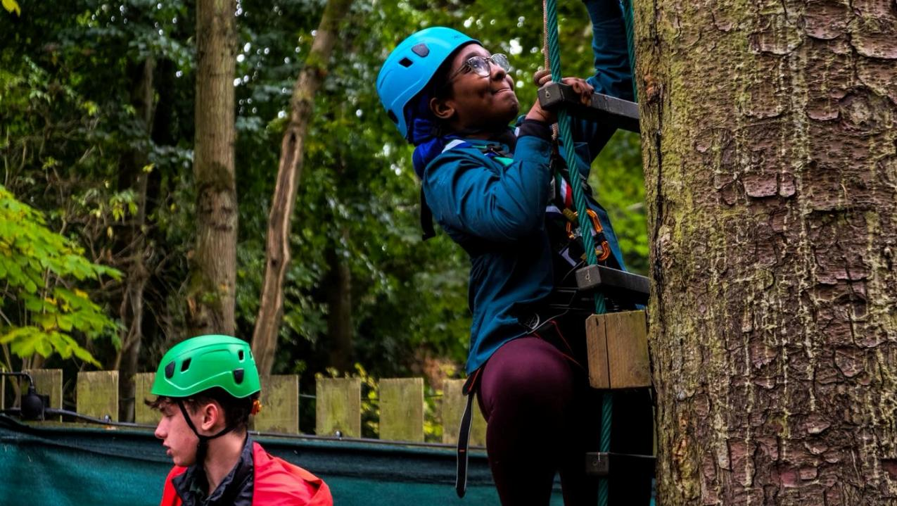


Why we looked ahead
Notes:
“Why now?
As Scouts, we’ve taken the time to step back and ask some hard questions.
Volunteers across the Movement fed in through events, focus groups and other engagement.
Young people have contributed directly through the UK Youth Forum and other activities.
Participation data and operational insight fed in, including the Scout Experience Survey.
And questions around what helps Scouts thrive, and what makes things harder than they need to be provided the answers that have shaped this strategy.
This strategy is grounded in that listening.”
Guidance
Use these words to help establish legitimacy and aim to prevent the audience from assuming the strategy is a top-down UKHQ opinion. Keep this part concise try not to get into the detail or over explain the methodology, or what’s happened to date.

Slide 4
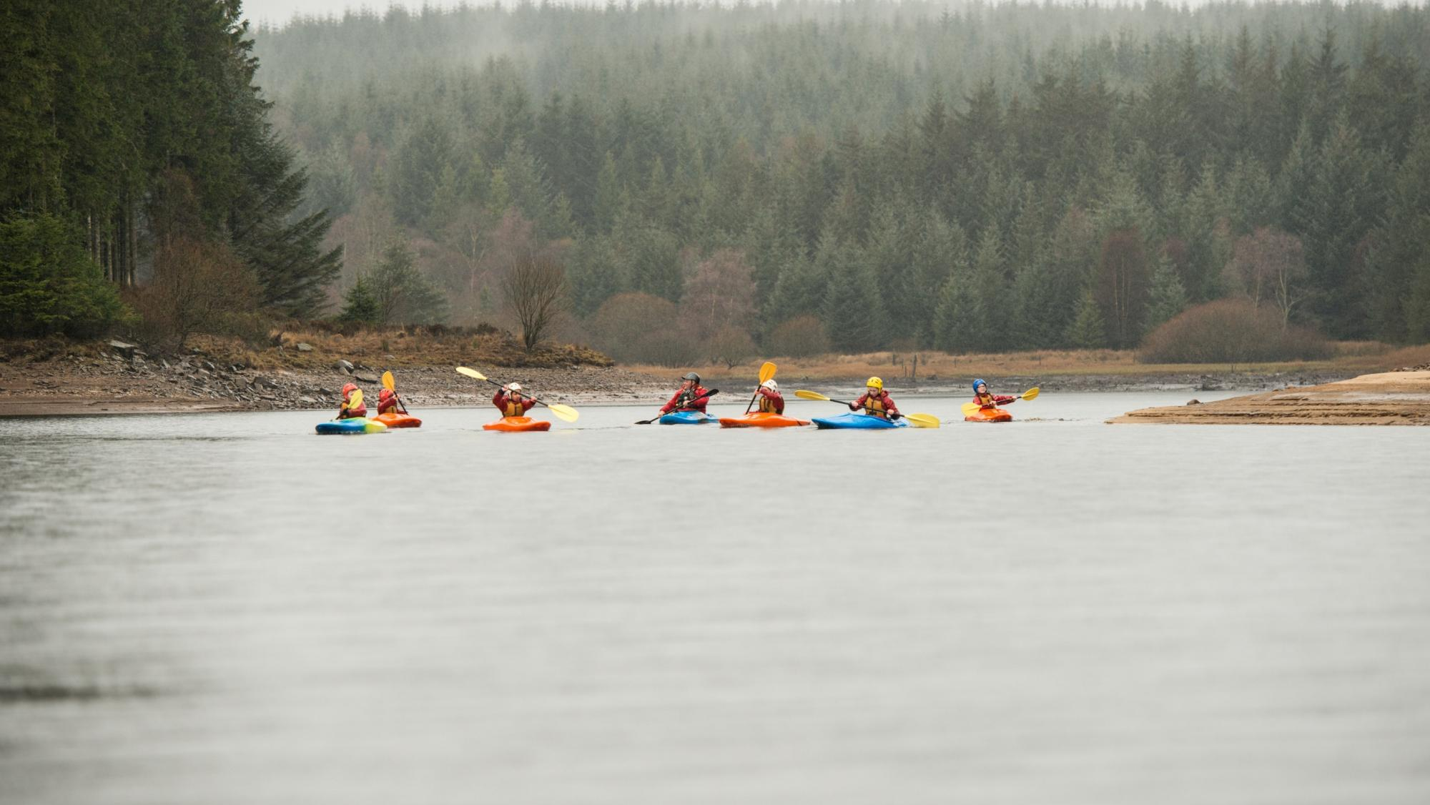


UKLT / Leadership Forum / The Board
12,500 responses to Scout Experience Survey
We listened
to 28,000
people
Summit25 – 700 leaders/ managers
3,500 young people (surveys/ focus groups)
External Young people consultation (Kids Know Best)
4 National Youth Forums (500+)
660 Scout Store parents
Engagement with key funders and stakeholders
10 Digital sector leaders
6 Focus Groups -SV/GLV/ DLV (100)
2,000 External parents research project
9,000+ All Member Survey
Notes:
“You’ll see on the slide that over 28,000 people fed into the consultation that built our new strategy, including thousands of young people and volunteers, as well as parents and people external to Scouts.”
Guidance
Use this information to show the scale of how many people fed into the strategy. You may want to talk about your experience of any of the consultation methods that you engaged in (or use someone else in your team to do that) or even ask your audience to raise their hand if they took part in anything that’s on the slide.

Slide 5
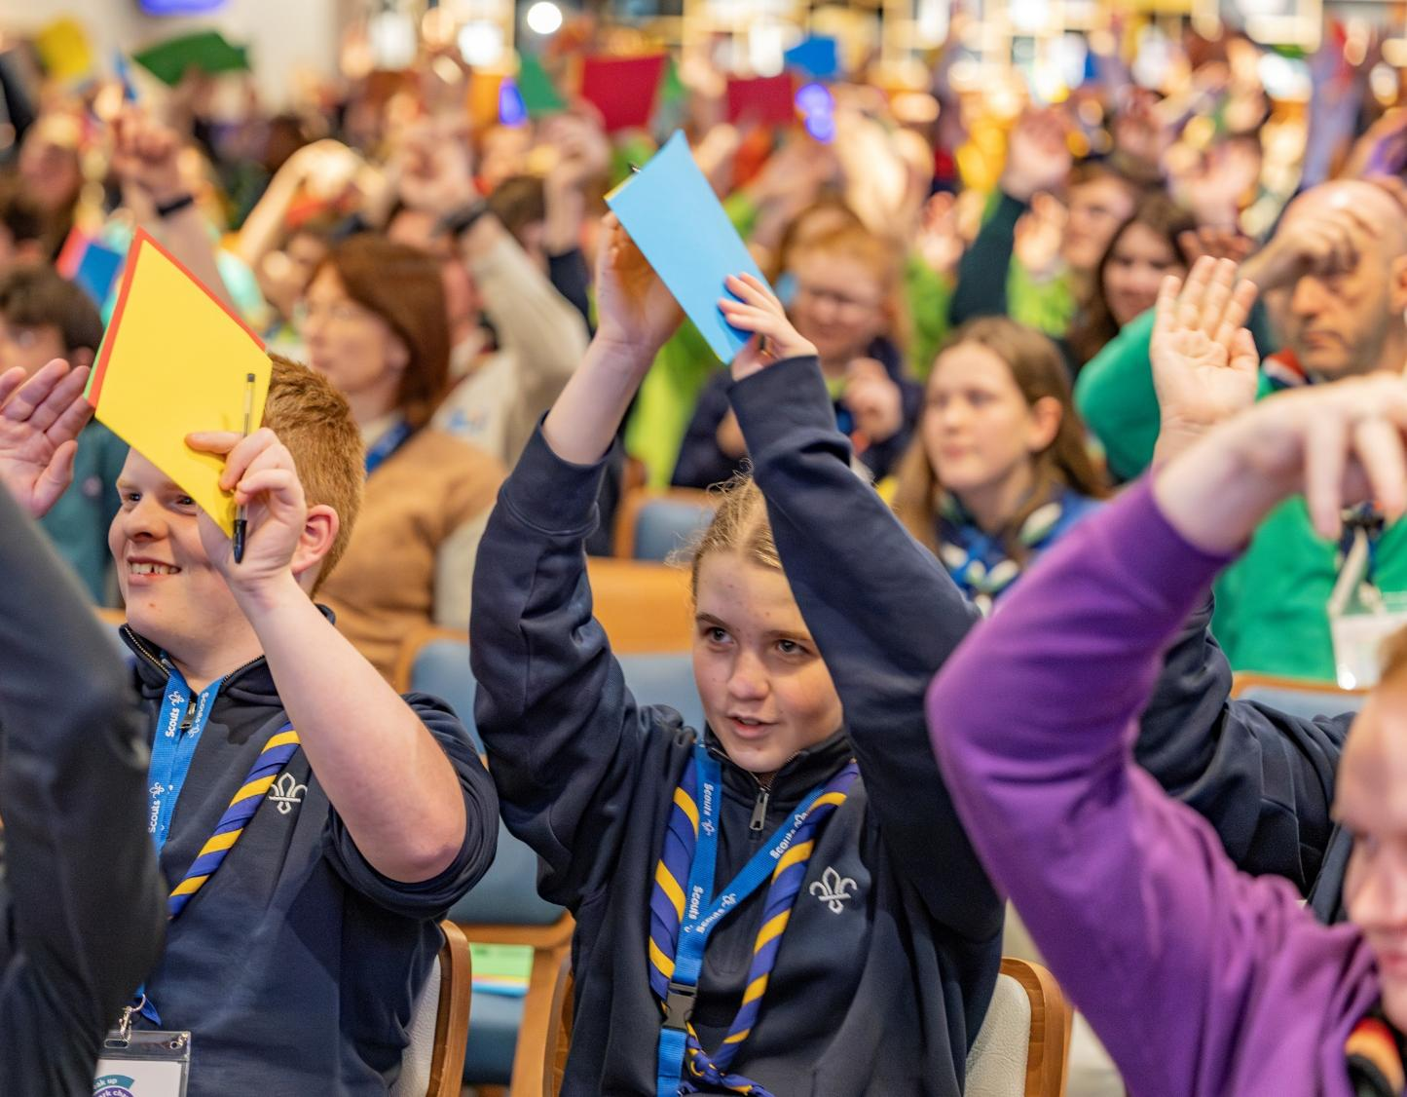
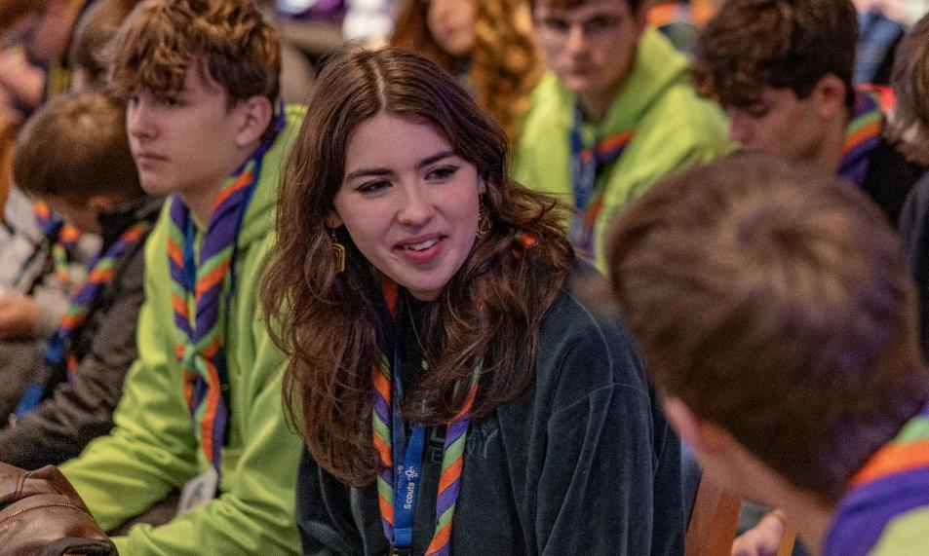
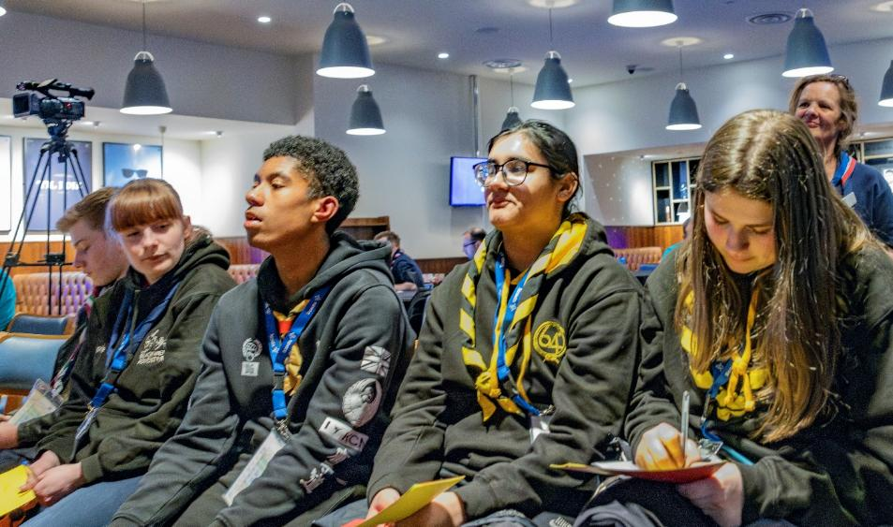
How young people shaped our strategy
Notes:
“There were four UK Youth Forum events held across the UK, with over 500 young people aged 10-24 attending. As we saw on the last slide, over 1,000 young people also took part in self-led activities as well as other surveys and focus groups.”
Guidance
Detail continues on the next slide, so speak across the two

Slide 6
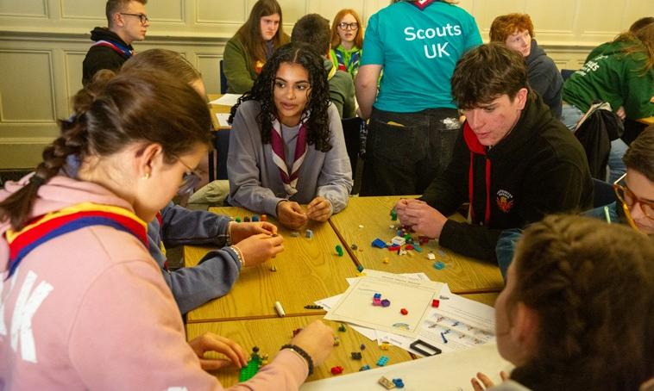
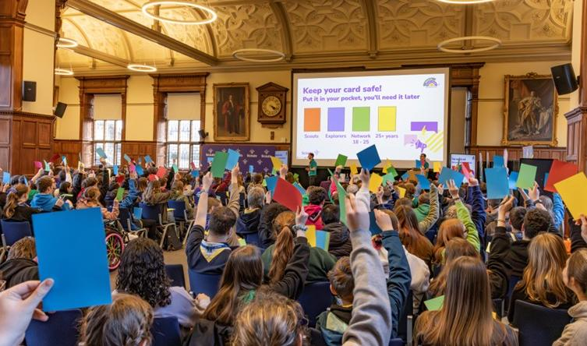
Over 500 Scouts aged 10–24 years attended the 4 UK Youth Forum events plus 1,000 aged 4–24 took part in self-led activities.
Priorities were safety, outdoor activities, life skills, youth leadership, mental well-being, community impact, and attracting new members.
Looking ahead to 2035, their goals were:
  developing awards and life skills
  promoting inclusivity and accessibility
  expanding youth-led initiatives
  encouraging growth
  fostering stronger connections.
Our young people wanted safe, judgement free-spaces supported by trusted, well trained volunteers.
Notes:
“You’ll see on the slide that across all of this research, the priorities of young people included safety, outdoor activities, life skills, youth leadership, mental wellbeing, community impact, and attracting more members – they can see the benefits of Scouts, want to double down on what’s already good, and get more people experiencing what they do. This is a really interesting lens on what Scouts has to offer and has massively helped to develop this strategy, shaping the next nine-years at Scouts.”
Guidance
Place to Belong is a strategy shaped by young people, for young people. These two slides should be used to impress upon your audience that we’re all here for young people, and that by listening to them, we can be successful.

Slide 7
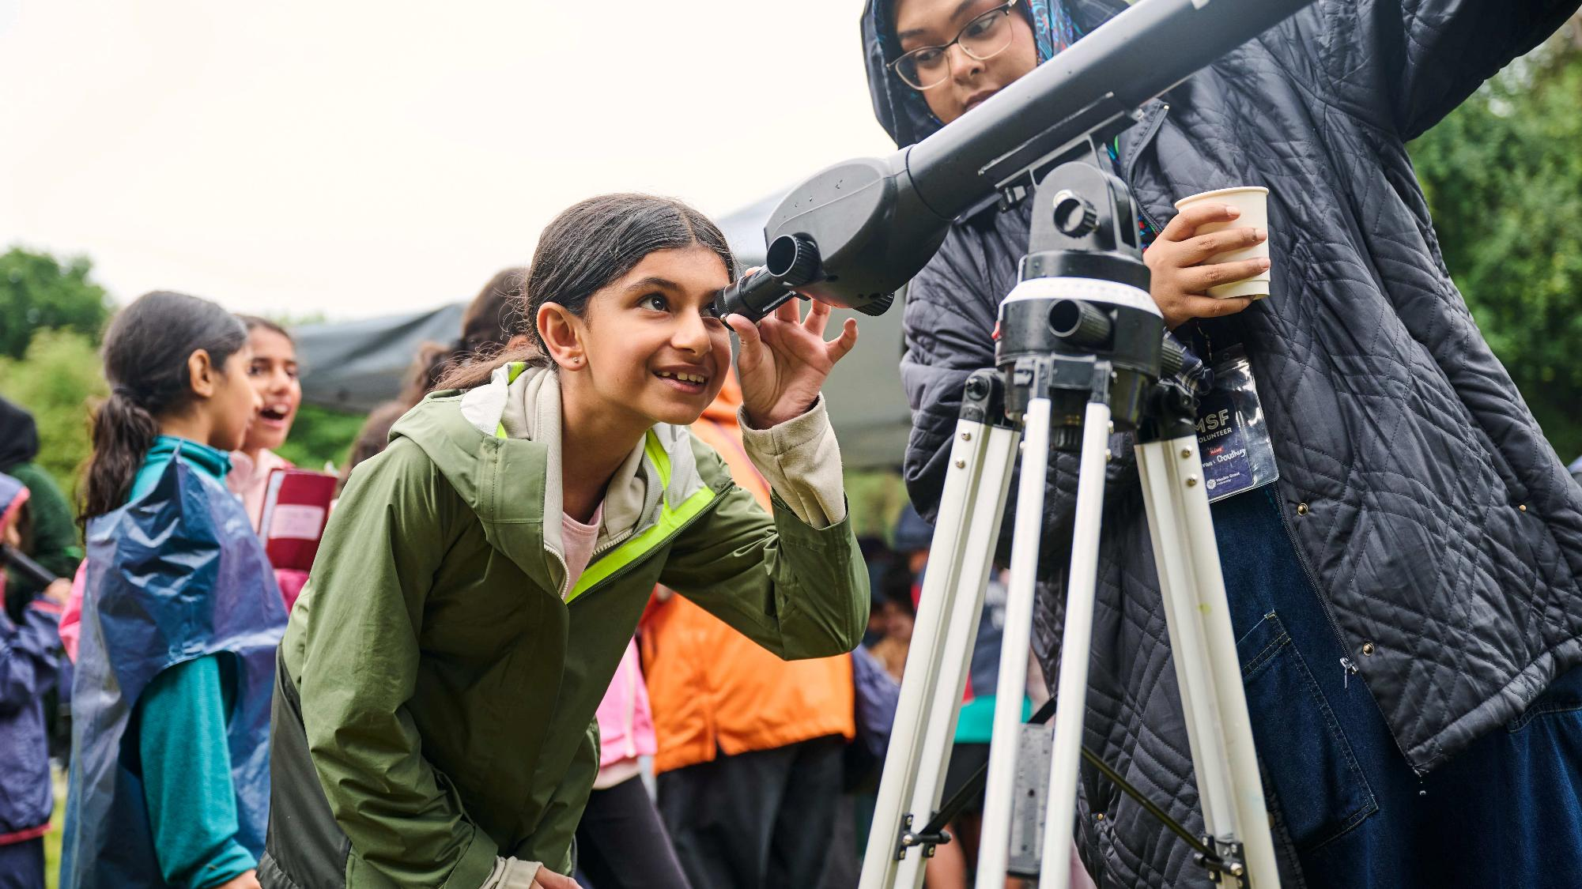
The core
insight
Notes:
“Across all the listening and analysis, clear and consistent themes emerged.
Programme quality is strong in many places, but it is not yet consistent across the whole Movement.
Volunteers are deeply committed, but many are also stretched, balancing Scouts alongside the pressures of everyday life.
Administrative processes can sometimes take too much time or focus away from delivering great experiences.
Support is there, but it can feel complex, fragmented, or harder to navigate than it should.
And young people told us clearly that they want Scouts to feel relevant to their lives today, and that they want a greater sense of ownership over their experience.
None of this is about criticism. It is about being honest on where we are now, so we can be clear about where we need to go next.”
Guidance
Normalise the findings, avoid defensiveness. Adopt a constructive, non-accusatory tone. You may wish to use some of your own examples, or tailor the bullet points for your audience, while remaining clear that these are challenges being heard loud and clear across the Movement.

Slide 8
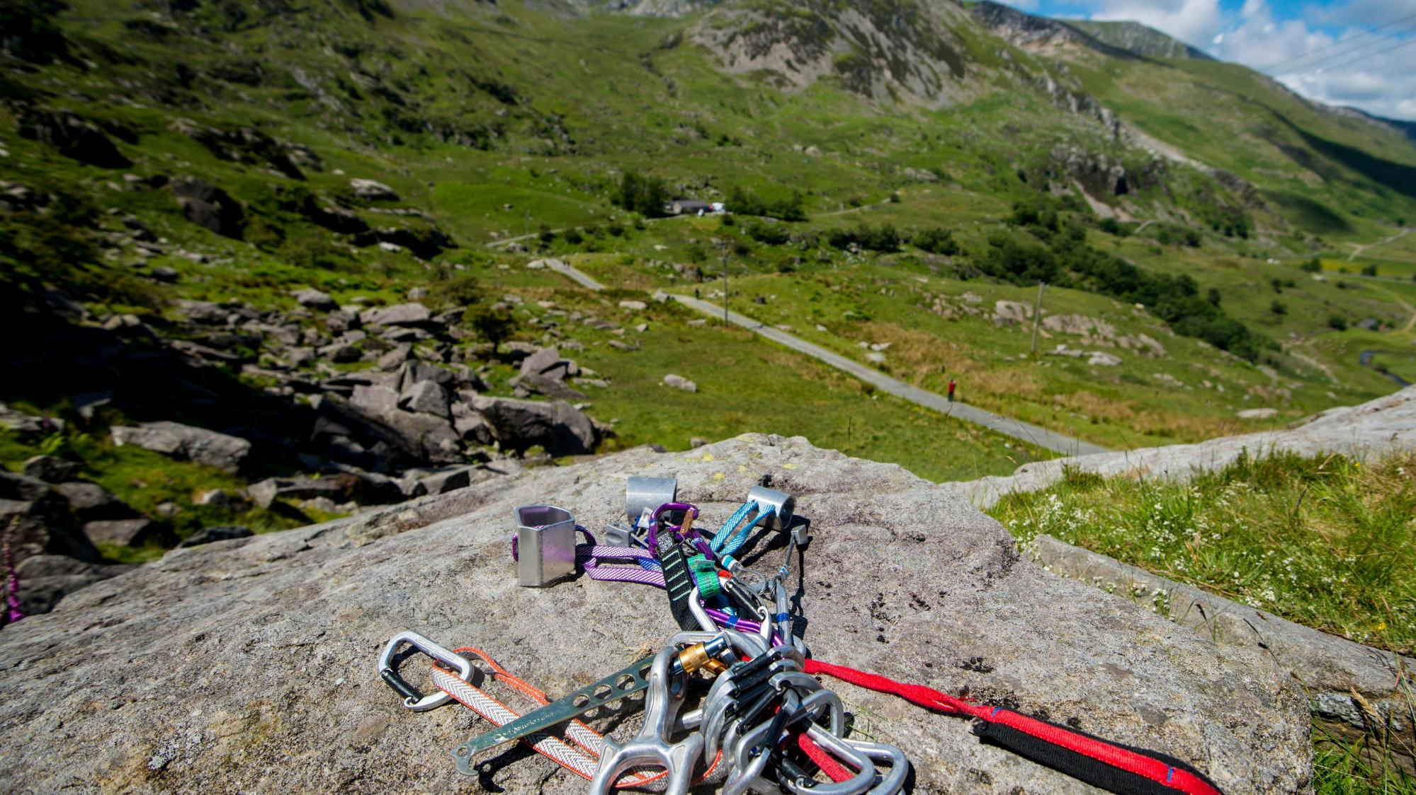
Focus on getting three things right
  Deliver a high-quality programme
  Make volunteering sustainable and fulfilling
  Simplify support around both and everything else improves
Notes:
“What became clear from all the engagement and analysis is this:
If we get three things right, a great deal else becomes possible.
If we deliver a more consistently high-quality programme, make volunteering more sustainable and fulfilling, and simplify the support around both, we create the conditions for Scouts to thrive.
These three priorities are closely connected. Great programme relies on volunteers who feel able to give their best. Volunteering is more sustainable when the systems and support around it are clearer and less burdensome. And better support helps strengthen both.
In the first three years of this strategy, especially, improving support will be a key priority, because it helps unlock progress elsewhere. Better programme and better volunteering are shaped by the environment around them, and we need to make that environment simpler, clearer and more enabling.”
Guidance
Distil complexity into simplicity. Place to belong is about focus. This part of the presentation is the anchor for the rest of what we will be sharing. If this is clear, the Strategy (and Three Year Plan) should feel focused rather than sprawling.

Slide 9
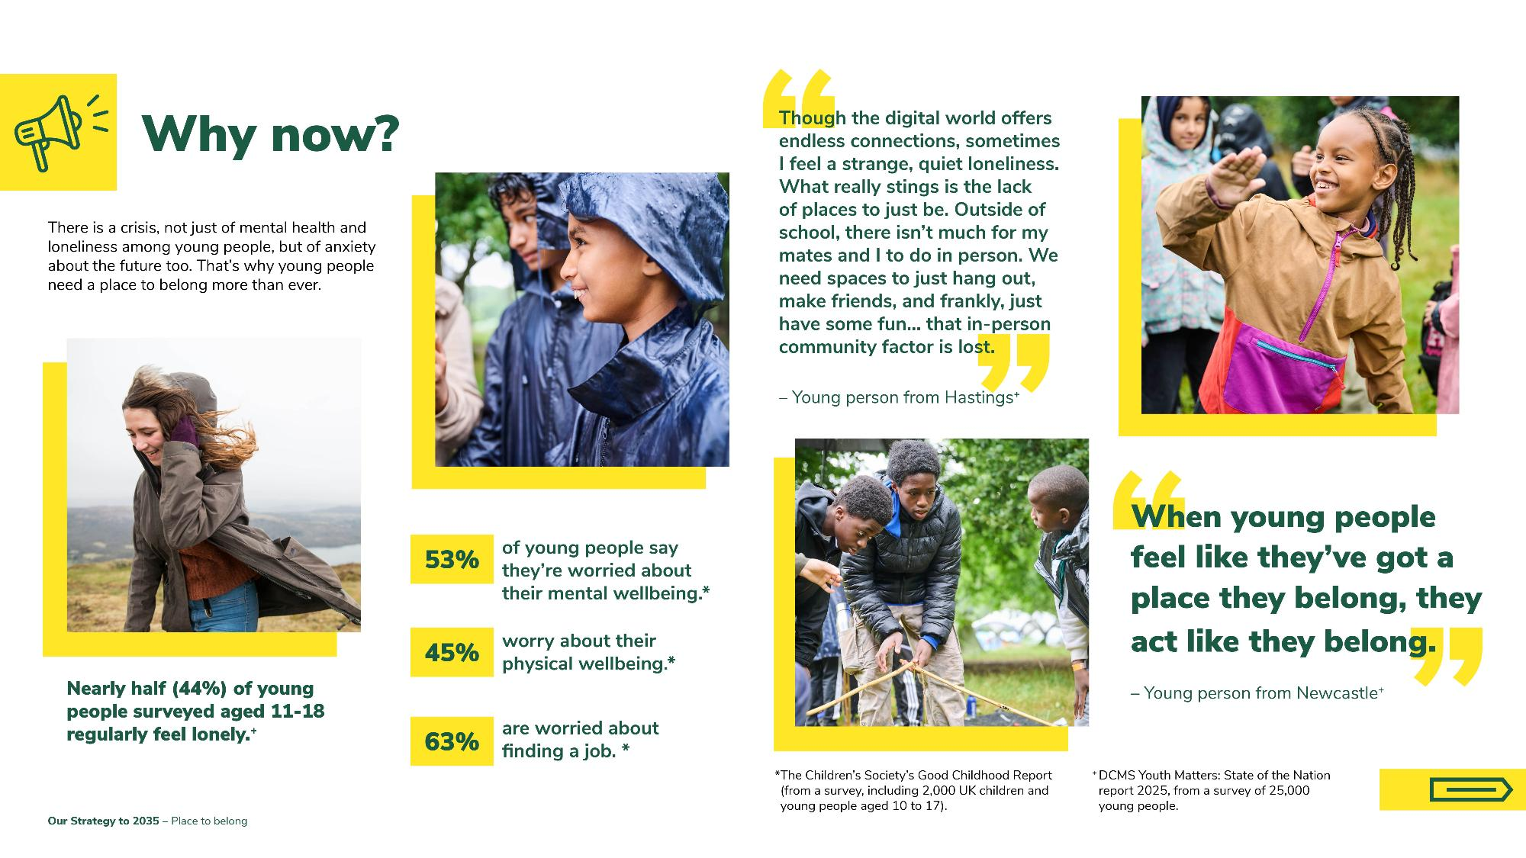
Why we looked ahead and why now?
Notes:
“The world is a challenging place to exist in, not least as an adult, but especially for young people. On this slide, you’ll see a number of statistics that highlight this. How have we got to a point as a society that almost or over half of all young people are lonely, or worried about their wellbeing, or what’s next? Scouts has been relevant since it started, and the needs of young people show that we’re still relevant, an important part of society, and why people should pay attention to the work we do. This strategy is built on these foundations.”
Guidance
The content on this slide impresses on your audience the need for Scouts to do something, to set a new strategy. Depending on how much time you have, you may want to read more of the statistics and quotes out, allow your audience time to read the slide and let the facts sink in, or add in additional quotes and research, such as from the wider reports used for this research.

Slide 10
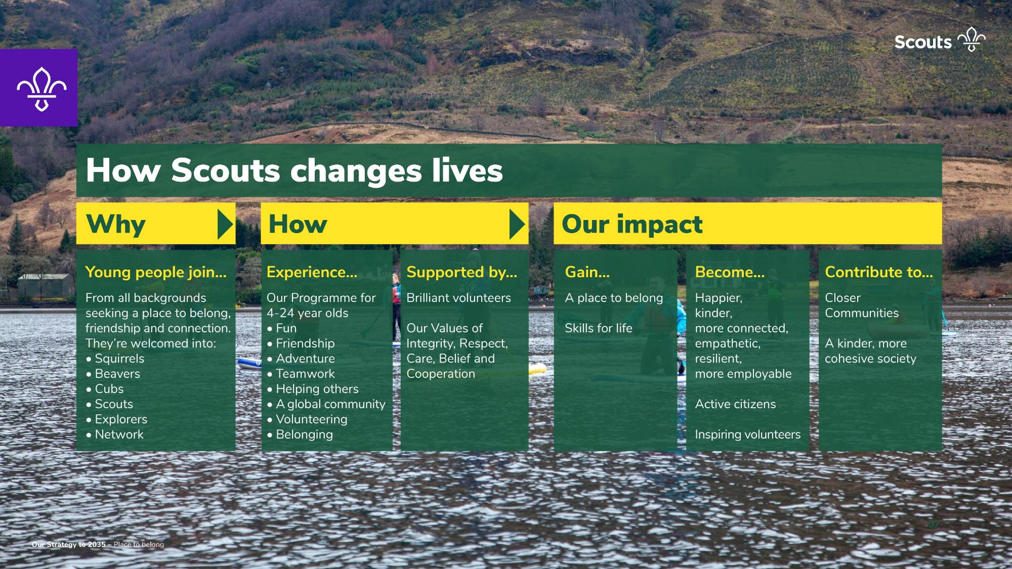
Why we looked ahead and why now?
Notes:
“Scouts is at least part of the answer to some of the challenges we’ve just spoken about. We know we make a difference, and we believe in what we do.
Scouts is made up of young people from all backgrounds who seek a place to belong, with friendship and connection. You can see from the slide all the things that young people get from Scouts, and that crucially it only happens because we have people like you, brilliant volunteers, championing our values.
Young people get a place to belong, as well as skills for life – that’s what we do, and it’s not changing. They become happier, kinder, more connected, empathetic, resilient young people who are more employable, active citizens. Many of them also become inspiring volunteers. All of this helps us contribute to closer communities, and a kinder, more cohesive society – who doesn’t want that?”
Guidance
This slide is a reminder that what we do really does have an impact. You may choose to summarise and allow the audience to read and reflect, or you may wish to talk them through it. Depending on the event, you may be able to relate back to specific groups of young people, if you have a closer audience, or you may wish to focus more on the impact we have on society.

Slide 11
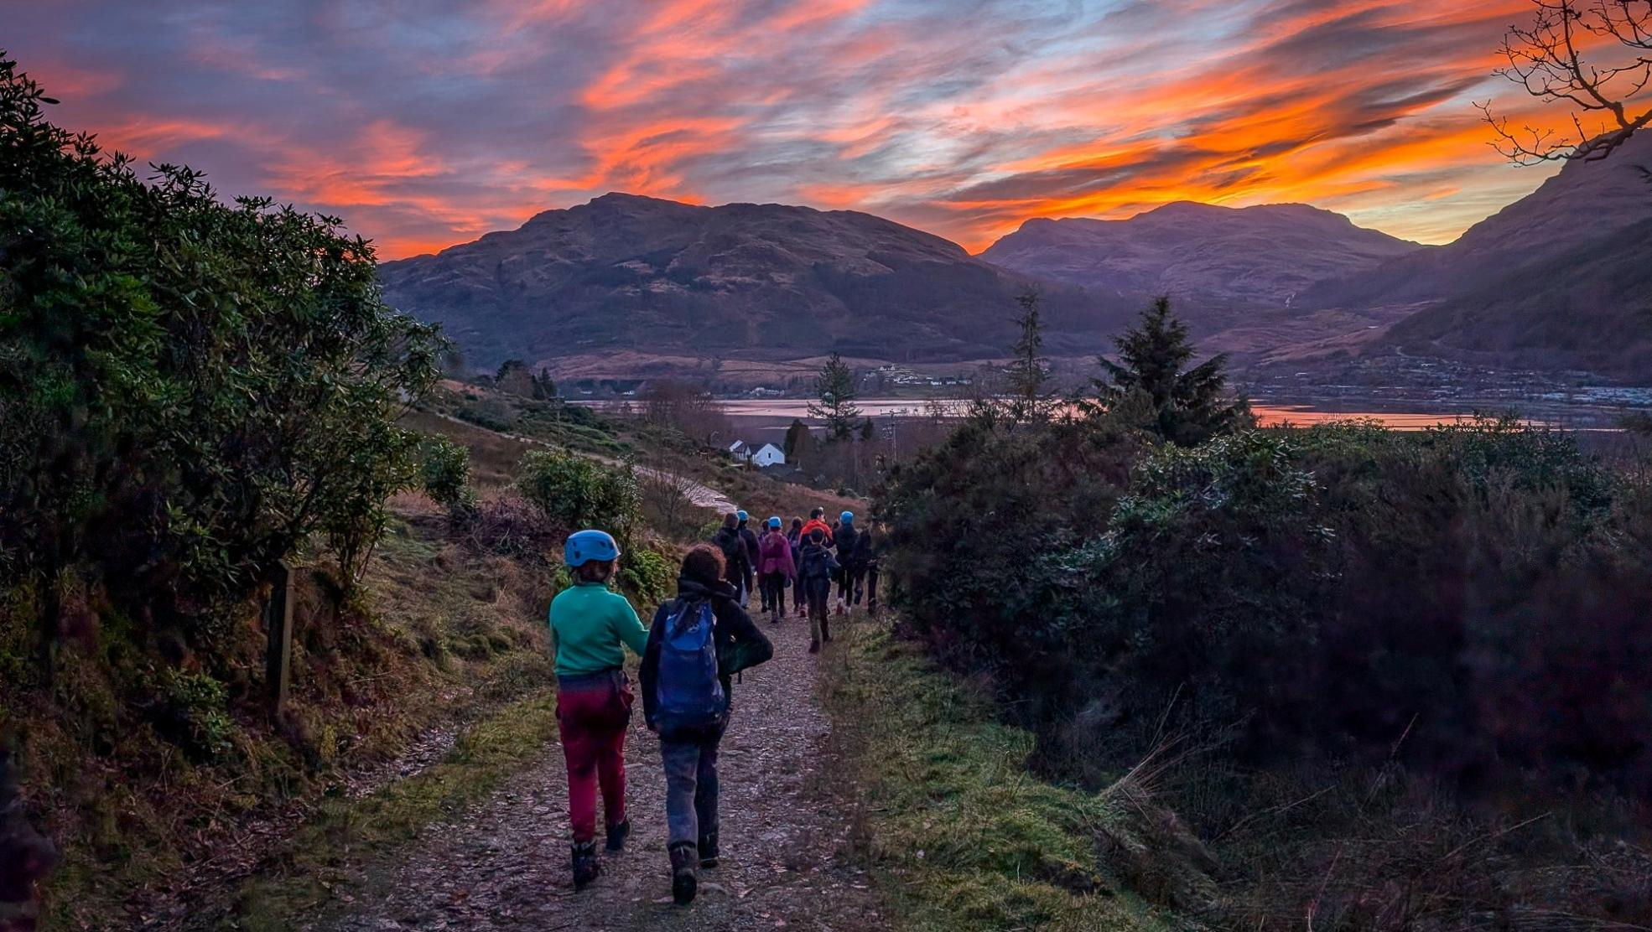

Place to belong
Shaping the next nine years
Notes:
“So, our next strategy to 2035: Place to Belong.
The title’s been chosen very deliberately, because it captures something deeply important about Scouts and the difference it can make in young people’s lives.
At its heart, Place to Belong expresses the emotional benefit of being part of this Movement. When young people feel they belong, they are more confident, more willing to build skills, more able to contribute to society, and better equipped to shape their futures.
Belonging was also one of the strongest themes to come through in the strategy consultation. It came up consistently in different ways from young people, volunteers and across the Movement.
So when we talk about Scouts as a Place to Belong, we are talking about something that is both central to who we are and highly relevant to the world young people are growing up in today.
Young people want a place to belong and this strategy is about helping more young people find that place through Scouts.”
Guidance
x

Slide 12
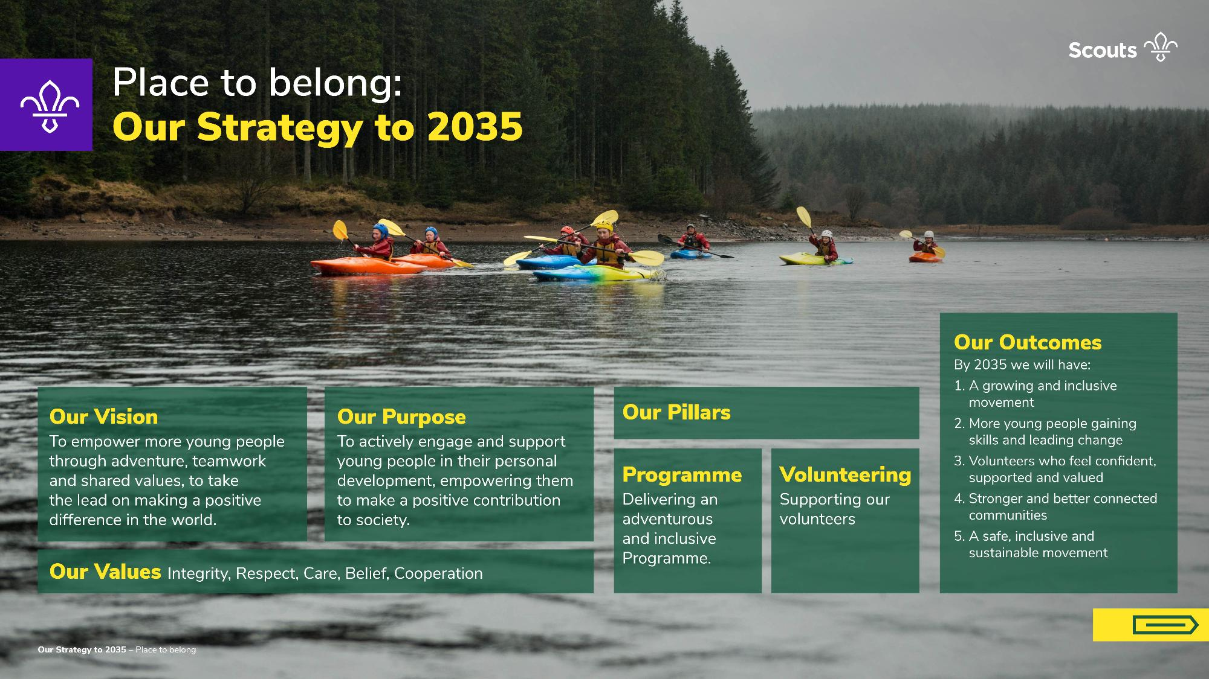
Why we looked ahead and why now?
Notes:
“Here is our new strategy, at a glance – we will walk through each of these areas in the following slides
You may have seen these words before as they’ve been available on scouts.org.uk since November last year, when they were approved.”
Guidance
Swiftly read what is on each of the following slides to help clarify each section.
You can let attendees know that they can go back and read all this on the Strategy part of scouts.org.uk, or that you’ll re-visit these slides as part of one of the later activities.

Slide 13
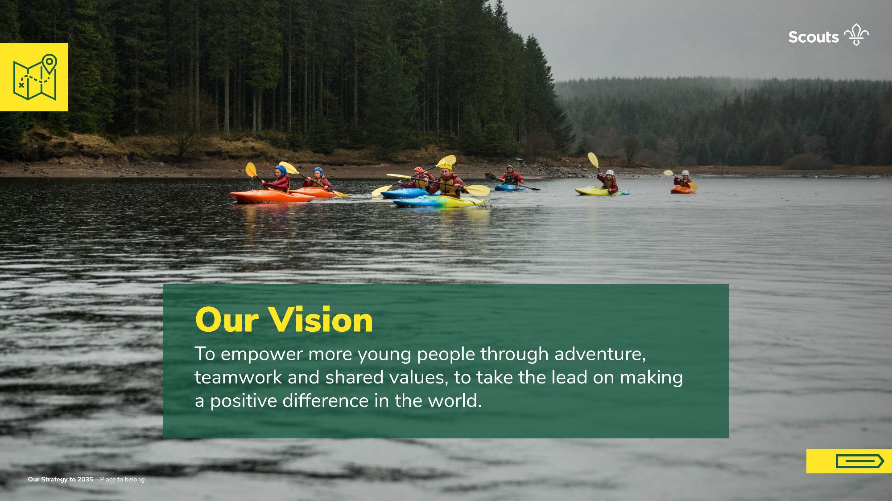
Why we looked ahead and why now?

Slide 14
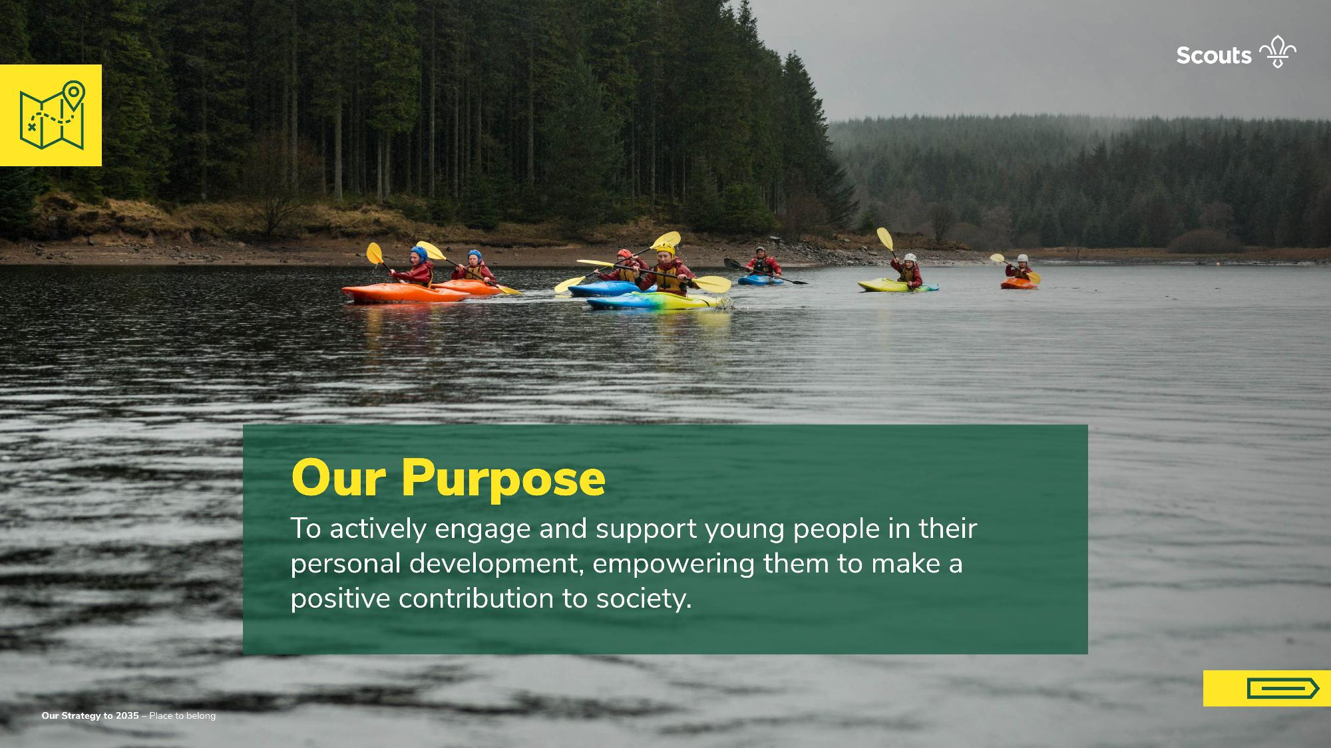
Why we looked ahead and why now?
Notes:
Guidance
Our purpose hasn’t changed – it’ll seem familiar to people.

Slide 15
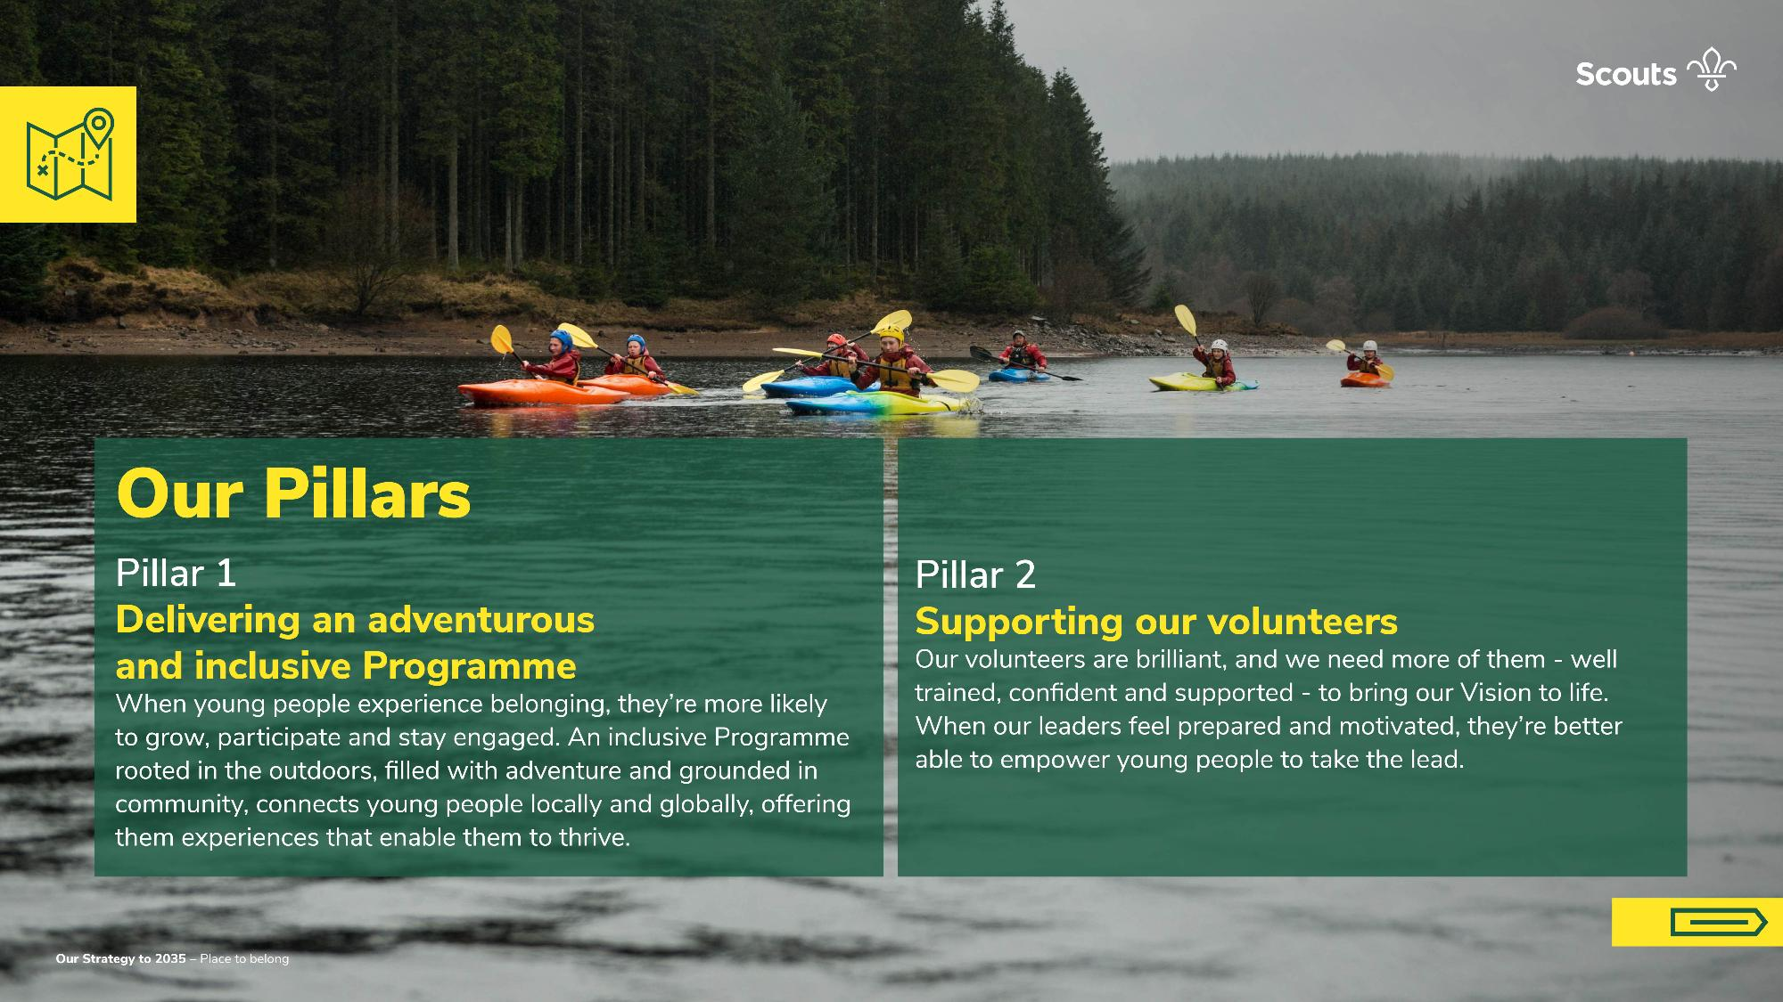
Why we looked ahead and why now?

Slide 16
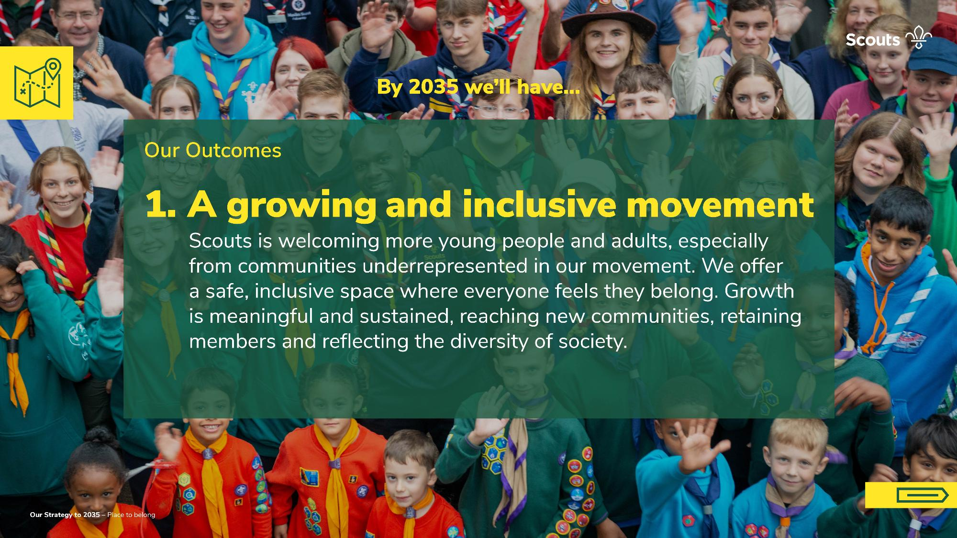
Why we looked ahead and why now?

Slide 17
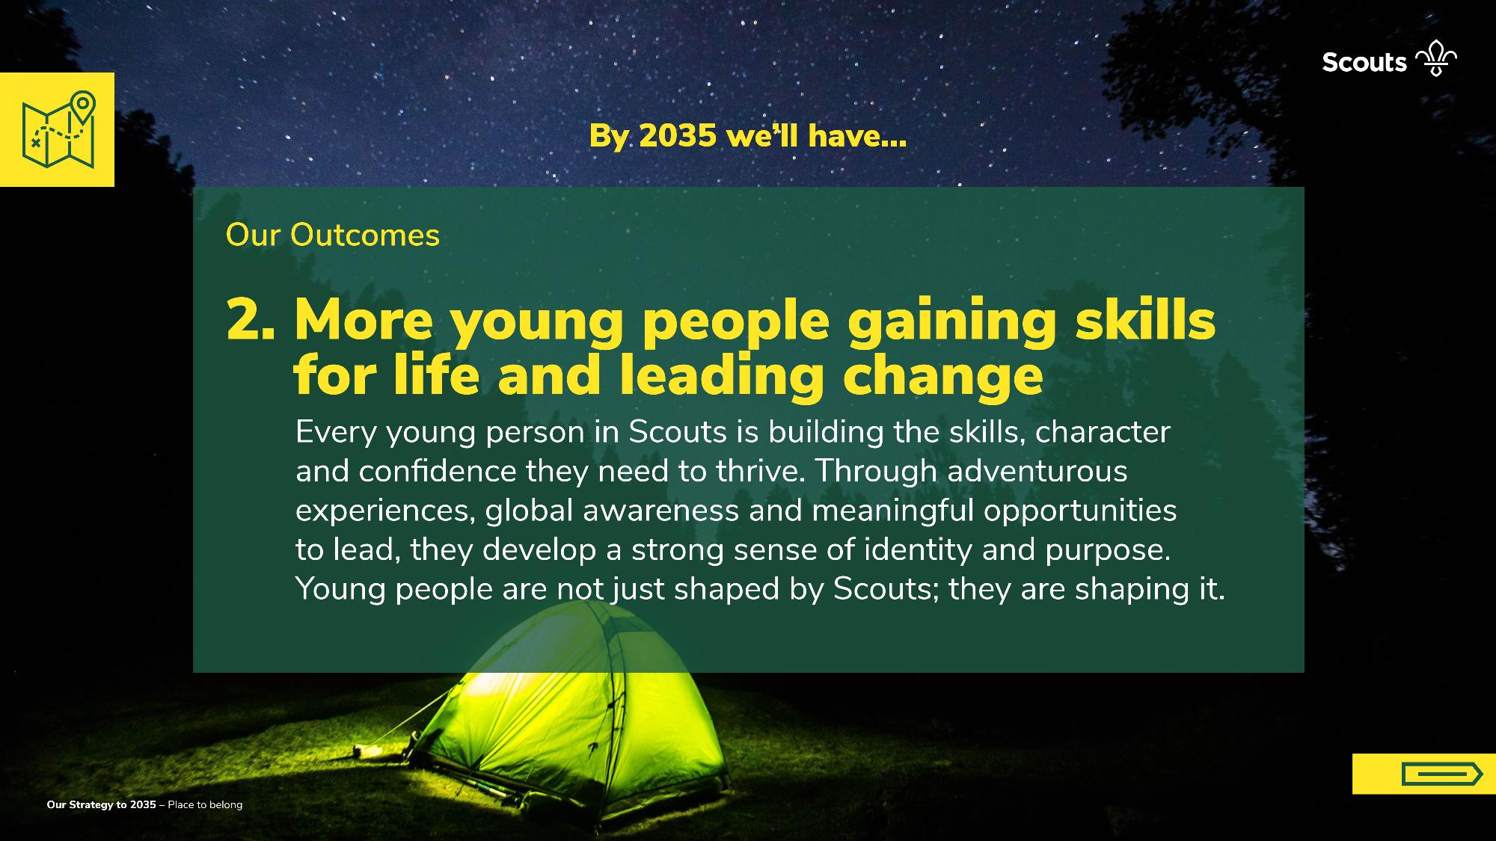
Why we looked ahead and why now?

Slide 18
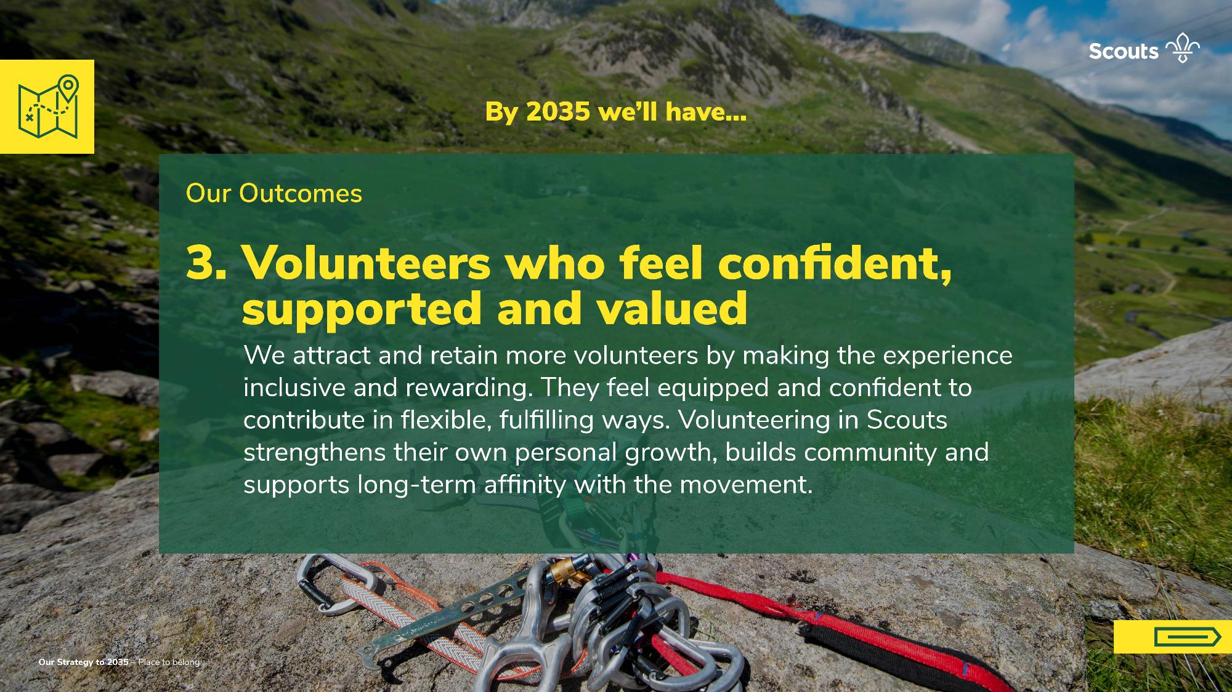
Why we looked ahead and why now?

Slide 19
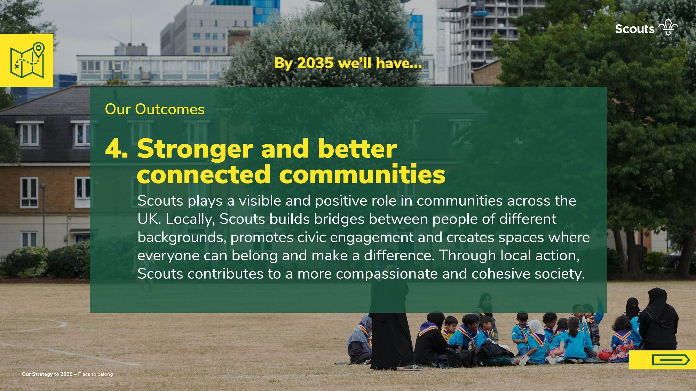
Why we looked ahead and why now?

Slide 20
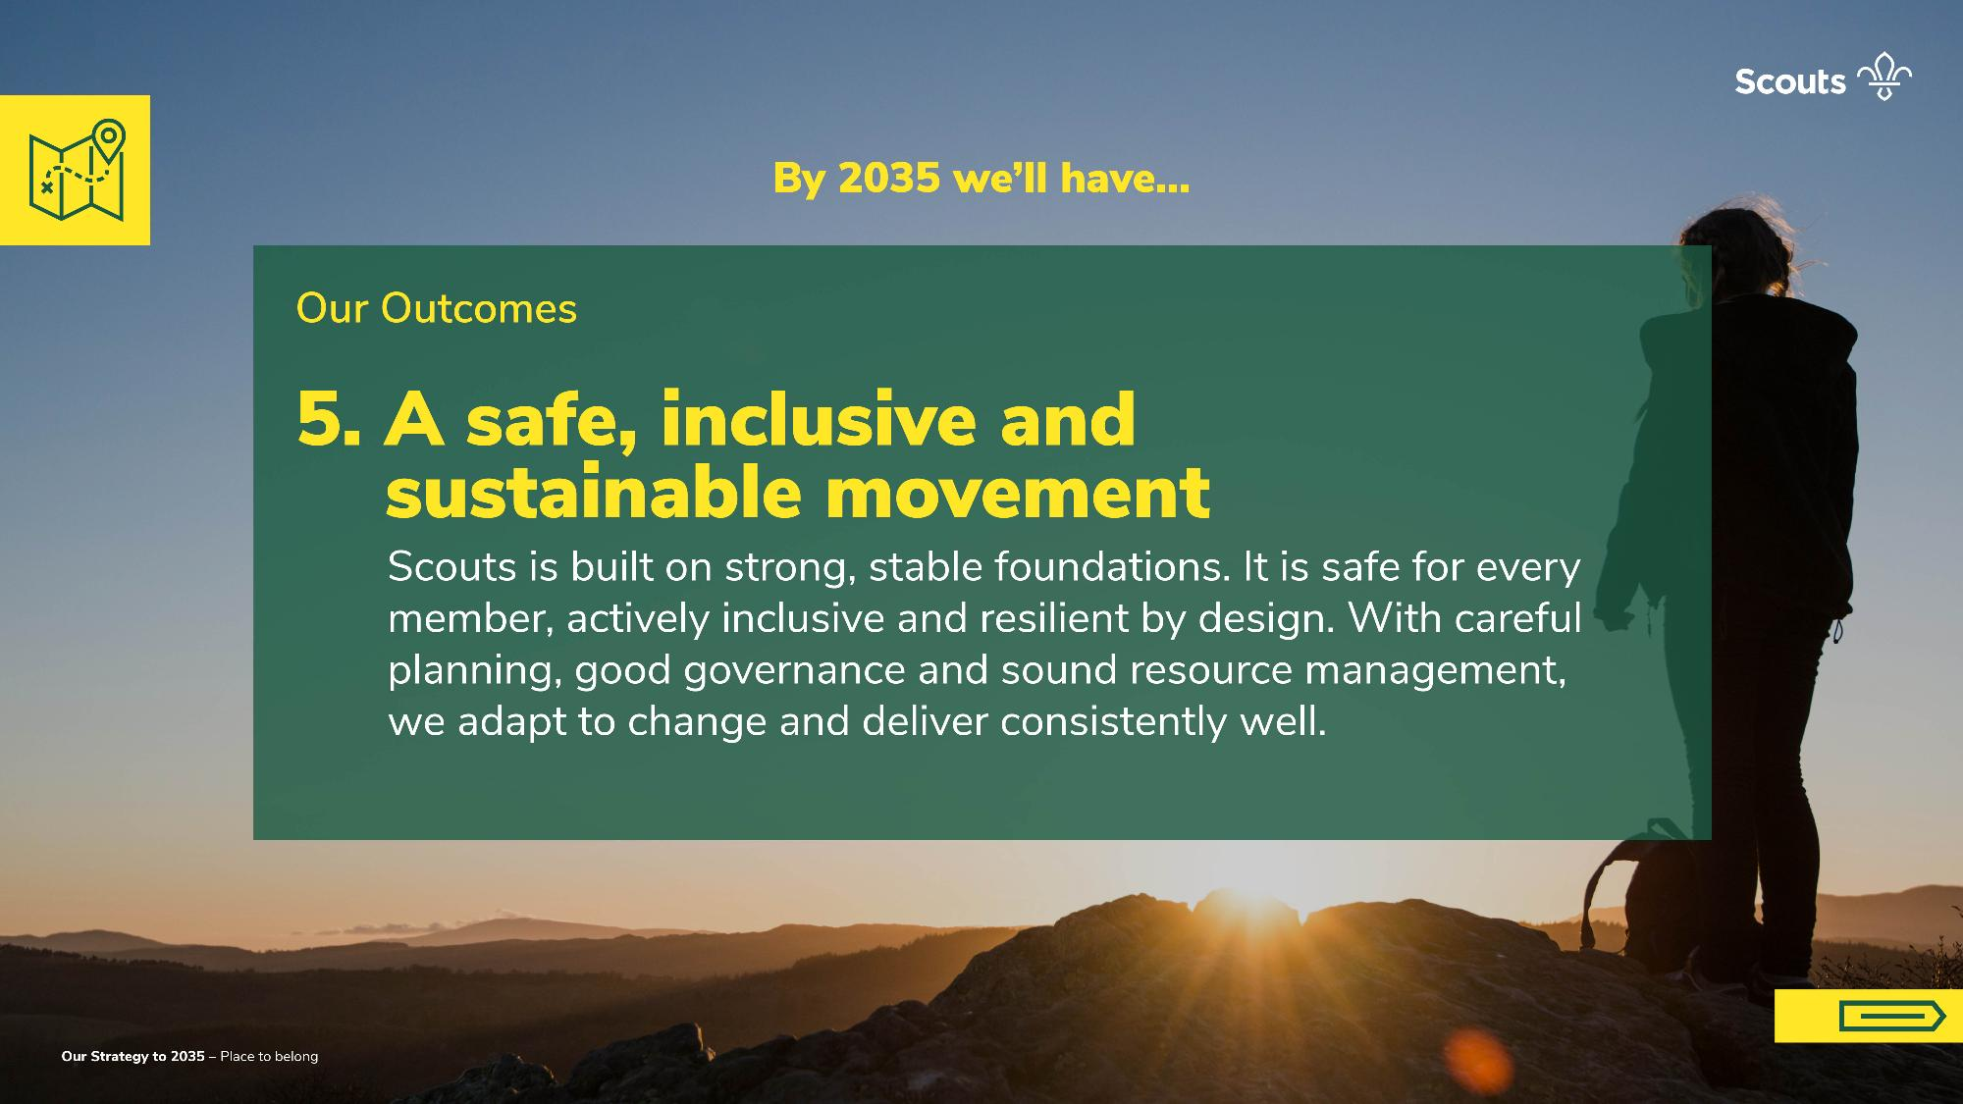
Why we looked ahead and why now?

Slide 21
Why we looked ahead and why now?
Notes:
“Now we’ve walked through each of the aspects, you’ll see a lot of it feels familiar – this strategy is about doing what we do best, reaching more people, being safe and inclusive, supporting our volunteers and contributing to strong and better-connected communities. Everything you see on this slide will underpin our next nine-years at Scouts – some of it remains the same, like our purpose and our values, but other parts are a new, fresh way of looking at things.”
Guidance
Use this slide to bookend the detail from the Strategy, reminding your audience of how it all fits together. Don’t dwell on this slide, as you’ve already looked at the details, and the next slide talks more about how this strategy is different to the last, building on this content.

Slide 22


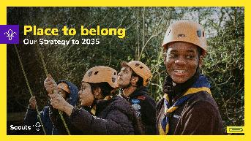
Strategic
shifts
From
To
National direction
Movement focused
Many priorities
Two pillars
One plan for 5-7 years
9-year vision and 3 plans
Pandemic recovery
Outdoor and adventure
Notes:
“For those of you familiar with Skills for Life, our strategy that started in 2018, and ran through until last year, you’ll notice some similarities, but also some pretty big shifts.
We’re moving from a place where UK Scouts set and drive the direction, to a place where everything we do is focussed on the movement – it’ll become clear, if it isn’t already, that we all need to work together, focussing on the pillars and outcomes we’ve just spoken about.
Skills for life was an ambitious strategy, with many priorities. Place to belong is shaped by two pillars to make sure we can be successful and get the two most important things right.
Skills for life started as a five-year plan, and ended up lasting for seven years – there were many influences behind this. Place to belong sets our vision for 2035, but it split into three, three-year plans, to make sure we can be bold and ambitious, but be measured when it comes to how long something takes.
The final shift on the slide may feel different for different people – Skills for Life didn’t plan for a pandemic, it planned for lots of transformative work. But like everyone, plans had to shift to support the recovery. Some Groups will look back on the pandemic as if it were a long-distant memory, but some are still feeling the effects of it. Place to belong looks ahead to the next nine years, with a focus on outdoor and adventure – whether it’s the first camp or adventurous activities since the pandemic, or you’ve been back to it for a long time, the plan recognises that, and champions getting young people active.”
Guidance
There are big shifts, notably, the way we’re structuring the plans, and how we’re focussing on one thing. The purpose of talking through these shifts is to impress on your audience the fact that Place to belong is a locally focussed plan, with a couple of key focusses that are bold, but achievable. You may choose to talk about some of the things that Skills for Life included (such as Squirrels, 14-24 Redesign, volunteer experience changes and new digital tools) if your audience are less clear on how ambitious we’ve been over the past 8 years.

Slide 23
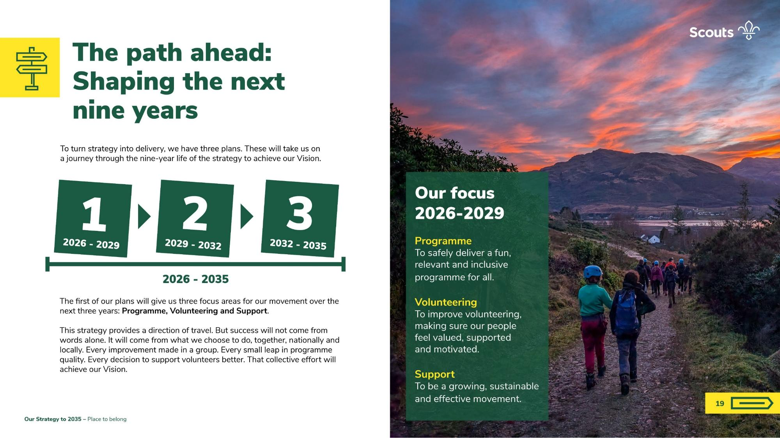
Why we looked ahead and why now?
To turn strategy into delivery we have three plans. These will take us on a journey through the nine-year life of the strategy.
Notes:
“I’ve already alluded to the next nine-years being split into three more manageable plans, so it’s now time to start looking at how that works in practice. Our focus initially is understanding where we want to be by 2035, but looking at what we’re going to do between now and 2029.”
Guidance
Use this slide to make sure your audience understand that the next part of the presentation is looking at the things we’re doing over the next three years. The focus is alluded to on the right hand side of this slide. You may wish to have Team Leaders of different teams talk more about the different areas across the next few slides, or just use this slide to cover-off the themes, and come back to them more if delivering activities, too.

Slide 24
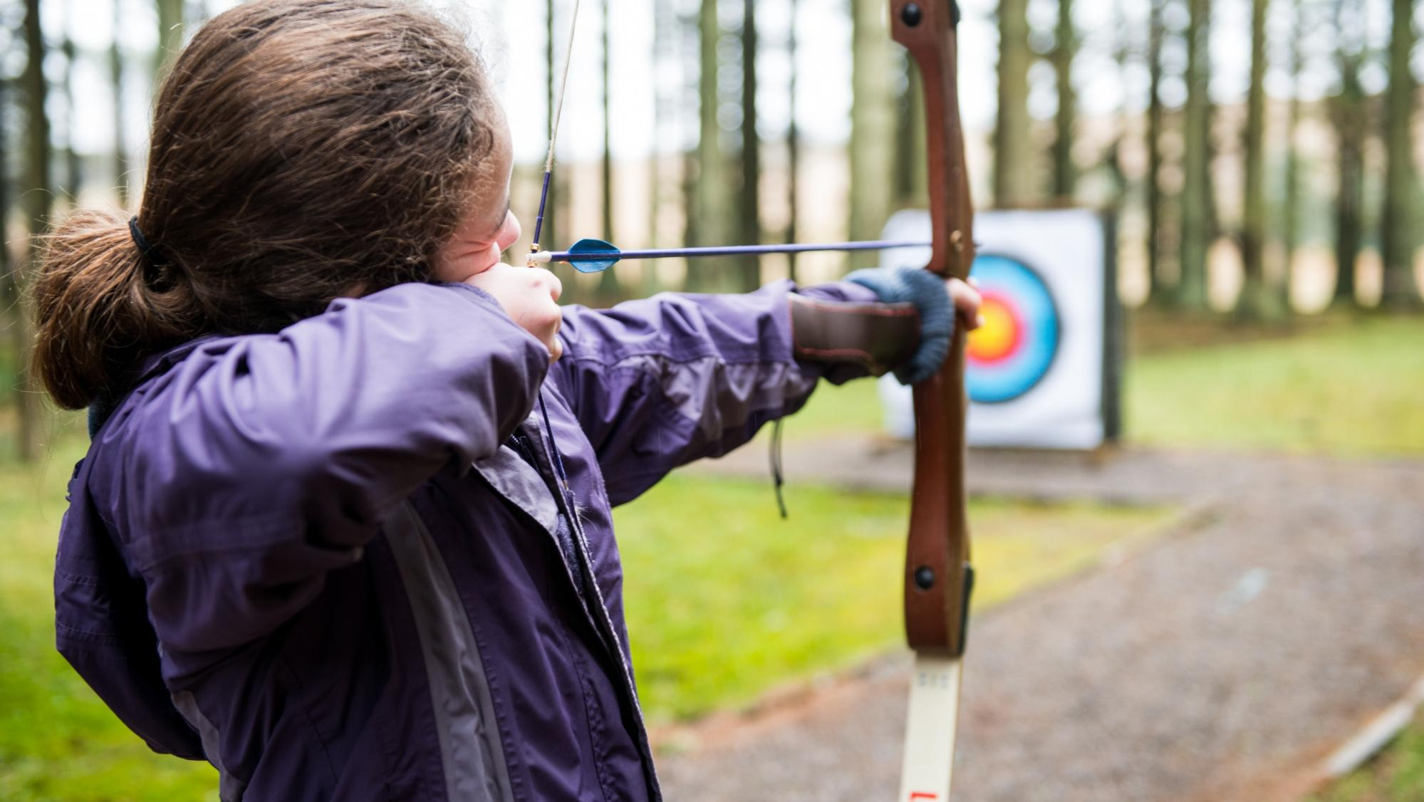
The core
insight
Programme
Volunteering
Support
Our focus for the next three years
Notes:
Guidance
This slide carries on from the previous slide. Use it if you want to be more explicit about the focus for the next three years, and need an intro for the next few slides.

Slide 25
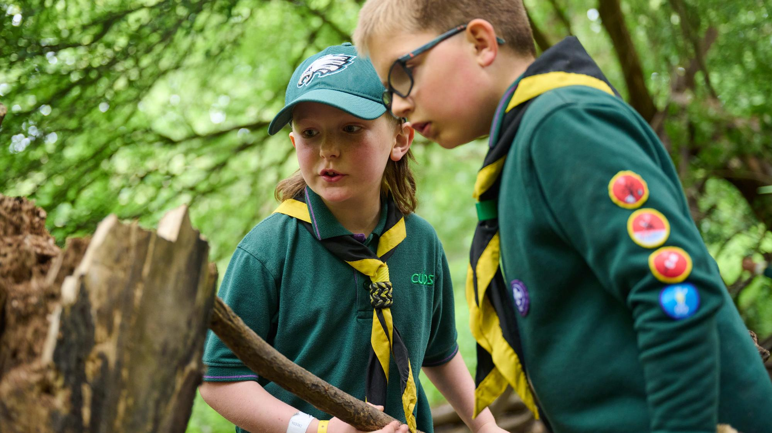

Programme
The experience young people have
Notes:
“Programme is where Scouts comes to life.
It is the part young people remember. It is where confidence grows, friendships are built, skills are learned, and adventure happens.
Today, we already see brilliant programme happening across Scouts. Young people are achieving badges and top awards, taking part in nights away, learning new skills, giving service, and having experiences they may not get anywhere else. But we also know that quality and consistency are not yet the same everywhere, and that matters, because every young person should be able to expect a great Scout experience wherever they are.
Over the next three years, young people have told us they want to be more involved in shaping what they do. They want stronger youth voice, more say in planning, and a programme that feels consistently high quality, exciting and relevant. They want it to be centred on outdoors and adventure, but also connected to the issues, interests and communities that matter to them.
So, in practical terms, that could mean young people having a much more active role in programme planning at section level, with leaders supported to build that in as the norm. It could mean better sharing of programme ideas and resources, so volunteers do not have to start from scratch each week. It could mean clearer expectations of what a high-quality programme looks like, while still leaving room for local flexibility and creativity. And it could mean making sure adventurous, outdoor experiences are more accessible and more consistently available.
In nine years, we want Scouts to be recognised as delivering one of the most modern, youth-shaped programmes in the UK. A programme that is relevant, adventurous and deeply rooted in communities. One that young people help shape, that reflects the world they are growing up in, and that still feels unmistakably like Scouts.
That is the ambition: protecting what is special about Scouts, while making sure the experience young people have is consistently brilliant, modern and shaped with them, not just for them.”
Guidance
Try to link to tangible outcomes (3 years) before visionary outcomes (9 years). This should hopefully make it feel relatable. You could also include some examples of good practice from your patch, or possible outcomes you may go after.

Slide 26
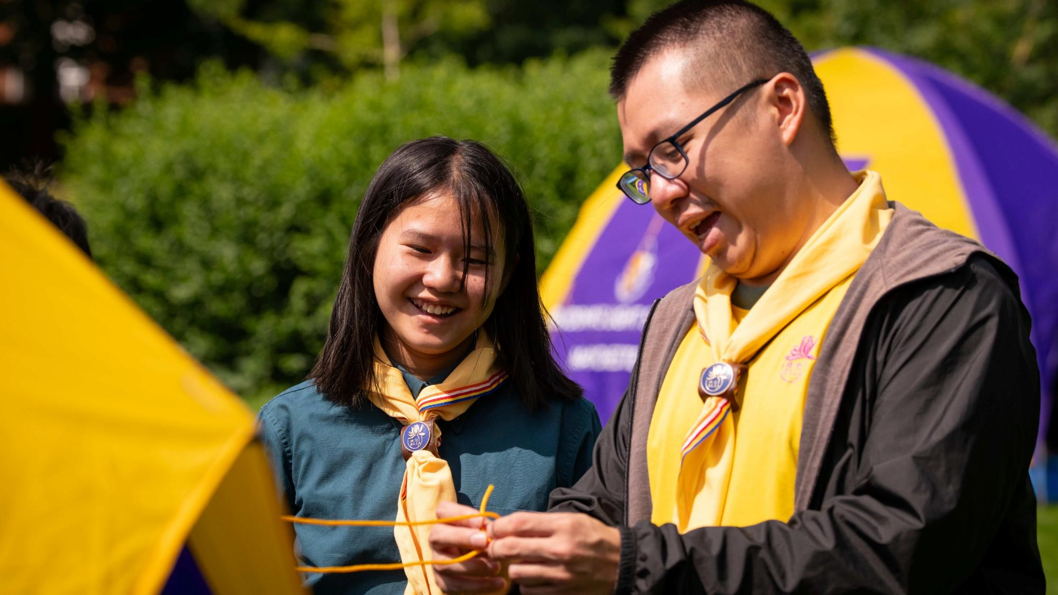

Volunteering
that fits around
people’s lives
Notes:
“Volunteers are the Movement. Everything Scouts achieves happens because people give their time, energy, care and commitment. That is one of our greatest strengths, and it is why this strategy has to work for volunteers as much as for young people.
Today, many volunteers find Scouts deeply rewarding, but we also know that for some it can feel complex, demanding or harder to fit around modern life than it should. We should be honest about that, while also recognising that a lot of work has already gone into improving volunteering, and some recent changes need time to bed in and settle.
Over the next three years, volunteering should not only feel clearer and more manageable, it should actually be clearer and more manageable. That means simpler ways to get started for people joining Scouts for the first time, so that enthusiasm is not lost in process. It means teams, tasks and expectations being easier to understand. It means making it more straightforward for people to contribute in different ways, including flexible or time-limited volunteering. And it means reducing friction from digital tools, so they support volunteers rather than slow them down.
In practice, that might look like a more intuitive first experience for new volunteers, clearer guidance on what is expected in different roles, less duplication in processes, and better support for teams to share tasks in ways that are realistic and sustainable. It could also mean making it easier for people to step in, help, and contribute without feeling that volunteering has to be all or nothing.
In nine years, volunteering in Scouts should fit modern life. It should be flexible, fulfilling and well supported. People should feel that their time is used well, that they understand how they contribute, and that they are part of something worthwhile. Volunteer retention should be strong, satisfaction should be higher than it is today, and more people should feel that Scouts is a place where they can give their time in a way that works for them.
This is not about saying volunteering is broken. It is about recognising the pressures people face, valuing what volunteers already give, and being serious about making volunteering sustainable for the future, because the young people at the centre of our strategy, need volunteers.”
Guidance
Acknowledge pressure volunteers feel today, and that some of the changes introduced recently need to settle. Avoid implying current approaches to volunteering are failing, but noting that new things always need refinement, and feedback is being listened to.

Slide 27
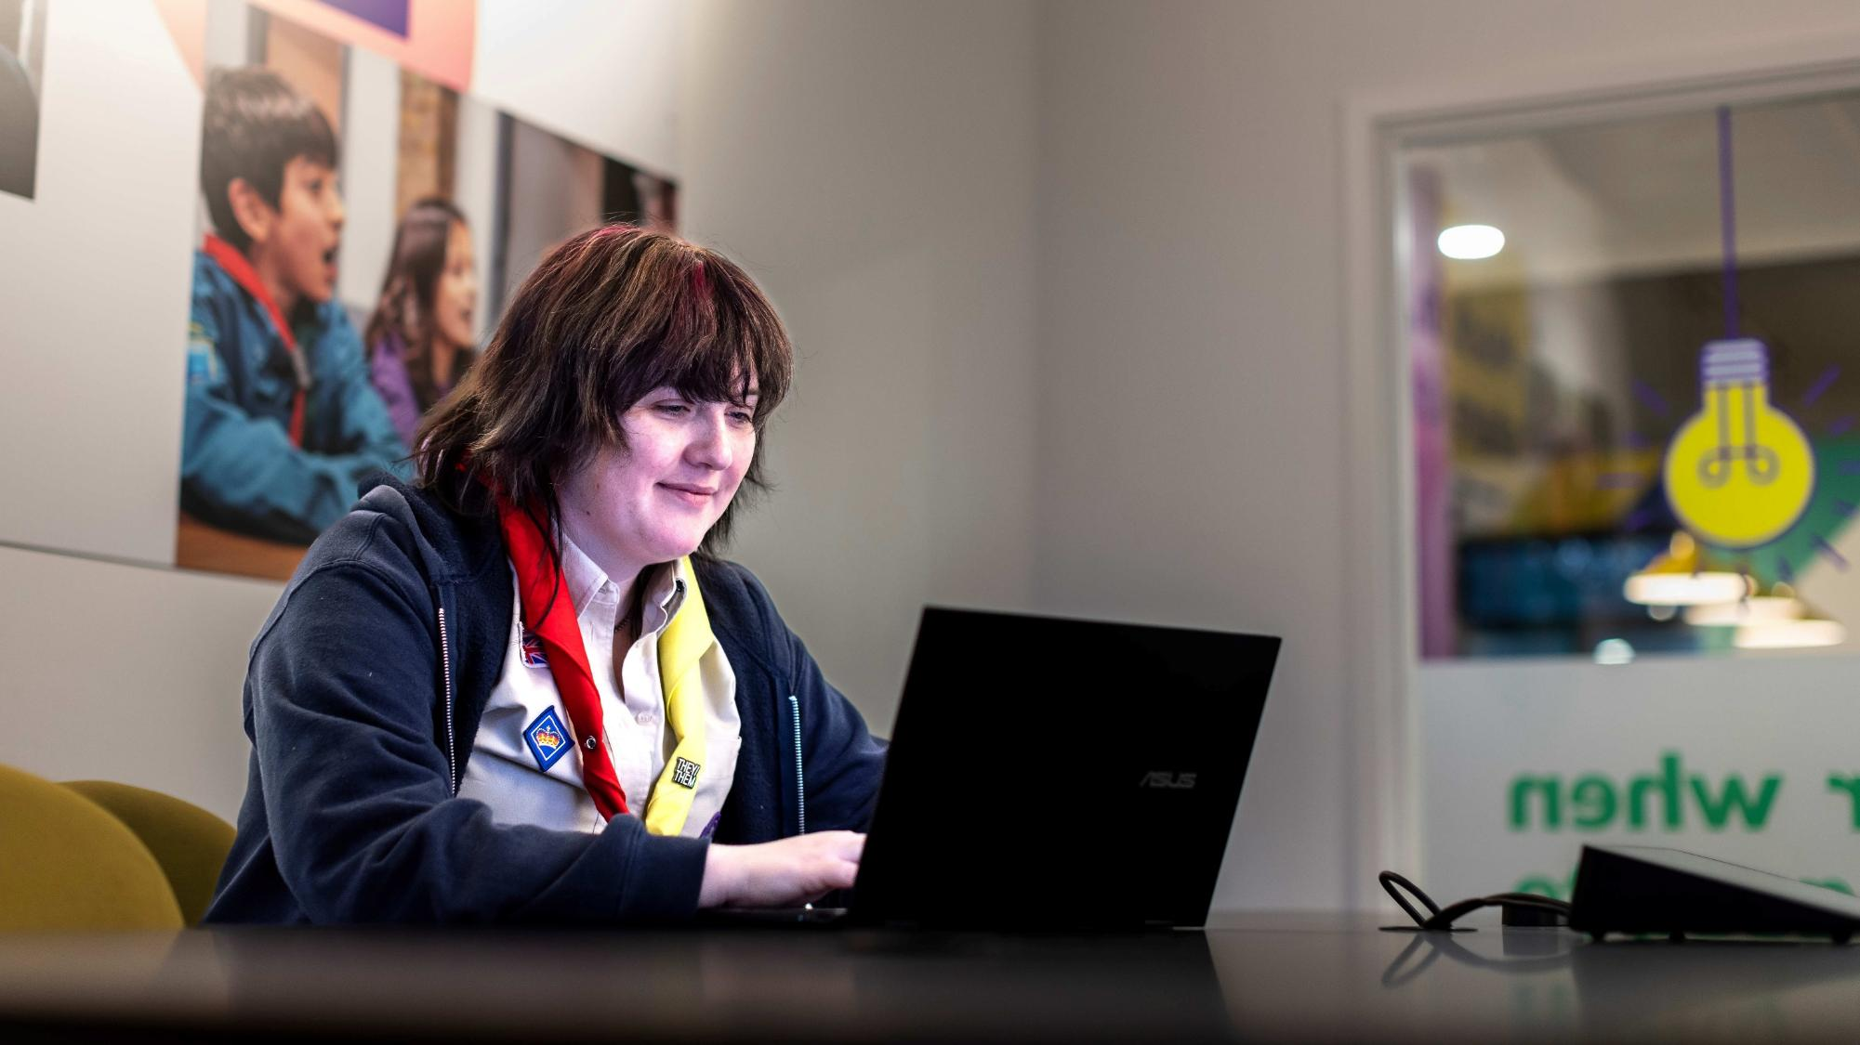
Support
Removing
friction
Notes:
“Support is all about helping Scouts happen. It should make things easier, clearer and more effective. When support works well, it enables great local Scouting. When it doesn’t, it can feel like friction.
Over the next three years, we want the support we provide to our membership should feel simpler. That means clearer routes for help, better digital tools, and less duplication. It means people knowing where to go, what they can expect, and getting support in a way that is timely and useful.
It also means being clearer about the different roles of support across the Movement, from UK to Counties, Areas & Regions, as well as Districts and local teams - so that support feels joined up rather than fragmented, as it sometimes does.
In practical terms, that could mean reducing overlap between systems and processes, improving signposting so volunteers do not have to work out the system for themselves, and making better use of data so support is more proactive and better targeted. It could also mean being more consistent about what support is available nationally and what is best delivered locally, so that people experience more coherent, joined up support.
In nine years, support should be seamless. It should be nationally coherent, locally available, data informed, and enabling rather than obstructing. That means the overall system works together more effectively, but support is still delivered in a way that makes sense for local realities and local relationships. It should feel like one Movement, with support that is easier to access and easier to trust.
This matters because support isn’t separate from delivering Scouts. It is part of how good Scouting happens. If we can remove friction, clarify expectations, and make support more joined up, we create better conditions for volunteers and better experiences for young people.”
Guidance
Frame support as an enabler, not bureaucracy. This should reduce resistance. The key message is that when we talk about support, we’re talking about it from UK Scouts AND from Counties and Districts.

Slide 28
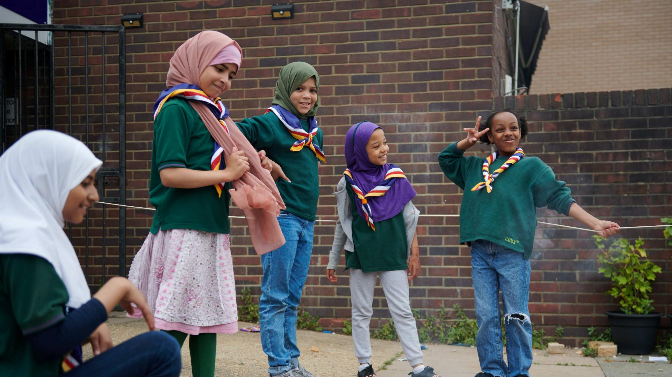

Strategy lives locally
One direction;
many decisions
Notes:
“One thing is critical, as we look the next stage of our journey as a Movement.
This strategy will not succeed simply because of decisions made at UK level.
It will succeed because of thousands of decisions taken locally, in Sections, Groups, Districts, and Counties. And if we’re serious about youth voice, about decisions made in Beaver Log Chews, Sixers Councils, Patrol Leaders Councils etc.
The strategy isn’t implemented in a boardroom at Gilwell Park. It’s implemented on a Tuesday night in a Scout Hut.”
Guidance
This is about shared ownership of Strategy. Without this, the audience may feel Strategy is being ‘done to’ them – it’s your role to lead them and this.

Slide 29
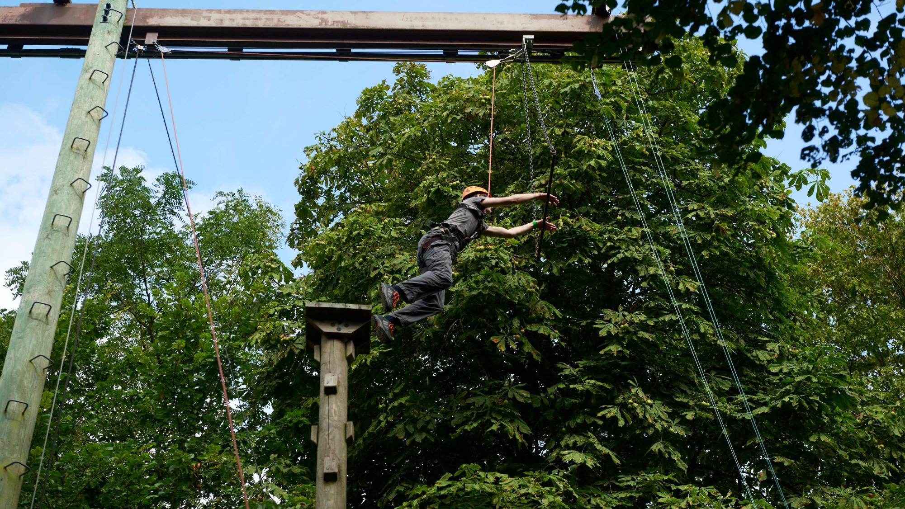
Big leaps
and small steps
Notes:
“Implementation isn’t only about national initiatives.
It’s about local choices.
Trying a new approach to programme.
Welcoming volunteers differently.
Reducing local admin burden.
Taking a leap to make sessions more youth led or ensuring more outdoor and adventure is experienced by young people.
Some decisions will be big.
Many will be small.
Together, they shape the experience of young people.”
Guidance
Make implementation feel achievable. Reduce intimidation. Empower action. It’s not just about County/Area/Region or District Development Plans, but about small decisions that can result in doing an activity outside rather than inside.

Slide 30
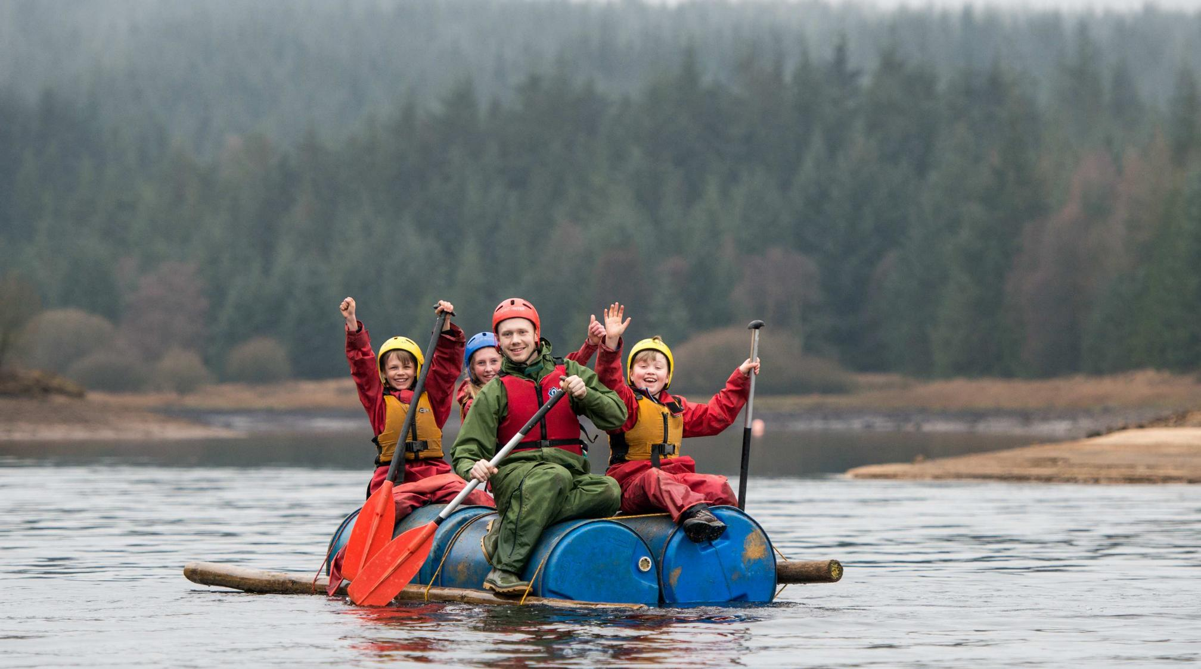
Shared responsibility
UK steers direction – local Scouts take it forward
Notes:
“At UK level, their role is to set clear direction, remove barriers, provide tools, and invest where it matters.
At local level, our role is to bring our amazing programme to life, adapt with confidence, strengthen volunteering, and improve the weekly experience.
This is about partnership.”
Guidance
Avoid sounding like burden of implementation has been delegated to local levels only – this is a call to action to get involved, and be part of something bigger, for positive change.

Slide 31
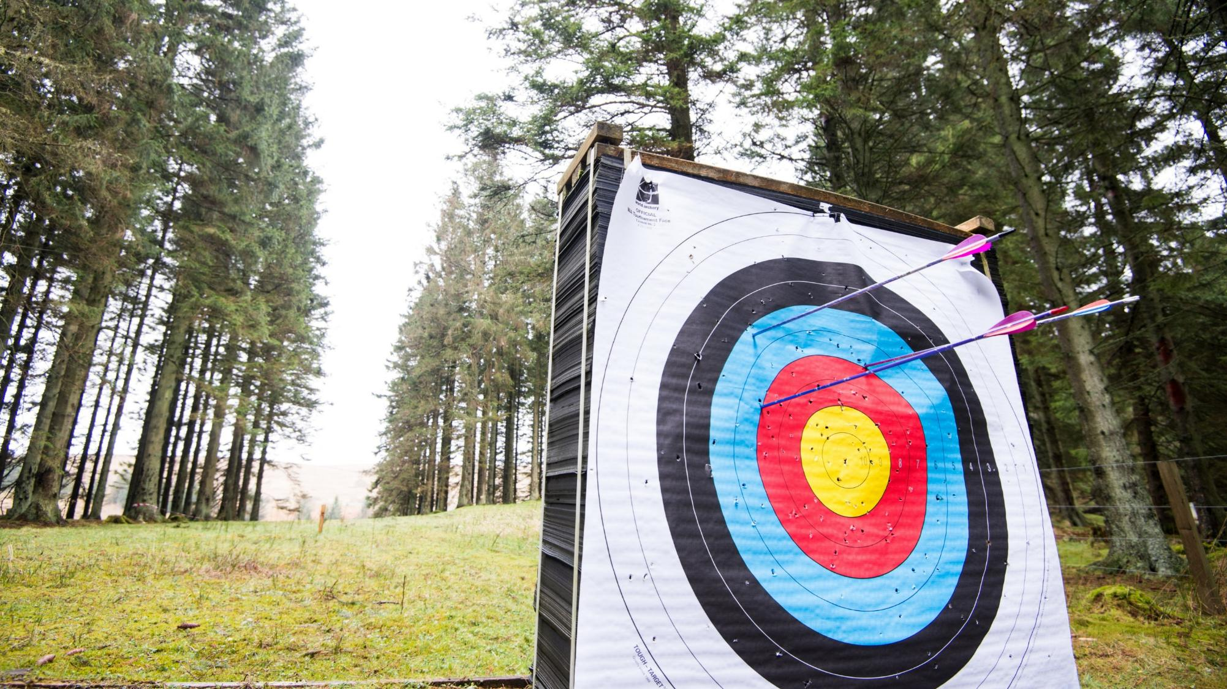
What success feels like in three years
Clearer priorities
Higher-quality programme
Less friction for volunteers
Volunteers feel better supported
Notes:
“In three years, Counties, Areas, Regions and Districts should be able to feel that change is happening.
Not as an abstract strategy on paper, but in the day-to-day reality of Scouting.
Priorities should feel clearer.
Programme quality should feel more consistent.
Volunteering should involve less friction.
And volunteers should feel better supported to do what matters most.
This is not about everything being perfect in three years’ time. It is about real progress, visible momentum, and growing confidence that we are moving in the right direction together.”
Guidance
We need to keep expectations realistic. Three-year success should feel credible.

Slide 32
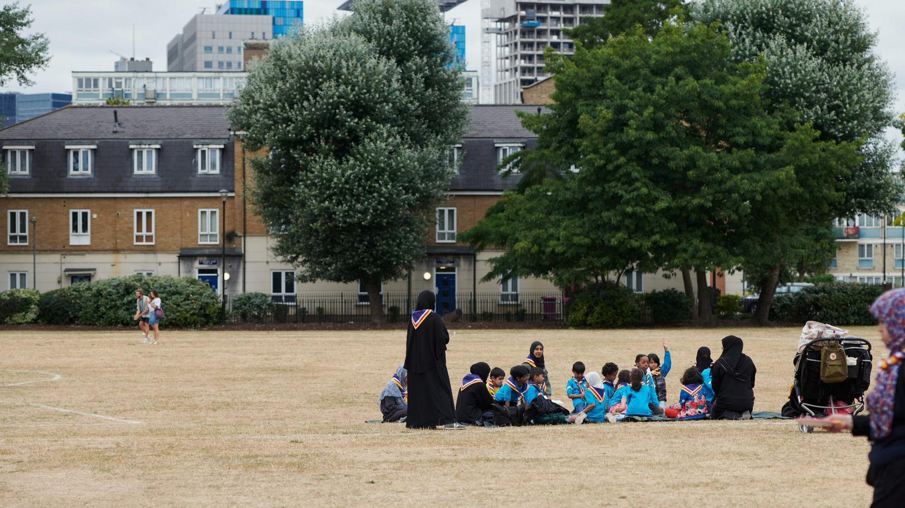
What success looks like in nine years
Scouts thriving in communities across UK
More young people enjoying a high-quality programme
Volunteering that fits modern life
Support systems that enable not constrain
Notes:
“In nine years, we should see something bigger and more lasting. What success looks like by that point is our Vision made real.
It means Scouts thriving in communities across the UK, with more young people able to access great Scouting and more communities feeling the positive impact of what we do.
It means a consistently high-quality programme, shaped with young people, rooted in adventure, relevant to the world they are growing up in, and recognisably Scouts wherever it is experienced.
It means volunteering that fits modern life better than it does today — more flexible, more sustainable, and more fulfilling — so that people can contribute in ways that work for them and feel valued for the part they play.
It means support systems that enable rather than constrain. Support that is clearer, more joined up, and more effective at helping volunteers focus their time and energy on delivering great experiences for young people.
And taken together, it means a Movement that feels modern, confident and outward-looking, without losing the heart of what makes Scouts, Scouts.
That is the bigger picture we are aiming for — not change for its own sake, but a stronger Movement, better able to serve young people and communities for the long term.”
Guidance
Shift tone to aspirational identity. This is about pride and legacy. Perhaps draw on the 5x Strategic Outcomes for this section.

Slide 33

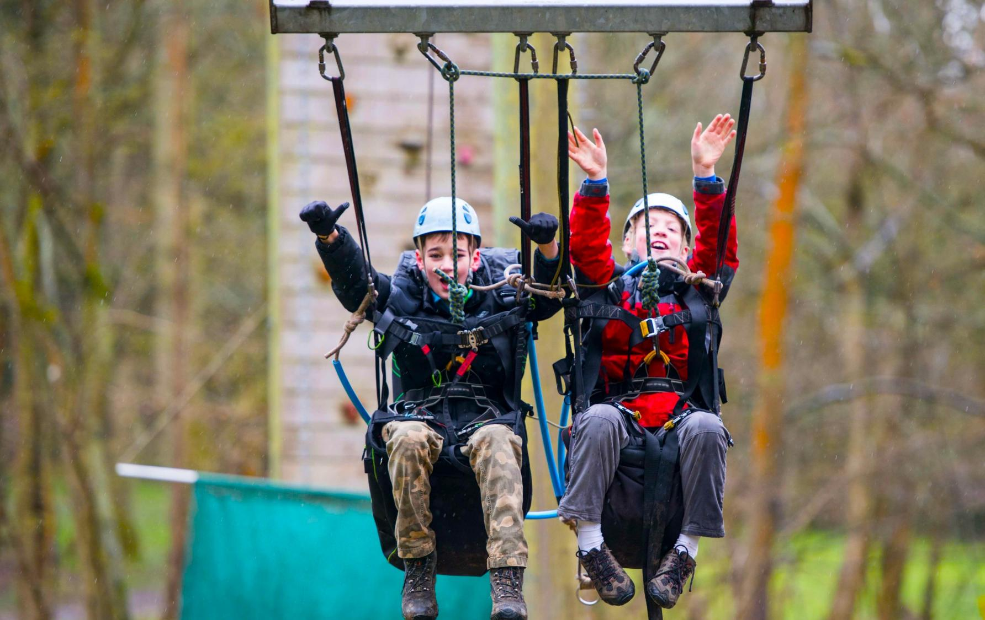
Preparing
for launch
April marks the transition
More support and resources coming
Now in familiarising and planning phase
Sharing learning
Notes:
“As we look ahead, it’s important to be clear about what happens next.
In April, we formally transition from our last Skills for Life strategy to this new Strategy.
But we want to reassure everyone: this is not a big bang moment. There is no expectation that everything changes overnight, or that immediate action is required in April itself.
We’ve had information from UK Scouts and we’re now sharing more information, more assets, and more practical support — guidance, communications, and resources to help bring the Strategy to life.
For Counties and Districts, the next phase is really about becoming familiar with the Strategy and the Plan, and beginning to think about what it means locally.
That means starting to plan in two horizons:
what progress should look like over the next three years, and
what we are collectively working towards over the full nine-year journey.
To help with that, next up, we’ll start translating the Strategy into practical thinking and local priorities for our teams.
Guidance
This is about reducing anxiety and prevents misinterpretation that launch equals immediate delivery pressure. It positions the launch as a transition into a supported phase, reinforcing the shared ownership model, and should build confidence by highlighting practical tools and peer examples rather than top down instruction.

Slide 34
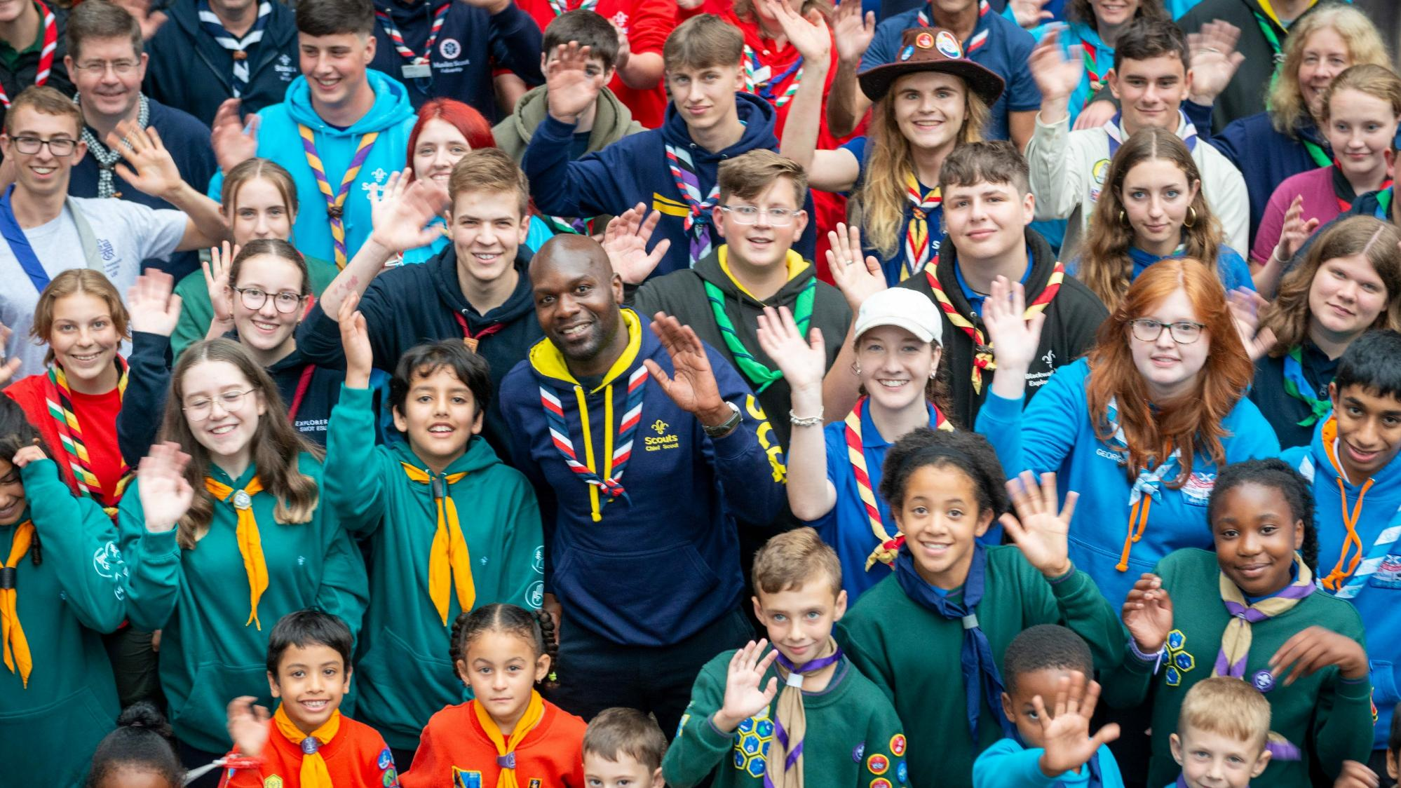

One movement
Shared direction,
local action
Notes:
“This strategy is about the next step of our journey as direction of travel.
But success will not come from what we write down today.
It will come from what we choose to do, together, nationally and locally.
Every improvement made in a group.
Every small leap in programme quality.
Every decision to support volunteers better.
That collective effort is what will shape the next nine years.”
Guidance
End with a sense of collective ownership and optimism.

Slide 35
Local action
What does it look like for us?
Notes:
Guidance
This part of the session is about breaking down the strategy and first three years into local action. It’ll be different in different places, so use this to focus efforts in a way that works for you, and your audience. Explain to your audience that it’s their turn, and whether they’ve contributed up to now, or this is their first exposure to the strategy, you want to hear their voice and ideas.

Slide 36
One strategy, different at each level
Groups – simple, practical and proportionate actions that improve experience.
Districts – practical support, co-ordination, shared problem solving and collaboration.
Counties – enabling Districts and Groups through co-ordination and support.
Notes:
Guidance
Focus attention on the relevant level for you/r audience, and how the directly adjacent levels work together. Make sure it’s clear that everything is about making practical decisions, but that the further ‘up’ the hierarchy you go, the focus becomes more on support. Maintain clarity that efforts should never be duplicated at each level, and that every action that every person takes, in the right direction, is working towards our strategy and our vision.

Slide 37

At Group, District or County level:
Which one or two outcomes or priorities matter most for you?
What would those look like in practice?
What are two realistic actions to prioritise in the next 12–18 months?
What is one thing to stop, simplify or do differently in order to create space for these actions?
Notes:
Guidance
Deliver this part of the session in the best way for you and your audience. Feel free to adapt the following plan:
Purpose
To move participants from understanding to practical application.
Group setup
Tables of five to eight participants
Mixed roles where possible
Each table chooses one level to work from: County, District or Group
Task
Each table is asked to agree:
Which one or two outcomes or priorities matter most for their chosen level
What those would look like in practice locally
Two realistic actions to prioritise in the next 12–18 months
One thing to stop, simplify or do differently in order to create space
Prompts for discussion
These are not exhaustive questions that your audience need to answer, but may be useful for you to introduce verbally part way through the discussion, to help keep groups focussed.
Where can your level add the most value?
What would success feel like for young people or volunteers locally?
What is already working that the strategy reinforces?
What support would you need from the level above?
Which small decisions would make the biggest practical difference?
Examples to stimulate thinking
These examples are practical examples, that may apply at different levels in our hierarchy. Avoid introducing them too early, to let your audience think outside of the box, but you may wish to pass these out after they’ve had their initial conversations.
more outdoor activity or more nights away
improving youth voice and youth leadership
improving volunteer recruitment, induction or recognition
sharing skills, facilities or resources across Groups
working with local schools or community organisations to widen access
using County events, training or communications to reinforce priorities
These examples are consistent with the local actions material, which emphasises improving programme quality, expanding outdoor opportunities, increasing youth leadership, supporting volunteers and widening access.
Notes
If your audience are doing well, or specific groups are making good progress, you may want to encourage participants to choose fewer priorities and make them specific. Remind them that the aim is not to cover the whole strategy, but to identify realistic areas of focus.

Slide 38
How did you get on?
What ideas did you like?
Where can we work together, or share ideas?
What are our favourite quick wins?
Where have we set our sights for 2035?
What’s one thing you’ll do after today?
Notes:
Guidance
We recommend inviting groups to review each others’ work – that way, they’ll identify patterns, build confidence in the small steps that could be taken, strengthen each others’ ideas, and recognise that alignment doesn’t mean uniformity – two different Districts may implement the plan differently, but end up working towards the same outcome.
Invite members to stand up and circulate around the room – ask them to leave their sheet of paper with their answers on it visible for other groups.
During the time, help groups identify emerging patterns, spark conversations, and encourage people to think about what they do next.

Slide 39
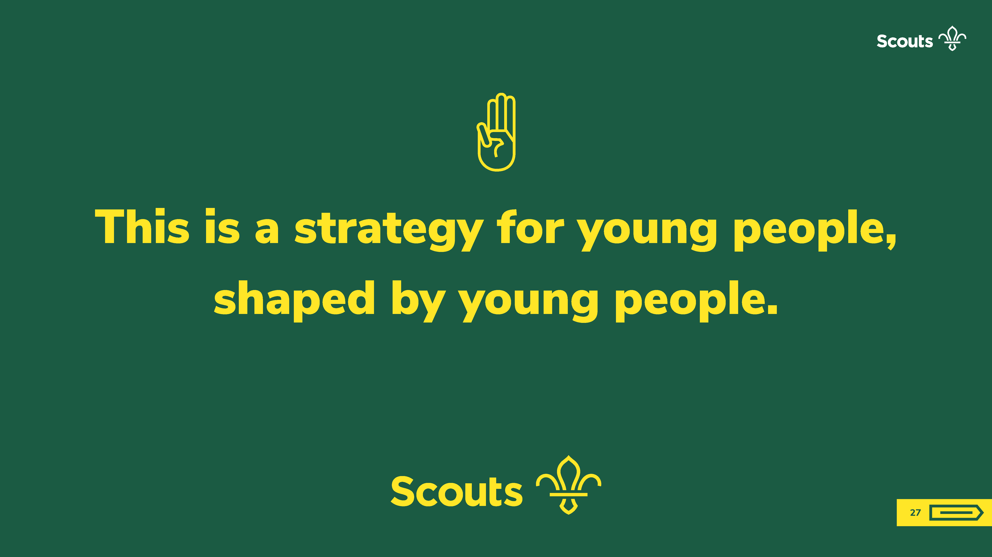
Notes:
“Place to Belong will not be judged by how well people can describe the strategy document. It will be judged by whether, in more places, more young people find friendship, adventure, trusted adults, opportunities to lead and a stronger sense that they belong. That will happen through hundreds of local decisions across Groups, Districts and Counties: choosing to get outdoors, choosing to support volunteers well, choosing to listen to young people, and choosing to focus effort where it makes the biggest difference. That is how the strategy becomes real.”
Guidance
At this point, you could ask people to write down the one thing that they’re going to take away as a small change/action/improvement, on a postcard, so they have a tangible outcome from the session. Couple that, with signposting to resources, and the message of the strategy will be taken away to more local meetings and conversations.

