Slide 1

Do more.
Be more.
Young Leaders’ Scheme
Scouts.org.uk
#SkillsForLife
Notes:
If you need to change the background please follow these instructions:
1. On your Windows tablet, tap the Design tab.
2. On your Windows phone, open the slide for editing (either by double-tapping it or by tapping it and then tapping Edit). Tap More at the bottom of your screen, tap Home, and then tap Design.
3. Tap Format Background.
4. You will see the background colours divided into Theme Colours and Standard Colours. Theme colours coordinate with the theme you selected previously. You can select a solid colour or colour gradient.

Slide 2
Explorer Scout Young Leader Training
Module D – Understanding behaviour

Slide 3
Do more. Be more
  Welcome
By the end of this module, you'll:
understand different types of behaviour
understand and talk about the causes and triggers underpinning different types of behaviour
demonstrate a number of tools or methods that could be used to manage behaviour
explain how Explorer Scout Young Leaders can assist with managing behaviour in the section
explain where they can get further assistance, and when to involve adults
Do more.
Be more.
Young Leaders’ Scheme

Slide 4

Getting to know you...
Notes:
Icebreaker: 5- 10 mins
Key points:
Participants will be working together during the session so it's a good idea to break the ice and get to know each other first.
Activity option 1 - Speed dating:
Everyone walks around the room, finds someone they don’t know and talk for 1 minute
Ask questions: Who got you into Scouts? When did you join Scouts? What key skill do you bring to your Scout team? what they’d like to learn from workshop,
After two minutes, blow a whistle or shout and they find a new partner
Presenters can come up with other questions if they can think of better ones!
Or alternatively depending on amount or type of participants
Activity option 2 – Group discussion
Participants to discuss above questions (from option 1) within their table groups

Slide 5
Discussion and reflection
Notes:
Task: suitable for groups of any size, approx. 15 minutes
1. Explain that the group will be spending some time reflecting on their own experiences, before thinking about how they can support others.
2.Ask the Explorer Scout Young Leaders :
How do you feel if you're having a bad day?
How do you feel when you're hungry?
How do you feel when you're tired?
How do you feel when you don’t understand something?
How do you feel when you're having a great day?
Is there anything that helps you function a little better when you're having a bad day?
What and who influences your mood?
What brings out the best in you?
3. Point out that everyone has good and bad days. Everyone is affected differently by different things, and everyone has their own sensitivities and triggers. However, there are some commonalities most of us share

Slide 6
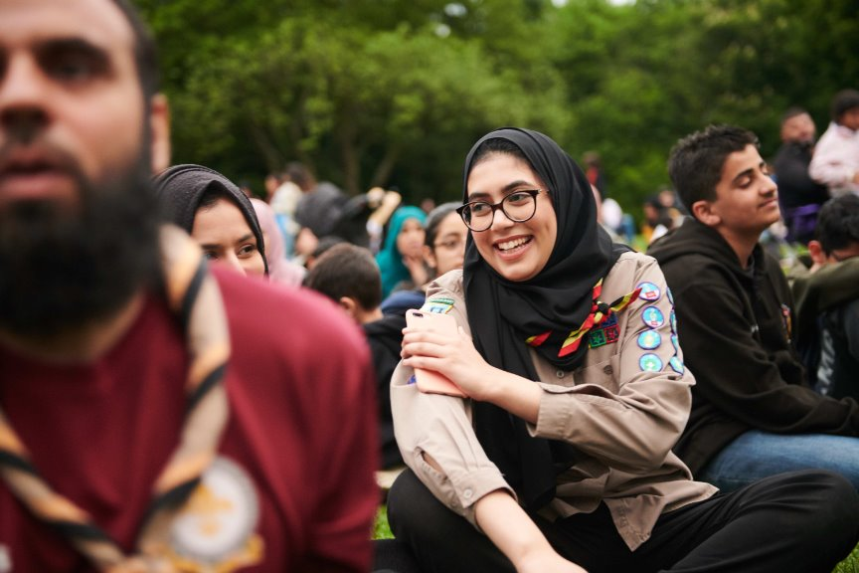
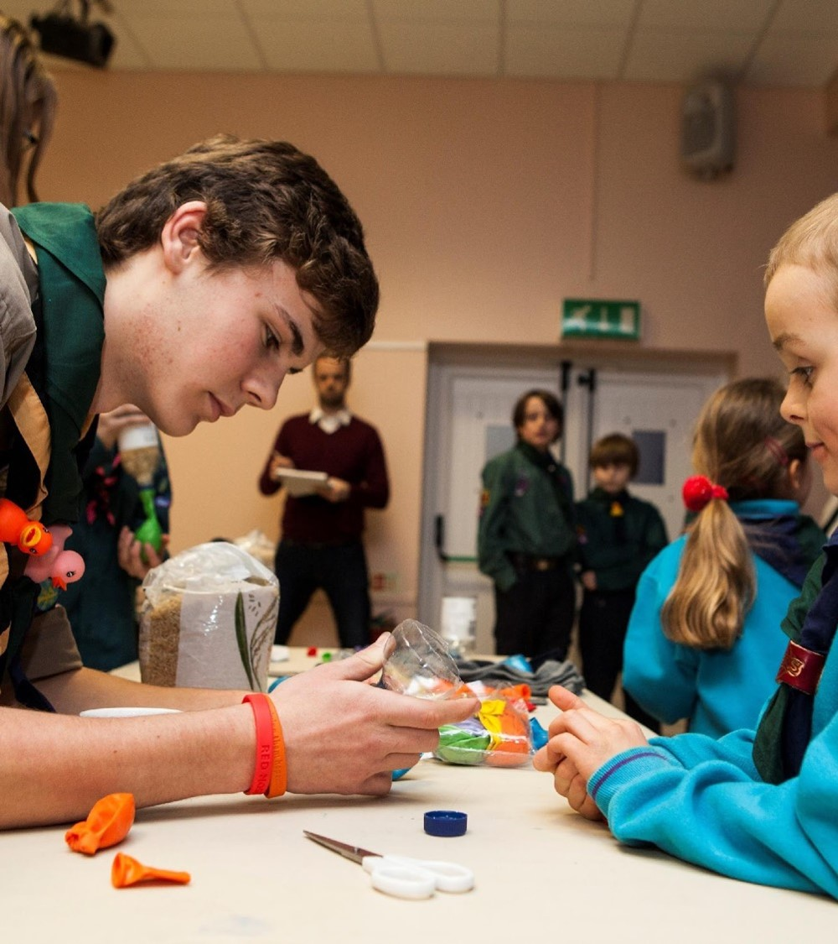
Starter for ten...
Behaviour is a manifestation of how someone is feeling - even bad behaviour should be treated with empathy
Experiencing challenging behaviour is difficult, even for the most experienced of leaders
A sudden change in behaviour may have an underlying cause. You may not be aware of it - behaviour communicates something

Slide 7
Types of behaviour
There are different types of behaviour:
Positive
Negative
Aggressive
Passive
Activity:
In pairs pick one of these types of behaviour and think of a scenario where a young person might show this behaviour.

Slide 8
Module D – Young Leader Scheme
  Reasons for behaviour
As you identified there could be lots of reasons for a young person behaviour:
Boredom
Misunderstanding
Over-excitement
Enthusiasm
Experiencing a bad mental health day
The environment e.g. Overwhelming, unfamiliar, noisy
Their best friend is not at the meeting
Reflection: Can leaders and young leaders choices impact on young people's behaviour?

Slide 9
How would you react?
Notes:
Task: approx. 20 minutes
This activity helps Explorer Scout Young Leaders to reflect on how their behaviour and communication style may affect others.
Ask two Explorer Scout Young Leaders to volunteer to run a game for the whole group, whilst taking on a persona.
The first Explorer Scout Young Leader should run a simple game with very long and drawn out instructions. They should keep going with the instructions until the rest of the Explorer Scout Young Leaders get bored, disengage and grow impatient or frustrated.
Afterwards, ask the group how they felt. Did they feel themselves losing focus or getting
annoyed?
The second Explorer Scout Young Leader should run a game, shouting and being very sharp with the others. Get them to imagine that they have had a bad day. How does it make them feel?
Explain that leaders need to be confident, calm, consistent and in control. It’s not about volume or power, but about effectively combining body language and verbal communication skills to set clear expectations.
Ask them how it felt to be shouted at. What does hearing adults shouting teach young people, considering that leaders are important role models? If shouting is used regularly, how effective will it be as a method of gaining attention in an emergency?

Slide 10
Flip it to a positive!
"Don't mess about"
"Give that here and listen!"
"You're very rude"
"Be quiet and listen"
"Stop talking when I am"
Notes:
Task: approx. 15 minutes
Explain that the Explorer Scout Young Leaders are going to take part in a thought experiment, where they will try and turn a negative statement into a positive one. This experiment will help them to see the impact using positive language can have when working with young people. Often, it can prevent and de-escalate a challenging situation.
Where possible, get Explorer Scout Young Leaders into groups based on the section they support, as the language used will depend on factors like age and level of understanding.
Provide each Explorer Scout Young Leaders with the list of sentences in below. Ask them to take it in turns to reword the sentences using positive language. What effect does this have?
Sentences:
‘Don’t mess about.’
‘Be quiet and listen.’
‘Give that here and listen to what is being said!’
‘Stop talking when I am!’
‘Don’t even think about running. I’m watching you!’
‘You're very rude!’

Slide 11
Code of conduct
Notes:
Task: approx 20 mins
Explain that one way Explorer Scout Young Leaders can provide a positive environment is by creating a Code of Conduct in partnership with their section. How can they ensure that everyone in the section buys into the agreement and understands exactly what it means?
Explain that a Code of Conduct is not just a list of rules for young people to follow. It can include rules for the leadership team to follow, too. You could consider how the leadership team should respond if a young person is having a bad day, for example.
In small groups, ask Explorer Scout Young Leaders to come up with some creative ideas to generate a Code of Conduct.
Regroup and discuss the following points:
What is the Explorer Scout Young Leaders role in managing behaviour?
When should an adult become involved?
How can the Explorer Scout Young Leader influence behaviour as a role model?
5. Create a central list or spider diagram of the group’s responses You can link back to the methods you currently use, as well as to any new methods Explorer Scout Young Leaders would like to introduce.
6. In small groups, ask Explorer Scout Young Leaders to list ways to recognise and reward positive behaviour and set standards. How can they introduce their ideas to the section? What are the advantages of focusing on positive behaviour instead of reacting to disruptive behaviour? When they’re finished, they should feed back to the wider group.

Slide 12
Module D – Young Leader Scheme
  Real life examples
In module B you reflected on leaders you have come across e.g. teachers, role models etc.
How do they manage behaviour?
Discussion:
In pairs come up your top 3 tips for managing behaviour based on your experiences.

Slide 13
Module C
Key takeaways
When discussing behaviour, it is important to remember the following:
Every young person is an individual and all young people should be treated equally. They can display a range of behaviours that can be both positive and negative.
  A sudden or noticeable change in behaviour may be due to a variety of underlying causes of which you might not be aware.
  All volunteers should focus on recognising and rewarding positive behaviour and should never label a young person or adult.
  When speaking about behaviour in the section, volunteers should focus on the behaviour itself, rather than on the young person in question. For example, instead of saying that young person is being ‘naughty’, they could talk to the young person about their behaviour, clearly explaining why it's not appropriate.
  Responding to challenging behaviour can be difficult for all leaders at times.
Notes:
Explorer Scout Young Leaders need to be prepared with the confidence and skills to respond consistently and appropriately to varying behaviour within the section. To allow them to explore the possible challenges, you'll need to ask them to give examples. It's important that this discussion is held in a positive and safe environment in which young people feel able to ask questions honestly and openly.

Slide 14
Final reflections….
Notes:
Task:
Ask each Explorer Scout Young Leader to reflect and answer the following questions on their own before sharing as a group:
What is one thing I am going to take away from today's session which I can implement into my section?
What is one way I like to learn that might help young people?
Is there anything you want to learn more about following today's session?

Slide 15
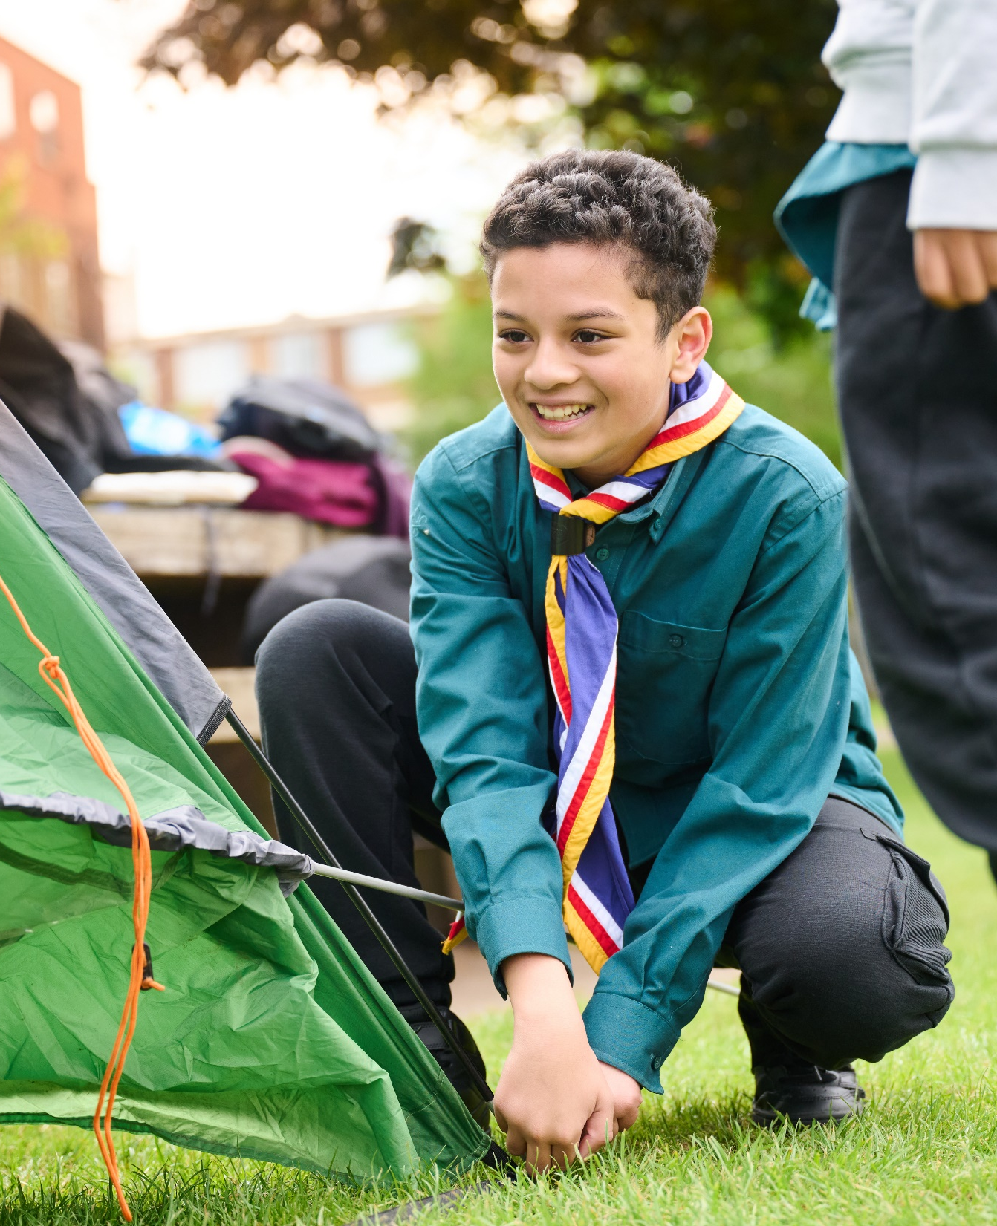
The Young Leader Scheme
Who to contact
If you have any questions, please contact the following people who will be able to help you.
Enter details of County/District contacts here

Slide 16

Thank you
Young Leaders’ Scheme
Scouts.org.uk
#SkillsForLife

