Slide 1
(Group Name)
Notes:
Welcome everyone
Introduce yourself
Introduce that you’re here to talk about Scouting and the amazing volunteering opportunities that are available

Slide 2
Video slide
(see notes for recommended video)
Notes:
Introduce Ted’s story; to give them an idea of the role Scouts plays in the lives of everyone who is involved and how it helps develop key life skills. (You can download Ted’s Story from the Brand Centre)
Play video
Talk about how the video shows how Scouts builds confidence and becomes an integral part of our lives
Scouts is really fun, but more importantly, the skills young people learn through Scouts can genuinely change their lives.

Slide 3
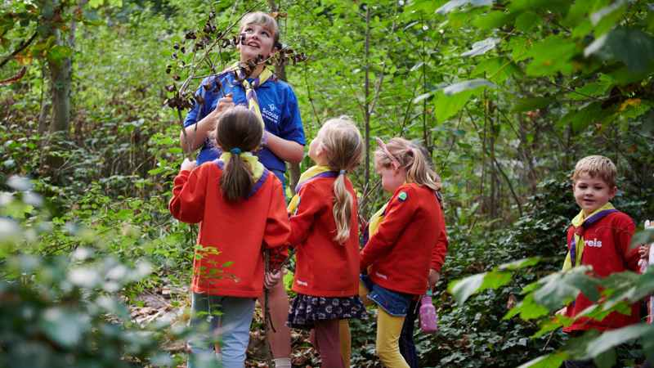
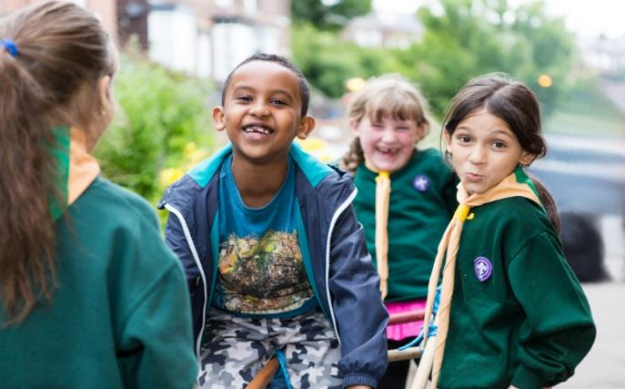
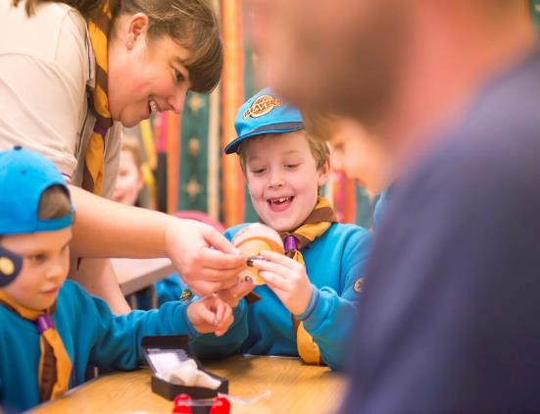
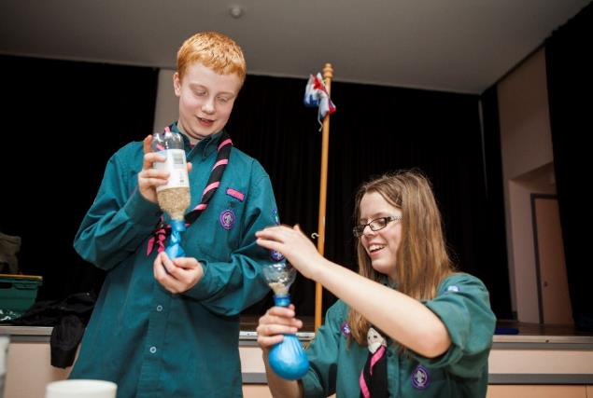
Who are we?
Scouts
10 ½ - 14 years old
Beavers
6 - 8 years old
Squirrels
4 - 6 years old
Cubs
8 – 10 ½ years old
Notes:
Introduce the key sections
If you are targeting volunteers for one section, use this slide for just that section
You might want to mention Explorers and Network as well

Slide 4
What do we do?
There’s a very simple answer…
EVERYTHING!
Notes:
Sell the broad range of benefits Scouting gives. You can use some of the points below:
The idea behind the Scouts is to help young people of all walks of life to develop skills for life like confidence, teamwork and community engagement. We teach young people how to leave the world a better place than they found it, to give things a go and to really be the change that they want to see in the world.
We’re no longer that bob-a-job organisation who just wash cars and help people cross the road, we make massive impacts in society, we change communities and make the lives of everyone involved better.
The best part is, our young people learn these skills for life without even realising it. We have a system where our young people work towards badges. Each badge has a different theme such as the gardener’s badge, DIY badge or parents’ favourite, the home help badge!
When they have completed the requirements, they get the badge to sew onto their uniform and we move onto another one. But what they don’t see when they get their badge is that now they have learnt how to speak in front of a group of people, they’ve learnt to have confidence in what they’re doing and they’ve learnt to just try something out and if it doesn’t go well, give it another go.
Through our badge system which covers basically everything imaginable, their lives will be changing in front of your eyes, without them even knowing.

Slide 5
We are a community and luckily, that means you too!
Notes:
Talk about by opening/growing your new section or Group means that their children can have all of these amazing and life changing experiences that we’ve talked about
Discuss the fact that a Scout Group isn’t just about Young People, it’s about them too.
Sell the fact that they now have the amazing opportunity to join in the fun, take part in all the activities and learn new life skills for themselves by becoming a volunteer.
Be open and tell them that in order to open/grow this Group successfully, you need them to join the adventure.

Slide 6
Let’s bust some myths…
1 - “you have to work with children to volunteer with the Scouts”
2 - “you need to be Bear Grylls”
3 - “you have to come every week”
4 - “you have to wear a uniform”
Notes:
There are lots of different volunteering opportunities in Scouts where you don’t have to volunteer with young people, such as joining a fundraising team, trustee board etc
None of our leaders are Bear Grylls; we all have our own unique skill sets and everyone can learn skills together
Scouting can be flexible and work around them, whatever time they have to give is great!
Not every role comes with a uniform and even those that do, you don’t have to wear it every week. It could be worn just for special events.

Slide 7
Video slide
(see notes for recommended video)
Notes:
Use the GoodForYou video to show an insight into why other people volunteer in Scouting and what benefits it could have for them. (You can download the #goodforyou video from the Brand Centre)

Slide 8
Volunteering with Young People
What does this look like?
Notes:
Talk to them about the key tasks involved in volunteering with young people, for example:
Working together to plan activities
Leading a game
Running an activity
Encouraging young people to get stuck in
Cleaning up at the end of the night
Think about tasks that need doing and add your own specific ones to the list
Let them know that they will:
get regular support
have opportunities for learning
have fun

Slide 9
Volunteering in Management
What does this look like?
Notes:
Talk to them about the key tasks involved with volunteering in management, for example:
Holding regular check-ins and reviews for volunteers
Hosting team meetings
Making sure that every section is running a fun and exciting programme
Working with the trustees to make sure the Scout Group is run well and is sustainable
Ensuring the volunteers have everything they need to successfully do their role
Think about tasks that need doing and add your own specific ones to the list
Let them know that they will:
Get regular support
Have opportunities for learning
Improve their own skills

Slide 10
Volunteering as a Trustee
What does this look like?
Notes:
Talk to them about the key tasks involved with volunteering as a trustee, for example:
Making sure the Group follows the rules
Making sure that they have enough money for activities
Completing any necessary admin
Checking that equipment and buildings are looked after
Checking we are aligning with our Scout values
Influencing the future of Scouts
Helping Scouts run activities with the Young People in the safest way possible
Think about tasks that need doing on the Trustee Board and add your own specific ones to the list, such as:
Recruitment of adults and young people
Fundraising
Organising events
Publicity
Administration
Governance
Also, let them know that they will work closely together as part of a team and help each other out.
Encourage them to give it a go before making a final decision to commit - check out our “4 step challenge” for more information

Slide 11
What do we need?
What are the next steps?
Notes:
Amend this slide to suit what you need in your Group. If you are opening a whole new Group then you may wish to advertise for these:
A team of adults willing to try volunteering with Young People for four weeks
A team of adults willing to support behind the scenes (management or executive committee)
A selection of adults willing to help on an adult rota
Think about how you are going to move forward from here.
Are you going to use the 4-week challenge?
Are you going to use the 4-step challenge for trustees?
Are you going to hold another meeting next week for adults who are interested to find out more?
Make sure you’re ready to act straight away so that those who are interested don’t have to wait
Don’t forget to take the details of anyone who is interested and follow up with them afterwards

Slide 12
(Group Name)
Thank you for supporting your Scout Group!
Notes:
Thank you

