Slide 1
#ReachTheTop
Top Awards and the Jamboree

Slide 2
Introductions
Ian
Sandra
Matthew
Stu

Slide 3
Aim of the session

Slide 4
Test your knowledge!

Slide 5
Link the
Top Award badge to the relevant requirement

Slide 6
The Answers!

Slide 7
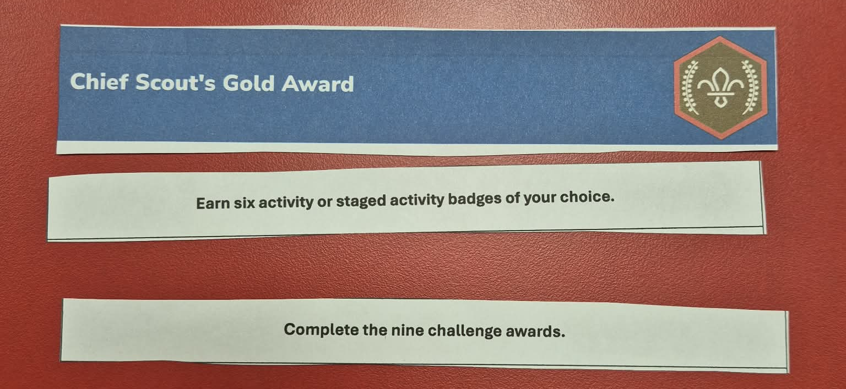
Top Awards and the Jamboree

Slide 8
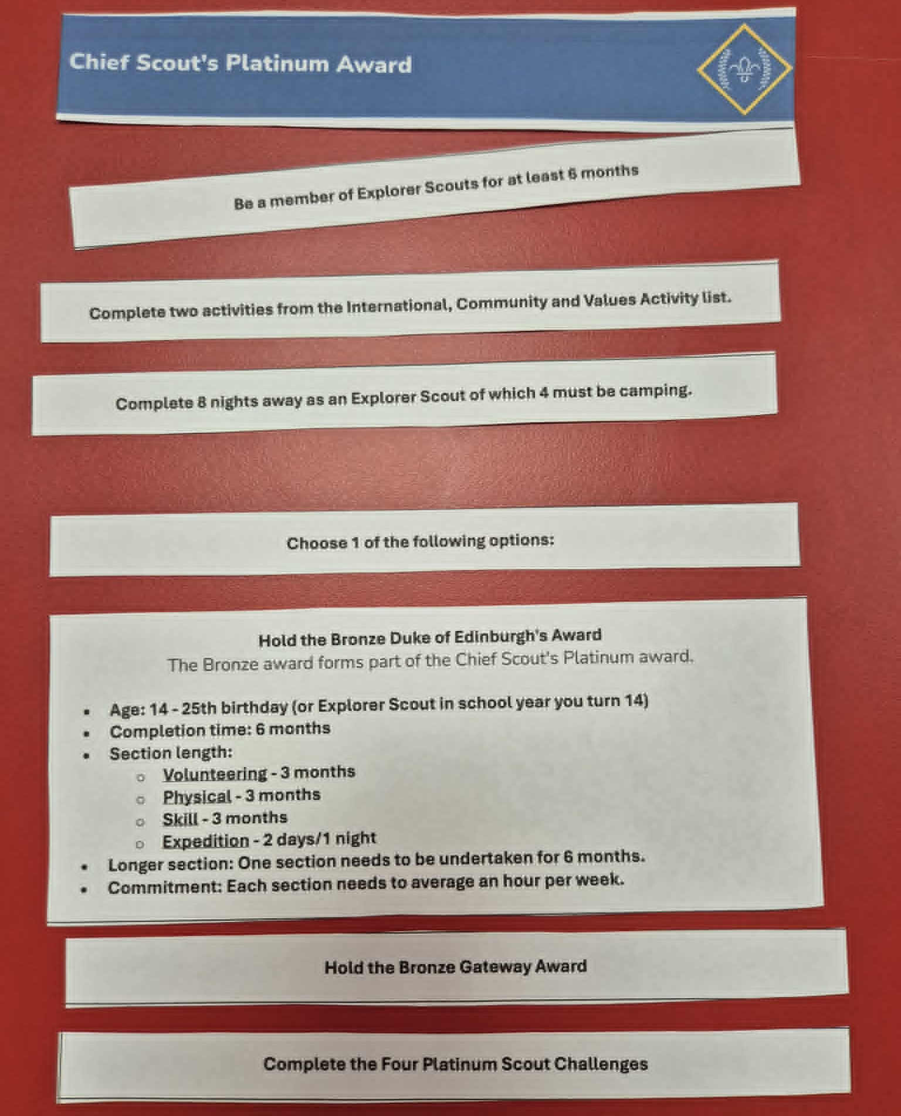
Top Awards and the Jamboree

Slide 9
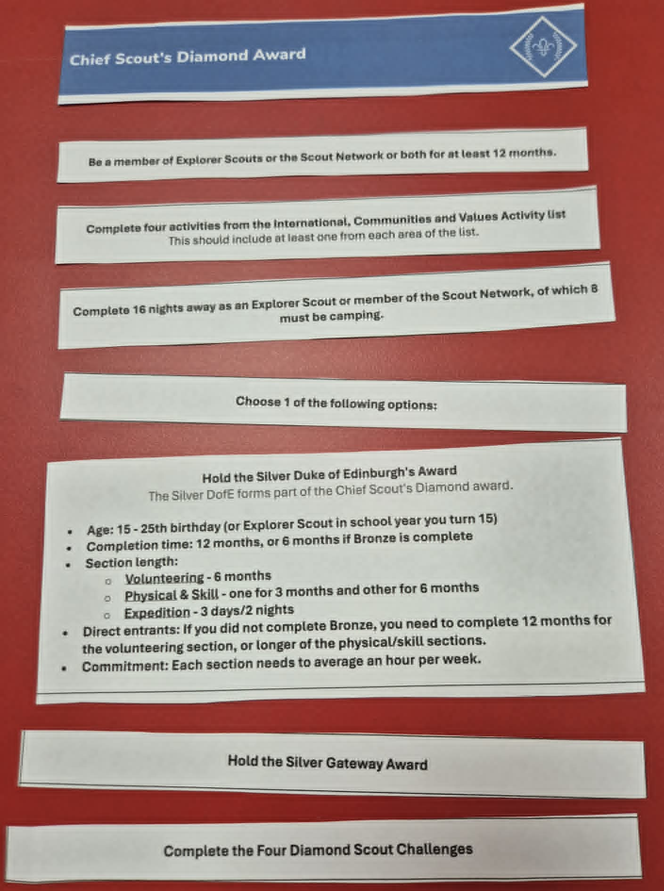
Top Awards and the Jamboree

Slide 10
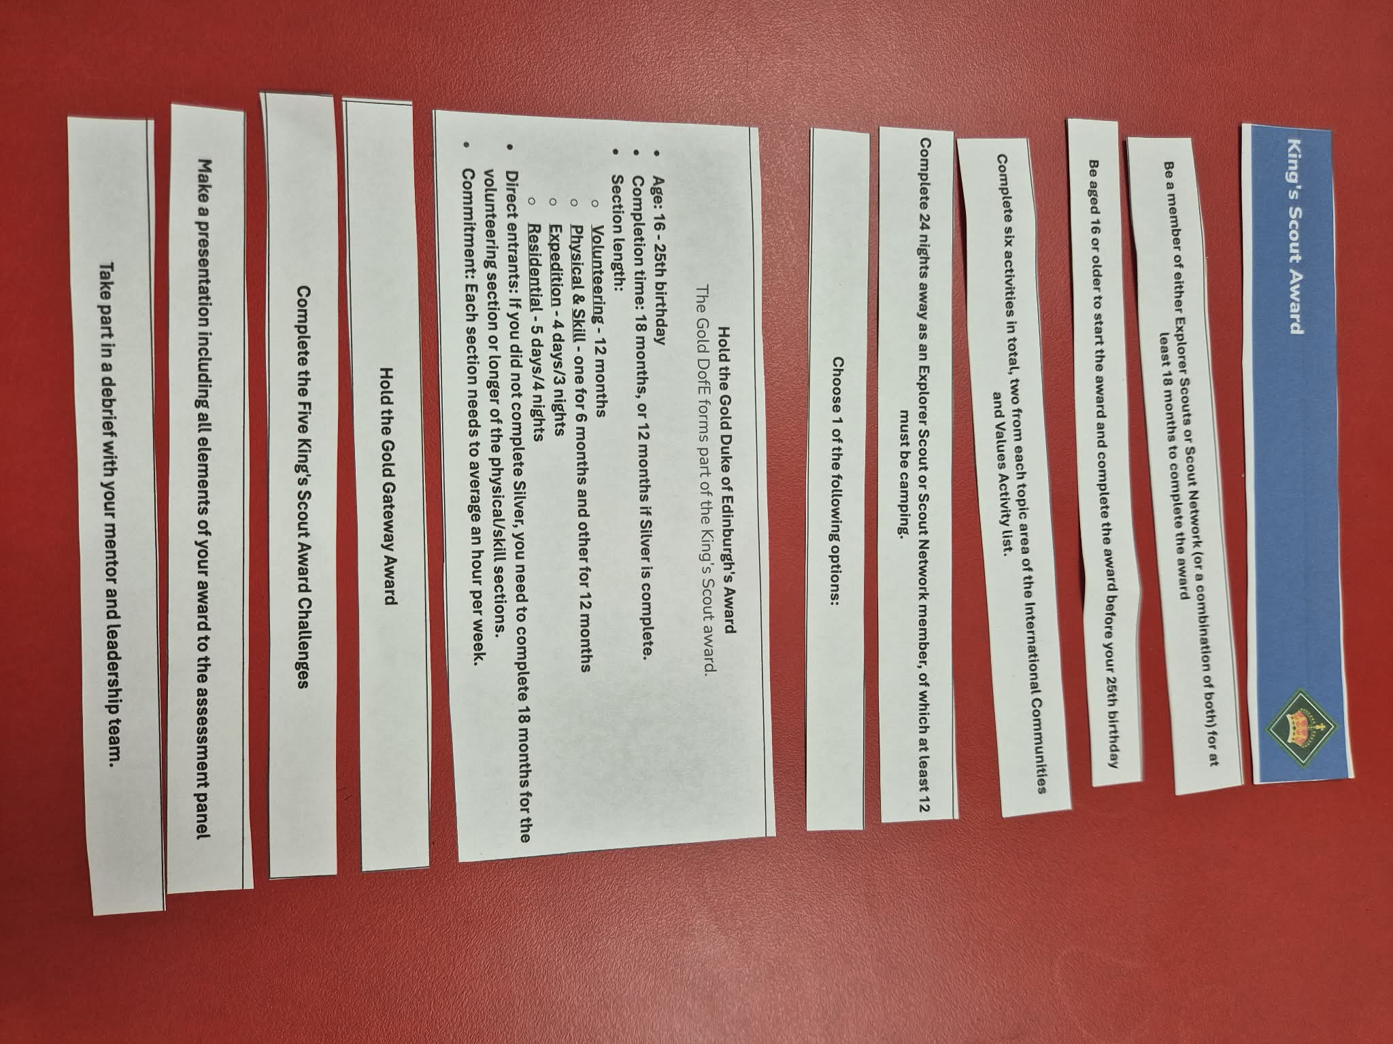
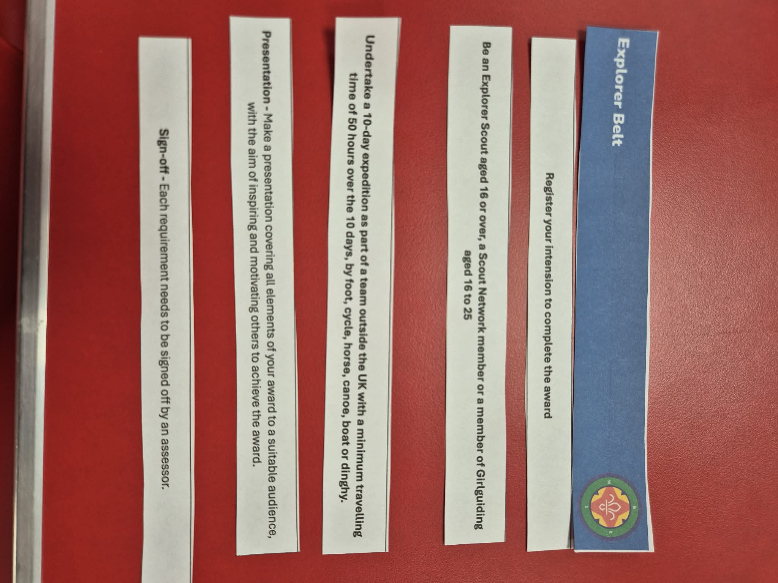
Top Awards and the Jamboree

Slide 11
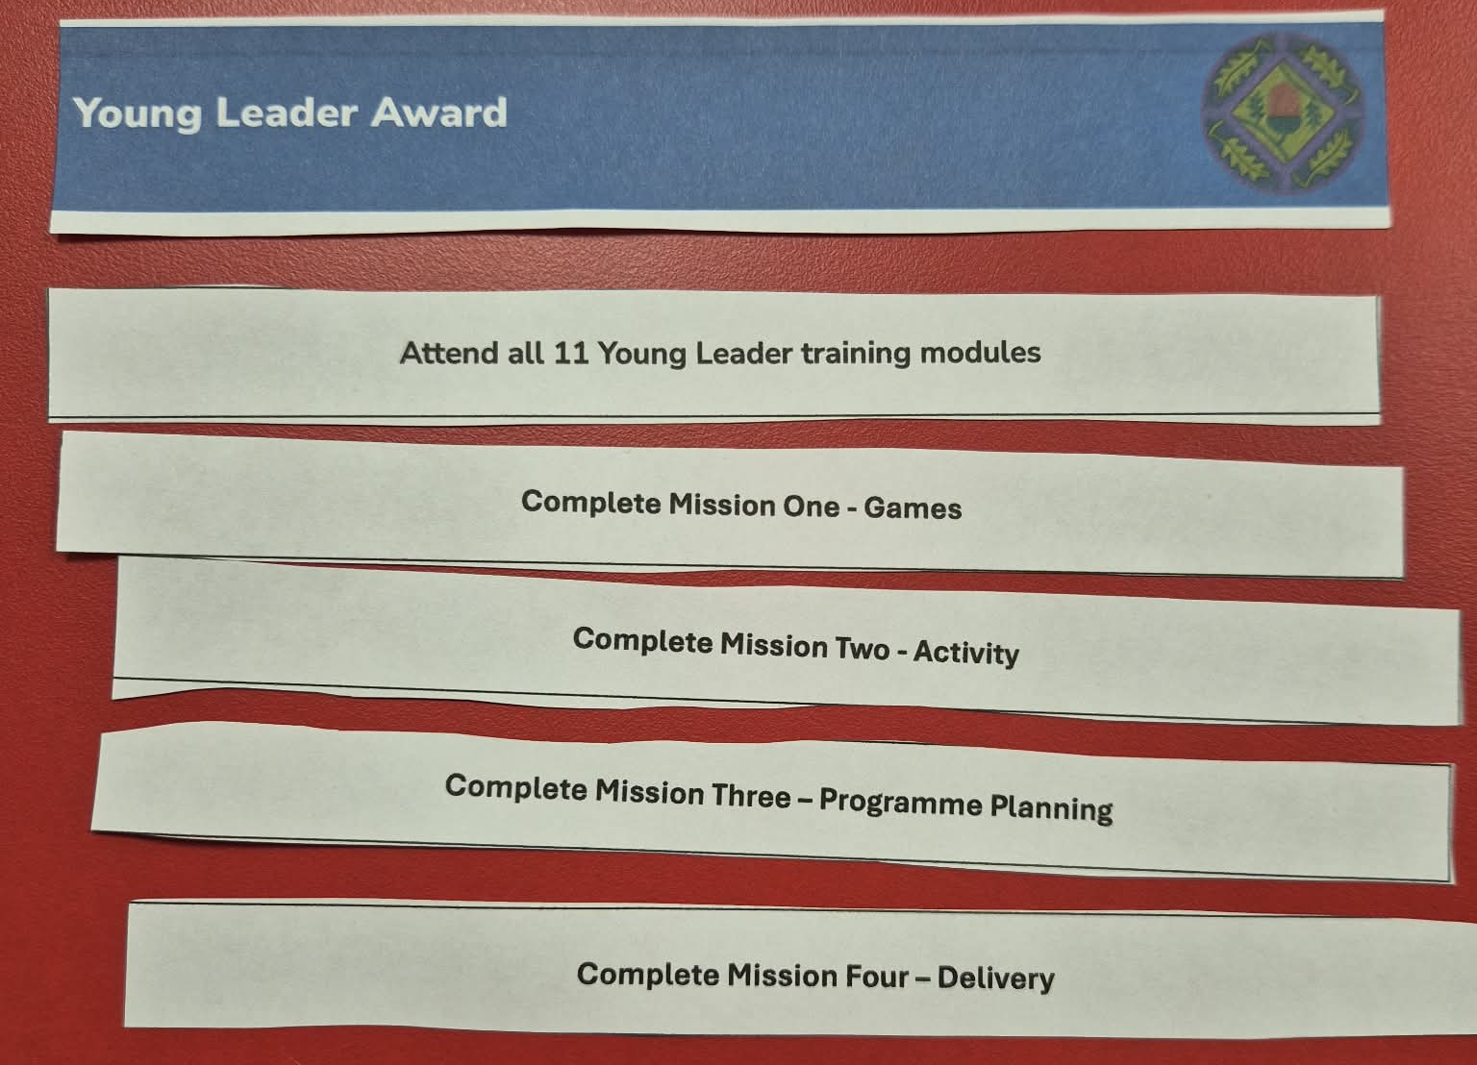
Top Awards and the Jamboree

Slide 12
Top Awards and the Jamboree

Slide 13
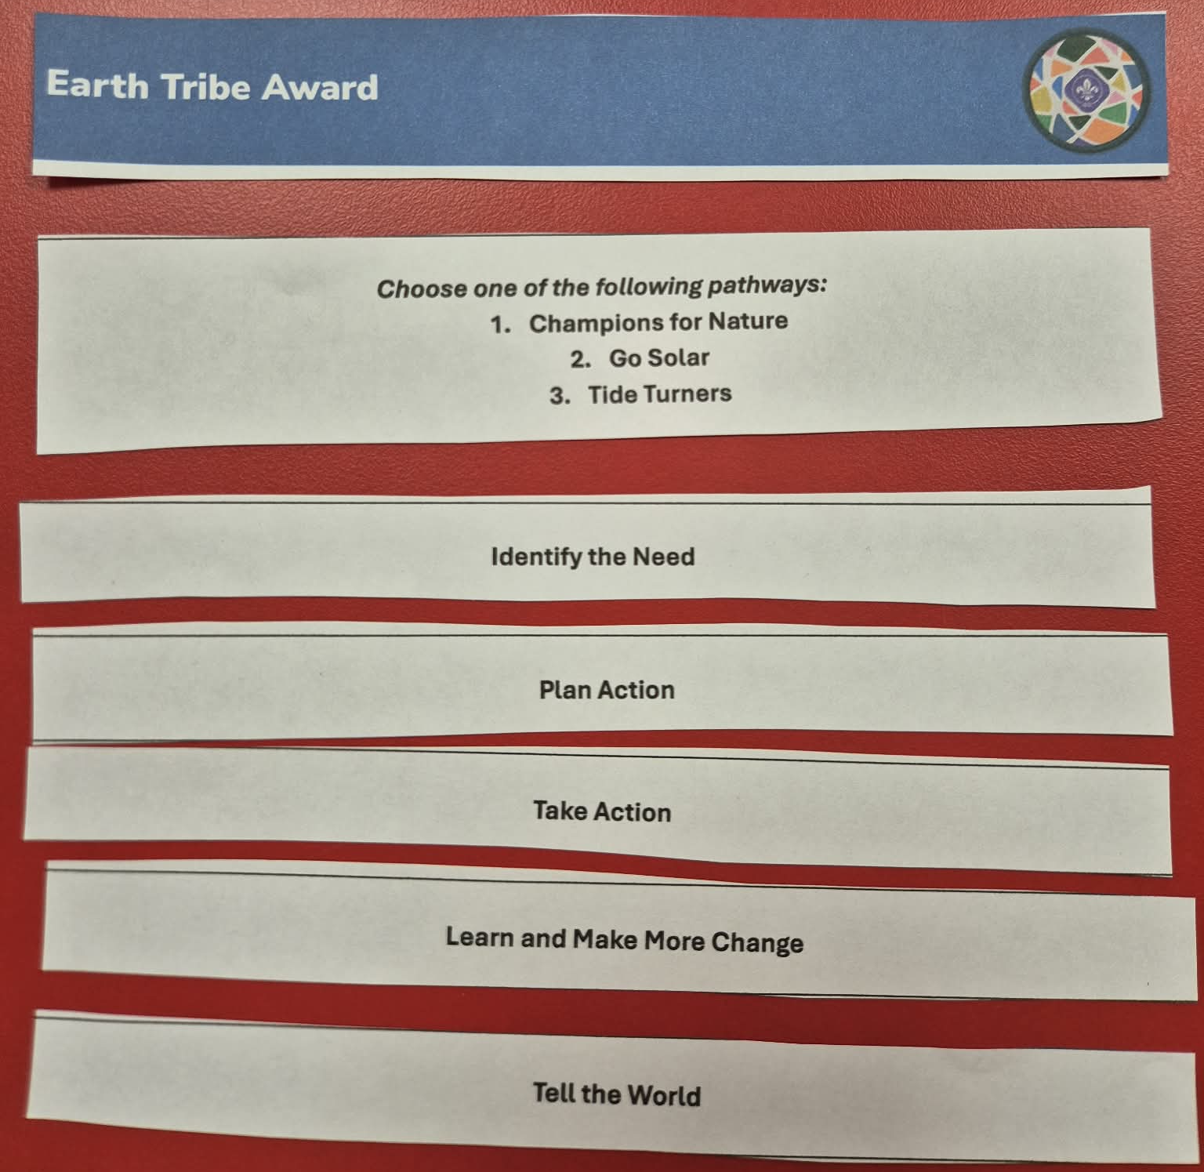
Top Awards and the Jamboree

Slide 14








Top Awards and the Jamboree
Chief Scout’s Gold Award
Chief Scout’s Platinum Award
Chief Scout’s Diamond Award
King’s Scout Award
DofE Bronze Award
DofE Silver Award
DofE Gold Award

Slide 15

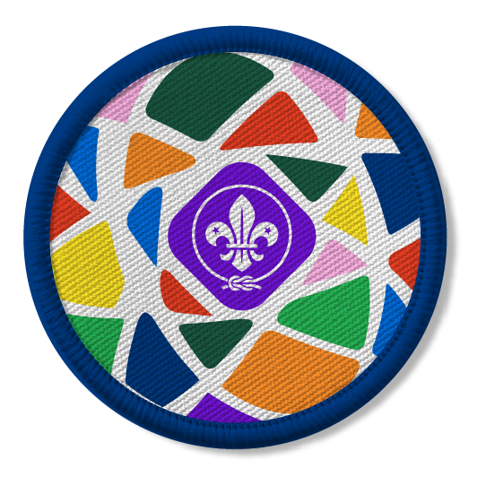


Top Awards and the Jamboree
Young Leader Award
Explorer Belt
Earth Tribe Award
YouShape Awards

Slide 16

Top Awards and the Jamboree
Chief Scout’s Gold Award
Highest award in the Scout section.
To complete young people need:
  All nine of the Challenge Awards
  Plus six Activity or Staged Activity badges
Jamboree journey could help members of your unit who are still Scouts to complete
this award.
If they haven't quite completed all challenges, they can be completed in their first term as an Explorer.

Slide 17


Top Awards and the Jamboree
Chief Scout Platinum Award & DofE Bronze
Chief Scout’s Platinum Award (age 13.5 – 18) | Volunteering | Physical | Skills | Expedition
Membership: 6 months as Explorer Scout Nights Away: 8 nights away as a Scout, at least 4 camping ICV: Complete 2 activities from the International, Community and Values list | 3 months | 3 months | 3 months | Plan, train for and complete a 2-day, 1 night expedition
 | *Requires an additional three months on either Volunteering, Physical or Skill

Slide 18


Top Awards and the Jamboree
Chief Scout Diamond Award & DofE Silver
Chief Scout’s Diamond Award (Explorers & Network) | Volunteering | Physical | Skills | Expedition
Membership: 12 months as Explorer and/or Scout Network Nights Away: 16 nights away as a Scout, at least 8 camping ICV: Complete 4 activities from the International, Community and Values list | 6 months | One section for 6 months The other for 3 months |  | Plan, train for and complete a 3 day, 2 night expedition
 | *Direct entrants must undertake a further 6 months in the Volunteering or the longer of the Physical or Skills sections.
Nights away & ICV from Platinum can be used

Slide 19


Top Awards and the Jamboree
King’s Scout Award & DofE Gold
King’s Scout Award (age 16 – 25) | Volunteering | Physical | Skills | Expedition | Residential
Membership: 18 months as Explorer and/or Scout Network from 16th birthday Nights Away: 24 nights away as a Scout, at least 12 camping ICV: Complete 6 activities from the International, Community and Values list (two from each section) Presentation: Give a talk about your award experience | 12 months | One section for 12 months The other for 6 months |  | Plan, train for and complete a 4 day, 3 night expedition | Undertake a shared activity in a residential setting away from home for 5 days and 4 nights
 | *Direct entrants must undertake a further 6 months in the Volunteering or the longer of the Physical or Skills sections.
Nights away & ICV from Platinum & Diamond can be used

Slide 20
Volunteering
Taking action and making a difference to other people’s lives.
From coaching a local football team or collecting for a foodbank to starting a campaign, you’ll provide your time to help others and change things for the better.
Young/Adult Leader (need to complete Module A or Getting Started for the first award)
Sports Leadership
Charity Shop
Youth Work
Helping at after School Club
Environmental Work
Physical
Focus on health and fitness and
have fun along the way.
Try something completely different or concentrate on something you already do, as long as it requires a continuous level of energy and physical activity.
Gym/Fitness
Swimming
Badminton
Cycling
Canoeing
Martial Arts
Archery
Kayaking
Skills
Learn a new talent, develop your skills and find something you enjoy.
If you’re interested in a specific field, this could be the perfect chance for you to do something related to it. So, if you’re interested in photography, you could do it as your skill.
Playing an Instrument
Marksmanship
Cooking
Drama and Theatre
Learning to Drive
Singing
Learning a Language
IT/Web Design
Photography

Slide 21
Expedition
Getting into the great outdoors and spending a night away with your friends; gaining lifelong memories.
Aim: what is your project going to be?
Area: what is the most suitable area to carry it out?
Transport: what is the best mode of transport to be able to achieve this?
Silver and Gold require practice expedition.
Presentation required at Silver & Gold/KSA level
Need to be assessed by an accredited assessor
All DofE expeditions need to be registered
Residential
Spending five days and four nights away from home on a shared activity with people you’ve never met before.
Participants learn how to work with people from different backgrounds and build confidence staying in new environments. They can build on a talent they’ve developed in another section, learn something completely new on an intensive course or do something to help others.
Here are some ideas….
  Assisting at a Kids’ Summer Camp
  Joining a Conservation Project
  Doing a Photography Course
  Improving Language Skills on an Intensive Course
  Attending a World Scout Jamboree
  University taster course

Slide 22
International
This section is all about exploration; both around global issues and taking part in international opportunities.
WSJ/Moot/Roverway
Explorer Belt
International Development Organisation
Camp in another country
International camp in the UK
Organise activities on an international theme for your unit or a younger section
JOTA/JOTI
Any other activity of a similar level approved by your mentor
Community
Developing knowledge and skills, and putting them into practice to make a real difference and impact to the local community.
Community based project
Beach tidy up
Helping at a food bank
Conversation project
Local Scouting role
Community Impact
Other sections
SOWA
Any other activity of a similar level approved by your mentor
Values
Reflecting upon your own and others beliefs and exploring what the Scouting Values mean to you.
Organise activities on our Scout Promise and Law to younger sections
Spiritual development
Faith
Activity day
EDI
Give a presentation/talk
Scouting values
SOWA
Any other activity of a similar level approved by your mentor

Slide 23
Top Awards and the Jamboree
Explorer Belt
A challenge of a lifetime
A 10 day expedition in another country
Understanding of the country, culture & way of life
A minimum of 50 hours spent travelling on an expedition, although public transport can be used
Age 16+ in a group of three or more young people
Those under 18 must have an in-country support team available to them
Register for your award online
Train in the core skills required
Budget and plan your expedition
Logbook needs to be kept during the venture
Project to include one major project chosen by the group and ten minor challenges chosen by the group, leadership team or peers.
Review the award and present back to the unit and mentor

Slide 24

Top Awards and the Jamboree
Young Leader Award
For young people aged 13.5 – 17 volunteering with Squirrels, Beavers, Cubs and Scouts
Young Leader training scheme
Module A to be completed by all young leaders within 3 months
Modules B to K develop their leadership skills and includes a first aid module.
Four missions to put learning into practice
Young Leader belt buckle awarded on completion of all modules and missions
Missions:
Mission 1 – Games
Mission 2 – Activity
Mission 3 – Programme planning
Mission 4 – Delivery
Awards:
Acorn badge (module A)
Acorn leaf (each mission)
Young Leader award certificate
Young Leader belt buckle
Adult leader recognition badge

Slide 25
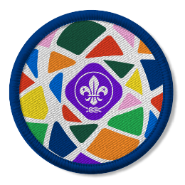
Top Awards and the Jamboree
Earth Tribe Award
Not quite a Top Award, but something you could do as a unit.
Helping young people understand more about protecting our world and becoming planet champions!
Three different pathways/projects:
  Champions for Nature
  Go Solar
  Tide Turners
Only need to complete one pathway to earn award, but can complete all the pathways multiple times.
The Earth Tribe Award pathways follow a similar structure to the Community Impact Staged badges, so can draw on past experiences.
Award for each section

Slide 26

Top Awards and the Jamboree
YouShape Award
Not quite a Top Award, but something you could do as a unit.
At Scouts, young people learn how to speak up and take the lead. But they told us that the programme didn’t recognise this enough. That’s what the YouShape Award is all about.
Award for each section
Central Badge
Plan
Lead
Represent

Slide 27
Top Awards and the Jamboree
Top Tips!
Fact Finding:
  Who is a Young Leader?
  Who has already completed a top award?
  Who has already started working towards a top award?
  Who has never thought about doing a top award but could complete one as part of their jamboree journey?
Use this information to see if there’s common themes or activities you could build into your camps/events to help multiple members tick items off
Create a Unit Night’s Away Log
Celebrate achievements no matter how big or small!
Support any Unit Leadership Team Members on their Top Awards journey
scouts.org.uk/top-awards
scouts.org.uk/scouts-and-employability

Slide 28
Changes to the Explorer Programme

Slide 29
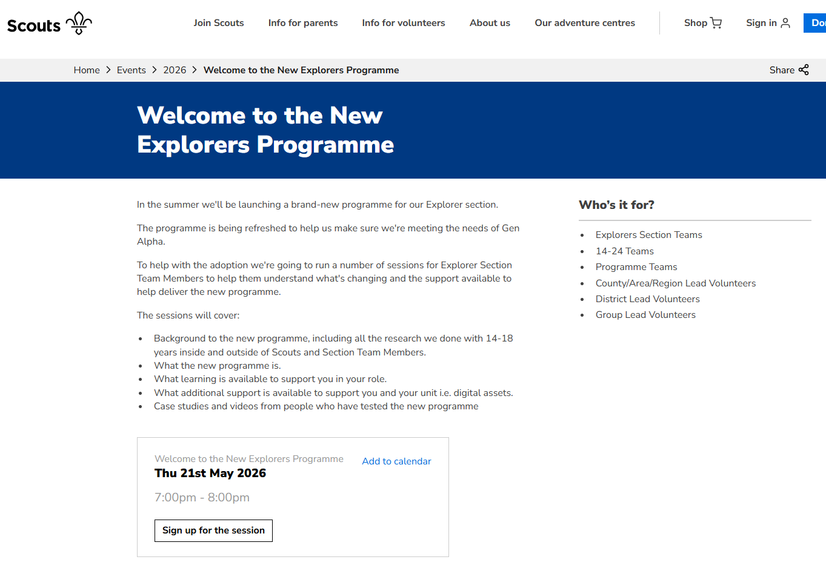
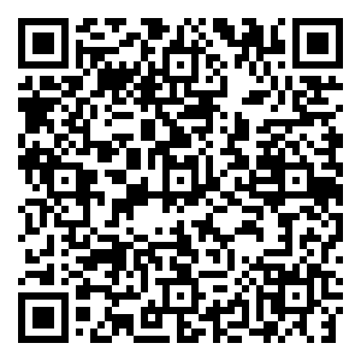

Slide 30
Share your Top Award Top Tips and what you could do for your unit

Slide 31
Questions and Feedback

Slide 32
Thank You!

