Slide 1
Culture – What it is and why it matters?
Have an otterly fabulous weekend

Slide 2
Session objectives
To understand why the culture of your unit matters
To help unit you define the culture of your unit will be
To understand where you are on your way to achieving this
To learn from each other.
To consider wider culture sensitivities at the Jamboree

Slide 3
What is your shared purpose and identity?

Slide 4
What do we mean by culture?

Slide 5
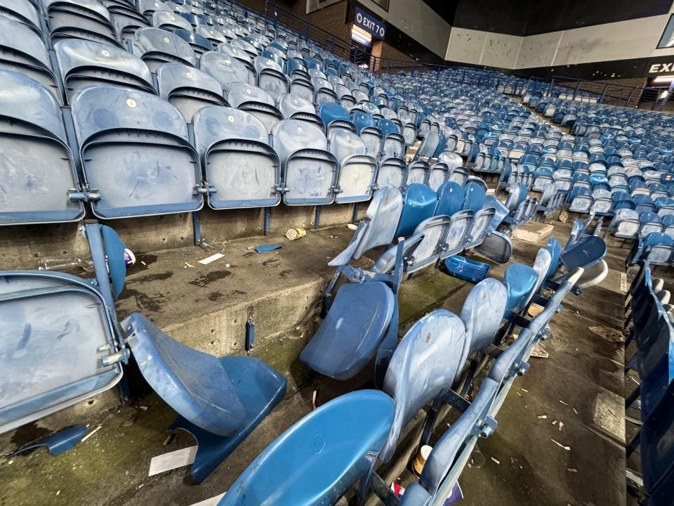

Slide 6
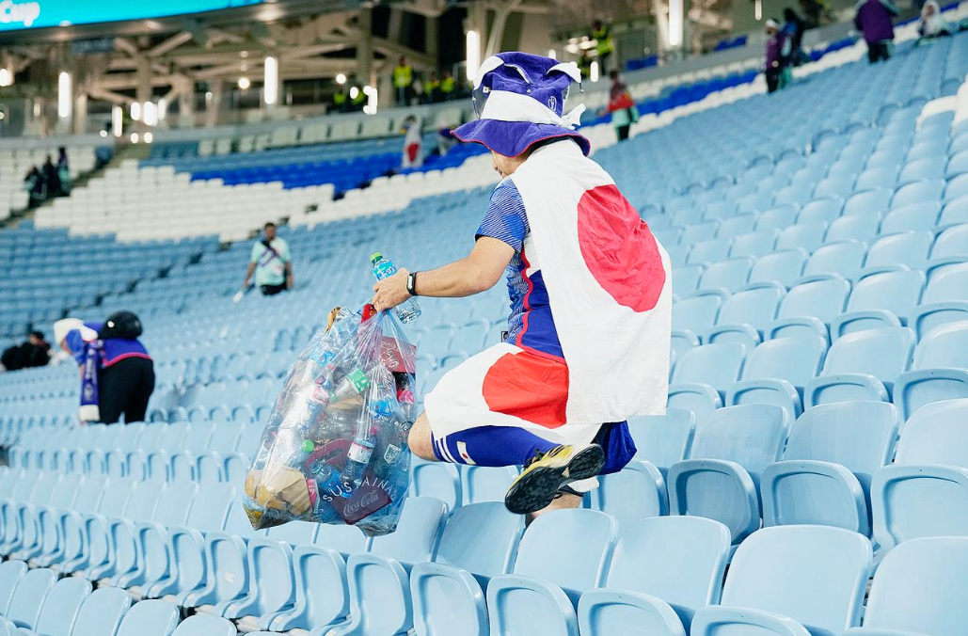

Slide 7
What is acceptable in your unit?

Slide 8
What will your unit be remembered for?

Slide 9
How are you going to establish this culture?

Slide 10
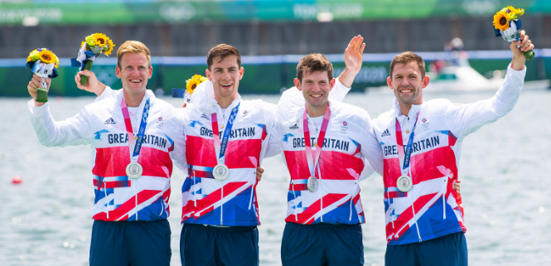

Slide 11
How do people communicate and raise their concerns?

Slide 12
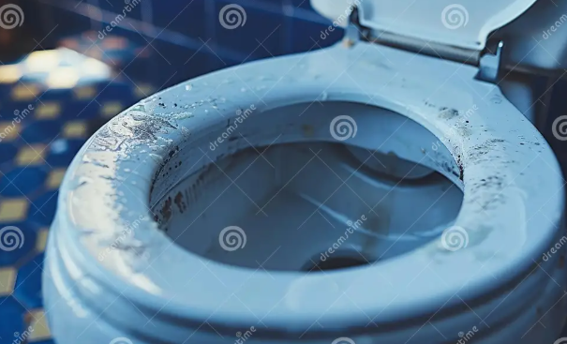
How do you react?

Slide 13
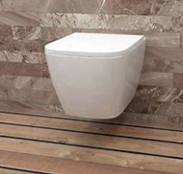
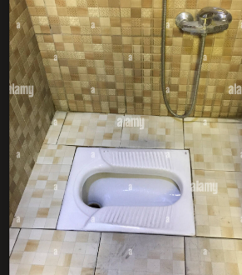
Respecting other people culture and being inclusive

Slide 14
Session objectives
To understand why the culture of your unit matters
To help unit you define the culture of your unit will be
To understand where you are on your way to achieving this
To learn from each other.
To consider wider culture sensitivities at the Jamboree

