Slide 1
Welcome to your team leader weekend
Have an otterly fabulous weekend

Slide 2
House keeping this weekend
Notes:
Toilets
Whilst around site, the toilet bocks should be open – whilst in the lid, the toilets are in the block opposite.
There are also toilets and showers in Branchet Lodge which you can use.
Fire
There are no fire alarms planned.
If you hear the fire alarm, calmly evacuate (do not collect personal belongings).
The assembly points:
At the end of the lid (near the big roller doors, turn right and go to the end of the building);
Wilson Way (the road behind our lodge); or
The lawn in front of the White House.
Tea & Coffee
Tea, Coffee and Squash is available throughout the day in Branchet.
There are also small coffee stations in each room.
Food
CIC – Lunchtime is 12:30, dinner time is 6:00.
Today it’ll be packed lunch, but tomorrow you will need to make your lunch for the day!

Slide 3
Aims for the weekend
To help you understand the Jamboree experience better.
To help you build connections with other unit teams and learn from them.
To help develop resilience within units for what ever the Jamboree might throw at us.

Slide 4
What I ask of you...
Engage in the sessions.
If you have questions then ask, if we have the answer we will share it. We won't make it up though.
Build your network, who will have your back in Poland if things are tough.
Be positive, its infectious and gives everyone the best experience.

Slide 5
Thank you....

Slide 6
What has been your highlight so far?

Slide 7
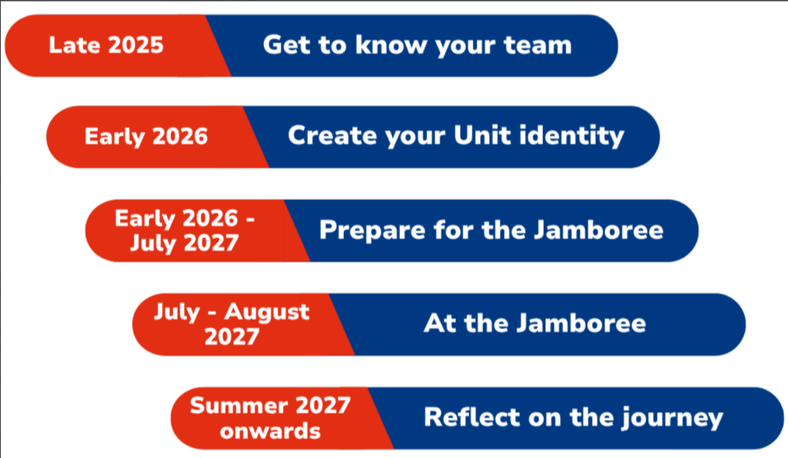
Where we are so far...

Slide 8

The UK Contingent Core Team

Slide 9
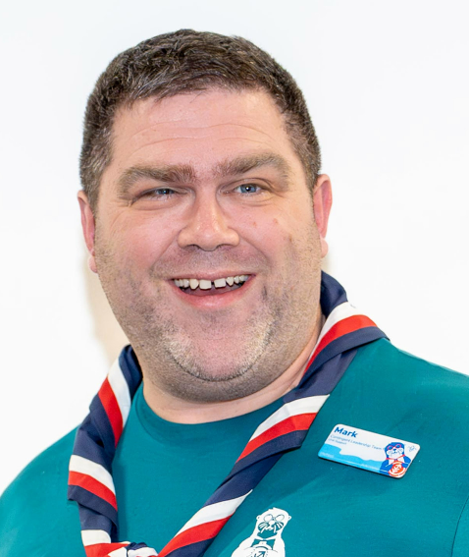
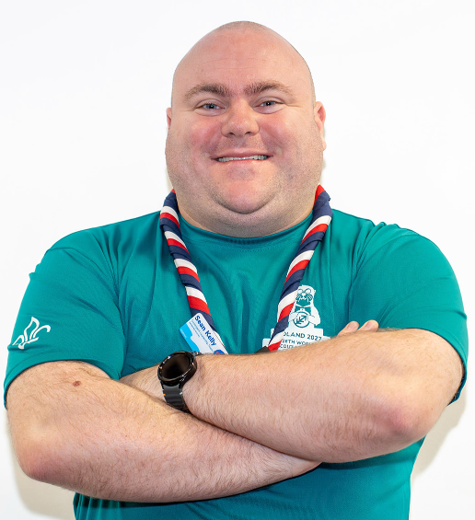

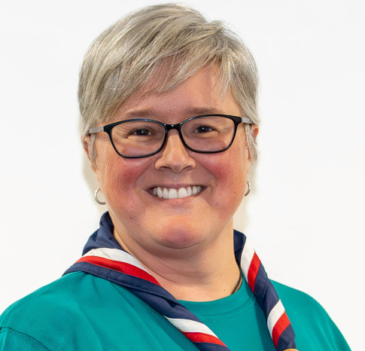
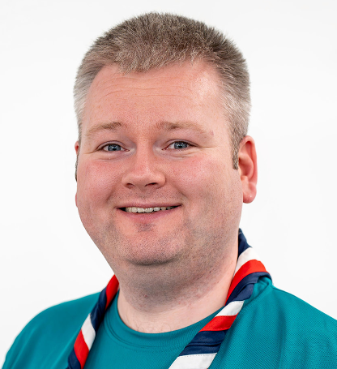
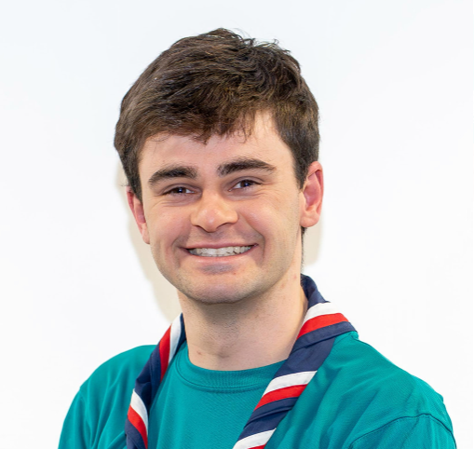
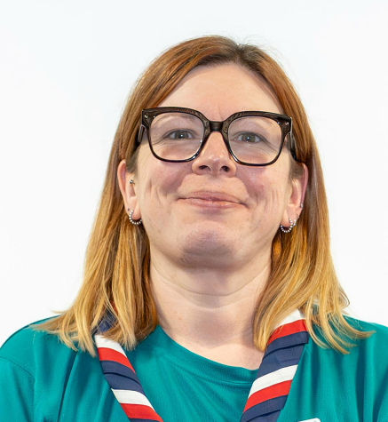
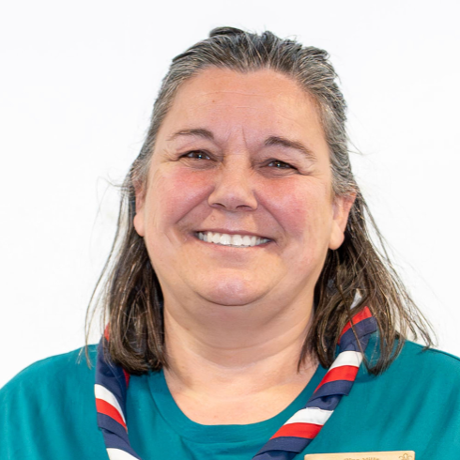

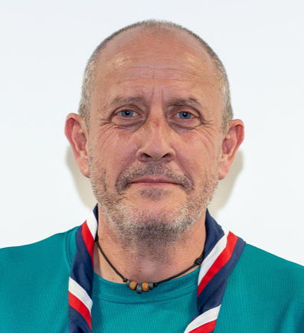
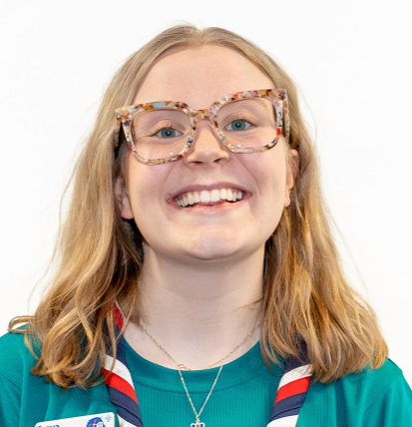
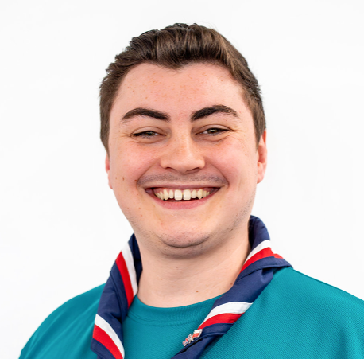
The UK Contingent Leadership
Team Leaders

Slide 10
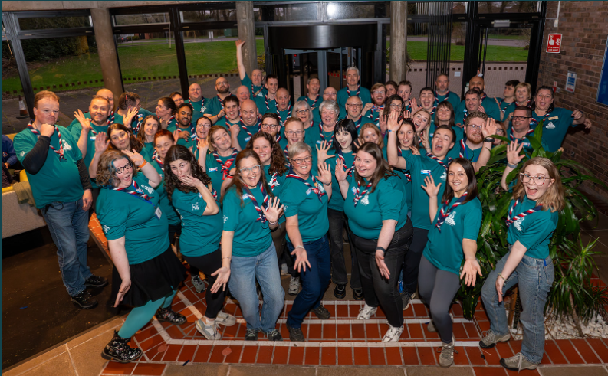
The UK Contingent Team

Slide 11
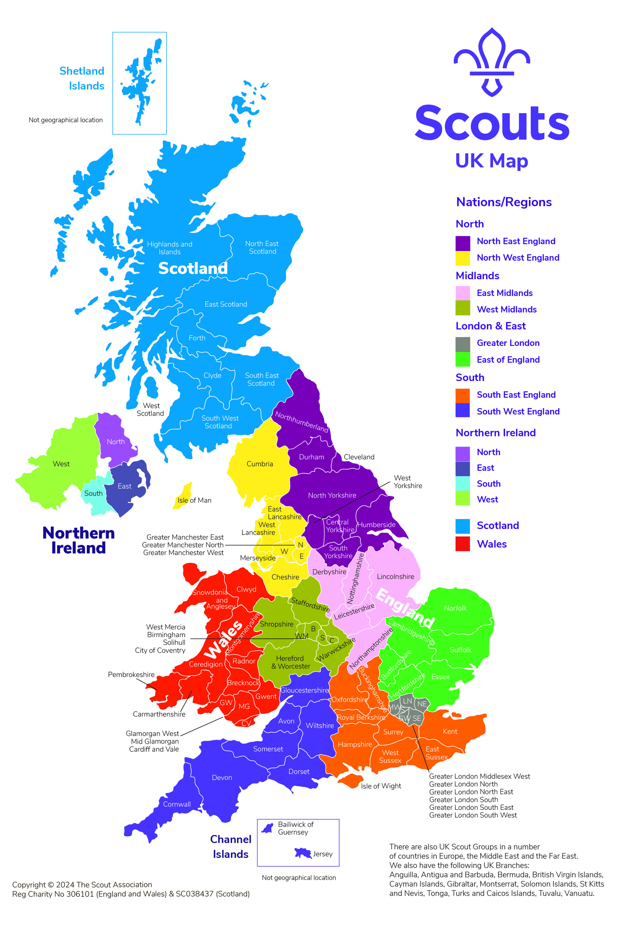
Your County, Region or Area

Slide 12

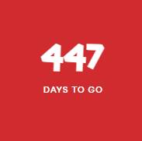

Slide 13
Jamboree Dates
Arrive on site 29th July 2027
Depart site on 9th August 2027
IST (International Service Team) dates will be different.
Ceremonies
Opening Ceremony – 30th July 2027
120 Years of Scouting Celebration- 1st August 2027
Closing Ceremony – 8th August 2027

Slide 14
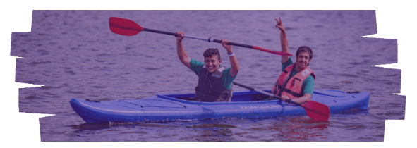
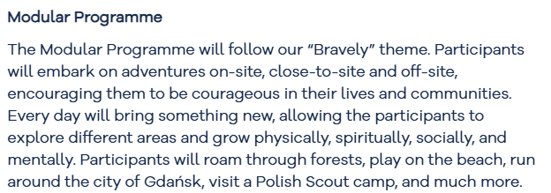
What do we know about the programme for the Jamboree?

Slide 15
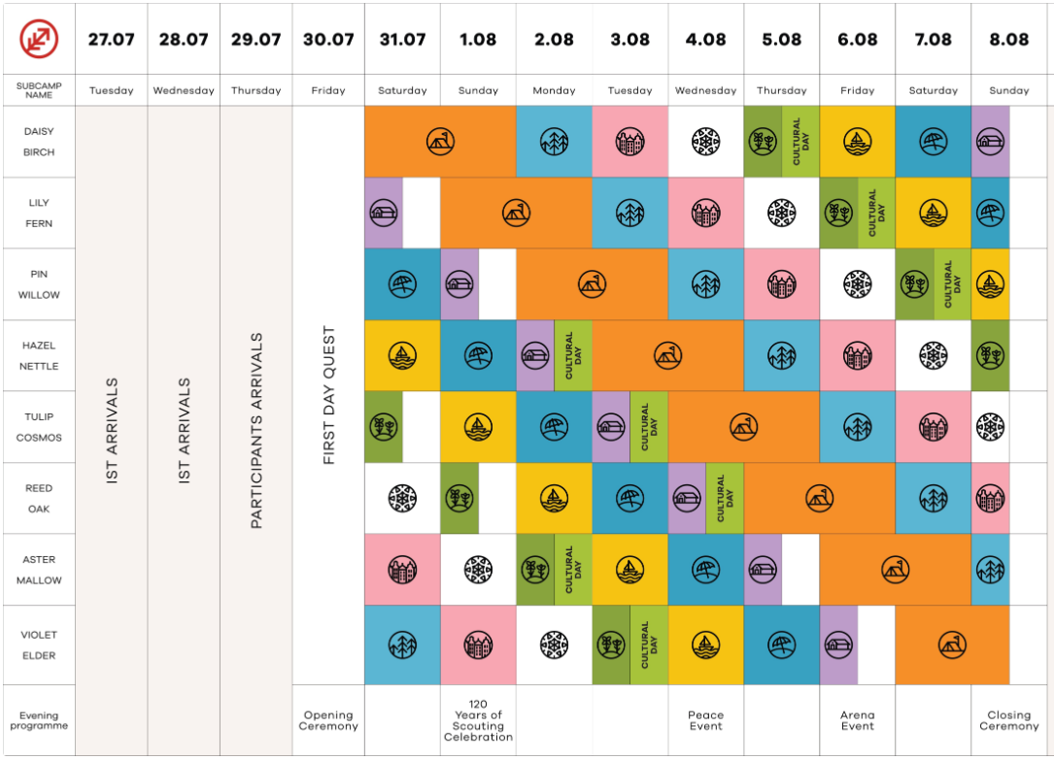

Slide 16

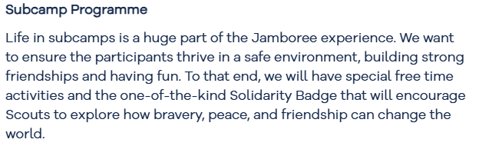
What do we know about the programme for the Jamboree?

Slide 17


What do we know about the programme for the Jamboree?

Slide 18

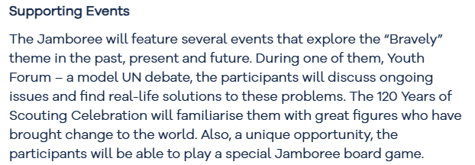
What do we know about the programme for the Jamboree?

Slide 19

How to ask us your questions...

Slide 20
Sessions start at 10am in the classrooms next to the lid

