Slide 1
First Response

Slide 2
Today’s trainer:
[insert name here]
Notes:
The accompanying training plan contains the key learning points and activities for each slide. In these PowerPoint trainer notes you will find background context and/or suggested delivery ideas to help you as a trainer as appropriate.
Trainers notes:
Outline the structure of the session - You may be delivering this as a standalone module (2hours) or as part of a full day of training (6 hours).
If delivering as virtual training all notes and trainers’ instructions can be found on the webinar PowerPoint

Slide 3
Aim
This course aims to cover the knowledge and skills necessary to enable members of The Scouts and Girlguiding to provide basic first aid and ensure safe management of a first aid incident.
Notes:
Trainers notes:
The above aims, objectives and learning outcomes are for the full course. Each session will have its own aims, objectives and outcomes.

Slide 4

Objectives
Learned simple first aid information that is relevant to their role.
Built confidence and skills in coping with emergency and first aid situations.
Gained the knowledge needed to manage these emergencies.
By the end of the course, participants will have:
Notes:
Trainers notes:
The above aims, objectives and learning outcomes are for the full course. Each session will have its own aims, objectives and outcomes.

Slide 5
Learning Outcome
Participants will be able to keep Scouting / Girlguiding members as safe as possible while they are in our care.
Notes:
Trainers notes:
The above aims, objectives and learning outcomes are for the full course. Each session will have its own aims, objectives and outcomes.

Slide 6
How confident are you
about being a first aider?
1 2 3 4 5
Notes:
​
Acknowledge where people are at the moment and explain the importance of the training.​
You can use the scale for a few questions – such knowledge confidence or skill confidence.
With a focus on the Life Support syllabus areas. Ask the participants what first aid scenarios they would currently feel confident dealing with.
It is important to acknowledge that some may be attending first aid training for the first time, and others may be refreshing their knowledge and understanding.
For those who have attended first aid training before - Ask how the training they had been on before prepared them for an accident or incident.
For those new to first aid - ask then what they are hoping to achieve training.

Slide 7
Session 1
    Life Support
Safe Approach
DR ABCDE approach
Adult CPR
Child CPR
AED
Choking
Unresponsiveness
Recovery position
Notes:
Trainers notes:
Introduce the life support session and inform the participants of the syllabus areas you will cover in the first session. Ask participants what they think they will be covering in the life support section and add anything missed.
Unless otherwise stated (as identified by * or **) items can be delivered in a theoretical way, using trainer delivered or video content.
Items identified with * can be delivered in either theory or practical methods, recognising that a variety of factors may make this not possible, where possible practical activities would be encouraged.
Items identified with ** must be demonstrated practically by the participants (although those who are not able to do this may instruct others in doing the skill), and with a combination of trainer delivered, video and practical teaching methods to aid with learning.
Life Support Key Topics:
Safe Approach *
Primary Survey and ABC assessment
Adult CPR*
Child CPR *
AED
Choking
Unresponsiveness
Recovery position
Objectives:
The participant will:
Practise the safe approach of a patient
Demonstrate the DRABCDE approach to the primary survey
Practise adult and child CPR
Practise the use of an AED
Learn how to deal with choking in an adult or child
Learn the causes of unresponsiveness
Practise putting a patient into the recovery position
Outcomes:
The participant will be able to, or able to instruct others to:
Safely approach and engage with a person requiring first aid
Seek the right kind of help
Carry out a primary survey of the patient
Perform CPR on an adult or child
Use an AED (automated external defibrillator) on a patient
Help a patient who is choking
Recognise the causes of unresponsiveness
Place a patient in the recovery position

Slide 8
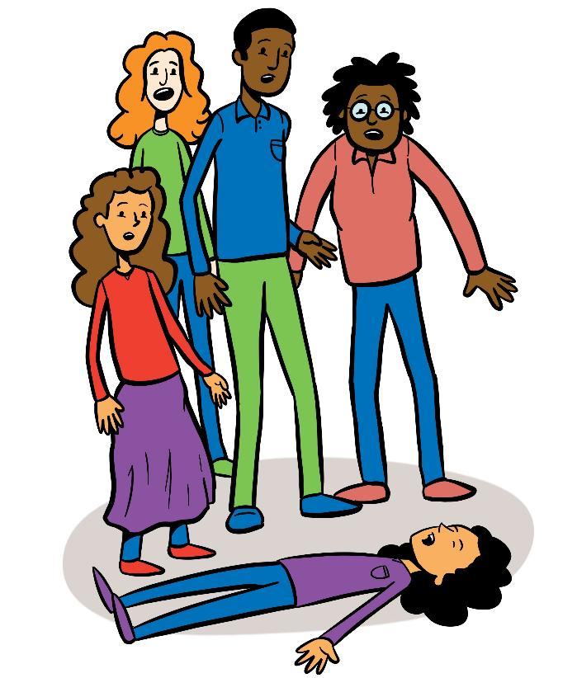
Safe Approach
Infection control
Call for help
Traffic
Electricity
Stay calm
"shake and shout"
Reassure others
Initial assessment
Notes:
This must be demonstrated practically by the participants (although those who are not able to do this may instruct others in doing the skill), and with a combination of trainer delivered, video and practical teaching methods to aid with learning.
Trainers notes:
1. Arrival at an incident
Assess the situation quickly and calmly:
Safety: Are you or they in any danger? Is it safe for you to go up to them?
Scene: What caused the accident or situation? How many casualties are there?
Situation: What are the environmental factors involved? Ages of casualties? Are the injuries life threatening?
2. Protect yourself and them from any further danger:
Always protect yourself first - never put yourself at risk
Only move them to safety if leaving them would cause them more harm
If you can’t make an area safe, call 999 for emergency help
3. Prevent infection between you and them:
Wash your hands or use alcohol gel
Wear disposable gloves or use the casualty’s hand to hold a wound if necessary
Don currently appropriate PPE – gloves, apron, mask and goggles or visor.
4. Comfort and reassure:
Stay calm and take charge of the situation
Introduce yourself to them to help gain their trust
Explain what’s happening and why using appropriate language to the age of the person.
Say what you’re going to do before you do it - Ask them if this is ok and wait for a response if they’re able to.
5. Arrange for the right kind of care:
Call 999 for an ambulance if you think it’s serious
Take or send them to hospital if it’s a serious condition but is unlikely to get worse
Suggest they see their doctor if they’re concerned about a less serious condition
Advise them to go home to rest, but to seek help if they feel worse as long as someone else will be at home with them. If this is a head injury, concerns for a concussion especially if they live alone, advise that they will need to find someone to stay with them
Stay with them until you can leave them in the right care
Inform parents/carers of what has happened
6. Record keeping:
Complete reports to include:
Details of the incident
Location
Date and time of incident
Who was involved
What was done
Who was notified

Slide 9
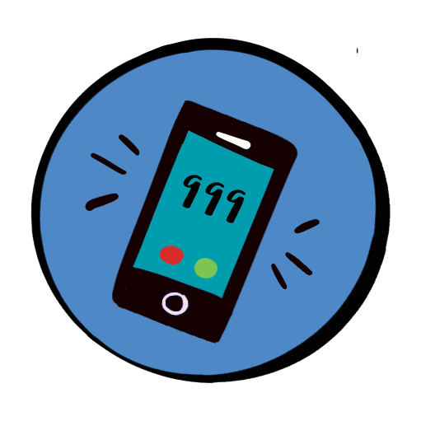

Unresponsive - Call 999
Notes:
Trainers notes:
As soon as someone is found to be unresponsive, call 999.
Send someone to call for help and to bring back an AED. If you are alone, call for help yourself and put your phone on speaker phone so the call handler can assist you

Slide 10
Primary Survey
D
R
A
B
C
D
E
<C>
Danger
Response
Catastrophic Bleeding
Airway
Breathing
Circulation
Disability
Exposure
If responsive:
Assess and treat what you find
If not breathing normally:
START CPR
If unresponsive:
CALL 999
Airway and breathing take priority
Catastrophic Bleeding
If you identify severe, life-threatening bleeding, control it immediately
Notes:
Trainers notes:
Primary Survey – Treat What You Find
Danger
Check it is safe to approach
Look and listen for danger to yourself, others and the casualty
Make the area safe if possible
Do not move the casualty unless they are in danger
Response – Decide your pathway
Ask: “Are you alright?” or “Open your eyes”
If RESPONSIVE:
They have an open airway and are breathing
Stay with them and assess what is wrong
Treat what you find (e.g. bleeding, breathing problems, illness)
If UNRESPONSIVE:
Call 999/112
Shout for help
Gently shake shoulders (tap for child)
Move immediately to Airway
<Catastrophic Bleeding>
If present:
Control bleeding immediately
Call 999
Airway
Responsive casualty:
Airway is open — continue assessment
Unresponsive casualty:
Open airway (head tilt, chin lift)
Check for obstruction
Breathing
Responsive casualty:
Look for signs of breathing difficulty (e.g. short sentences, distress)
Treat what you find
Unresponsive casualty:
Check breathing (no more than 10 seconds)
Normal breathing → Recovery position
Not breathing / abnormal breathing → Start CRP
(Agonal gasps are NOT normal breathing)
Circulation
Check circulation and look for signs of shock
Pale, cold or clammy skin
Rapid pulse
Ongoing bleeding
Reduced level of consciousness.
Treat for shock
Continue assessment
Disability (Level of Response)
Assess alertness (e.g. confusion, drowsiness)
Look for serious conditions:
Stroke
Hypoglycaemia
Head injury
Temperature-related illness
Treat what you find
Exposure
Check for other injuries or illnesses
Look for:
Fractures
Spinal injury
Burns
Environmental issues
Protect dignity and prevent heat loss
Key Teaching Point
➡️ Responsive = assess and treat what you find
➡️ Unresponsive = Call 999/112, airway and breathing take priority

Slide 11
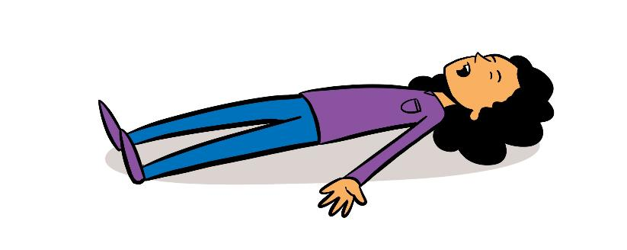
Primary Survey and initial assessment
Is it safe to approach them?
Do they respond to you?
Is their airway open and clear?
Are they breathing normally?
Are there any signs of severe bleeding?
Is anything affecting brain function?
Are any other injuries or illnesses present?
Notes:
This must be demonstrated practically by the participants (although those who are not able to do this may instruct others in doing the skill), and with a combination of trainer delivered, video and practical teaching methods to aid with learning.
Remember as soon as someone is found to be unresponsive, call 999.

Slide 12
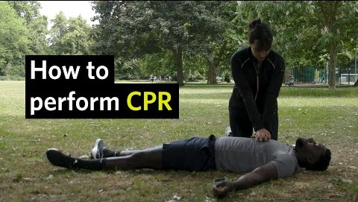
Notes:
(St John Ambulance) First Aid Training: CPR

Slide 13
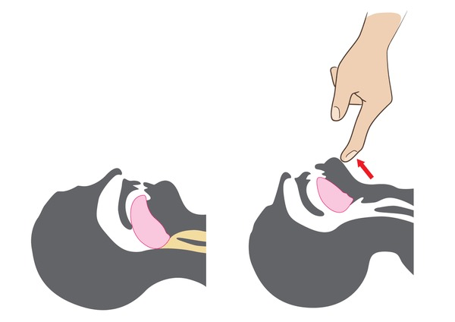
Airways
Head tilt – chin lift
Remember to open airway when assessing breathing and giving rescue breaths.
Notes:
Trainers notes:
Emphasis on the key areas

Slide 14
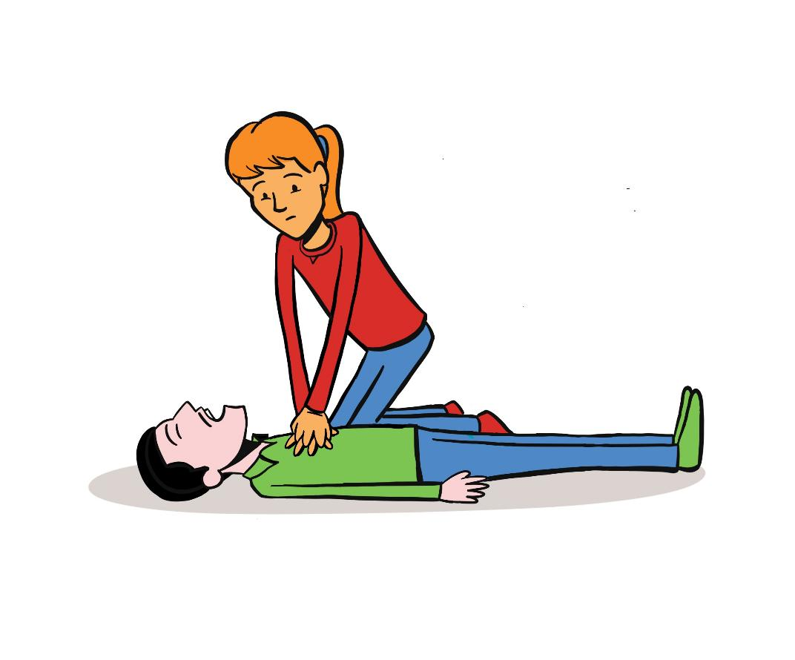
CPR
Adults
Notes:
This must be demonstrated practically by the participants (although those who are not able to do this may instruct others in doing the skill), and with a combination of trainer delivered, video and practical teaching methods to aid with learning.
Trainers notes:
Basic life support for child post puberty or adult
If you suspect a cardiac arrest, call 999 and follow the call handler’s instructions on how to perform cardiopulmonary resuscitation (CPR).
Perform CPR - cardiopulmonary resuscitation. This involves giving someone chest compressions and rescue breaths to keep their heart and circulation going.
Saving a person’s life is a priority, and you should not be concerned about causing harm to the patient.
Continue CPR: until professional help arrives and takes over (or tells you to
stop), the individual becomes responsive (speaks, opens eyes, moves
purposefully, or breathes normally), or the rescuer becomes exhausted.

Slide 15
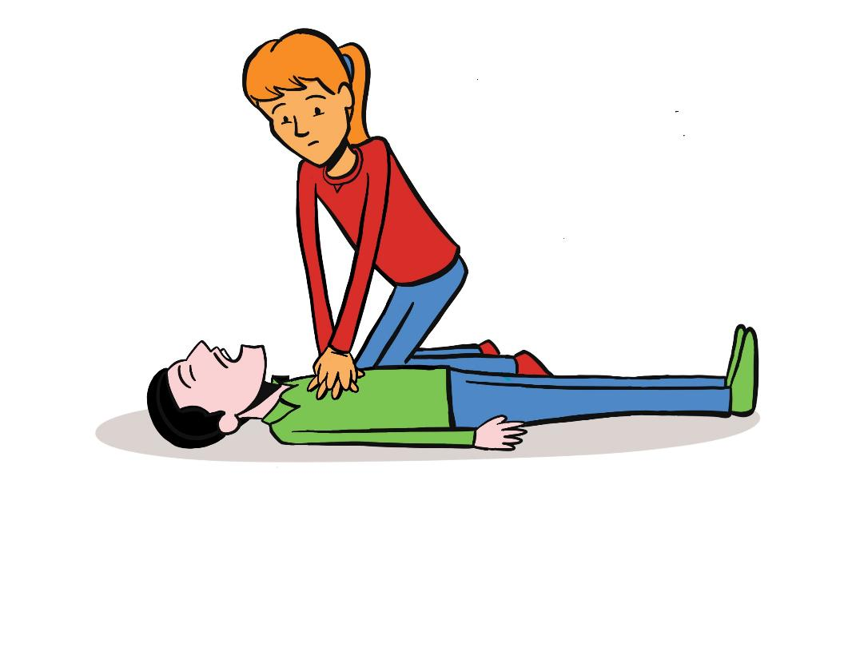
Chest compressions
30:2 Chest compressions to rescue breaths
Press the chest down by 5-6cm
Rate of 100-120/min
Notes:
Trainers notes:
How to give chest compressions:
Kneel down beside the casualty on the floor level with their chest.
Place the heel of one hand towards the end of their breastbone, in the centre of their chest.
Place the heel of your other hand on top of the first hand and interlock your fingers, making sure you keep the fingers off the ribs.
Lean over the casualty, with your arms straight, pressing down vertically on the breastbone, and press the chest down by 5-6cm.
Release the pressure without removing your hands from their chest. Allow the chest to come back up fully – this is one compression.
Repeat 30 times, at a rate of about twice a second (100-120/min)
If there is more than 1 rescuer, alternate the rescuer giving chest compressions every 1-2 minutes to prevent fatigue.
Make no more than 2 attempts to achieve rescue breaths before continuing chest compressions
Emphasis on the key areas
If there is more than 1 rescuer, alternate the rescuer giving chest compressions every 1-2 minutes to prevent fatigue

Slide 16
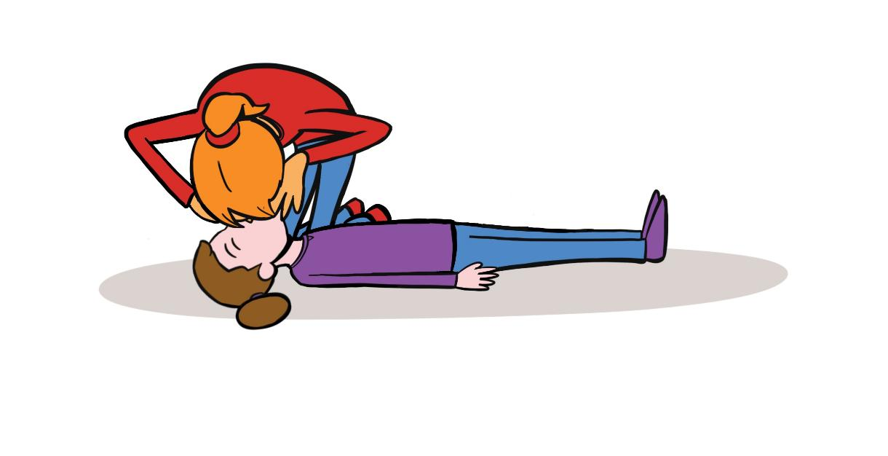
Rescue breaths
Give if you are able or willing
Notes:
Trainers notes:
Emphasis on the key areas
Make no more than 2 attempts to achieve rescue breaths before continuing chest compressions

Slide 17
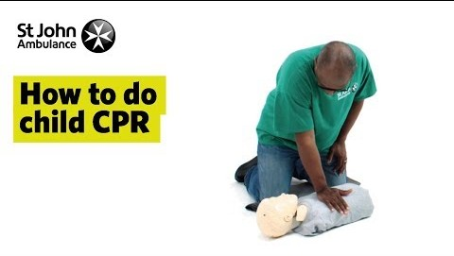
Notes:
(St John Ambulance) How to do Child CPR - First Aid Training - St John Ambulance

Slide 18
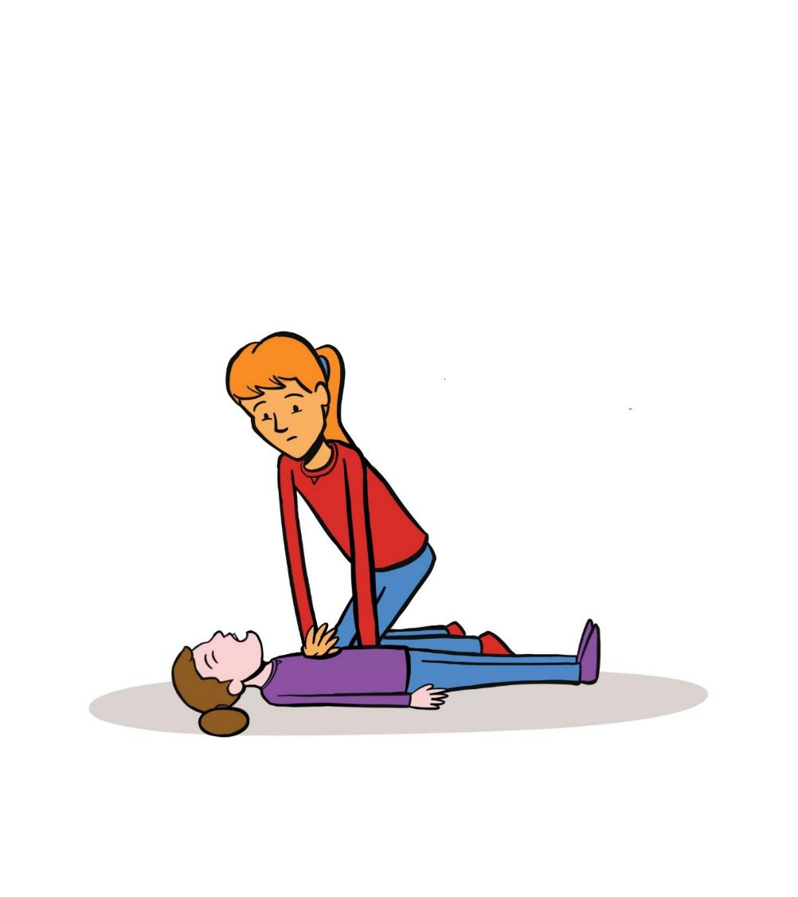
CPR
Children
More likely to be a respiratory cause
Give 5 rescue breaths
30:2 compressions to rescue breaths
Notes:
This must be demonstrated practically by the participants (although those who are not able to do this may instruct others in doing the skill), and with a combination of trainer delivered, video and practical teaching methods to aid with learning.
Trainers notes:
Basic life support for child.
A child is between 1 and 18 years of age.
Note: we are teaching the sequence for lay rescuers- the adult sequence with paediatric modifications. (Healthcare professionals may have been trained to perform a different sequence.)
Check for response by gently stimulating child and asking –“are you alright?”
If unresponsive – shout for help.
Turn child onto back and open airway using a head tilt and chin lift.
Look, listen and feel for breathing for up to 10 seconds.
Simultaneously look for signs of life – movement, coughing.
Give 5 rescue breaths.
If there are no signs of life – start chest compressions.
Rate 100-120 per minute
Place the heel of 1 hand on the centre of the child's chest and push down a depth of 1/3 of chest - approx. 5cm for a child. Use 2 hands if you can't achieve a depth of 5cm using 1 hand.
Ratio of 30 chest compressions to 2 rescue breaths.
If you have to leave to get help -perform 1 minute of CPR before going for help.

Slide 19
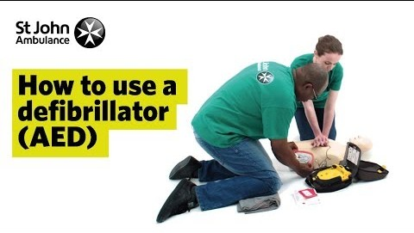
Notes:
(St Johns Ambulance) How to Use a Defibrillator (AED) - First Aid Training - St John Ambulance

Slide 20
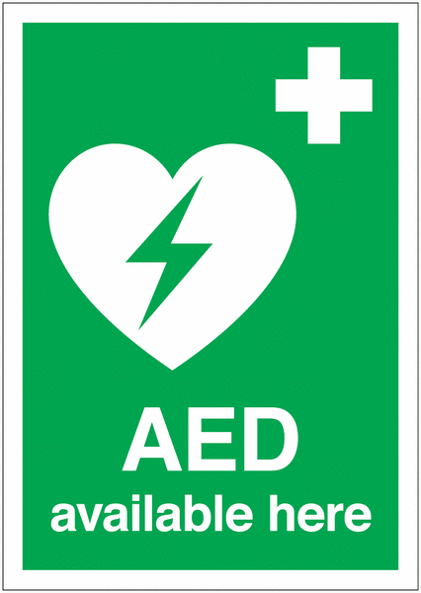
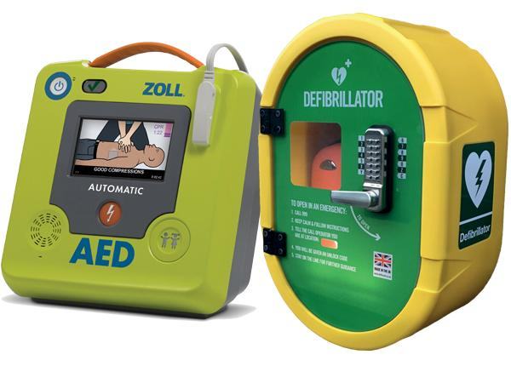
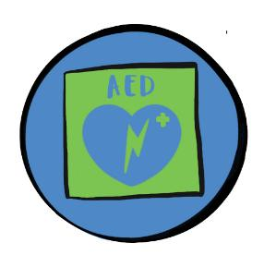
Use of an AED
Really easy to use without training
Listen to the verbal prompts
Use at any point after confirming a casualty is not breathing normally
These really do save lives!
Notes:
Trainers notes:
The most common cause of cardiac arrest is an abnormal rhythm of the heart, known as ventricular fibrillation.
A machine called an AED (automatic external defibrillator) can be used on adults and children over 1 year to correct the heart rhythm by giving it an electric shock.
AEDs can be used safely and effectively with no prior training.
Question the group: Do you know where your nearest AED is in your meeting place?
The ambulance service should be able to direct callers to the nearest accessible AED during the 999 call. In the UK, this is facilitated by The Circuit, a national database of the location and availability of public-access AEDs. Circuit-registered AEDs local to your area can be located on Defib Finder.

Slide 21
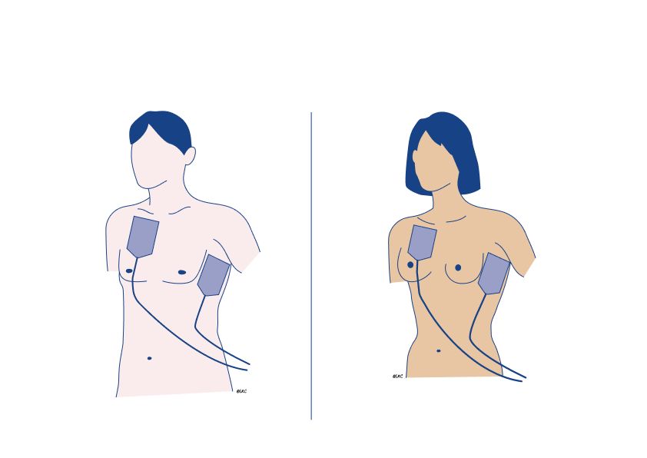
When and how to use an AED
Resuscitation Council UK 2025
Notes:
Trainers notes:
Use an AED as soon as it is available.
Open the AED case (if present). Some AEDs automatically turn on when opened. If not, identify the power button and turn it on.
Follow the audio/visual prompts from the AED.
Attach the electrode pads to the person’s bare chest according to the position shown on the AED (or AED pads).
Removing a bra before defibrillation: You should prioritise correct pad placement and contact with bare skin. If this can be quickly achieved without removing the bra, then it is acceptable to keep the bra in place. If the bra interferes with correctly locating the pad position, then the bra should be removed. You should not be concerned about exposing the person's chest to apply the pads and should prioritise life-saving interventions.
If more than one person is present, continue CPR while the pads are being attached.
Ensure that nobody touches the person whilst the AED is analysing the heart rhythm.
If a shock is indicated, ensure that nobody is touching the person.
Some AEDs (fully automatic AEDs) will deliver a shock automatically, while others (semi-automatic AEDs) will require the rescuer to press the shock button to deliver the shock.
After the shock has been delivered, immediately restart chest compressions.
If no shock is indicated, immediately restart chest compressions.
Continue to follow the AED instructions.
Usually, the AED will instruct the rescuer to perform CPR, then, after a set time interval, the AED will instruct the rescuer to pause CPR to undertake rhythm analysis.
Use adult pads for adults and children aged 8 years and upwards.
Use paediatric pads for children aged 1-8 years.
Pads can be placed in the same position as an adult for larger children. For smaller children place on pad on the back and one on the left hand side of chest.
Do not use for children under 1.

Slide 22
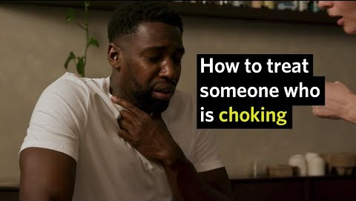
Notes:
First Aid Training: Choking (St John Ambulance)

Slide 23
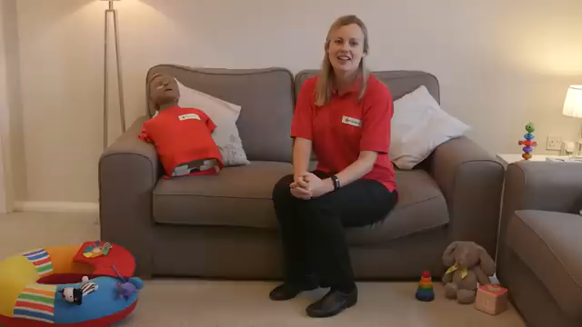
Notes:
Choking (child) (British Red Cross)

Slide 24
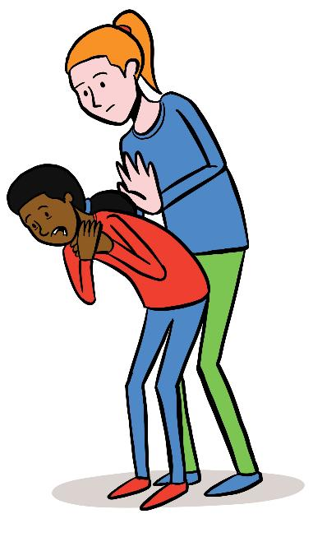
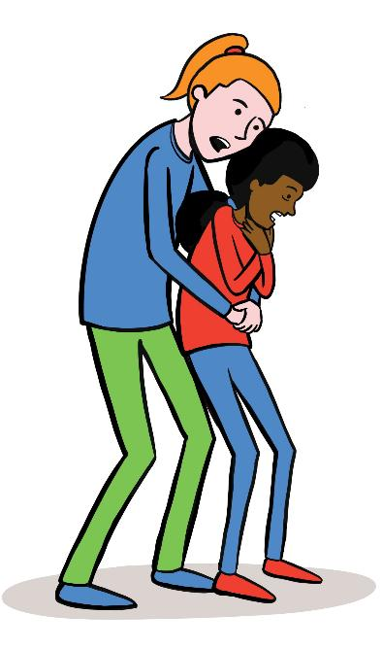
Choking
Encourage coughing
5 back blows
5 abdominal thrusts
Call for emergency help
Repeat back blows and abdominal thrusts
Notes:
Trainers notes:
If you think someone is choking, ask them: ‘Are you choking?’ to check they’re not suffering from something else. Can they speak, cry, cough or breathe? If they can, they should be able to clear their throat on their own by coughing, so encourage them to cough.
If they can’t cough or make any noise, take the following action:
Cough it out
Encourage them to cough a couple of times. If this doesn't clear the obstruction, support their upper body with one hand and help them lean forward.
Slap it out
If coughing doesn’t work, help the casualty bend forward.
Use the heel of your hand to give up to five sharp back blows between their shoulder blades.
Check their mouth to see if there’s anything in there and, if there is, get them to pick it out.
Squeeze it out
If back blows don’t work, give up to five abdominal thrusts.
To do this:
Stand behind them.
Link your hands between their tummy button and the bottom of their chest, with your lower hand clenched in a fist.
Pull sharply inwards and upwards.
Repeat up to five times.
Call for help
If they’re still choking, call 999 or 112 for medical help.
Once you’ve called, continue steps 2 and 3 – back blows and abdominal thrusts – until what’s in there has cleared, help arrives or they become unresponsive.
If they become unresponsive at any stage, open their airway and check their breathing.
If they’re not breathing, start chest compressions and rescue breaths (CPR). If the patient becomes unresponsive the throat muscles may relax and the airway open enough to allow rescue breaths.
However the Resuscitation Council does also advise “it may be difficult to carry out abdominal thrusts in a choking individual who is very obese, and abdominal thrusts should not be performed on a pregnant person. If you are enable to encircle the person’s abdomen, you should stand behind the individual, as for abdominal thrusts, but position your hands somewhat higher, over the lower end of the sternum (breastbone). Pull hard into the chest with quick thrusts.”
Any person successfully treated for choking with abdominal thrusts or chest compressions should be evaluated by a healthcare practitioner since complications and injuries may occur

Slide 25
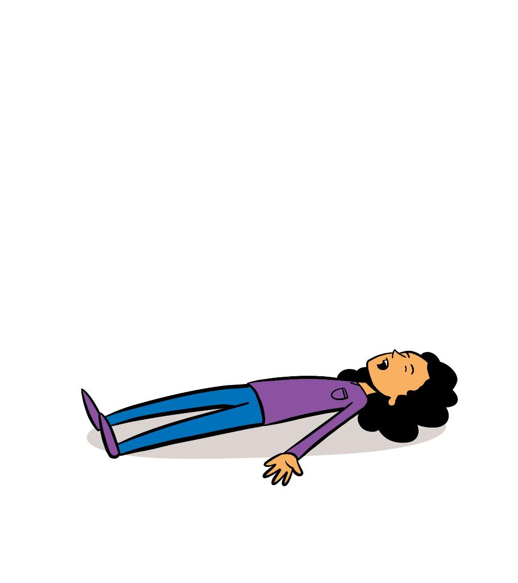

What are the causes of unresponsiveness?
Notes:
Trainers notes:
Use this slide to gather thoughts from participants

Slide 26
What are the causes of unresponsiveness?
Fainting
Shock
Head Injury
Seizures
Stroke
Hypoglycaemia
Asphyxia
Drowning
Choking
Asthma
Notes:
Trainers notes:
Causes of unresponsiveness
Fainting
Shock
Head Injury
Seizures
Stroke
Hypoglycaemia
Asphyxia
Drowning
Choking
Asthma

Slide 27

Notes:
The Recovery Position (St Johns Ambulance)

Slide 28
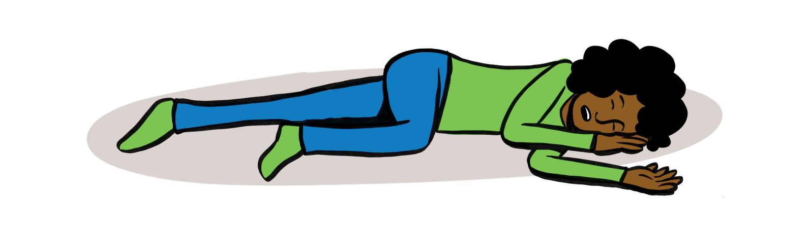
Recovery position
Safe Airway position
Continue to assess
Keep warm
Notes:
This can be delivered in either theory or practical methods, recognising that a variety of factors may make this not possible, where possible practical activities would be encouraged.
After performing a primary survey – adults and children with a reduced level of responsiveness who do not meet the criteria for starting CPR should be put in the recovery position. Casualties should be closely monitored and should be returned to lying on their backs if they deteriorate.
Trainers notes:
Ask Participants if any of them know the stages of the recovery position. Try and get as many participants as possible feeding into this.
Trainers notes:
This will keep their airway open.
This position is used when someone is unresponsive.
The example below is for someone in the left side-lying position, but either is appropriate
Kneel down next to them on the floor. The next steps are for if you find the casualty lying on their back. If you find them lying on their side or their front you may not need all these steps. However please move them as safely as possible into the recovery position using relevant steps below.
Check casualty’s pockets for any objects on the side they will be laying on – remove sharp objects.
Place their left arm at a right angle to their body, with their palm facing upwards.
Bring their right arm and place it across their chest so the back of their hand is against their cheek nearest you, and hold it there.
With your other hand, lift their far knee and pull it up until their foot is flat on the floor.
Carefully pull on their bent knee and roll them towards you.
Once you’ve done this, the top arm should be supporting the head and the bent leg should be on the floor to stop them from rolling over too far. Ensure hip and knee are at right angles.
Cover casualty with a blanket if possible.
Once you’ve put them safely into the recovery position, call 999 or 112 for medical help. Until help arrives, keep checking the casualty's breathing.
If they stop breathing at any point, call 999 or 112 straight away and give them CPR.
If you think the casualty could have a spinal injury, keep their neck as still as possible. Instead of tilting their neck, use the jaw thrust technique: place your hands on either side of their face and with your fingertips gently lift the jaw to open the airway, avoiding any movement of their neck.

Slide 29

Q&A
Notes:
Allow time for any questions on the topics covered
Trainers notes:
Ask participants if they think we met the session outcomes and for them to feedback what in particular they have learnt today or will take away from this section of the course.

Slide 30
Break time
Notes:
If delivering a full 6-hour course, please take a break here.

Slide 31
Session 2
    Trauma and Injury
Shock
Bleeding
Burns
Spinal Injuries
Fractures and sprains
Head injury
Dental incidents
Notes:
Trainers notes:
Introduce the Trauma and Injury session and inform the participants of the syllabus areas you will cover in the first session. Ask participants what they think they will be covering in the Trauma and Injury section and add anything missed.
Items identified with * can be delivered in either theory or practical methods, recognising that a variety of factors may make this not possible, where possible practical activities would be encouraged.
This session covers the following topics:
Shock
Bleeding*
Burns
Spinal injuries
Fractures and sprains
Head injury
Dental incidents
Objectives:
The participant will learn the signs and symptoms of, causes of, and treatment of:
Shock
Bleeding
Burns
Spinal injuries
Fractures and sprains
Head injury
Dental incidents
Outcomes:
The participant will be able to recognise the signs and symptoms of the following traumas or injuries, and undertake the required action in each case:
Shock
Bleeding
Burns
Spinal injuries
Fractures and sprains
Head injury
Dental incidents
With a focus on the Trauma and Injury syllabus areas. Ask the participants what first aid scenarios they would currently feel confident dealing with.
It is important to acknowledge that some may be attending first aid training for the first time, and others may be refreshing their knowledge and understanding.
For those who have attended first aid training before - Ask how the training they had been on before prepared them for an accident or incident.
For those new to first aid - ask then what they are hoping to achieve training.

Slide 32

Where to get help and how to get there
Notes:
Trainers notes:
This may involve sending someone to telephone for the emergency services or letting a parent/carer know that a minor incident (eg grazed knee) has taken place.
In a serious emergency, it is important to get help as quickly as possible. Either phone yourself or ask someone you trust to call 999 or 112. The call handler will ask you a set of questions to ensure you get the help you need. It is important to be able to give an accurate location.
You may need to know the postcode, know local landmarks or use the What3words app.
In less urgent situations, there are other places you can look for help:
NHS 111 service – by phone. They will ask questions to ensure you are directed to the correct help. They can call a 999 ambulance, or help book an out of hours GP appointment or direct you to an urgent dentist.
NHS 111 website
Local minor injury unit
Pharmacy
Resources on GG Learning Platform
An up to date first aid manual (recommended Dorling Kindersley - authorised manual of St John Ambulance, St Andrew’s First Aid and the British Red Cross)
Consider whether in a less urgent situation an alternative method of transport could be used instead of an emergency ambulance. This may include calling parents/carers to take patient in their car

Slide 33
Shock
Shock is a life-threatening condition when the circulatory system fails and the vital organs fail to get an adequate supply of oxygen.
Symptoms of shock
Pale, cold, clammy skin
Weak, dizzy, light-headed
Nausea or vomiting
Thirsty
Yawning
Rapid, weak pulse
Anxiety or irrational behaviour
Rapid, shallow breathing
Dropping levels of responsiveness
Ultimately results in Cardiac arrest
Notes:
Trainers notes:
What is shock?
Shock is a life-threatening condition when the circulatory system fails and the vital organs fail to get an adequate supply of oxygen.
Symptoms of shock
Pale, cold, clammy skin
Weak, dizzy, light-headed
Nausea or vomiting
Thirsty
Yawning
Rapid, weak pulse
Anxiety or irrational behaviour
Rapid, shallow breathing
Dropping levels of responsiveness
Ultimately results in Cardiac arrest

Slide 34
Causes of shock
Severe blood loss is most common cause.
Loss of other fluids – diarrhoea and vomiting, burns.
Heart attack or heart failure
Septic shock – overwhelming infection
Anaphylaxis
Spinal Cord Injury – neurogenic shock
Notes:
Trainers notes:
Causes of shock
Severe blood loss is most common cause
Loss of other fluids – diarrhoea and vomiting, burns
Heart attack or heart failure
Septic shock – overwhelming infection
Anaphylaxis
Spinal Cord Injury – neurogenic shock

Slide 35
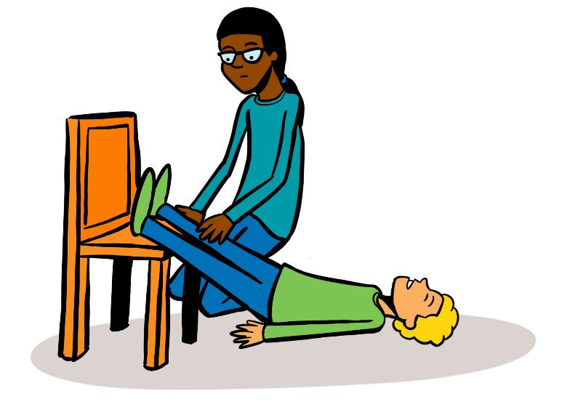
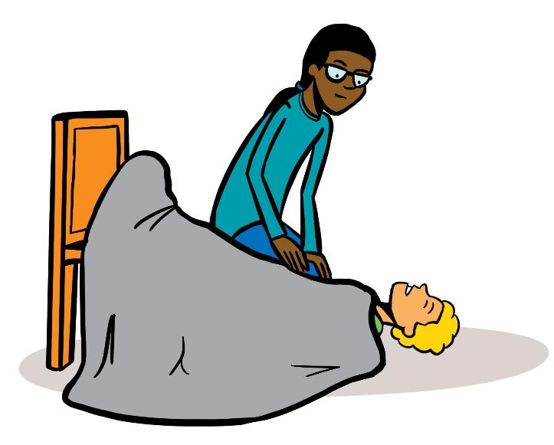
Treatment of shock
Notes:
Trainers notes:
Treatment of shock
Treat any possible cause of shock e.g. severe bleeding, anaphylaxis.
Lie casualty down on rug or blanket if possible as this will help keep them warm.
Discourage walking.
Elevate the casualty’s legs to help improve blood supply to major organs.
Keep the casualty warm with blankets etc.
Do not allow casualty to eat or drink in case an anaesthetic is needed. If thirsty, they may moisten their lips with water.
Call 999/112 and tell the call handler that the patient is suffering from shock

Slide 36
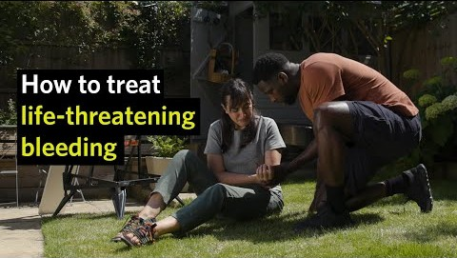
Notes:
First Aid Training: Life-threatening bleeding (St Johns Ambulance) Please provide a trigger warning for blood

Slide 37
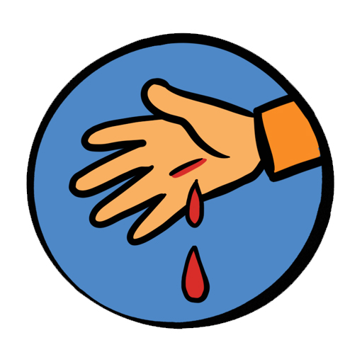
Treatment for Severe or Life-threatening bleeding
Apply firm, direct pressure
Severe
Apply standard dressing
If bleeding is under control, apply a pressure dressing
Life threatening
Apply a tourniquet as soon as possible for life-threatening extremity bleeding that is not controlled by direct manual pressure
Notes:
Trainers notes:
Severe bleeding – treatment
Call 999.
Apply firm, direct manual pressure to any bleeding injury site.
Apply a standard or ideally a haemostatic dressing directly to the bleeding injury, then apply firm direct pressure, which may require at some sites the dressing to be packed into the wound. In the absence of any first aid dressings, any clean material can be utilised in this way, with an emphasis on stopping the bleeding.
Once bleeding is under control, apply a pressure dressing.
Apply a tourniquet as soon as possible for life-threatening extremity bleeding that is not controlled by direct manual pressure:
Place the tourniquet around the traumatised limb 5-7cm above the
injury, but not over a joint.
Tighten the tourniquet until the bleeding slows and stops. This may be painful for the person.
Write the time the tourniquet was applied.
Do not release the tourniquet. It should only be released by a healthcare professional.
In some cases, you may need to apply a second tourniquet, above the first tourniquet, to control the bleeding.
Trainers notes
There are some rare but potential situations in which the area around an incident has been sealed off for safety, and medical and rescue services are unable to enter. An example of this would be the Manchester Arena bombing or some natural disasters. In these situations first aiders may need to control life threatening bleeding until help arrives by using a tourniquet.
We do not expect first aid kits to include haemostatic dressings and tourniquets, and the inclusion of this treatment is to ensure first aiders can use it if they have it available.
Haemostatic dressings and tourniquets are available in Public Access Community Bleed Kits.
Citizen Aid have both an app and a tourniquet kit giving excellent advice on what to do in these situations. If you feel in your risk assessment that you may potentially be in a situation like this – then you could prepare yourself beforehand by looking through this advice.

Slide 38
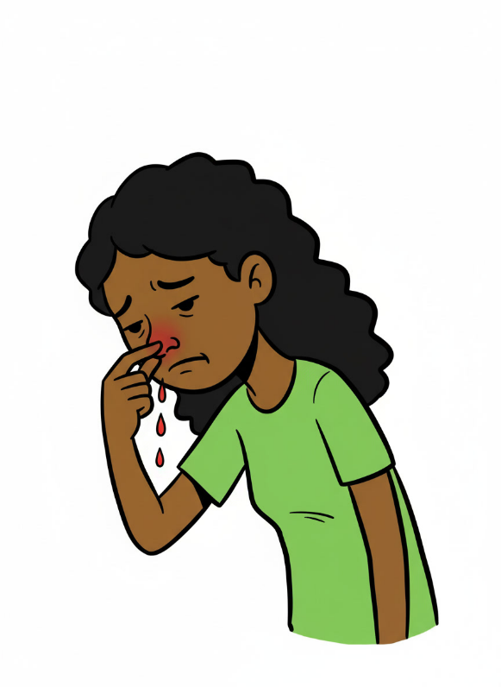
Bleeding nose
Apply pressure to the lower part of the nose
Apply firm pressure just below the firm part of the nose
Get them to sit down and lean forward.
Try to make sure they do not breathe through their nose, speak, swallow, cough, spit or sniff.
Apply the pressure to their nose for ten minutes. If the bleeding still has not stopped, continue this for a further ten minutes.
Notes:
Trainers notes:
Nosebleeds
Nosebleeds are fairly common and may be caused by a blow to the nose, picking, sneezing or blowing it. Nosebleeds can lead to considerable loss of blood which, if swallowed, may cause vomiting.
What to do:
Apply firm pressure just below the firm part of the nose (you may have to do this for a younger casualty).
Get them to sit down and lean forward. If possible, protect their clothing with a cloth or
bowl.
Try to make sure they do not breathe through their nose, speak, swallow, cough, spit or sniff.
Apply the pressure to their nose for ten minutes. If the bleeding still has not stopped, continue this for a further ten minutes.
When the bleeding has stopped, advise them to rest, to avoid exertion and not to pick or blow their nose for a few hours.
If the nosebleed persists for longer than 30 minutes, take them to hospital.
Avoid hot drinks for 24 hours once the bleeding has stopped

Slide 39
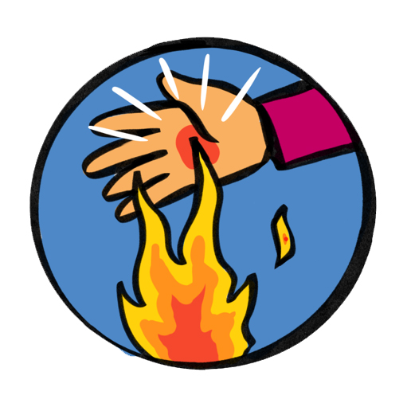
Burns
“Cool the burns but warm the patient”
Immediately provide 20 minutes of cooling with cool running water
Seek urgent medical attention if:
The patient is a child
The burn is deep
The burn affects the face, eyes, hands, feet or genitals
All burns that go all the way around a limb
Burns that are greater than the size of the patient’s hand
Notes:
Trainers notes:
Burns can be caused by dry heat, friction, radiation (including sunrays), hot liquids, steam and chemicals.
What to do:
Immediately cool the skin with cool water for at least 20 minutes or until the pain stops.
Once cooled, lay cling film ideally or if not, a clean dry dressing.
If possible, immediately remove jewellery, watches or other restrictions as the area can swell very quickly.
Be prepared for shock to develop and lay the casualty down if you can.
Do not burst blisters.
Leave on any clothing which has stuck to the body. If possible gently remove rings, watches or shoes before swelling occurs.
Do not apply anything but water. Special dressings, sprays and gels are not recommended.
Do not apply adhesive dressings.
Seek urgent medical attention if:
The patient is a child
The burn is deep
The burn affects face, eyes, hands, feet or genitals
All burns that go all the way around a limb
Superficial burn if larger than 5 palms of the casualty.
Partial/full thickness burns that are larger than 1 palm of patient
Burns caused by tar, oil, fat, chemicals or electricity
Chemical burns
Some industrial and domestic chemicals can burn the skin. When going to the aid of someone with chemical burns it is vital to ensure your own safety first. If possible, note the name of the chemical.
What to do:
Wash the affected area for at least 20 minutes, with the flow of water running away from the casualty. Take care not to splash the chemical on to yourself or the casualty.
Chemical burns around the mouth and throat can cause swelling, which can restrict or close the airway, therefore:
loosen clothing around the neck
give a conscious casualty sips (not more) of cold water
be prepared to start CPR but remember to protect your mouth from the chemical by using a resuscitation face shield.
Get urgent medical help.
Sunburn
Although sunburn is a common condition, it can be quite serious. It can be prevented by wearing a sun hat and clothes made of natural fibres that cover the whole body, and by using appropriate sun protection cream.
What to do:
Move the casualty into a shaded area.
Cool the sunburnt area by sponging or showering it with cold water or get the casualty to soak in a cool bath for at least ten minutes.
Seek medical aid if there is extensive blistering or skin damage
Useful link: https://www.britishburnassociation.org/wp-content/uploads/2017/06/BBA-First-Aid-Guideline-24.7.18.pdf

Slide 40
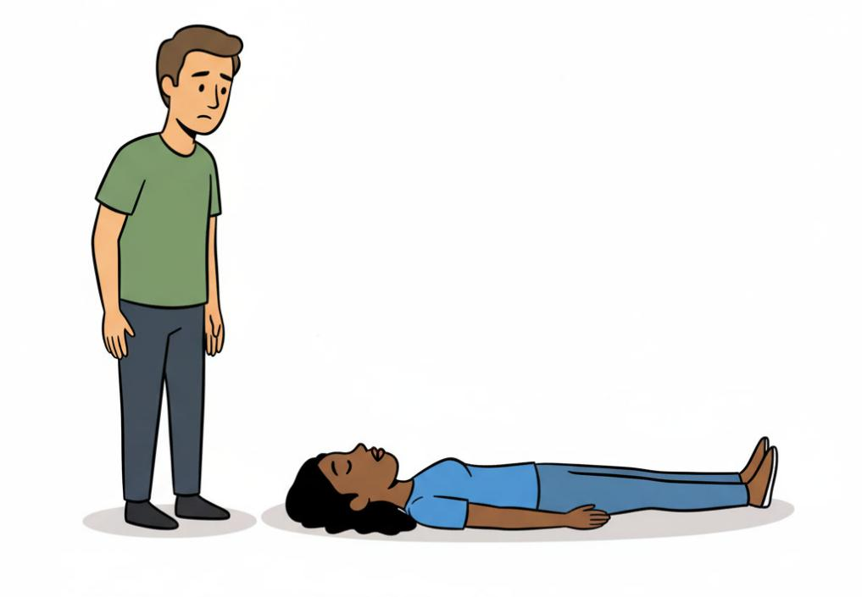
Spinal injuries
Approach the patient from the head or feet to avoid turning their head.
Instruct the patient to keep their head completely still.
Notes:
Trainers notes:
Suspect a cervical spine injury in a person who fell or dived from a height, was crushed by a heavy object or was involved in a road traffic or a sporting accident.
Minimise movement of the neck. If the person is awake and alert, encourage them to self-maintain their neck in a comfortable, stable position.
Never force an uncooperative person into any position, as this may exacerbate an injury.
Do not move the patient. If the patient is unresponsive you may need to open the airway whilst avoiding moving the neck.
Approach & Positioning:
Approach the patient from the head or feet, not the side, to avoid turning their head.
Instruct the patient to keep their head completely still.

Slide 41
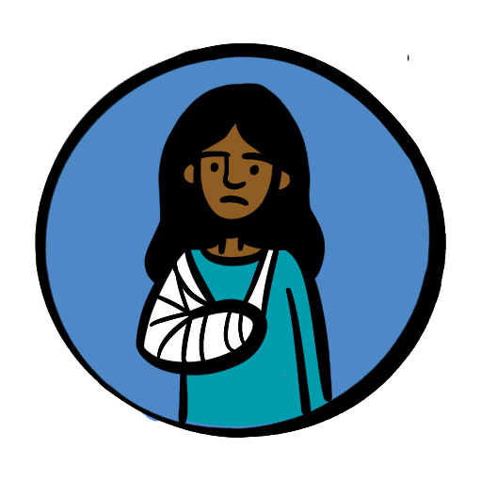
Fractures
Signs and symptoms
Pain or difficulty moving the area/limb
Tenderness around the area
Deformity, swelling and bruising around the fracture area (a lump or bump)
Shock
Bone breaking through the skin
Awareness of grating of bones together
Shortening, bending and twisting of limb
Notes:
Trainers notes:
Signs and Symptoms:
Pain or difficulty moving the area/limb
Tenderness around the area
Deformity, swelling and bruising around the fracture area (a lump or bump)
Shock
Bone breaking through the skin
Awareness of grating of bones together
Shortening, bending and twisting of limb

Slide 42
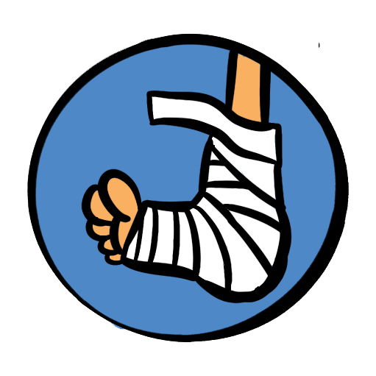
Fractures
It is easy to miss a fracture if the signs are subtle
Have a low threshold for seeking medical advice and getting an x-ray
Notes:
Trainers notes:
Immobilise in the position found with as little movement as possible and apply a sling or splint.
Seek medical help – it is common for fractures to be “missed”
Arrange transport for further assessment, if in severe pain –call 999/112.

Slide 43
R I C E
Notes:
Trainers notes:
Sprains
A soft tissue injury occurs when a ligament or tendon around a joint has been torn or pulled. This sort of injury can often give similar symptoms to a fracture. If you are in any doubt, treat as a fracture. Remember RICE in caring for a soft tissue injury.
R – Rest the injured part.
I – Apply Ice (not directly to the skin) or a cold compress.
C – Provide Comfortable support – soft padding and a bandage support.
E – Elevate the limb
ice application only applied for maximum of 20 minutes
If an accident occurs when you are away from help, such as on a hike, it may be applicable to use added protection – this may include the tightening of high top boots (hiking boots) etc to prevent further (or worsening of the) injury. This is most applicable in relatively minor sprains/strains
Additional information can be found here: https://cks.nice.org.uk/topics/sprains-strains/management/management/

Slide 44
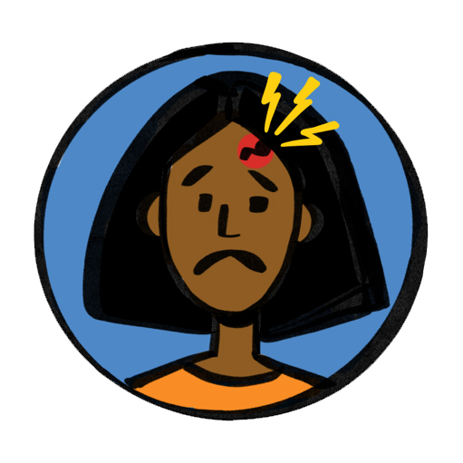
Head injury
Head injuries are very common but can occasionally become very serious
For this reason, the casualty’s parent/carer or person they live with must be informed of even an apparently minor bump to the head, since symptoms can be delayed.
Notes:
Trainers notes:
Head injuries are very common but can become very serious. For this reason, the casualty’s parent/carer or person they live with must be informed of even an apparently minor bump to the head, since symptoms can be delayed. All head injuries must be taken seriously.

Slide 45
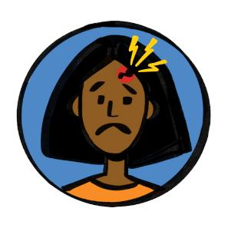
Head injury
Seek medical help if:
Persistent headache
Increasing drowsiness
Confusion, loss of balance, loss of memory
Difficulty speaking
Difficulty walking
Patient is on anti-coagulation/anti-clotting medication
Vomiting episodes after the injury has occurred
Double vision or strange movement of the eyes
Changes in behaviour
Seizures
Patient is aged over 65
Patient has had previous brain surgery
Notes:
Trainers notes:
What to do:
Seek medical help if:
Signs of worsening injury
Increasing drowsiness
Persistent headache
Confusion, loss of balance, loss of memory
Difficulty speaking
Difficulty walking
Vomiting episodes after the injury has occurred
Double vision or strange movement of the eyes
Seizures
Patient is aged over 65
Patient has had previous brain surgery
Patient is on anti-coagulation/anti-clotting medication
There is no responsible person to keep an eye on the patient
Remove the person from physical activities.
Refer to a healthcare professional for assessment and further advice.

Slide 46
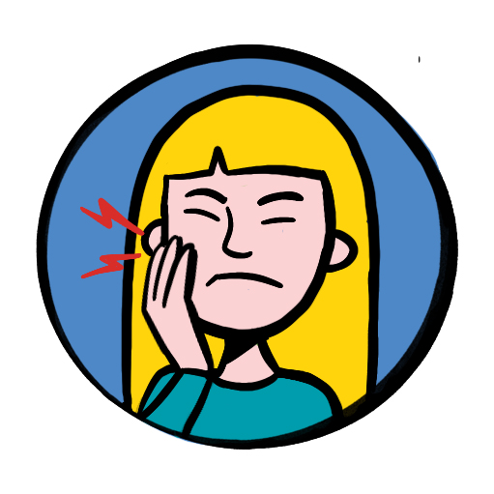
Dental
Treatment
Hold the tooth by the white bit that sticks out of the gum (the crown) – do not touch the root.
If the tooth is dirty, rinse it gently in milk, saline or saliva.
Try to put it back into the hole in the gum.
Bite down gently on a clean cloth to hold the tooth in place if it goes back in easily.
Go to a dentist as soon as possible..
Notes:
Trainers notes:
Emergency First Aid will be required if an adult tooth is knocked out
What to do?
There are things you can do yourself before seeing a dentist if your tooth has been knocked out.
Hold the tooth by the white bit that sticks out of the gum (the crown) – do not touch the root.
If the tooth is dirty, rinse it gently in milk, saline or saliva.
Try to put it back into the hole in the gum.
Bite down gently on a clean cloth to hold the tooth in place if it goes back in easily.
Go to a dentist as soon as possible.
Tap water and saline are not recommended.
Do not put a baby tooth back in as it could damage the tooth growing underneath.

Slide 47
Q&A
Notes:
Allow time for any questions on the topics covered
Trainers notes:
Ask participants if they think we met the session outcomes and for them to feedback what in particular they have learnt today or will take away from this section of the course.

Slide 48
Break time
Notes:
If delivering a full 6-hour course, please take a break here.

Slide 49
Session 3
    Major Illness
Asthma
Anaphylaxis
Chest pain
Stroke
Seizures
Hypoglycemia
Sepsis
Notes:
Trainers notes:
Introduce the major illness session and inform the participants of the syllabus areas you will cover in the first session.
Ask participants what they think they will be covering in the Trauma and Injury section and add anything missed.
Trauma and injury Key Topics:
Asthma
Anaphylaxis
Chest pain
Stroke
Seizures
Hypoglycaemia
Sepsis
Objectives:
The participant will:
1. Learn how to use adjustment plans to manage known conditions/illnesses.
2. Learn the signs and symptoms of, causes of, and treatment of:
Asthma
Anaphylaxis
Chest pain
Stroke
Seizures
Hypoglycaemia
Sepsis
Outcomes
The participant will be able to:
1. Recognise the signs and symptoms of the following conditions/illnesses:
Asthma
Anaphylaxis
Chest pain
Stroke
Seizures
Hypoglycaemia
Sepsis
2. Seek appropriate professional medical help and advice regarding the conditions/ illnesses listed above.
3. Provide immediate first aid treatment to patients with the conditions/illnesses listed above, including helping the patient to use their own emergency medication.
With a focus on the major illness syllabus areas. Ask the participants which major illnesses they would be confident dealing with.
It is important to acknowledge that some may be attending first aid training for the first time, and others may be refreshing their knowledge and understanding.
For those who have attended first aid training before - Ask how the training they had been on before prepared them for an accident or incident.
For those new to first aid - ask then what they are hoping to achieve training.

Slide 50
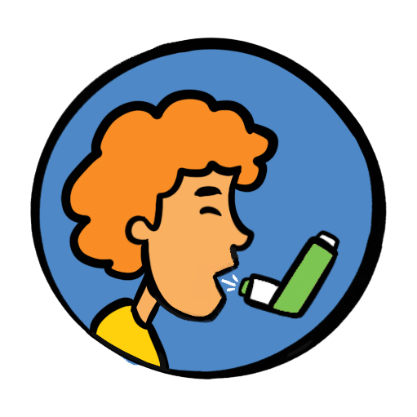
Asthma
What is asthma?
What are the signs and symptoms?
Difficulty breathing – short sentences and whispering
Wheezing
Coughing
Distress and anxiety
Grey-blue tinge to lips, earlobes and nailbed
Exhaustion in a severe attack
Notes:
Trainers notes:
What do participants know about Asthma?
Asthma is a chronic (long-term) condition in which the muscles of the air passages go into spasm making the airways narrow and causing the patient to have difficulty in breathing.
Signs and symptoms
Difficulty breathing – short sentences and whispering
Wheezing
Coughing
Distress and anxiety
Grey-blue tinge to lips, earlobes and nailbed
Exhaustion in a severe attack

Slide 51

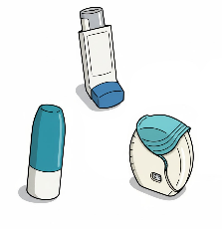
Asthma
Treatment depending on inhaler type
One puff of reliever inhaler every 30-60 seconds for up to 10 puffs
Use spacer device if available
Call for help if no improvement after 10 puffs.
The 10-puff routine can be repeated after 10 minutes if ambulance hasn’t arrived
One puff of MART inhaler every 1 to 3 minutes up to six puffs.
Call for help if no improvement after 6 puffs.
The 6-puff routine can be repeated after 10 minutes if symptoms have not improved and ambulance hasn’t arrived
Notes:
Trainers notes:
Treatment
If a person with asthma is experiencing breathing difficulties, we should help them to use their own reliever inhaler, using a spacer device if one is available.
One puff of reliever inhaler every 30-60 seconds for up to 10 puffs. Use spacer device if available. Call for help if no improvement after 10 puffs. The 10 puff routine can be repeated after 10 minutes if ambulance hasn’t arrived.
Some asthmatics now use a combination (MART/AIR) inhaler as both their reliever and maintenance therapy – they should use this during an asthma attack. This may not be a pump (like the one in the picture)and may be inhaled without a spacer. They can still take 1-2 puffs every minute, but the maximum doses can vary and so it's important to check with them/their parent/guardian and record this in their adjustment plan. Most MART inhalers have a maximum of 6 puffs.
Call 999/112 for medical help if:
Reliever/MART inhaler not easing attack
Patient is becoming exhausted
Patient is too breathless to speak
Patient cannot complete full sentences

Slide 52
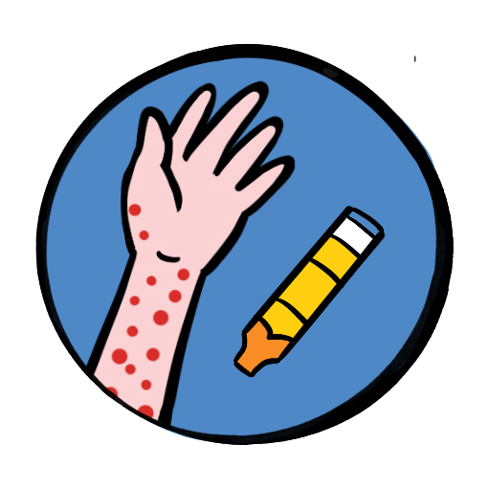
Anaphylaxis
Anaphylaxis is a severe allergic reaction affecting the whole body. It may develop within seconds or minutes of coming into contact with a trigger and can be fatal.
Common signs and symptoms:
Red itchy rash
Red itchy eyes
Swelling of hands feet or face
Abdominal pain, vomiting and diarrhoea
Wheezing and difficulty breathing
Swelling of tongue or throat
Agitation and feeling of terror
Shock
Notes:
Trainers notes:
Anaphylaxis is a severe allergic reaction affecting the whole body. It may develop within seconds or minutes of coming into contact with a trigger and can be fatal.
Signs and symptoms will depend on the allergen, but can include:
Red itchy rash
Red itchy eyes
Swelling of hands feet or face
Abdominal pain, vomiting and diarrhoea
Wheezing and difficulty breathing
Swelling of tongue or throat
Agitation and feeling of terror
Shock

Slide 53
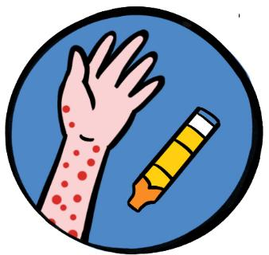
Anaphylaxis
Treatment
Patients need emergency treatment with adrenaline
Call for help – 999/112
Remove the trigger (if known)
If the patient has an adrenaline auto-injector – help them to use it
If symptoms not improving after 5 mins or they return – give second dose of adrenaline
Notes:
Trainers notes:
Treatment
Ensure that the person is lying down unless there are breathing difficulties, in which case they may sit up with their legs extended.
Remove the trigger if known and possible.
Intramuscular adrenaline should be given (either self-administered or by trained individuals) as soon as possible via autoinjector into the outer thigh, which delivers the recommended dose.
If symptoms persist five minutes after administration, give a second dose of adrenaline, ideally in the opposite leg.
Anyone receiving adrenaline treatment must be taken to hospital.
Adrenaline auto-injectors cannot be shared.
There are several types of adrenaline auto injectors available in the UK. All deliver ‘adrenaline’ (also referred to as ‘epinephrine’). All types are prescription only medicines, and need to be prescribed by an allergy specialist. The dose of adrenaline required is dependent on the age and weight of the person requiring the adrenaline auto injector device, and will be prescribed by the clinician. Each adrenaline auto injector device will differ in appearance and the availability of the dose/strength available in that particular brand.

Slide 54
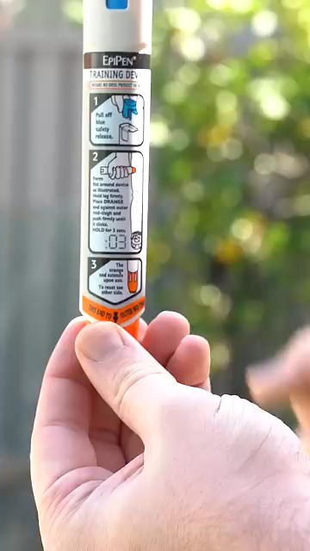
Anaphylaxis
Auto-injector
Notes:
How to use an EpiPen

Slide 55

Chest pains
Other signs and symptoms
Feeling lightheaded or dizzy
Sweating
Shortness of breath
Feeling sick (nausea) or being sick (vomiting)
An overwhelming sense of anxiety (similar to having a panic attack)
Coughing or wheezing
Notes:
Trainers notes:
Chest pain is pain or discomfort in the area between the neck and belly. Chest pain may be sharp or dull. It might come and go, or you might always feel the pain. The exact symptoms depend on the cause.
Many different things can cause chest pain. The most life-threatening causes involve the heart or lungs. So it's important to get medical help for an accurate diagnosis.
Heart related chest pain often has other signs and symptoms:
Feeling lightheaded or dizzy
Sweating
Shortness of breath
Feeling sick (nausea) or being sick (vomiting)
An overwhelming sense of anxiety (similar to having a panic attack)
coughing or wheezing
Although the chest pain in heart attack is often severe, some people may only experience minor pain, similar to indigestion. In some cases, there may not be any chest pain at all, especially in women, older people, and people who have diabetes.
It's the overall pattern of symptoms that helps to determine whether you are having a heart attack.
Treatment and positioning
Call 999 for an ambulance.
If the casualty is still conscious, sit them up, supporting them from behind with their knees slightly bent (the ‘W’ position).
Encourage and assist adults with cardiac sounding chest pain in self-administering 300 mg of aspirin (ideally chewable or dissolvable) as soon as possible, whilst awaiting emergency assistance (but not to adults with a known aspirin allergy). Do not give to under 16s, those with severe allergy to aspirin, those with known stomach problems, or those with severe asthma.
It is shown that when aspirin is given early, survival rates are better and there are no increased side effects
If the casualty is known to have angina and has medication for it, they can be helped to use it as instructed on the prescription Constantly monitor their level of response, circulation and breathing until help arrives.
If they lose consciousness, put them in the recovery position if still breathing normally.
If breathing deteriorates, begin CPR
NEVER give aspirin to anyone under 16

Slide 56
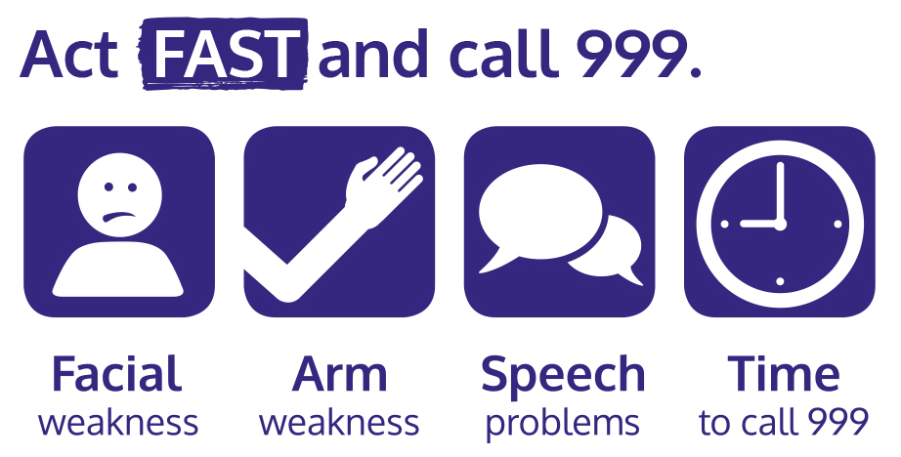
Stroke
Notes:
Trainers notes:
A stroke is a medical emergency when the blood supply to the brain is disrupted. The majority of strokes are caused by a clot in a blood vessel that blocks the flow of blood to part of the brain. Some strokes are the result of a ruptured blood vessel that causes bleeding into the brain.
A transient ischaemic attack, or TIA, is sometimes called a mini-stroke. It is similar to a full stroke but the symptoms last for a short while, improve and disappear.
Face ‒ look at their face and ask them to smile. Are they only able to smile on one side of their mouth? If yes, this is not normal.
Arms ‒ ask them to raise both arms. Are they only able to lift one arm? If yes, this is not normal.
Speech ‒ ask them to speak. Are they struggling to speak clearly? If yes, this is not normal.
Time ‒ if the answer to any of these three questions is yes, then it is time to call 999 or 112 for medical help and say you think the casualty is having a stroke

Slide 57
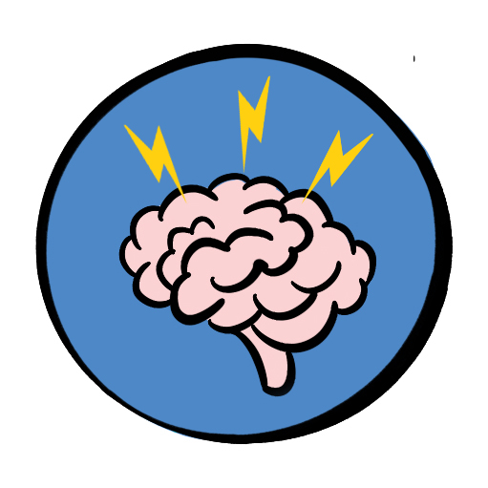
Seizures
Symptoms and treatment
Sudden loss of responsiveness
Patient becomes rigid and arches back
Breathing may be noisy and become difficult, lips may show a grey-blue tinge – cyanosis
Uncontrollable jerking and shaking, called a "fit" may lose bladder control
Most seizures terminate within a few minutes
After a seizure the patient may feel tired and fall into a deep sleep.
Notes:
Trainers notes:
A seizure – or convulsion or fit – consists of involuntary contractions of many of the muscles in the body, due to a disturbance in the electrical activity of the brain. The most common cause of seizures is epilepsy. Epilepsy is a chronic condition and patients often take medication to prevent or reduce seizures. Other causes include head injury, lack of oxygen to the brain, excess of alcohol or drugs, fever in young children.
Symptoms and signs
Sudden loss of responsiveness
Patient becomes rigid and arches back
Breathing may be noisy and become difficult, lips may show a grey-blue tinge – cyanosis
Uncontrollable jerking and shaking, called a "fit" may lose bladder control
Most seizures terminate within a few minutes
After a seizure the patient may feel tired and fall into a deep sleep.
Some people have a form of epilepsy known as absence seizures during which they appear distant and unaware of their surroundings. You may notice slight or localised twitching or jerking of lips, eyelids, head or limbs.
Treatment
Make space around patient and move bystanders out of the way.
Remove any potentially dangerous items such as hot drinks or sharp objects
Note what time fit started
Do not move patient unless they are in immediate danger
When the fit has stopped, check airway and breathing and place into recovery position.
Note how long seizure lasted.
Call for emergency help if:
There are repeated seizures or if this is first seizure
The seizure continues for more than 5 minutes
The patient is unresponsive for more than 10 minutes

Slide 58
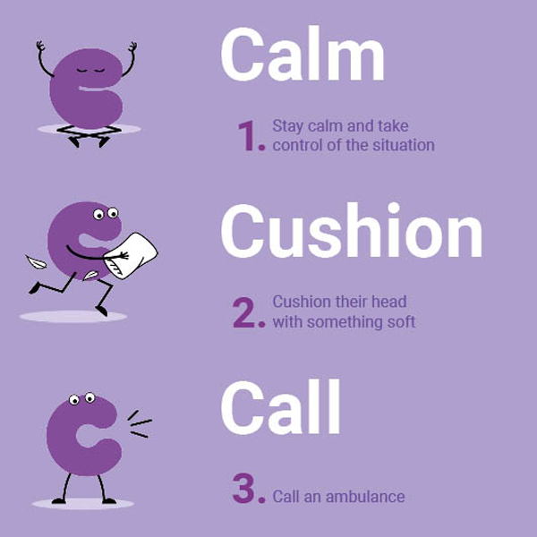
Seizures
The most common cause of seizures is epilepsy.
Epilepsy is a chronic condition, and patients often take medication to prevent or reduce seizures.
Other causes of seizures include head injury, lack of oxygen to the brain, excess of alcohol or drugs, fever in young children.
Notes:
Trainers notes:
Epilepsy Society 3 c’s ca- The charity’s new campaign gives people three simple but key instructions to remember in an emergency: “Calm, Cushion, Call” Campaign

Slide 59
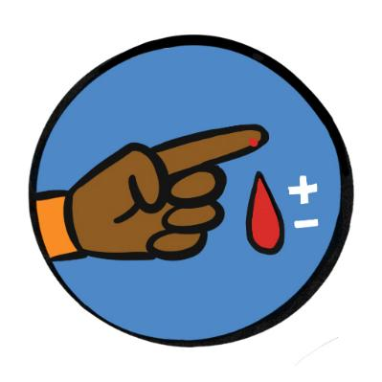
Hypoglycaemia (low blood sugar)
Signs and symptoms
Weakness, fainting, hunger
Confusion, being irrational
Sweaty with clammy skin
Rapid pulse
Decreasing level of responsiveness
History of diabetes or evidence of medical warning device
Notes:
Trainers notes:
Diabetes is a chronic (long-term) condition in which the body fails to produce sufficient insulin, which is a hormone that controls blood sugar level. This can result in higher than normal blood sugar (hyperglycaemia) or lower than normal blood sugar (hypoglycaemia or hypo).
Hypoglycaemia is the emergency. If a patient with diabetes is unwell giving them sugar will rapidly restore blood sugar, and is unlikely to do harm in hyperglycaemia. The need is to act urgently rather than trying to decide.
Signs and Symptoms
A history of diabetes – some people may recognise a “Hypo” coming
Weakness, fainting, hunger
Confusion, being irrational
Sweaty with clammy skin
Rapid pulse
Decreasing level of responsiveness
Evidence of medical warning device – or carrying glucose gel or sweets
Treatment
Give sugar.
Patient may have their own emergency supplies (think about a adjustment plan). Give glucose or dextrose tablets (15-20 g) by mouth if the person is awake and able to swallow.
If not give 50-100ml of fruit juice or a sugar containing drink, 3 jelly babies, 3 sugar lumps
If the casualty feels better –help them to check their own blood sugar
Call 999 if the person is/or becomes unresponsive, or the condition does not improve.
Following recovery from symptoms (5-10 min after sugar intake), encourage the person to eat a light snack.
In an unresponsive person, do not give oral sugar in any; instead, call 999 and consider the recovery position

Slide 60
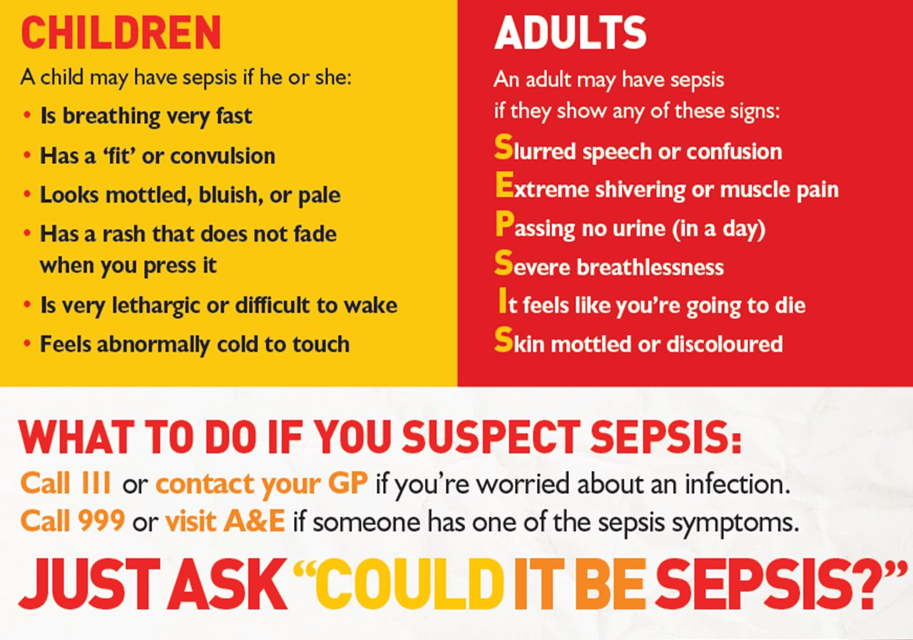
Sepsis
Notes:
Trainers notes:
Sepsis (also known as blood poisoning) is the immune system’s overreaction to an infection or injury. Normally our immune system fights infection – but sometimes, for reasons we don’t yet understand, it attacks our body’s own organs and tissues. If not treated immediately.
Although it is not a common condition, you should also be aware of meningitis. Meningitis is an infection of the protective membranes that surround the brain and spinal cord (meninges). It can affect anyone, but is most common in babies, young children, teenagers and young adults
Signs and symptoms (Children)
Breathing very fast
Has a ‘fit’ or convulsion
Looks mottled, bluish or pale
Has a rash that does not fade when you press it
Is very lethargic or difficult to wake
Feels abnormally cold to touch
They may not have all these symptoms.
Signs and symptoms (Adult)
Slurred speech of confusion
Extreme shivering or muscle pain
Passing no urine (in a day)
Severe breathlessness
It feels like you’re going to die
Skin mottled or discoloured
Sometimes symptoms can be vague and can be like other conditions, including flu or chest infection.
Image: The Sepsis Trust

Slide 61
Q&A
Notes:
Allow time for any questions on the topics covered
Trainers notes:
Ask participants if they think we met the session outcomes and for them to feedback what in particular they have learnt today or will take away from this section of the course.

Slide 62
Break time
Notes:
If delivering a full 6-hour course, please take a break here.

Slide 63
Session 4
    Environmental emergencies
Drowning
Prevention of hypothermia
Heat stroke
Snake bite
Tick removal
Notes:
Trainers notes:
Introduce the environmental emergencies session and inform the participants of the syllabus areas you will cover.
This session covers the following topics:
Drowning
Prevention of hypothermia
Heat stroke
Snake bite
Tick removal
Objectives:
The participant will learn how to deal with the following environmental emergencies:
Drowning
Hypothermia and its prevention
Heat stroke
Snake bite
Tick bite and removal
Outcomes:
The participant will be able to recognise the signs and symptoms of the following environmental emergencies, and undertake the required action in each case:
Drowning
Hypothermia
Heat stroke
Snake bite
Tick bite
With a focus on the the environmental emergencies syllabus areas. Ask the participants what first aid scenarios they would currently feel confident dealing with.
It is important to acknowledge that some may be attending first aid training for the first time, and others may be refreshing their knowledge and understanding.
For those who have attended first aid training before - Ask how the training they had been on before prepared them for an environmental incident.

Slide 64
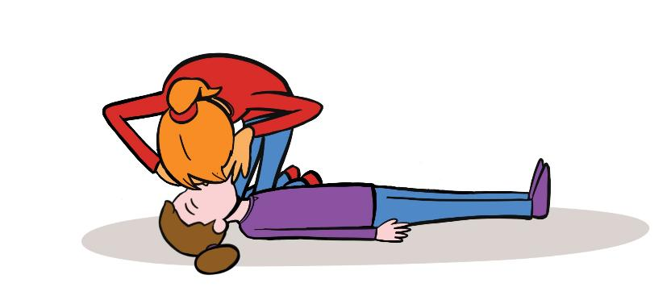
Drowning
Call for help: 999
If you are not trained in water rescue, do not enter the water
If unresponsive but breathing normally:
Place in the recovery position
Continue to monitor breathing
If unresponsive and not breathing normally:
Give 5 initial rescue breaths
Then begin CPR (30 compressions : 2 breaths)
Notes:
Trainers notes:
Call for help: (lifeguard) and 999
If the person is awake and responsive, stay on land and reach out to the person through flotation devices, a lifebuoy, a rescue tube or other rescue equipment.
Treatment
Once on land or a rescue boat, check if the person is unresponsive and not breathing.
If so, immediately give five rescue breaths, then begin standard CPR.
If an AED is available, dry the chest quickly and follow the device prompts to apply and use it.
Continue CPR and AED use until the person shows signs of life or emergency assistance help arrives, and they take over.

Slide 65
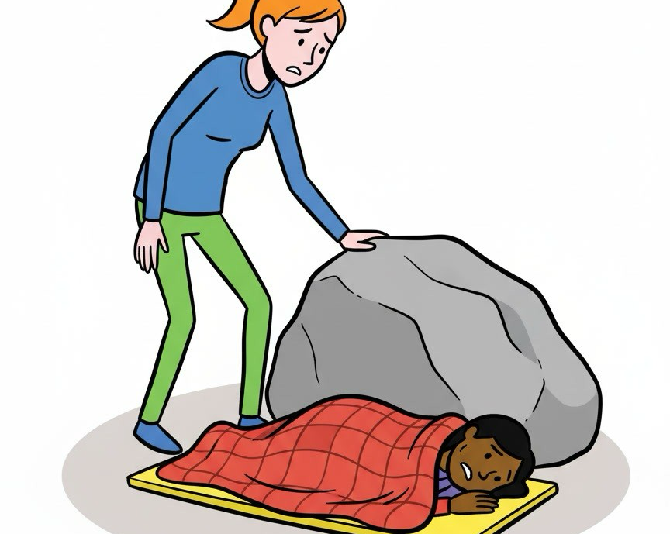
Prevention of hypothermia
What are the common symptoms of hypothermia?
Treatment
Insulation
Wind protection
Wet clothing removal
Ground isolation
Notes:
Trainers notes:
If hypothermia is likely to occur (eg. winter camp) implement tailored prevention plan and consider additional training in Outdoor First Aid.
Ask: What are the common symptoms?
Shivering
Cold, pale skin
Slurred speech
Clumsiness
Confusion or unusual behaviour
Drowsiness
Slow breathing or pulse
Unresponsive (severe)
Treatment and positioning
Insulation: Cover the person with blankets or clothing to minimise heat loss
Wind protection: shield from wind
Wet clothing removal: Gently remove wet clothing and replace with dry garments
Ground isolation: Place insulating materials (eg. blankets) between the individual and cold ground to prevent direct contact
An individual suffering from hypothermia may not be an isolated case, and you should check and treat the rest of the group

Slide 66
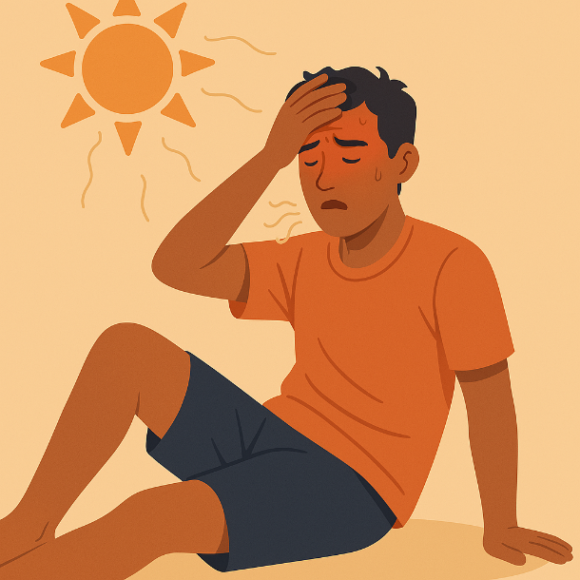
Heat stroke
Symptoms
Hot skin that's not sweating and might look red (this can be harder to see on brown and black skin)
Fast breathing or shortness of breath
Confusion and lack of coordination
Seizure
Loss of consciousness
Notes:
Trainers notes:
Heatstroke is a condition caused by the body overheating. This usually happens because of exposure to high temperatures or physical activity in high temperatures for too long. There are a few stages of heat injury, including heat exhaustion, and heatstroke is the most serious when someone is still unwell after 30 minutes of resting in a cool place, being cooled and drinking fluids
Symptoms
Hot skin that's not sweating and might look red (this can be harder to see on brown and black skin)
Fast breathing or shortness of breath
Confusion and lack of coordination
Seizure
Loss of consciousness
Treatment and positioning
Call 999
Move them to a cool place.
Remove all unnecessary clothing like a jacket or socks.
Get them to drink a sports or rehydration drink, or cool water.
Cool their skin – spray or sponge them with cool water and fan them. Cold packs, wrapped in a cloth and put under the armpits or on the neck are good too.
Put the person in the recovery position if they lose consciousness while you're waiting for help.

Slide 67
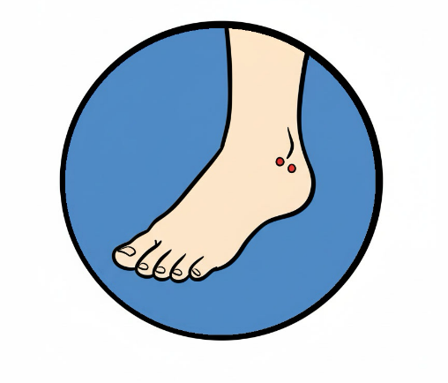
Snake bite
Treatment
Call 999 or attend the nearest emergency department.
Keep calm and at rest
Keep the bitten body part still and immobilise the affected limb, as this may slow the spread of venom.
Remove tight clothes, rings or watches from the affected limb
Notes:
Trainers notes:
The only indigenous, highly venomous snake in the UK is the Adder (also
known as the European Viper), which has a haemolytic toxic venom.
Treatment and positioning
Call 999 or attend the nearest emergency department..
Keep the person calm and at rest.
Keep the bitten body part still and immobilise the affected limb, as this may slow the spread of venom.
Remove tight clothes, rings or watches from the affected limb.
Avoid harmful actions:
Do not apply a pressure dressing, ice, heat, or use tourniquets.
Do not cut the wound and never try to suck out the venom..

Slide 68
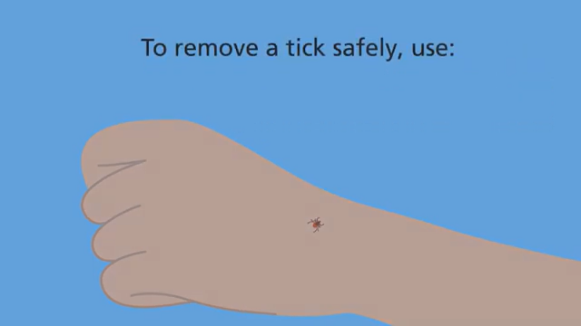
Notes:
How to remove a tick (NHS)

Slide 69
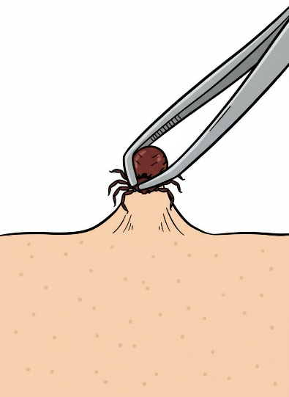
Tick removal
Lyme disease is a bacterial infection that can be spread to humans by infected ticks
To remove a tick safely:
Use fine-tipped tweezers or a tick-removal tool.
Grasp the tick as close to the skin as possible.
Slowly pull upwards, taking care not to squeeze
or crush the tick.
Clean the bite with antiseptic or soap and water.
Notes:
Trainers notes:
Ticks can transmit bacteria that cause diseases such as Lyme disease. Lyme disease can cause serious problems such as nerve damage and arthritis. Not all tick bites can lead to illness, but it is important to know how to avoid tick bites and what to do if somebody gets bitten, as prevention and early detection are crucial.
Ticks are often found in dense vegetation or long grass, and climb onto people as they brush past them. They bite to attach to the skin and start to feed on the blood..
People don’t always know they’ve been bitten so it is important to check thoroughly. Look over clothes or body for any ticks to brush off. Ticks prefer warm moist places such as groin area, waist, arm pits, behind the knee or along the hairline. You’re looking out for anything as tiny as a freckle or speck of dirt. This will need to be handled sensitively and appropriately in a residential setting.
How to avoid tick bites
To reduce the chance of being bitten by a tick:
cover your skin while walking outdoors and tuck your trousers into your socks
use insect repellent on your clothes and skin – products containing DEET are best
stay on clear paths whenever possible
wear light-coloured clothing so ticks are easier to see and brush off
To remove a tick safely:
Use fine-tipped tweezers or a tick-removal tool. You can buy these from some pharmacies, vets and pet shops.
Grasp the tick as close to the skin as possible.
Slowly pull upwards, taking care not to squeeze or crush the tick. Dispose of it when you have removed it.
Clean the bite with antiseptic or soap and water.
The chance of getting ill is low. You do not need to do anything else unless you notice a rash or become unwell.
Symptoms of Lyme disease
A circular or oval shape rash around a tick bite can be an early symptom of Lyme disease in some people.
The rash can appear up to 3 months after being bitten by an infected tick, but usually appears within 1 to 4 weeks. It can last for several weeks.
Other symptoms include flu-like symptoms, fatigue, muscle and joint pain.
It is easily treated with a course of antibiotics in the early stages.
Lyme disease symptoms can appear even after 3 months, so it is important parents / carers are told about what symptoms they will need to look out for

Slide 70
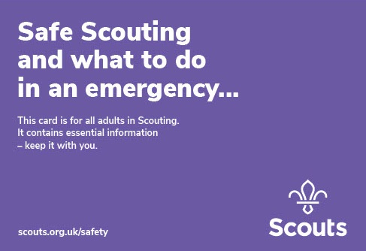
Reporting incidents
It is important that any incidents that required first aid or medical intervention be reported in some capacity.
Always refer to your Purple Card.
For critical incidents:
Deal with the immediate situation and alert the appropriate emergency services, if required.
Alert UK Headquarters as soon as you can. A Critical Incident Manager will guide you through what to do next.

Slide 71
Reporting incidents
It is important that any incidents that required first aid or medical intervention be reported in some capacity.
For any other incident:
Deal with the immediate situation and alert the appropriate emergency services, if required.
Alert your lead volunteer or their designated person.
Alert the emergency contract of those involved.
If abroad, alert any agencies required by the insurers.
For incidents involving air activities or water activities in coastal or deep-sea waters, notify the appropriate government agency.
Inform UK Headquarters at the earliest opportunity if
      Someone suffers an injury or illness requiring a doctor, nurse, paramedic, dentist or hospital visit (you might find this out after the event)
      Someone requires an emergency service rescue.
      Third party property is damaged. You will need to provide basic information such as details about the injured party, what happened, where it happened and who is reporting the incident.

Slide 72
Recording incidents
Accident books
You will need an accident book in your meeting place to record all accidents that occur to help stop common accident and safety issues.
Data Protection:
Data Protection Regulations requires you to ensure that the information in it is not accessible to others. The best solution is to have an accident book with detachable pages. This ensures that all accidents are recorded as usual but that after the incident the record is removed from the book and stored securely by the leader. In this way records are still available to the leader should they need to refer to them, but cannot be viewed by anyone who shouldn't see it.

Slide 73
Recording incidents
Near misses
Near misses are situations where there was almost an incident.
It is also important to log and track incidents which could have resulted in significant injury or impact or could have been much worse given a few minor changes to the situation.
The Scout Association have an online reporting form for near misses which allows members to share information about these incidents which can then be learned from to prevent future incidents.
Notes:
How to report incidents is in Chapter 7 of POR

Slide 74
Q&A
Notes:
Allow time for any questions on the topics covered
Trainers notes:
Ask participants if they think we met the session outcomes and for them to feedback what in particular they have learnt today or will take away from this section of the course.

Slide 75
How confident are you
about being a first aider?
1 2 3 4 5
Notes:
​
Back to the first question –
​
​
This is a good way to test what people have learnt throughout the course and their confidence levels now.
You can use the scale for a few questions – such knowledge confidence or skill confidence

Slide 76
Trainer feedback
Insert a link/QR code for your feedback here
Notes:
Use this slide to add your own QR code for your own feedback as a training team.

