Slide 1

Do more.
Be more.
Young Leaders’ Scheme
Scouts.org.uk
#SkillsForLife
Notes:
If you need to change the background please follow these intructions:
1. On your Windows tablet, tap the Design tab.
2. On your Windows phone, open the slide for editing (either by double-tapping it or by tapping it and then tapping Edit). Tap More at the bottom of your screen, tap Home, and then tap Design.
3. Tap Format Background.
4. You will see the background colours divided into Theme Colours and Standard Colours. Theme colours coordinate with the theme you selected previously. You can select a solid colour or colour gradient.

Slide 2
Explorer Scout Young Leader Training
Module B – Leading Together - Teamwork

Slide 3

Getting to know you...
Notes:
Icebreaker: 5- 10 mins
Key points:
Participants will be working together during the session so it's a good idea to break the ice and get to know each other first.
Activity option 1 - Speed dating:
Everyone walks around the room, finds someone they don’t know and talk for 1 minute
Ask questions: Who got you into Scouts? When did you join Scouts? What key skill do you bring to your Scout team? what they’d like to learn from workshop,
After two minutes, blow a whistle or shout and they find a new partner
Presenters can come up with other questions if they can think of better ones!
Or alternatively depending on amount or type of participants
Activity option 2 – Group discussion
Participants to discuss above questions (from option 1) within their table groups

Slide 4
Do more. Be more
  Welcome
In this session, we are going to look at:
Getting to know each other
What is leadership?
What type of leader are you?
Running programme activities
Do more.
Be more.
Young Leaders’ Scheme

Slide 5
Leadership

Slide 6

Do more. Be more
  What is leadership?
  The word leadership can mean different things in different contexts.
  Task: Look at the word cloud below, pick a word connected to leadership. You have 2 minutes to consider why this word is linked to good leadership. Get ready to share with the group.
Notes:
Task: Look at the word cloud below, pick a word connected to leadership. You have 2 minutes to consider why this word is linked to good leadership. Get ready to share with the group.

Slide 8
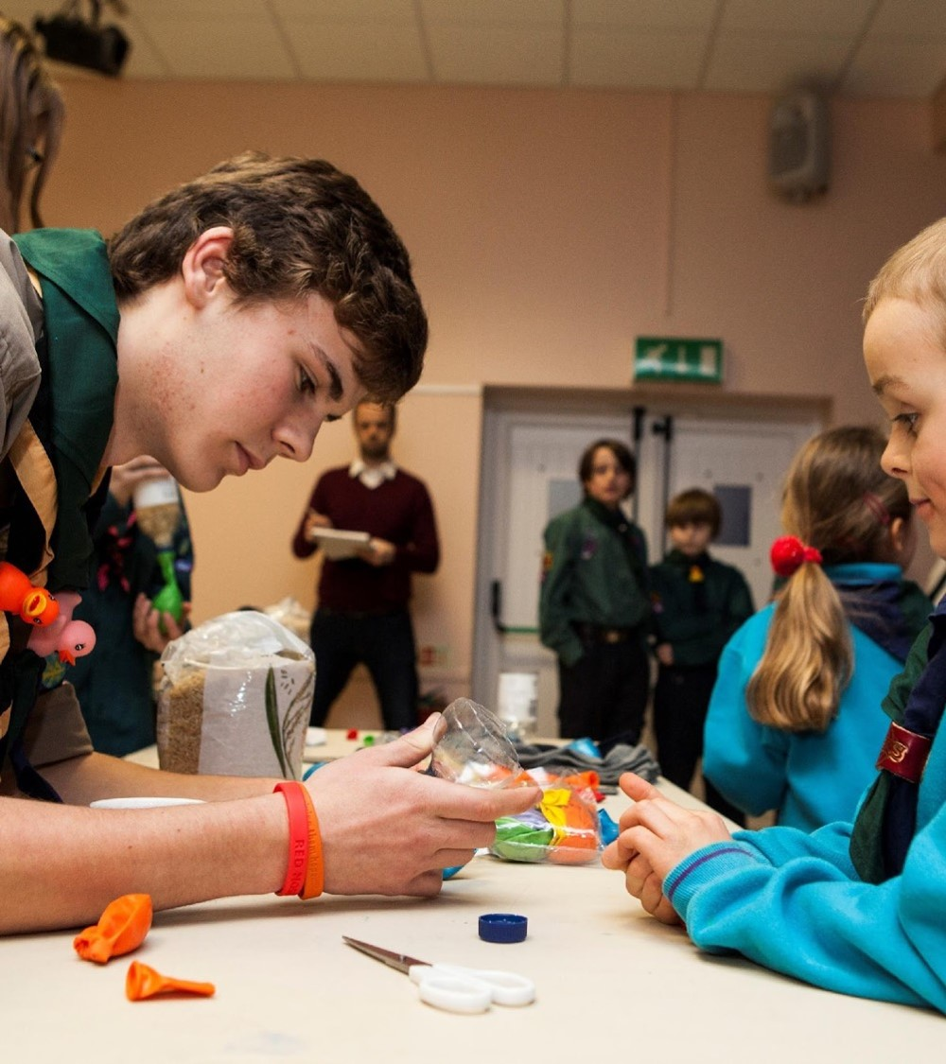
Where can we find leaders?
Teachers
Politicians
Business managers
Religious figures
Family/friends
Activists
Sports managers/coaches
Judges
Scout leaders
Youth Parliament members
Notes:
Task: Ask ‘Where have you encountered leaders?’
Examples show on the slide

Slide 9
Do more. Be more
  Leaders
  You will have come across lots of leaders in your life (e.g. Teachers, Coaches etc.). You will have an idea of what you think makes a good leader.
  In pairs try to answer the following questions:
  Can you think of 2 good leaders?
  What do they do?
  Why are they a good leader?
  What similarities does their leadership have with being a young leader?

Slide 10
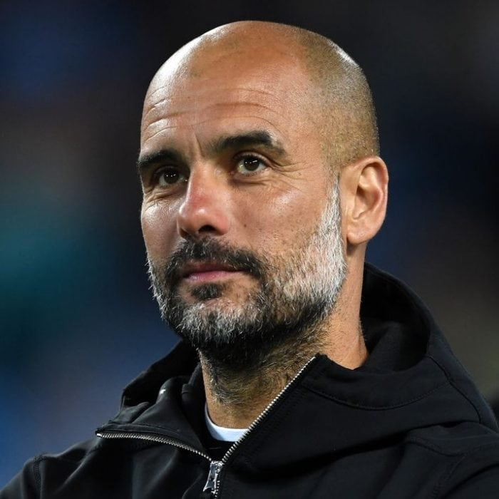
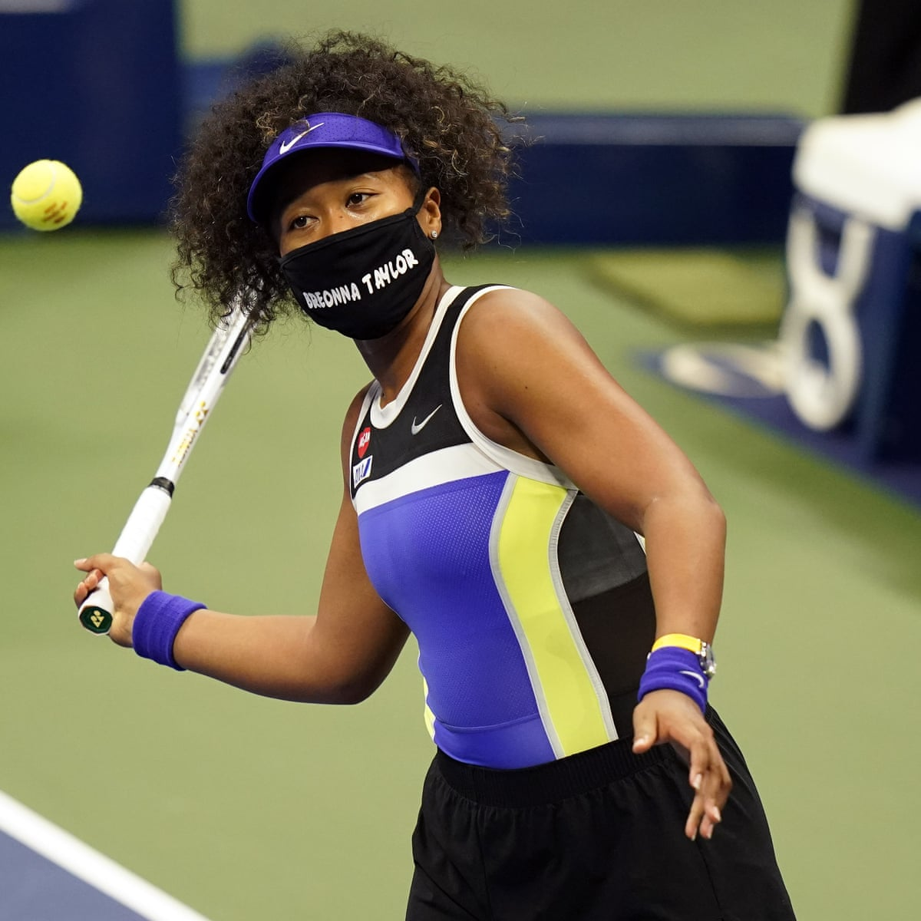
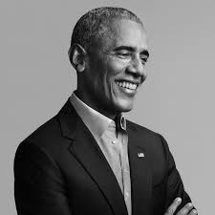
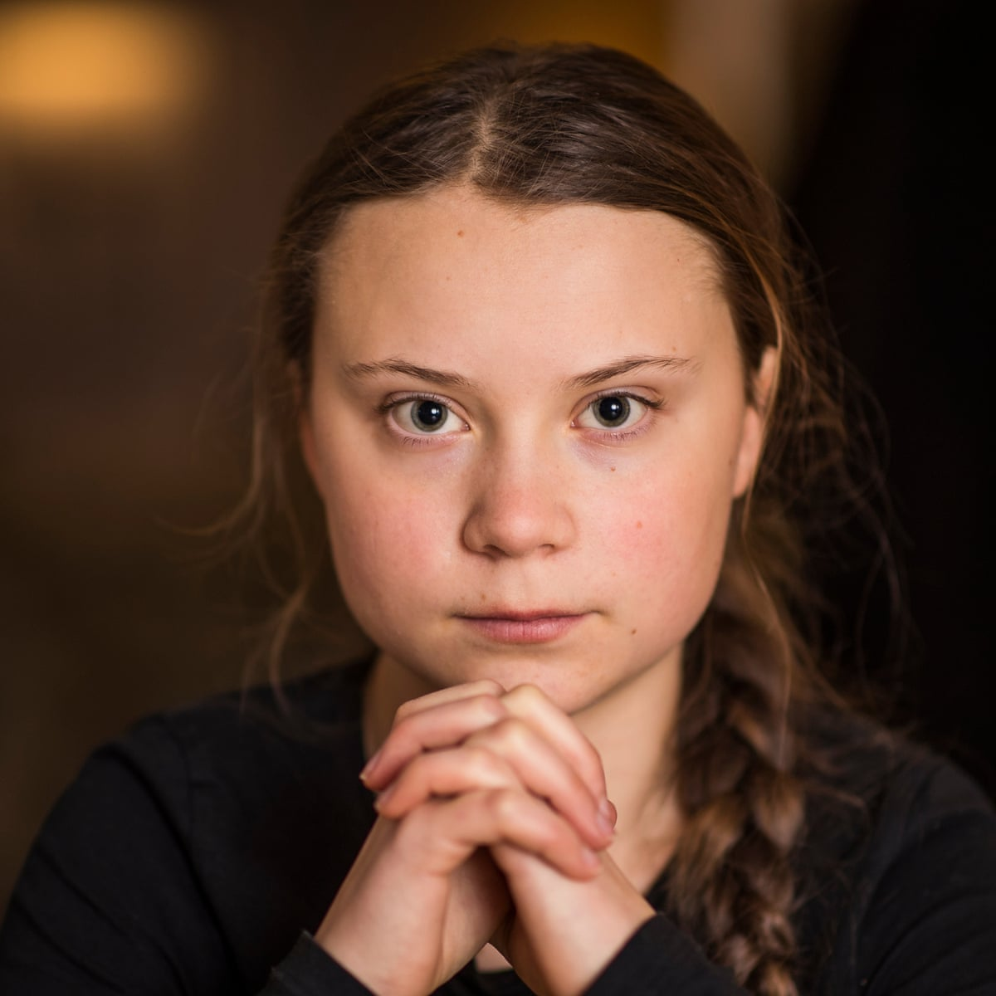
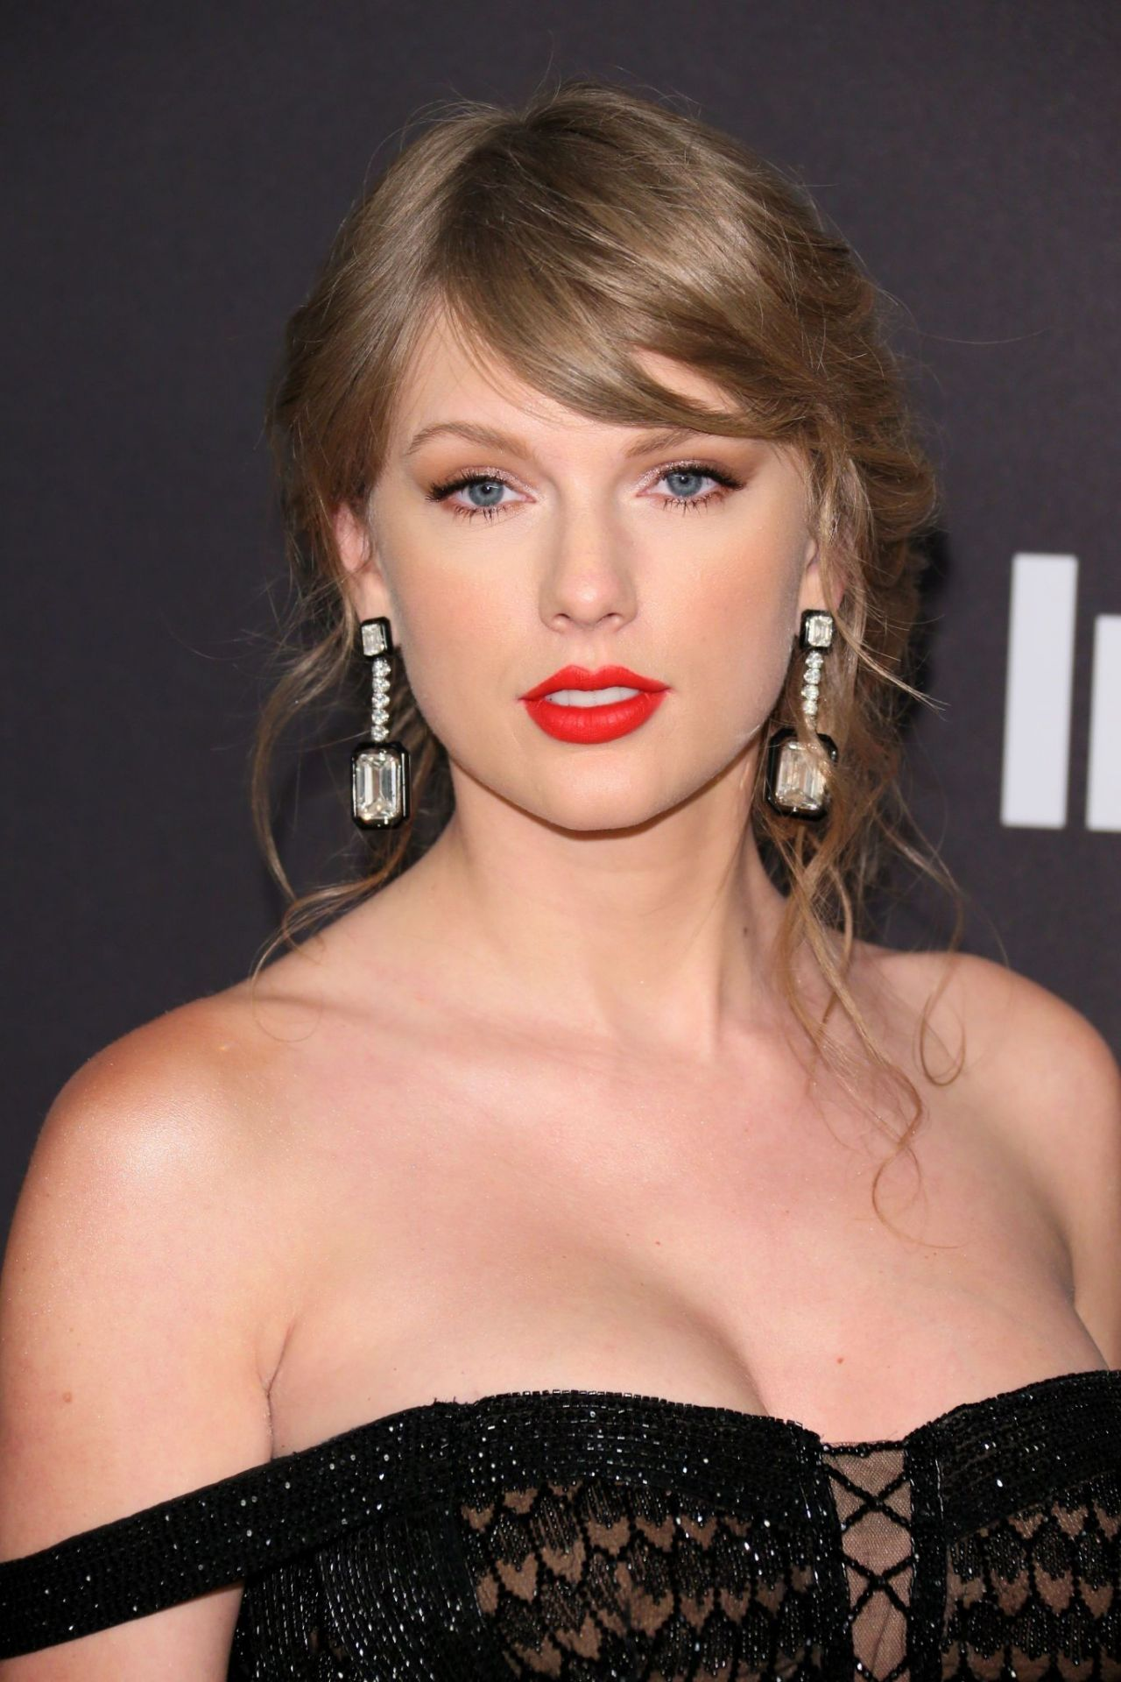
  Try to answer the following for each leader:
  Who are they?
  What do they do?
  Do you think they are a good leader? Why?
  What similarities does their leadership have with being a young leader?
Notes:
Leaders from left to right:
Pep Guardiola - Manager of Manchester City FC and formerly FC Barcelona
Naomi Osaka - Tennis player, won multiple grand slams and activist
Barak Obama – Former US president
Greta Thunberg - Environmental activist
Taylor Swift - Musician/artists, first musician to become a billionaire purely off her music/performances

Slide 11
Effective Leaders
In pairs decide which column each leadership character trait belongs in.
Effective leaders | Ineffective leaders
Generate ideas | Impose
Notes:
Character traits to use:
Generate ideas
Impose
Encourage others
Help others learn
Try to do everything themselves
Don’t listen to others
Not leaving room for flexibility
Give positive feedback
Listen
Don't learn from past experiences
Team player
Asks for help when needed
Bends rules
Learns from mistakes
Takes their time
Rushes people
Unrealistic expectations of others

Slide 12
Do more. Be more
  Leadership styles and the programme
  Task 1: Look around the room at the different leadership styles:
  Stand by your favourite
  Move to your current.
  Move to your aspirational.
  Task 2: Identify Programme activities that fit best the different leadership styles
  Task 3: Explain why you think the different activities fit different leadership styles and why

Slide 13
Do more. Be more
  Why do we work in teams?
  Effective teams working together achieve more than individuals can working alone. Scouts work in teams for lots of reasons, including:
  Collaborative problem-solving in teams leads to faster, better outcomes
  No one person can do everything well
  You learn from your team-mates
  Teams are more flexible and can adapt to change
  Teams can address more complex problems than individuals
  Teams are more than the sum of their parts

Slide 14
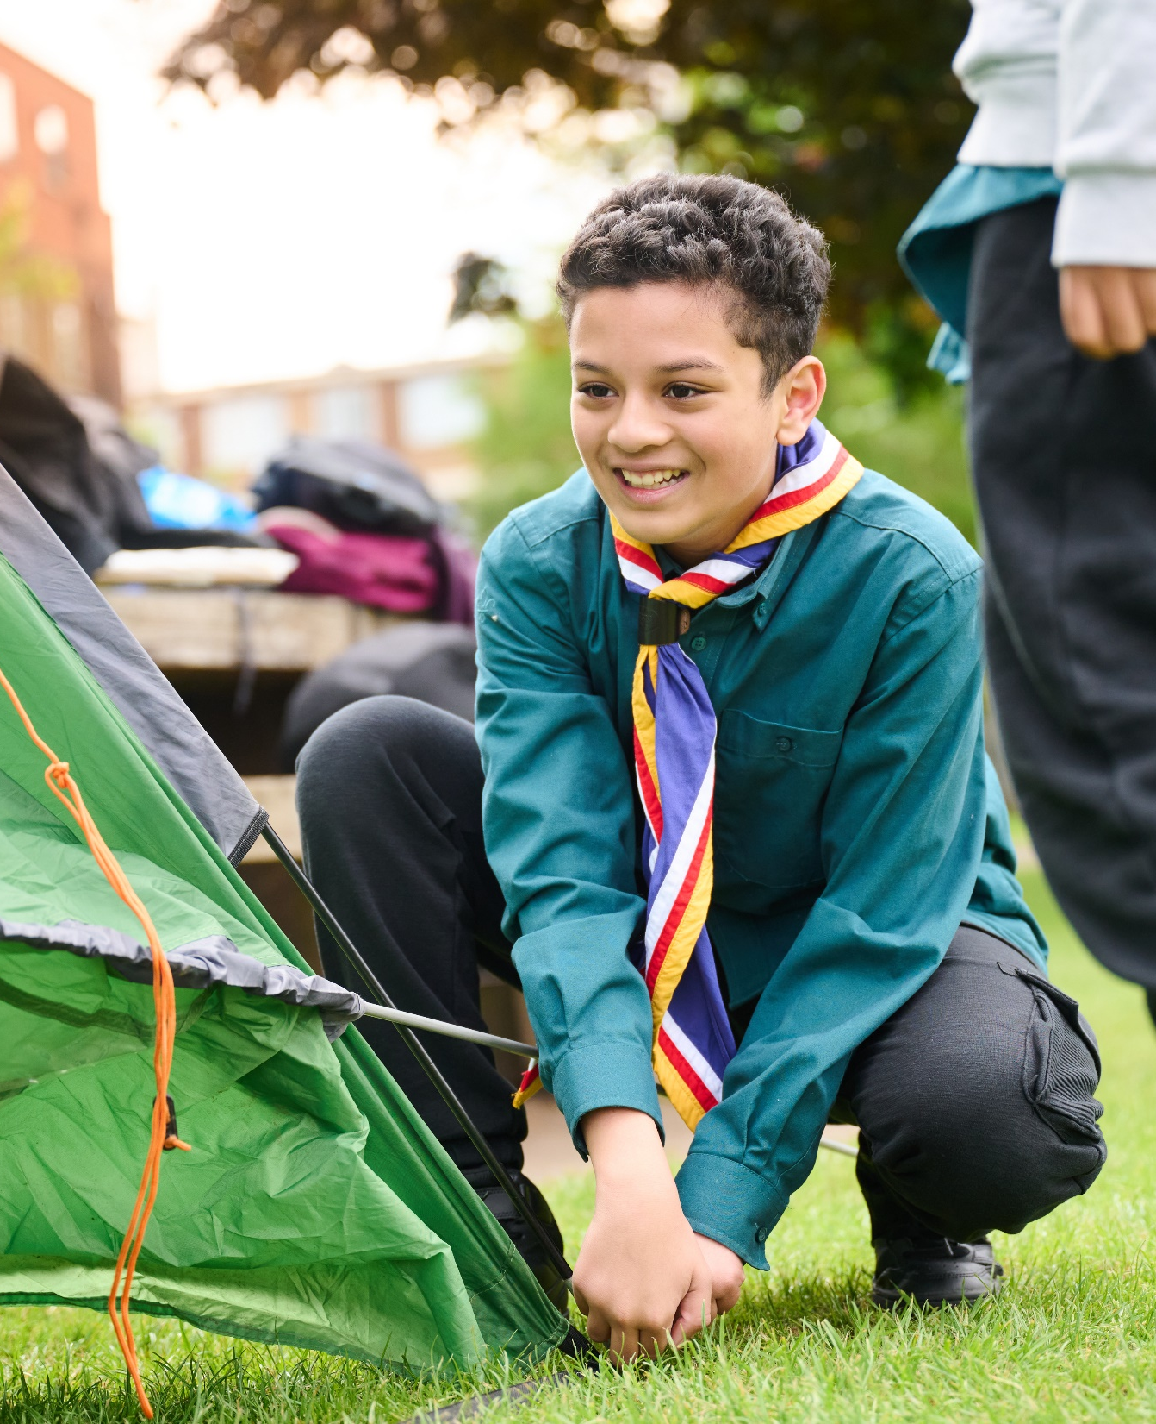
The Young Leader Scheme
Who to contact
If you have any questions, please contact the following people who will be able to help you.
Enter details of County/District contacts here

Slide 15
Thank you
Young Leaders’ Scheme
Scouts.org.uk
#SkillsForLife

