Slide 2
Notes:
Barack Obama and Bear Grylls
Barack – previous USA president
Bear – Survival instructor, adventurer, TV presenter

Slide 3
Notes:
Duchess of Cambridge – Kate Middleton
Future Queen

Slide 4
Notes:
Tim Peake
British Astronaut
Spent time in Space at the International Space Station

Slide 5
What do you think all these people have in common?
Notes:
They have all been Scouts
Barrack was a Cub Scout
Bear is Chief Scout of the world
Kate has been a leader and continues to support Scouting
Tim was a Scout and is now a Scout Ambassdor

Slide 6
Squirrels
4-5 years
Notes:
Early Years is our newest and first section in Scouting.
They enjoy all that Scouting has to offer; being introduced to outdoor activities, having the opportunity to be make new friends, explore their local community and experience the excitement of trips to activity centers with their friends
Beaver Scouts are young people aged between 6 and 8 years old.

Slide 7
Beavers
6-8 years
Notes:
Beavers are our second section in Scouting, and generally meet for an hour per week.
They enjoy all that Scouting has to offer; being introduced to outdoor activities, having the opportunity to be creative, explore their local community and experience the excitement of a Beaver Scout sleepover with their friends.
Beaver Scouts are young people aged between 6 and 8 years old.

Slide 8
Cubs
8-10 years
Notes:
For Cubs, excitement and adventure are key. Their programme offers a huge variety of activities surrounding areas of fitness, global and beliefs; whilst allowing them to be creative and get involved in their local communities. Cubs are introduced to exciting outdoor skills and take part in adventurous activities, as well as camps and residential experiences. The Cub Pack is the second section of the Scout Group following on from Beavers. Cub Scouts are young people aged between 8 and 10 ½.

Slide 9
Scouts
10-14 years
Notes:
Scouts aims to build and develop young people’s confidence, sense of adventure and outdoor skills, as well as encouraging them to explore their beliefs and attitudes and be creative. It offers them the independence to put these skills into practice at camps and even on international trips. Scouts are encouraged to work together and take the lead on all sorts of projects, from community based work to planning games and activities for their meetings. The Scout Troop is the third section in the Scout Group, above Beavers and Cubs. The Scout Section is for young people aged between 10½ and 14 years. ple with additional needs. For further information, see our guidance on age range flexibility.

Slide 10
Is Scouting just for boys?
Notes:
Its for boys and Girls

Slide 11
Notes:
Well we earn these things. Badges. We take part in lots of different activities to earn different badges and awards (for example the highest award a Scout can earn is the Chief Scout Gold award).
BUT more importantly we have fun, while learning important life skills along the way.
We have over 200 outdoor activities to choose from…
What activities to we do? Ideas?
Badges left to right – Time on the water, Teamwork, Adventure, Hikes away, Emergency aid. Personal challenge, Backwoods cooking, Astronomer

Slide 12
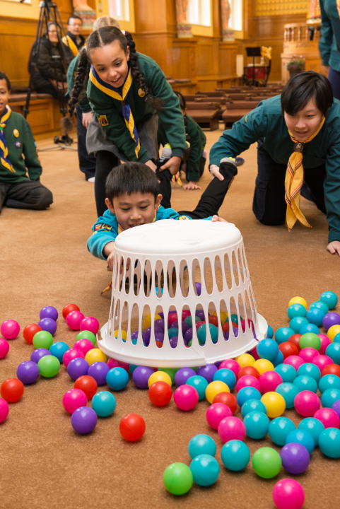
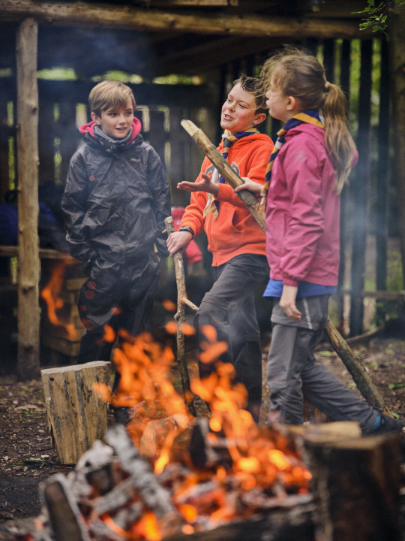
Notes:
Some of our activities that you can take part in?
Fire lighting
Hungry Hippos

Slide 13
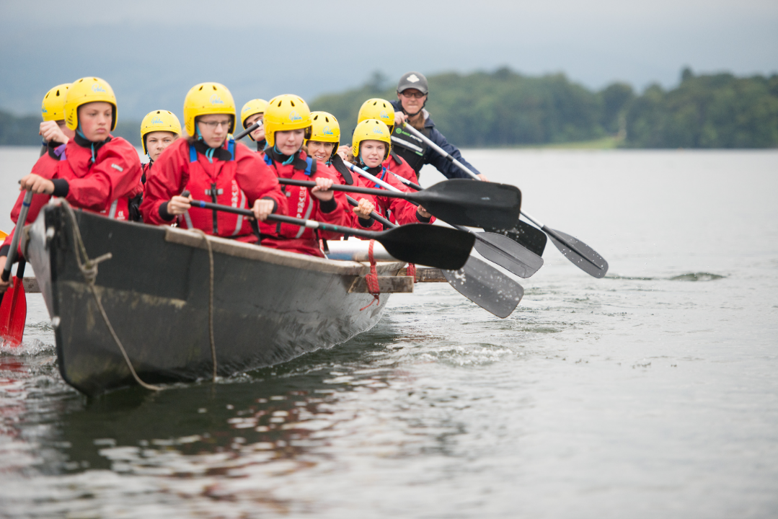
Notes:
Paddling

Slide 14
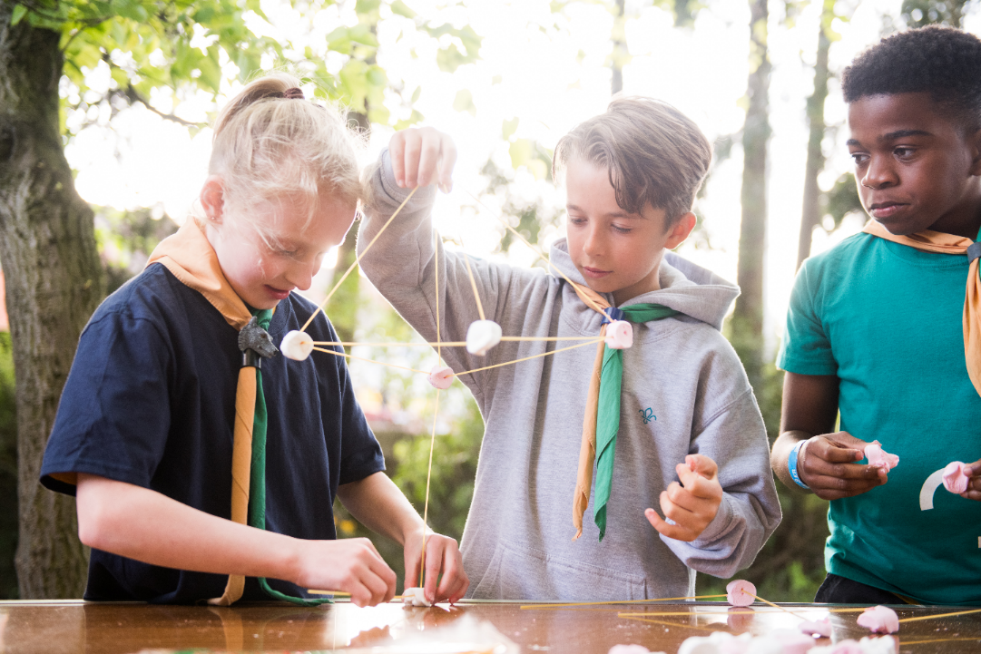
Notes:
Pioneering / Making structures

Slide 15
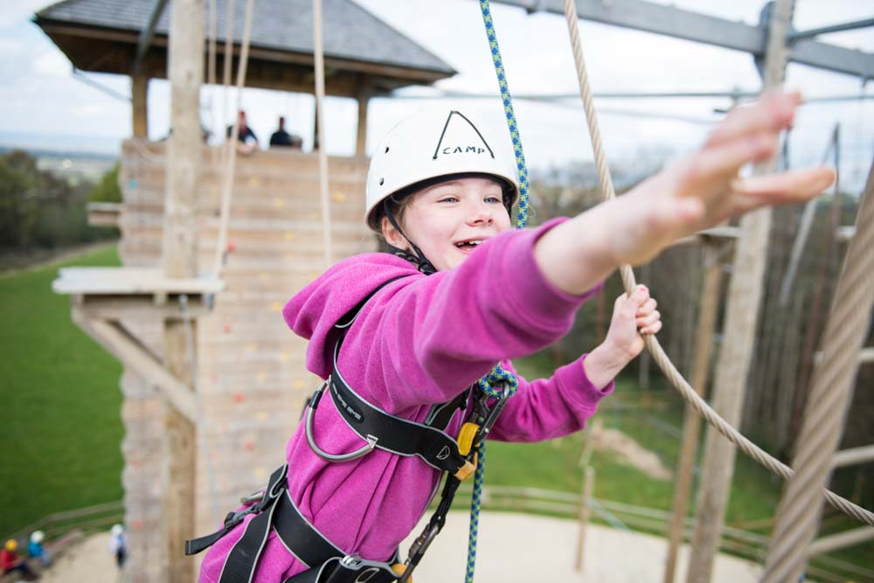
Notes:
High Ropes

Slide 16
What activities do we do?
Notes:
What activities do we do? – play video

Slide 17
What next?
Free open event
Date
Time
Venue

