Slide 1
Welcome to the
Transformation Leads call
Notes:
Craig

Slide 2
Who's on the call?
Craig Turpie, Deputy UK Chief Commissioner
Jack Caine, UK Commissioner for People
Hamish Stout, Deputy UK Commissioner for People (Transformation)
James Booker, Head of Portfolio Delivery & Change
Pete Jeffreys, Volunteer Project Lead
Helen Mitchell, Interim Communications Manager
Kirsty Waugh, Senior Change Manager
Susan Wallace, Change Manager
Notes:
Craig

Slide 3
Purpose
Timeline Update
Volunteer Framework Update
Open Forum
Transformation Lead in Action
Ongoing Support
Next Steps
Notes:
Craig

Slide 4
Timeline Update
Notes:
Craig

Slide 5
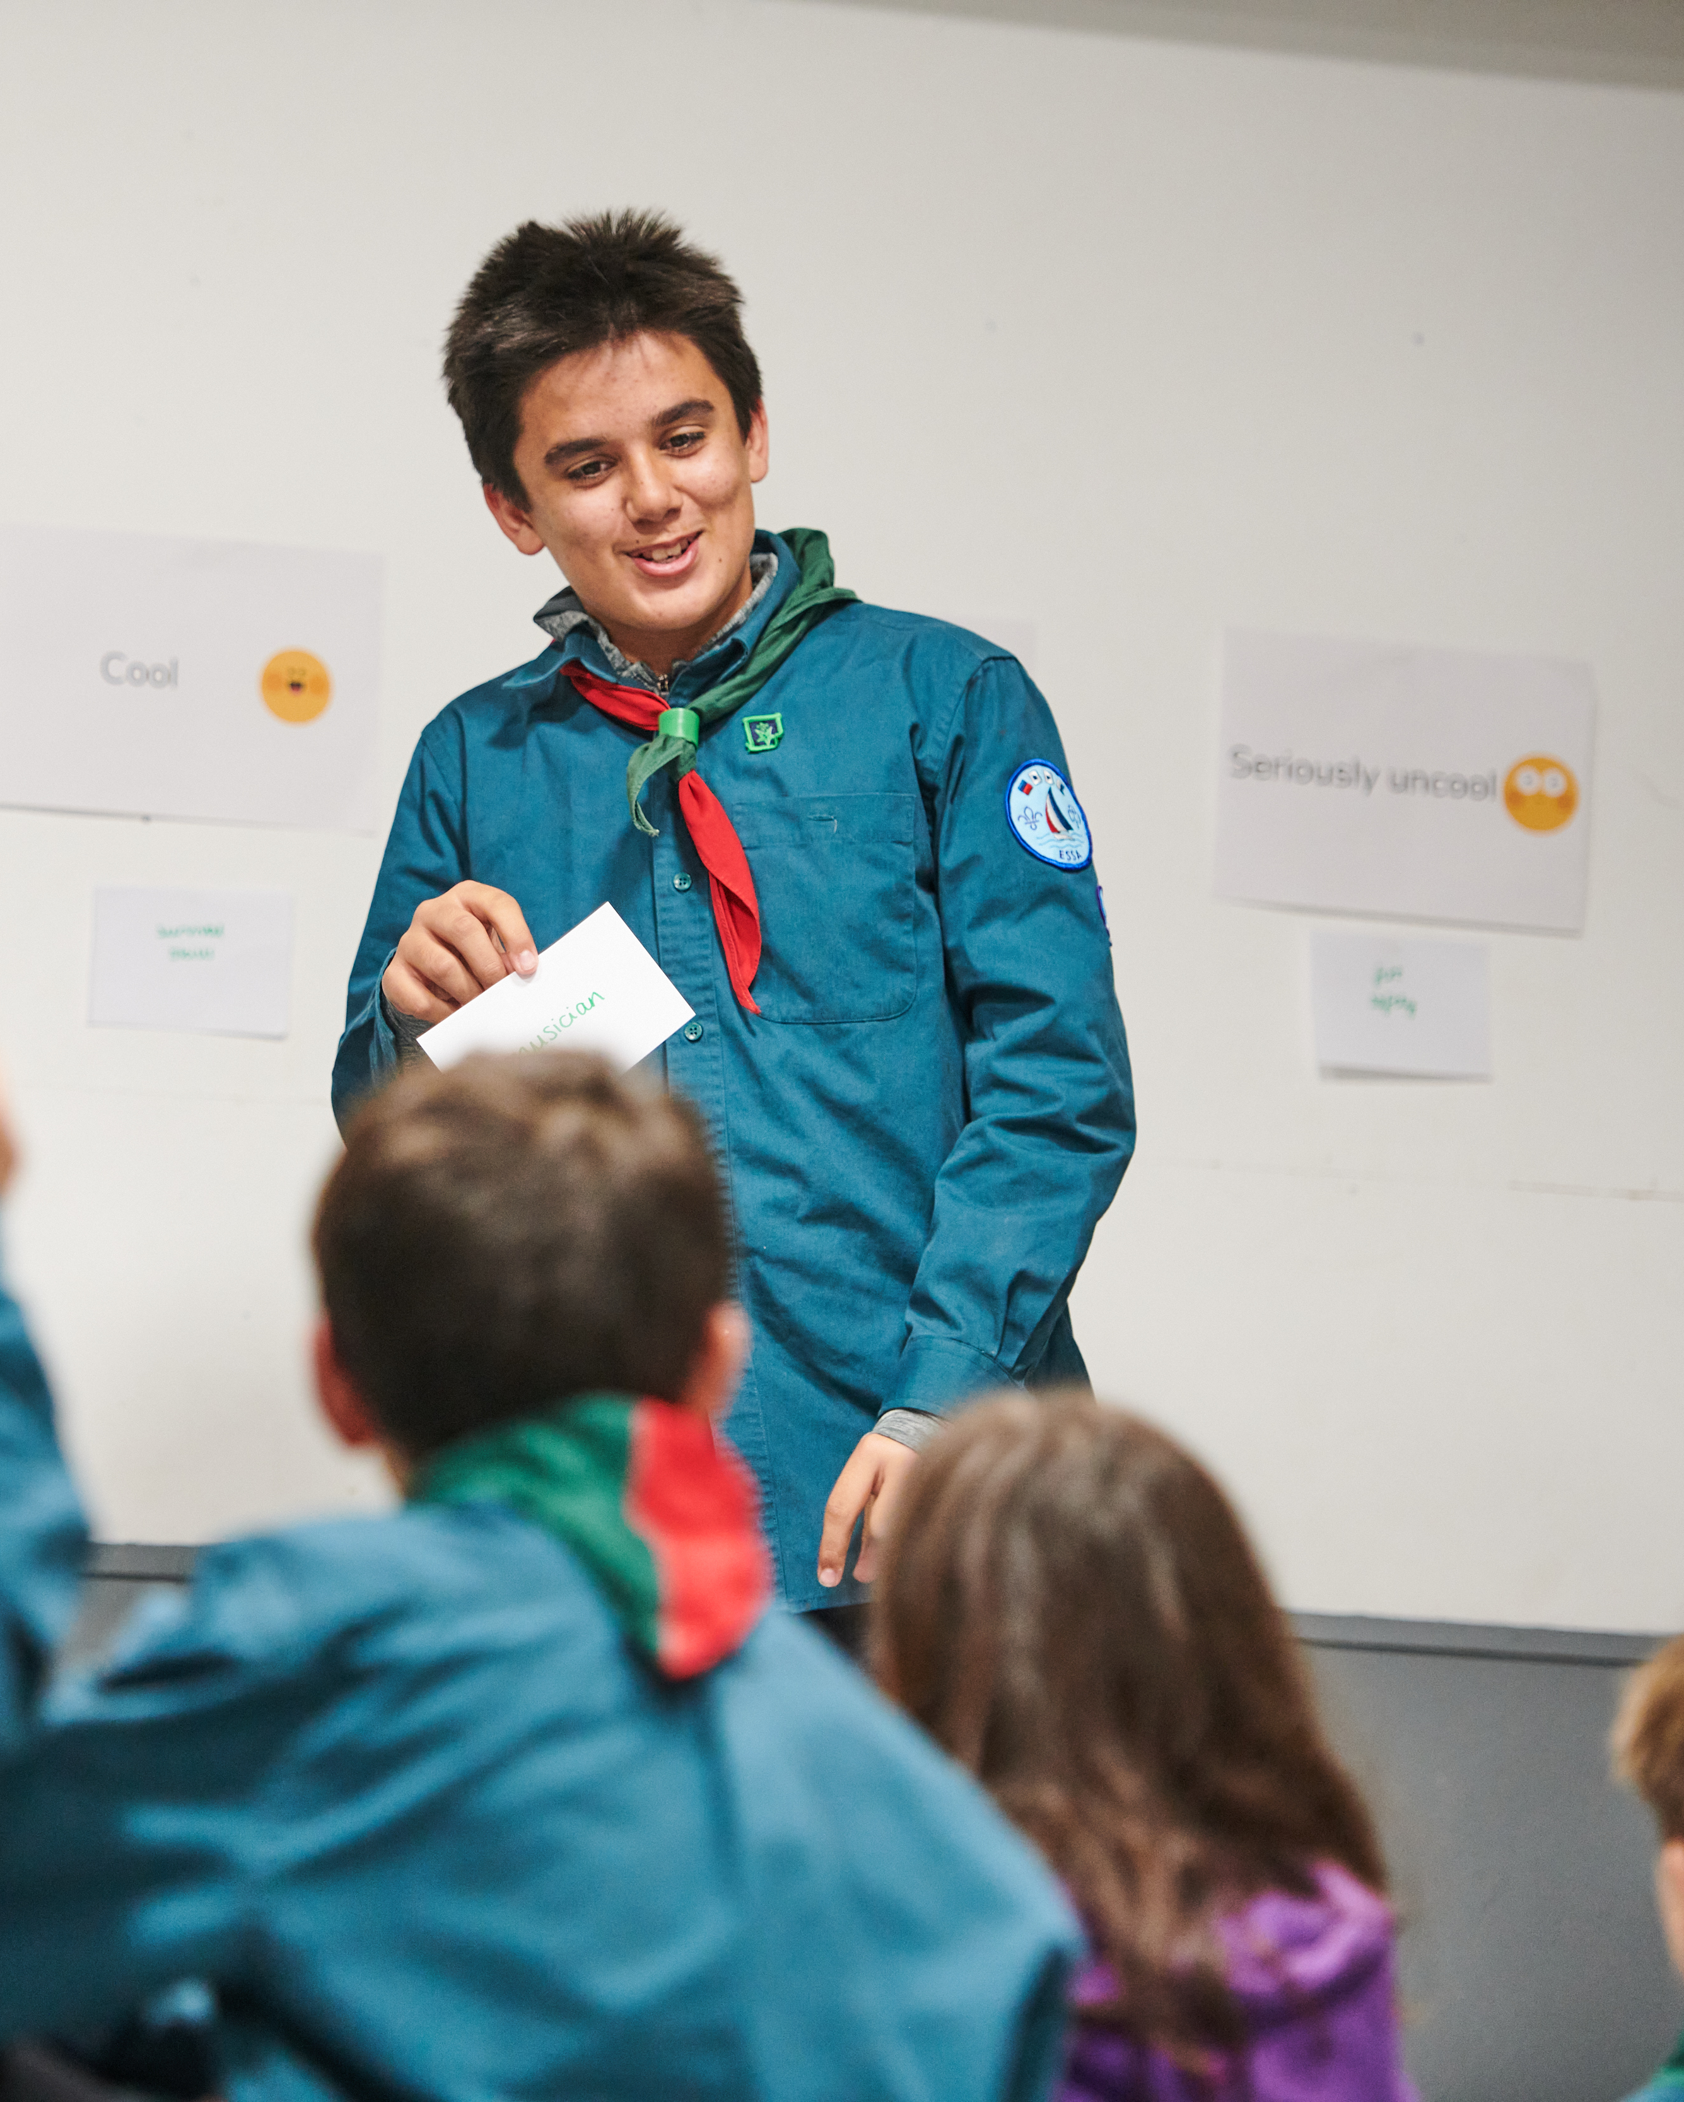
Timeline Update
Since our last call:
Decision to extend the timeline agreed by Strategy and Delivery Committee and Board of Trustees
Work is ongoing to provide a more detailed timeline breakdown
Notes:
Andrew

Slide 6
Revised Timeline Update
Build your local delivery team
Communicate out the coming changes to;
County/Area/Region Team
District Teams
Groups & Sections
Cleaning up Compass data
Continue communicating in your area
Build your local change plan
Cultural and guidance change to team roles
Changes to our welcome conversations and how we welcome new volunteers
Changes to local Trustee Boards
Sharing Our Volunteering Culture locally
Preparation for new systems
Migrate members across the new systems
Provide feedback to support future development of digital systems
SEPT - DEC 22
JAN - DEC 23
JAN – MAR 24
2022
2023
2024
NOV 23
FEB 24
Go-live of new digital systems
For Early Adopter Cohort
Go-live of new digital systems for all​​
Notes:
Word version add link in chat, FB group and email out next week

Slide 7
Revised Timeline - All Areas
Understand
Plan
& Deliver some cultural elements
Deliver
Keep going
&
May - Dec 22
Jan 23 - Jan 24
Feb 24
March 24 Onwards
Revised Timeline - Early Adopter Areas
Understand
Plan
& Deliver some cultural elements
Deliver
Keep going
&
May - Dec 22
Jan 23 - Oct 24
Nov 23 - March 24
March 24 Onwards
Notes:
Craig

Slide 8
Volunteer Framework
Notes:
Craig

Slide 9
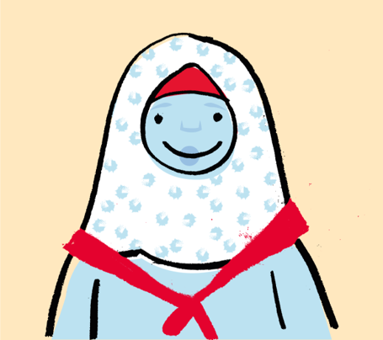
What’s Changing?
From | To
Unclear expectations of volunteers Individual, inflexible fixed roles A small number of people with lots of responsibility (and stress) Feels like work | Clearer roles Volunteers working in teams on tasks Teams have a clear and distinct purpose Individuals contributing in a way that matches their skills, interests and availability Flexible volunteering the norm
I receive regular support in a way that is safe, open, and honest. I feel respected and seen
What might new volunteers say
We don’t feel very supported by the District, and it scares me, because I quite often worry that I’m going to melt and say ‘I can’t do this anymore’
- GSL/Scout Section Leader
Notes:
Rob

Slide 10
How we talk about teams and roles
Every team has a team leader (or leaders) and team members
Role titles will change
Named roles retained where they serve a clear purpose
Notes:
Rob

Slide 11
November 2022 version
Section & Group Structure
Sections
Team Leader(s)
Team Member
Team Member
Section Team
Group
Young Leader
Team Member
Young Leader
Group Leadership Team
Trustee Board

Slide 12
November 2022 version
District & County Structure
Young Leaders
Explorers
Trustee Board
Leadership Team
14 - 24 Team
Network
Trustee Board
Leadership Team
District
County
Volunteering Development Team
Groups
Volunteering Development Team
Districts
Support Team
Programme Team
Programme Team
Support Team

Slide 13
November 2022 version
Group Teams Explained
Plan and deliver a safe programme
Make sure admin is done correctly
Communicate with others
Look after section finances
Sections
Group
Group Leadership Team
Trustee Board
Help the group’s sections to run well
Develop our volunteers and help recruit new ones
Engage with the community
Enable growth and new provision
Manage incidents
Support effective processes (e.g., admin, finance, equipment, etc.)
Look after the money
Ensure buildings and equipment are in good working order
Manage a risk register
Make sure everyone follows legal requirements
Full details are in each Team Description

Slide 14
November 2022 version
Make sure all District teams work well
Make sure all teams are inclusive and reflective of the local community
Make sure safety and safeguarding responsibilities are fulfilled
Support the District Youth Lead to make sure decisions are shaped by young people
District Teams Explained
Young Leaders
Explorers
Look after the money
Ensure buildings and equipment are in good working order
Manage a risk register
Make sure everyone follows legal requirements
Trustee Board
Leadership Team
14 - 24 Team
Network
14-24 Team, for their Sections
Support each Explorer, Young Leader and Scout Network section team
Attract and welcome new volunteers to Group and District teams
Make sure volunteers are well-supported
Make sure volunteers are recognised
District
Group Leadership Teams
Support each of their section teams
Develop our volunteers
Engage with the community
Enable growth and new provision
Manage incidents
Support effective processes
Volunteering Development Team
Groups
Help section teams run high-quality programmes
Facilitate programme networking opportunities
Provide access to specialist expertise
Manage approvals for activities and permits
Support Team
Programme Team
Engage with the local community
Grow sections and groups
Manage incidents
Manage administration, property and equipment
Full details are in each Team Description

Slide 15
November 2022 version
County Teams Explained
Trustee Board
Leadership Team
Make sure all County teams work well
Make sure all teams are inclusive and reflective of the local community
Make sure safety and safeguarding responsibilities are fulfilled
Support the County Youth Lead to support sections to be shaped by young people
Look after the money
Ensure buildings and equipment are in good working order
Manage a risk register
Make sure everyone follows legal requirements
County
Districts
For County teams and District Lead Volunteers:
Attract and welcome new volunteers
Ensure volunteers are well-supported
Ensure volunteers are recognised
Volunteering Development Team
Programme Team
Support Team
Provide events best run at scale
Lead the assessments for activity permits
Manage approval for activities and permits
Engage with the local community
Manage incidents
Manage administrative tasks
Manage property and equipment
Full details are in each Team Description

Slide 16
November 2022 version
How your patch might look
Group: 1st Anytown
Group Leadership Team
Beaver Colony
Cub Pack
Scout Troop
Group Trustee Board
Team Leader(s)
Young Leaders
Team Members
Team Leader(s)
Team Members
Young Leaders
Team Leader(s)
Team Members
Young Leaders
Chair
Treasurer
Trustee
Group Leadership Team
Group Lead Volunteer
Trustee
Group Lead Volunteer
Squirrel Drey
Team Leader(s)
Team Members
Young Leaders

Slide 17
How your patch might look
District: West Blanksville
District Leadership Team
Programme Team
Volunteering Development Team
Support Team
District Trustee Board
Team Leader(s)
Team Members
Team Leader(s)
Team Members
Team Leader(s)
Team Members
Chair
Treasurer
Trustee
District Leadership Team
District Lead Volunteer
Trustee
District Lead Volunteer
District Youth Lead

Slide 18
How your patch might look
District: Mid-Elsewhere
District Leadership Team
Programme Team
Volunteering Development Team
Support Team
District Trustee Board
Team Leader(s)
Hillwalking Sub-Team shared with two other Districts
Team Members
Team Leader(s)
Team Members
Team Leader(s)
Team Members
Chair
Treasurer
Trustee
District Leadership Team
District Lead Volunteer
Trustee
District Lead Volunteer
Sub-Team Leader(s)
Top Awards Sub-Team
Sub-Team Leader(s)
Sub-Team Members
Recognition Sub-Team
Sub-Team Leader(s)
Sub-Team Members
District Youth Lead
Sub-Team Members
Team Members
Growth Team shared with a nearby District

Slide 19
Open Forum Q&A
Notes:
Craig

Slide 20
Transformation Lead in Action
Anthony (Joker) Streets - Dorset
Notes:
Craig

Slide 21
Preparation
What did we want to get out of the day?
How best can we deliver the day?
Who can help us?
Dorset Event Team
HQ
South West Transformation Leads
Other people
Venue
Catering

Slide 22
Attendees
Group Scout Leaders & Group Chairs
District Commissioners & District Chairs
District roles approx. 5 people
County Commissioner & County Chair
County Training Team
County roles approx. 5 people
Events Team

Slide 23
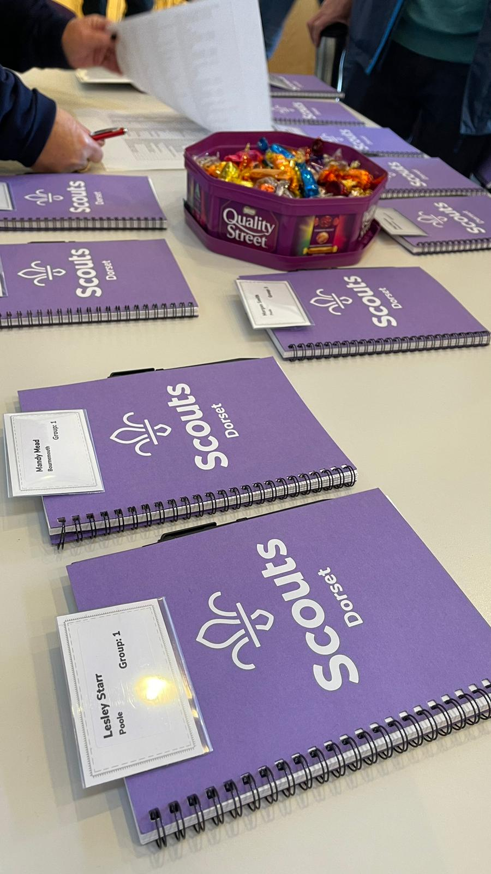
Agenda
Quiz / Skills for Life Vision – Led by Youth Commissioner
What’s Changing?
Videos
Slides
Virtual tools
Break out into groups
A Warmer Welcome
A More Engaging Learning Expereience
Positive Volunteering
Digital Experience
Interactive - Slido
Notes:
Craig

Slide 24
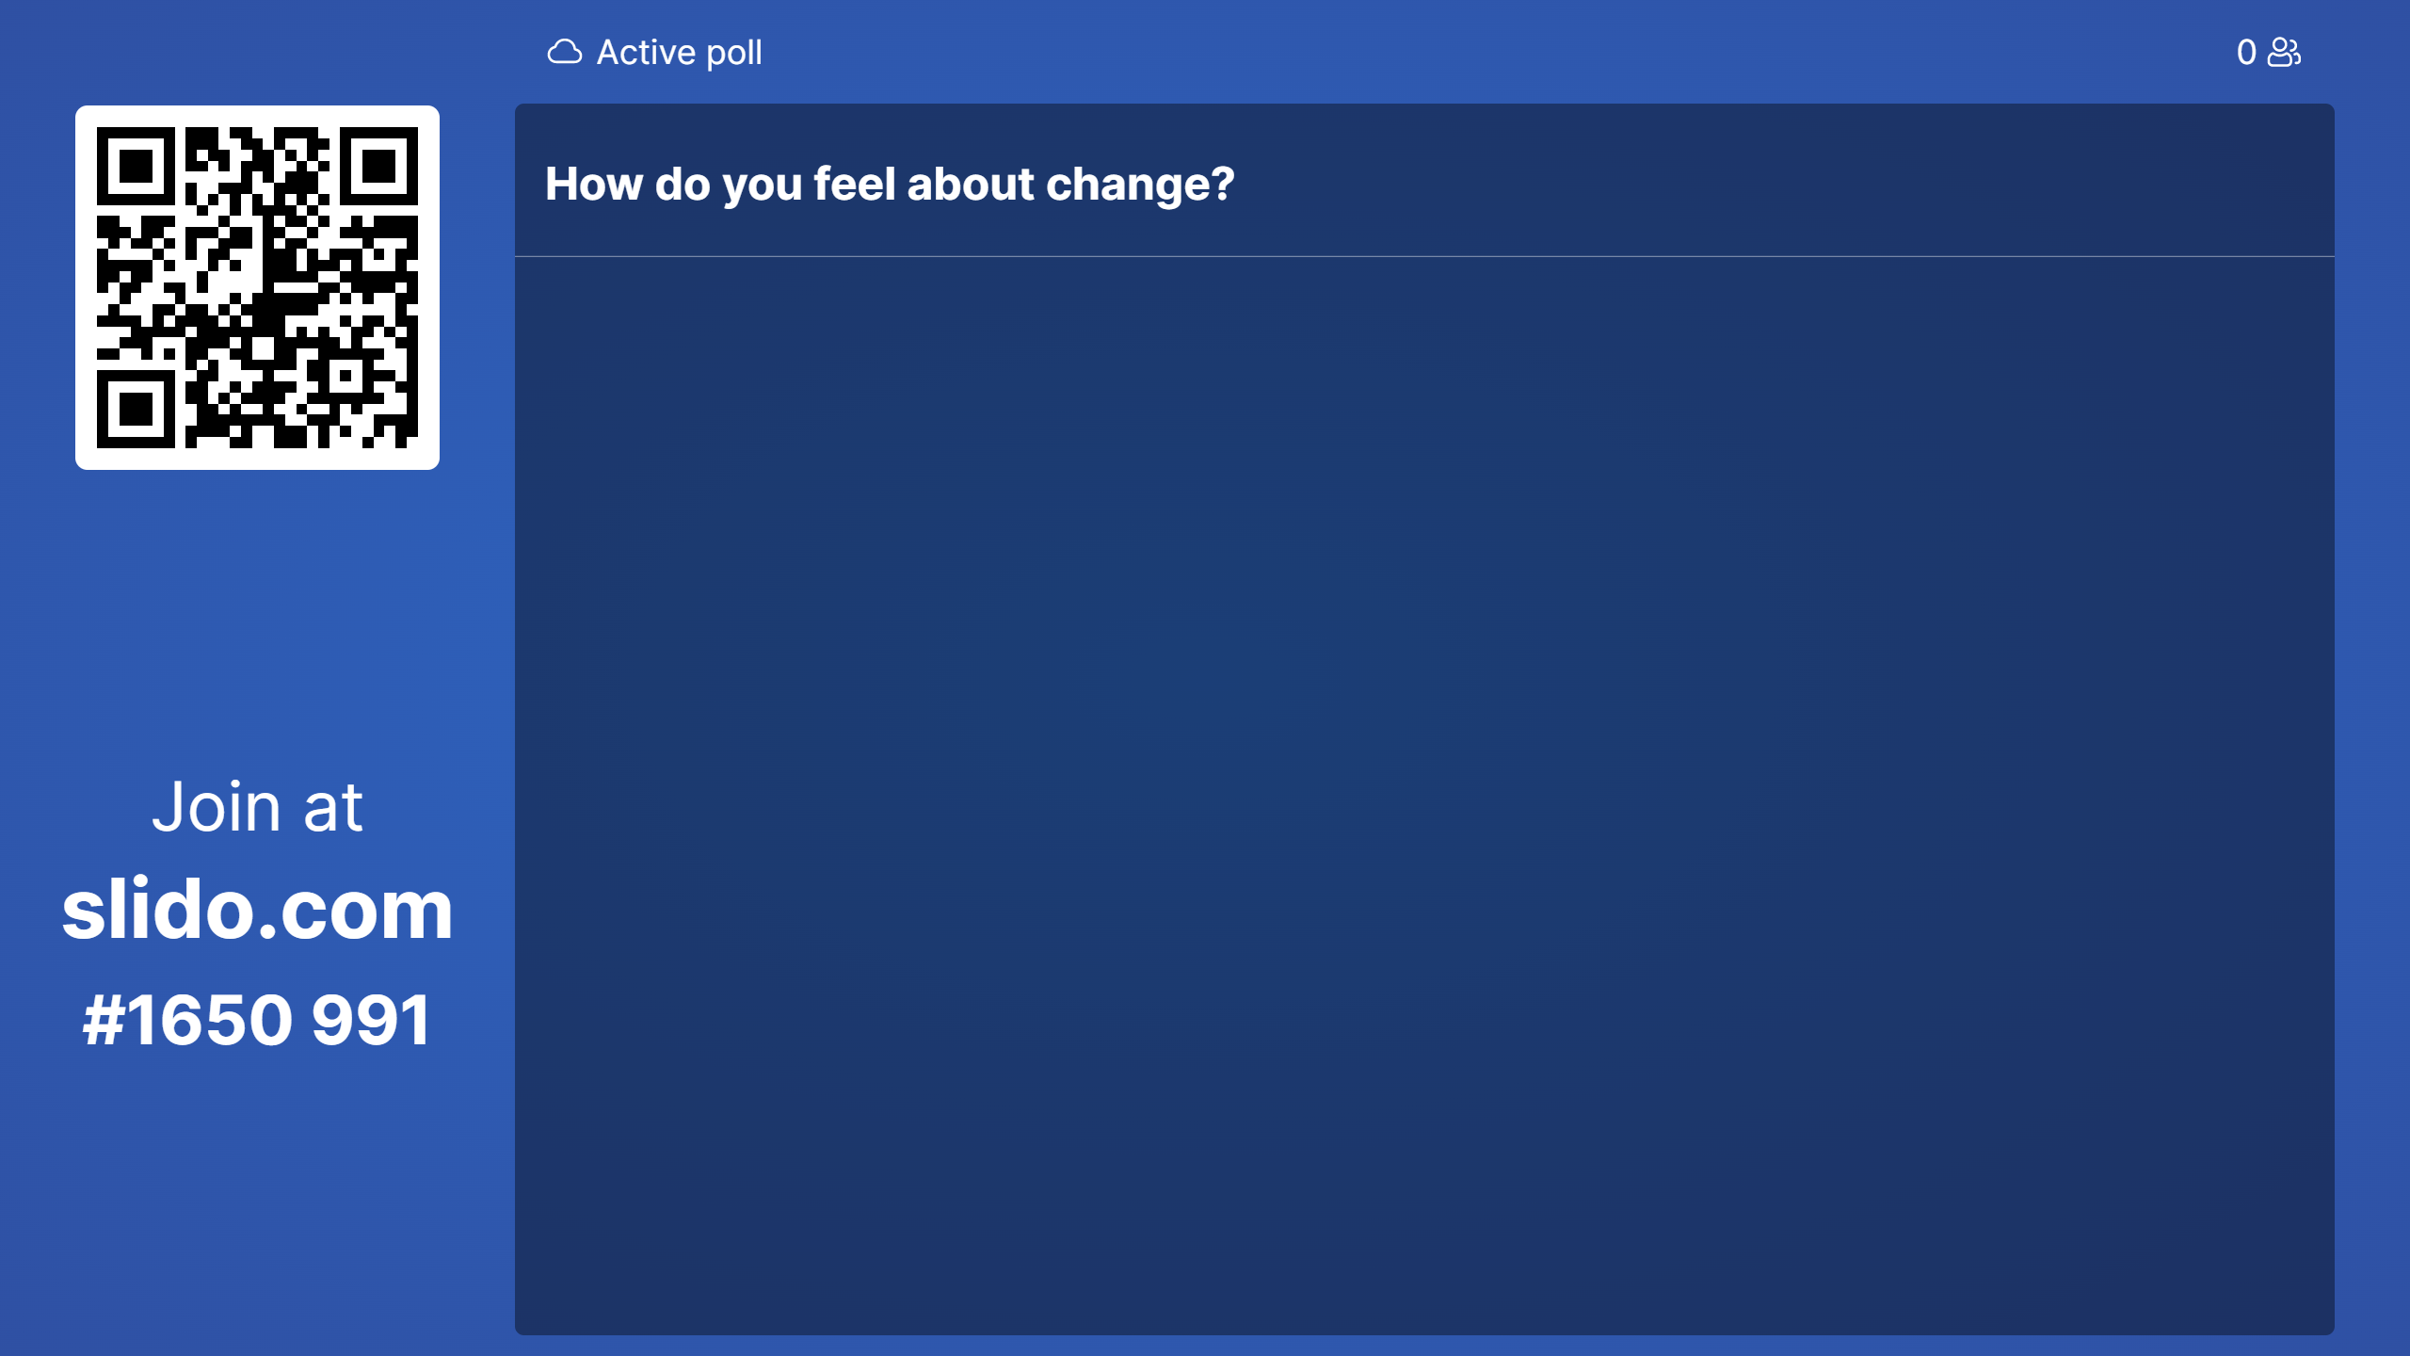
Slido
Slido.com
#1650991
Notes:
Craig

Slide 25
Agenda
What does it mean to us?
District / County time
What’s next?
How are we going to communicate
Actions now
Lessons Learnt
Time
How do we can more people there
Notes:
Craig

Slide 26
Ongoing Support
Notes:
Craig

Slide 27
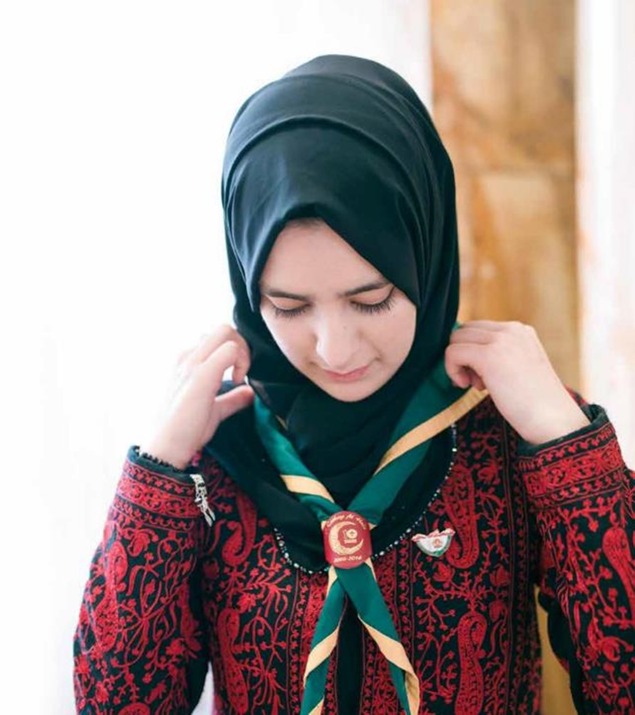
Ongoing Support
Transformation Lead Resource Hub
http://Scouts.org.uk/TransformationLeads
Email
transformationleads@scouts.org.uk
Facebook
https://www.facebook.com/groups/scoutstransformation
Event Support
Online Meetings (2nd Tuesday of every month until March)
Notes:
Susan

Slide 28
Next Steps
Use resources and tools to build understanding locally including "Is My Patch Ready for Change?"
Build local delivery teams including digital support
Ensure data is up to date in Compass
Join the Facebook group and/or use Transformation.Leads@scouts.org.uk for questions and support
Accept invites to calls Dec – March 23
https://www.facebook.com/groups/scoutstransformation
Notes:
Susan

Slide 29
Thank You

