Slide 1
Welcome to the
Transformation Leads call

Slide 2
Transformation Lead Call - December 22
Introduction
Who's on the call?
Craig Turpie, Deputy UK Chief Commissioner
Andrew Sutherland, Deputy Programme Sponsor for Volunteer Experience
Hamish Stout, Deputy UK Commissioner for People (Transformation)
Anders Wulff, Learning Design Manager
Matt Cobble, Deputy UK Commissioner for People (Operations)
Alex Harvey, Theme Lead for Volunteer Framework
James Booker, Head of Portfolio Delivery & Change
Helen Mitchell, Interim Communications Manager
Kirsty Waugh, Senior Change Manager
Susan Wallace, Change Manager
Rob Groves, Change Manager

Slide 3
Transformation Lead Call - December 22
Introduction
Purpose
Learning Update
Team Descriptions Update
Open Forum
Event Support
Transformation Lead in Action
Volunteer Role Vacancies
Next Steps

Slide 4
Learning Update

Slide 5
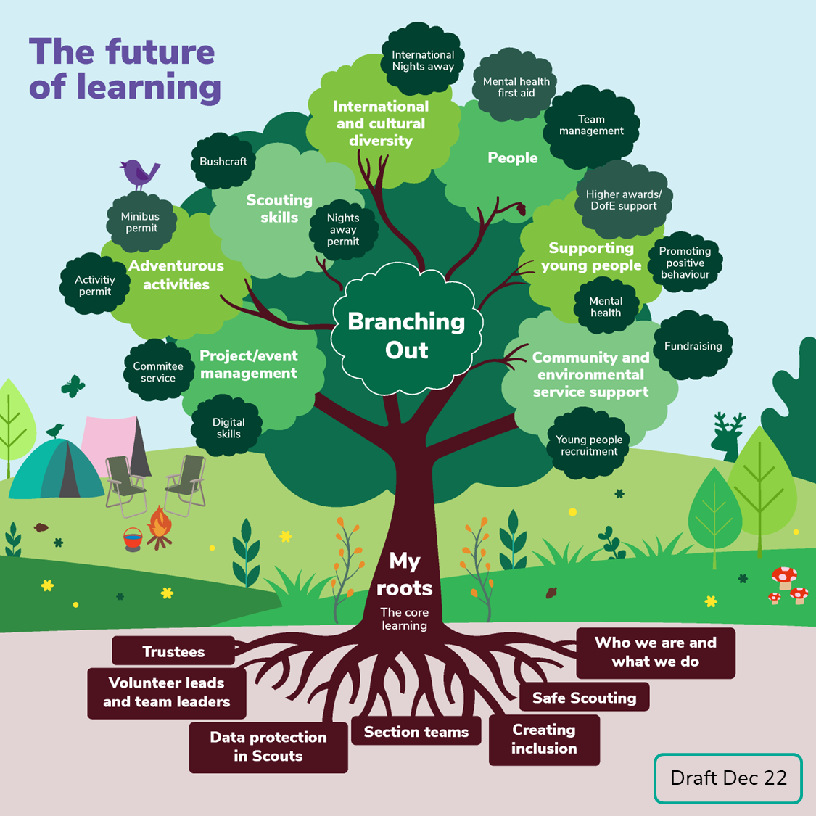
Transformation Lead Call
Engaging Learning
DRAFT
DRAFT

Slide 6
Transformation Lead Call - December 22
Engaging Learning
Roadmap for learning
We're building content
We'll tell you more about Wood Badge and future Learning
First testing of content
We're testing our ideas on the Wood Badge and future of learning
Wider testing of content
Clarity about the "Roots" and the new Wood Badge
Open testing of new content
Plans for 2024 onwards
Full launch of new "Roots"
Development and testing of "Branching Out"
α
β
β
JAN – MAR 23
APR – JUNE 23
JUL – SEPT 23
OCT – DEC 23
JAN – MAR 24
2023
2024

Slide 7
Transformation Lead Call - December 22
Engaging Learning
The things everyone needs to know to get started
Data Protection in Scouts
Data breaches & deleting data
What we do & How we do it
Purpose and values
Creating Inclusion
Self-awareness
Safe Scouting
Storing & sharing data
Working with others
Good communication
Running our programme (The basics)
Self-care
Creating inclusive spaces
Supporting specific needs
Challenging bias and discrimination
E-Safety
Assessing risk
Incidents - respond and report
Mental health basics
Child/Adult protection
Gathering data

Slide 8
Transformation Lead Call - December 22
Engaging Learning
The things you need for your type of role:
"Delivery"
Section Teams
How to work with parents/guardians
"Trustee"
Trustees
Charity regulator processes
"Manager"
Team Leaders, Lead Volunteers
Teamwork, inclusion and conflict from a management perspective
How to actively involve young people
Running our programme (In practice)
Insurance, legal responsibilities (Inc. GDPR), equality impact assessments
Finance and asset management
Suspensions, sanctions and difficult conversations
Delegation and external relationships
Potential Content*:
Potential Content*:
Potential Content*:
*Exact content is being scoped and developed during early 2023

Slide 9
Transformation Lead Call - December 22
Engaging Learning
Create
Test
Review
Start
End

Slide 10
Team Descriptions

Slide 11
Transformation Lead Call - December 22
Team Descriptions
Changing the titles of Group Scout Leader, and Commissioners
Discovery research (Snook)
Focus Groups (July 2021 & March 2022)
Testing Hub (Feb 2022)
External Research (Opinium)
Testing Hub (June 2022)
Basecamp participants (May 2022)

Slide 12
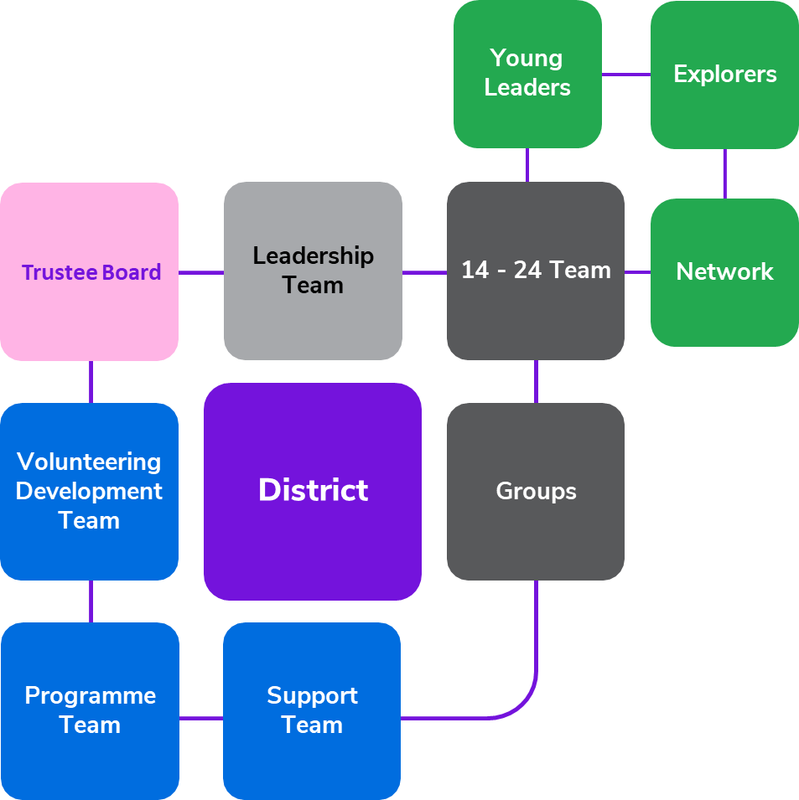
Transformation Lead Call - December 22
Team Descriptions
Team descriptions – A reminder
November 2022 version

Slide 13
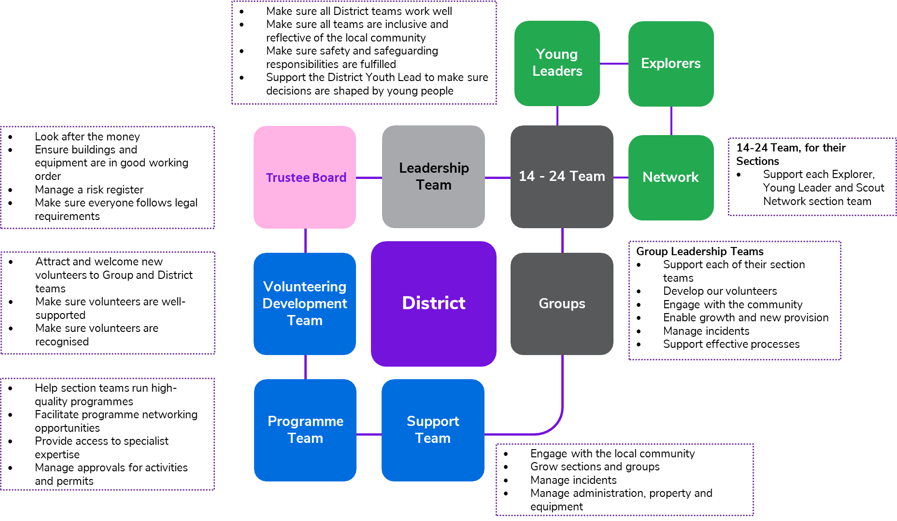
Transformation Lead Call - December 22
Team Descriptions
Team descriptions – A reminder
November 2022 version

Slide 14
Transformation Lead Call - December 22
Team Descriptions
Team descriptions
Each team description has:
Purpose to explain what the team is for and how it plays a part towards our vision
Who’s in the team to be clear about who is involved in the team and what they’re called
Tasks for the whole team are things which everyone in the team will be involved with
Allocated tasks are things which are things which can be shared out between members of the team

Slide 15
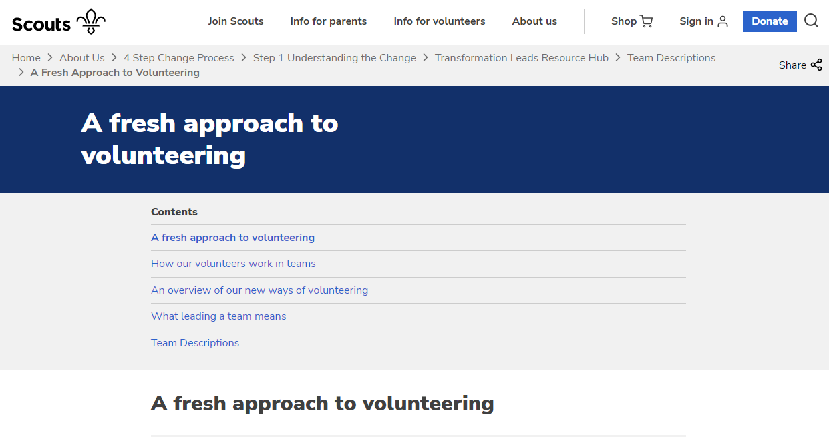
Team descriptions
December 2022 version

Slide 16
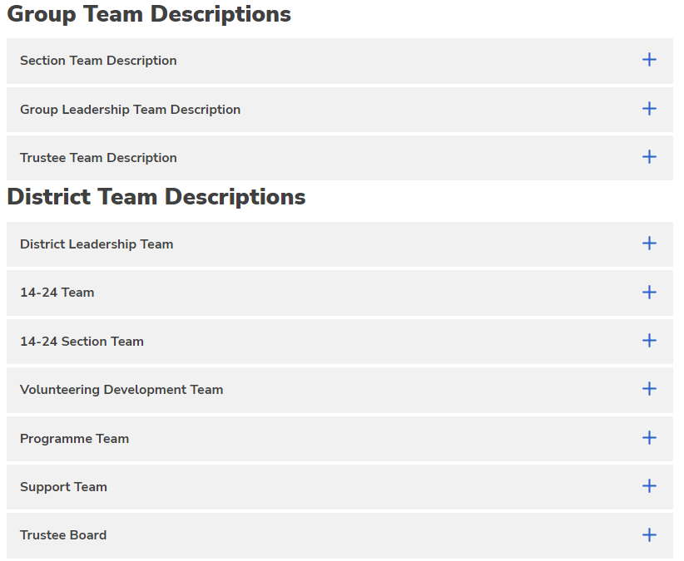
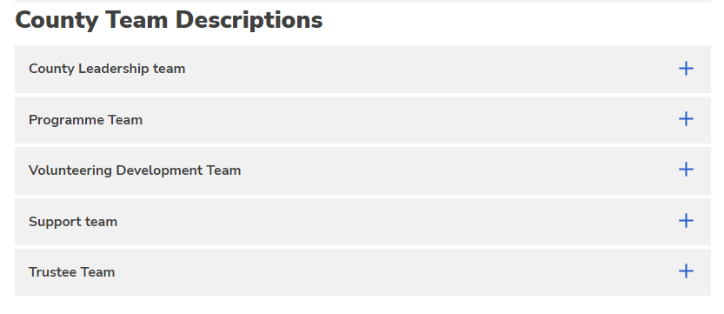
Team descriptions
December 2022 version

Slide 17
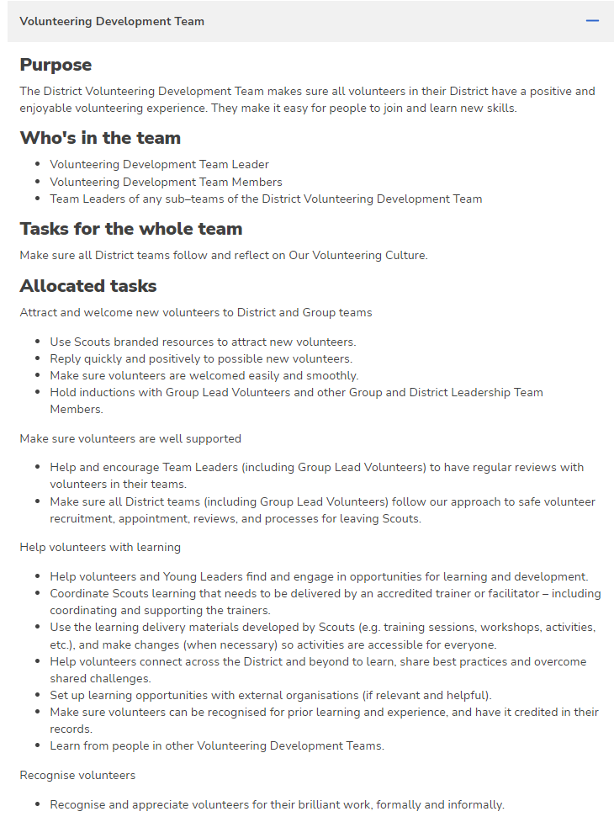
Team descriptions
December 2022 version

Slide 18
Team descriptions
What now?
We’ll share the link with you in the next few days
Work with your County, District and Group teams to understand the new teams and their team descriptions
Where that understanding raises comments, questions or feedback, please forward it to transformation.leads@scouts.org.uk
What next in 2023?
We’ll continue to iterate the team descriptions based on feedback from Transformation Leads and others. Based on your feedback the pages will improve further over the coming months
We will be giving resources to support Counties, Districts and Groups to adopt some of these new approaches ahead of the formal date of transformation

Slide 19
Open Forum Q&A

Slide 20
Event Support

Slide 21
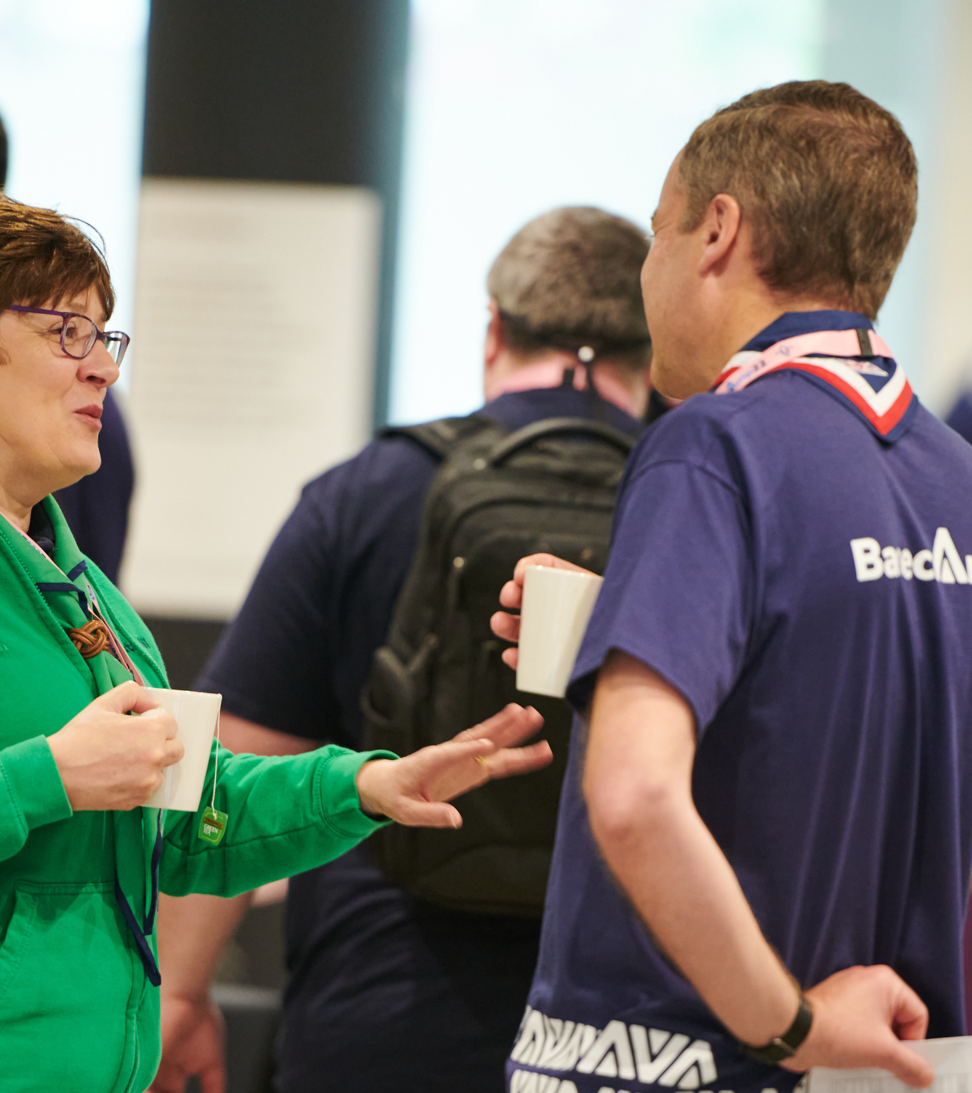
Event Support
What makes a great Transformation Event?
Relevant to your patch
Clear Objectives
Engaging and empowering people in a positive way
Support is available
Event Support

Slide 22
Transformation Lead in Action
James Hopkins

Slide 23
Why Essex Basecamp?
To kick-start the journey in Essex
Bring everyone attending up to the same level
To create a ‘buzz’
Peer-led self-help
Distinction to BAU / Demonstrate the importance

Slide 24
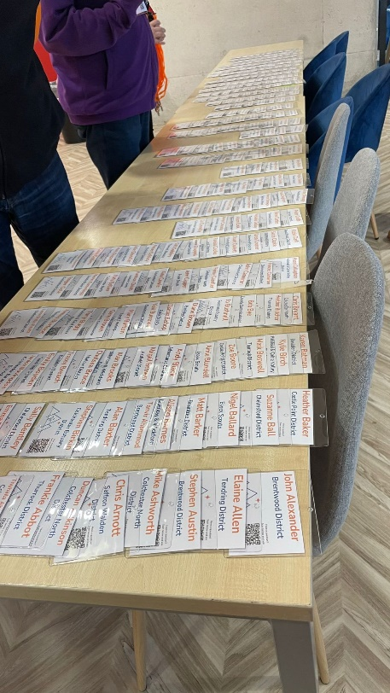
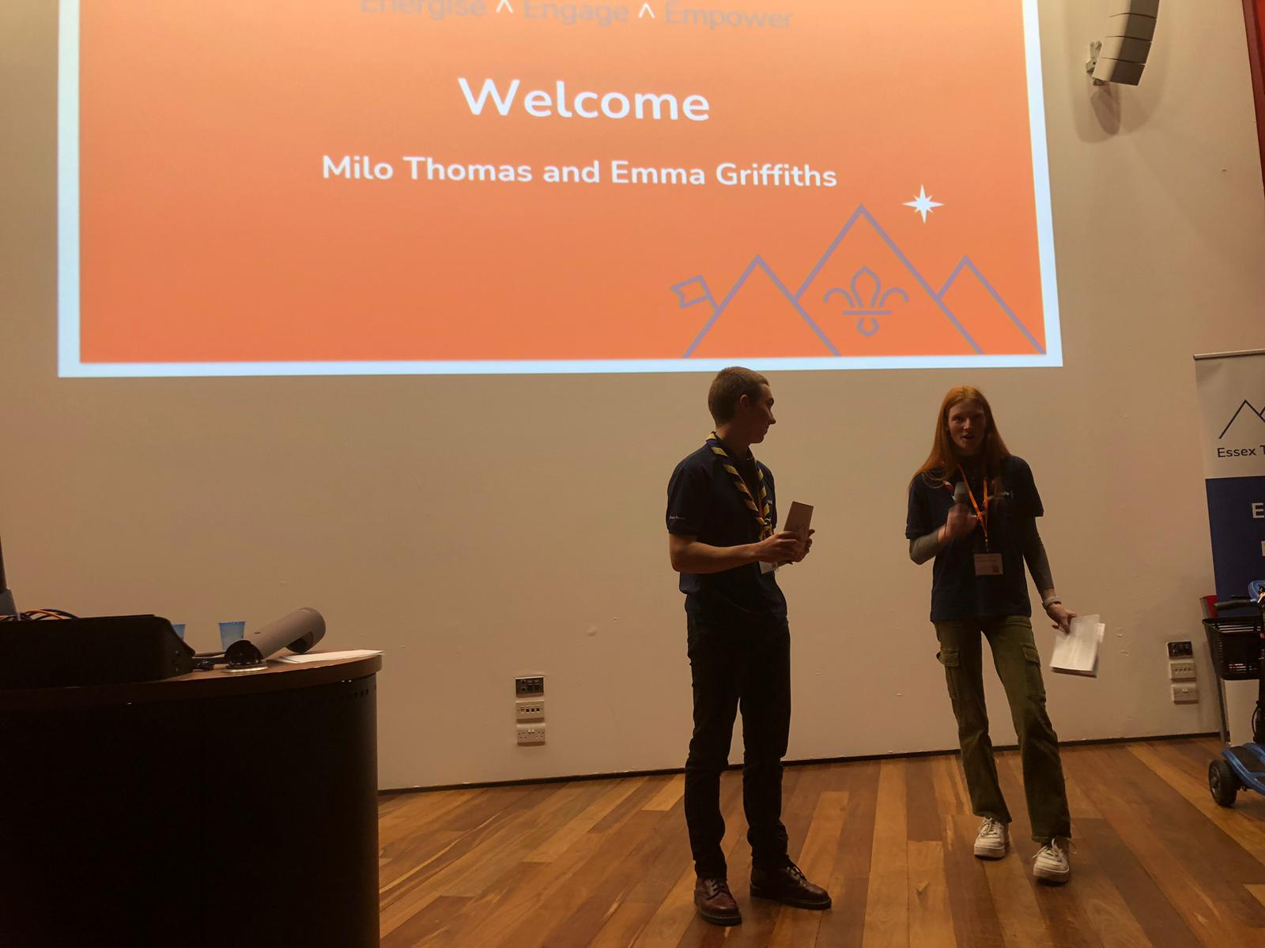
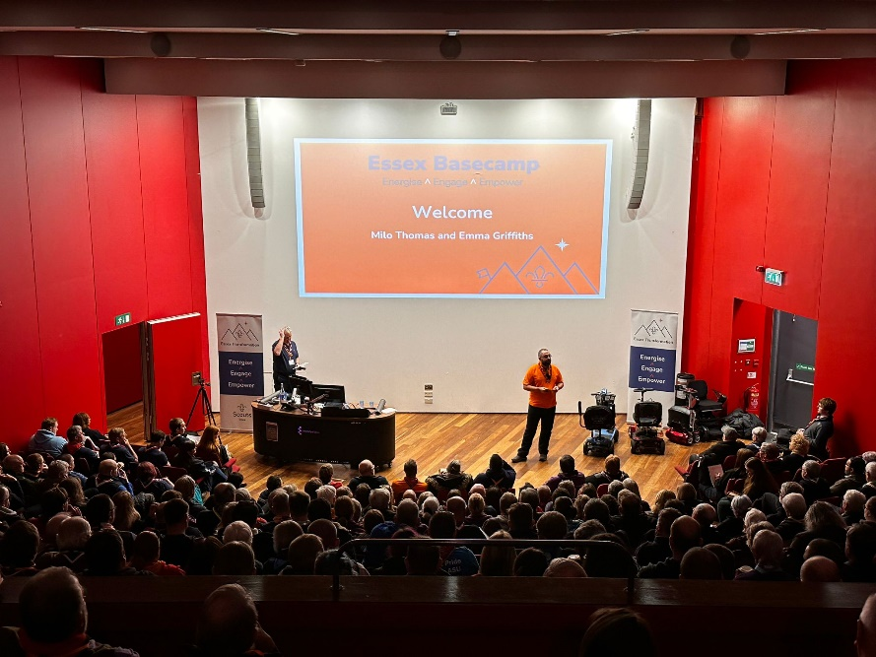
The ‘What’
Over 300 adult volunteers
Mixture of seminars and workshops
Focus on the next 15 months of delivery
Tailored to Essex

Slide 25
Insights
Over 200 questions to analyse & turn into FAQ’s
Digital Skills and having Difficult Conversations – top asks for skills to learn
Title changes largest ‘noise’
Overwhelmingly positive response (8/10) on feelings towards transformation
82% motivated to implement the transformation changes locally after attending Essex Basecamp

Slide 26
Next steps
Sharing videos and FAQ’s in January 2023
Delivering our plan…

Slide 27
Volunteer Role Vacancies

Slide 28
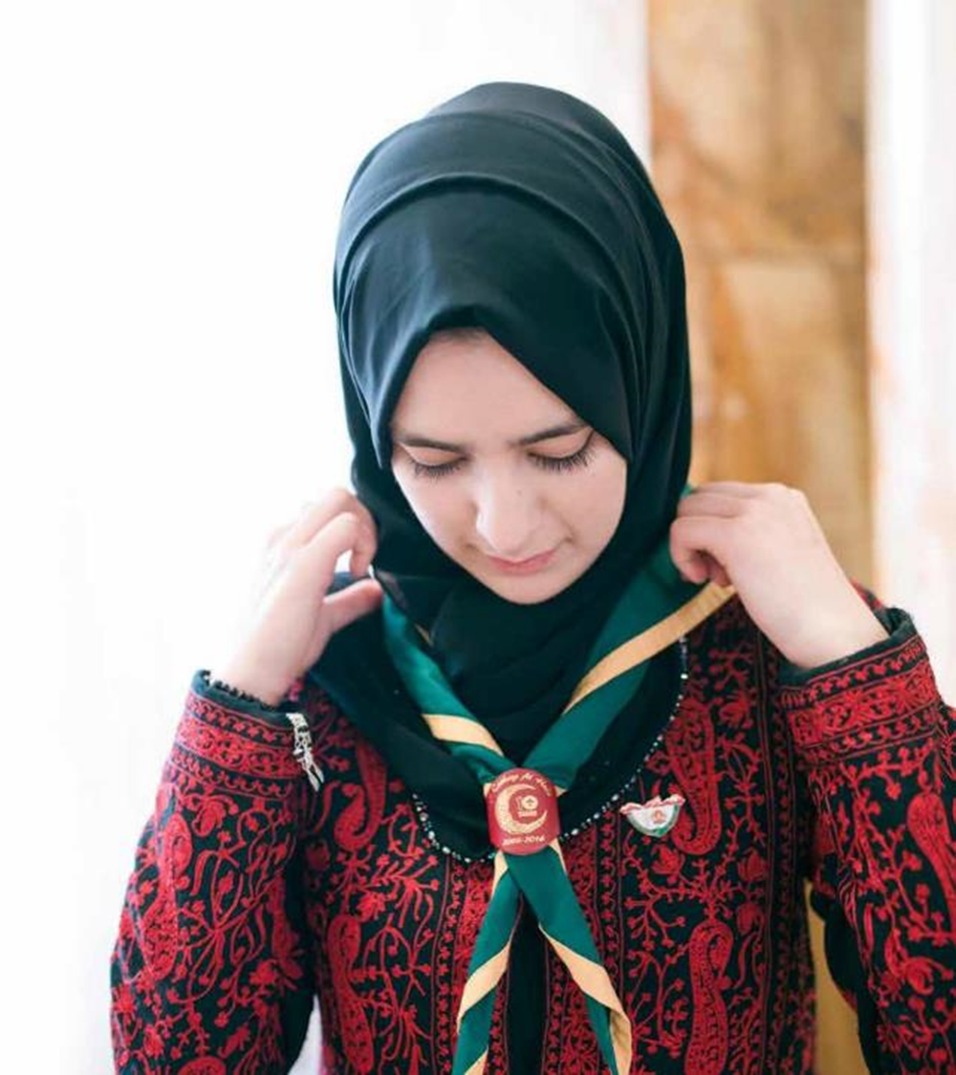
Volunteer Role Vacancies
Digital Readiness Lead
Youth Delivery and Membership Management
Community of Practice Lead - Insights

Slide 29
Next Steps
Use resources and tools to build understanding locally including "Is My Patch Ready for Change?“
Build local delivery teams including digital support
Ensure data is up to date in Compass
Join the Facebook group and/or use Transformation.Leads@scouts.org.uk for questions and support
Accept invites to calls
https://www.facebook.com/groups/scoutstransformation

Slide 30
Thanks for everything in 2022
Here’s to a great 2023 together!

Slide 31
Thank You

