Slide 1
Transforming our Volunteer Experience

Slide 2
Transforming our Volunteer Experience
Introduction
Purpose
To give an overview of the upcoming changes, covering;
Why we’re transforming volunteering
What is changing?
A warmer welcome for everyone
More engaging learning
How we volunteer together
How is this being delivered?

Slide 3
Transforming our Volunteer Experience
Why we’re transforming volunteering

Slide 4
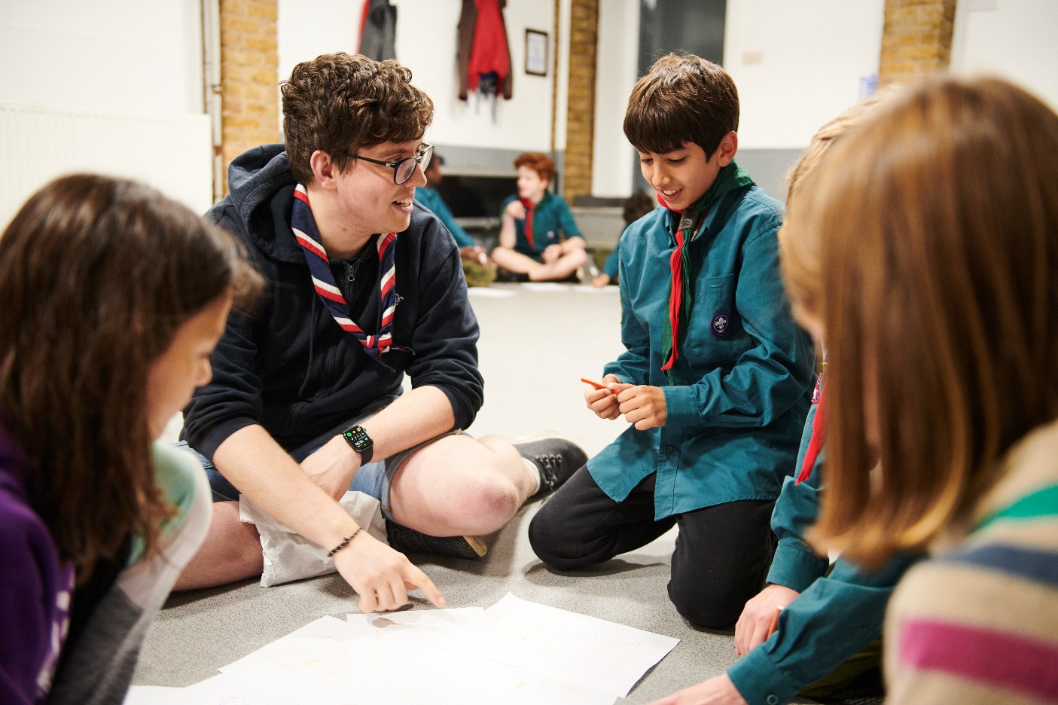
Transforming our Volunteer Experience
Why we’re transforming volunteering
Why we’re transforming volunteering
Our Skills for Life strategy
To provide more young people, and the ones we already have, with skills for life, we need more volunteers
Every volunteer deserves to feel valued during their time with Scouts
The world is changing, and volunteers want more flexibility in the time they give
Ultimately…..

Slide 5
Transforming our Volunteer Experience
Why we’re transforming volunteering
We want to make volunteering with Scouts easier and more fun…
…so that we can attract more volunteers and our current volunteers want to stay

Slide 6
Making volunteering easier and more fun is how we reach our North star...
More young people gaining skills for life
Consistently and safely
deliver a great programme
Recruit more volunteers
and retain current ones

Slide 7
Transforming our Volunteer Experience
Why we’re transforming volunteering
Throughout 2019 and 2020 we spoke to…
All volunteers invited to have their say
Over 5,000 so far
All UK nations
Young People
Those we want to welcome into scouting
Wide range of backgrounds and communities
Members of the public
British Scouting Overseas
Groups and sections
Volunteers who’ve left us
Other volunteering organisations
Volunteer managers

Slide 8
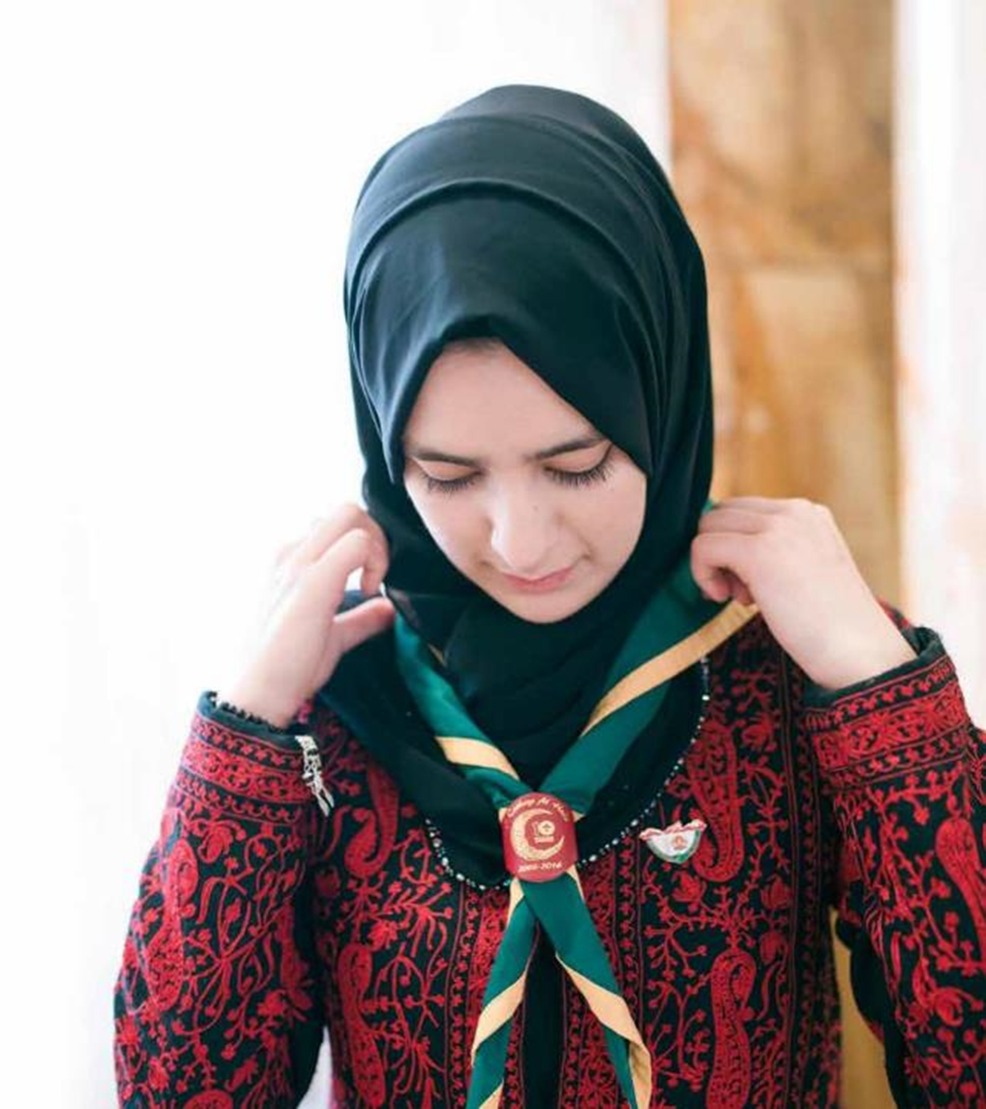
Transforming our Volunteer Experience
Why we’re transforming volunteering
What did we learn?
Leaders deeply enjoy volunteering and providing young people with skills for life
However, challenges to this still exist:
Only 30% of potential volunteers want to give time regularly
Current volunteers spend lots of time carrying out administrative tasks
Some of our current processes, role structures and training doesn’t support easier recruitment of new volunteers

Slide 9
Transforming our Volunteer Experience
Why we’re transforming volunteering
We cannot grow to meet our ambitions for young people, from section level to the whole of the UK, without making some fundamental changes

Slide 10
Transforming our Volunteer Experience
What is changing?

Slide 11
Transforming our Volunteer Experience
What is changing?
The culture we need to build…
Inclusive
Supportive
Digitally Enabled
Clear Roles
Learning, not training
Welcoming

Slide 12
Transforming our Volunteer Experience
What is changing?
Listening to our volunteers, young people and more we’ve identified three key areas for change:
Providing a warmer welcome for everyone
Delivering a more engaging learning experience
Simplifying how we volunteer together
All of which will be supported by easy-to-use digital tools

Slide 13
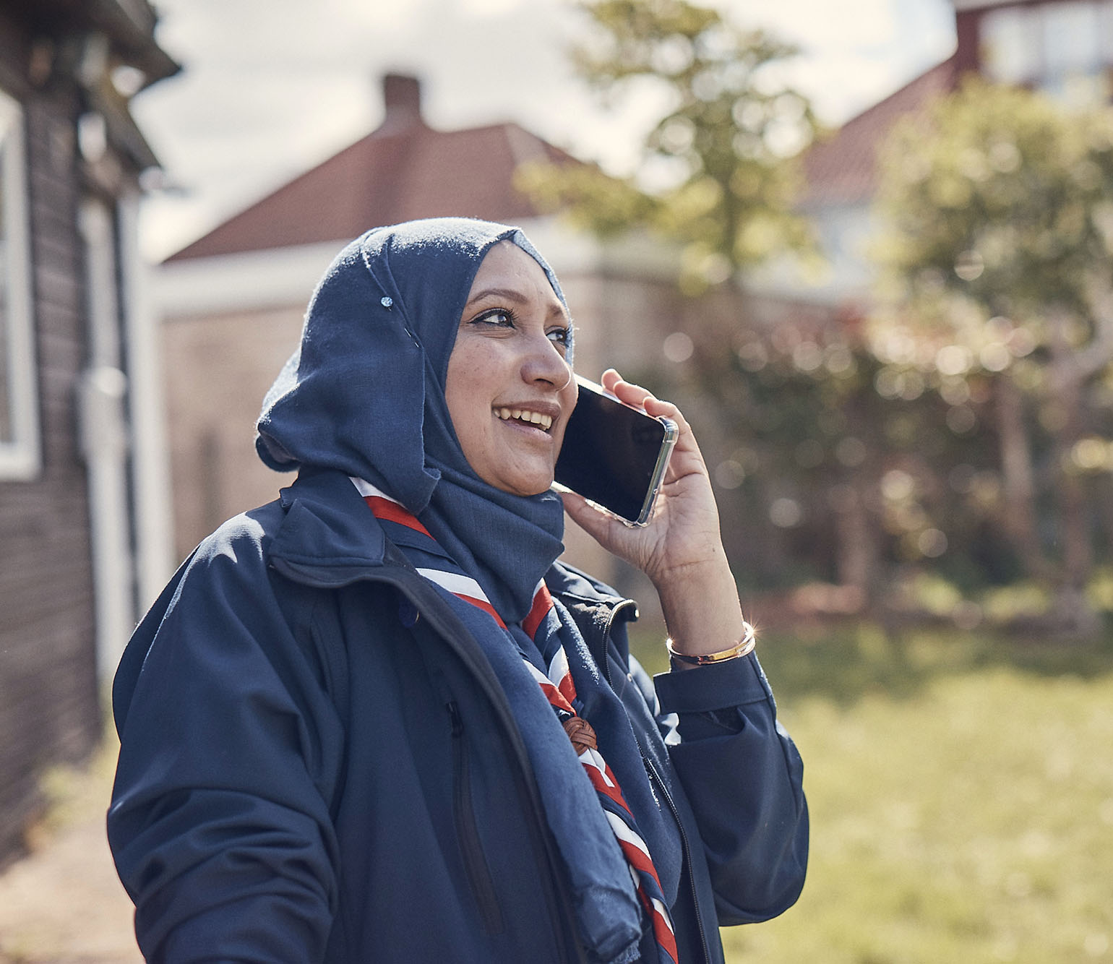
Transforming our Volunteer Experience
What is changing?
Digital systems supporting this change
To support these changes, we’re adopting a digital first, but not digital only, approach.
Along with developing a new digital system, with features including;
Specialist functionality to support each key area of change
A joined-up experience through a single scouts.org.uk login
Easy to use and mobile friendly
Fewer steps and less administration

Slide 14
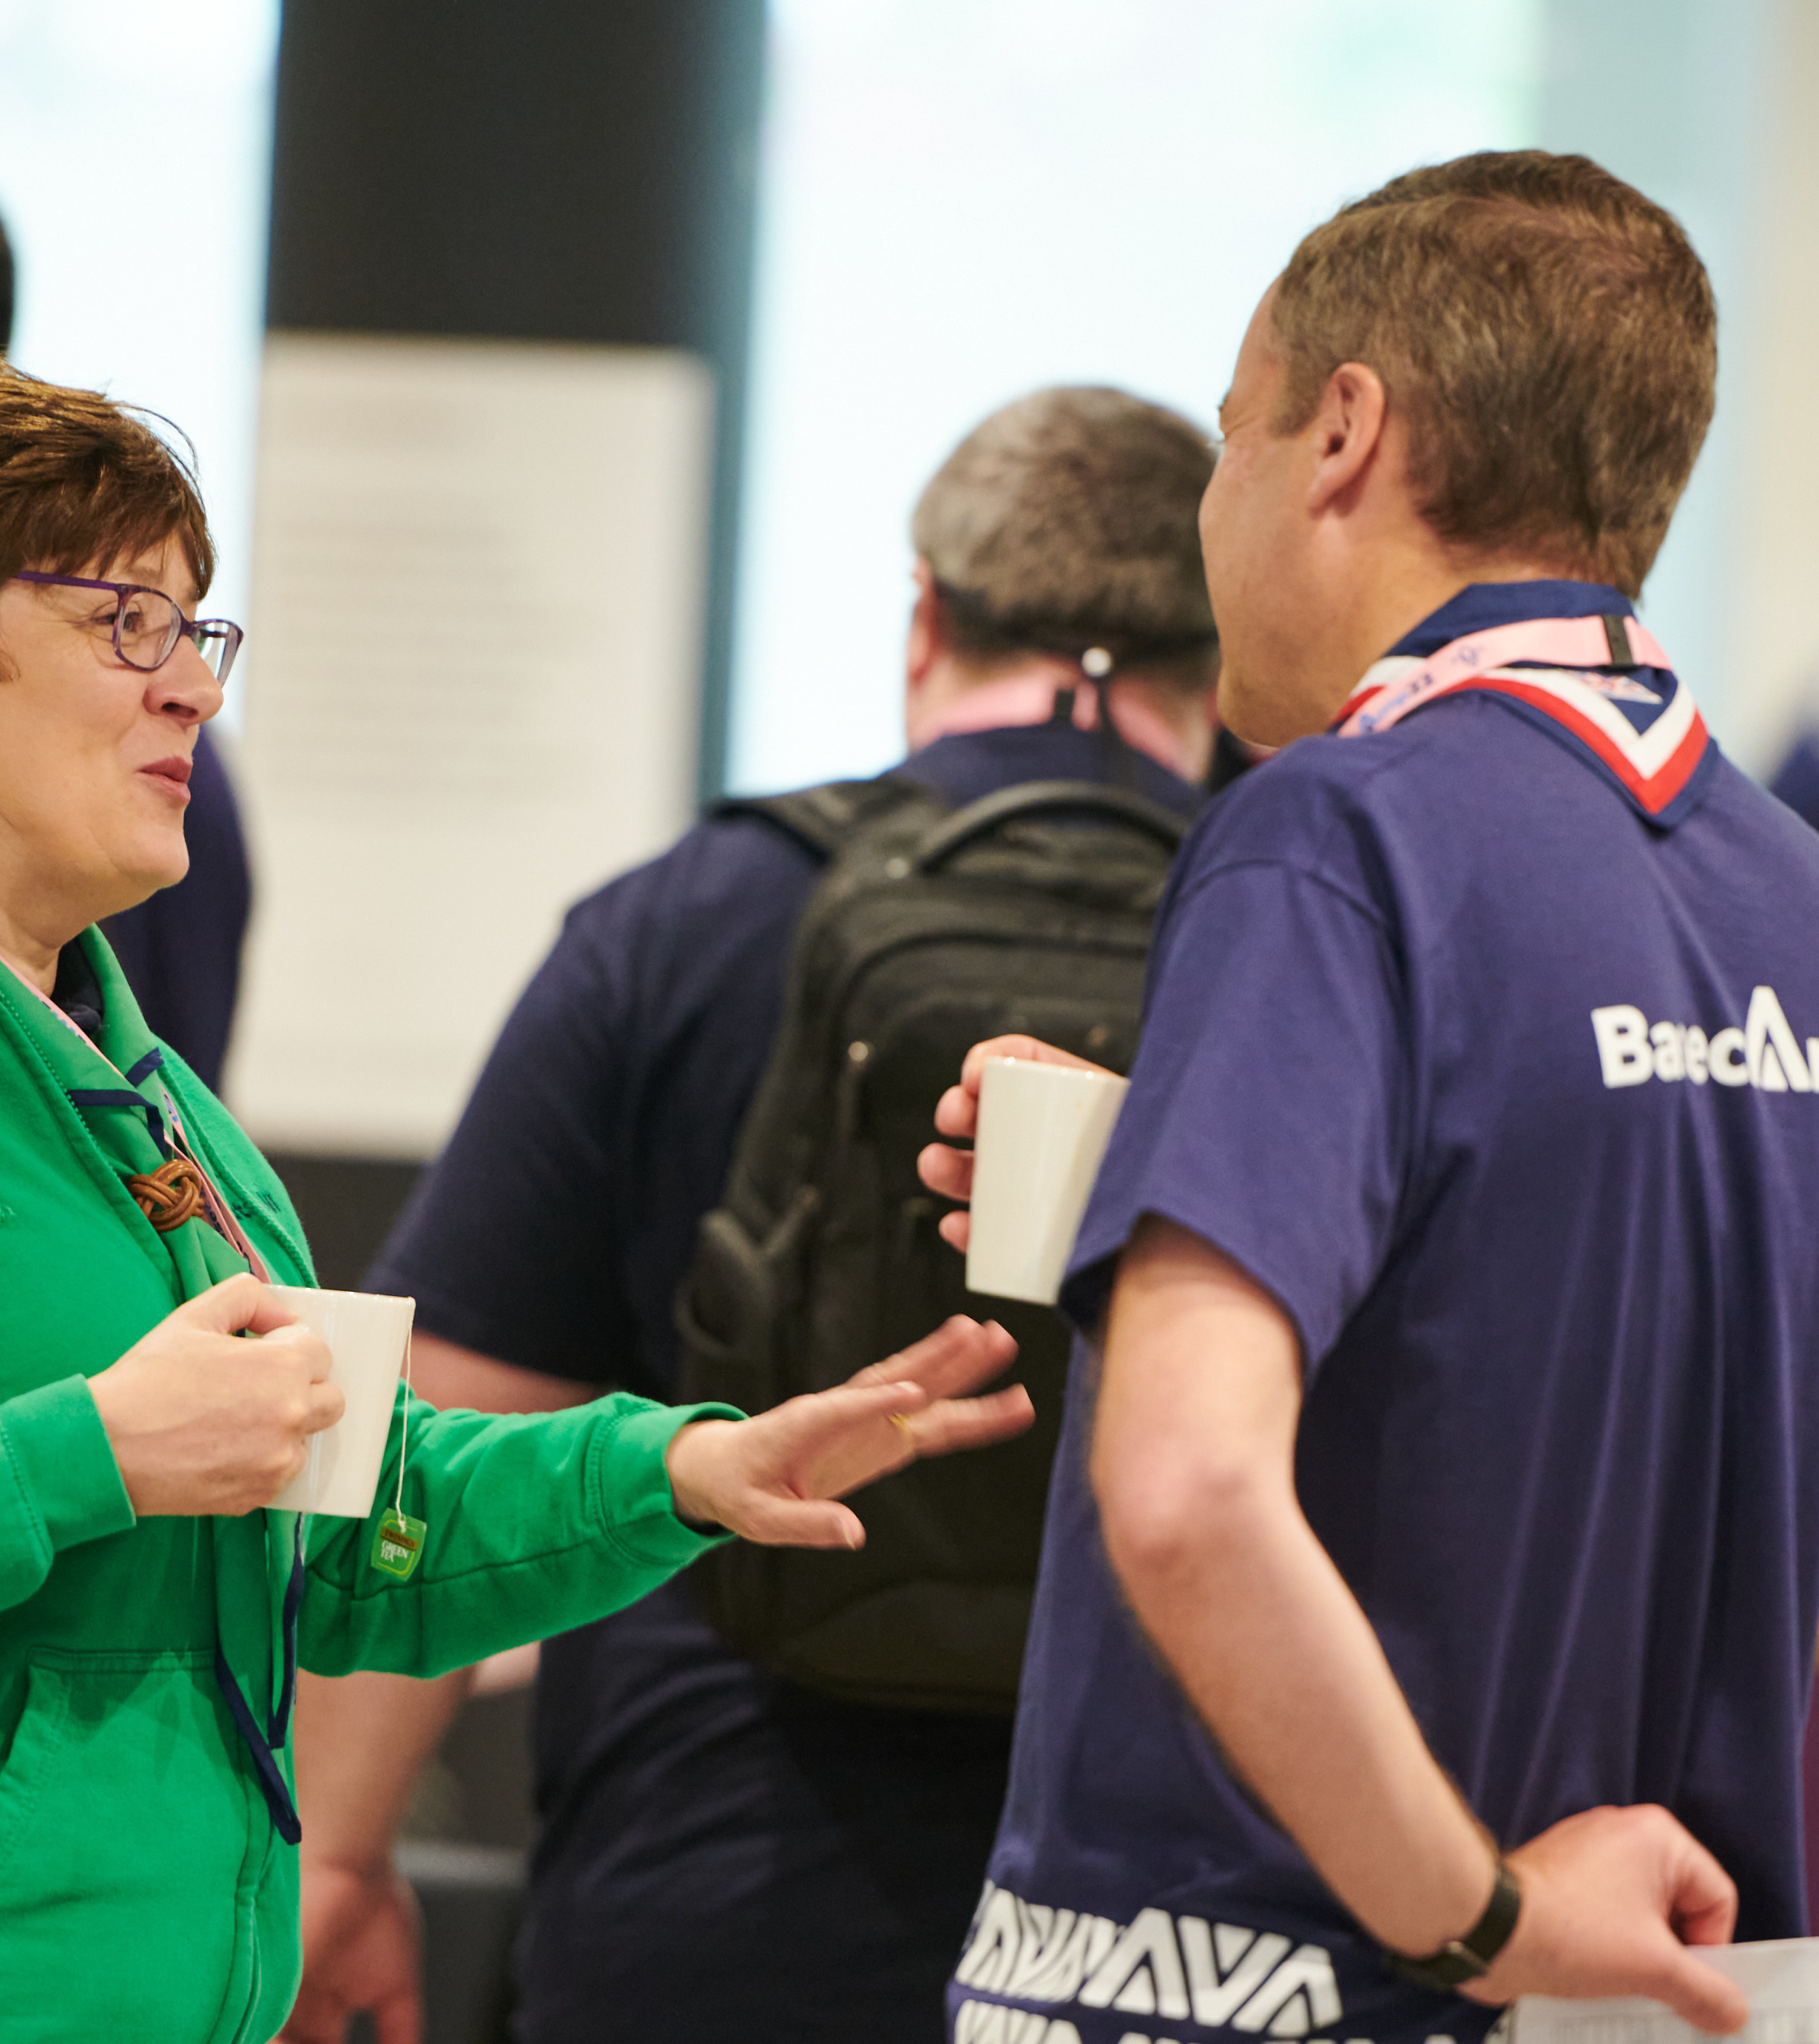
Transforming our Volunteer Experience
What is changing?
How are we designing the changes?
Ensuring these changes practically support our volunteers is extremely important. To that end we have:
Volunteers leading alongside staff on each area of change
A volunteer experience group, open to all our volunteers, to help shape the changes
The digital membership testing group, open to all our volunteers, to help test and shape our digital tools
An early adopter cohort of 10 different areas across the UK who will go first with the changes and help to shape the resources and support available

Slide 15
Transforming our Volunteer Experience
A warmer welcome for everyone

Slide 16
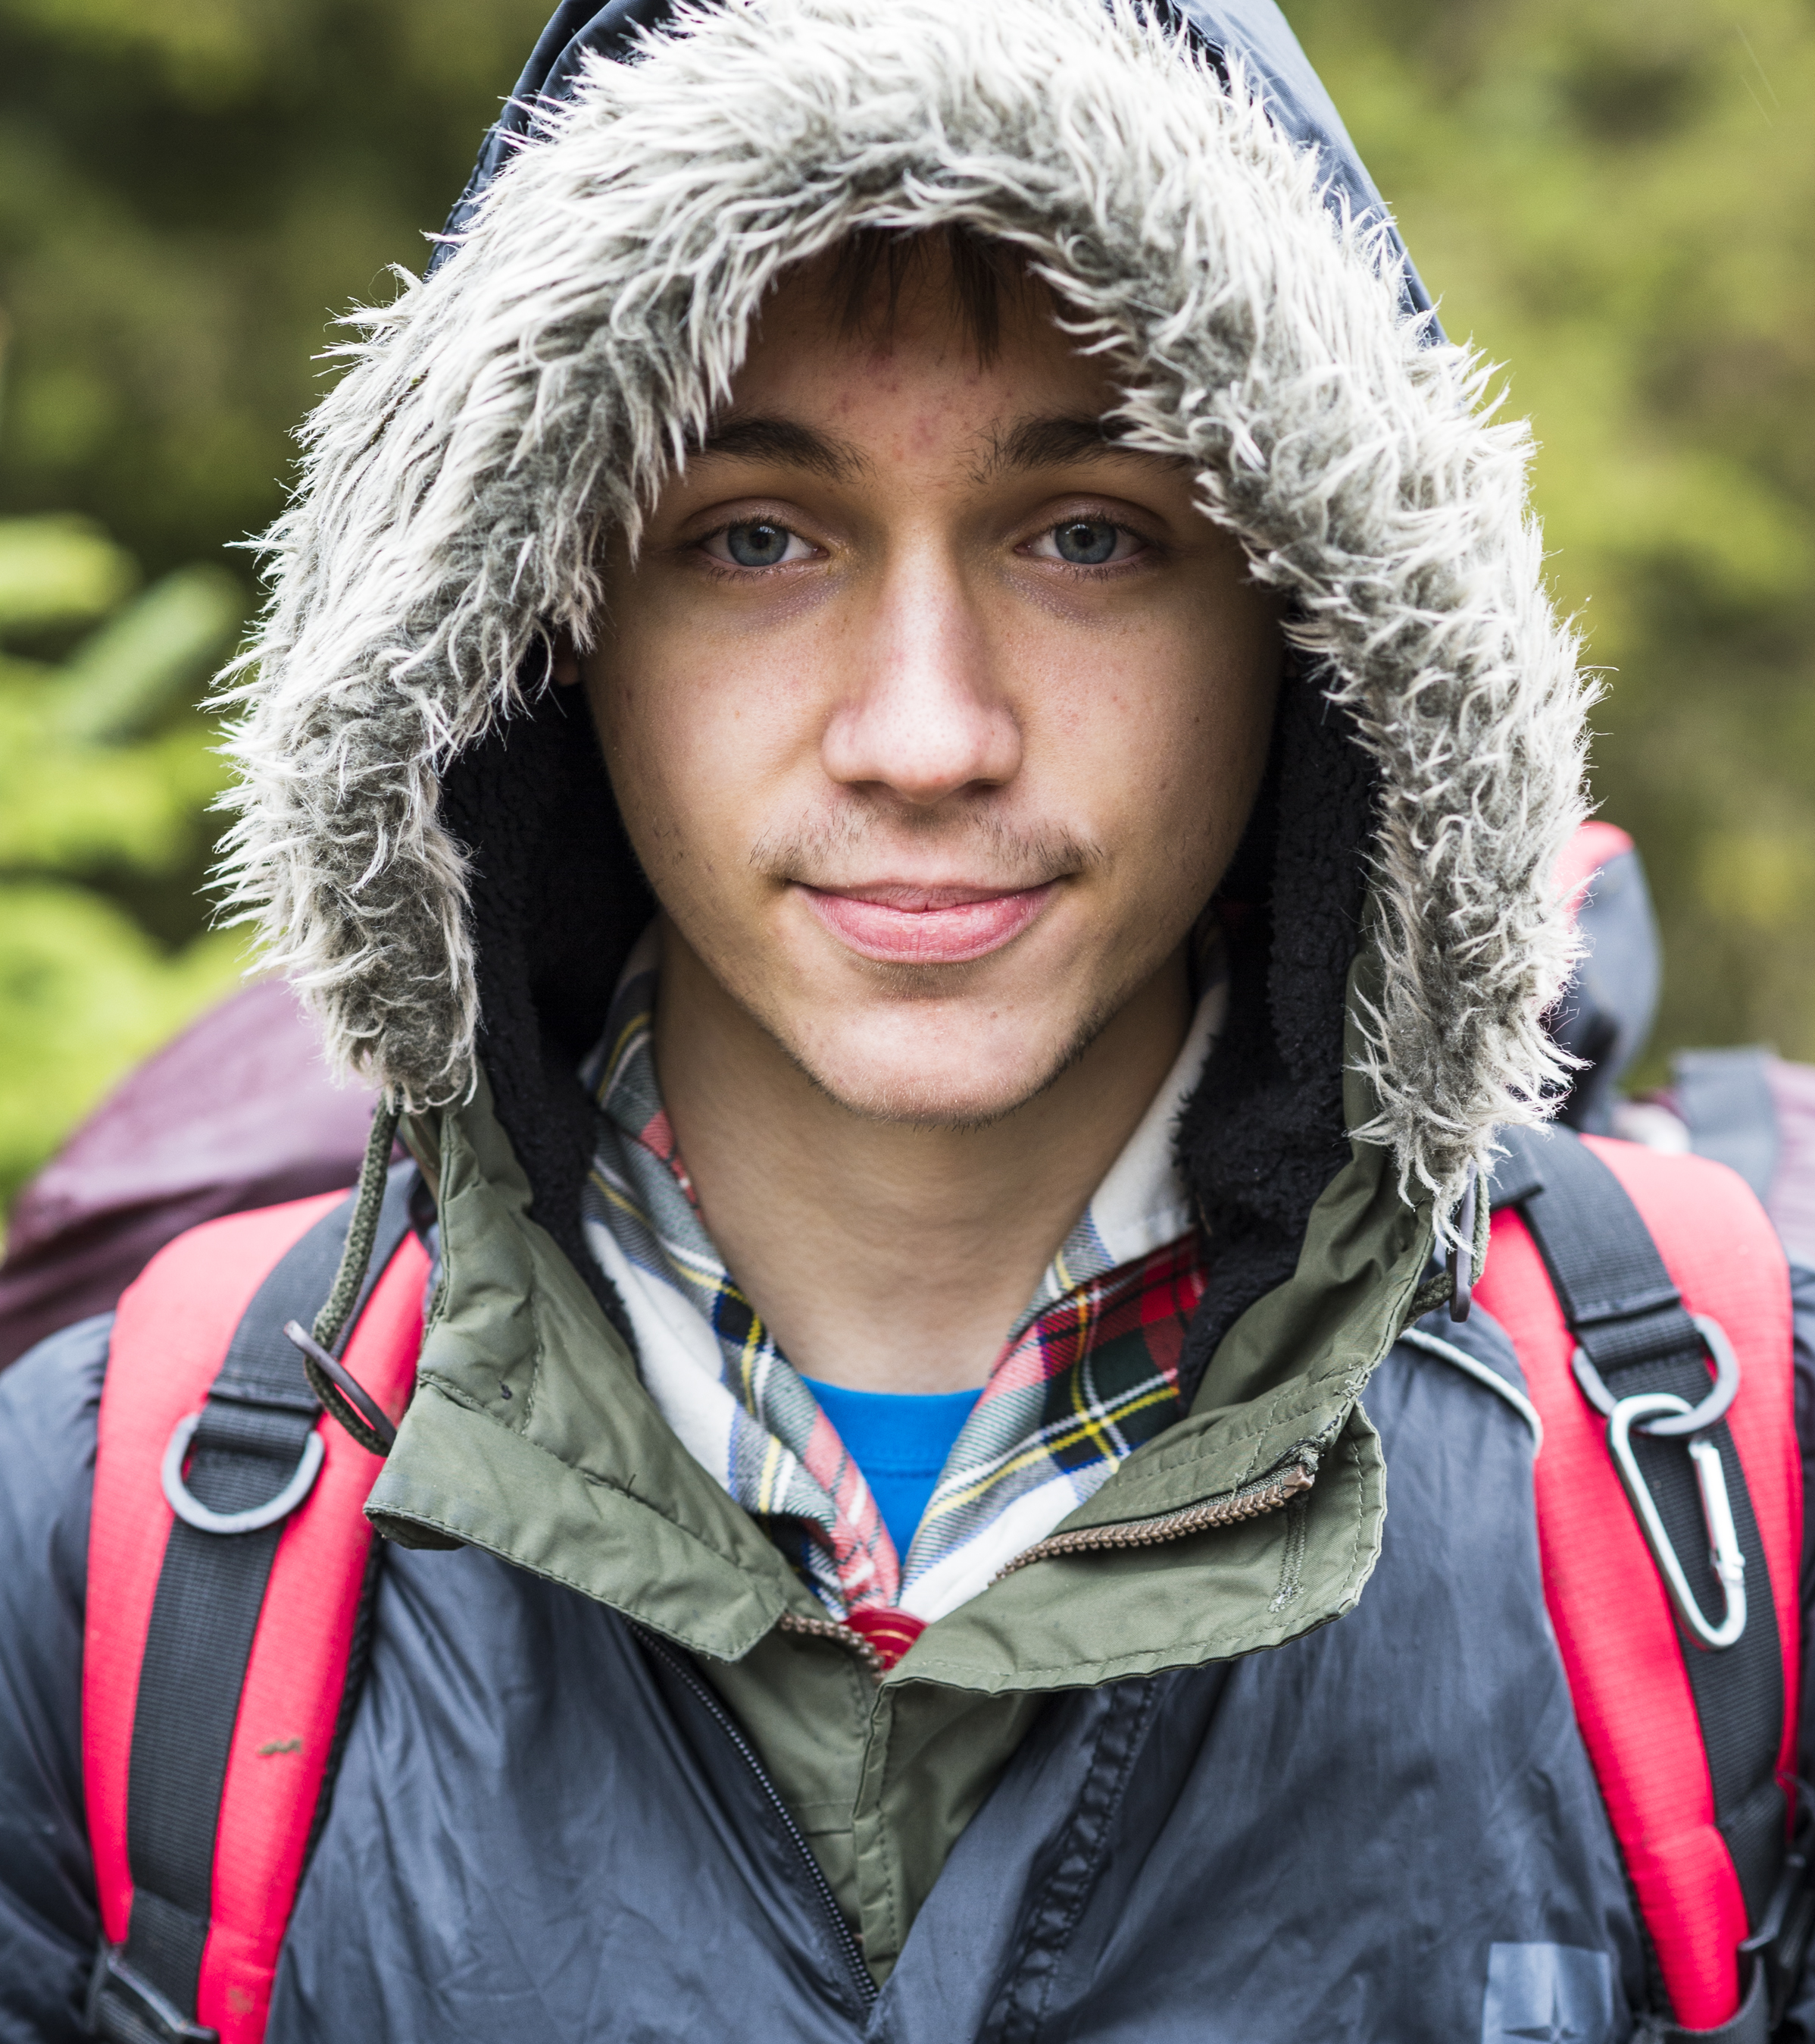
Transforming our Volunteer Experience
A warmer welcome for everyone
What have we learnt?
In our research with volunteers, we have learnt that:
Joining us can feel daunting for new volunteers
New volunteers feel like our appointments panels are more like a job interview
Appointments are time consuming and rely on inefficient tools and processes
We want more volunteers locally but need the support to make it happen
We’re often reliant on our existing networks to get new volunteers - Parents, Carers, Ex-Members and current volunteers…

Slide 17
Transforming our Volunteer Experience
A warmer welcome for everyone
What’s changing?
From | To
Intimidating appointments process and inefficient processes | Volunteers feel welcomed, value and at ease from day one
Appointments Panels - (Part of Appointments Advisory Committees) | Welcome conversation where you volunteer A buddy throughout your induction
Volunteers feeling unsupported when joining | Volunteers being provided with the information, key knowledge and skills required to ensure they can be successful in their role
Manual, time-consuming admin | New digital systems which: Reduce administration Have self-service and automated referencing Empower new volunteers
Reliance on existing networks to recruit | Capability to connect with popular apps and platforms, ensuring more people know about volunteering with Scouts

Slide 18
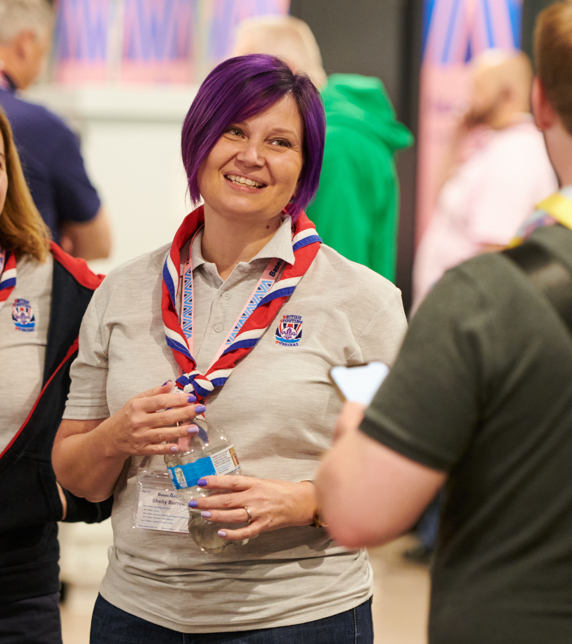
Transforming our Volunteer Experience
A warmer welcome for everyone
Digital systems supporting this change
New recruitment and attraction tools supporting this area of change will form part of the new digital systems. Features include:
Improved visibility of volunteering opportunities with easily shareable advertisements
Improved attraction of volunteers who have no previous experience of Scouting
Transparency for new volunteers, showing them each step of their recruitment journey
An automated and mobile friendly referencing system

Slide 19
Transforming our Volunteer Experience
A warmer welcome for everyone
We want to get to a place where our volunteers might say…
“I’ve been thoroughly introduced to my new volunteer role and now I can hit the ground running”

Slide 20
Transforming our Volunteer Experience
More engaging learning

Slide 21
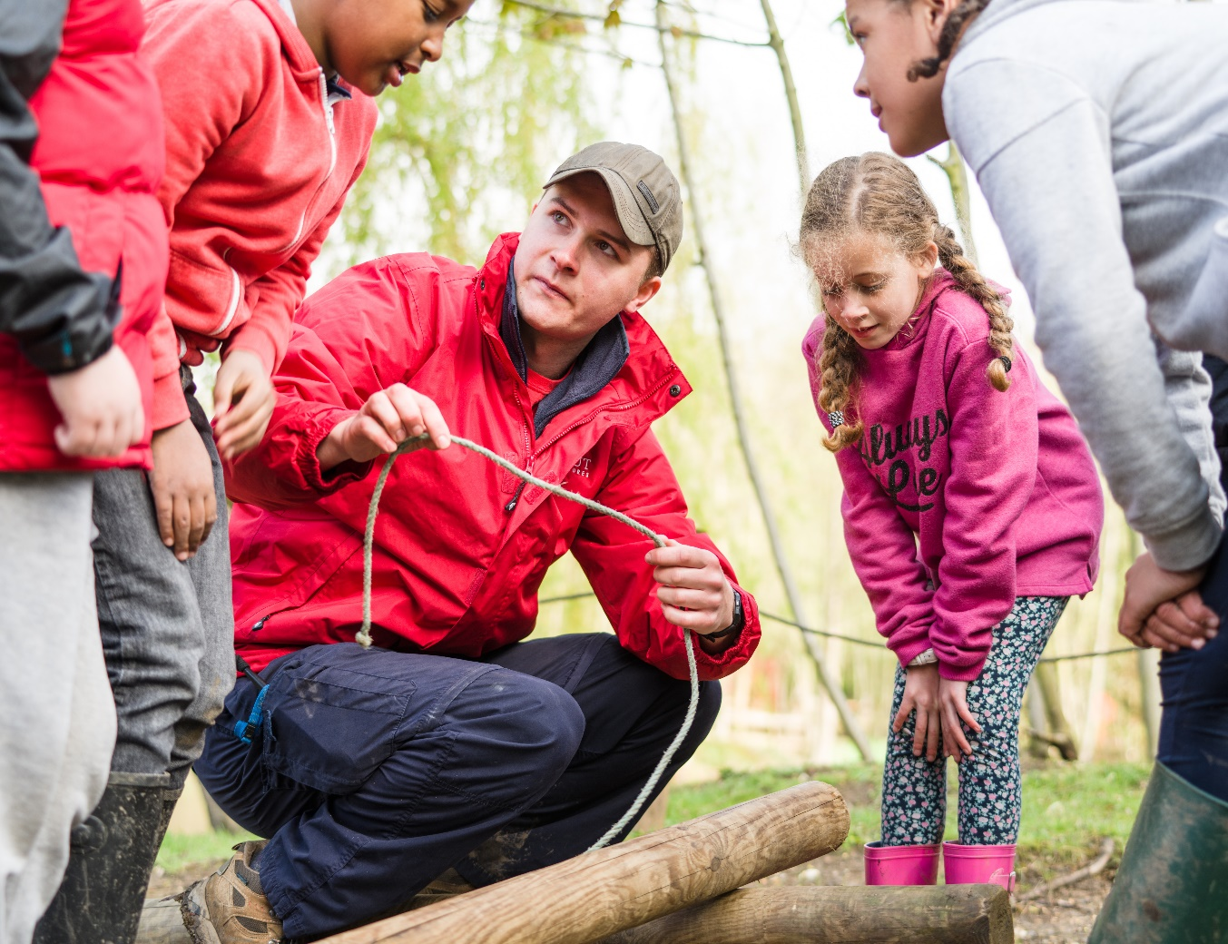
Transforming our Volunteer Experience
More engaging learning
What have we learnt?
In our research with volunteers, we have learnt that:
Our training scheme can feel overwhelming for new volunteers
Some learning is hard to access and requires finding more time available to attend
We don’t have enough training advisers to support learners this also delays validation which can be frustrating for the learner
The average length of time someone volunteers is 2 years, but nearly every volunteer role must complete the wood badge which can take up to 3 years to complete

Slide 22
Transforming our Volunteer Experience
More engaging learning
What’s changing?
From | To
‘Training’ and Training teams | Personalised learning when you need it, tailored to your role Support and management of learning built into our structures and digital systems
Time-consuming administration, managing multiple learners, compliance and validation | Existing skills recognised and sign off built in, no separate validation required New digital learning systems to support learners and reduce administration including easy to manage and report compliance
An off-putting digital learning experience | Digital first (but not digital only) approach, revitalised learning modules including bite sized learning, all in one place
Wood badge for almost every volunteer role | Wood badge is optional and available to all

Slide 23
Transforming our Volunteer Experience
More engaging learning
Digital systems supporting this change
A new learning tool will form part of the new digital system supporting this change. Features include:
Learning accessible all in one place
Improved accessibility features and support for all
Easy reporting and management of learning, including compliance
Recognition of learning previously completed in Scouting
Updated and improved Core Learning

Slide 24
Transforming our Volunteer Experience
More engaging learning
We want to get to a place where our volunteers might say…
“The training I’ve completed so far has been so helpful and easy to absorb - I’ve really enjoyed it”

Slide 25
Transforming our Volunteer Experience
Our Volunteer Journey

Slide 26
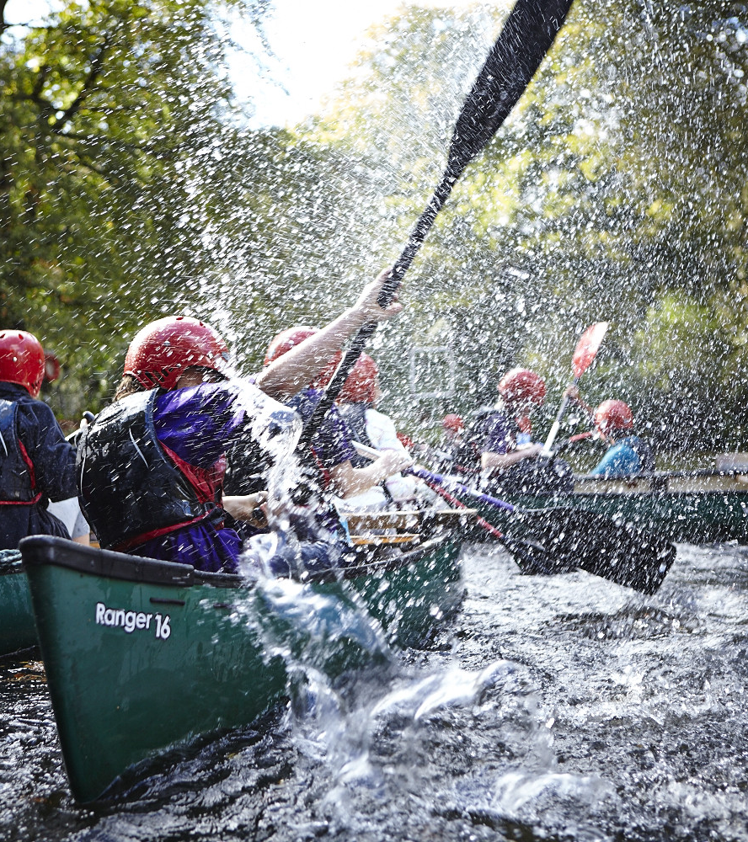
Transforming our Volunteer Experience
Our Volunteer Journey
What have we learnt?
In our research with volunteers, we have learnt that:
We have too many roles, these are often fixed and can feel like work
New volunteers find it hard to understand the expectations of different roles which can put them off joining
We have a small number of people/roles with lots of responsibility and stress placed on them
The digital systems which manage volunteers are inefficient and time consuming to use

Slide 27
Transforming our Volunteer Experience
Our Volunteer Journey
What’s changing?
From | To
Individual, inflexible and fixed roles | Volunteers working in teams, on tasks with a clear purpose
Unclear expectations for new and current volunteers | Clearer roles with titles that people inside and outside Scouting understand
A small number of people/roles with lots of responsibility and stress | Improved team structures with clearer responsibilities, new digital systems to reduce administration
Ineffective and time-consuming digital systems for volunteers | New digital easy-to-use systems to support volunteers and volunteer managers
Volunteering can feel like work | Structures and teams which allow for individuals to contribute in a way that matches their skills, interests and availability

Slide 28
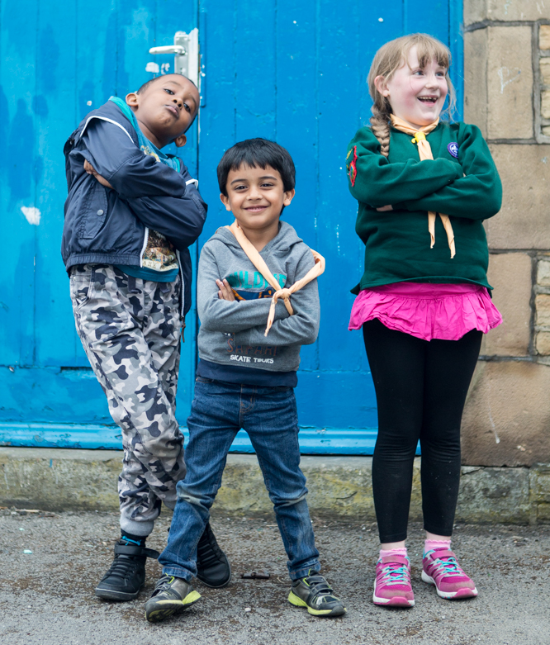
Transforming our Volunteer Experience
Our Volunteer Journey
What’s changing?
In addition:
There have been significant changes in Charity Governance by all regulators over the past few years.
As part of this;
Executive Committees will be changing to Trustee Boards
The Trustee Board will be focused on making sure the charity is well managed, risks are assessed and mitigated, buildings and equipment are in good working order, and everyone follows legal requirements and Policy, Organisation and Rules (POR).
Their support helps other volunteers run a fantastic programme that gives young people skills for life

Slide 29
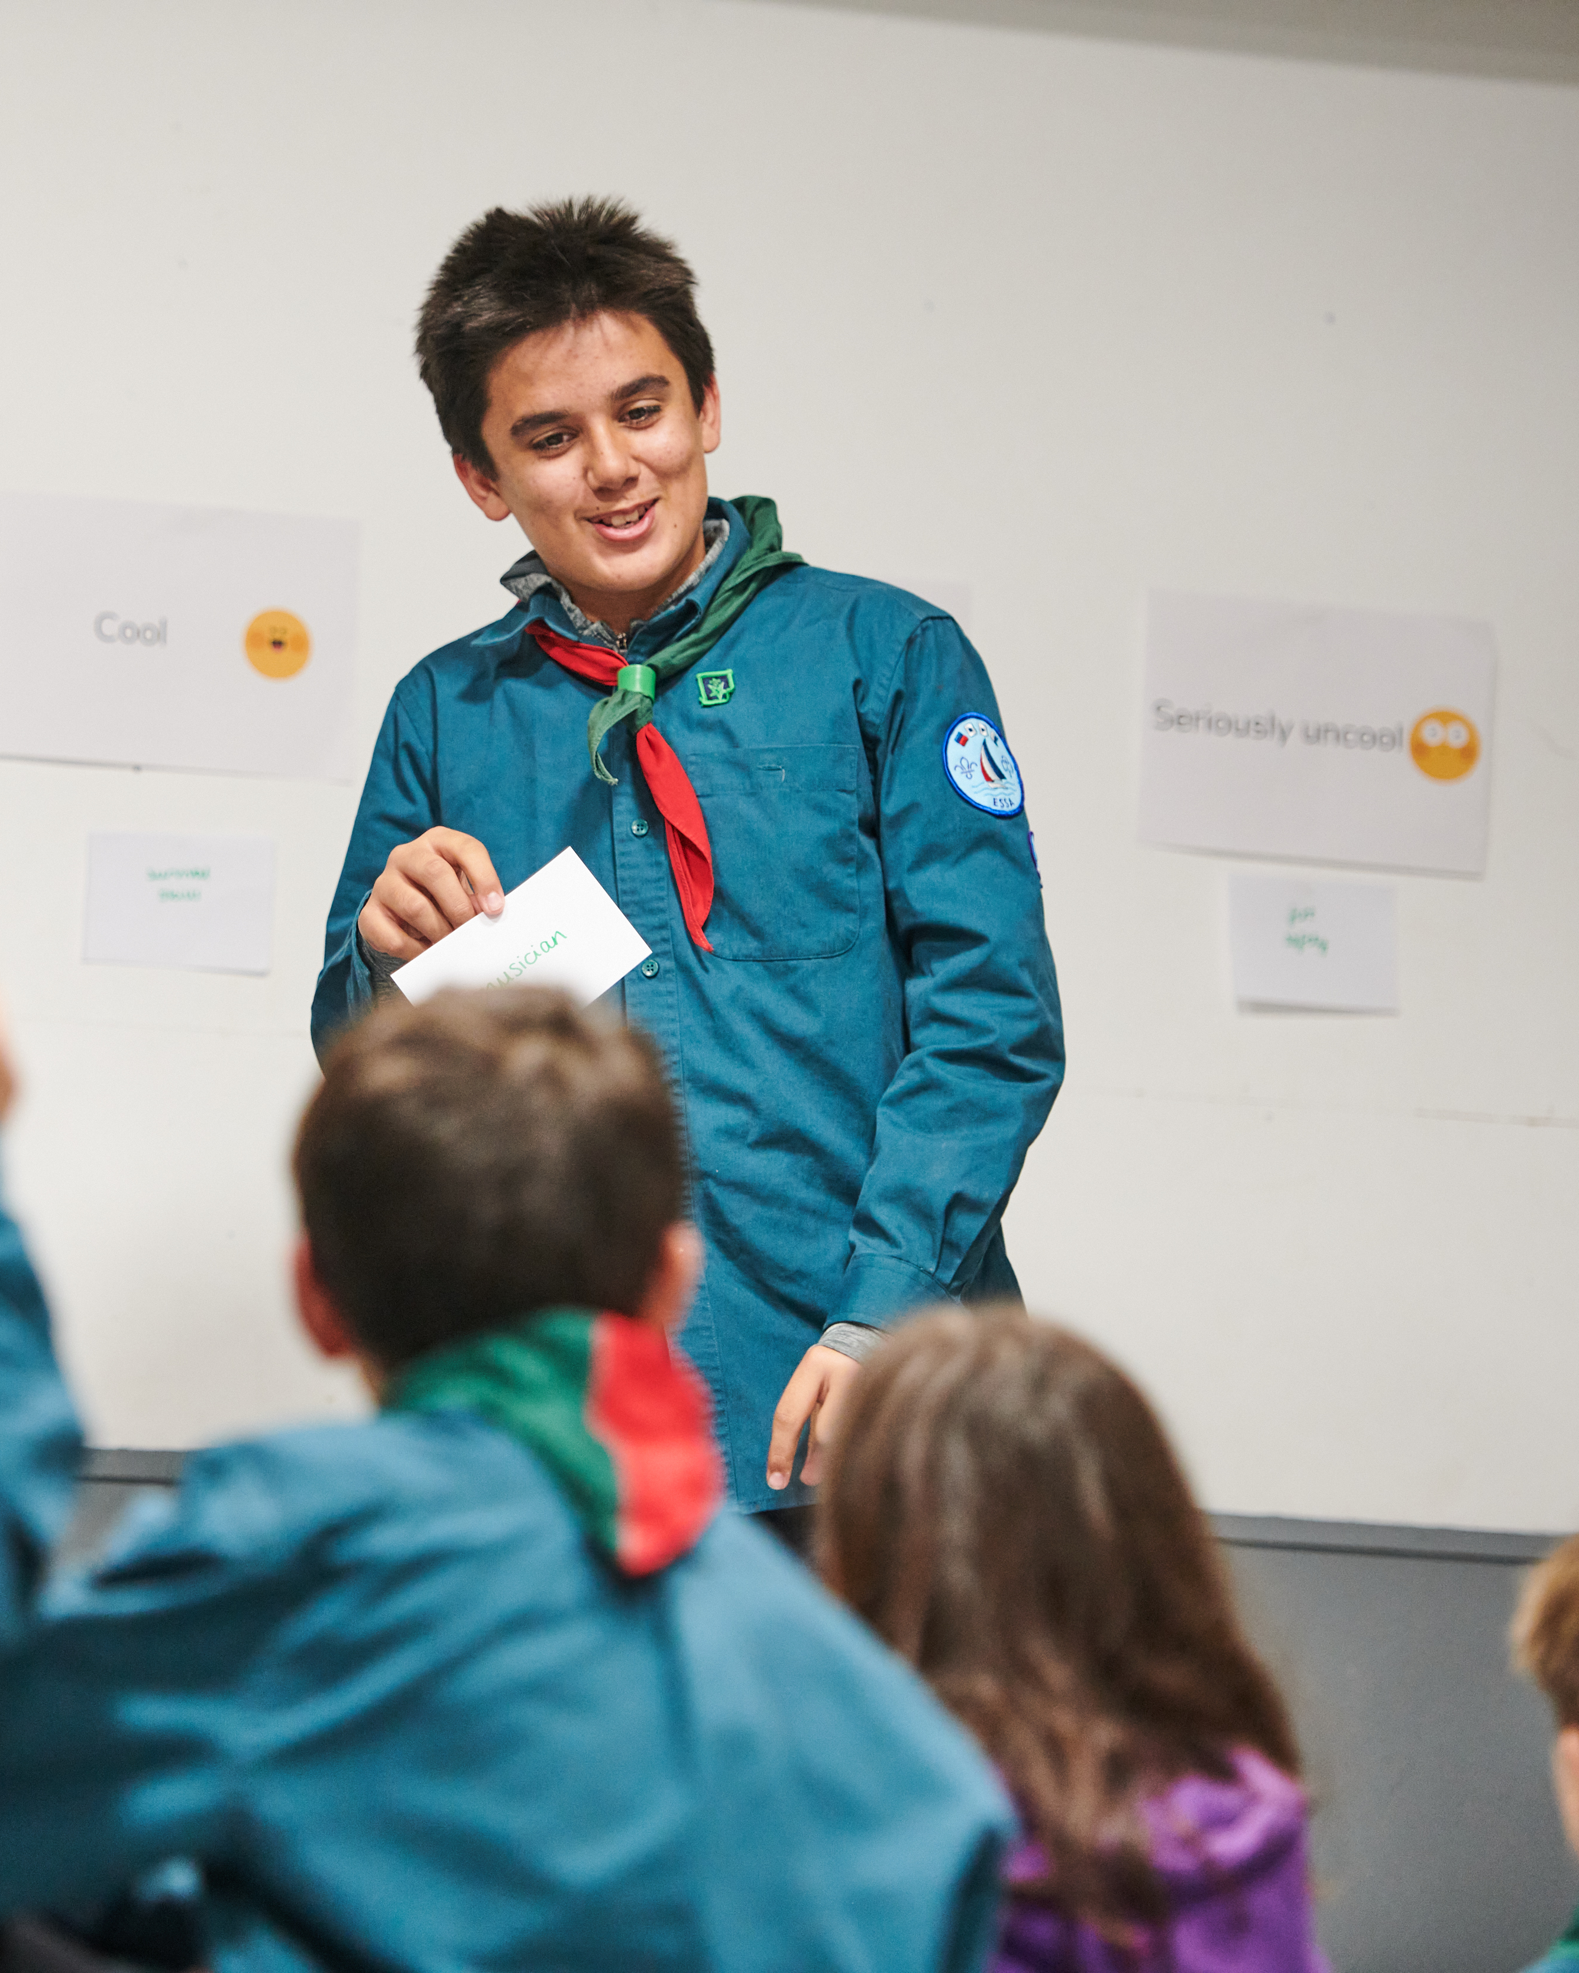
Transforming our Volunteer Experience
Our Volunteer Journey
Digital systems supporting this change
A new membership system will form part of the new digital system supporting this change. Features include:
Easier and improved management of
Volunteer Roles
Permits
Awards
Nights Away Notifications
Additional features added over time

Slide 30
Transforming our Volunteer Experience
Our Volunteer Journey
We want to get to a place where our volunteers might say…
“I receive regular support in a way that is safe, open, and honest. I feel respected and seen”

Slide 31
Transforming our Volunteer Experience
How is this being delivered?

Slide 32
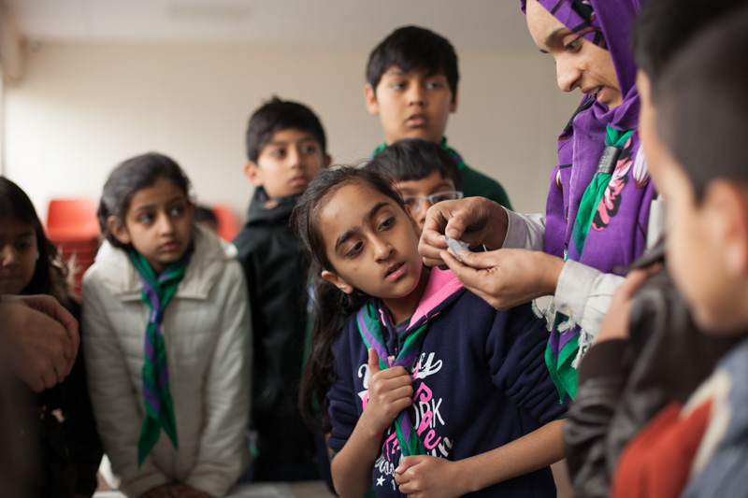
Transforming our Volunteer Experience
How is this being delivered?
Leading change locally
Each local County/Area/Region (Scotland) has appointed a Transformation Lead
Transformation Leads will be working with County and District teams in your area to translate the ‘big picture’ plans and helping to make these work in your local area
10 Counties/Areas/Regions (Scotland) have been chosen as Early Adopter areas, these areas will go-live with the changes early to ensure that the transition for everyone is as smooth as possible

Slide 33
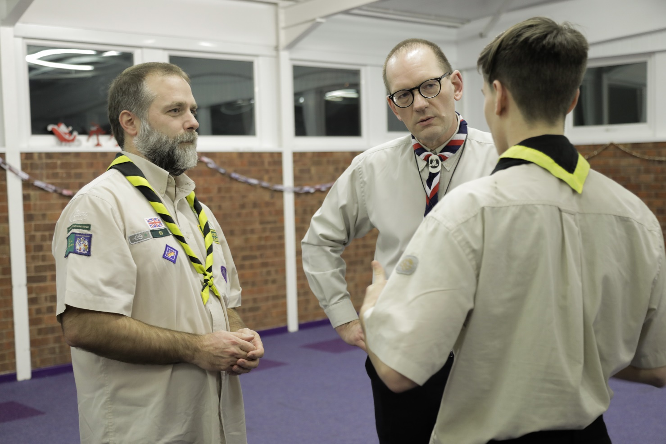
Transforming our Volunteer Experience
How is this being delivered?
Leading Change Locally
The changes will come in an iterative way, building on each other to improve our Volunteer Experience
There will be a period of adjustment for everyone – Some changes might be more relevant to your role than others
Imbedding the changes to the way we do things, and the use of new digital systems will take time

Slide 34
Transforming our Volunteer Experience
How is this being delivered?
When will I see the changes?
You’ll start hearing about the changes locally
More detail will be shared on the specifics of the Volunteer Experience changes
Parts of the changes will start being introduced and embedded in your local area
Changes will continue being introduced and embedded in your local area
All areas will go live with new digital systems in Feb 24
SEPT - DEC 22
JAN - NOV 23
DEC 23 – MAR 24
2022
2023
2024
NOV 23
NOV 23
FEB 24
Go-live of new digital systems
For Early Adopter Cohort
Go-live of new digital systems for all​​

Slide 35
Transforming our Volunteer Experience
How is this being delivered?
When will I see the changes (Early Adopters)?
You’ll start hearing about the changes locally
More detail will be shared on the specifics of the Volunteer Experience changes
Parts of the changes will start being introduced and embedded in your local area
The new digital systems will go-live early in November 23
Getting accustomed to the new digital systems
Providing feedback to improve and inform the transition for the other areas
SEPT - DEC 22
JAN - NOV 23
DEC 23 – MAR 24
2022
2023
2024
NOV 23
NOV 23
FEB 24
Go-live of new digital systems
For Early Adopter Cohort
Go-live of new digital systems for all​​

