Slide 1
Welcome to the
Transformation Leads call
Notes:
Craig

Slide 2
Who's on the call?
Craig Turpie, Deputy UK Chief Commissioner
Hamish Stout, Deputy UK Commissioner for People (Transformation)
Andrew Sutherland, Deputy Programme Sponsor for Volunteer Experience
Alison Fell, Lead Volunteer, Welcome Project
Helen Mitchell, Interim Communications Manager
Susan Wallace, Change Manager
Rob Groves, Change Manager
Notes:
Craig

Slide 3
Purpose
Networking Session One
POR Timeline
Welcome Update
Open Forum
Transformation Lead Survey
Networking Session Two
Next Steps
Notes:
Craig

Slide 4
Networking Session One
Notes:
Susan

Slide 5
Transformation Lead Call - January 23
Networking Session One
Mural Tutorial
Notes:
Susan

Slide 6
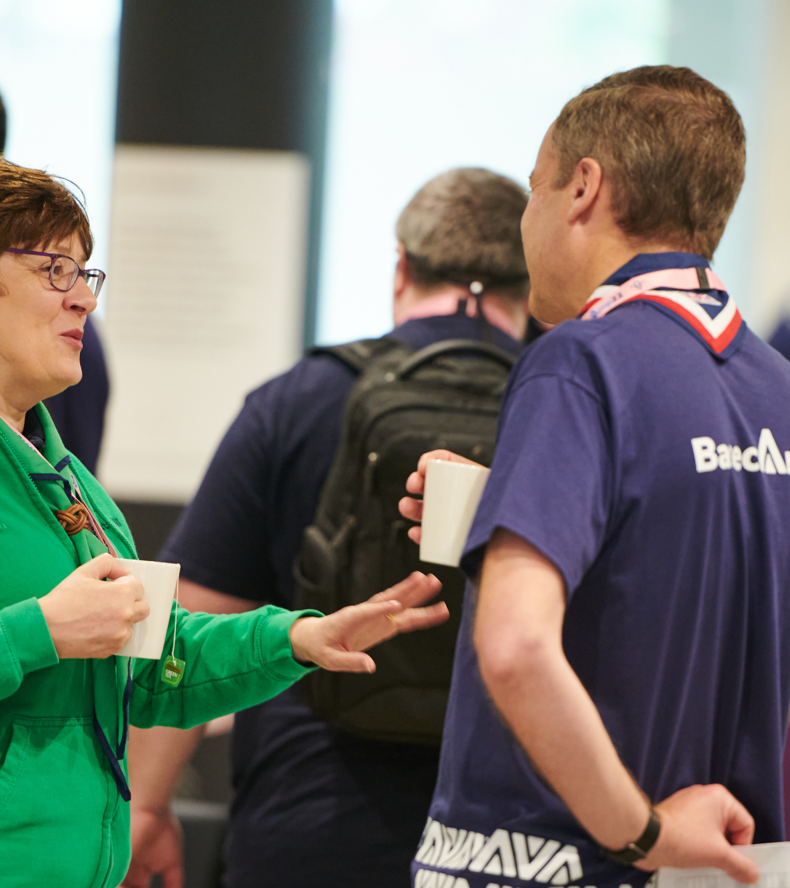
Transformation Lead Call - January 23
Networking Session One
Breakout rooms of 4-5 Transformation Leads
When the pop-up appears in Zoom select to go into your breakout room
Take two minutes each to;
Introduce yourselves
What have you been doing in your area so far?
What has gone well?
What have you found most challenging?
Be ready to feedback;
One thing from your breakout room that has gone well which would be beneficial to share with others
Notes:
Susan

Slide 7
Feedback Session
Notes:
Rob

Slide 8
POR Timeline
Notes:
Hamish

Slide 9
Transformation Lead Call - January 23
POR Timeline
POR Timeline @ January 2023
Jan 2023
Publication - w/c 30th Jan
Changes:
Complete the process to move all chapters to new numbering format (Chapters 3,4,5,15)
Restructuring of Chapters 3, 4 and 5
Volunteer Experience changes:
Removal of Associate Member status
Other notified changes:
Activities changes
Updating uniform requirements (remove items not now stocked)
Move youth suspension/dismissal from Ch15 to Ch3
April 2023
Publication - w/c 10th April
Volunteer Experience changes:
Trustee Board/Constitutions changes (chapter 5)
Other notified changes:
Updating charity finance rules (chapter 5)
July 2023
Publication - w/c 10th July
Changes:
None notified as yet
Important Note:
This will be the final version of POR for Counties to use prior to their transition and will apply in every County until the date of their transition
IMPORTANT: The above is subject to change but is our current best understanding!!
Notes:
Hamish

Slide 10
Transformation Lead Call - January 23
POR Timeline
POR Timeline @ January 2023
Oct 2023
Publication - w/c 16th Oct
Volunteer Experience Changes:
All changes needed by a County from the point of their transition. This will particularly affect chapters 3, 4, 5 and 16. And any chapter where there is mention of current roles that are becoming accreditations (e.g., chapter 9)
Important Note:
This will be the version of POR for Counties to use from the time of their transition.
Draft Version:
A “good draft” of this version will be made available to Early Adopters in July 2023. This will support Early Adopters in their planning but will not come into effect until the point of each County's transition. The time between June and October will also be used for a pre-publication check so that clarifications can be made to POR prior to formal publication.
2024
There will be two editions of POR - in April and October.
There will be NO January or July editions of POR
IMPORTANT: The above is subject to change but is our current best understanding!!
Notes:
Hamish

Slide 11
Welcome Update
Notes:
Alison

Slide 12
Transformation Lead Call - January 23
Welcome Update
A Warmer Welcome
Attraction
A simple process to support attracting volunteers to opportunities
Attraction
Appointment
A self-service appointment process that makes volunteers feel welcomed and valued but also ensures that volunteers are appointed safely
Appointment
Joining
A transparent joining process by enabling new volunteers to have clarity of what is required of them through a simple and visually articulated journey
Joining
Induction
Making sure we provide a new volunteer with all the skills they need to undertake their role in a way that complements future learning
Induction
Notes:
Alison
At the foundation of our plans to make volunteering a brilliant experience for everyone is the way in which our volunteers join us, how they are in control of their journey along with the appointments

Slide 13
Transformation Lead Call - January 23
Welcome Update
Attraction
Our vision
Allow existing and new volunteers to explore and find out about roles available
De-mystify Scouting and be more transparent
Flexible volunteering
We are achieving this by?
New digital recruitment tool
Existing volunteers recruiting to share 'adverts' to help reach new people
Notes:
Alison

Slide 14
Transformation Lead Call - January 23
Welcome Update
Attraction
Deliver new digital tool to support volunteers with attraction, both those seeking an opportunity and those recruiting.
Tool will enable us to link better with the wider volunteering community.
Will work for those joining from outside the movement but also for those who already have an attachment to Scouting
Notes:
Alison

Slide 15
Transformation Lead Call - January 23
Welcome Update
Appointment
We will have a more welcoming, easy to complete and consistent process.
We are removing the pre-provisional appointment to make it simpler
We are removing the 'Commissioner approval' step
Volunteers will have one welcome conversation when they join Scouting
Notes:
Alison

Slide 16
Transformation Lead Call - January 23
Welcome Update
Full Appointment Process
We will have 6 step process*
Disclosure check (in England & Wales we can use a mobile friendly version)
Streamlined CE checks where a flag is found
A welcome conversation that is supportive and friendly
A referencing system that is mobile friendly and automated
Updated Declarations dependent on role
Core learning
*For trustee roles there will be an additional step
Notes:
Alison

Slide 17
Transformation Lead Call - January 23
Welcome Update
Joining
Our vision
A transparent joining process, allowing volunteers, and line managers to track their progress
Working with volunteers to help them understand the details of their roles & responsibilities
How will we achieve this?
Developing a new 'self-service' recruitment process through the digital system
Notes:
Alison

Slide 18
Transformation Lead Call - January 23
Welcome Update
Induction
Our vision
Every volunteer is welcomed and supported
Central information and support, with key knowledge being shared with you
How will we achieve this?
Local welcome with a buddy to help you
Provide information that a new volunteer requires to be successful
Core learning
Notes:
Alison

Slide 19
Open Forum Q&A
Notes:
Craig

Slide 20
Transformation Lead Survey Feedback
Notes:
Rob

Slide 21
Transformation Lead Call - January 23
Transformation Lead Survey Feedback
Areas Responded
Outstanding
Facebook Group
Not on Facebook
45
43
40
5
14
Green - Everything is going according to plan and meeting the expected timescales.
28
Amber - Most things are going according to plan, but some things are taking longer or are more challenging than planned and this might affect the expected timescales.
3
Red - We've encountered an issue(s) that is more challenging or taking much longer than planned
Notes:
Rob

Slide 22
Transformation Lead Call - January 23
Transformation Lead Survey Feedback
We asked...
What challenges/barrier you have, What additional support or information you might need going forwards
You Responded:
We are going to:
A detailed timeline which informs what changes are coming when and what we should be doing
More cohesive slide decks rather than having to build slide decks to present from lots of different places
Work towards delivering a detailed timeline [first iteration in February 2023 TL call]
Create a series of slide decks which collate the information about the changes [Overview on TL Hub, further slide decks coming]
Notes:
Rob

Slide 23
Transformation Lead Call - January 23
Transformation Lead Survey Feedback
We asked...
What challenges/barrier you have, What additional support or information you might need going forwards
You Responded:
We are going to:
Clarity of reasoning for the changes, particularly the role title changes
Questions we don’t know the answer to
Provide more detail on the ‘why’ behind the changes, particularly for role title changes [Being added to new slide packs and specific resources for role titles created]
Develop a clear strategy for managing questions [Ready in February]
Notes:
Rob

Slide 24
Transformation Lead Call - January 23
Transformation Lead Survey Feedback
We asked...
What challenges/barrier you have, What additional support or information you might need going forwards
You Responded:
We are going to:
Information about what other areas are doing
Having breakout sessions to discuss with other Transformation Leads
Utilise different engagement methods on Transformation Leads calls
Improve opportunities for engagement outside of Transformation Lead calls for neighbouring areas
Notes:
Rob

Slide 25
Networking Session Two
Notes:
Susan

Slide 26
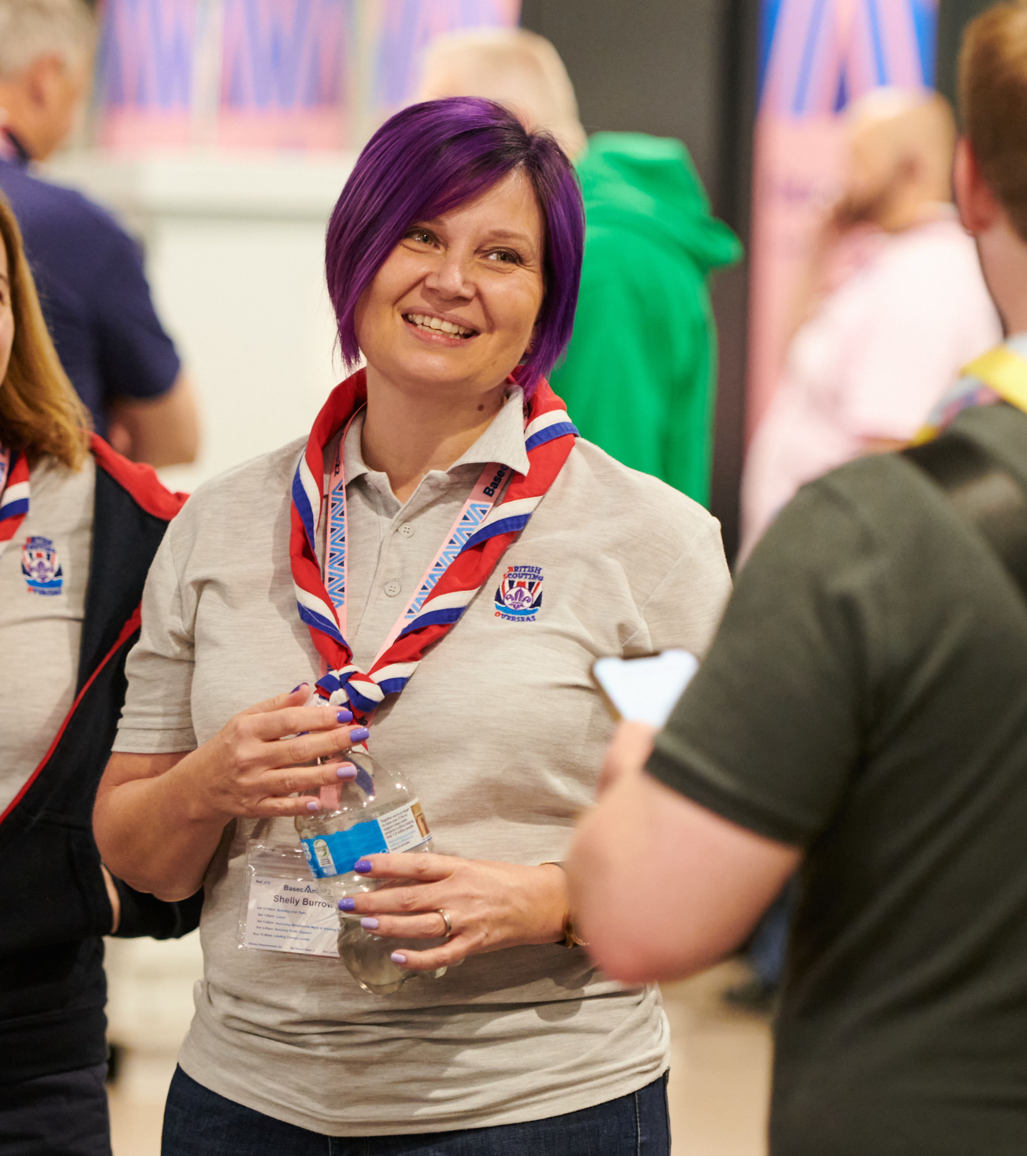
Transformation Lead Call - January 23
Networking Session Two
Same breakout rooms as before
Discuss;
What else would you want to add to the list of actions we’ve pulled together?
What else would you like to see on future Transformation Leads calls in terms of function and format (More networking sessions etc.)
What resources have you created to support your local area?
Notes:
Susan

Slide 27
Feedback Session
Notes:
Rob

Slide 28
Next Steps
Notes:
Craig

Slide 29
Transformation Lead Call - January 23
Next Steps
Next Steps
Use resources and tools to build understanding locally including "Is My Patch Ready for Change?“
Continue sharing information in your local areas
Continue getting Compass data up to date
Join the Facebook group and/or use Transformation.Leads@scouts.org.uk for questions and support
https://www.facebook.com/groups/scoutstransformation
Notes:
Craig

Slide 30
Thank You
Notes:
Craig

