Slide 1
Transformation Lead Call

Slide 2
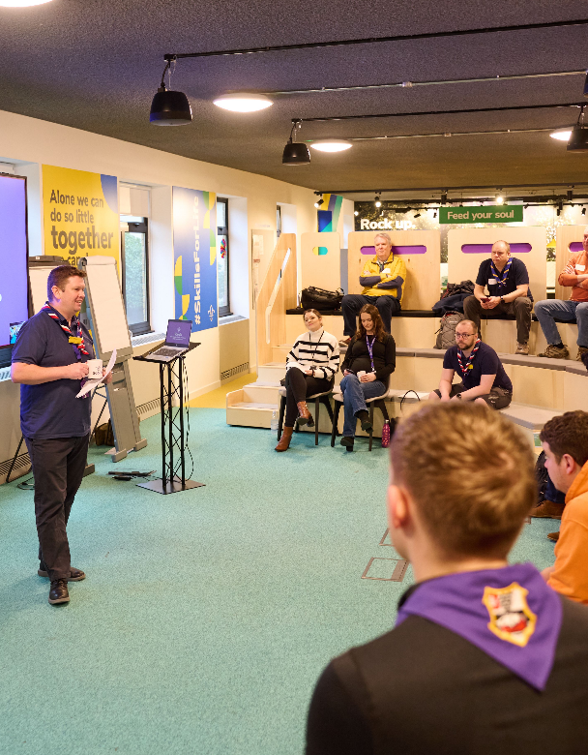
Who's on the call?
  Craig Turpie, Deputy UK Chief Volunteer
  Jack Caine, UK Lead Volunteer for People
  Andrew Sutherland, Deputy Programme Sponsor
  Rebecca Young, Head of Digital Delivery
  Hamish Stout, Project Sponsor, Change and Infrastructure
  Elizabeth Stormfield & Rob Groves, Change Team
  Adam Ray, Communications Manager

Slide 3

What we’ll cover
  Update on Digital System
  Open Forum
  Change Readiness overview
  Go-Live Support Teams
  Data Readiness
  Open Forum
  Next Steps & Close

Slide 4
Update on Digital System

Slide 5



Any Questions?

Slide 6
Change Readiness overview

Slide 7
Change Readiness Overview
Overall RAG - Progress so far
Nov 23
Jan 24
June 24
Predicted RAG at Go-Live
Nov 23
Jan 24
June 24

Slide 8
Change Readiness Overview – Jan 24

Slide 9
Change Readiness Overview – June 24

Slide 10

  Key Themes
Communicating Locally
Some areas haven’t yet communicated with or cascaded to their Districts or Groups
District & Group Readiness
District and Group readiness is still a key area to work on, though great progress has been made
Accreditations
Some uncertainty around how accreditations will work
Timing with digital system
Several areas holding back from doing any further work until the launch date of the digital system is confirmed

Slide 11
Go-Live Support Teams

Slide 12
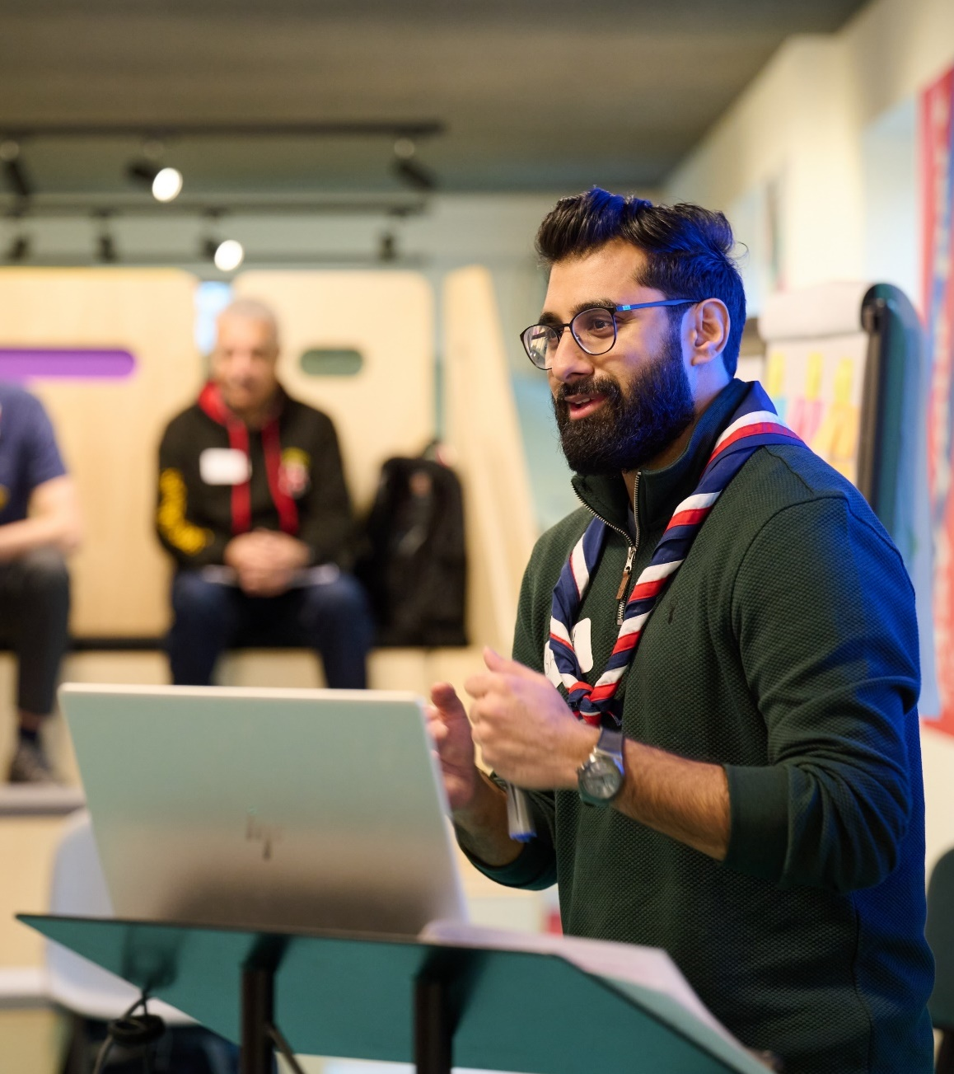
  Go-Live Support Teams
This is the team local volunteers will go to first to ask questions about changes to local processes or the new digital tools
We’ll be holding an online introduction for all of those interested in being part of this role in mid-July.
Let us know who is on your team - you already have via the link from our last newsletter
(You can add more people or change them later)

Slide 13
Data Readiness

Slide 14

  Report Sharing
In the first week of July, alongside your usual compliance reports, all County & District Lead Volunteers and Transformation Leads will get a report showing some key data migration issues.
An updated report will be shared again at the beginning of September.

Slide 15
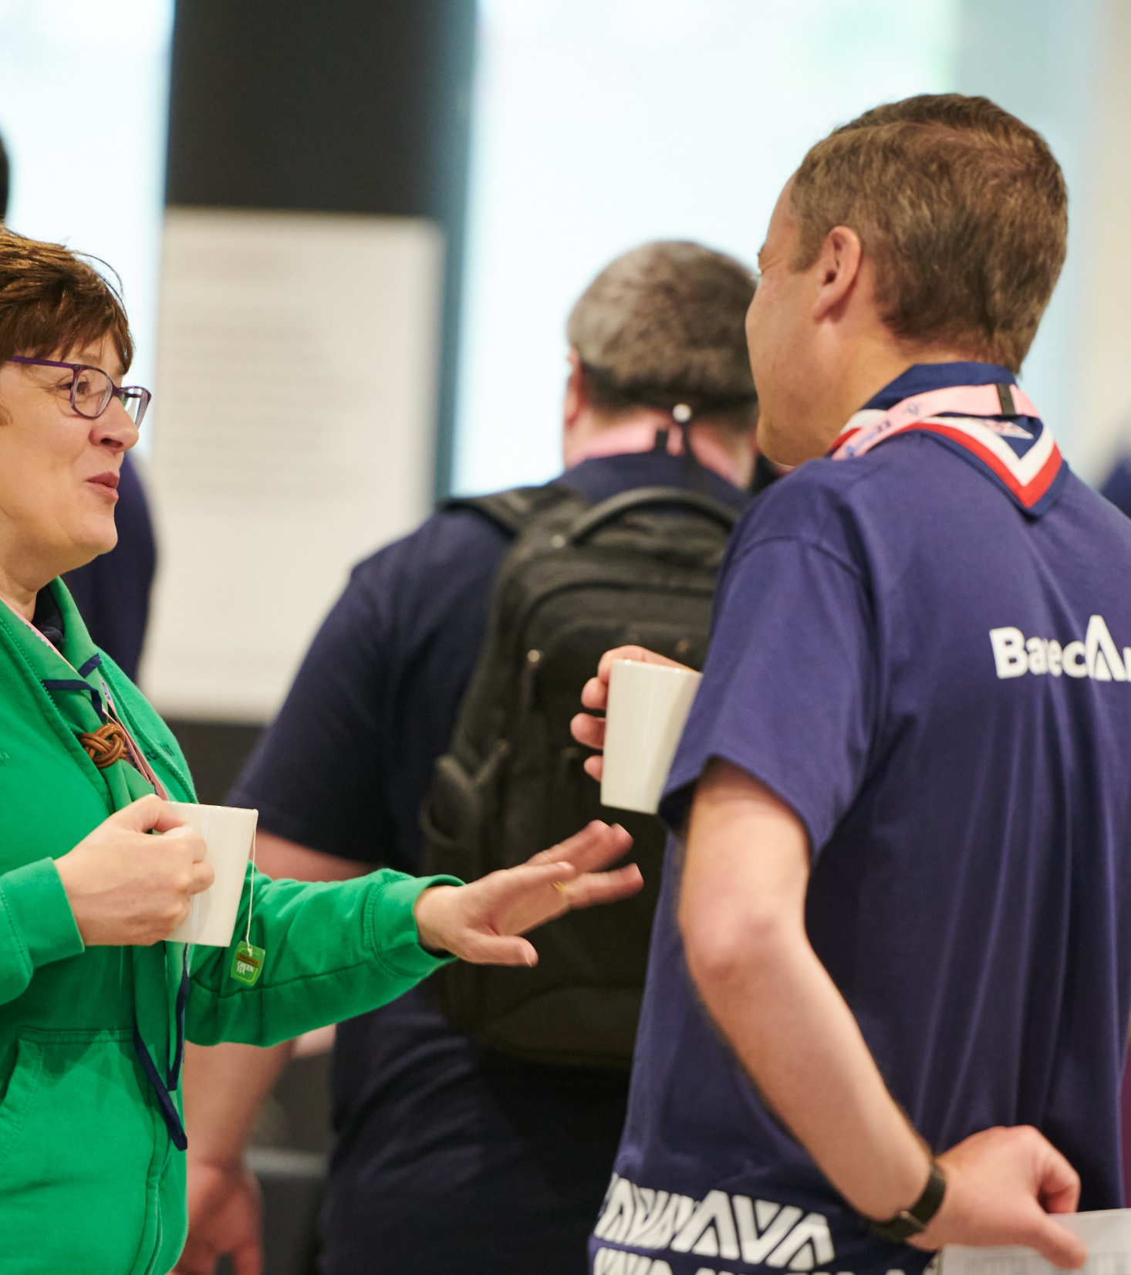
  Data Readiness
Make sure each volunteer’s records on Compass are as up to date as possible – this is extremely important to support a smooth migration.
Without up-to-date records when volunteers migrate across, local line managers will need to support volunteers to:
Contact the Support Centre to create a username
Update role(s) which have mapped incorrectly
Update missing information which needs adding to the new system
Undertake learning that they have already completed

Slide 16
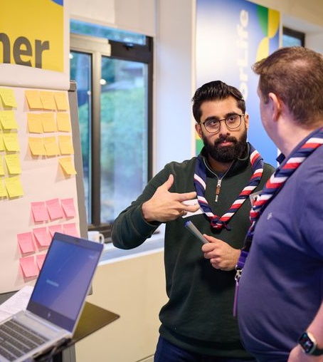
  How to get Compass updated
Now we’re going to run through:
What to update on Compass
Why these need updating
How to update them
Where to get information or reports

Slide 17

  Email Addresses
  Essential
What:
Add missing emails and correct duplicate emails – volunteers need a personal (not role-specific) email
Why:
2,314 volunteers have no email address. 4,486 volunteers only have a duplicated email address.
Usernames need to be generated for each person and that needs to be a unique email address.
It also makes sure communications are sent to the right email.
How:
Missing and duplicates shared in upcoming report
Role-specific requires individual checking

Slide 18
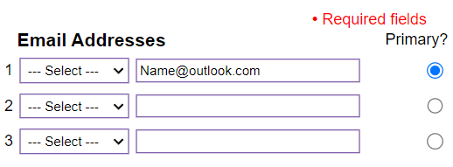
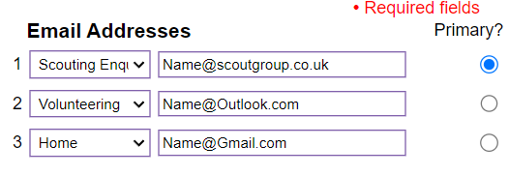
Email addresses
Can easily find missing email addresses from Compass appointments report
Can also find duplicate email addresses from Compass appointments report
Correct Email Setup Examples:

Slide 19
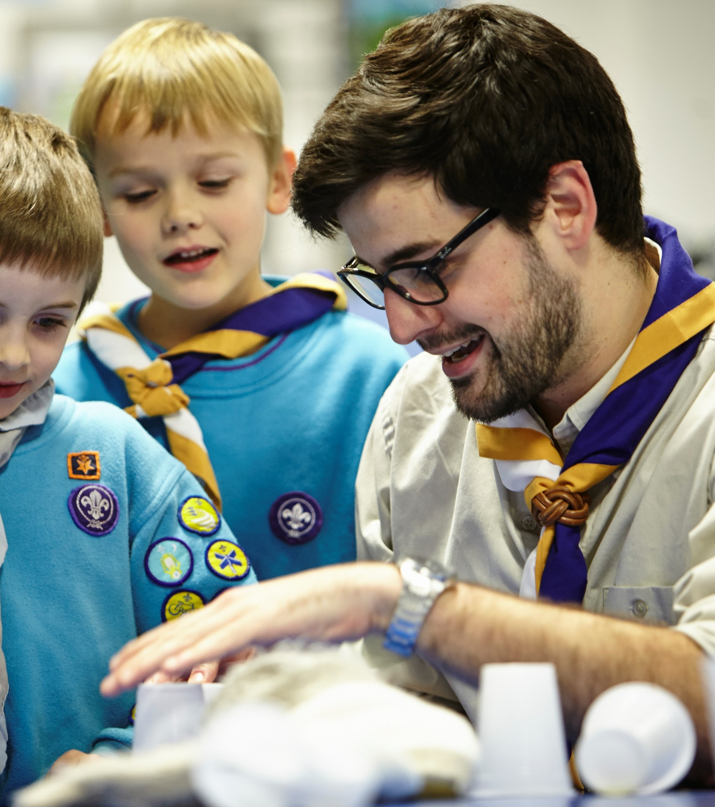
  Training Validation
  Essential
What:
Make sure all completed training is shown as validated on Compass
Why:
Training modules not showing on Compass as validated will not be migrated
The learning requirements for each volunteer on the new system will be determined from what is migrated
How:
Use the Compliance Assistant and the Training Assistant (links on https://www.scouts.org.uk/volunteers/running-things-locally/recruiting-and-managing-volunteers/welcome-managers-in-scouting)

Slide 20
Compliance Assistant Report – sample columns

Slide 21
Training Assistant Report – sample columns
R = Required V = Validated

Slide 22
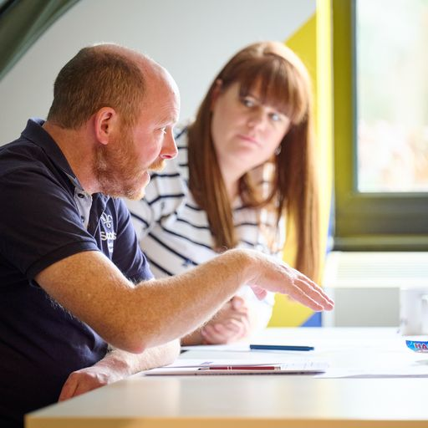
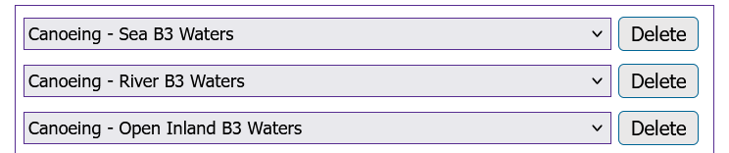
  Assessors with multiple variants
  Essential
What:
307 Assessors have one Assessor role with multiple variants, rather than one role per Assessor skill. This needs updating.
For example:
Why:
Where there are multiple variants, only the first will be migrated – the others must be manually input after migration.
How:
Use the report in early July to highlight changes needed.

Slide 23
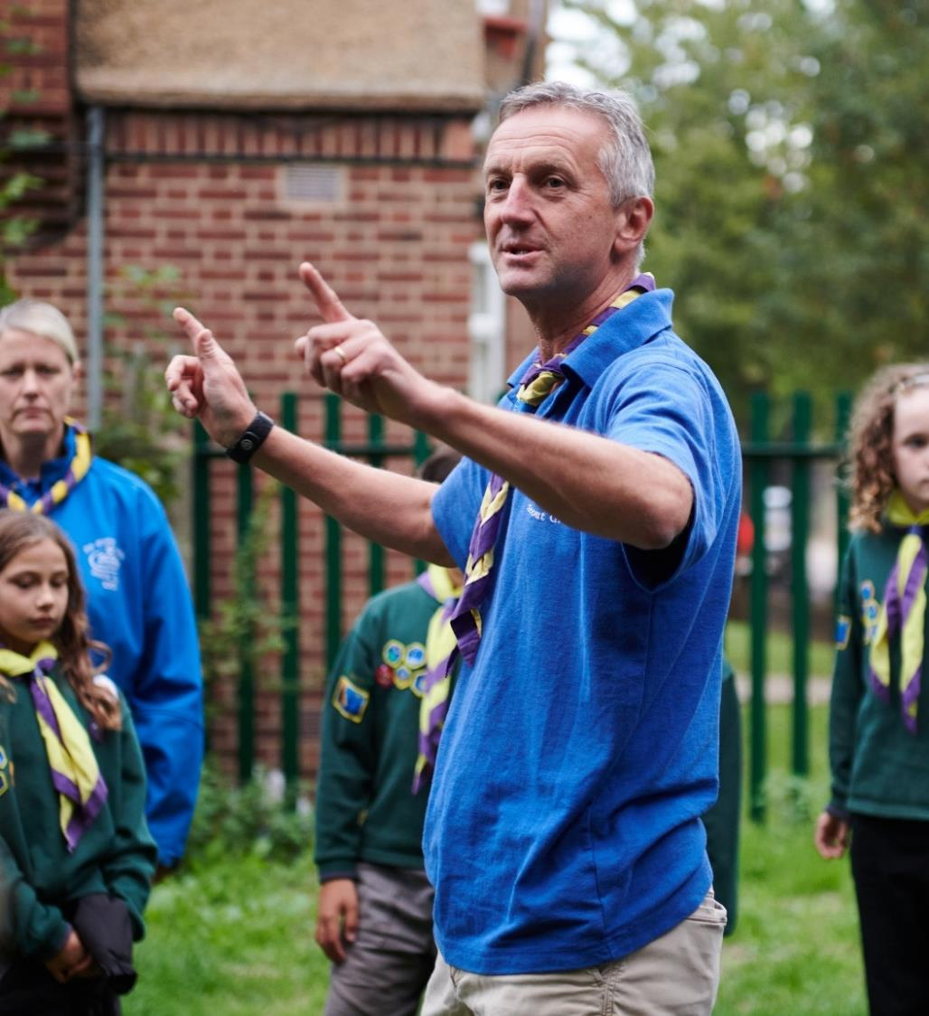
  Accurate Roles
  Preferred
What:
Close roles that are no longer active.
Close Occasional Helper or PVG-only roles that are no longer active.
Also, note that the same multiple variants points applies, as for Assessors.
Why:
To minimise the number of wrongly allocated, or unallocated, roles after migration
How:
Action for Group, District and County Lead Volunteers

Slide 24
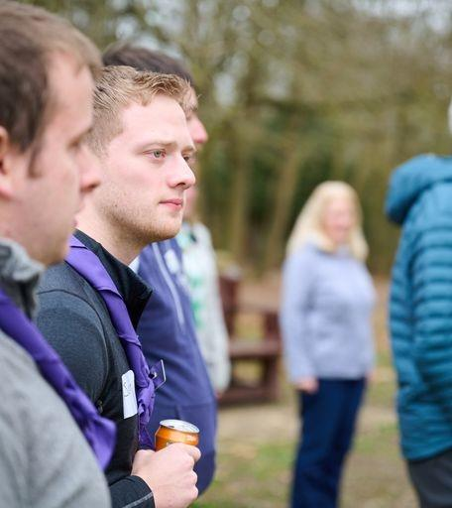
  Wrong roles at section level
  Preferred
What:
Some Section team members on Compass show as SASU members or Supporters rather than Section Leaders, Assistant Section Leaders.
Also a few Unit Leader roles (for Explorers) are held at County level
Why:
There are 759 of these who will not transition. And SASUs will not be migrated.
How:
Move to correct roles in the Section, or in a SASU.

Slide 25
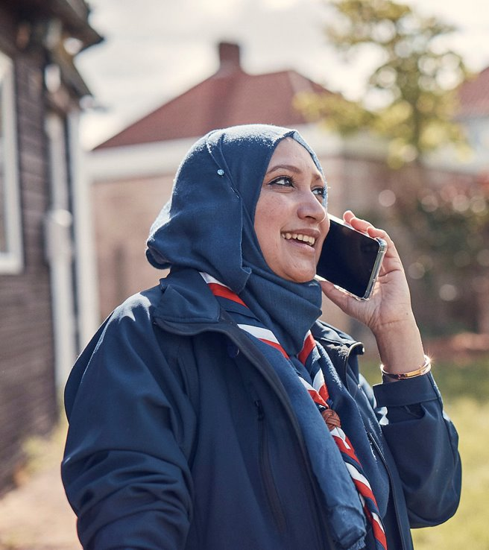
  Section roles at wrong level
  Preferred
What:
Many roles show at District or Group level instead of as part of a Section (Section Leaders and Assistant Section Leaders, Section Assistant).
Why:
There are 2,800 of these. These will not migrate to the new system because they are not in sections that will migrate.
How:
We will tell you who they are!!

Slide 26
  Report Sharing
In the first week of July, alongside your usual compliance reports, all County & District Lead Volunteers and Transformation Leads will get a report showing the following:
Wrong roles held at Section level i.e. SASU or Supporter
Section roles held at wrong level i.e. Section Assistants at Group or District Level
Assessors with multiple variants in a single role
Roles with no email address recorded or where emails have been undelivered centrally
Duplicated email addresses
Along with instructions on what needs to be done with each of these

Slide 27
Any Questions?

Slide 28


Next Steps

Slide 29
  What we’re doing:
  What you can do:
Ensure local data readiness - Transformation Leads need to make sure they have a phone number recorded on Compass
Continue working with your Districts and/or Groups to be ready for migration
Recruit and share with us the members of your Go-Live Support Team
Producing more reports, tools and support for data readiness
Data Migration webpage covering all personal, learning and role migration details will be shared along with the Data Migration Issues Report
Building webpages walking through process changes during Compass freeze

