Slide 1
Welcome to the
Transformation Leads call
Notes:
Craig

Slide 2
Who's on the call?
Craig Turpie, Deputy UK Chief Commissioner
Jack Caine, UK Commissioner for People
Lara Burns, Chief Digital Officer and SRO for Volunteer Experience
Hamish Stout, Deputy UK Commissioner for People (Transformation)
Helen Mitchell, Interim Communications Manager
Lauren Golding, Senior Communications Manager
Bebbe Hron, Lucy Burrows-Smith, Pete Jeffreys, Volunteer Journey Team
Kirsty Waugh, Susan Wallace, Rob Groves, Change Team
Notes:
Craig

Slide 3
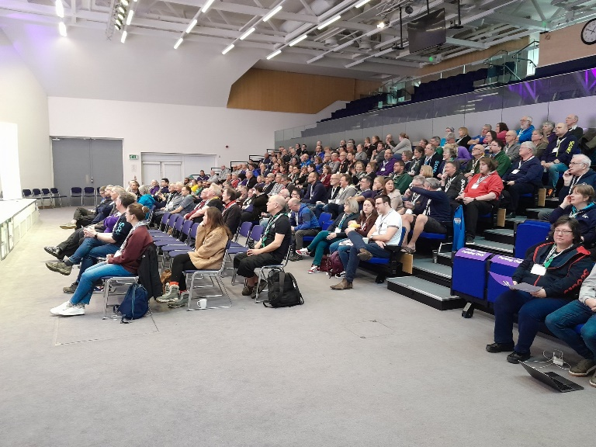
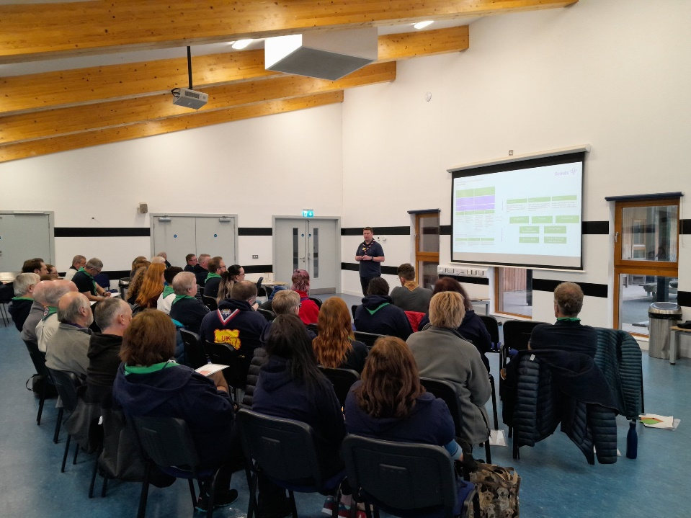
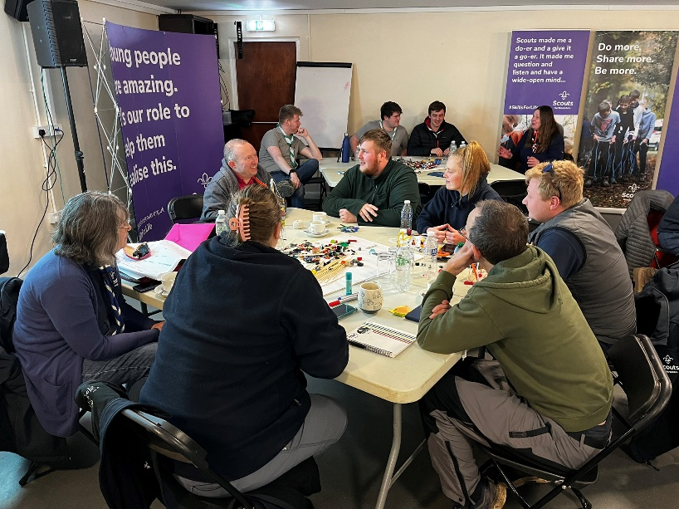
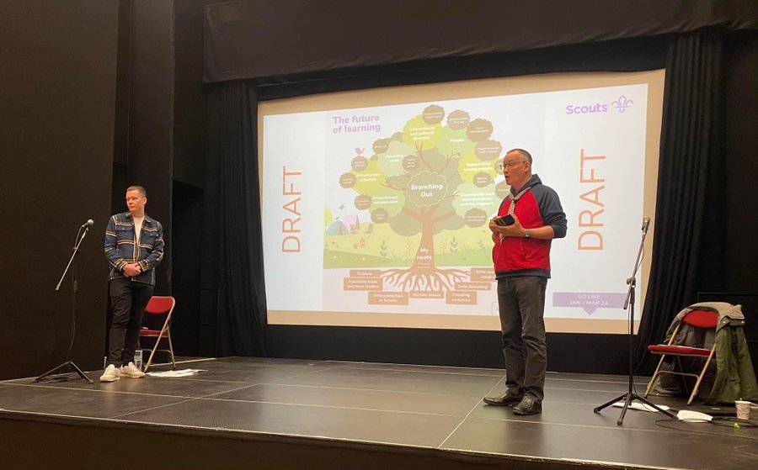
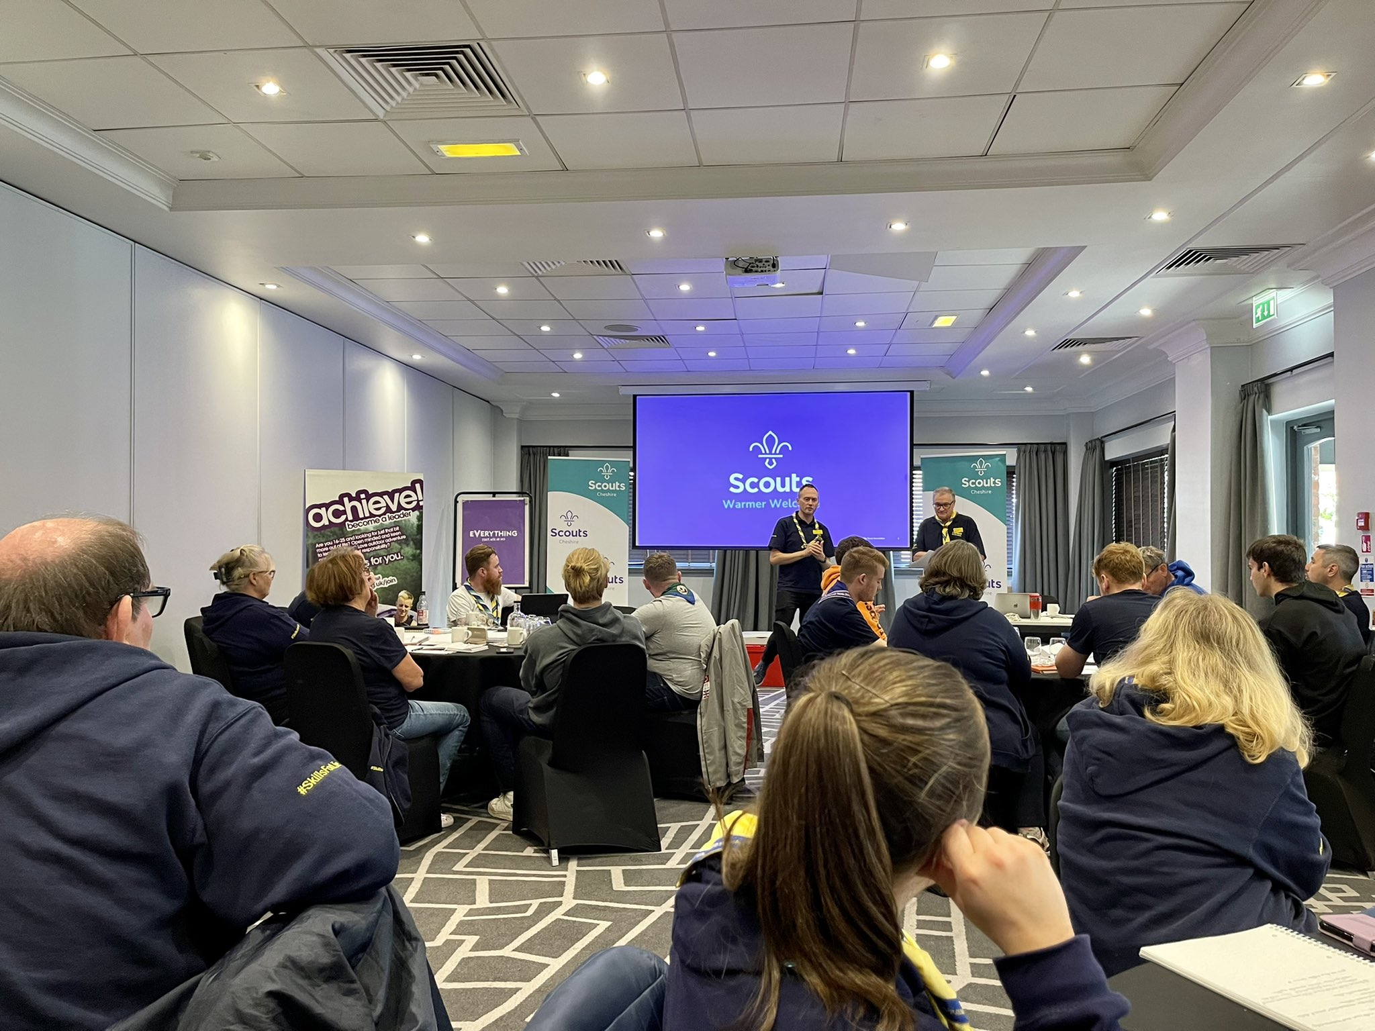
Purpose
Roadmap for Change
Trustee Board Changes Update
Open Forum
Change Planning Tool
Next Steps
Notes:
Craig

Slide 4
Roadmap for Change
Notes:
Hamish

Slide 5
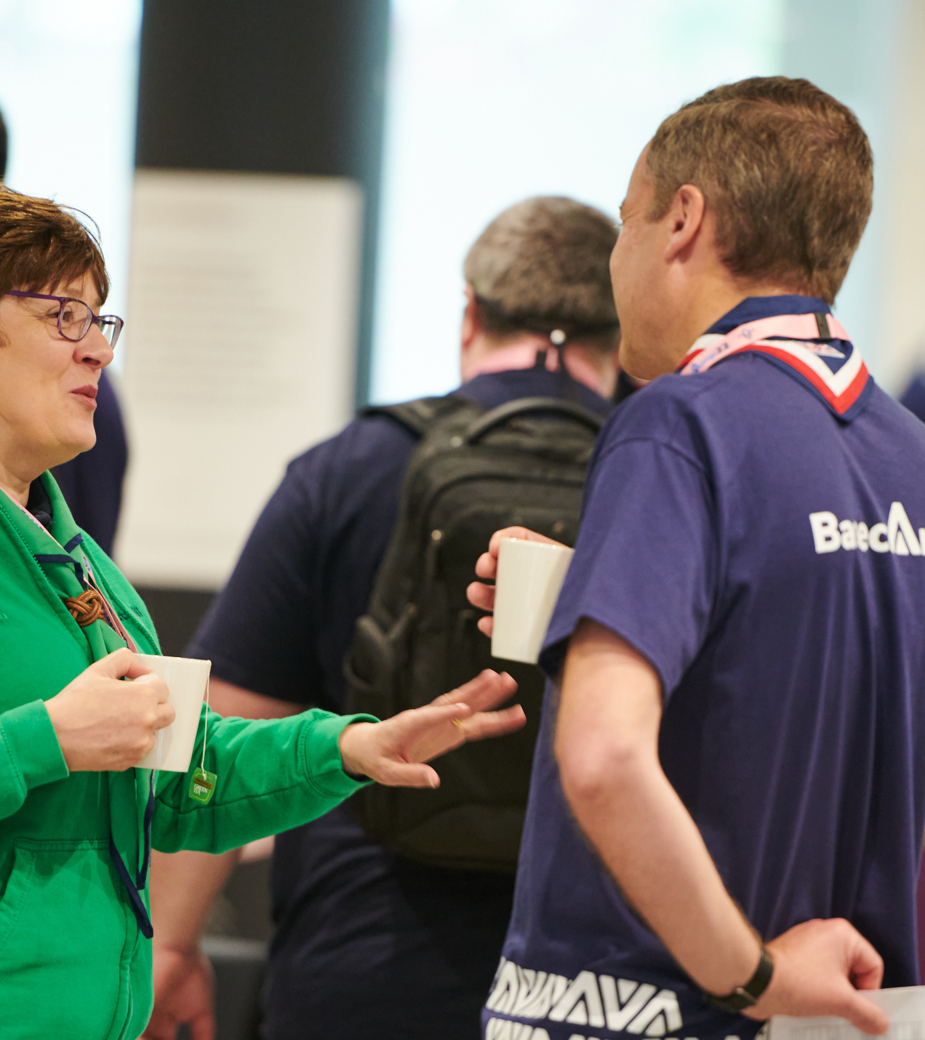
Roadmap for Change
The Volunteer Experience programme is focussed on making cultural changes to how we volunteer in Scouting
These cultural changes are supported by a series of digital tools
Parts of these cultural changes will come before we release the new digital tools
Further cultural changes will then be supported by the release of these tools
Notes:
Jack

Slide 6
What changes are happening pre-digital tools?
Team-Based Approach
We will be moving from our current roles and structures to a team-based approach to volunteering
This will then be formalised when the new membership system goes live
Resources to support this will be made available during April 23
Our Volunteering Culture
We will be introducing "Our Volunteering Culture" into the way we volunteer
This culture change will take some time to embed, so it is important to start this process soon
Resources to support this will be made available during April 23
Trustee Boards
We will be moving from Exec Committees & Exec Committee members to Trustee Boards & Trustees
We will be aligning with Charity Commission good practice
Resources to support this will be shared in March 23 with the finalised POR version releasing in April 23
Additional
Clarification around the purpose and boundaries of the ‘Occasional Helper’ role
Mapping of current training to new core learning
Continued focus on training compliance
Notes:
Jack

Slide 7
February
What you’ll need to do
The Roadmap for Change
What cultural changes will be coming before the digital systems
What changes will come alongside the digital systems
What resources you’ll get and when you’ll get them
Change Planning Tool
A tool to translate the Roadmap for Change to your local area
Compliance
Continued focus on training compliance
Use the roadmap for change to start or continue your local change planning
Use the draft team descriptions to help your area understand what their future teams will look like
Plan briefings for District & Group Chairs on the Trustee Board Changes for Mid-March onwards
Continue focus on training compliance
Continue cleaning up Compass data
Continue informing your area about the upcoming changes through events, local emails and more
Notes:
Jack

Slide 8
March
Information and resource pack for Trustee Board changes on March TL call
Early look at Culture and Teams resources which will be shared as finalised versions in April 23
Additional guidance on cleaning up Compass
Time on Transformation Leads calls to share progress with current local planning and collaborate with other areas
What you’ll need to do
Complete your local change plan, including non-digital changes and other activities, up to September 23
Plan & deliver briefings for District & Group Chairs on the Trustee Board Changes Mid-March onwards
Continue cleaning up Compass data
Continue informing your area about the upcoming changes through events, local emails and more
Continue using the draft team descriptions to help your area understand what their future teams will look like
Notes:
Jack

Slide 9
April
What you’ll need to do
Our Volunteering Culture Resources
Our Volunteering Culture Statement
Video explaining Our Volunteering Culture and whys it’s important
Interactive workshop and guidance to help review and implement Our Volunteering Culture
Team Resources
Team descriptions, including named role and accreditation descriptions
Role mapping from current roles to new teams
Supporting guidance for building new teams
Guidance for changing an Executive Committee into a Trustee Board
Change Resources
Video introducing cultural changes happening pre-digital transition
Webinar for District/County/Area/Region (Scotland) Commissioners to understand how these changes fit into the wider Volunteer Experience changes and the Skills for Life Strategy
POR
Trustee Board & Constitution updates
Notes:
Jack

Slide 10
April
Use the team resources to finalise the plan of what your new teams will look like
Start introducing Our Volunteering Culture to your volunteers
Start introducing use of teams in Groups, Districts, Counties
Start introducing the Trustee Board changes via AGMs for Groups/Districts/Counties/Regions/Areas…
Continue cleaning up Compass data
Continue informing your area about the upcoming changes through events, local emails and more, using the new videos and other resources to support this
Continue delivering briefings for District & Group Chairs on the Trustee Board Changes
Notes:
Jack

Slide 11
May
Mapping of current training modules to new Growing Roots base learning content (The learning every member will need to complete)
Digital Skills Tool Launch and supporting resources
Time to share how work is progressing in your areas and tips for success along with support for any challenges being faced
What you’ll need to do
Use mapping of current training to new learning to support your local planning and compliance
Ensure all local members are aware of upcoming changes and what they need to do
Get to know the Digital Skills Tool and plan how you will introduce this in your area
Continue cleaning up Compass data
Continue introducing Our Volunteering Culture
Continue introducing use of teams in Groups, Districts, Counties etc.
Continue introducing the Trustee Board changes via Group/Districts/County AGMs
Notes:
Jack

Slide 12
June
Sharing with Transformation Leads draft plans on how Branching Out will look and work
Sharing with Transformation Leads draft plans for how the Wood Badge will change
What you’ll need to do
Continue cleaning up Compass data
Continue ensuring all local members are aware of upcoming changes and what they need to do
Continue introducing Our Volunteering Culture
Continue introducing use of teams in Groups, Districts, Counties
Continue introducing the Trustee Board changes via Group/Districts/County AGMs
Continue to introduce the Digital Skills Tool in your area and increase usage
Notes:
Jack

Slide 13
July - September
July
POR - This will be the final version of POR for Counties to use prior to their transition and will apply in every County until their transition to the new digital solutions in February
September
Growing Roots (Role Specific) learning content
What you’ll need to do
Utilise additional mapping of current training to new learning to further support planning
Continue cleaning up Compass data
Continue introducing Our Volunteering Culture
Continue introducing use of teams in Groups, Districts, Counties
Continue introducing the Trustee Board changes via Group/Districts/County AGMs
Continue to introduce the Digital Skills Tool in your area and increase usage
Notes:
Jack

Slide 14
Aims for September
Understood –
Your volunteers are aware of Our Volunteering Culture and the new team structures
Your volunteers understand Our Volunteering Culture; they understand how to set up the new District and County team structures, what tasks each team does, and the team responsibilities of Sections and Groups
Your Executive Committee members understand the purpose and tasks of Trustee Boards
Planned -
Your volunteers have planned how they are going to set up their new teams and what steps to take to implement Our Volunteering Culture
Your Executive Committees have planned how they will become Trustee Boards
Now Delivering -
Your volunteers are implementing Our Volunteering Culture, setting up the new District and County team structures (or be on the way to having this structure), and are operating in a team-based volunteering way
Your Executive Committees will have become Trustee Boards (or are on the way to), and are operating in this way
What you’ll need to do
Notes:
Jack

Slide 15
October
Guidance on:
Team (Self) Reviews
Permits & Nights Away
New welcome processes
Changes to disclosure process
Using the new recruitment tool
Further areas of change coming with digital tools
POR
All changes needed by a County from the point of their transition
This will be the version of POR for Counties to use from the time of their transition
What you’ll need to do
Provide additional support to Districts and Groups which are continuing to move to the new team-based volunteering model
Provide additional support to Districts and Groups which are continuing to move to Trustee Boards
Use the POR version for post-transition and new guidance to prepare teams for transition
Continue cleaning up Compass data
Continue embedding Our Volunteering Culture into new teams
Notes:
Early Adopters will be covered this weekend

Slide 16
November – January 2024
Details of transition plan
User guides on digital solutions
Training & Webinars
Digital systems
Welcome Conversations
Early Adopter Learnings
Prepare for systems go live
Prepare for migration of members to the new systems
Attend training on digital tools, absorb user guides and disseminate information
Field questions and support your local transition
Continue cleaning up Compass data
Continue embedding Our Volunteering Culture into new teams
What you’ll need to do
Notes:
Early Adopters will be covered this weekend

Slide 17
February 2024
Digital Tools Go-Live
Start utilising the new POR version
Support your local area to utilise the systems
Ensure new team structures at all levels are reflected on the membership system accurately
Field questions and support your local transition
Continue embedding Our Volunteering Culture
What you’ll need to do
Notes:
Early Adopters will be covered this weekend

Slide 18
March 2024 Onwards
Ongoing additional support
Further Early Adopter case studies and learnings to support and provide tips
Targeted support for those having difficulty utilising the new digital tools
Celebrate your successes!
Feedback on future needs for digital systems
Continue embedding use of digital tools into all areas
Continue embedding Our Volunteering Culture
What you’ll need to do
Notes:
Early Adopters will be covered this weekend

Slide 19
Roadmap for Change -
Summary
Notes:
Rob

Slide 20
High Level Roadmap for Change – 90%
Change Planning
Cleaning up Compass
Brief on Trustee Board Changes
Start planning your new teams
Cleaning up Compass
Start introducing Our Volunteering Culture
Start introducing use of new teams
Start introducing Trustee Board changes
What you'll need to do
JANUARY – MARCH 23
APRIL – JUNE 23
Roadmap for Change
Change Planning Tool
Further guidance on Compass clear up
Trustee Board resource pack
Our Volunteering Culture Resources
Team Resources
Change Resources
POR update - Trustee Boards
Digital Skills Tool
More Growing Roots learning details
What we'll provide
Notes:
Rob

Slide 21
High Level Roadmap for Change – 90%
Start utilising the new POR version
Support your local area to utilise the digital tools
Ensure new team structures at all levels are reflected on the membership system accurately
Continue embedding Our Volunteering Culture
Continue embedding digital tools into all areas
Continue embedding Our Volunteering Culture
Feedback on future needs for digital systems
Celebrate our successes!
What you'll need to do
FEBRUARY 24
MARCH 24 Onwards
DIGITAL TOOLS GO-LIVE
Ongoing support
Early Adopter case studies and learnings
Targeted support
What we’ll provide
Notes:
Rob

Slide 22
High Level Roadmap for Change – 90%
Cleaning up Compass
Continue introducing Our Volunteering Culture
Continue introducing use of new teams
Continue introducing Trustee Board changes
Utilise POR version for post transition to prepare teams for transition
Cleaning up Compass
Provide additional support to those continuing to move to new teams and Trustee Board changes
Continue embedding Our Volunteering Culture
Prepare for migration to new digital tools
What you'll need to do
JULY – OCTOBER 23
NOVEMBER 23 – JANUARY 24
Final POR edition pre-digital transition
Further Growing Roots learning details
Further guidance on changes coming with the digital tools
October POR edition for use post-transition
Transition plan details
User guides for digital tools
Training & webinars in preparation for digital transition
Early Adopter case studies and learnings
What we’ll provide
Notes:
Rob

Slide 23
What changes are happening pre-digital tools?
Team-Based Approach
We will be moving from our current roles and structures to a team-based approach to volunteering
This will then be formalised when the new membership system goes live
Resources to support this will be made available during April 23
Our Volunteering Culture
We will be introducing "Our Volunteering Culture" into the way we volunteer
This culture change will take some time to embed, so it is important to start this process soon
Resources to support this will be made available during April 23
Trustee Boards
We will be moving from Exec Committees & Exec Committee members to Trustee Boards & Trustees
We will be aligning with Charity Commission good practice
Resources to support this will be shared in March 23 with the finalised POR version releasing in April 23
Additional
Clarification around the purpose and boundaries of the ‘Occasional Helper’ role
Mapping of current training to new core learning
Continued focus on training compliance
Notes:
Rob

Slide 24
What changes are happening with the digital tools?
Warmer Welcome
The formal change to the new appointment process will come at the point of transition to the new digital systems
Prior to this, areas are encouraged to utilise the guidance on the Scout website appointment panels page, but care should be taken to ensure this fits within the context of the current POR edition
Learning
The move across to an optional Woodbadge and the new digital learning will come at the point of transition to the new digital systems
Prior to this, there will be additional guidance shared around which areas Commissioners should focus on when it comes to compliance
Volunteer Journey
Digital adoption of new teams and titles will come at the point of transition
Compass will not have the new teams and titles available
Prior to this, non-digital adoption of teams and titles will be undertaken as noted on the previous slides
Notes:
Rob

Slide 25
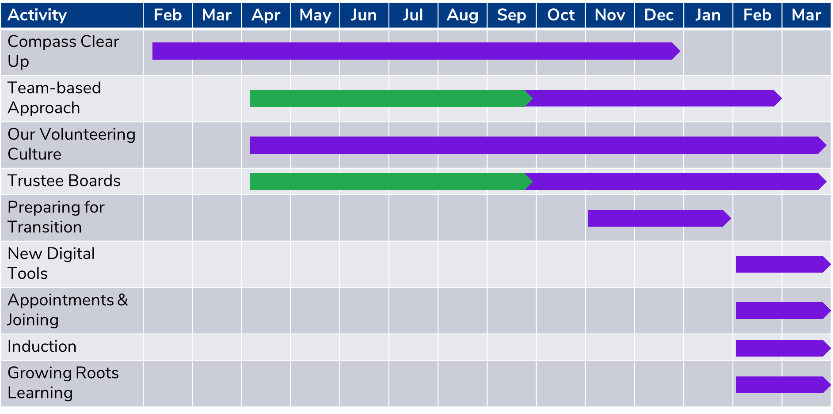
Timeline Overview
Expected time frame of activity
Time frame of activity to achieve the ‘Aims for September’
Notes:
Rob

Slide 26
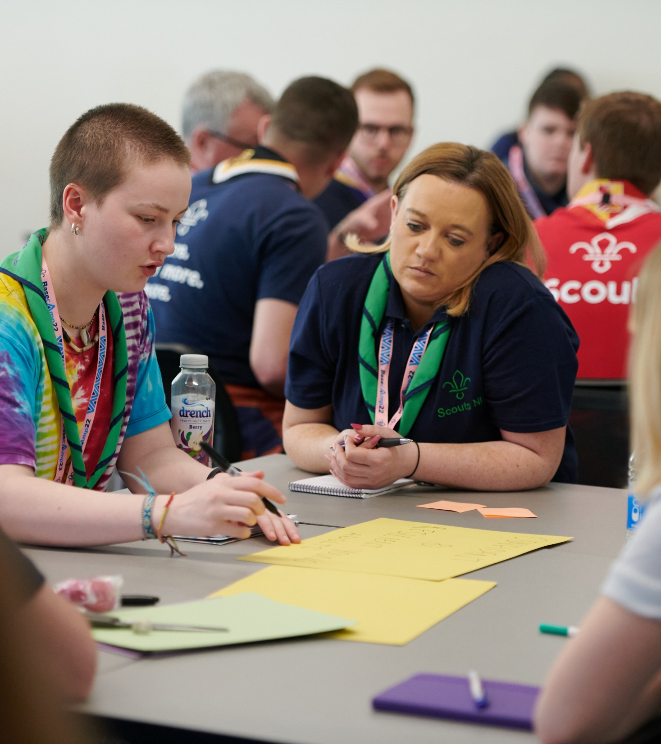
Next Steps
This timeline will be updated as we progress with more detail
We’ll provide the detailed resources relevant to what you need to be doing, at the time it’s needed
This will let you focus on what needs to be done at that time and prevent volunteers being overloaded with information
Notes:
Rob

Slide 27
Support
Resources & tools available on the Transformation Lead hub
Event support requests
Contact your neighbouring areas or your wider Region to share ideas, plan together and collaborate
Additional support requests and questions answered through:
Transformation Lead Facebook Page
Transformation.Leads@Scouts.org.uk
Notes:
Rob

Slide 28
Trustee Board changes update
Notes:
Hamish

Slide 29
Trustee Board changes update
There have been significant changes in Charity Governance by all regulators over the past few years
To ensure regulatory compliance:
Executive Committees will be changing to Trustee Boards, members of which will be called Trustees
The Trustee Board will focus on governance, making sure the charity is well managed, and everyone follows legal requirements and POR
Regulatory good practice is that Trustee Boards should comprise of at least five, but no more than twelve Trustees
Effective governance support will help other volunteers to run a fantastic programme that gives young people skills for life

Slide 30
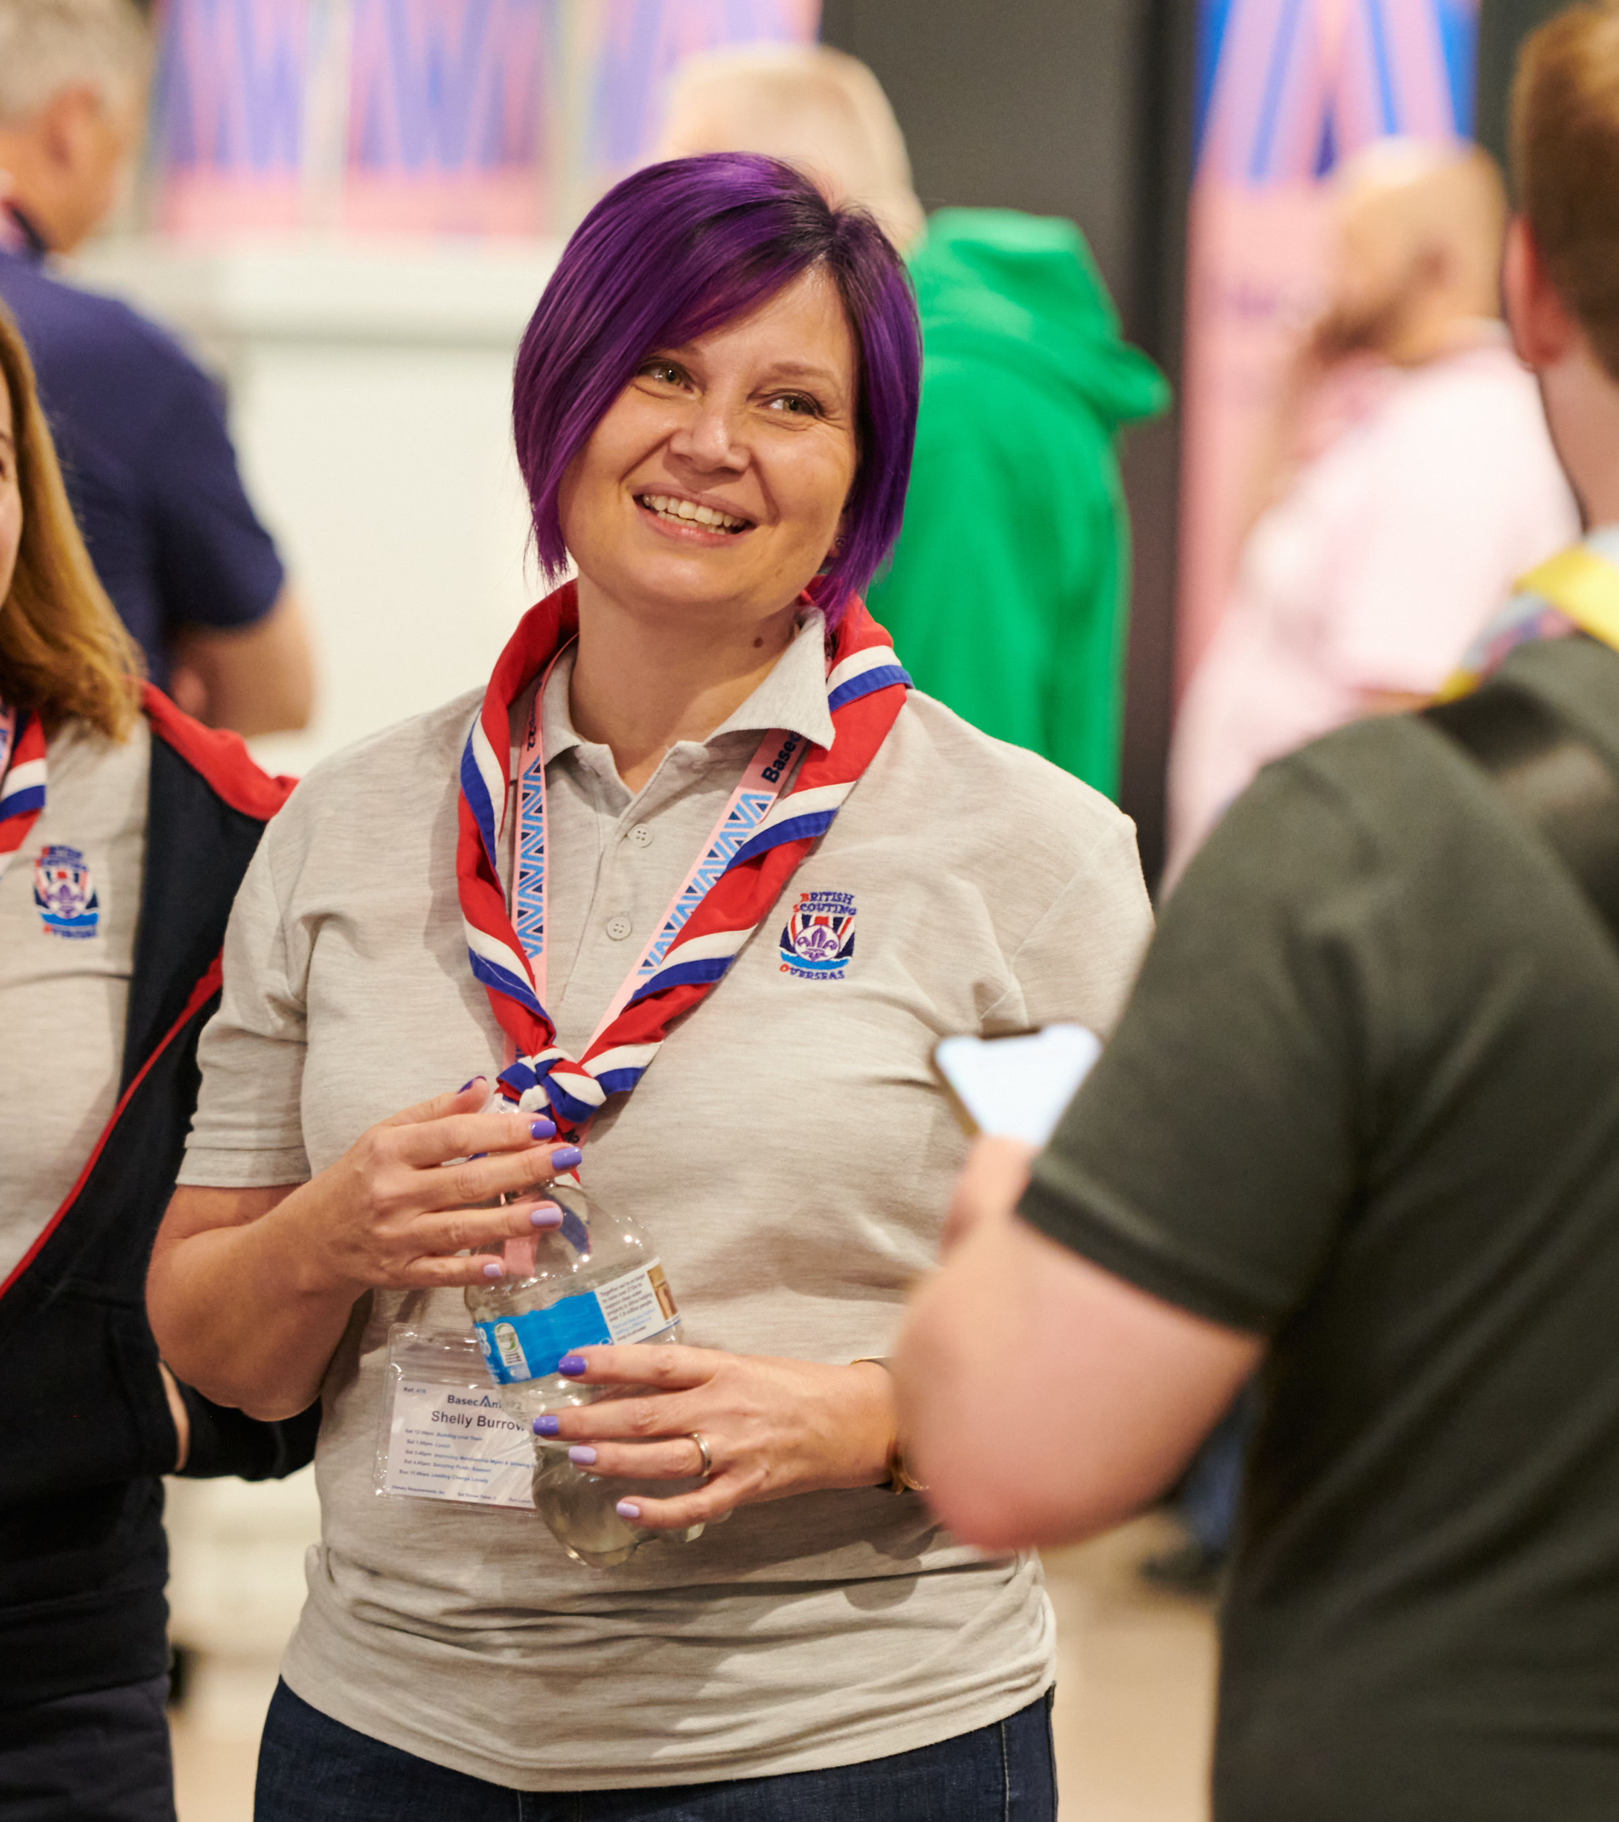
Trustee Board changes update
An update will be shared with County Chairs, County Commissioners and equivalents on 21st February leadership email
An overview of the Trustee Board changes is being shared with County and equivalent Chairs at appropriate meetings
Any further information will be shared with Transformation Leads in the follow up email from this call
March's Transformation Lead call will include a section covering the Trustee Board changes in more detail

Slide 31
Trustee Board changes update
Key Actions
Work with your County Chair to fully brief District & Group Chairs about the changes
It is important that the changes are factored into Group, District and County 2023 AGMs.
If additional time is needed, then they should consider delaying their 2023 AGM (though it must still take place within six months of the end of their financial year)
Resources to support this will be shared during March and April

Slide 32
Open Forum Q&A
Notes:
All

Slide 33
Change Planning Tool
Notes:
Susan

Slide 34
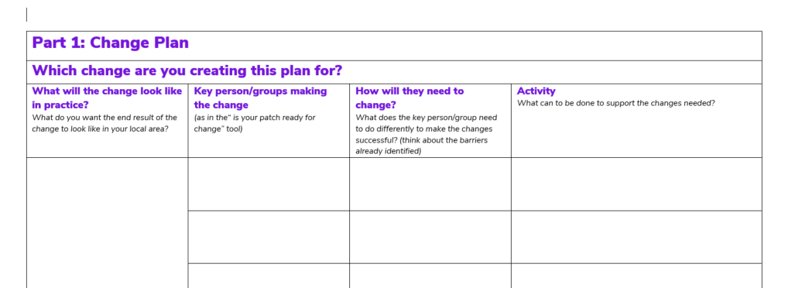
Change Planning Tool
This tool will support you to bring all the information you have together and plan actions that will allow you to implement change locally
We’ll be sharing this tool with the follow up email for this call
Notes:
Susan

Slide 35
Next Steps
Notes:
Craig

Slide 36
Next Steps
Use the roadmap for change to start or continue your local change planning
Use the draft team descriptions to help your area understand what their future teams will look like
Plan briefings for District & Group Chairs on the Trustee Board Changes for Mid-March onwards
Continue focus on training compliance
Continue cleaning up Compass data
Continue informing your area about the upcoming changes through events, local emails and more
Notes:
Craig

Slide 37
Next Steps
Request support for your local events where required
We’ll do our best to attend in person when requested
Please provide us 4-weeks or more notice
Additional support requests and questions answered through:
Transformation Lead Facebook Page
Transformation.Leads@Scouts.org.uk
https://www.facebook.com/groups/scoutstransformation
Notes:
Craig

Slide 38
Notes:
Craig

