Slide 1
Welcome to the
Transformation Leads call
Notes:
Craig

Slide 2
Transformation Lead Call - March 23
Culture & Teams Resources - Early Look
Who's on the call?
Craig Turpie, Deputy UK Chief Commissioner
Jack Caine, UK Commissioner for People
Hamish Stout, Deputy UK Commissioner for People (Transformation)
Hermione Clulow, Head of Communications
Lauren Golding, Senior Communications Manager
Pete Jeffreys, Volunteer Journey Project
Eleanor Coker, Volunteer Experience Team
Matthew Cobble, Deputy UK Commissioner for People (Operational)
James Booker, Head of Portfolio Delivery & Change
Rob Groves, Change Manager
Notes:
Craig

Slide 3
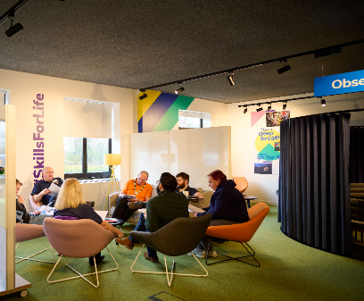
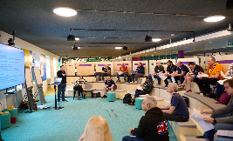
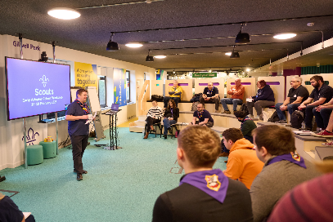
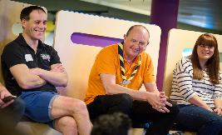
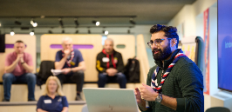
Transformation Lead Call - March 23
Purpose
Culture & Team Resources
Trustee Board Changes Update
Open Forum One
Role Title Changes
Learning Update
Open Forum Two
Early Adopter Update
Transformation Lead in Action
Next Steps
Notes:
Craig

Slide 4
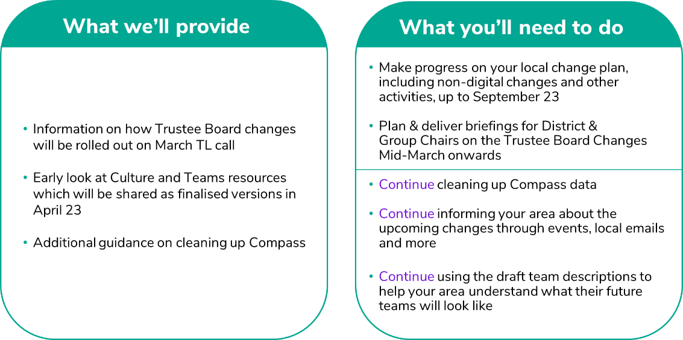
Transformation Lead Call - March 23
March
What you’ll need to do
Notes:
Craig

Slide 5
Culture & Team Resources – Early Look
Notes:
Pete

Slide 6
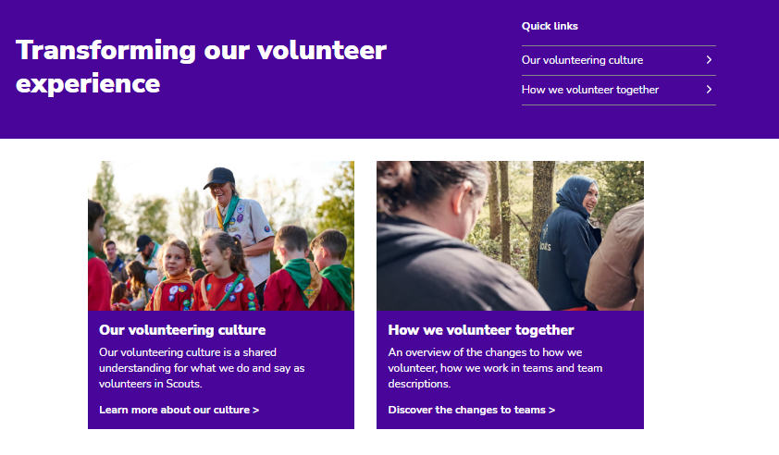
Transformation Lead Call - March 23
Culture & Teams Resources - Early Look
Culture & Team Resources
Our Volunteering Culture
Teams
How to build your teams
Notes:
Pete

Slide 7
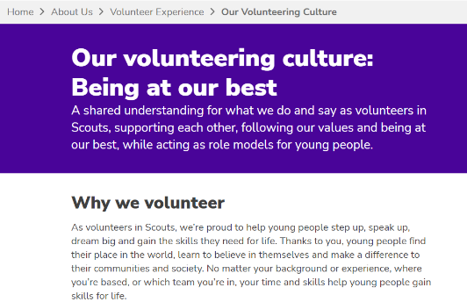
Transformation Lead Call - March 23
Culture & Teams Resources - Early Look
Our Volunteering Culture
Our Volunteering Culture resources
Our Volunteering Culture statement
Video
Guidance on putting it into practice
Activity to support introduction with teams
Notes:
Pete

Slide 8
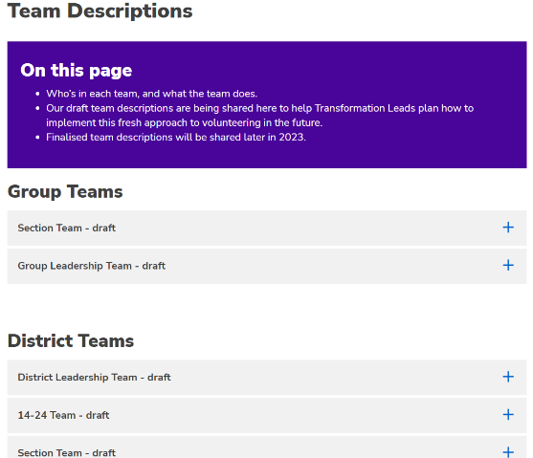
Transformation Lead Call - March 23
Culture & Teams Resources - Early Look
Teams
Teams resources
Team Descriptions
Sub-team examples
Additional volunteer roles
Accreditations overview
Notes:
Pete

Slide 9
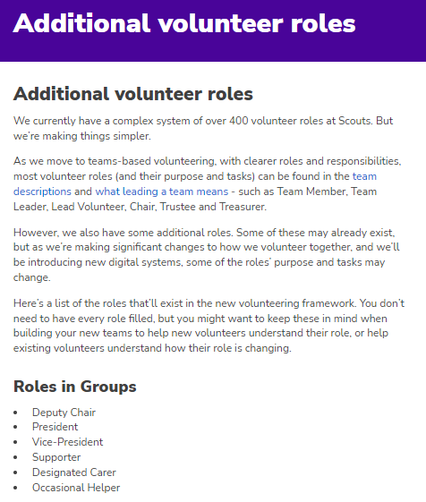
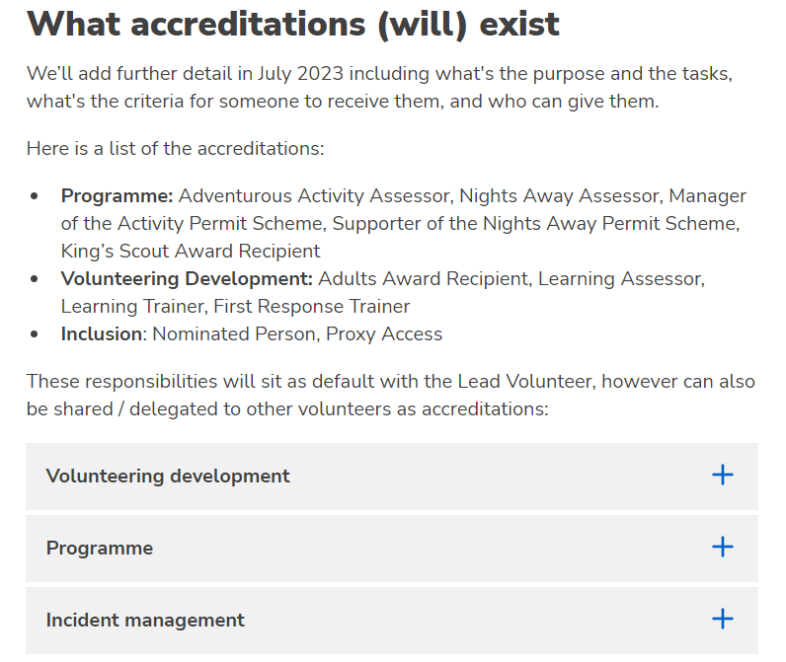
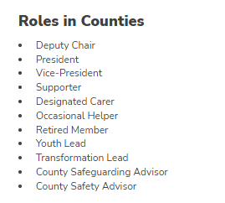
Transformation Lead Call - March 23
Culture & Teams Resources - Early Look
Teams
Notes:
Pete

Slide 10
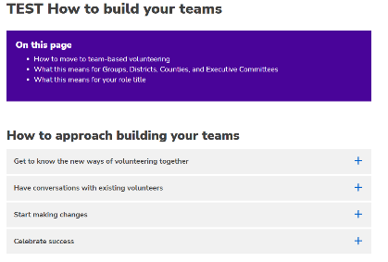
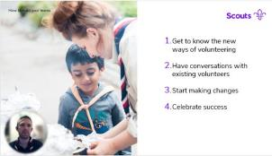
Transformation Lead Call - March 23
Culture & Teams Resources - Early Look
How to build your teams
Support for managers to build new teams
Resources for how to build your teams
Suggestions for how to approach
What this means for Groups, Districts, Counties and Executive Committees
Information for specific current teams (e.g. Appointments AdvisoryCommittees, Training)
Finding the right team
Notes:
Pete

Slide 11
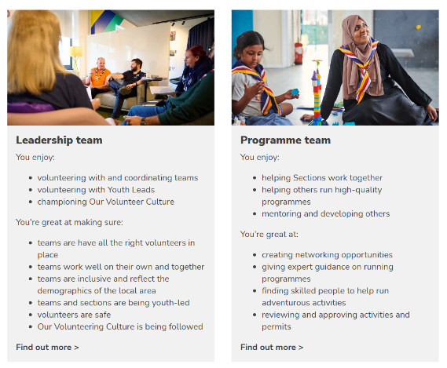
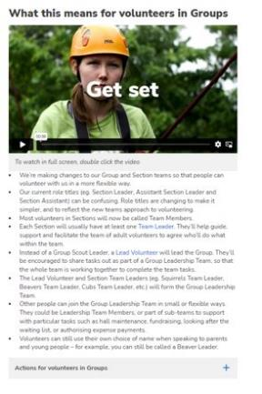
Transformation Lead Call - March 23
Culture & Teams Resources - Early Look
How to build your teams
Finding the right team
What this means for your team(s)
Notes:
Pete

Slide 12
Transformation Lead Call - March 23
Culture & Teams Resources - Early Look
Next steps
March
Draft webpages shared with Early Adopters for feedback
April
Final webpages to be shared with all Transformation Leads to aid local conversations around Teams approach and volunteering culture
Notes:
Pete

Slide 13
Trustee Board changes update
Notes:
Hamish

Slide 14
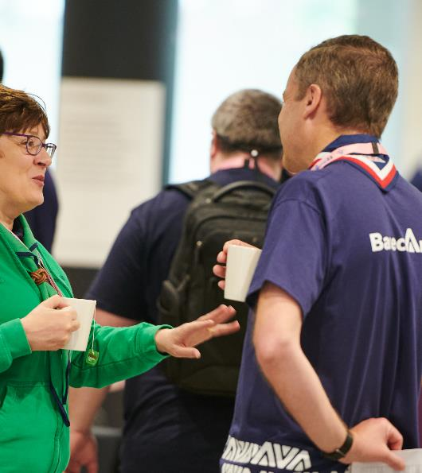
Transformation Lead Call - March 23
Trustee Board Changes
Trustee Board Culture Changes
Name
Membership
Purpose
Informed by ….
The transition to the teams-based approach
Current charity regulatory good practice advice
Notes:
Hamish

Slide 15
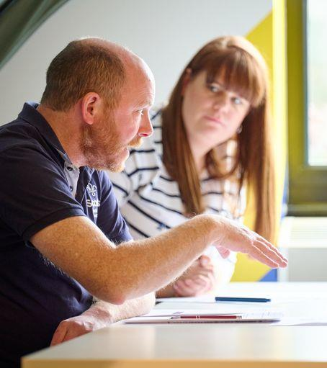
Transformation Lead Call - March 23
Trustee Board Changes
Trustee Board Changes - April 2023
Name
Membership
Purpose
Change 1
Executive Committees renamed as Trustee Boards.
Executive Committee Members renamed as Trustees.
Why?
To help reinforce focus on the real role – Trustee Boards are not fundraising committees or hall management teams. They do need to know that the hall is being managed, and that funds are being raised but their primary focus is on their role and responsibilities as charity Trustees.
When?
From publication of POR in mid-April 2023. It then happens immediately and does not need to be adopted through AGMs (indeed, it has already happened in quite a few Groups, Districts and Counties). The renaming does not need approval at an AGM.
POR updated?
In the April 2023 edition of POR, all references to Executive Committees are changed to Trustee Boards in all chapters. Similarly for Executive Committee Members being renamed as Trustees. Note that in Scotland the process to update Scottish Variations from POR may take a little longer.
Notes:
Hamish

Slide 16
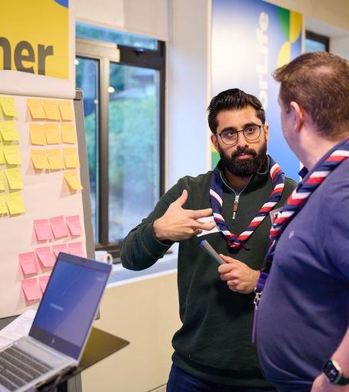
Transformation Lead Call - March 23
Trustee Board Changes
Trustee Board Changes - April 2023
Name
Membership
Purpose
Change 2
Clearer purpose statements for Trustee Boards, to fit with the ‘focus on governance’ theme. From transition this will include ‘operational’ tasks being managed through the Group Leadership Team or the Support Team in District or County.
Why?
To focus on ensuring effective governance – the absolute core of any charity Trustee Board’s responsibility and an important part of ensuring that the charity focusses on meeting its objectives. This is at the very heart of our Trustee Board culture change.
When?
From publication of POR in mid-April 2023. It then happens immediately. This change does not require an AGM to implement, particularly for the very many Groups, Districts, Counties that have already adopted the POR model constitution.
POR updated?
In the April 2023 edition of POR, chapter 5 will contain the updated ‘Trustee Board Purpose’ statements. And supporting material will also be available on scouts.org.uk (during April & May).
Notes:
Hamish

Slide 17
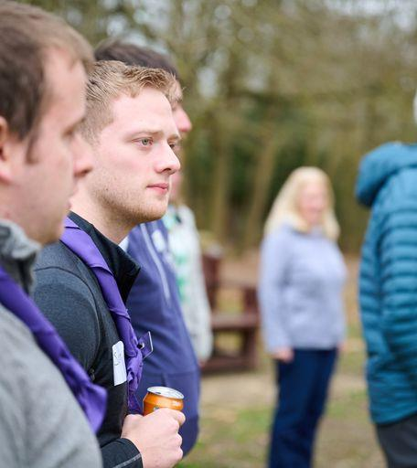
Transformation Lead Call - March 23
Trustee Board Changes
Trustee Board Changes - April 2023
Name
Membership
Purpose
Examples of elements of the Trustee Board purpose are:
Being confident that:
Young people are meaningfully involved in decision making at all levels
There are sufficient resources (funds, people, property and equipment) available to meet the planned work of the Group, District or County
The Scouts has a positive image in their local community
Developing and maintaining a risk register, including putting appropriate mitigations in place
Ensuring that:
The charity’s finances are properly managed and appropriately budgeted
Effective administration is in place to support the work of the Trustee Board

Slide 18
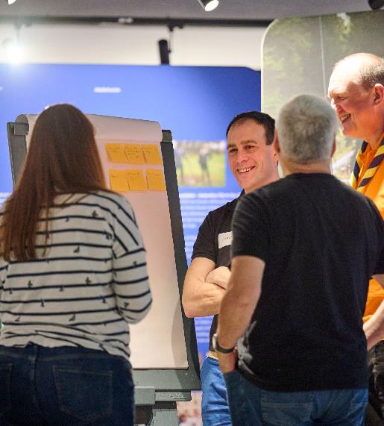
Transformation Lead Call - March 23
Trustee Board Changes
Trustee Board Changes - After transition (Nov 23 or Feb 24)
Name
Membership
Purpose
The change
Ensuring that current charity sector best practice is reflected into all aspects of Trustee Boards at Group, District and County.
Why not introduce any other Trustee Board changes during April?
It is the changing of the purpose of the Trustee Board that is vital and is at the core of Trustee Board culture change. To introduce changes other than the Trustee Board purpose may well prove to be a short-term distraction from the core culture change task.
We are determining what other changes (including 'sizing' suggestions previously discussed) may be useful as part of ensuring that we have effective Trustee Boards that follow charity sector best practice guidance - any such changes will be introduced later.
POR updated?
Further changes identified will be reflected in the October 2023 edition of POR and will be implemented after transition.
Notes:
Hamish

Slide 19
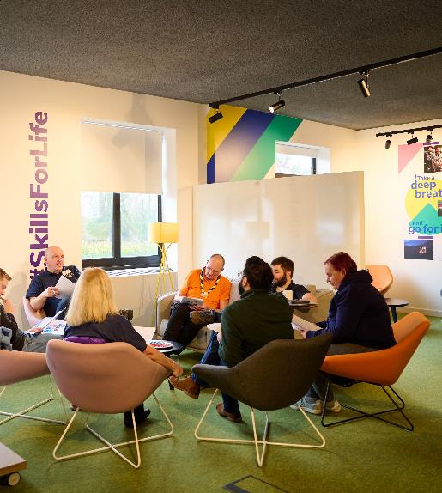
Transformation Lead Call - March 23
Trustee Board Changes
Trustee Board Changes - Next Steps
In March/April 2023, Transformation Leads should work with their County Commissioner and County Chair to plan to introduce from April 2023 onwards the Trustee Board name changes and the purpose changes in a way that reaches every current Executive Committee at Group, District and County.
The outcome must be that, prior to transition, every current Executive Committee recognises that they are now a Trustee Board. Also, that they start to use the (April 2023) purpose statements to shape their future Trustee Board agendas and their governance support for The Scouts.
IMPORTANT This evening's slides are not your 'rollout' slides but are for this evening to brief you as Transformation Leads and County Commissioners.
At the time that POR is published in April
we will make available to you a presentation
that can be used to brief the Trustees across your County.
Name
Membership
Purpose
Notes:
Hamish

Slide 20
Open Forum Q&A
Notes:
All - James facilitating

Slide 21
Role Title Changes and Communications
Notes:
Jack

Slide 22
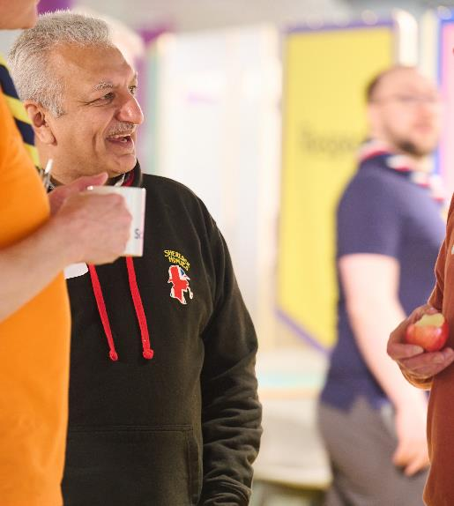
Transformation Lead Call - March 23
Role Title Changes
Role Title Changes
Support communicating what comes next
The move to a team-based approach and the new role titles that come with this are key to transforming our volunteer experience.
We are aware that titles can hold a lot of significance for some, and so talking about this change can be difficult
Resources and guidance will be produced and shared centrally to all members to provide clarity on what the role title changes are, and why they are taking place
We will talk to you soon about what’s planned and how it will be shared to ensure you are fully supported
Notes:
Jack

Slide 23
Learning Update
Notes:
Wulff/Matt

Slide 24
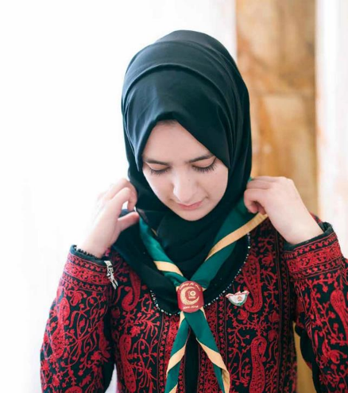
Transformation Lead Call - March 23
Learning Update
News Today
First peak at which modules might be replaced by new learning when we launch, and which will remain for a while.
Clarity that we still need trainers and validation to continue for a while yet – so don't stand people down!
Reminder of the core driver in developing the new learning – it must be a good use of time for our volunteers!
Notes:
Wulff/Matt

Slide 25
Transformation Lead Call - March 23
Learning Update
The things everyone needs to know to get started
Data Protection in Scouts
Data breaches & deleting data
What we do & How we do it
Purpose and values
Creating Inclusion
Self-awareness
Safe Scouting
Storing & sharing data
Working with others
Good communication
Running our programme (The basics)
Self-care
Creating inclusive spaces
Supporting specific needs
Challenging bias and discrimination
E-Safety
Assessing and Managing risk
Incidents - respond and report
Mental Health Awareness
Safeguarding
Gathering data
Replaces:
GDPR
Some of Module 11 (Administration)
Replaces:
Module 1 (Essentials of Scouting)
Some of Module 3 and 4 (Tools for the Role)
Module 5 (The Fundamentals)
Module 9 (Working with Adults)
Replaces:
Module 7 (Scouting for all)
Potentially some of Module 36 (Additional Needs)
Replaces:
Safety,
Safeguarding and
Some of Module 17 (Running Safe Activities)
Notes:
Wulff/Matt

Slide 26
Transformation Lead Call - March 23
Learning Update
The things you need based on the team you’re in:
"Delivery"
Section Teams
How to work with parents/guardians
"Trustee"
Trustees
Charity regulator processes
”Leading Local Scouting"
Team Leaders, Lead Volunteers
Teamwork, inclusion and conflict from a management perspective
How to actively involve young people
Running our programme (In practice)
Insurance, legal responsibilities (Inc. GDPR), equality impact assessments
Finance and asset management
Complaints, suspensions, difficult conversations
Delegation and external relationships
Replaces:
Module 12A (Delivering a quality programme)
Module 12B (programme planning)
Parts of Module 14 (Supporting young people
Parts of Module 15 (Promoting positive behavior)
Replaces:
Trustee Introduction
Parts of stand-alone Trustee Training
Replaces:
Some aspects of M&S E-learning
Allows timely delivery of some of the key content on skills courses
Potential Content*:
Potential Content*:
Potential Content*:
*Exact content is being scoped and developed during early 2023
Notes:
Wulff/Matt

Slide 27
Transformation Lead Call - March 23
Learning Update
How does it work if you don’t fall into these groupings? (e.g. Volunteering Development Team, Programme Team)
You do the learning that everybody does (Data Protection in Scouts, Safe Scouting, Who we are & what we do, Creating Inclusion)
Plus, task specific learning depending on what you are doing such as:
First aid trainer, Welcome Conversation Volunteer, etc…
Additional specific learning flexible and agreed with Team Leader with support from volunteer development team
Notes:
Wulff/Matt

Slide 28
Transformation Lead Call - March 23
Learning Update
What modules remain?
Module 18 (Practical Skills)
Module 16 (Introduction to Residential Experiences)
Module 19 (International)
Module 13 (Growing the section)
Module 8 (Skills of Leadership)
All supplementary modules (25-39) except for 37 (Advising on Adult appointments)
Notes:
Wulff/Matt

Slide 29
Transformation Lead Call - March 23
Learning Update
First Response delivery models
Face to Face
Theory (10A) and Practical Demo (10B)
1 x 6-hour session
OR
3 x 2-hour sessions
Online
Theory
Practical Demo
3 x 2-hour online
trainer-led sessions
1 x 20-minute practical F2F
Blended
Theory
Practical Demo
1 x 2.5-hour
E Learning
THEN
1 x 3-hour online trainer-led session
1 x 20-minute practical F2F
Notes:
Wulff/Matt

Slide 30
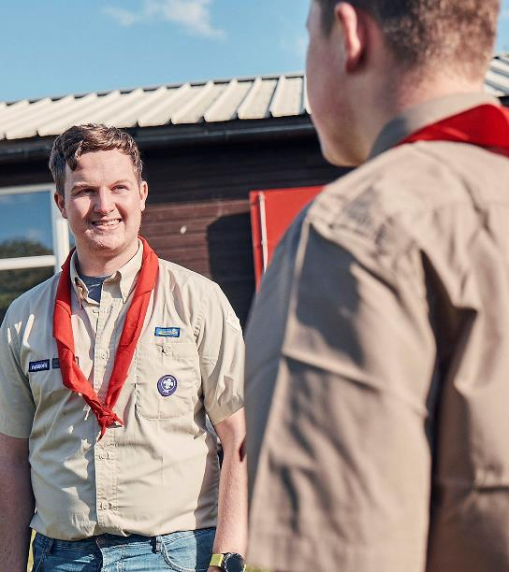
Transformation Lead Call - March 23
Learning Update
Manager & Supporter Training
Remains in its current form for the next 18-24 months
Materials will be published online
Notes:
Wulff/Matt

Slide 31
Transformation Lead Call - March 23
Learning Update
How long will it take?
Growing Roots to be done within first 6 months
The learning must be a good use of people's time
We will test to make sure it's a reasonable amount
We will work out a fair migration, so people don't suddenly have to do learning that isn't helpful for them
New videos coming!
Notes:
Wulff/Matt

Slide 32
Open Forum Q&A
Notes:
All - James facilitating

Slide 33
Early Adopter Update
Notes:
Craig

Slide 34
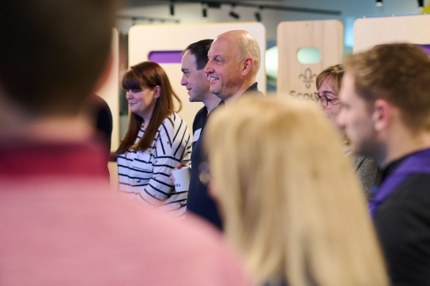
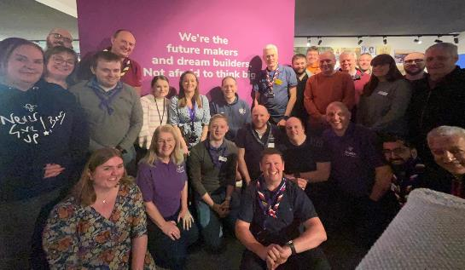
Transformation Lead Call - March 23
Early Adopter Update
Early Adopter Update
Early Adopter Cohort Workshop, Gilwell Park, Feb 18th & 19th March
We continue to work with Early Adopters to shape resources and gather feedback
Opportunities to test Digital Skills & membership integration
Lessons Learned
Notes:
Craig

Slide 35
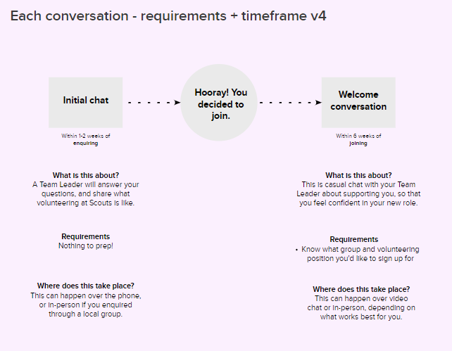
Transformation Lead Call - March 23
Early Adopter Update
Notes:
Craig

Slide 36
Transformation Lead in Action
Scott Goddard
Notes:
Scott Goddard

Slide 37
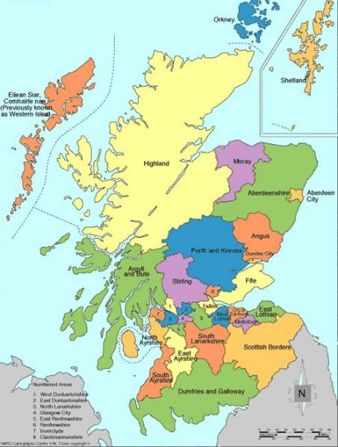
Transformation Lead in Action – March 2023
South East Scotland Region
1 of 8 Regions in Scotland
Edinburgh, Midlothian, East Lothian & Scottish Borders Local Authorities
6768 Young People
1928 Adult Volunteers
1967 on Waiting List
7 Districts
89 Groups
Early Adopter
sessscouts.org.uk
Notes:
Craig Turpie & Jack Caine

Slide 38
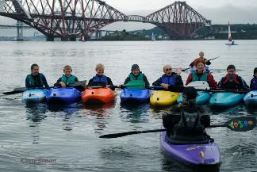
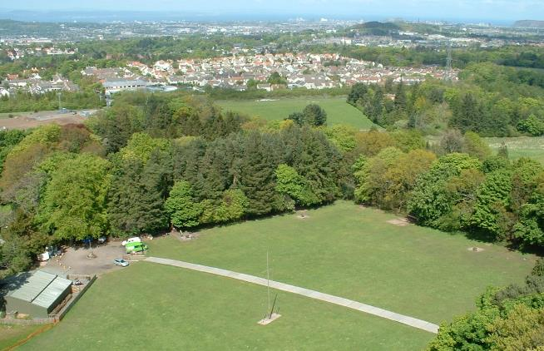
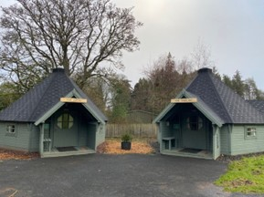
Transformation Lead in Action – March 2023
Longcraig Scout Centre
Bonaly Scout Centre
sessscouts.org.uk
Notes:
Craig Turpie & Jack Caine

Slide 39
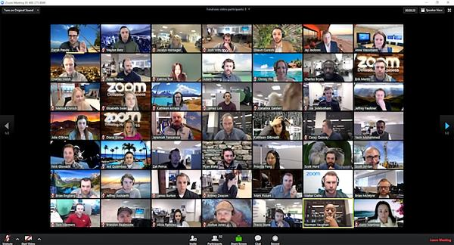
Transformation Lead in Action – March 2023
Scouts Scotland
Transformation Overview Group (TOG)
Transformation Implementation Group (TIG)
South East Scotland
Transformation Regional Operational Group (TROG)
sessscouts.org.uk
Notes:
Craig Turpie & Jack Caine

Slide 40
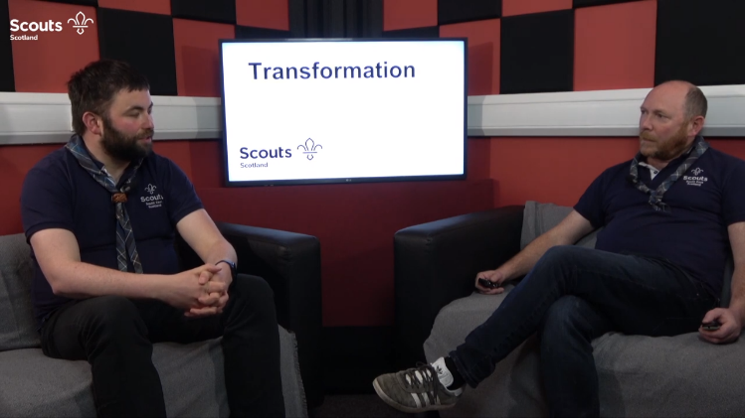
Transformation Lead in Action – March 2023
5 Videos
Aimed at all members
Related to our Regional Strategy
Aimed at hearts & minds rather than just the facts
Conversational style rather than a broadcast to the nation
sessscouts.org.uk
Notes:
Craig Turpie & Jack Caine

Slide 41
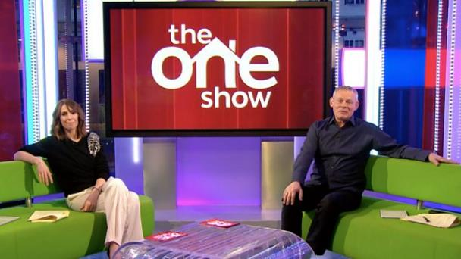
Transformation Lead in Action – March 2023
sessscouts.org.uk
Notes:
Craig Turpie & Jack Caine

Slide 42
Transformation Lead in Action – March 2023
sessscouts.org.uk
Notes:
Craig Turpie & Jack Caine

Slide 43
Transformation Lead in Action – March 2023
5 Videos
Former Venture Scout who runs a Podcast Studio
Could be recorded on Zoom
Key is it being with 2 people and conversational
Hosted on website
Played at First Response Courses
Videos Available HERE
sessscouts.org.uk
Notes:
Craig Turpie & Jack Caine

Slide 44
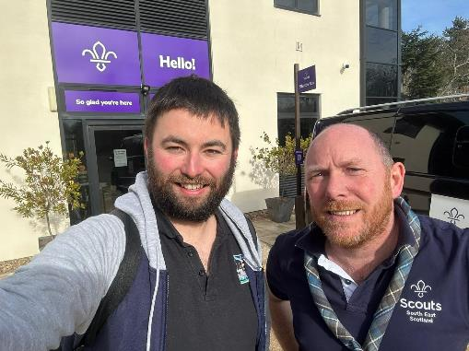
Transformation Lead in Action – March 2023
Early Adopter Cohort
Weekend at Gilwell Park in February 2023
More time to spend absorbing the timeline
Hear from the project leads
Have conversations face to face
Not be on Zoom
Immerse ourselves in the task in hand
sessscouts.org.uk
Notes:
Craig Turpie & Jack Caine

Slide 45
Transformation Lead in Action – March 2023
Longcraig Scout Centre
Bonaly Scout Centre
sesscouts.org.uk/transformation-video-resources/
sessscouts.org.uk
Notes:
Craig Turpie & Jack Caine

Slide 46
Next Steps
Notes:
Craig

Slide 47
Transformation Lead Call - March 23
Next Steps
Next Steps
Use the roadmap for change to start or continue your local change planning
Use the draft team descriptions to help your area understand what their future teams will look like
Plan briefings for District & Group Chairs on the Trustee Board Changes for Mid-March onwards
Continue focus on training compliance
Continue cleaning up Compass data
Continue informing your area about the upcoming changes through events, local emails and more

Slide 48
Transformation Lead Call - March 23
Next Steps
Next Steps
Request support for your local events where required
We’ll do our best to attend in person when requested
Sign up to future calls
Complete the Transformation Lead Survey
Additional support requests and questions answered through:
Transformation Lead Facebook Page
Transformation.Leads@Scouts.org.uk
https://www.facebook.com/groups/scoutstransformation
Notes:
Craig

Slide 49
Thank You
Notes:
Craig

