Slide 1
Transitioning to Trustee Boards

Slide 2
Transitioning to Trustee Boards
Introduction
Slide Deck Overview
Purpose:
This information can be used by Transformation Leads to explain the reason for the forthcoming transition from Executive Committees to Trustee Boards and how this fits as part of our work on implementing a transformed Volunteer Experience.
These slides can be used as they are, or tailored to suit local branding and messaging to fit with what progress you have made in your area. Care should be taken to ensure that core messages are not diluted.
Author: This information has been prepared by the Trustee, Governance and Volunteer Journey Working Group at Scouts.
Effective Date: This information is accurate as of 21 March 2023.
Support: Transformation Leads should direct any questions that they have to transformation.leads@scouts.org.uk

Slide 3
Transitioning to Trustee Boards
Introduction
Important Notes
Scout Council - The charity membership of the Group, District or County (or equivalent), as defined in POR
Trustee Board - The representatives of the Scout Council. The terms of reference for each Trustee Board are defined in the April 2023 POR edition.
Annual General Meeting (AGM) - A meeting of the Scout Council, where the Trustee Board reports back on their activities during the previous financial year. The necessary agenda topics for this are defined in the April 2023 POR edition.
Central resources, such as the Scouts.org.uk website, will be updated after the April POR release for the changes described in this slide deck, this could some time. Whilst many points will remain accurate, please follow POR in case of any conflicting statements.
Compass will not be updated with any new titles, these will be reflected in the new membership system.

Slide 4
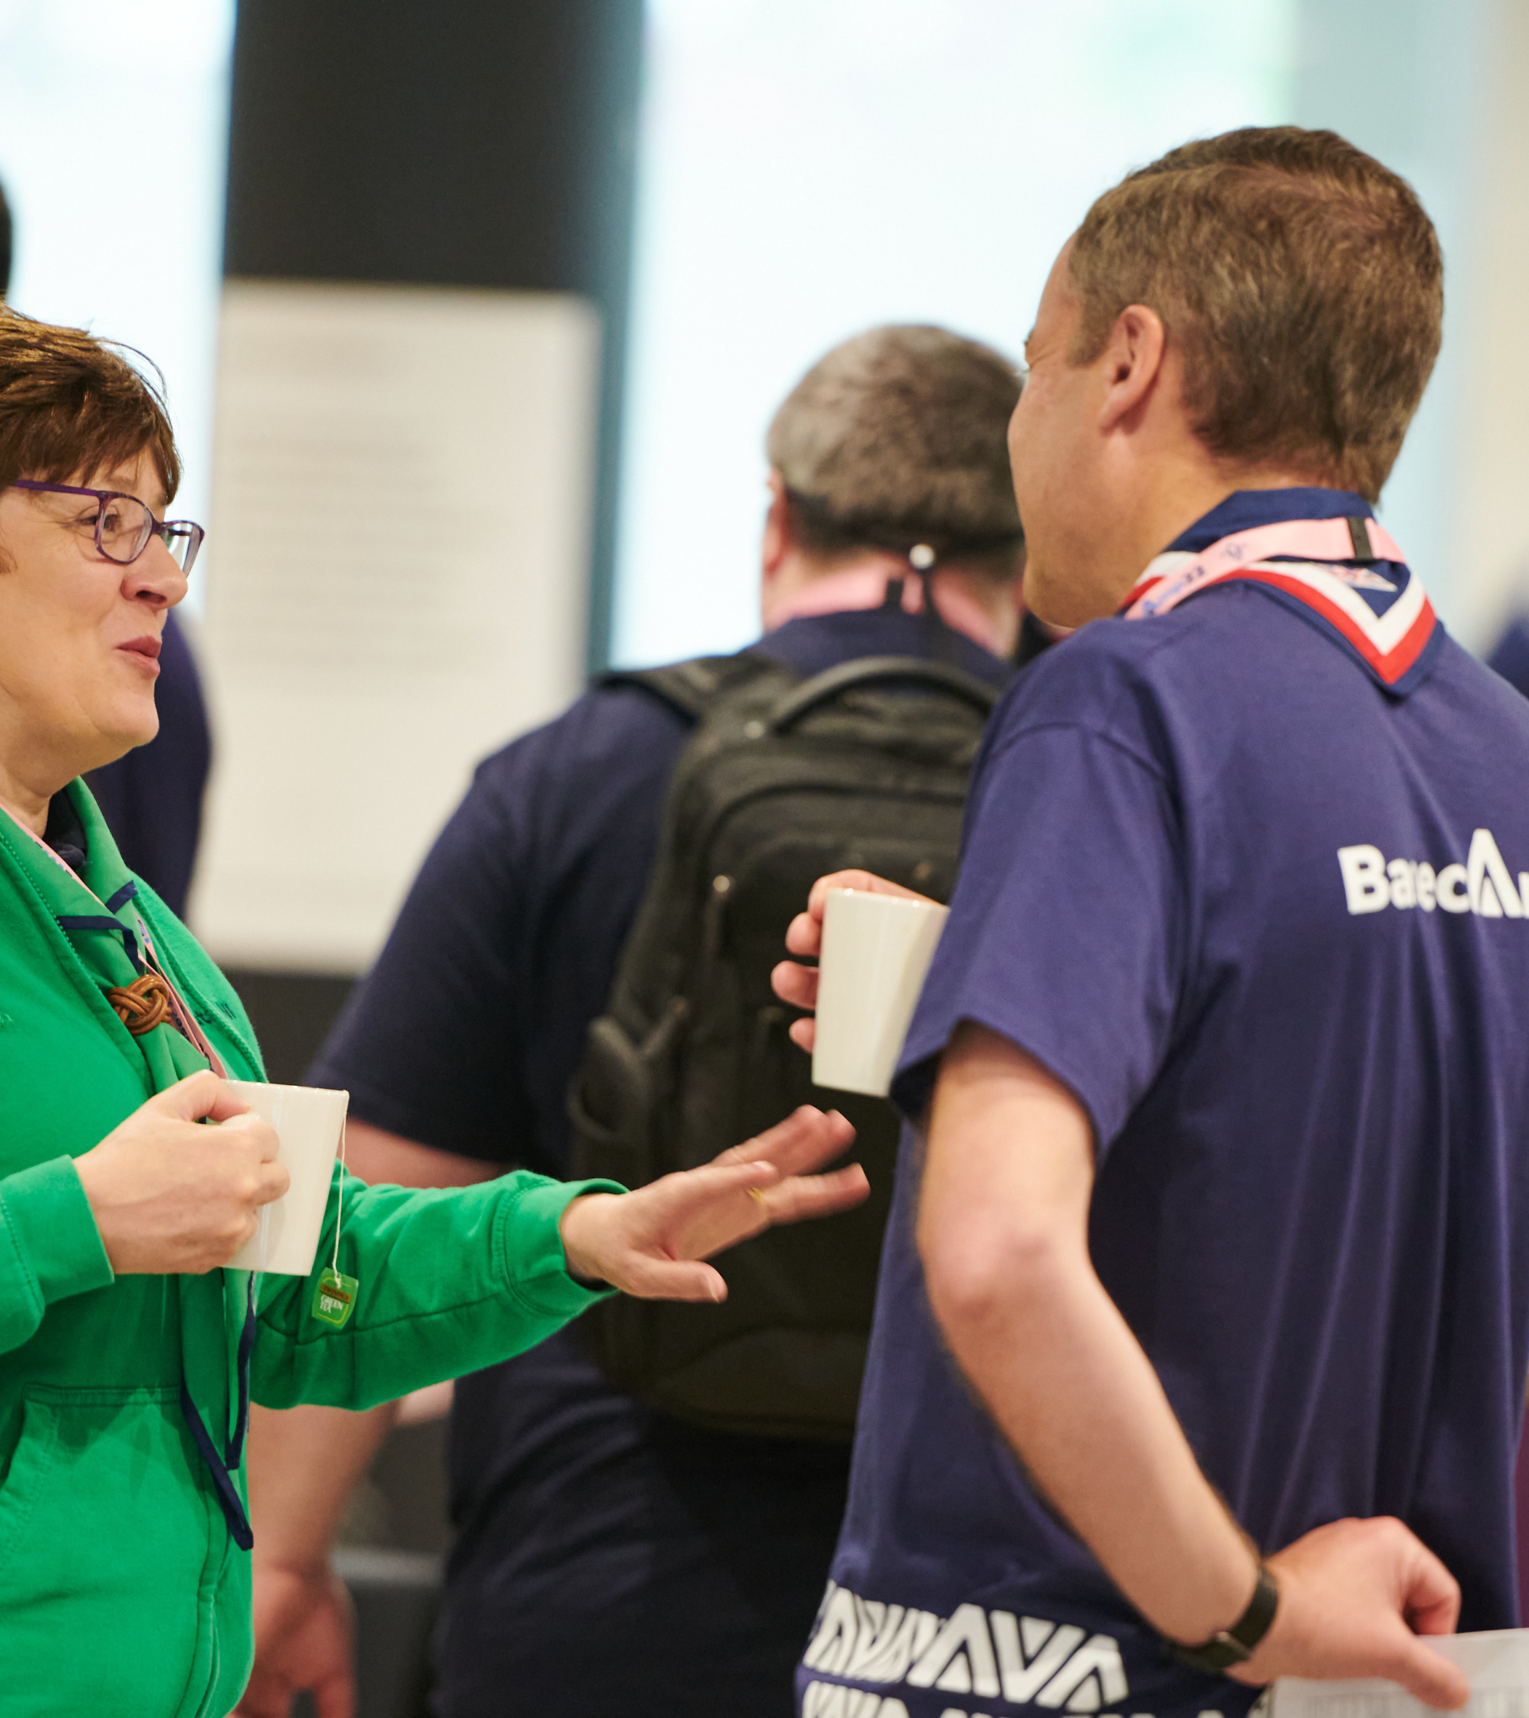
Transitioning to Trustee Boards
Introduction
Introduction
As part of the work to transform the volunteer experience within Scouts there will be changes to Executive Committees and how they function.
These changes are informed by:
The evolution of good practice guidance from charity regulators
Our move to a teams-based approach.
These cultural and procedural changes to how Executive Committees currently operate will support our Skills for Life strategy, our ‘North Star’ and the overall aims of the volunteer experience transformation.

Slide 5
Making volunteering easier and more fun is how we reach our North star...
More young people gaining skills for life
Consistently and safely
deliver a great programme
Recruit more volunteers
and retain current ones

Slide 6
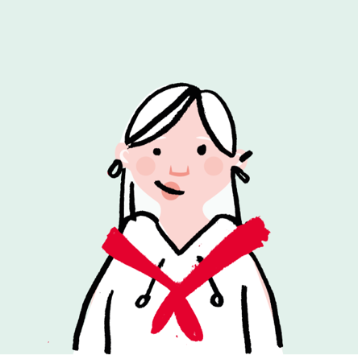
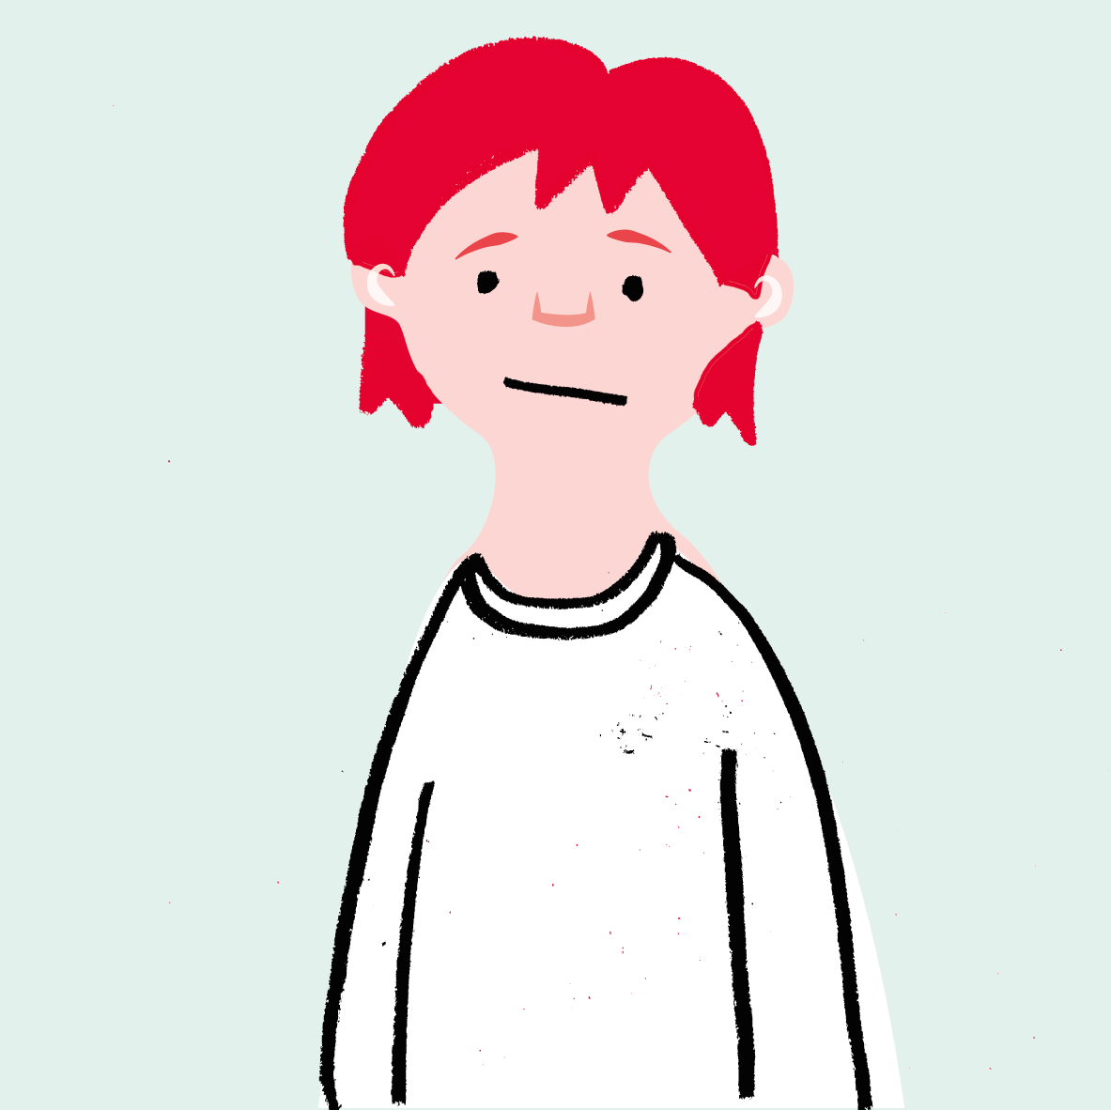
Transitioning to Trustee Boards
Why we’re transforming volunteering
We want to make volunteering with Scouts easier and more fun…
…so that we can attract more volunteers and our current volunteers want to stay

Slide 7
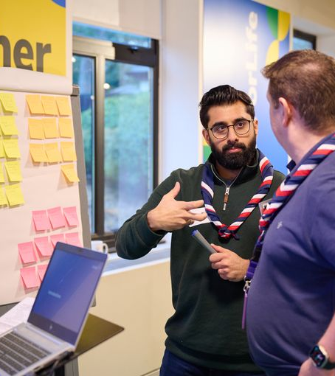
Transitioning to Trustee Boards
Introduction
Setting up for success
Good governance is fundamental to a charity's success, enabling and supporting the charity to:
Comply with the law and relevant regulations
Meet the charity’s objectives
Good practice for this is set by the charity regulators, where there have been significant changes over the past few years.

Slide 8
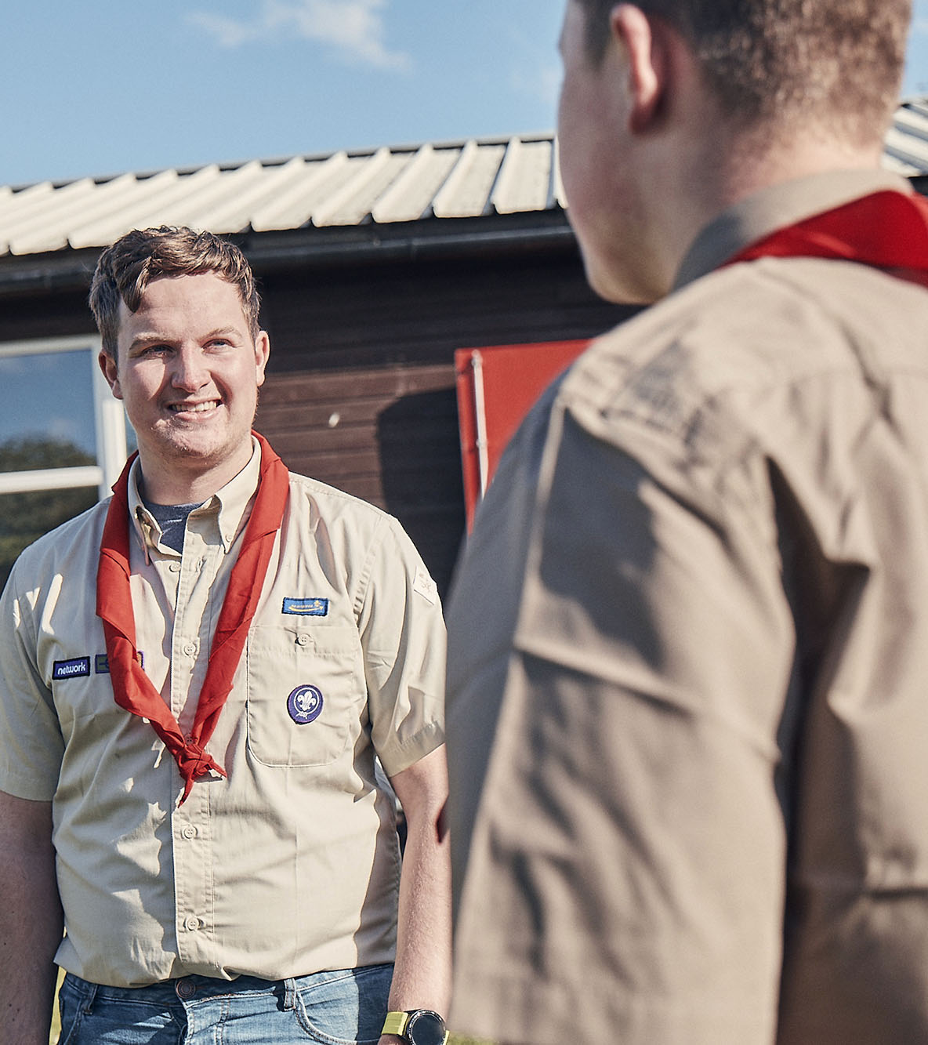
Transitioning to Trustee Boards
Why we’re changing
Our current position
Many Groups, Districts and Counties (or equivalent) have Executive Committees which oversee a mixture of governance and operational tasks.
Governance processes such as risk and financial management, are often not carried out or well supported.
Charities must adopt a constitution. On census 2023, 51% of Groups, Districts and Counties (or equivalent) said they had not adopted a constitution or didn’t know if they had.

Slide 9
Transitioning to Trustee Boards
Moving to a team-based approach

Slide 10
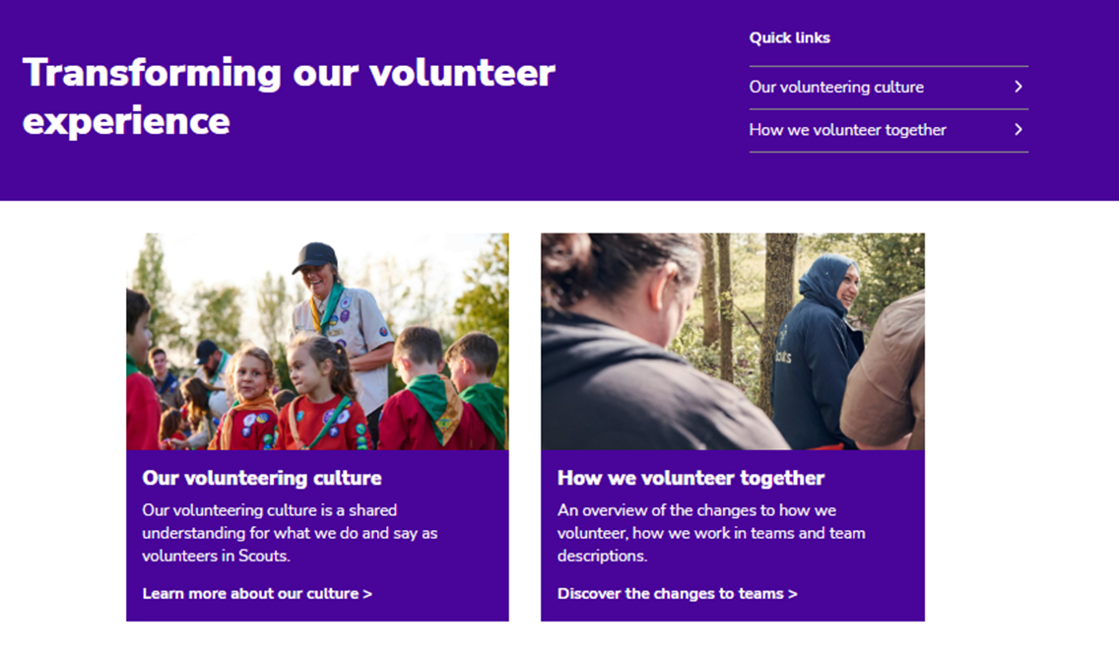
Transitioning to Trustee Boards
Moving to a team-based approach
Moving to a team-based approach
The key principles for these new teams are to:
Allow for flexible volunteering that suits people’s skills, interests, and time
Provide clear purpose and responsibilities to ensure our volunteers and young people have the required support
Have tasks that will be shared among a team
Be led by a Team Leader or Lead Volunteer

Slide 11
Transitioning to Trustee Boards
Moving to a team-based approach
Section & Group Structure
Team Leader(s)
Sections
Team Member
Team Member
Section Team
Group
Young Leader
Team Member
Young Leader
Group Leadership Team
Trustee Board

Slide 12
Transitioning to Trustee Boards
Moving to a team-based approach
District & County Structure
Young Leaders
Explorers
Trustee Board
Leadership Team
Trustee Board
Leadership Team
14 - 24 Team
Network
County
(or equivalent)
Districts
District
Volunteering Development Team
Volunteering Development Team
Groups
Programme Team
Support Team
Programme Team
Support Team

Slide 13
Transitioning to Trustee Boards
What’s changing for Trustee Boards

Slide 14
Transitioning to Trustee Boards
What’s changing?
What’s changing?
Name
Purpose
To bring our current structure in line with the good practice guidance set out by the charity regulators there are currently two key areas of change
Name
Executive Committees will be renamed Trustee Boards, members of which will be renamed Trustees
Purpose
Trustee Boards will have a clearer purpose statement, to fit with the focus on governance

Slide 15
Transitioning to Trustee Boards
What‘s changing?
Renaming as Trustee Boards
Executive Committees are renamed as Trustee Boards, members of which are renamed as Trustees
Why is this changing?
To align with good practice guidance from the charity regulators
To help reinforce the purpose of Trustee Boards and focus on the role and responsibilities of being a charity Trustee

Slide 16
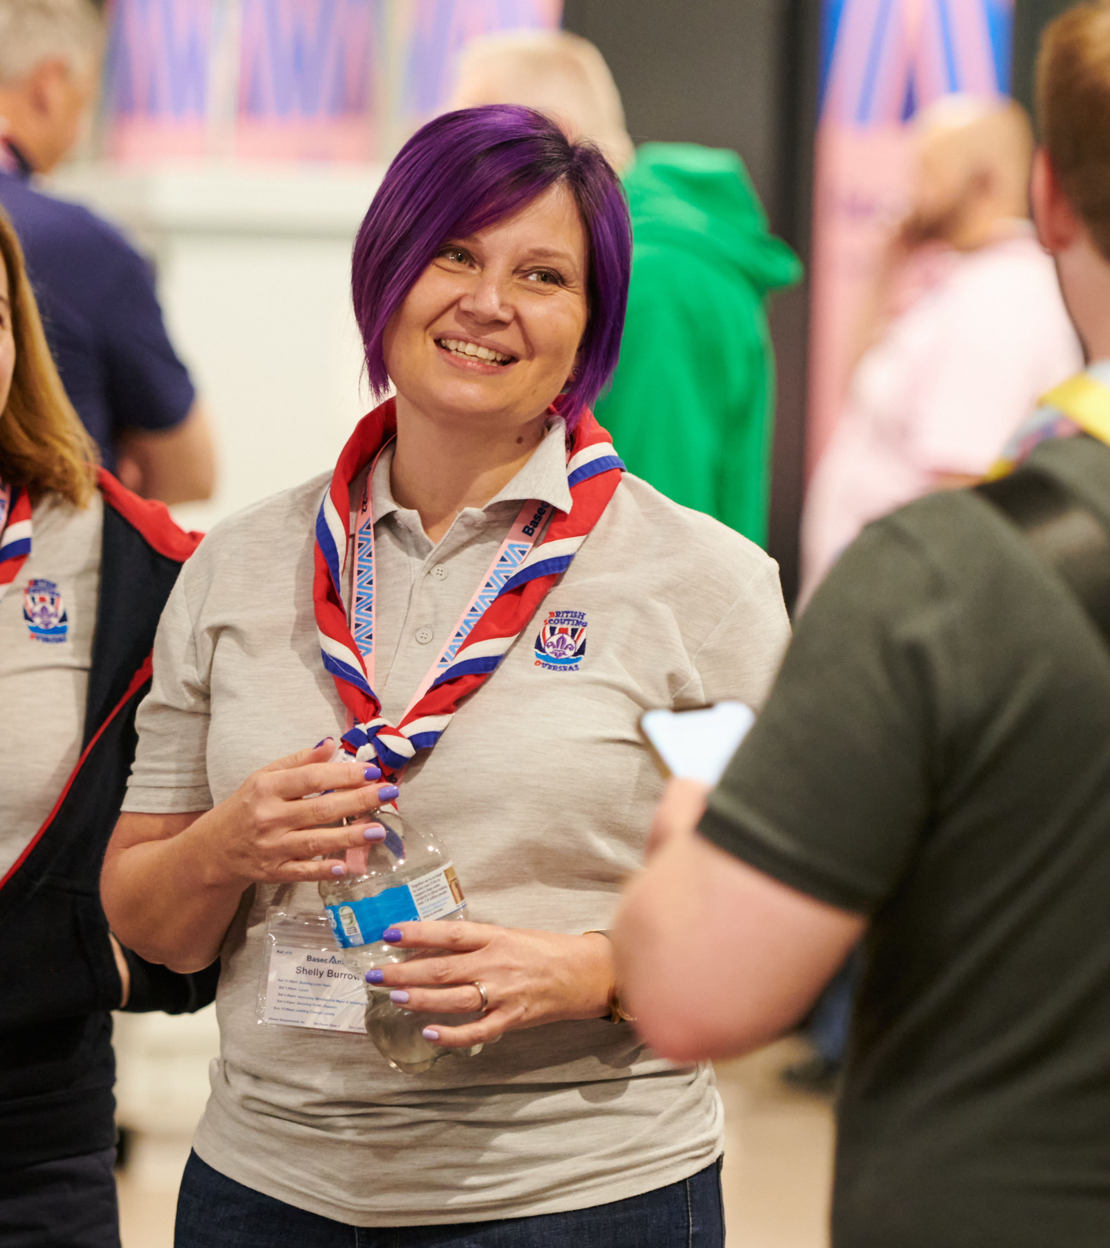
Transitioning to Trustee Boards
What’s Changing?
Renaming as Trustee Boards
When is this changing?
From publication of POR in mid-April 2023 onwards
This renaming happens from the release of POR and does not need to be adopted or approved through AGMs (Some areas have already made this change)
What will be the changes in POR?
The April 2023 edition of POR will reference Trustee Boards and Trustees instead of Executive Committees and Executive Committee members respectively, in all chapters
Regions in Scotland should discuss timing of these changes with Scottish HQ

Slide 17
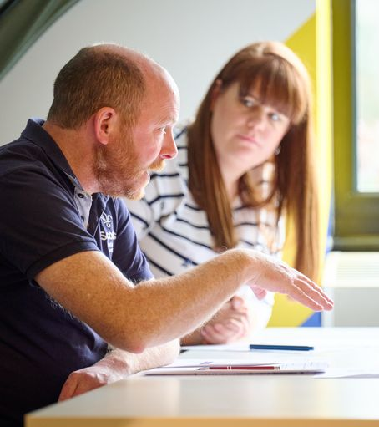
Transitioning to Trustee Boards
What‘s changing?
The purpose of Trustee Boards
Trustee Boards have a clearer purpose statement, to fit with the focus on governance. This will mean ‘operational’ tasks are managed through the Group Leadership Team or the Support Team in District or County (and equivalent)
Why is this changing?
To align with good practice guidance from charity regulators
To focus on ensuring effective governance. This is the core of any charity Trustee Board’s responsibility and an important part of ensuring that the charity focusses on meeting its objectives

Slide 18
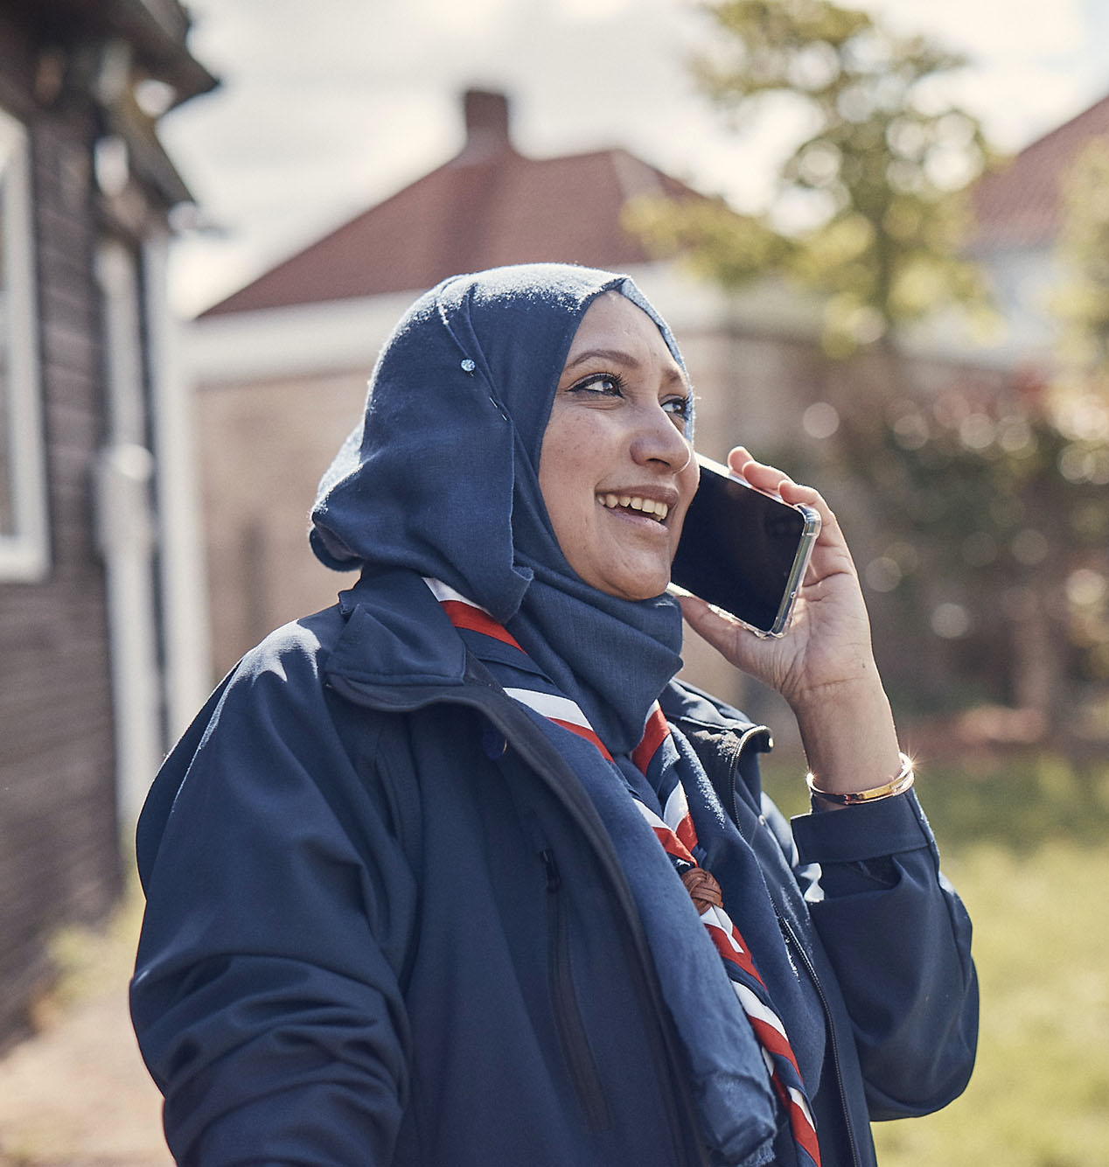
Transitioning to Trustee Boards
What’s Changing?
The purpose of Trustee Boards
When is this changing?
From publication of POR in mid-April 2023
Those who have already adopted the constitution as set out in POR - This change can happen from the release of POR and does not need to be adopted or approved through AGMs
For those who have not adopted the POR constitution - This change can be informally adopted and worked towards from the release of POR and will then need to be confirmed at the next AGM
What will be the changes in POR?
The April 2023 edition of POR, will contain the updated ‘Trustee Board Purpose’ statements within chapter 5

Slide 19
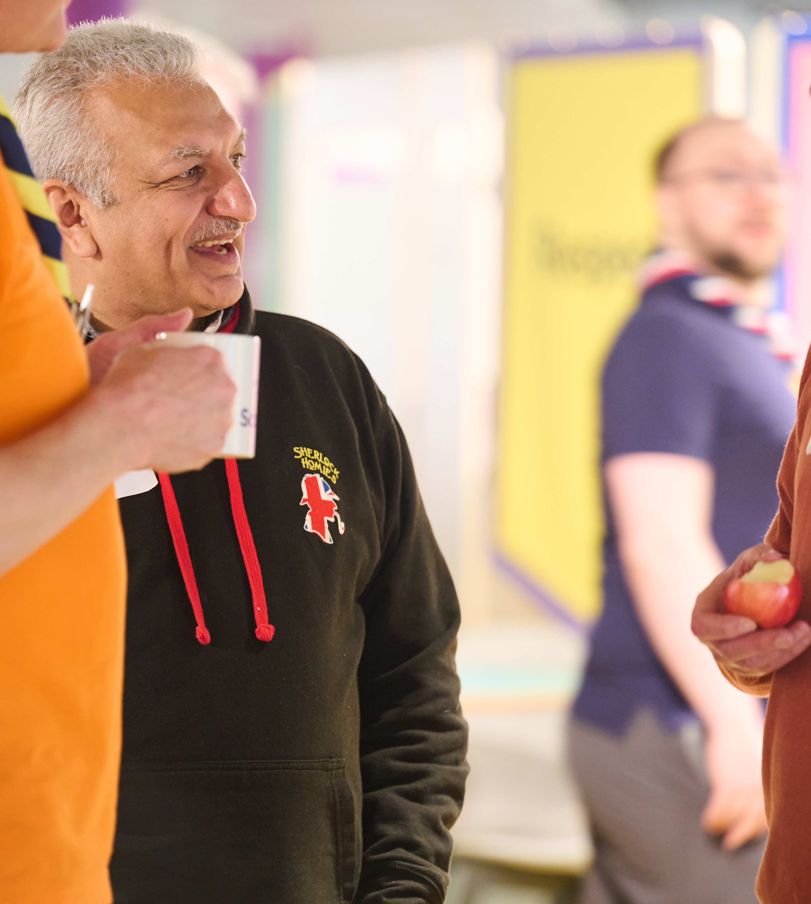
Transitioning to Trustee Boards
What’s changing?
The purpose of Trustee Boards
What will this look like in practice?
Some areas will be for trustees to be confident that they are being done. This is different from doing it themselves!
Some areas will be for trustees themselves collectively to do. These are the core governance tasks.
In future, this will mean that ‘operational’ tasks such as repairing the hut, cutting grass, fundraising and similar are managed through the Group Leadership Team, or the Support Team in a District or County.
These operational tasks can be carried out by people who are also Trustees, however, they will be managed under the relevant team rather than in their Trustee role.

Slide 20
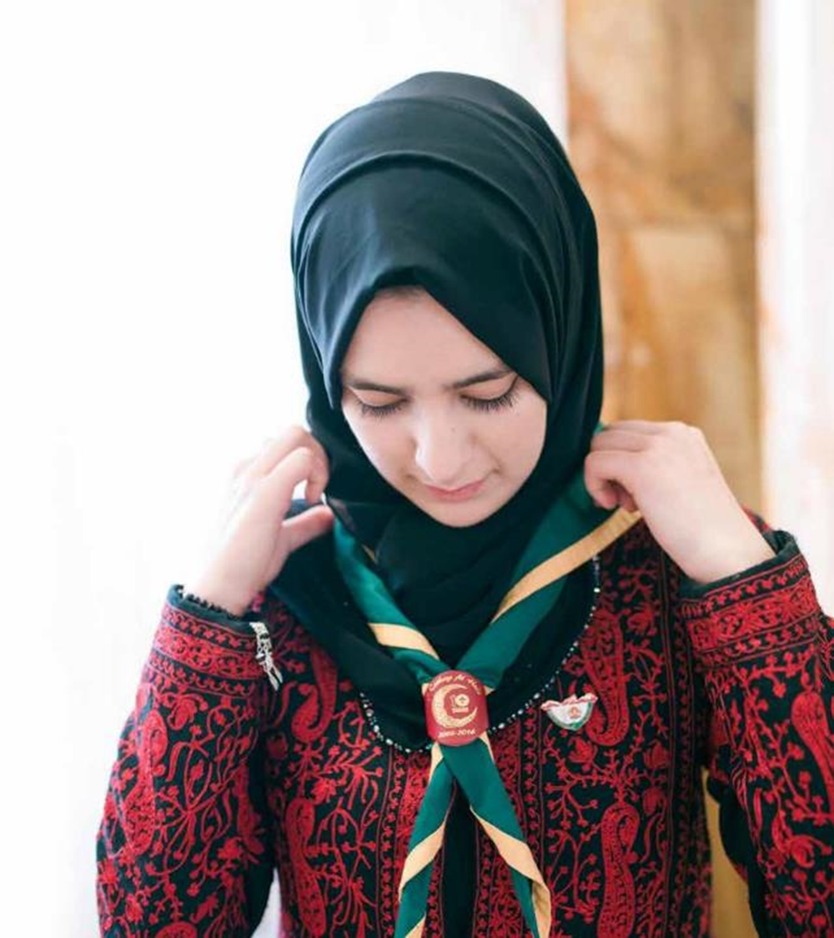
Transitioning to Trustee Boards
What’s changing?
Additional tasks
In addition to the changes mentioned above, support should be provided to all Trustee Boards to ensure they have adopted a constitution. Whilst this is not a change in POR, it is important that this is done.
This could be:
The constitution as set out in POR
An adapted version of the constitution as set out in POR
Why?
This has been a requirement of Annual General Meetings since 2011 (and was more clearly called out in POR in 2021). It continues to be a requirement for Trustee Boards

Slide 21
Transitioning to Trustee Boards
What’s changing?
Additional tasks
When should this be done?
It is important that the model AGM agenda outlined in the April 2023 edition of POR Chapter 5 is followed from the next AGM where possible
For 2023 AGM agenda planning 5.4.5 from the January 2023 edition of POR will not be significantly different. (The April 2023 edition tidies up that wording but doesn't make fundamental changes.)

Slide 22
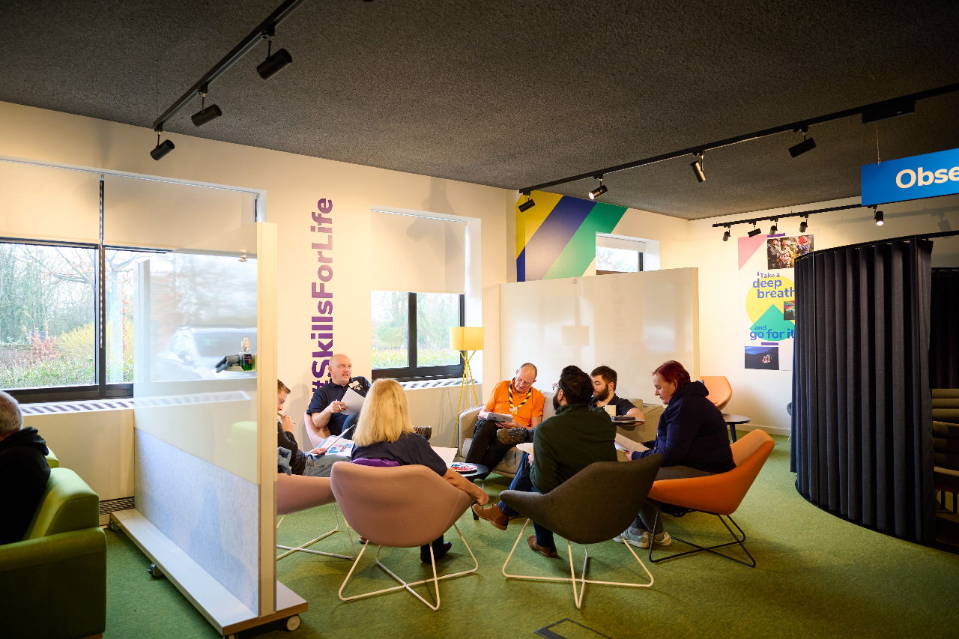
Transitioning to Trustee Boards
What’s changing?
Supporting resources
To support the planning for these changes we have also provided two short sections extracted from the April 2023 edition of POR. These contain:
The updated Trustee Board purpose
The necessary agenda topics for an AGM
Please Note:
These are still draft and should not be shared outside of Executive Committee members until the April POR release
There may be some minor changes to these before they are released in April, so note that what you have been provided may not be the final wording

Slide 23
Transitioning to Trustee Boards
What’s changing?
Summary
These changes are an important first step to ensuring effective governance by all Trustee Boards at Group, District and County (or equivalent). Changes to the name and purpose of Trustee Boards is the core part of this transition
There may be further changes from the point at which a County (or equivalent) transitions to the new digital tools. Any further developments will be communicated later in the year.

Slide 24
Transitioning to Trustee Boards
Next Steps

Slide 25
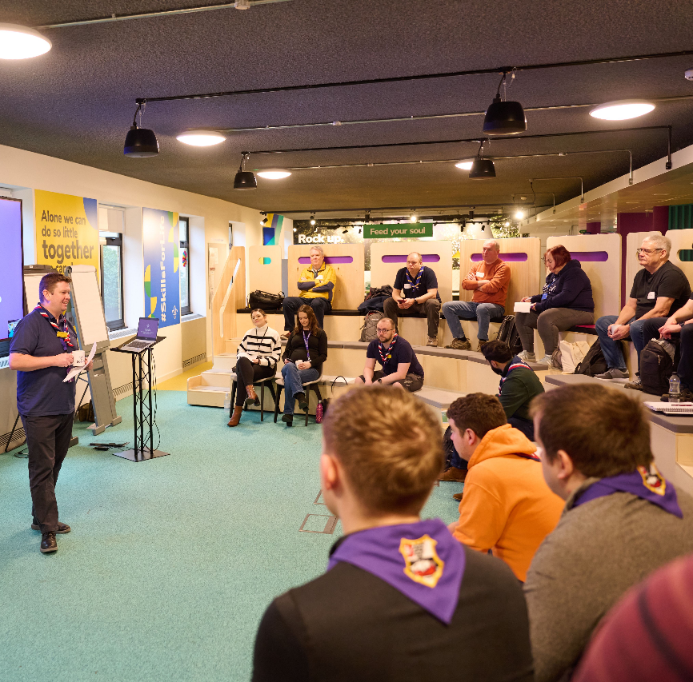
Transitioning to Trustee Boards
Next Steps
Next steps
Transformation Leads should work with their County Commissioner and County Chair to plan and deliver the following for every current Executive Committee at Group, District and County (or equivalent):
From April 2023 POR release
Trustee Board name and purpose change:
For Group/District/County Scout Councils who have adopted the constitution as per POR, these can be introduced without needing approval at an AGM
For Scout Councils who have not adopted the constitution as per POR, these can be informally introduced and then formally adopted at the next AGM
At the next AGM
Ensure a constitution has been adopted or re-adopted

Slide 26
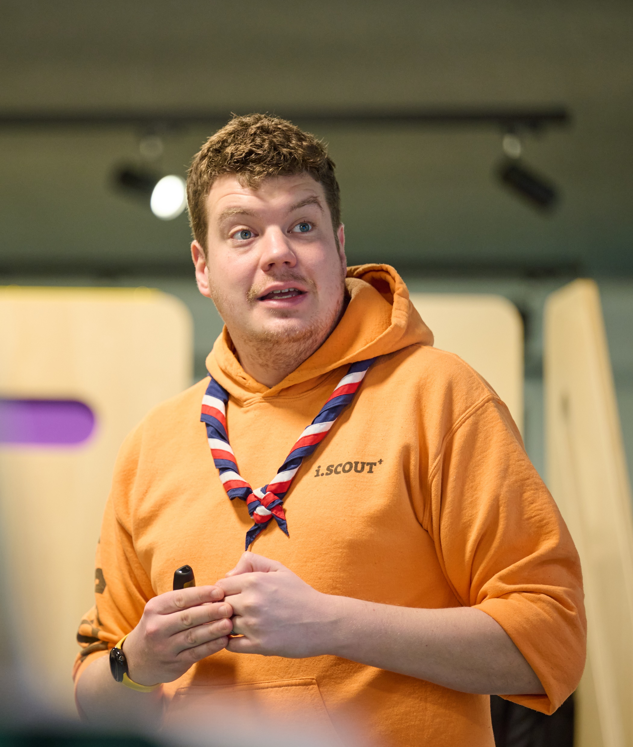
Transitioning to Trustee Boards
Next Steps
Outcomes
The outcome of these changes should be that:
Prior to digital transition, every current Executive Committee recognises that they are now a Trustee Board
Trustee Boards are starting to use the new purpose statements to shape their future Trustee Board agendas and their governance support for The Scouts
Trustee Boards have all adopted a constitution
It is recognised that different Trustee Boards, for a variety of reasons, will take different lengths of time to be fully aligned with the new purpose statements
The important part is that all Trustee Boards are working towards reflecting best practice as outlined in POR

Slide 27
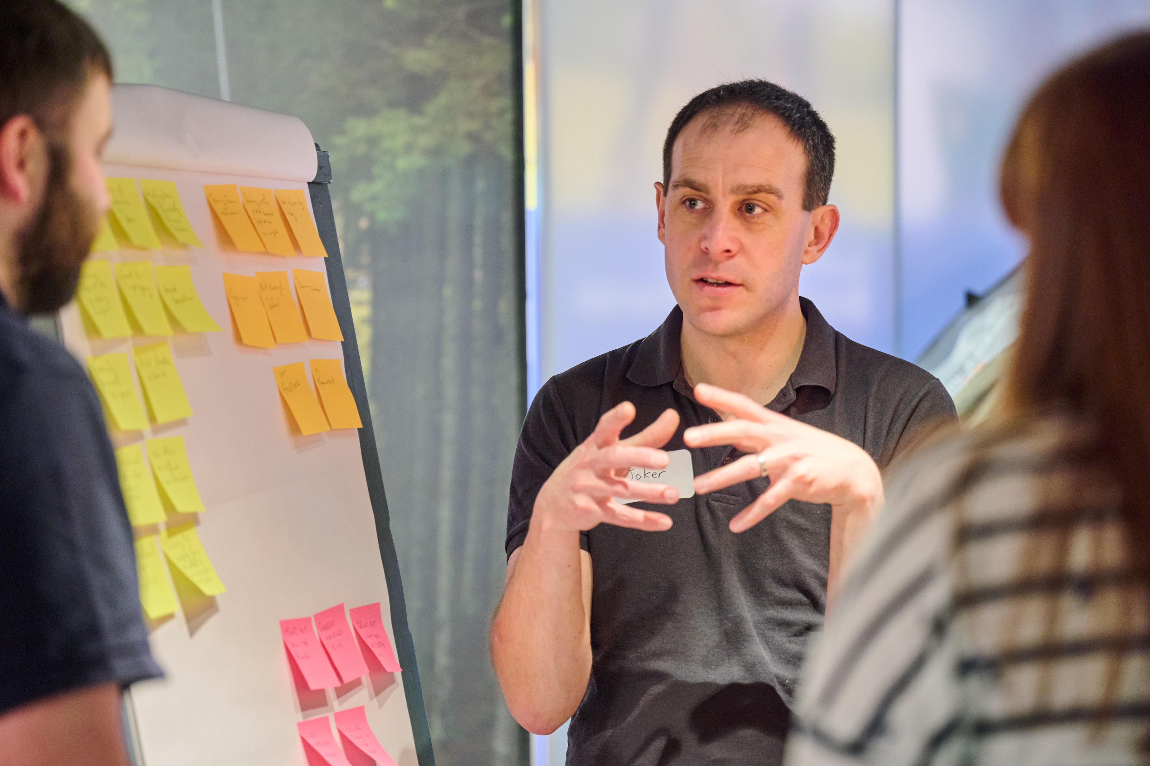
Transitioning to Trustee Boards
Next Steps
Additional resources
To further support these changes, additional resources are being developed. This includes:
Web pages on scouts.org.uk providing further detail on the changes
Explanatory notes to give more support and guidance on topics both from the POR statements and the team description for a Trustee Board
Template scripts for AGMs and agendas for Trustee Board meetings
These resources will be shared during April 2023, alongside the teams and culture resources to Transformation Leads

Slide 28
Thank You

