Slide 1
Transforming Our Volunteer Experience -
How we Volunteer Together

Slide 2
Engaging Learning
Using this slide deck
Slide Deck Overview
Purpose:
This slide deck is designed to provide an overview of the ‘How we Volunteer Together’ change and is collated from information shared through slides, emails and verbally to Transformation Leads.
These slides will be updated regularly to reflect information shared in future, please check the document version you have against the one current on the TL Resource Hub to ensure you have the latest version.
The next slides outlines how to best use the information on these slides.
Author: This information has been prepared by the Change team, support by the Volunteer Experience project teams
Version: This is document version 1.0, effective as of 18/04/23
Support: Transformation Leads should direct any questions that they have to transformation.leads@scouts.org.uk

Slide 3
Engaging Learning
Using this slide deck
How to use this slide deck
Using this slide deck locally:
These slides contain a combination of both information and context, some of which makes several slides ‘text heavy’. This is done purposefully to ensure whoever is presenting has the context and information needed to talk to each point, without needing a separate script.
However, when presenting these slides, it’s recommended that some of this text is moved into the presenters' notes so that the slides are easy to read and understand and then the presenter can still ensure the core messages are not diluted.
You might also wish to tailor this to your audience by including just the slides relevant to them and combining these slides with those from the other ‘Transforming Our Volunteer Experience’ slide decks. This is recommended as presenting each of the slide decks for the areas of change would be incredibly long and detail heavy, the important part is the core message being shared.
Please also feel free to tailor these to suit local branding and messaging to fit with what progress you have made in your area already.

Slide 4
How we Volunteer Together
Purpose
Purpose
To provide a detailed overview of;
Why we’re changing how we volunteer together
What is changing?
Our Volunteering Culture
Role title changes
Team-based approach
Trustee Boards

Slide 5
How we Volunteer Together
Changing the way we volunteer together

Slide 6
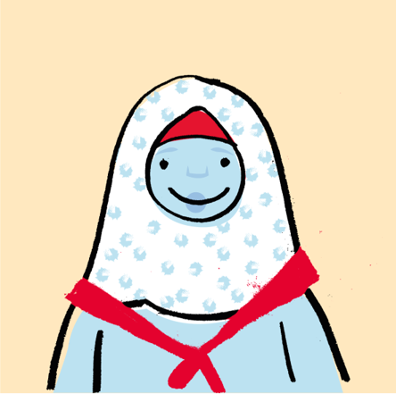
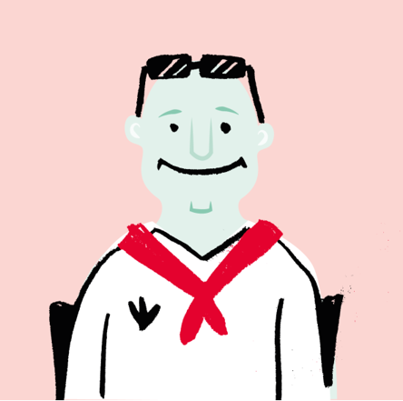
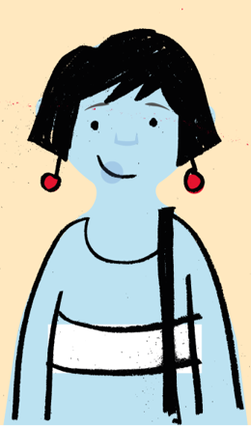
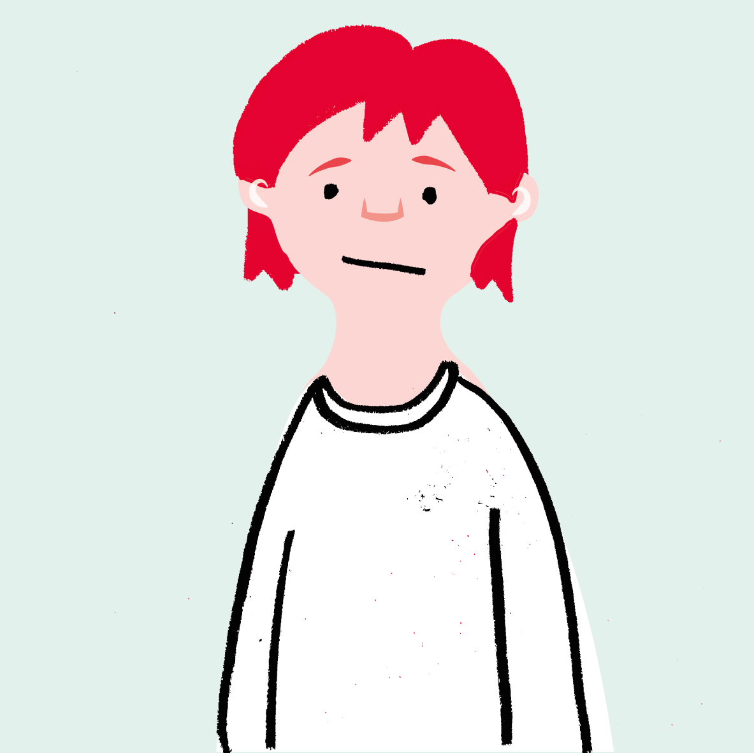
How we Volunteer Together
Changing the way we volunteer together
We want to make volunteering with Scouts easier and more fun…
…so that we can attract more volunteers and our current volunteers want to stay

Slide 7
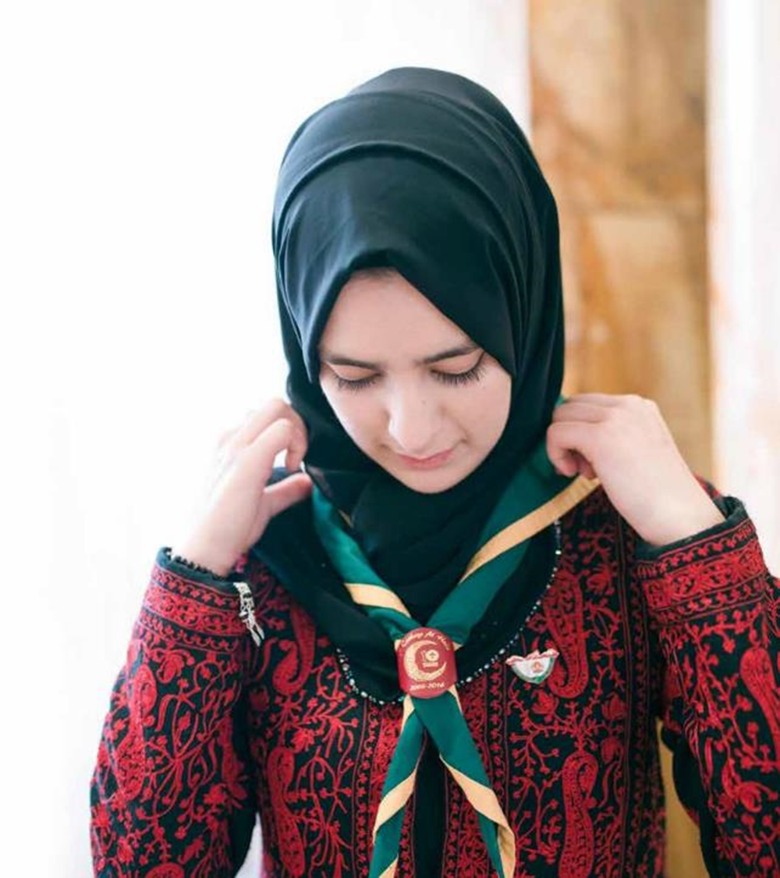
How we Volunteer Together
Changing the way we volunteer together
Why are we changing?
At Summit 17, with nearly 1,000 of our volunteers, we worked together to build our Skills for Life Strategy.
This included multiple suggestions and recommendations from volunteers around changing the terminology we use, making volunteering more flexible and improving our public perception
Following this we:
Carried out external and internal research
Commissioned an independent research expert report
Developed a joint volunteer and staff team to lead this work

Slide 8
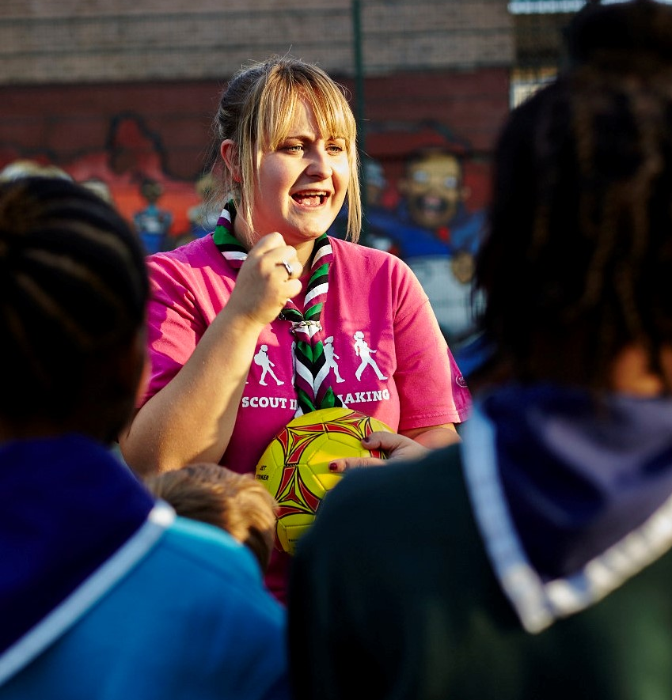
How we Volunteer Together
Changing the way we volunteer together
What have we learnt?
In our research with volunteers, we learnt that:
We have too many roles, these are often fixed and can feel like work
New volunteers find it hard to understand the expectations of different roles which can put them off joining
We have a small number of people/roles with lots of responsibility and stress placed on them
The digital systems which manage volunteers are inefficient and time consuming to use

Slide 9
How we Volunteer Together
Changing the way we volunteer together
What is changing?
As part of changing the way we volunteer together we’ll be;
Adopting a team-based approach to how we volunteer in Scouting
Moving from having Executive committees to Trustee Boards focussed on making sure Scouting is run safely and legally
Embedding a positive volunteering culture within Scouting to support each other as volunteers
Implementing a new membership system to support our volunteers

Slide 10
How we Volunteer Together
Our Volunteering Culture

Slide 11
How we Volunteer Together
Our Volunteering Culture
“A shared understanding for what we do and say as volunteers in Scouts,
supporting each other, following our values and being at our best,
while acting as role models for young people.”

Slide 12
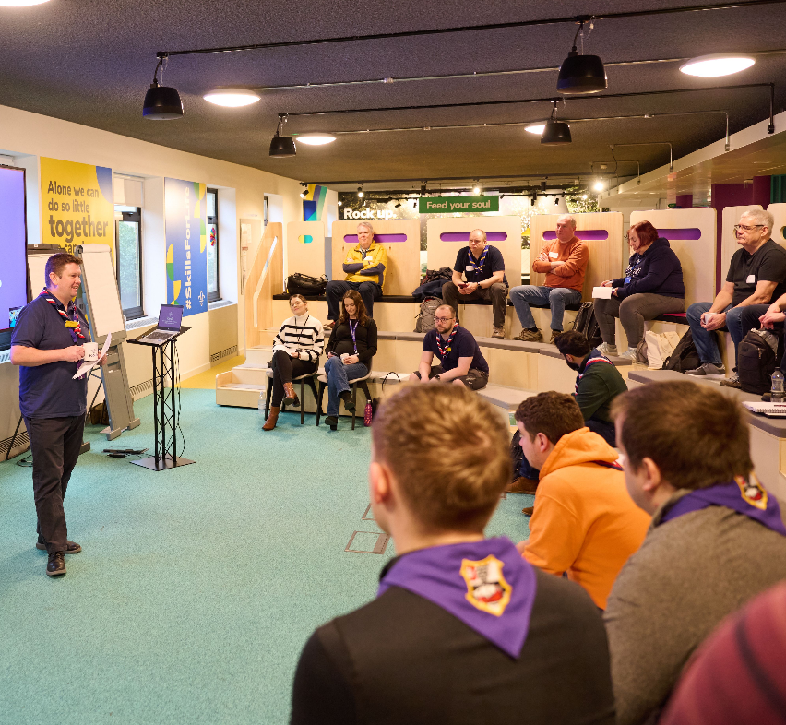
How we Volunteer Together
Our Volunteering Culture
Our Volunteering Culture
We want Our Volunteering Culture to be something we're all proud of
As volunteers in Scouts, we’re proud to help young people step up, speak up, dream big and gain the skills they need for life
By working together, and living our values of integrity, respect, care, belief and cooperation, our aim is to have a positive, safe and rewarding experience as volunteers for a movement we truly believe in
It’s not something ‘extra’ to do. It’s at the heart of everything we do and it’s there to help us all

Slide 13
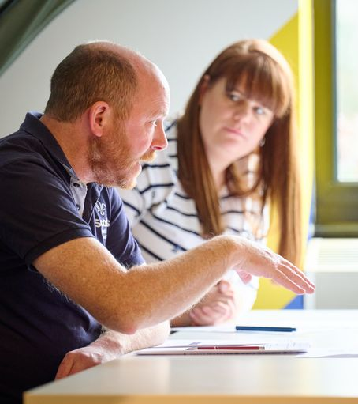
How we Volunteer Together
Our Volunteering Culture
Our Volunteering Culture
Our Values describe Scouting at its best, while Our Volunteering Culture is how we make our best a daily reality. It sets out:
What to expect from UK Scouts
What is expected as a volunteer
What we’ll work together to do
It guides and reminds us of our goal, both as a movement and as a volunteer team: to help more young people gain Skills for Life
It's there to help our volunteers thrive from the moment they join, giving them clear expectations and a shared understanding of what it really means to be a volunteer in Scouts

Slide 14
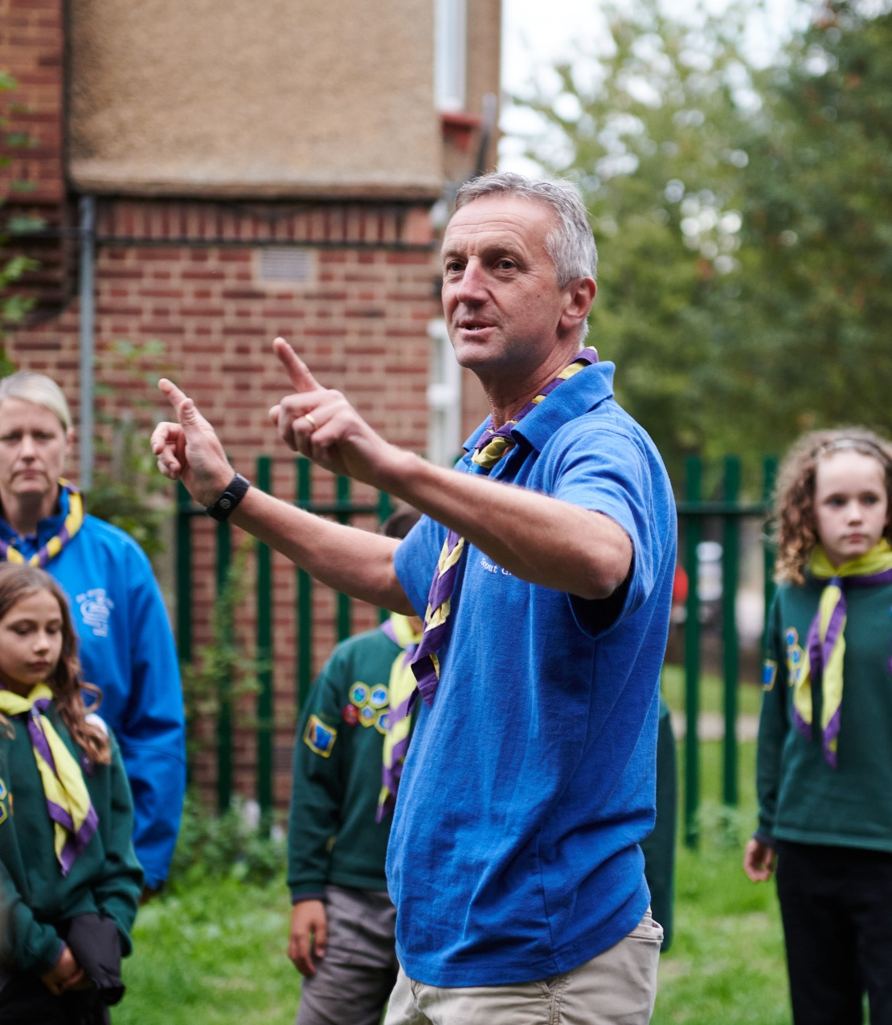
How we Volunteer Together
Our Volunteering Culture
Our Volunteering Culture
Most of our volunteers will already be role modelling the behaviour described in Our Volunteering Culture
However, it’s important that we always need to address when we, and those around us, don’t get things quite right. We do this even when it would be easier to ignore problems
As role models and champions for our values, when we challenge behaviour that doesn’t align with what we believe, we’re actively creating Our Volunteering Culture

Slide 15
How we Volunteer Together
Changing our role titles

Slide 16
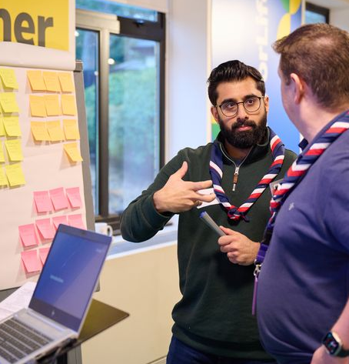
How we Volunteer Together
Changing our role titles
Changing our Role Titles
The volunteer experience changes being made are part of transforming our culture within Scouts
It’s important that we recognise how our role titles are part of both our culture and our perception as a movement
We’re changing many of our role titles within Scouts to:
Reflect on our perception outside of Scouts
Provide a consistent and clear structure across our leadership roles
Make our roles and responsibilities clearer
Make it easier to share tasks within a team
Set out what we want our culture to be

Slide 17
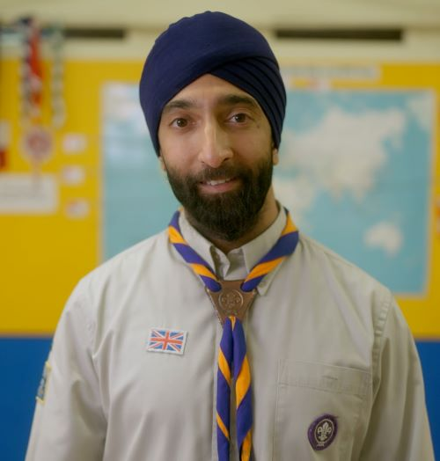
How we Volunteer Together
Changing our role titles
Changing our Role Titles
We currently have over 400 role titles, which can make our structure difficult to understand and remain consistent
As part of changing how we volunteer together we’re simplifying our role structures and role titles
We’ll be introducing Team Leader and Team Member role titles as part of this
These titles will replace many of our current roles such as Section Assistant and Assistant Section Leader and more, along with our Deputy and Assistant roles

Slide 18
How we Volunteer Together
Changing our role titles
Those in leadership roles have told us:
Introducing Lead Volunteers
30% of all leadership roles are vacant
It’s important that we have a consistent and clear structure across our leadership roles
We currently find our leadership roles some of the hardest to recruit for, in part due to their high levels of workload and perception both internally and externally
From research and surveys with our current commissioners, volunteers and outside of scouting we’re making changes to our ‘Commissioner’ and Group Scout Leader role titles
53% of District Commissioner and manager roles
45% said their workload was ‘difficult’ or ‘really difficult’
27% of Group Scout Leader roles
Our external research role told us:
Provides leadership and inspiration to other volunteers
The Commissioner title is used in a very different context outside of Scouts
7% said Commissioner
43% said Lead Volunteer

Slide 19
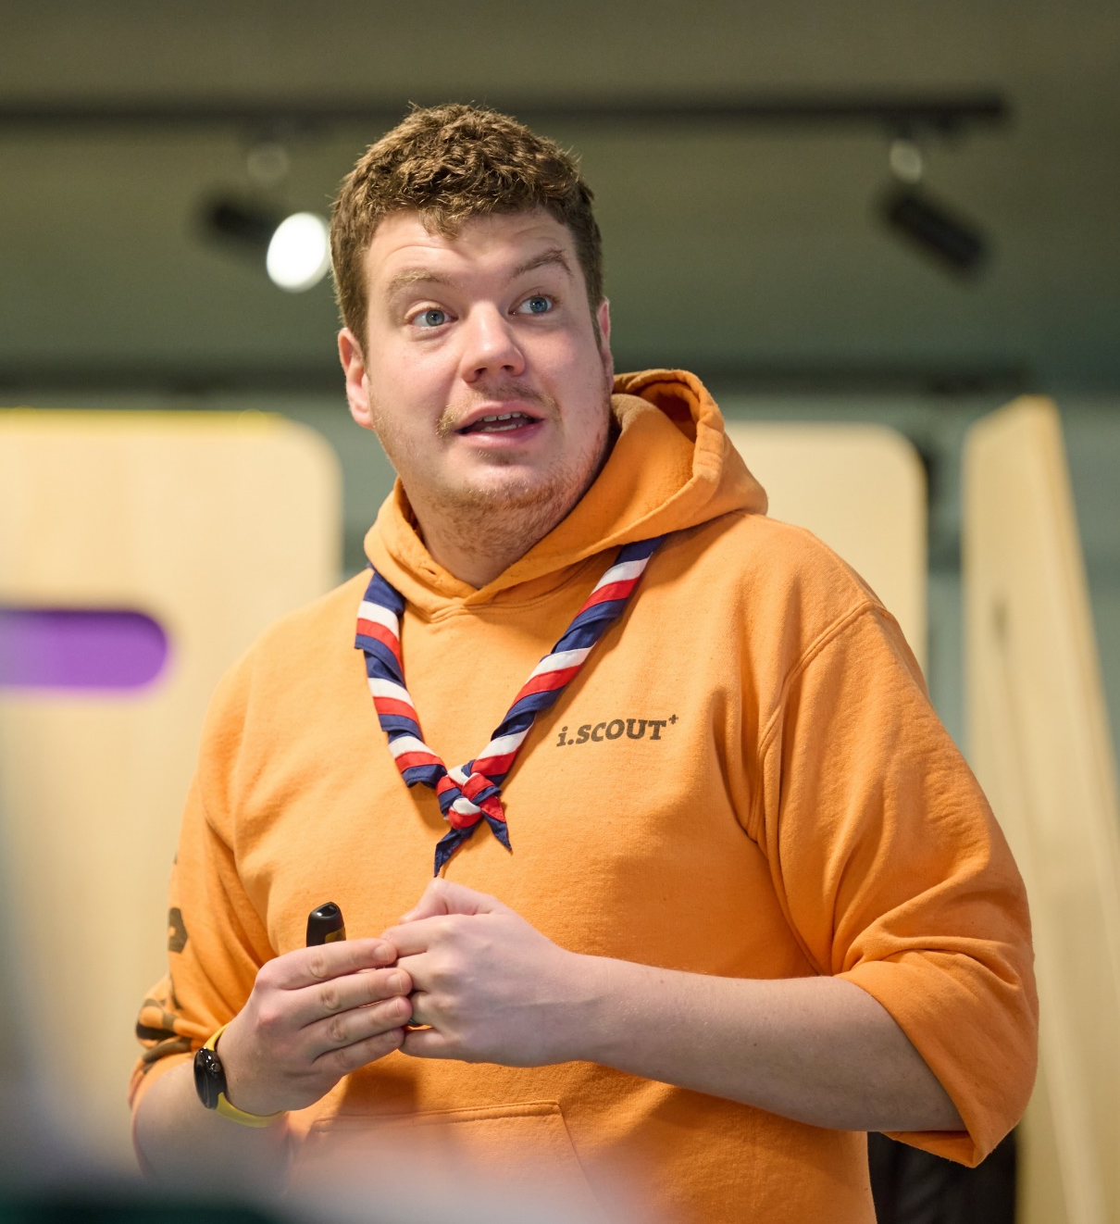
How we Volunteer Together
Changing our role titles
Introducing Lead Volunteers
The ‘Commissioner’ and ‘Group Scout Leader’ titles will change across Scouting
GSLs along with District, County, Area, Region (and so on) Commissioners will be called Lead Volunteers
Youth Commissioners will be called Youth Leads

Slide 20
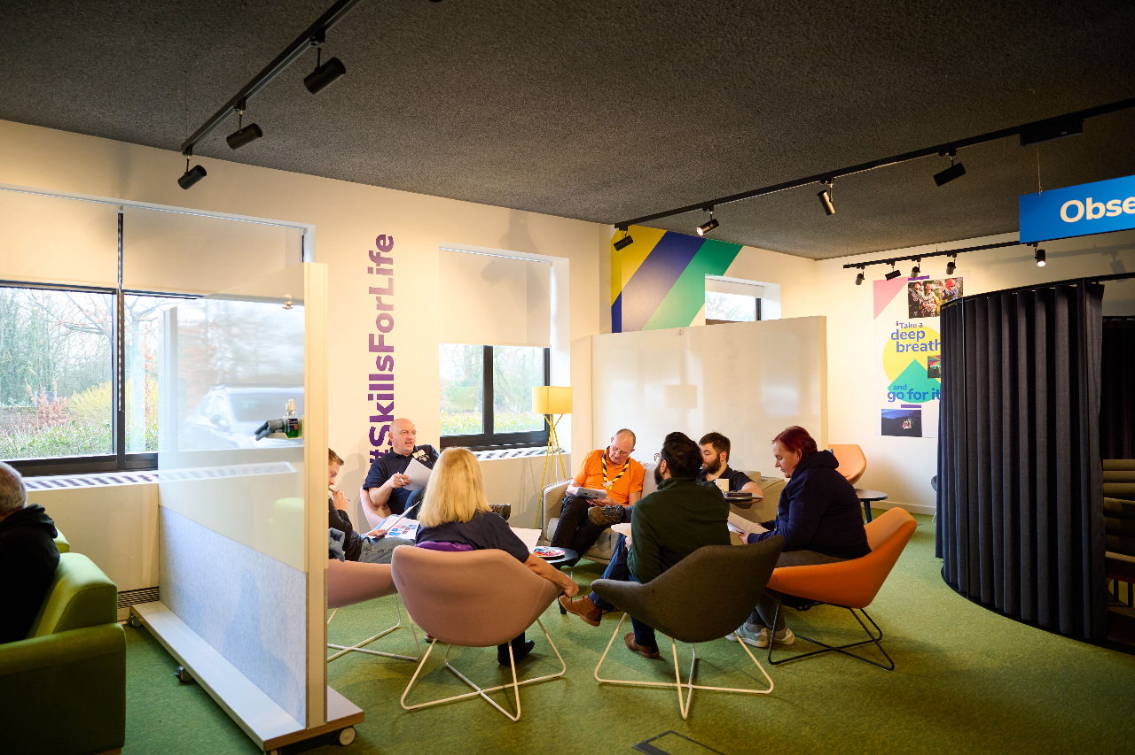
How we Volunteer Together
Changing our role titles
Changing Role Titles
These changes support us to recruit new volunteers and make roles for current volunteers clearer and more flexible and help us to:
Make our roles clearer
Make it easier to share tasks as a team
Support recruitment of new volunteers
These changes are about how we organise ourselves and our teams, but you’re still…
A Scout Leader, Beaver Leader, Skip, Owl, Badger, Akela, Raksha…
That isn’t changing!

Slide 21
How we Volunteer Together
Adopting a team-based approach

Slide 22
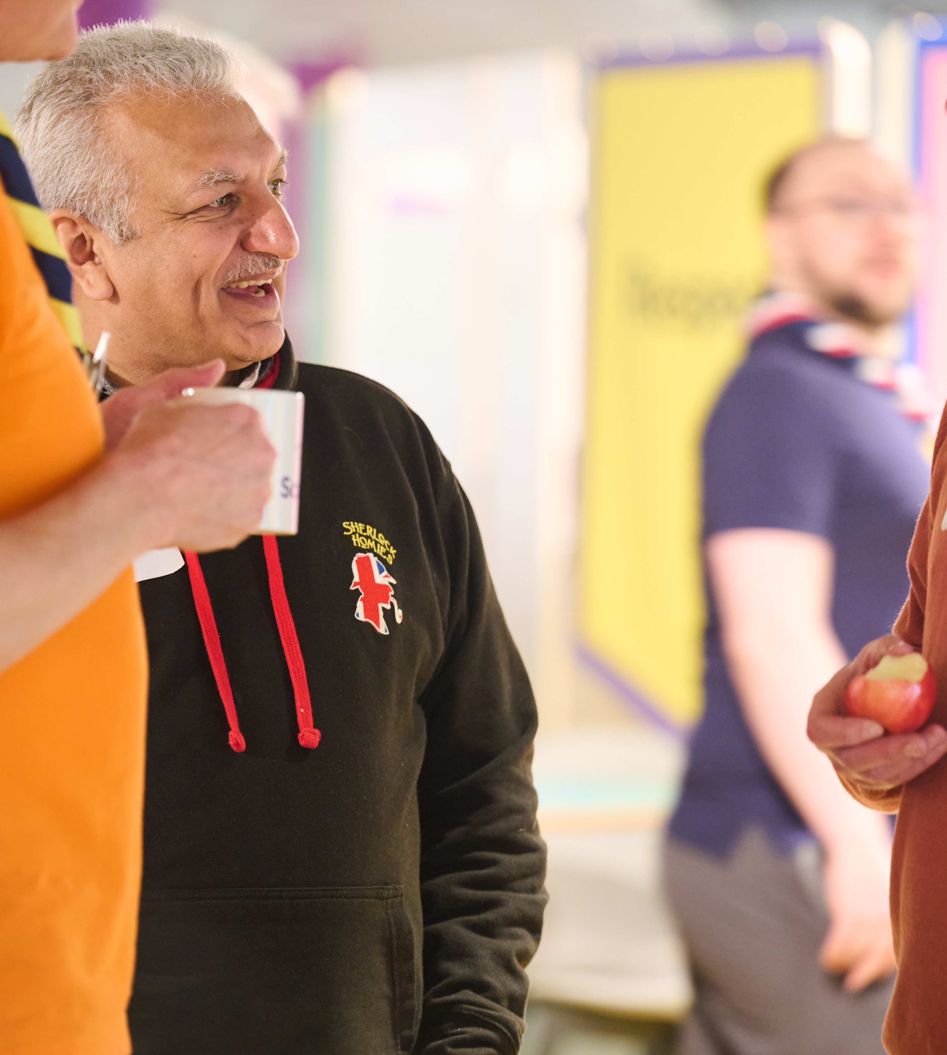
How we Volunteer Together
Adopting a team-based approach
Team-based Approach
Our current approach is heavily roles based, with volunteers often holding multiple different roles within an area
In place of this we’ll have teams and team descriptions
The key principles for this approach are:
We volunteer flexibly as part of a team with a shared purpose
Our teams and titles are easier to understand and more appealing to new volunteers
Teams agree how to share tasks between them, and this can change over time

Slide 23
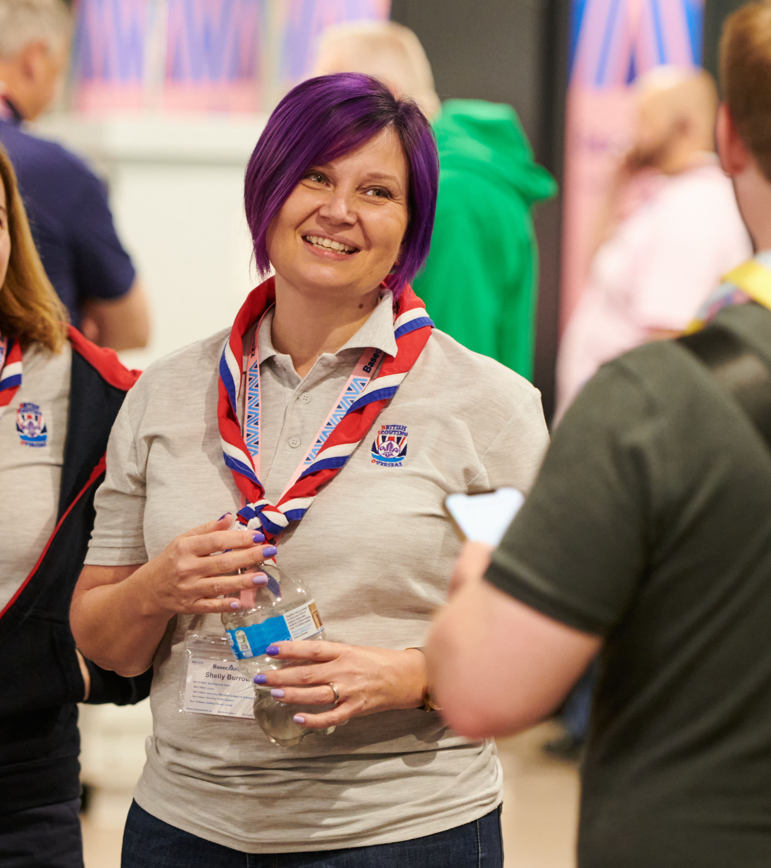
How we Volunteer Together
Adopting a team-based approach
Team Descriptions
Every team description will have:
Purpose - To explain what the team is for and how it plays a part towards our vision
Who’s in the team - To explain who is in the team and what they’re called
Tasks for the whole team - Are things which everyone in the team will be involved with
Allocated tasks - Are things which are things which can be shared out between members of the team

Slide 24
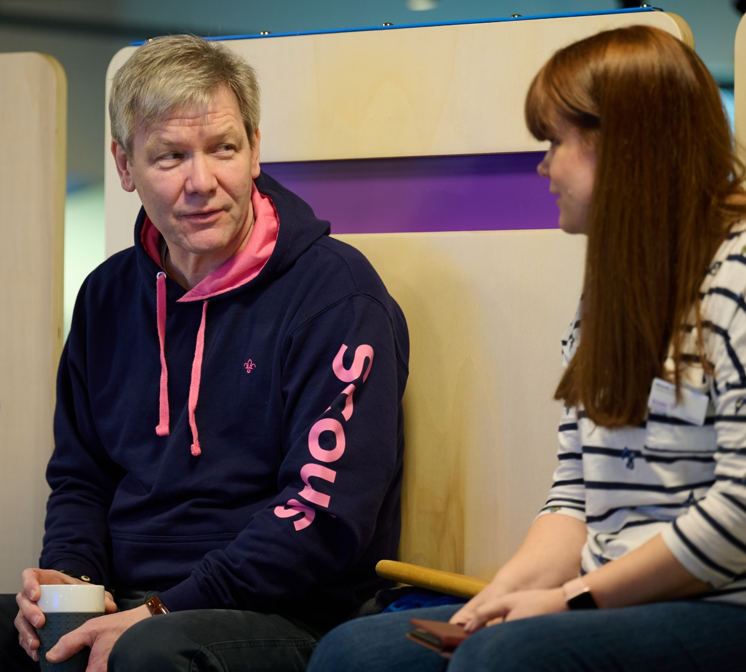
How we Volunteer Together
Adopting a team-based approach
How volunteers work in teams
Each team will have a team description, setting out the tasks for that team
There are two types of tasks:
Tasks for the whole team - Everyone helps with these tasks
Allocated tasks - The Team Leader(s) make sure there’s at least one volunteer responsible for each task and support them to get it done
This approach means:
It’s easier for new volunteers to join the team
We have clearer purpose and responsibilities
Volunteering is more flexible and suits people’s skills, interests, and time
Each team is led by a Team Leader(s) or Lead Volunteer(s)

Slide 25
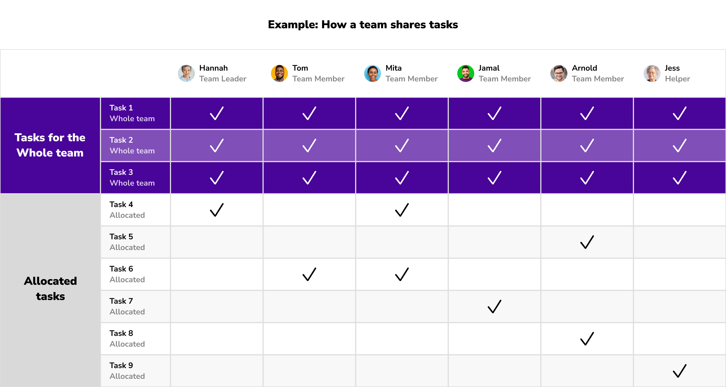
How we Volunteer Together
Adopting a team-based approach
How volunteers work in teams

Slide 26
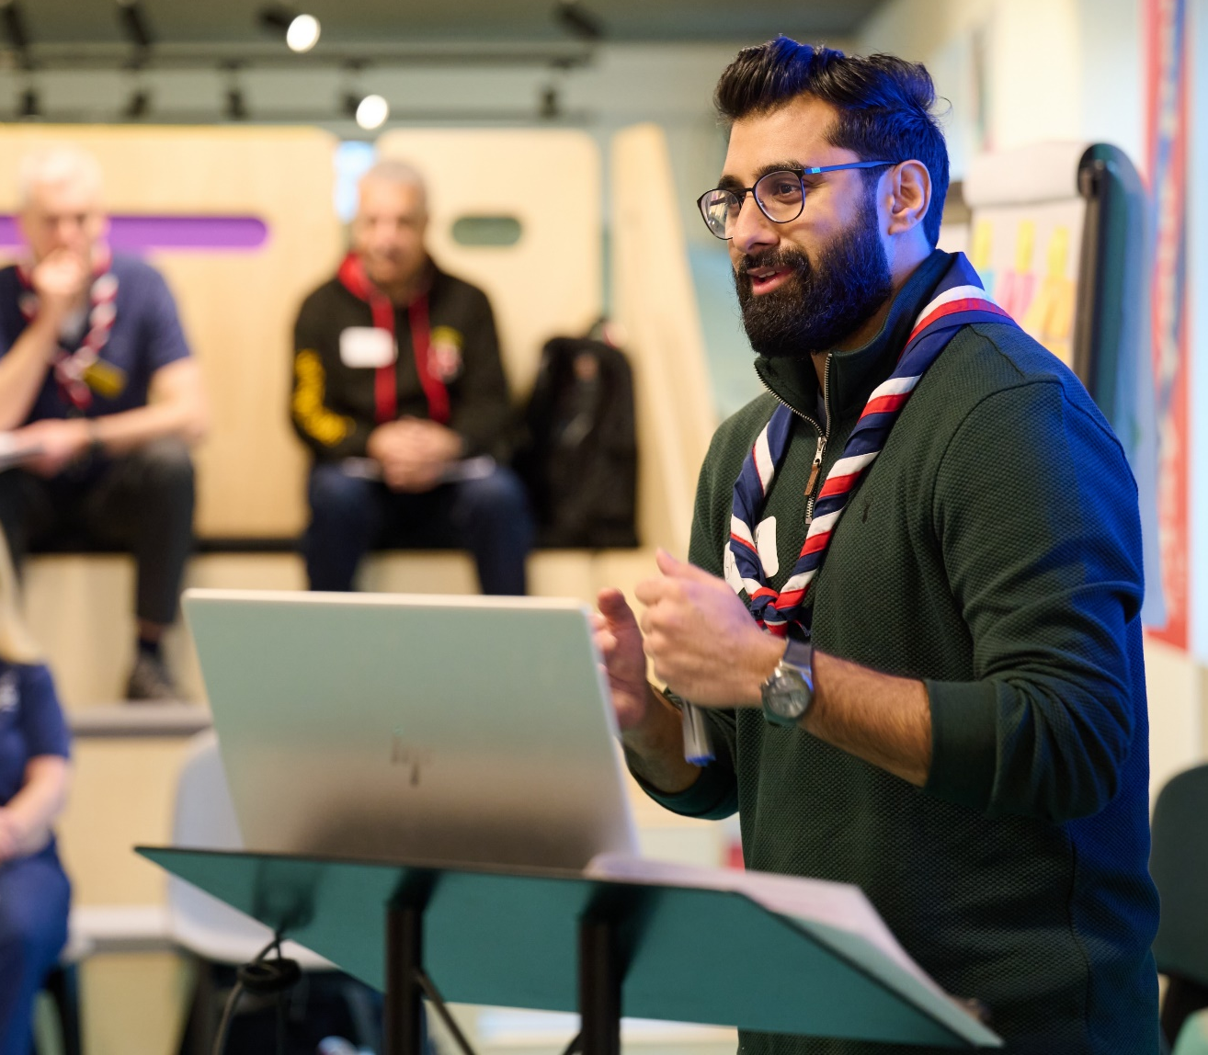
How we Volunteer Together
Adopting a team-based approach
Lead Volunteers & Team Leaders
Each team will have at least one Team Leader or Lead Volunteer
They work with Team Members to share tasks out and make sure the team runs smoothly, they are not responsible for doing all the tasks themselves
There may be multiple Lead Volunteers or Team Leaders in a team
They are responsible for;
Creating a positive team environment
Helping volunteer find what they need
Attracting and welcoming new volunteers into their teams as needed
Reflecting and Reviewing with the team

Slide 27
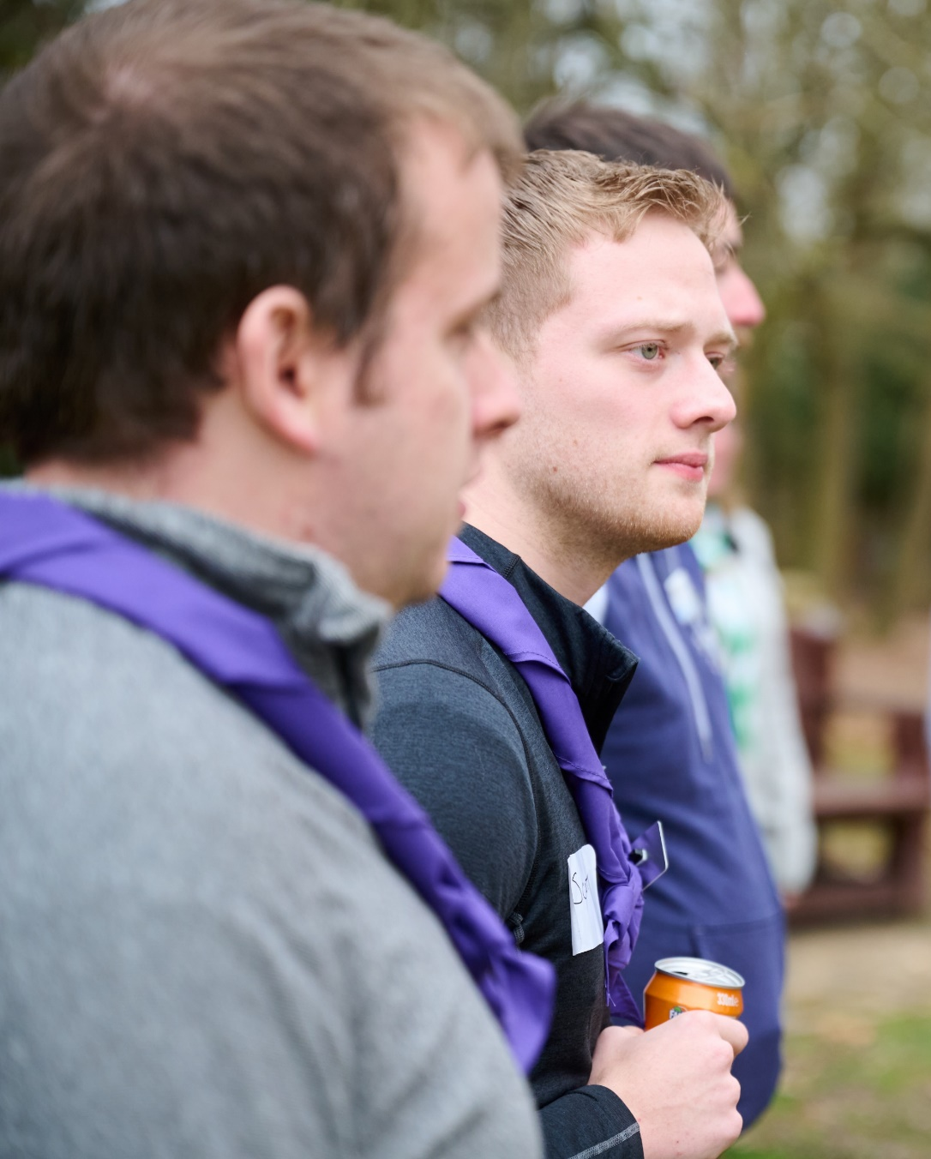
How we Volunteer Together
Adopting a team-based approach
Changes to our current teams
These changes to how we volunteer together, along with the wider volunteer experience changes will mean changes to our current teams and roles
We rely on the committed and passionate volunteers we have to make things happen across the whole movement
There’s a team for everyone in the new structure which will match to your experience, skills and interests

Slide 28
How we Volunteer Together
Adopting a team-based approach
Section Structure
Team Leader(s)
Team Member
Team Member
Section Team
Young Leader
Team Member
Young Leader
Full details are in each Team Description

Slide 29
How we Volunteer Together
Adopting a team-based approach
Group Structure
Plan and deliver a safe programme
Make sure admin is done correctly
Communicate with others
Look after section finances
Sections
Group
Group Leadership Team
Trustee Board
Help the group’s sections to run well
Develop our volunteers and help recruit new ones
Engage with the community
Enable growth and new provision
Manage incidents
Support effective processes (e.g., admin, finance, equipment, etc.)
Look after the money
Ensure buildings and equipment are in good working order
Manage a risk register
Make sure everyone follows legal requirements
Full details are in each Team Description

Slide 30
How we Volunteer Together
Adopting a team-based approach
Section & Group Structure
Section Team -
Plans, delivers, and runs high-quality programmes safely. They make sure all young people can take part in the programme and gain skills for life
Group Leadership Team -
Helps volunteers across all Sections to work well together and feel motivated. They make sure the Group is respected and supported in their local community
Trustee Board -
Trustees make sure the charity is well managed, risks are assessed and mitigated, buildings and equipment are in good working order, and everyone follows legal requirements and Policy, Organisation and Rules (POR)

Slide 31
How we Volunteer Together
Adopting a team-based approach
Group Leadership Team
Group Lead Volunteer(s)
Squirrel Team Leader(s)
Cub Team Leader(s)
Leadership Team Member(s)
Beaver Team Leader(s)
Scout Team Leader(s)
Group: 1st Anytown
Group Trustee Board
Chair
Treasurer
Trustees
Group Lead Volunteer
Group Leadership Team
Squirrel Drey
Cub Pack
Scout Troup
Team Members
Young Leaders
Team Members
Young Leaders
Beaver Colony
Team Members
Young Leaders
Team Leader(s)
Team Members
Young Leaders
Team Leader(s)
Team Leader(s)
Team Leader(s)

Slide 32
How we Volunteer Together
Make sure all District teams work well
Make sure all teams are inclusive and reflective of the local community
Make sure safety and safeguarding responsibilities are fulfilled
Support the District Youth Lead to make sure decisions are shaped by young people
Adopting a team-based approach
Young Leaders
Explorers
District Structure
Look after the money
Ensure buildings and equipment are in good working order
Manage a risk register
Make sure everyone follows legal requirements
Trustee Board
Leadership Team
14 - 24 Team
Network
14-24 Team, for their Sections
Support each Explorer, Young Leader and Scout Network section team
Attract and welcome new volunteers to Group and District teams
Make sure volunteers are well-supported
Make sure volunteers are recognised
District
Group Leadership Teams
Support each of their section teams
Develop our volunteers
Engage with the community
Enable growth and new provision
Manage incidents
Support effective processes
Volunteering Development Team
Groups
Help section teams run high-quality programmes
Facilitate programme networking opportunities
Provide access to specialist expertise
Manage approvals for activities and permits
Programme Team
Support Team
Engage with the local community
Grow sections and groups
Manage incidents
Manage administration, property and equipment
Full details are in each Team Description

Slide 33
How we Volunteer Together
Adopting a team-based approach
District Structure
District Leadership Team -
Leads and inspires volunteers to give young people great experiences and skills for life. They make sure the teams in their District are organised, have enough volunteers, and can deliver a great programme.
Trustee Board -
Trustees make sure the charity is well-managed, risks are assessed and mitigated, buildings and equipment are in good working order, and everyone follows legal requirements and Policy, Organisation and Rules (POR)
14-24 Team -
Helps all volunteers in Explorer (including Young Leaders) and Network Sections. They help section teams plan and deliver great programmes for young people

Slide 34
How we Volunteer Together
Adopting a team-based approach
District Structure
Volunteering Development Team -
Makes sure all volunteers in their District have a positive and enjoyable volunteering experience. They make it easy for people to join and learn new skills.
Programme Team -
Helps every section in the District run a safe, enjoyable and high-quality programme. To help do this, they bring Section Team volunteers together with activity experts.
Support Team -
Provides the tools and resources to help Scouts run smoothly

Slide 35
How we Volunteer Together
Adopting a team-based approach
District: West Blanksville
District Leadership Team
District Lead Volunteer(s)
Programme Team Leader
Group Lead Volunteers
Leadership Team Member(s)
14-24 Team Leader
District Youth Lead(s)
Volunteering Development Team Leader
Support Team Leader
District Leadership Team
Programme Team
Support Team
14-24 Team
Team Members
Explorer Units
Young Leader Units
Volunteering Development Team
Team Members
Team Leader(s)
Team Members
Team Leader(s)
Team Leader(s)
Team Leader(s)
Scout Network
District Trustee Board
Chair
Treasurer
Trustees
District Lead Volunteer

Slide 36
How we Volunteer Together
Adopting a team-based approach
County Structure
Trustee Board
Leadership Team
Make sure all County teams work well
Make sure all teams are inclusive and reflective of the local community
Make sure safety and safeguarding responsibilities are fulfilled
Support the County Youth Lead to support sections to be shaped by young people
Look after the money
Ensure buildings and equipment are in good working order
Manage a risk register
Make sure everyone follows legal requirements
County
Districts
For County teams and District Lead Volunteers:
Attract and welcome new volunteers
Ensure volunteers are well-supported
Ensure volunteers are recognised
Volunteering Development Team
Programme Team
Support Team
Provide events best run at scale
Lead the assessments for activity permits
Manage approval for activities and permits
Engage with the local community
Manage incidents
Manage administrative tasks
Manage property and equipment
Full details are in each Team Description

Slide 37
How we Volunteer Together
Adopting a team-based approach
County Structure
County Leadership Team -
Leads and inspires volunteers to give young people great experiences and skills for life. They make sure their County teams are organised, have enough volunteers, and can deliver a great programme.
Trustee Board -
Trustees make sure the charity is well managed, risks are assessed and mitigated, buildings and equipment are in good working order, and everyone follows legal requirements and Policy, Organisation and Rules (POR)
Support Team -
Provides the tools and resources to help Scouts run smoothly in their County.

Slide 38
How we Volunteer Together
Adopting a team-based approach
District Structure
Volunteering Development Team -
Makes sure all volunteers in County teams have a fantastic volunteering experience. By doing so, they’ll make it easy for people to join and learn new skills.
Programme Team -
Supports Section programmes when activities or events are best done at County scale. They help volunteers with their assessments for adventurous activity permits.

Slide 39
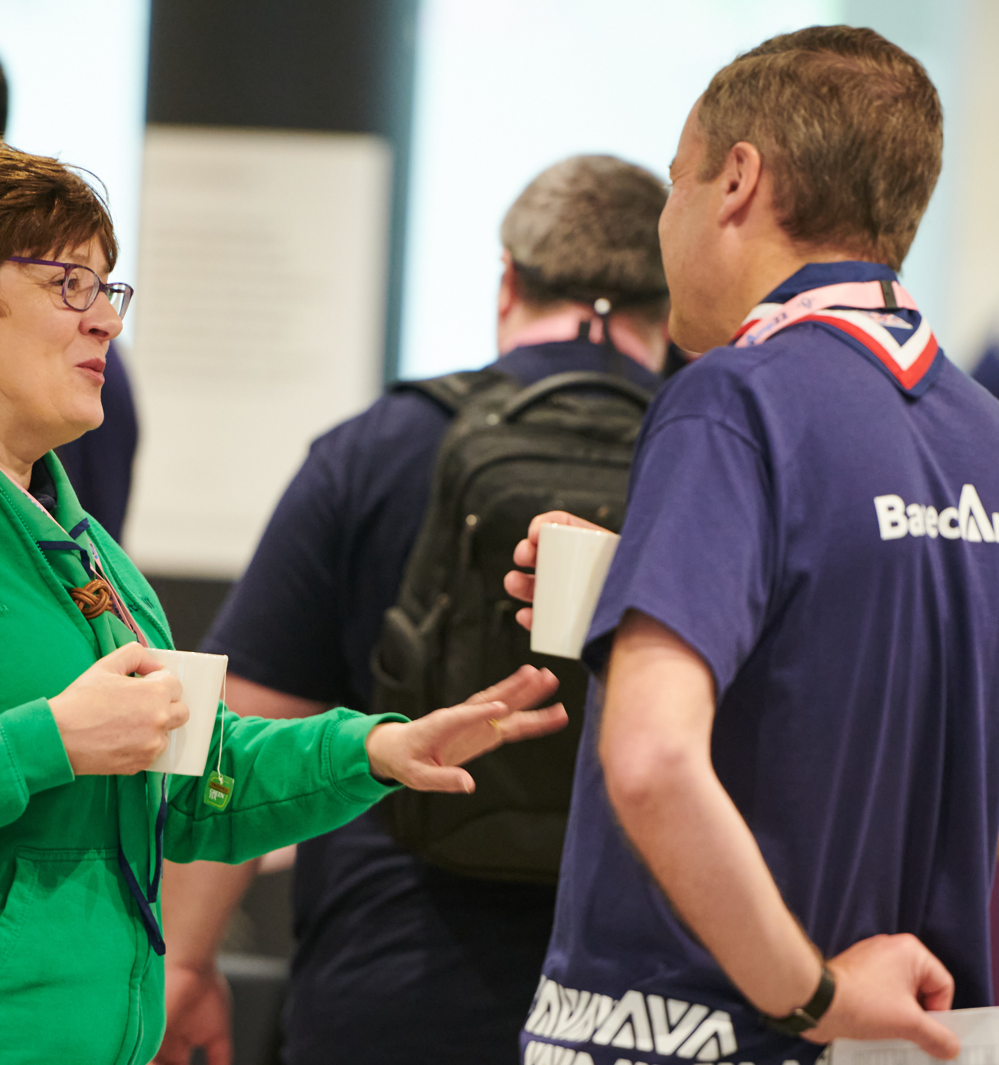
How we Volunteer Together
Adopting a team-based approach
Sub-teams
Sub-teams are being introduced to help organise our volunteers and will sit within another team
Each sub-team will have a specific area of focus within the overall scope of the larger team
We can use sub-teams to:
Increase a sense of identity and belonging within volunteers
Make better use of volunteers’ time and resources
Help make it clearer what people do, and what they’re responsible for
For example, setting up a Hillwalking or Climbing Team within the Programme Team

Slide 40
How we Volunteer Together
Adopting a team-based approach
District Leadership Team
Programme Team
Support Team
14-24 Team
Team Members
Explorer Units
Young Leader Units
Volunteering Development Team
Team Leader(s)
Team Members
Team Leader(s)
Team Leader(s)
Scout Network
Hillwalking Sub-Team shared with two other Districts
Top Awards Sub-Team
Sub-Team Leader(s)
Sub-Team Members
Sub-Team Leader(s)
Sub-Team Members
Growth Team shared with a nearby District
Team Leader(s)
Team Member(s)
Recognition Sub-Team
Sub-Team Leader(s)
Sub-Team Members
District: Mid-Elsewhere

Slide 41
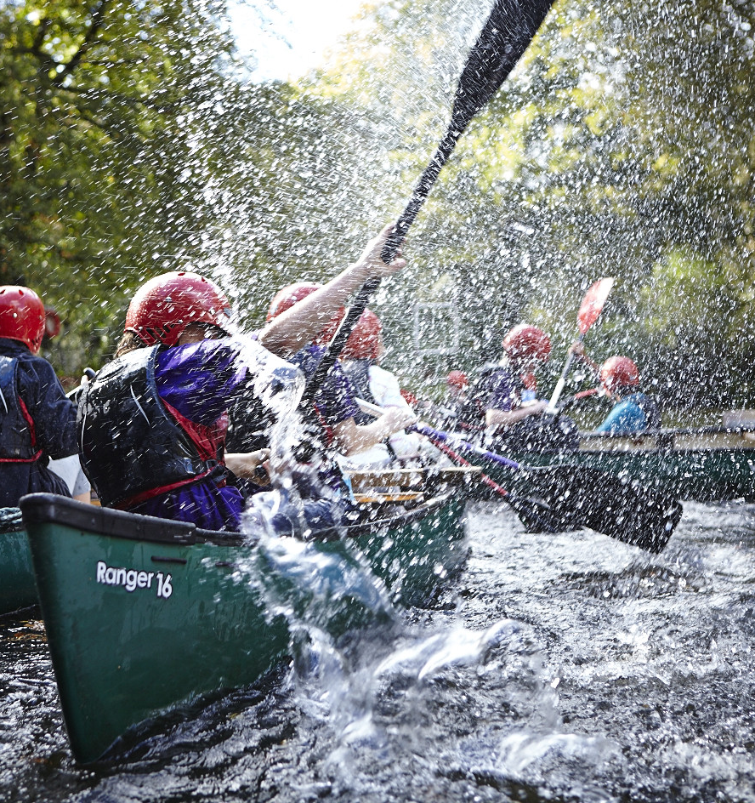
How we Volunteer Together
Adopting a team-based approach
Accreditations
Sometimes, a person needs to be given permission to do a specific task, this is called and ‘accreditation’
Accreditations will be introduced along with the new digital systems
For Example:
A task that needs to be done with someone with specific skills or qualifications - A Kayak or Archery permit assessor
A task where someone needs to find and contact a specific person - The HQ Awards Team knowing who to post awards to

Slide 42
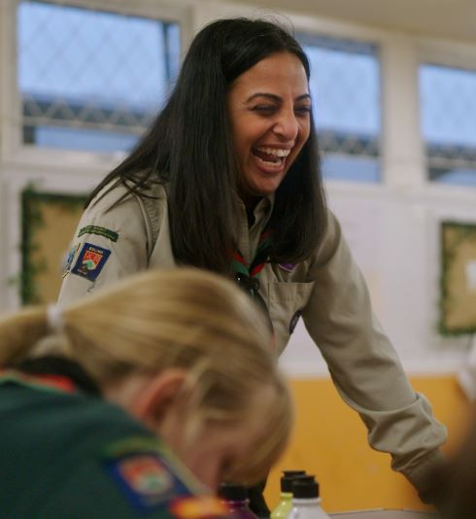
How we Volunteer Together
Adopting a team-based approach
Accreditations
Volunteers will need to meet the right criteria to receive an accreditation, for example:
Holding a certain qualification
Completed specific learning
Be in a particular role
Specific accreditations will be:
Adventurous Activity Assessor
Night Away Assessor
First Response Trainer
Manager of Activity Permit Scheme
And more!
These will all come alongside the launch of the digital systems

Slide 43
How we Volunteer Together
Moving to Trustee Boards

Slide 44
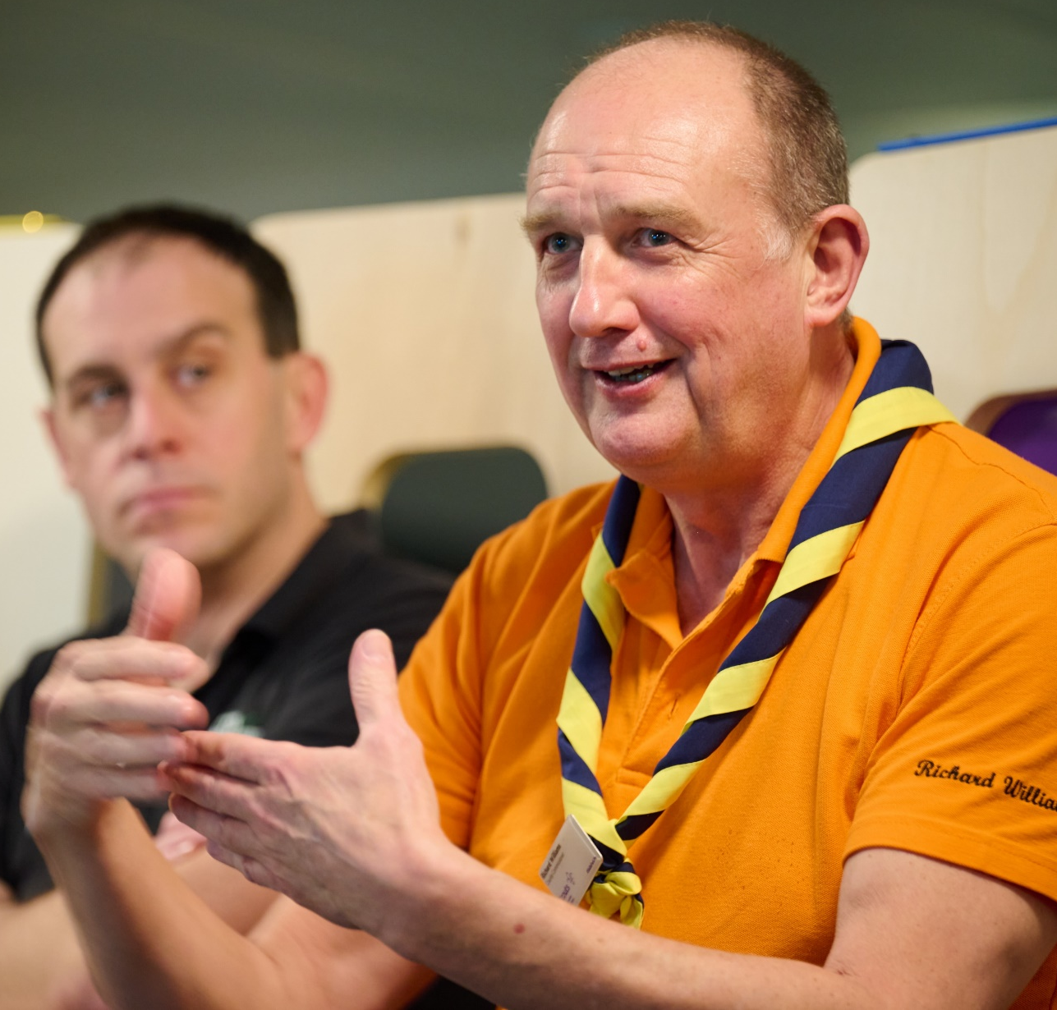
How we Volunteer Together
Moving to Trustee Boards
Introduction
As part of the work to transform the volunteer experience within Scouts there will be changes to Executive Committees and how they function.
These changes are informed by:
The evolution of good practice guidance from charity regulators
Our move to a teams-based approach
These cultural and procedural changes to how Executive Committees currently operate will support our Skills for Life strategy, our ‘North Star’ and the overall aims of the volunteer experience transformation.

Slide 45
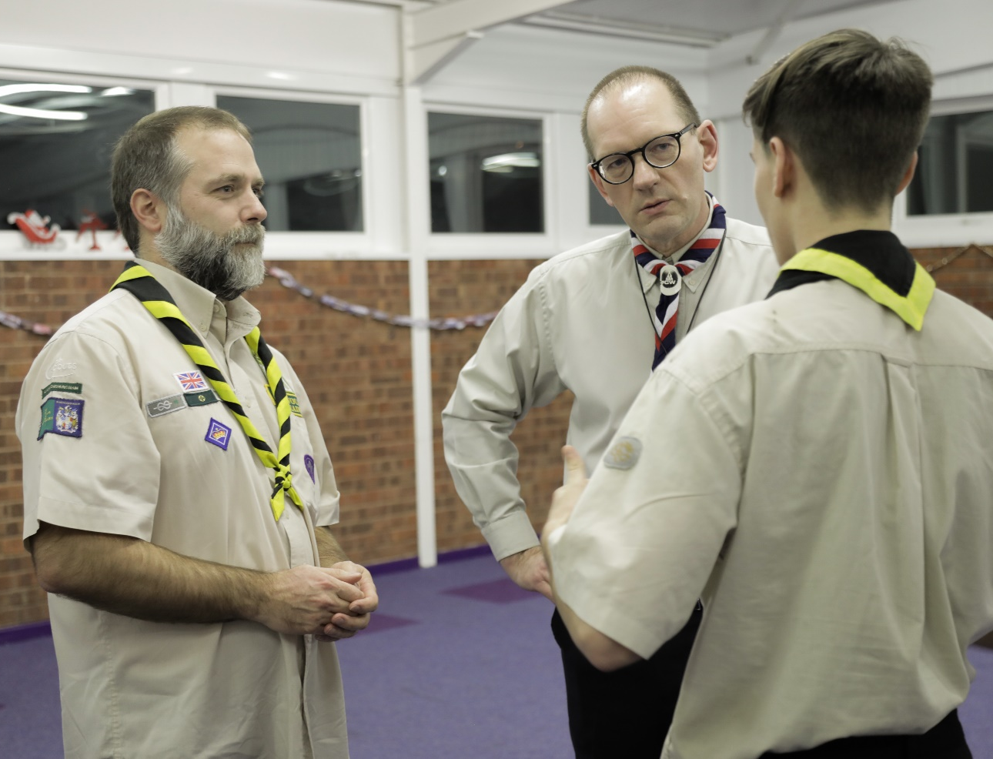
How we Volunteer Together
Moving to Trustee Boards
Setting up for success
Good governance is fundamental to a charity's success, enabling and supporting the charity to:
Comply with the law and relevant regulations
Meet the charity’s objectives
Good practice for this is set by the charity regulators, where there have been significant changes over the past few years.

Slide 46
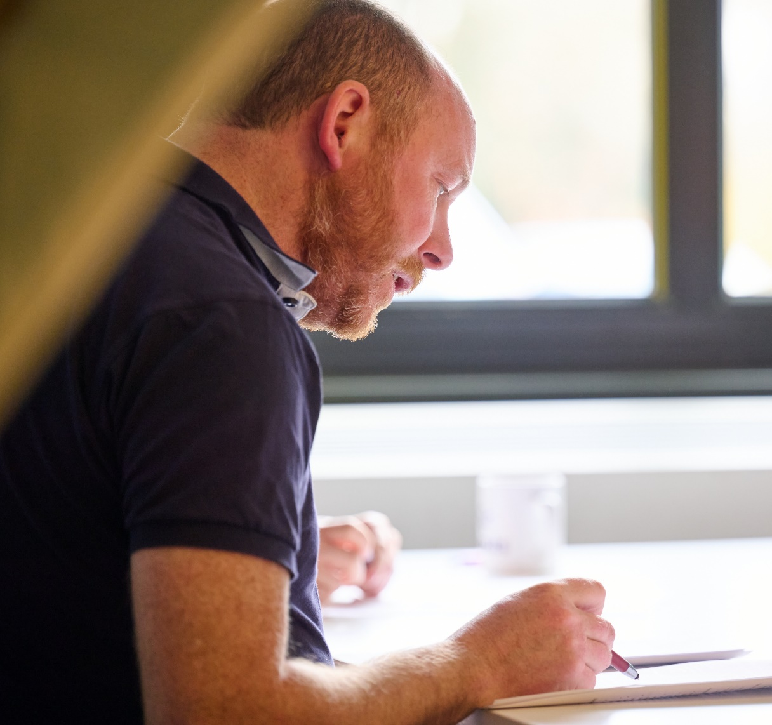
How we Volunteer Together
Moving to Trustee Boards
Renaming as Trustee Boards
Executive Committees are renamed as Trustee Boards, members of which are renamed as Trustees
Why is this changing?
To align with good practice guidance from the charity regulators
To help reinforce the purpose of Trustee Boards and focus on the role and responsibilities of being a charity Trustee

Slide 47
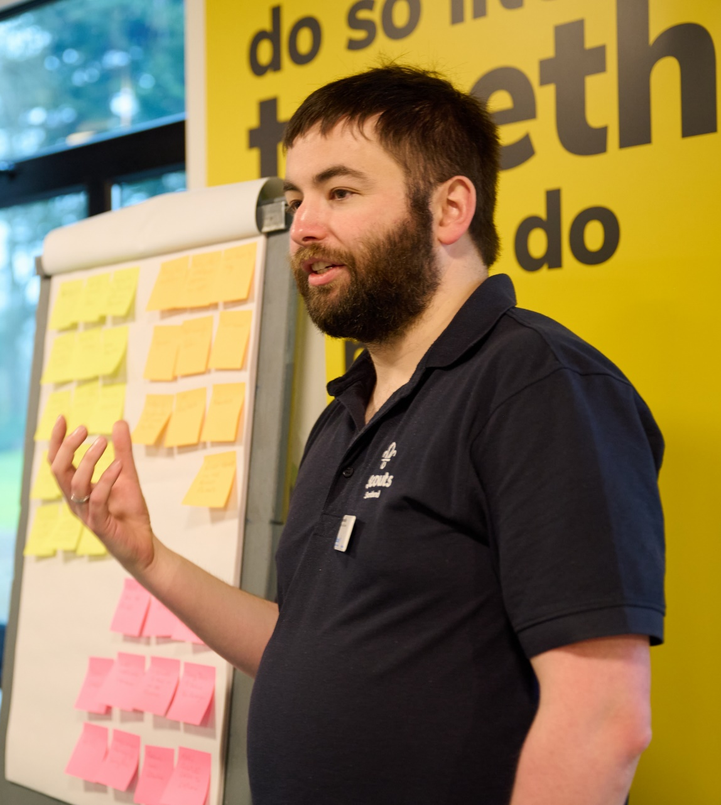
How we Volunteer Together
Moving to Trustee Boards
The purpose of Trustee Boards
Trustee Boards have a clearer purpose statement, to fit with the focus on governance. This will mean ‘operational’ tasks are managed through the Group Leadership Team or the Support Team in District or County (and equivalent)
Why is this changing?
To align with good practice guidance from charity regulators
To focus on ensuring effective governance. This is the core of any charity Trustee Board’s responsibility and an important part of ensuring that the charity focusses on meeting its objectives

Slide 48
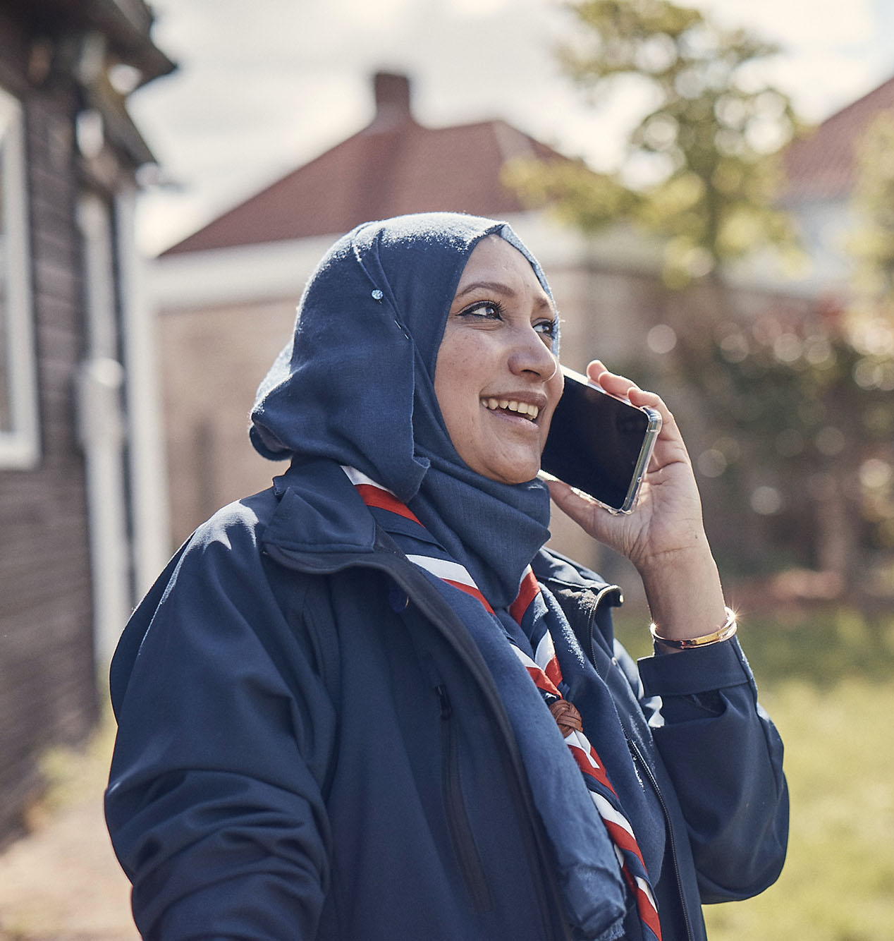
How we Volunteer Together
Moving to Trustee Boards
What does this mean for us?
All Groups, Districts, Counties and such will move from an executive committee to a Trustee Board
Operational tasks such as repairing the hut, cutting grass and fundraising will be separated from Governance tasks such as risk management and following Scout policies
At District level and above operational matters will move into the appropriate team most relevantly, the Support Team
At Group level operational matters will move into the Group Leadership Team, this could be as part of support sub-team
The same individuals can carry out the tasks they do now but this will be as part of two separate teams so the Trustee Board can maintain a clear focus

