Slide 1
Transforming Our Volunteer Experience -
Engaging Learning

Slide 2
Engaging Learning
Using this slide deck
Slide Deck Overview
Purpose:
This slide deck is designed to provide an overview of the ‘Engaging Learning’ change and is collated from information shared through slides, emails and verbally to Transformation Leads.
These slides will be updated regularly to reflect information shared in future, please check the document version you have against the one current on the TL Resource Hub to ensure you have the latest version.
The next slides outlines how to best use the information on these slides.
Author: This information has been prepared by the Change team, support by the Volunteer Experience project teams
Version: This is document version 1.0, effective as of 18/04/23
Support: Transformation Leads should direct any questions that they have to transformation.leads@scouts.org.uk

Slide 3
Engaging Learning
Using this slide deck
How to use this slide deck
Using this slide deck locally:
These slides contain a combination of both information and context, some of which makes several slides ‘text heavy’. This is done purposefully to ensure whoever is presenting has the context and information needed to talk to each point, without needing a separate script.
However, when presenting these slides, it’s recommended that some of this text is moved into the presenters' notes so that the slides are easy to read and understand and then the presenter can still ensure the core messages are not diluted.
You might also wish to tailor this to your audience by including just the slides relevant to them and combining these slides with those from the other ‘Transforming Our Volunteer Experience’ slide decks. This is recommended as presenting each of the slide decks for the areas of change would be incredibly long and detail heavy, the important part is the core message being shared.
Please also feel free to tailor these to suit local branding and messaging to fit with what progress you have made in your area already.

Slide 4
Engaging Learning
Purpose
Purpose
To provide a detailed overview of;
Why we’re moving from training to learning and changing how we learn in Scouting
What is changing?
Digital Learning
Growing Roots
Branching Out
Wood Badge
Volunteering Development Team
What’s Next?

Slide 5
Engaging Learning
Changing the way we learn in Scouts

Slide 6
Engaging Learning
Changing the way we learn in Scouts
We want to make volunteering with Scouts easier and more fun…
…so that we can attract more volunteers and our current volunteers want to stay

Slide 7
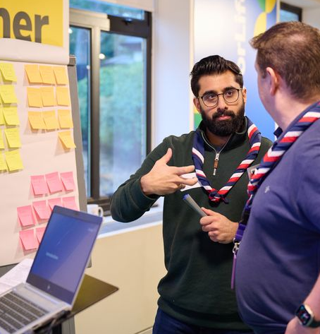
Engaging Learning
Changing the way we learn in Scouts
Why are we changing?
At Summit 17, with nearly 1,000 of our volunteers, we worked together to build our Skills for Life Strategy.
This included multiple suggestions and recommendations from volunteers around simplifying our learning, expanding the learning we offer and improving our digital learning experience.
Following this we:
Carried out external and internal research
Commissioned an independent research expert report
Developed a joint volunteer and staff team to lead this work

Slide 8
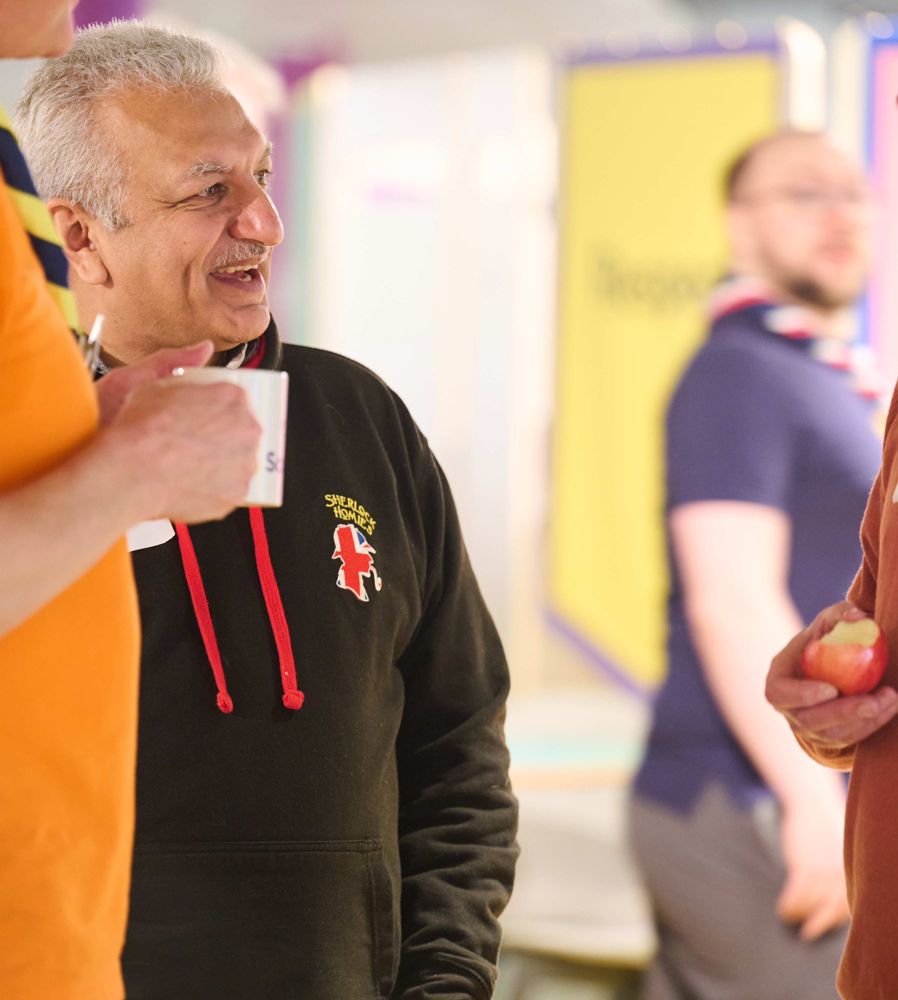
Engaging Learning
Changing the way we learn in Scouts
What have we learnt?
In our research with volunteers, we learnt that:
Our training scheme can feel overwhelming for new volunteers
Some learning is hard to access and requires finding more time available to attend
We don’t have enough training advisers to support learners this also delays validation which can be frustrating for the learner
The average length of time someone volunteers is 2 years, but nearly every volunteer role must complete the wood badge which can take up to 3 years to complete

Slide 9
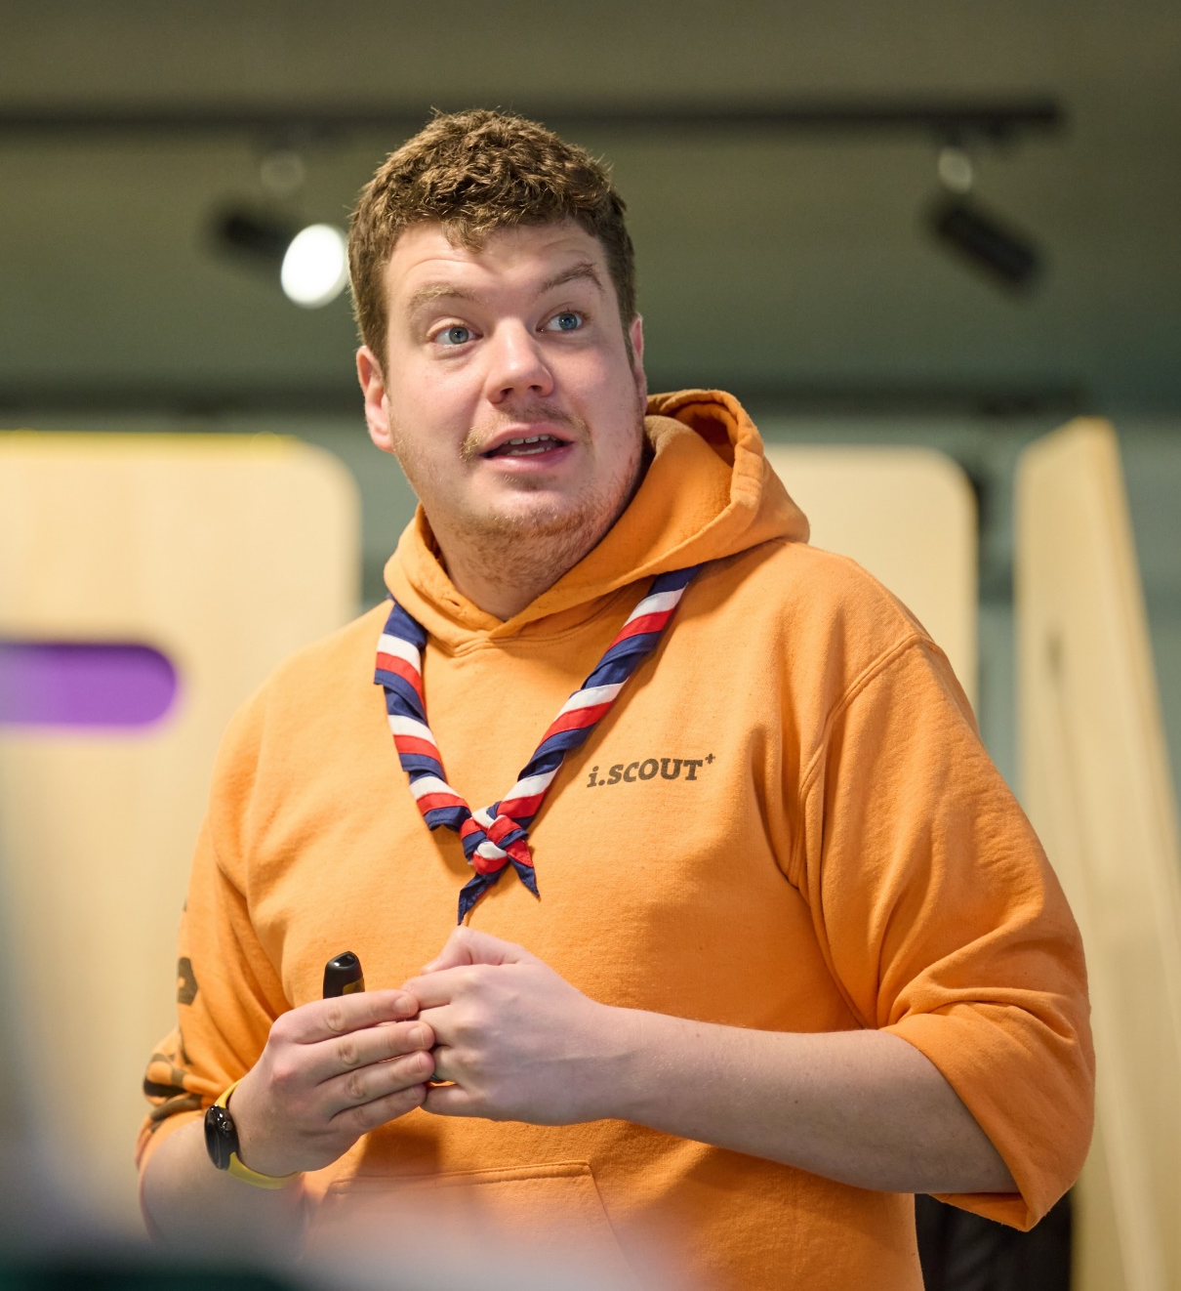
Engaging Learning
Changing the way we learn in Scouts
What will changing our learning achieve?
A simpler and easier to access learning experience
Learning specific to a volunteer's role
Reducing the duplication of learning
Improving the accessibility and inclusivity of the learning we offer
Modernise and improve on our current scheme which is now twenty years old
Improve how we recognise prior learning and experience for volunteers

Slide 10
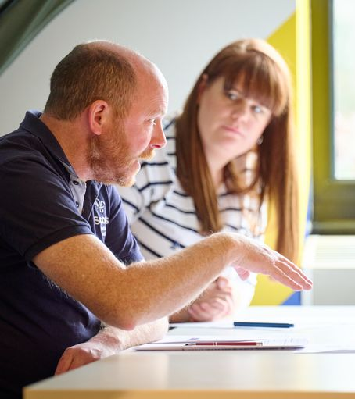
Engaging Learning
Changing the way we learn in Scouts
What is changing?
As part of moving from training to learning we’ll be:
Reviewing all our current training modules by 2025
Developing new framework for learning
Growing Roots
Branching Out
Moving to an optional Wood Badge
Having Volunteer Development Teams
Bringing in a new tool for digital learning

Slide 11
Engaging Learning
Digital Learning

Slide 12
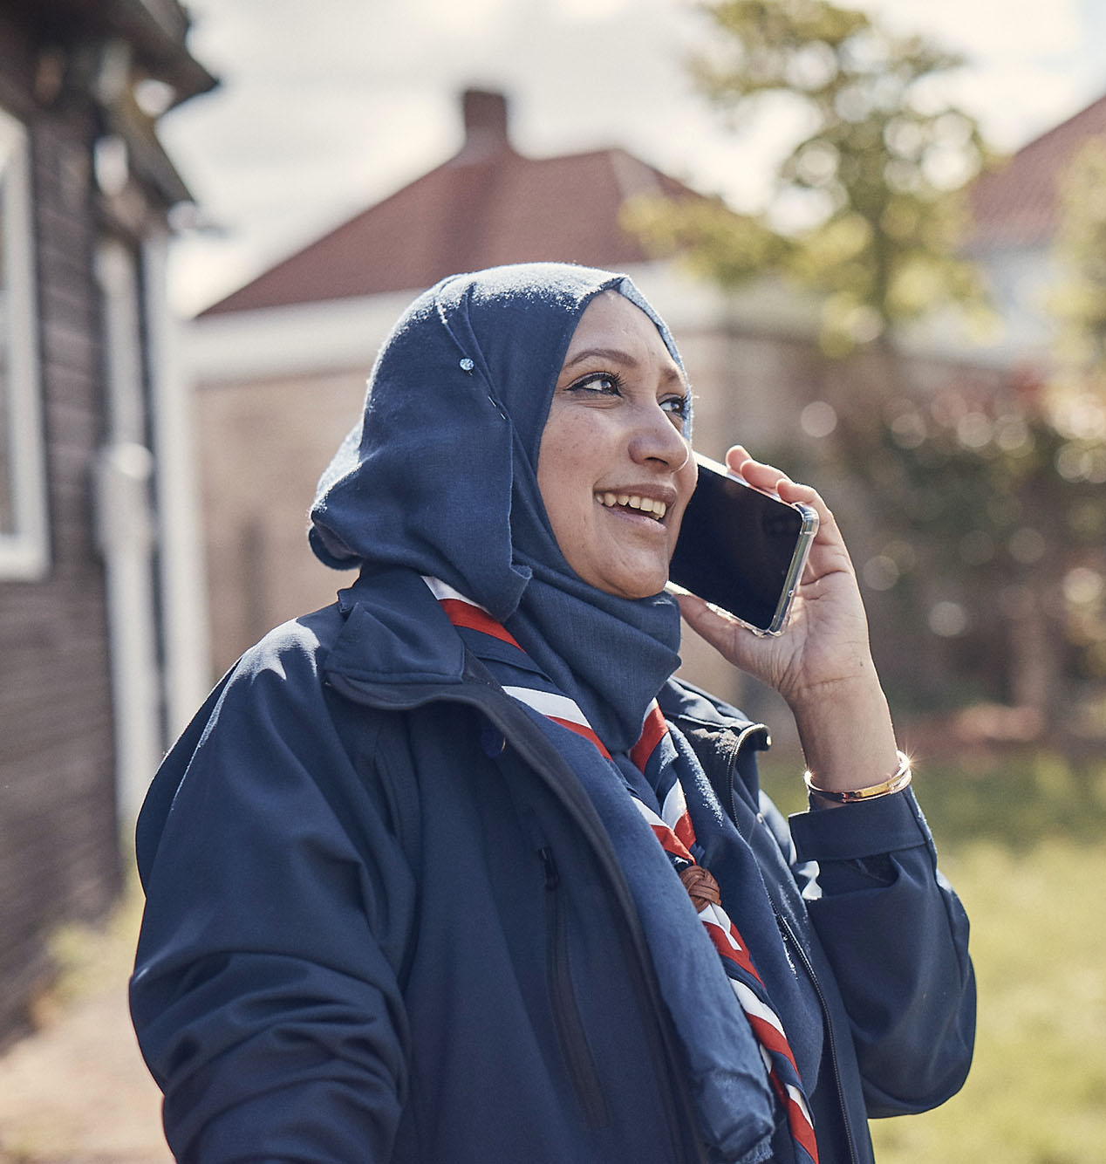
Engaging Learning
Digital Learning
Digital Learning
To support the delivery of learning there will be a new digital learning system on the Scouts.org.uk website
The new learning system will:
Have all learning in one easy to find place
Give easy access to learning whenever and wherever a volunteer wants
Simplify reporting and management of learning including compliance
Remove the need for validation in its current form
Allow for better approaches to crediting volunteers for the learning they do
Create an accessible learning experience for volunteers

Slide 13
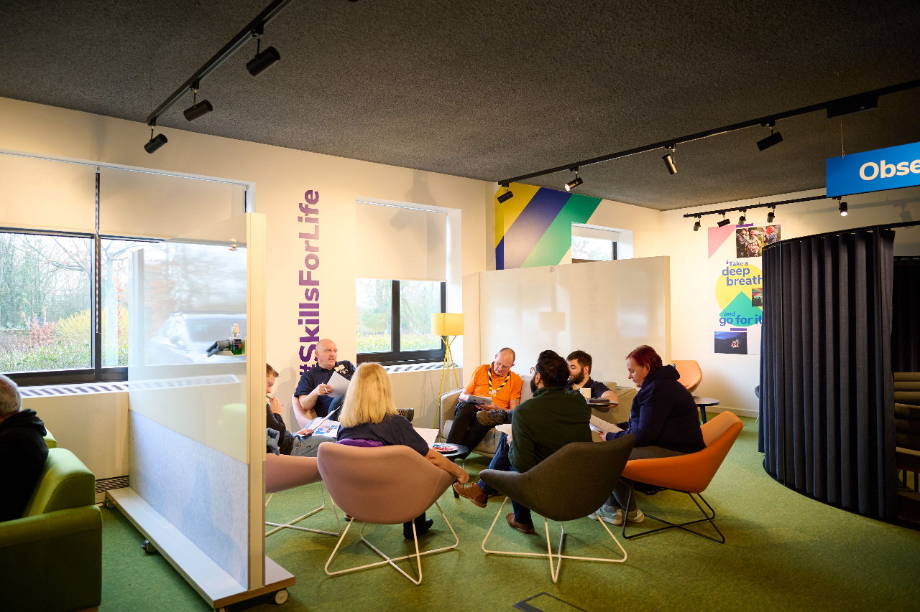
Engaging Learning
Digital Learning
Accessibility
It’s important that volunteers can access and engage with learning on our new learning platform. To support this, we are using:
Universal Design for Learning (UDL) Guidelines
These help to create learning which meets the needs of all users by reducing barriers and creating accessible and meaningful learning experiences
AND
Web Content Accessibility Guidelines (WCAG)
These set out recommendations for creating web content which is more accessible to all. This includes:
Alternative text for images
Simple and consistent navigation
Support for screen readers
Subtitles and transcripts
And more!

Slide 14
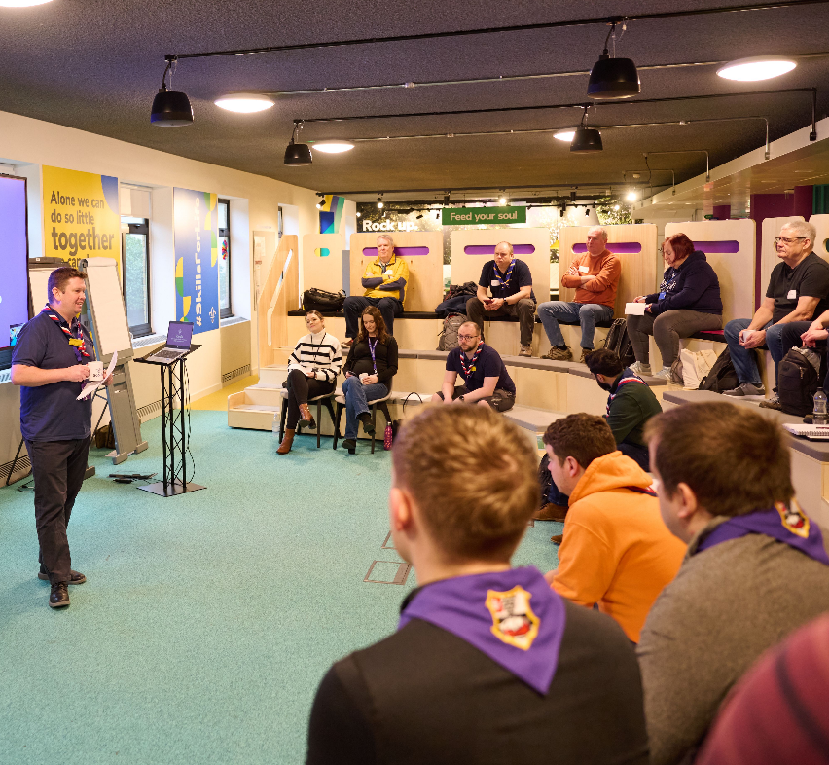
Engaging Learning
Digital Learning
Digital first, not digital only
It’s important that volunteers who are not as digitally skilled or don’t have access to technology can also access our learning.
As part of this we will:
Support volunteers to develop their digital skills through a bespoke digital skills tool
Develop processes for volunteers to be supported locally with completing their digital learning
Ensure that there is non-digital support for learning available

Slide 15
Engaging Learning
Growing Roots

Slide 16
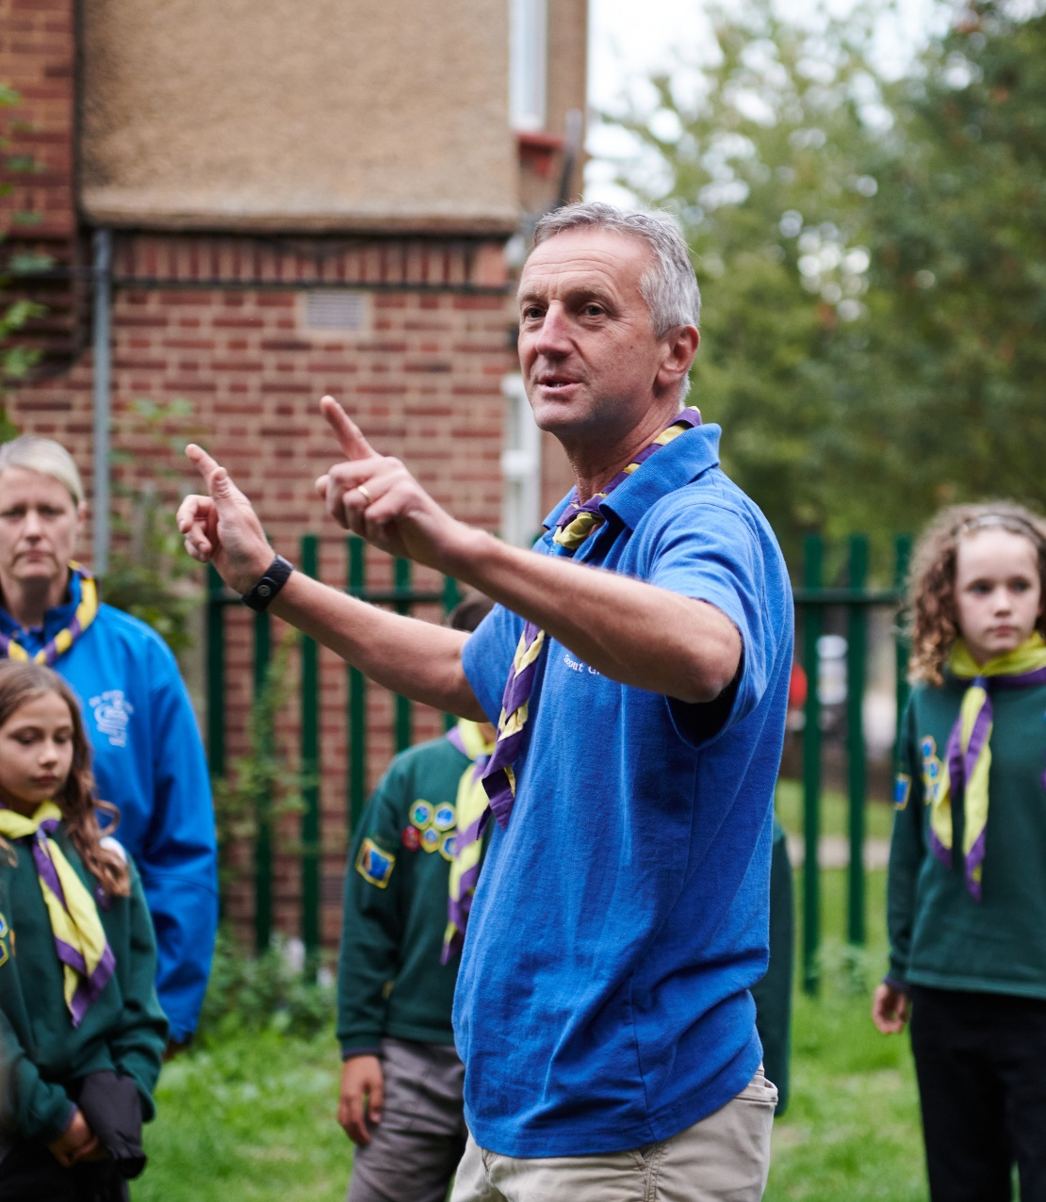
Engaging Learning
Growing Roots
Growing Roots
Growing Roots will become the new mandatory learning for our volunteers
Volunteers will have 6 months to complete their Growing Roots learning
Growing Roots will comprise of two parts;
The learning a volunteer needs to get started
The learning a volunteers needs for their team and role

Slide 17
Engaging Learning
Growing Roots
The learning everyone needs to get started
Data Protection in Scouts
Data breaches & deleting data
What we do & How we do it
Purpose and values
Creating Inclusion
Self-awareness
Safe Scouting
Storing & sharing data
Creating inclusive spaces
Supporting specific needs
Challenging bias and discrimination
E-Safety
Assessing and Managing risk
Incidents - respond and report
Mental Health Awareness
Safeguarding
Gathering data
Working with others
Running our programme (The basics)

Slide 18
Engaging Learning
Growing Roots
The learning everyone needs to get started
Data Protection in Scouts
What we do & How we do it
Creating Inclusion
Safe Scouting
Replacing:
Replacing:
Replacing:
GDPR
Some of Module 11 (Administration)
Module 1 (Essentials of Scouting)
Some of Module 3 and 4 (Tools for the Role)
Module 5 (The Fundamentals)
Module 9 (Working with Adults)
Module 7 (Scouting for all)
Potentially some of Module 36 (Additional Needs)
Safety
Safeguarding
Some of Module 17 (Running Safe Activities)
Replacing:
Notes:
Wulff/Matt

Slide 19
Engaging Learning
Growing Roots
The learning a volunteer needs for their role
“Delivering a Great Programme”
Section Teams
“Leading Scout Volunteers”
Team Leaders, Lead Volunteers
Potential Content*:
“Being a Trustee in Scouts”
Trustees
Potential Content*:
Potential Content*:
How to work with parents/guardians
How to actively involve young people
Running our programme (In practice)
Teamwork, inclusion and conflict from a management perspective
Charity regulator processes
Suspensions, sanctions and difficult conversations
Insurance, legal responsibilities (Inc. GDPR), equality impact assessments
Trustee Responsibilities
*Exact content is being scoped and developed during early 2023

Slide 20
Engaging Learning
Growing Roots
The learning a volunteer needs for their role
“Delivering a great programme”
Section Teams
“Leading Scout Volunteers”
Team Leaders, Lead Volunteers
“Being a Trustee in Scouts”
Trustees
Module 12A (Delivering a quality programme)
Module 12B (programme planning)
Parts of Module 14 (Supporting young people
Parts of Module 15 (Promoting positive behavior)
Trustee Introduction
Parts of stand-alone Trustee Training
Some aspects of M&S E-learning
Allows timely delivery of some of the key content on skills courses
Replacing:
Replacing:
Replacing:
Notes:
Wulff/Matt

Slide 21
Engaging Learning
Growing Roots
First Response delivery models
First Response should continue to be delivered as per the current model. Who will need to complete this in the new learning model will be shared once agreed.
Face to Face
Theory (10A) and Practical Demo (10B)
1 x 6-hour session
OR
3 x 2-hour sessions
Online
Theory
Practical Demo
3 x 2-hour online
trainer-led sessions
1 x 20-minute practical F2F
Blended
Theory
Practical Demo
1 x 2.5-hour
E Learning
THEN
1 x 3-hour online trainer-led session
1 x 20-minute practical F2F
Notes:
Wulff/Matt

Slide 22
Engaging Learning
Growing Roots
How does learning work if you don’t fall into these groupings?
For those in the Volunteer Development Team, Programme Team etc. your learning might look like this:
You do the learning that everybody does (Data Protection in Scouts, Safe Scouting, etc….)
Plus, task specific learning depending on what you are doing such as:
First aid trainer, Welcome Conversation Volunteer, etc…
And you're always welcome to engage in further learning and development relevant to you or your team.
Notes:
Wulff/Matt

Slide 23
Engaging Learning
Branching Out

Slide 24
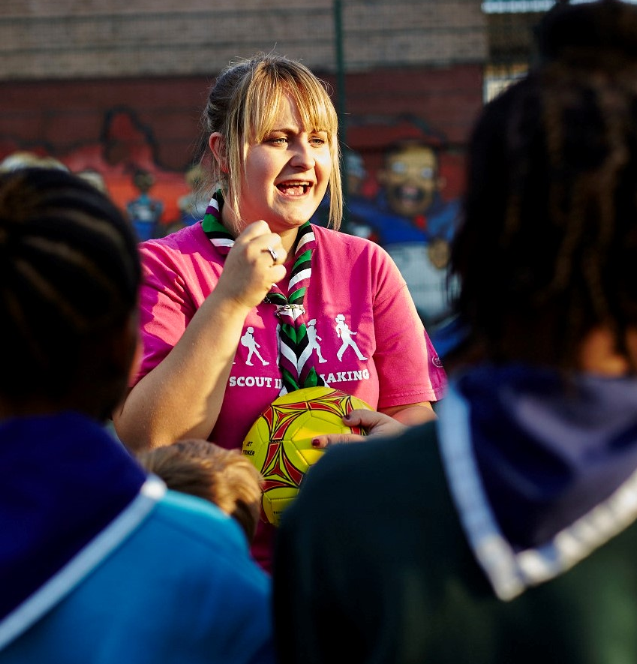
Engaging Learning
Branching Out
Branching Out
Branching Out will form the learning you can take on beyond Growing Roots
It will be delivered through a variety of methods including digital, face-to-face and blended models
Some current training modules will keep running for a while, as we work to update or replace them and add more new content.
This suite of new learning will become available over the course of 2024-2025 and will be updated and added to on an ongoing basis after that

Slide 25
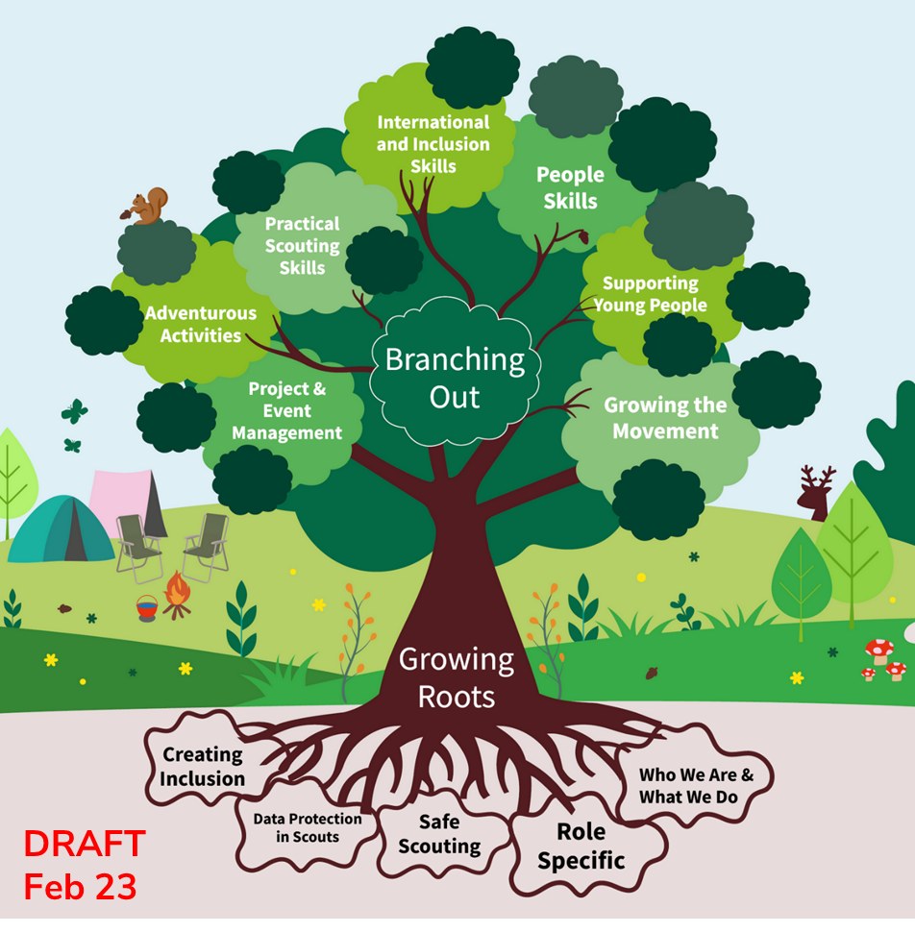
Engaging Learning
Branching Out
What might Branching Out look like?
Branching Out will allow for volunteers to shape their learning journey based on what is most beneficial to them or their team
This will encompass a variety of learning options such as;
Digital Skills
Permits & Adventurous Activities
Practical Scouting Skills
Team Leadership
And much more...

Slide 26
Engaging Learning
Branching Out
Manager & Supporter Training
Beyond the learning in Growing Roots, manager and supporter training will also become optional
For those that choose to complete this it will continue to be delivered in its current form
These will be reviewed and refreshed or replaced along with the other remaining modules to form part of the Branching Out learning
This will take place over the next 18-24 months, with the updated learning being released during 2025

Slide 27
Engaging Learning
Wood Badge

Slide 28
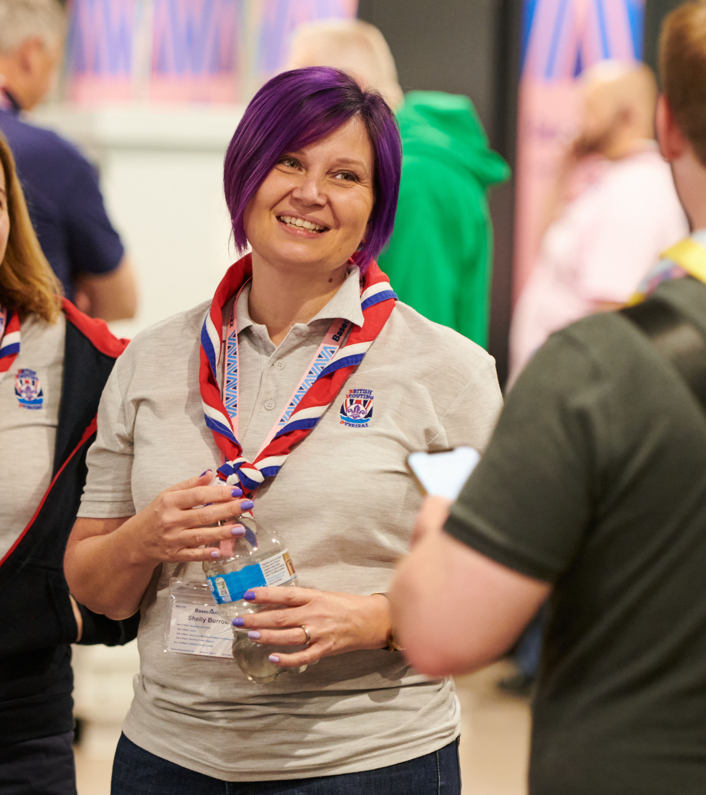
Engaging Learning
Wood Badge
Changing the Wood Badge
As part of improving the learning experience we’ll be moving to an optional Wood Badge
Every volunteer will be able to decide what learning will be most beneficial to them to earn their Wood Badge and whether they want to do a Wood Badge at all
You won’t be required to repeat any learning when you change teams or roles
The Wood Badge changes will come in two stages:
A transitional Wood Badge while the current modules are reviewed
A new Wood Badge launched during 2025
More information will be shared about what this looks like later in 2023

Slide 29
Engaging Learning
Volunteering Development Team

Slide 30
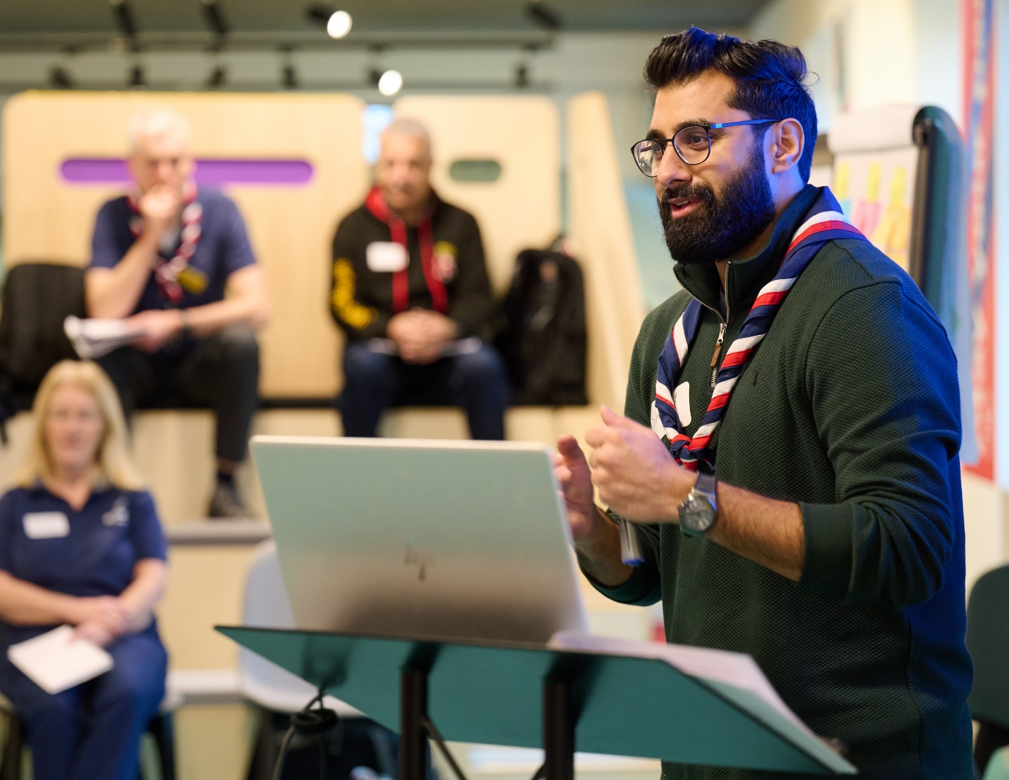
Engaging Learning
Volunteering Development Team
Volunteering Development Team
Changes to how we learn in Scouting will also mean that training teams in their current forms will change
In place of County training teams with local training administrators and managers there will be District and County Volunteering Development Teams
Volunteering Development Teams will be responsible for;
Attracting and welcoming new volunteers
Making sure volunteers are well supported
Support volunteer learning
Recognising volunteers

Slide 31
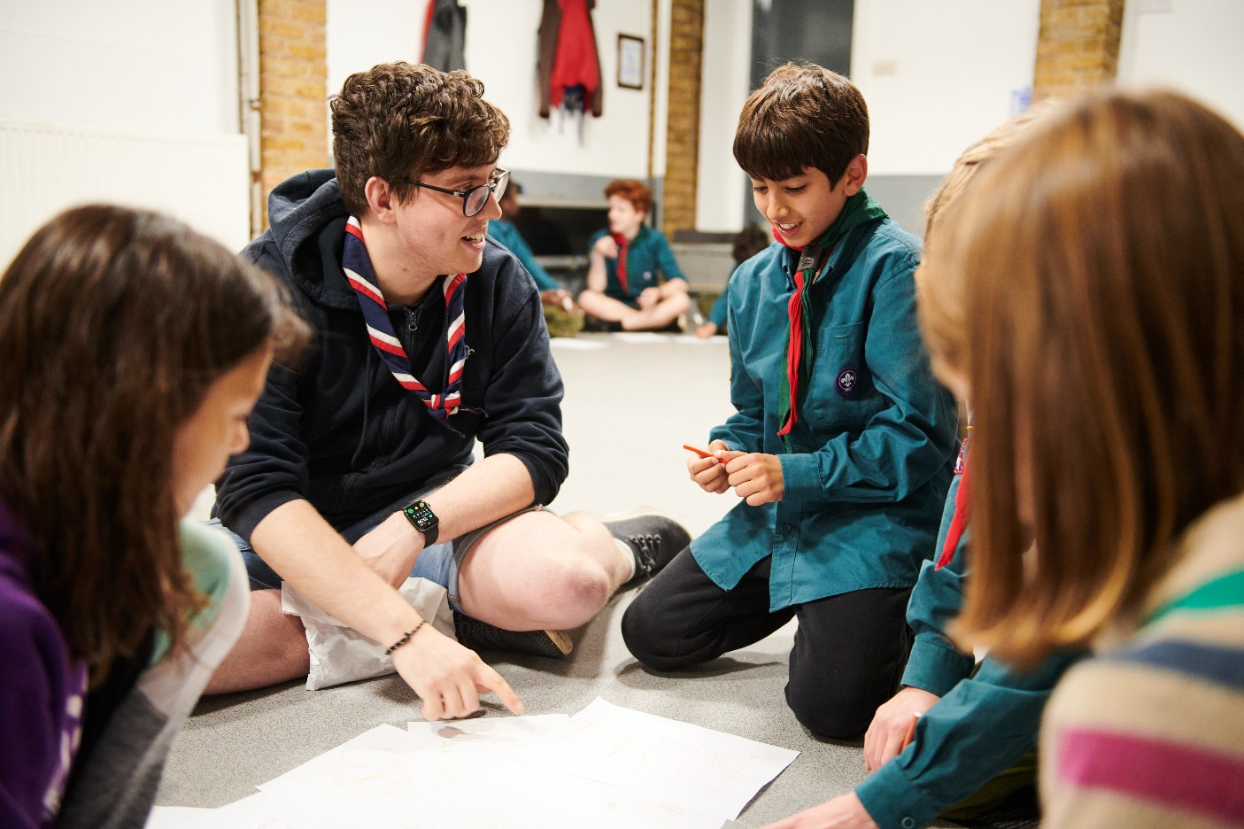
Engaging Learning
Volunteering Development Team
Supporting Learning
As part of supporting volunteers with their learning they will;
Help volunteers and Young Leaders find and engage in learning and development opportunities
Coordinate learning that needs to be delivered by a trainer, including external organisations where relevant
Use learning delivery materials and adjust them where needed to ensure activities are accessible to all
Help volunteers share best practice and overcome challenges
Recognise prior learning and experience

Slide 32
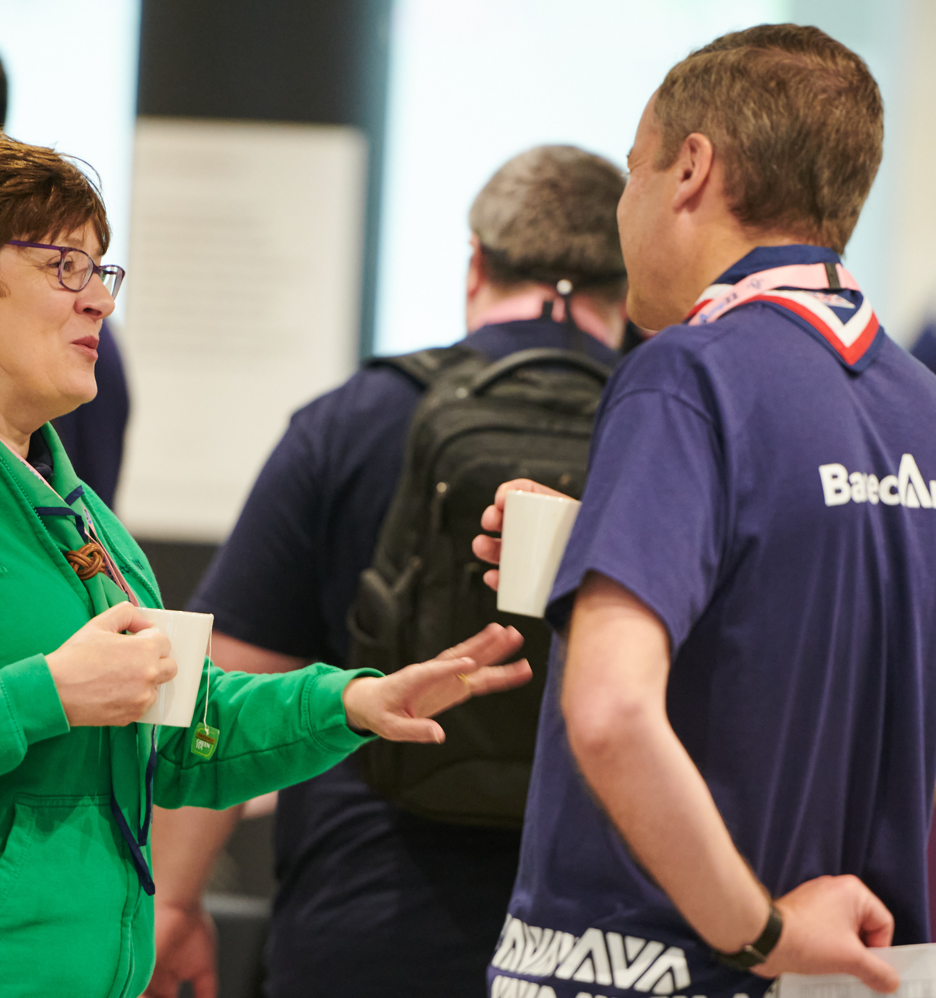
Engaging Learning
Volunteering Development Team
Transition
Learning will require a longer transition than the other changes as part of transforming the volunteer experience
During this period Volunteer Development Teams will support volunteers by;
Delivering the current learning modules as required
Supporting and delivering the new learning modules as they are rolled out
Full details of what transition will look like and how this will be supported will be shared later in 2023

Slide 33
Engaging Learning
What’s Next?

Slide 34
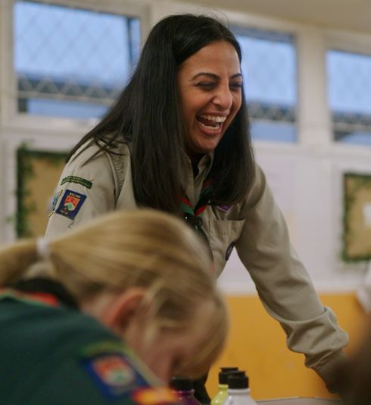
Engaging Learning
What’s Next?
What’s Next?
Changes to our learning modules will take time and be rolled out over the next few years
Growing Roots learning will be released alongside the new learning system in late 2023 for our Early Adopters and February 2024 for everyone else
Branching Out learning will be developed and added over the course of 2024-2025, with more learning being added on an ongoing basis after that

