Slide 1
Transforming Our Volunteer Experience -
A Warmer Welcome

Slide 2
Engaging Learning
Using this slide deck
Slide Deck Overview
Purpose:
This slide deck is designed to provide an overview of the ‘Engaging Learning’ change and is collated from information shared through slides, emails and verbally to Transformation Leads.
These slides will be updated regularly to reflect information shared in future, please check the document version you have against the one current on the TL Resource Hub to ensure you have the latest version.
The next slides outlines how to best use the information on these slides.
Author: This information has been prepared by the Change team, support by the Volunteer Experience project teams
Version: This is document version 1.0, effective as of 18/04/23
Support: Transformation Leads should direct any questions that they have to transformation.leads@scouts.org.uk

Slide 3
Engaging Learning
Using this slide deck
How to use this slide deck
Using this slide deck locally:
These slides contain a combination of both information and context, some of which makes several slides ‘text heavy’. This is done purposefully to ensure whoever is presenting has the context and information needed to talk to each point, without needing a separate script.
However, when presenting these slides, it’s recommended that some of this text is moved into the presenters' notes so that the slides are easy to read and understand and then the presenter can still ensure the core messages are not diluted.
You might also wish to tailor this to your audience by including just the slides relevant to them and combining these slides with those from the other ‘Transforming Our Volunteer Experience’ slide decks. This is recommended as presenting each of the slide decks for the areas of change would be incredibly long and detail heavy, the important part is the core message being shared.
Please also feel free to tailor these to suit local branding and messaging to fit with what progress you have made in your area already.

Slide 4
A Warmer Welcome
Purpose
Purpose
To provide a detailed overview of;
Why we are changing the way we welcome volunteers into Scouting
What is changing?
Attraction
Joining
Appointment
Induction

Slide 5
A Warmer Welcome
Changing the way we welcome new volunteers

Slide 6
A Warmer Welcome
Changing the way we welcome new volunteers
We want to make volunteering with Scouts easier and more fun…
…so that we can attract more volunteers and our current volunteers want to stay

Slide 7
A Warmer Welcome
Changing the way we welcome new volunteers
Why are we changing?
At Summit 17, with nearly 1,000 of our volunteers, we worked together to build our Skills for Life Strategy this included multiple suggestions and recommendations from volunteers around improving the experience of joining Scouts
Following this we;
Carried out external and internal research
Commissioned an independent research expert report
Developed a joint volunteer and staff team to lead this work

Slide 8
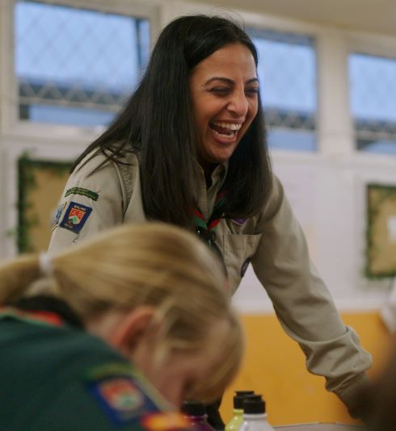
A Warmer Welcome
Changing the way we welcome new volunteers
What have we learnt?
In our research with volunteers, we learnt that:
Joining us can feel daunting for new volunteers
New volunteers feel like our appointments panels are more like a job interview
The Appointments is time consuming and relies on inefficient tools and processes
We want more volunteers locally but need the support to make it happen
We’re often reliant on our existing networks to get new volunteers - Parents, Carers, Ex-Members and current volunteers…

Slide 9
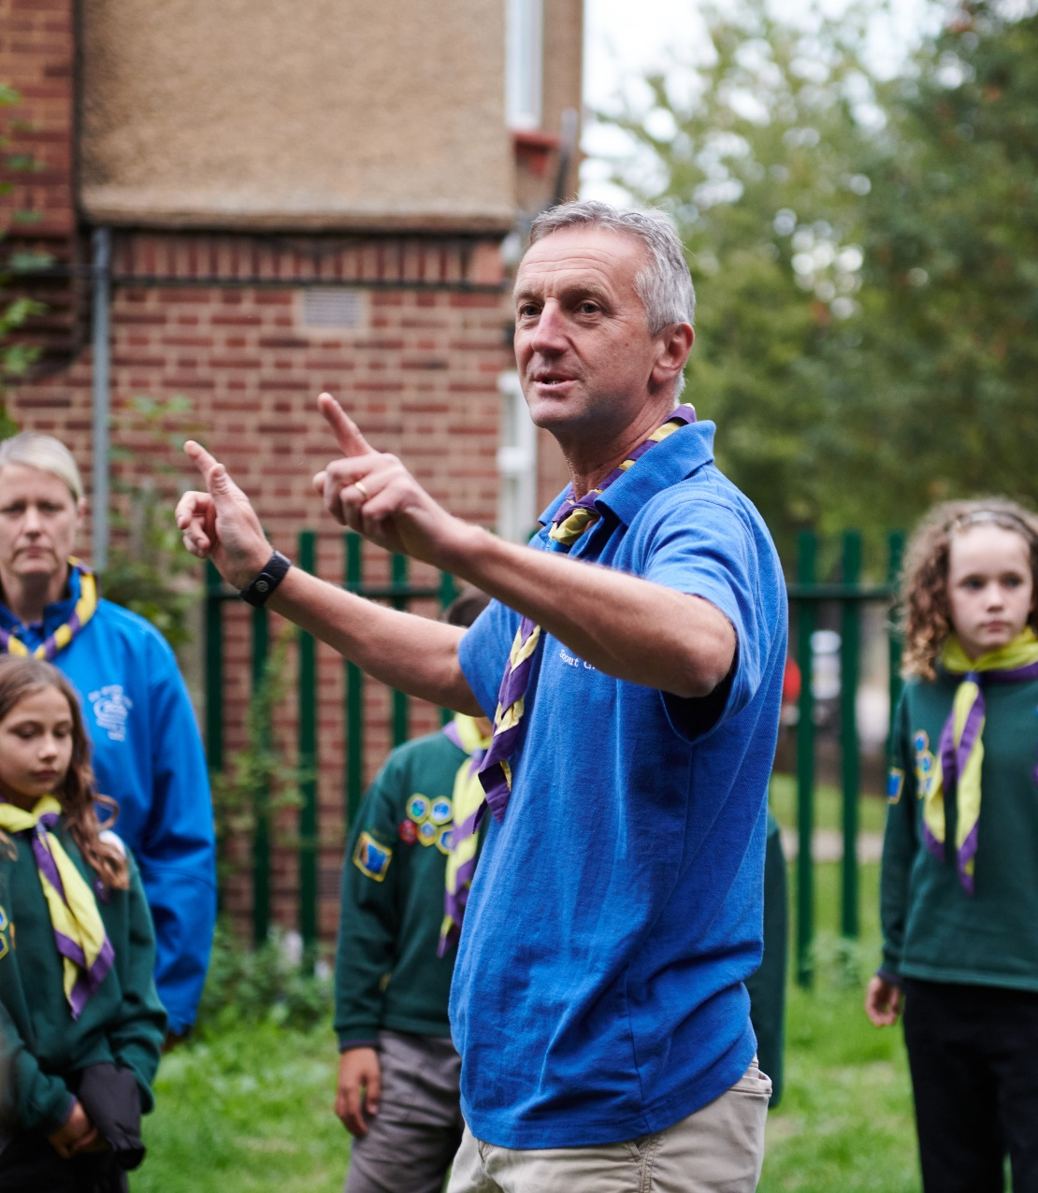
A Warmer Welcome
Changing the way we welcome new volunteers
What will changing our appointment process achieve?
Provide volunteers with tools to proactively manage recruitment
Reducing the administrative burden on volunteers
Enable new volunteers to clearly see what the joining process looks like and what is expected
Make the appointment process more welcoming and easier to complete
Protect new volunteers from being scared off by information overload
Valuing the experience of our current volunteers when they change teams or roles in Scouts
And more!

Slide 10
Transforming our Volunteer Experience
What is changing? -
Attraction

Slide 11
A Warmer Welcome
What is Changing - Attraction
What are we aiming for?
A simple process which supports the attraction of volunteers into Scouting opportunities

Slide 12
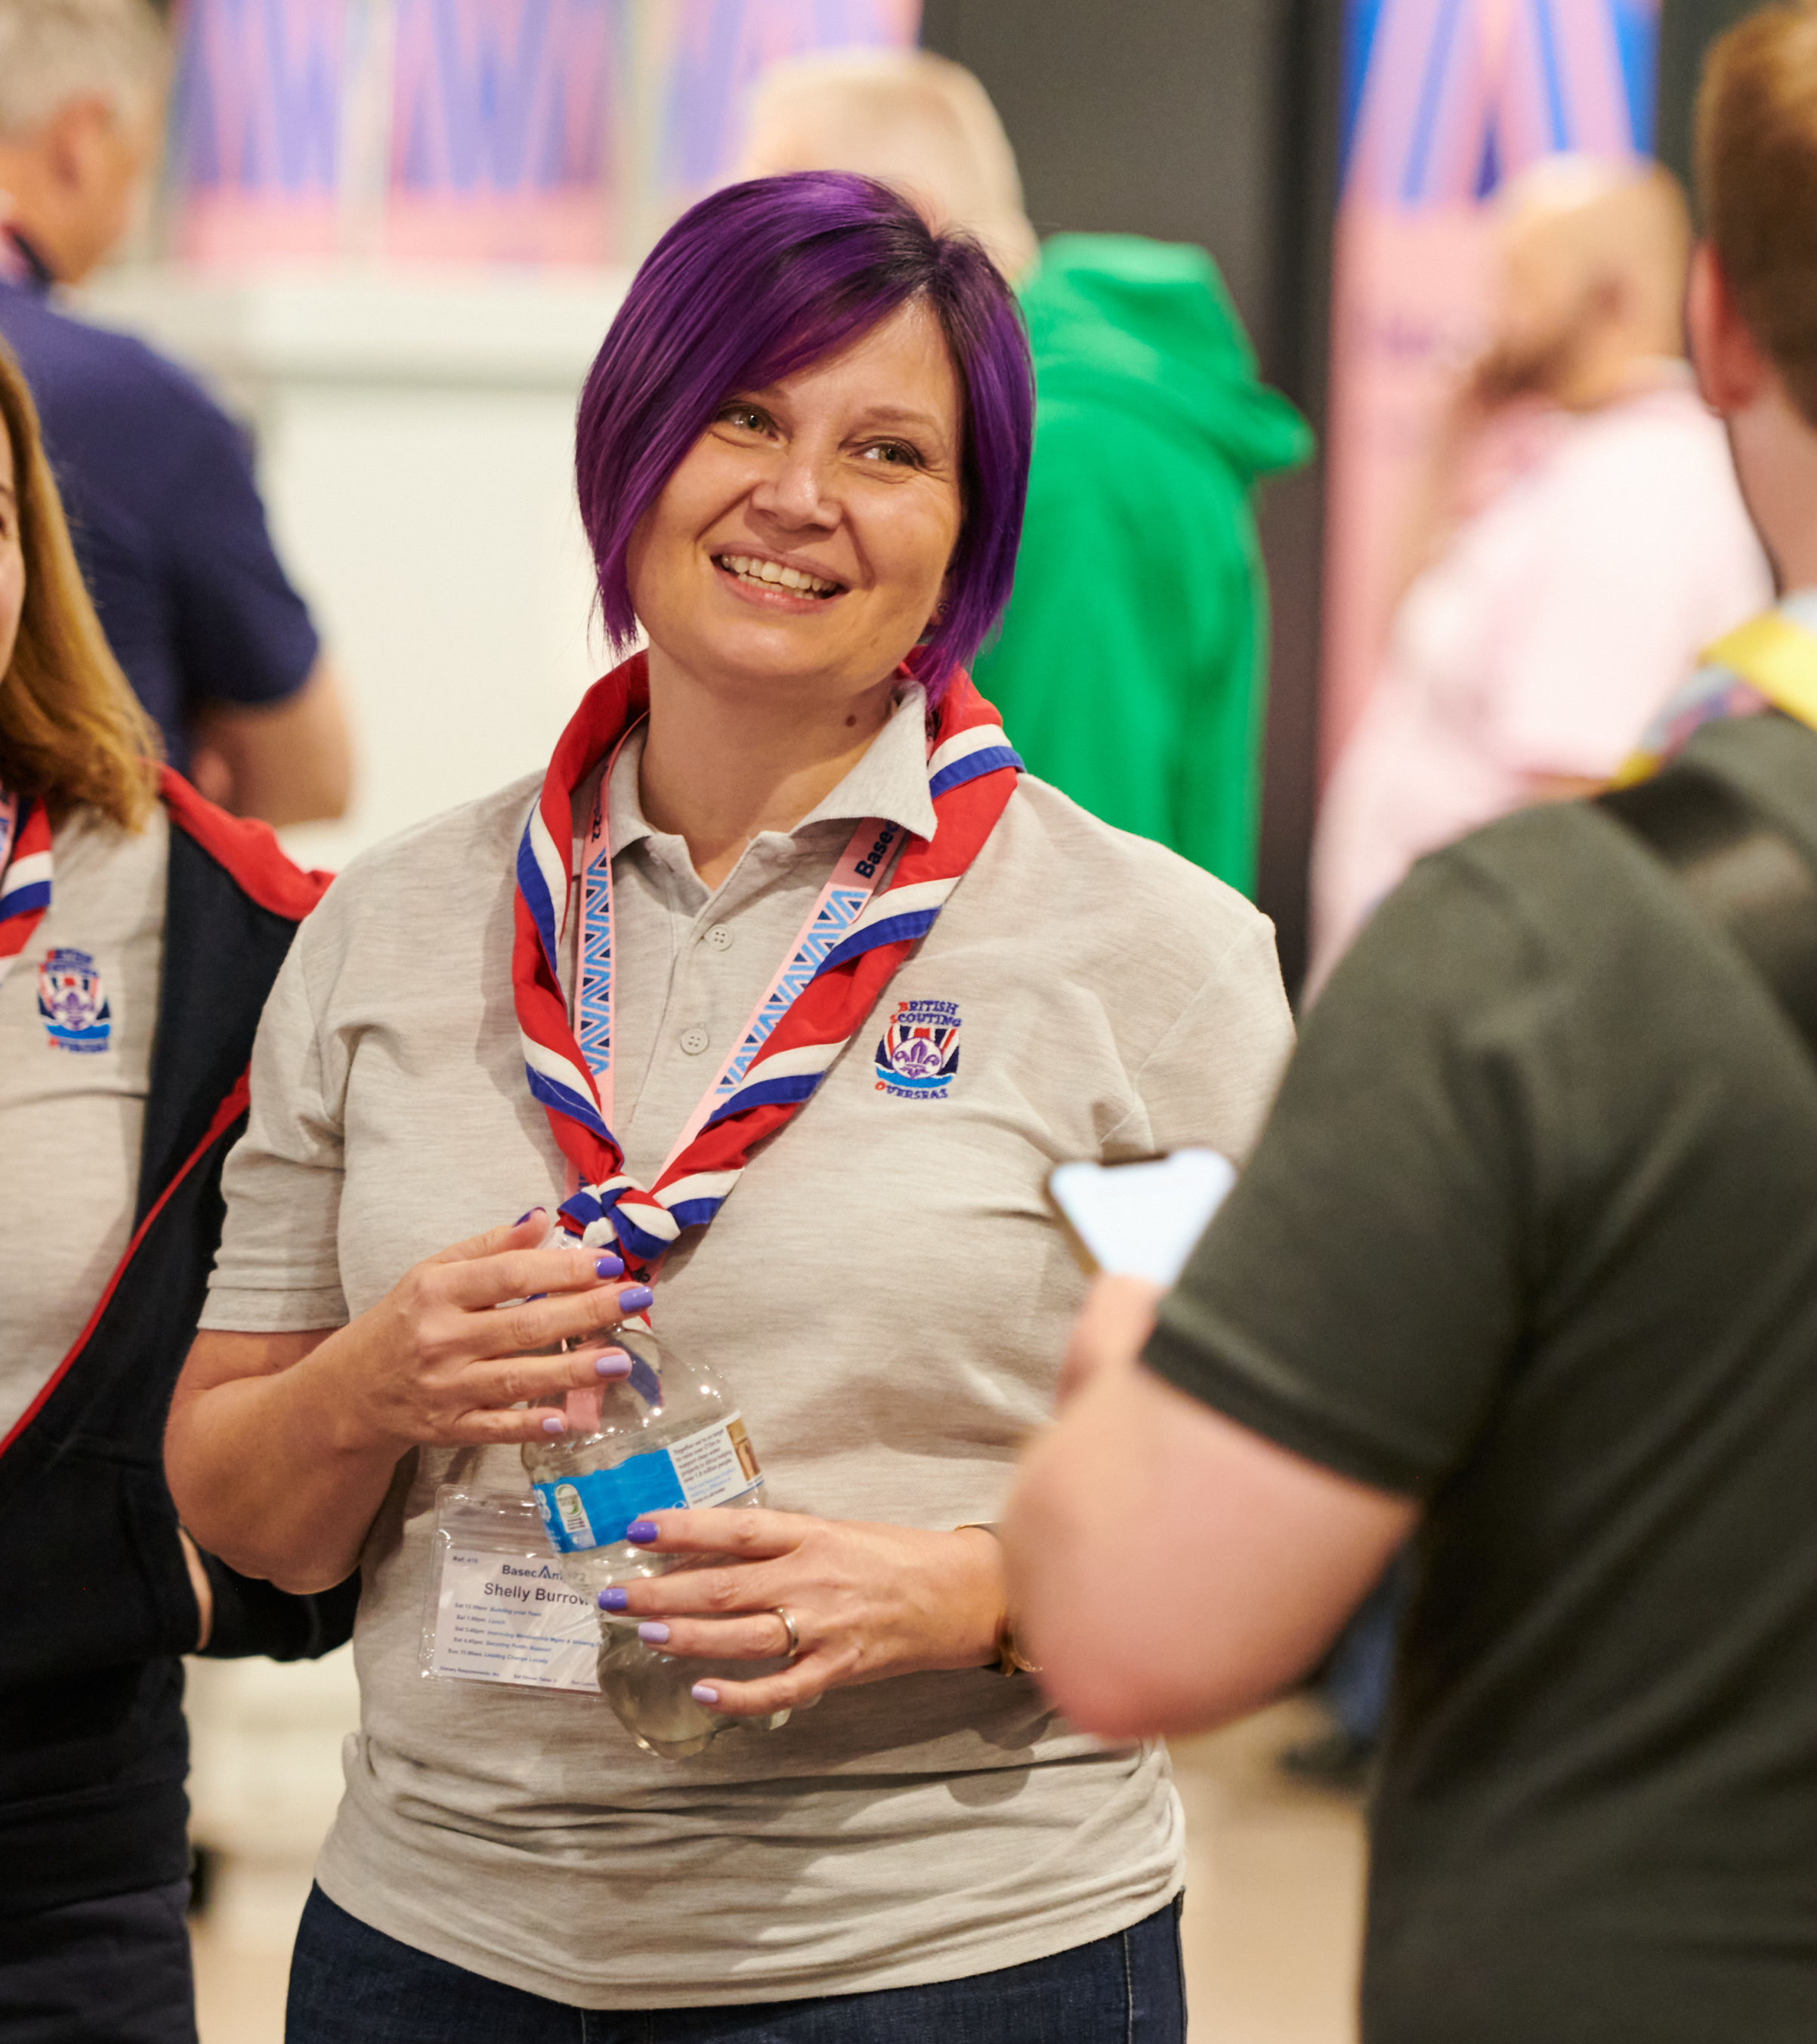
A Warmer Welcome
What is Changing - Attraction
Attraction
A new digital tool is being developed, part of which will improve our attraction processes.
This tool will;
Make sharing volunteering opportunities easier for those recruiting
Improve attraction for new volunteers by linking with the wider volunteering community
Support those already within the movement and those from outside the movement

Slide 13
A Warmer Welcome
What is changing? -
Joining

Slide 14
A Warmer Welcome
What is Changing - Joining
What are we aiming for?
A transparent joining process which enables new volunteers to have clarity of what is required of them through a simple, and visually articulated, journey

Slide 15
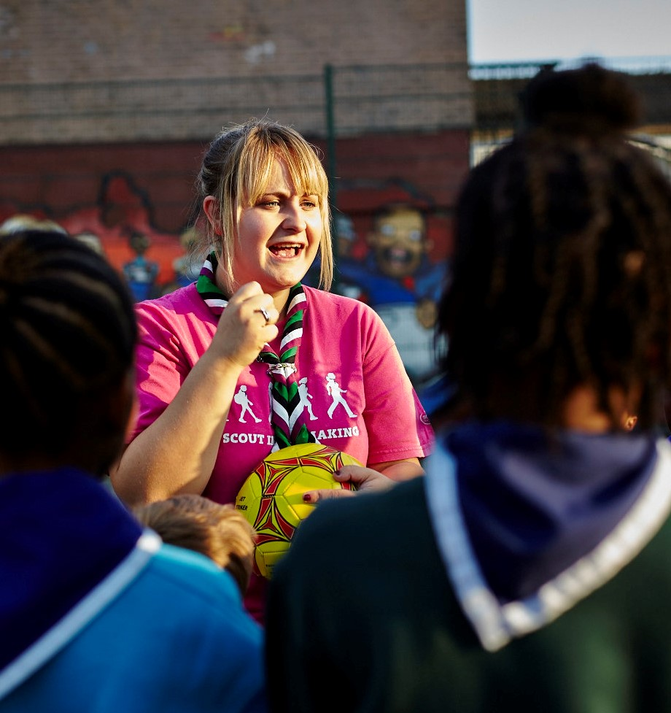
A Warmer Welcome
What is Changing - Joining
Joining
A self-service recruitment process will be in place, underpinned by a new digital tool
These changes will;
Put the volunteer in control of their joining journey
Provide an easier to navigate and mobile friendly way of providing personal details

Slide 16
A Warmer Welcome
What is changing? -
Appointment Process

Slide 17
A Warmer Welcome
What is Changing - Appointment Process
What are we aiming for?
A self-service appointment process that makes volunteers feel welcomed and values whilst ensuring that volunteers are appointed safely

Slide 18
A Warmer Welcome
What is Changing - Appointment Process
Appointment
Changes to the appointment process will include;
A more consistent, welcoming and easy to complete process
Removal of commissioner approval step and pre-provisional appointments to simplify the appointment process
Introduce a single ‘Welcome Conversation’ when a volunteer first joins Scouting

Slide 19
A Warmer Welcome
What is Changing - Appointment Process
The Appointment Process
Disclosure Check
Welcome Conversation
Trustee Eligibility Check (Trustee roles only)
Internal Check
Referencing
Declarations
Growing Roots Learning

Slide 20
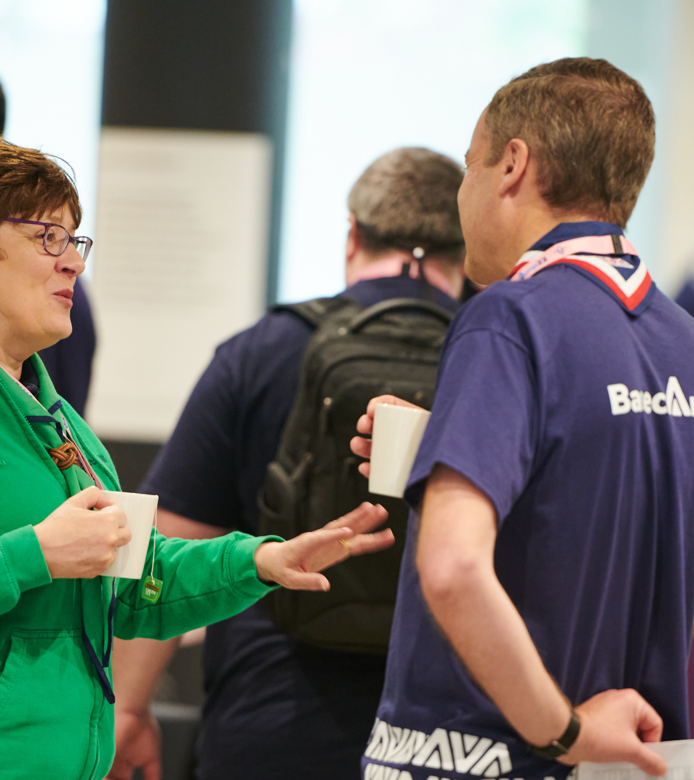
A Warmer Welcome
What is Changing - Appointment Process
The Appointment Process
The appointment process covers everything needed for a volunteer to reach full appointment
A new volunteer has 6-months to complete their full appointment
The following should be completed as soon as possible (These can be completed in any order):
Disclosure Check, Internal Check, Welcome Conversation, References, Declarations, Trustee Eligibility Check (Trustee roles only)

Slide 21
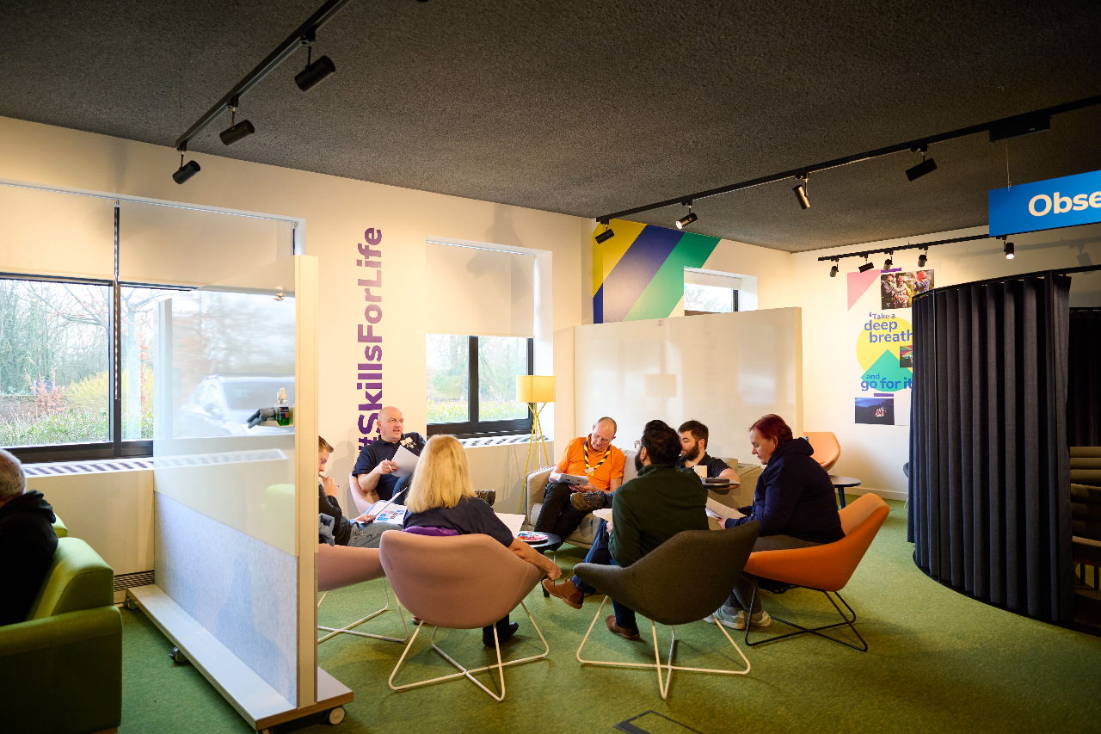
A Warmer Welcome
What is Changing - Appointment Process
Disclosure Check
The way we complete disclosure checks will be improved:
A self-driven and mobile friendly disclosure process through Atlantic Data in England & Wales
For Scotland, Northern Ireland and BSO an improved disclosure processes reducing additional admin time required
The update service will be not be available on day one

Slide 22
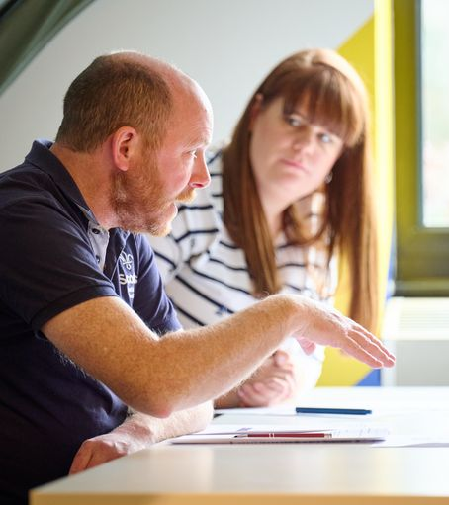
A Warmer Welcome
What is Changing - Appointment Process
Internal Check
Also known as a Confidential Enquiry or CE check which checks a volunteer's name against internal records
Today UK Headquarters automatically does a CE check on a volunteer when a role is added, which can involve additional manual checks
We're making this more streamlined by:
Introducing an automated CE check process so that not all checks will require manual intervention
Ensuring volunteers and their line managers can see their information and be aware of any live limitations applied to someone's membership by HQ

Slide 23
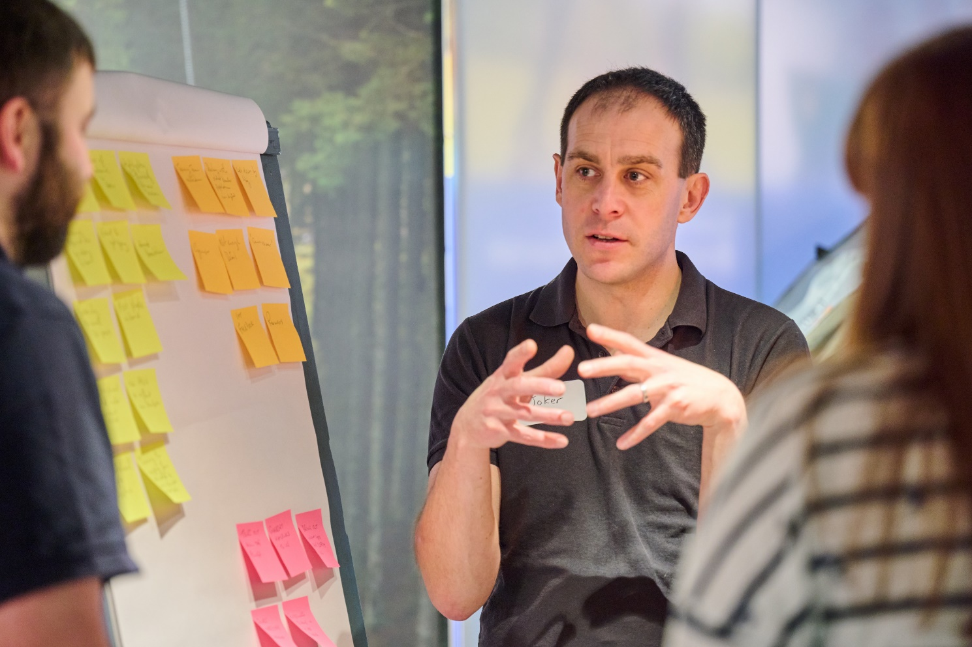
A Warmer Welcome
What is Changing - Appointment Process
Referencing
As part of our safeguarding commitment to young people, references are required to help us ensure the suitability of any new volunteers
We’re making this easier by;
Allowing new volunteers to provide up to 4 references instead of just two
Automating the reference requests and reminders for referees
Automating the approval of received references, with any comments or adverse references reviewed locally

Slide 24
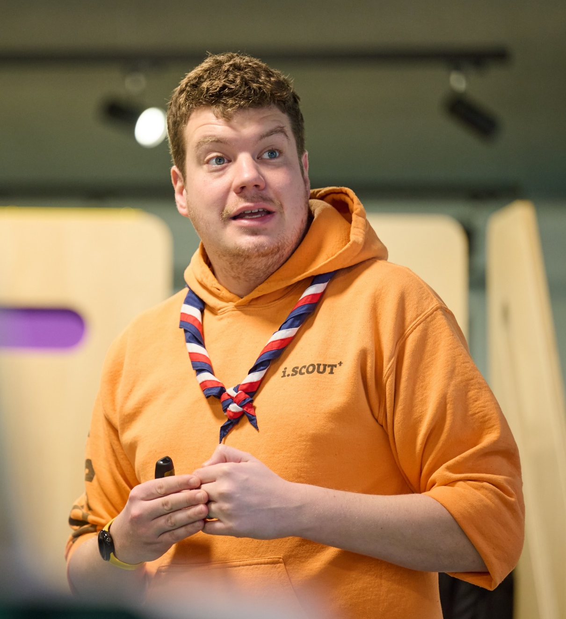
A Warmer Welcome
What is Changing - Appointment Process
Declarations
We’ve always had a series of declarations when joining as a member of Scouts. This include things such as:
Accepting the values of Scouting
Abiding by the policies and rules of Scouts
Agreeing to take on the learning required
We’re making these clearer by;
Updating and improving the wording of our declarations
Ensuring only the relevant declarations are visible directly to new volunteers

Slide 25
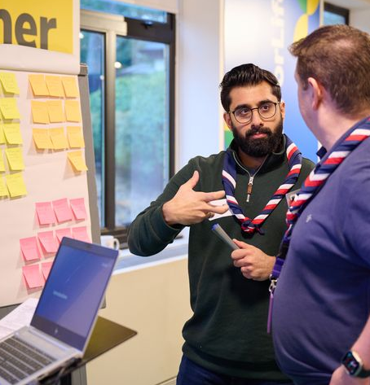
A Warmer Welcome
What is Changing - Appointment Process
Trustee Eligibility Check
Timeframe: Completed over the first 4-6 weeks
This will only need to be completed for those in a Trustee role
As part of being a Charity Trustee all charity regulators in the UK have an eligibility declaration form that must be completed
To improve how we manage and maintain these we’ll be:
Updating and improving the wording of our declarations
Ensuring only the relevant declarations are visible directly to new volunteers

Slide 26
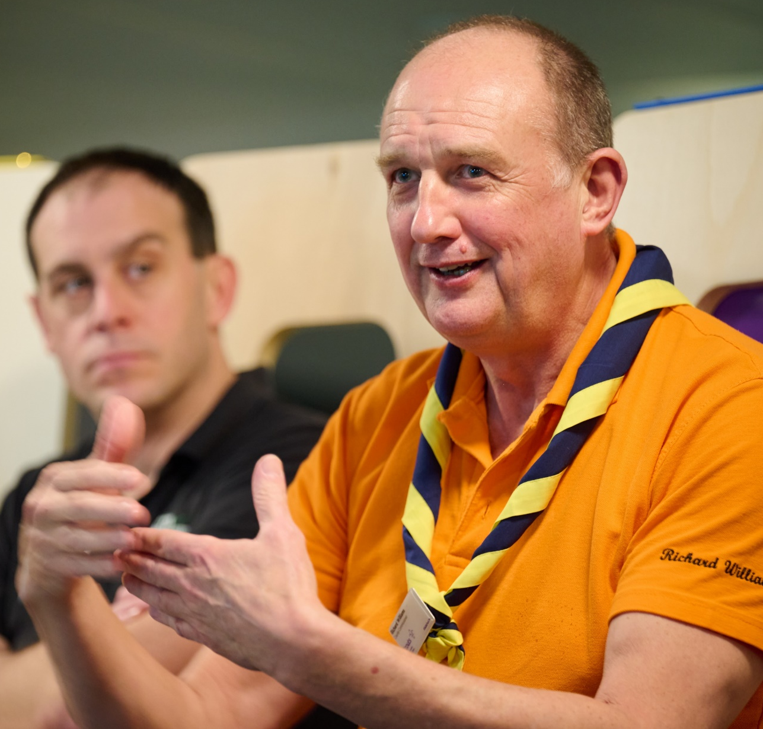
A Warmer Welcome
What is Changing - Appointment Process
Welcome Conversation
A Welcome conversation will replace the current appointments panel. This will be:
A conversation carried out by the relevant Team Leader or Lead Volunteer and an independent person from a similar area
Held within 4-6 Weeks of agreeing to take on the role
A single welcome conversation. If you change your team or role in Scouts, you’ll have a change of role conversation focused the specifics of the team or role

Slide 27
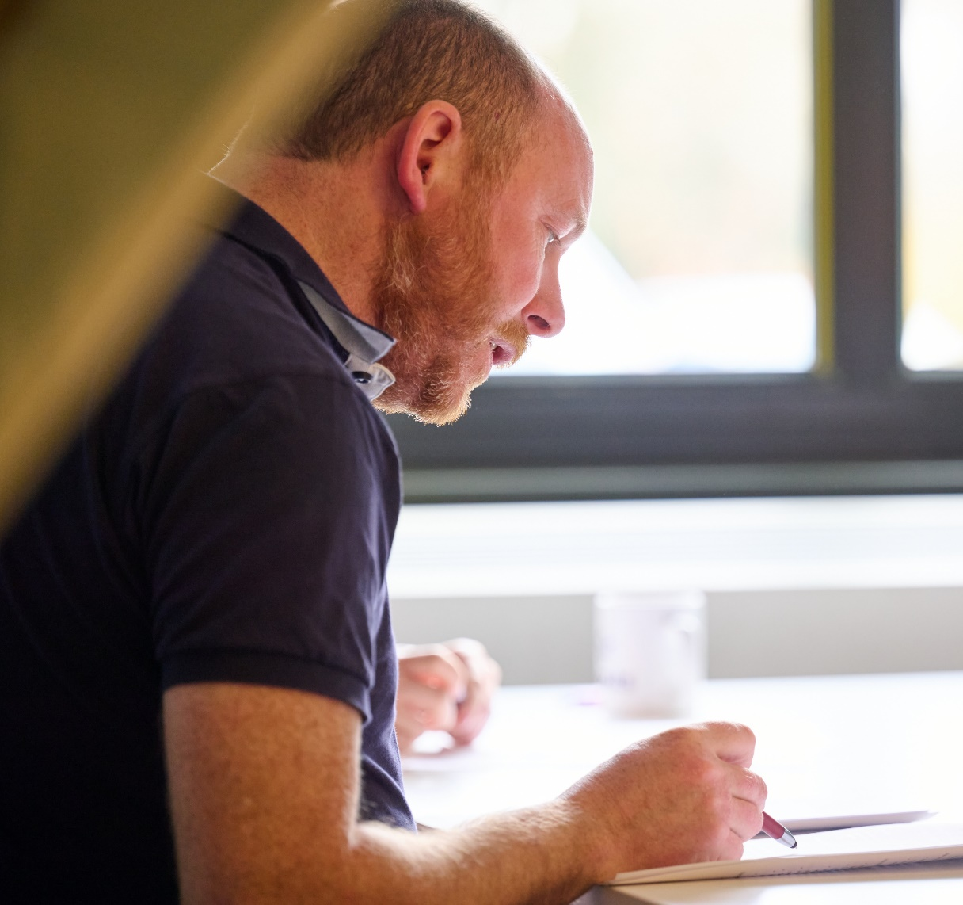
A Warmer Welcome
What is Changing - Appointment Process
Growing Roots Learning
Timeframe: Completed within 6 months of joining
Growing Roots will become the new mandatory learning for volunteers
Growing Roots will comprise of two parts;
The learning a volunteer needs to get started
The learning a volunteers needs for their team and role

Slide 28
A Warmer Welcome
What is changing? -
Induction

Slide 29
A Warmer Welcome
What is Changing - Induction
What are we aiming for?
All new volunteers will be provided with the skills they need to undertake their role, in a way which complements future learning

Slide 30
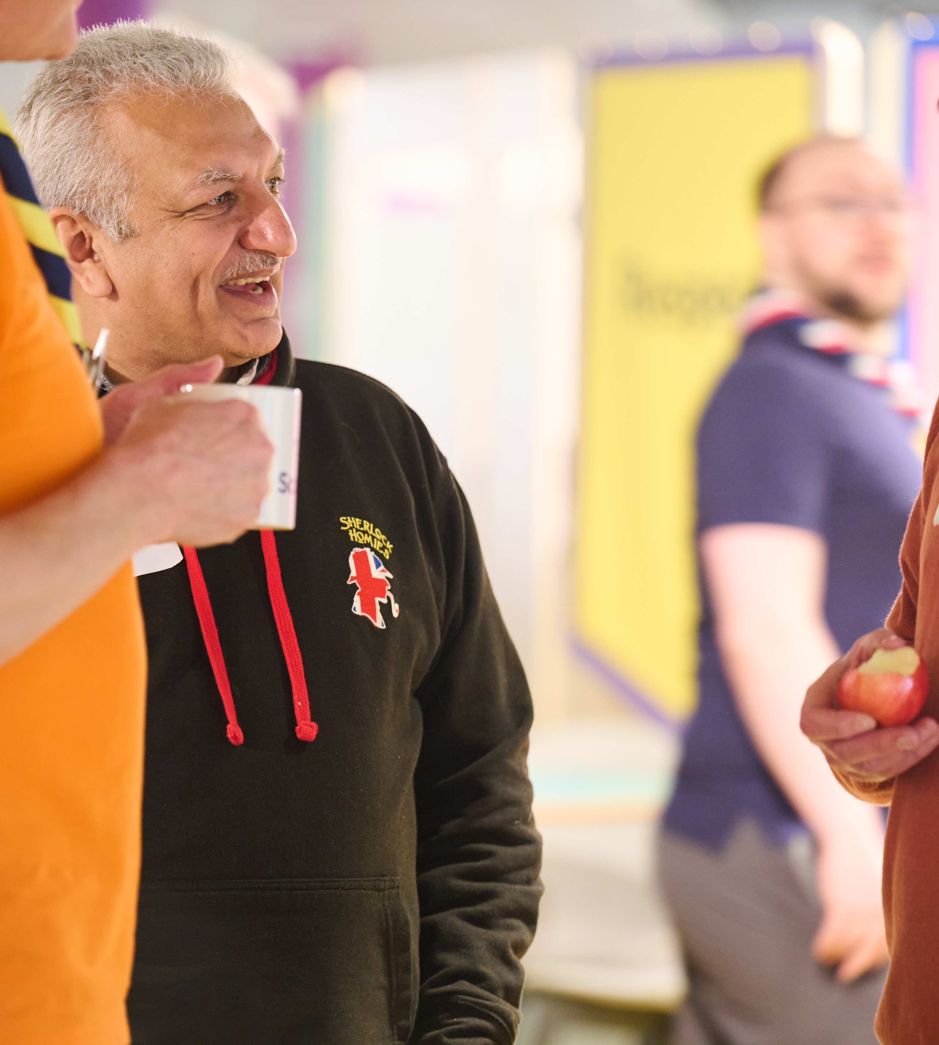
A Warmer Welcome
What is Changing - Induction
Induction
Induction runs alongside the appointment process and is about ensuring that new volunteers have the local and central information they need to do their role
We’re changing induction by:
Ensuring there is central information and support for the induction process
Supporting key knowledge to be shared locally with volunteers
A local welcome buddy to support volunteers

Slide 31
A Warmer Welcome
What is changing? -
Continuing to volunteer

Slide 32
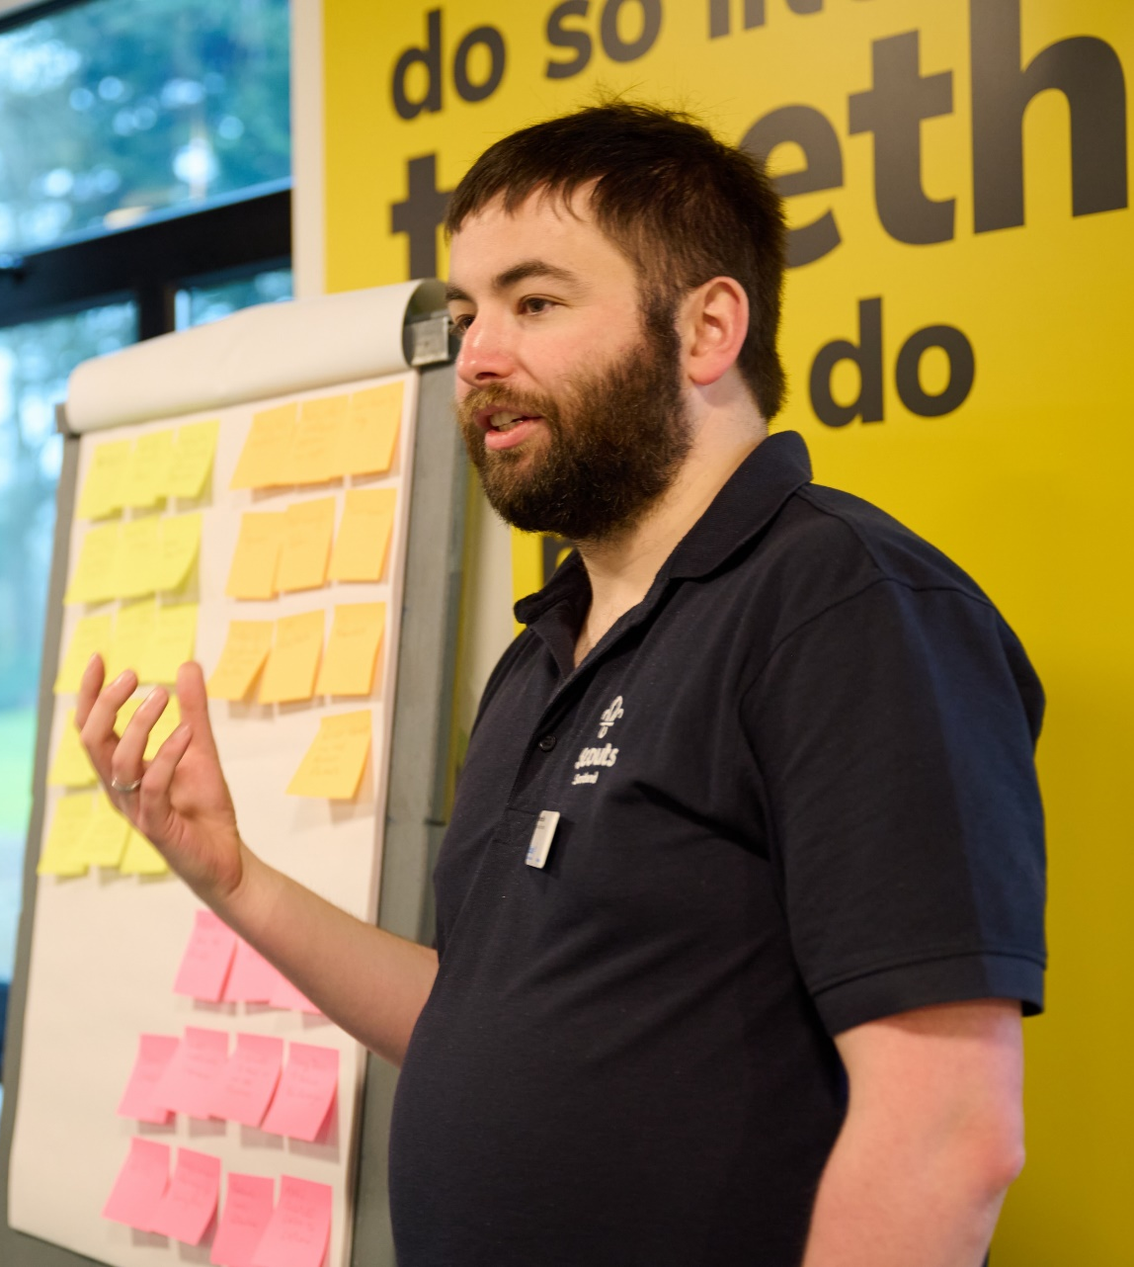
A Warmer Welcome
What is Changing - Appointment Process
Changing teams or roles
It’s important that we continue to value the experience and skills our volunteers have
Throughout a volunteer's time with us they might change teams, roles or even locations
When this happens:
A welcome conversation is not required, though it's important that a conversation has taken place about the role they are going to undertake
A valid Disclosure must be in place and a Confidential enquiry will be carried out
The volunteer may need to undertake additional learning relevant to the new team or role

