Slide 1
Transformation Leads Call

Slide 2
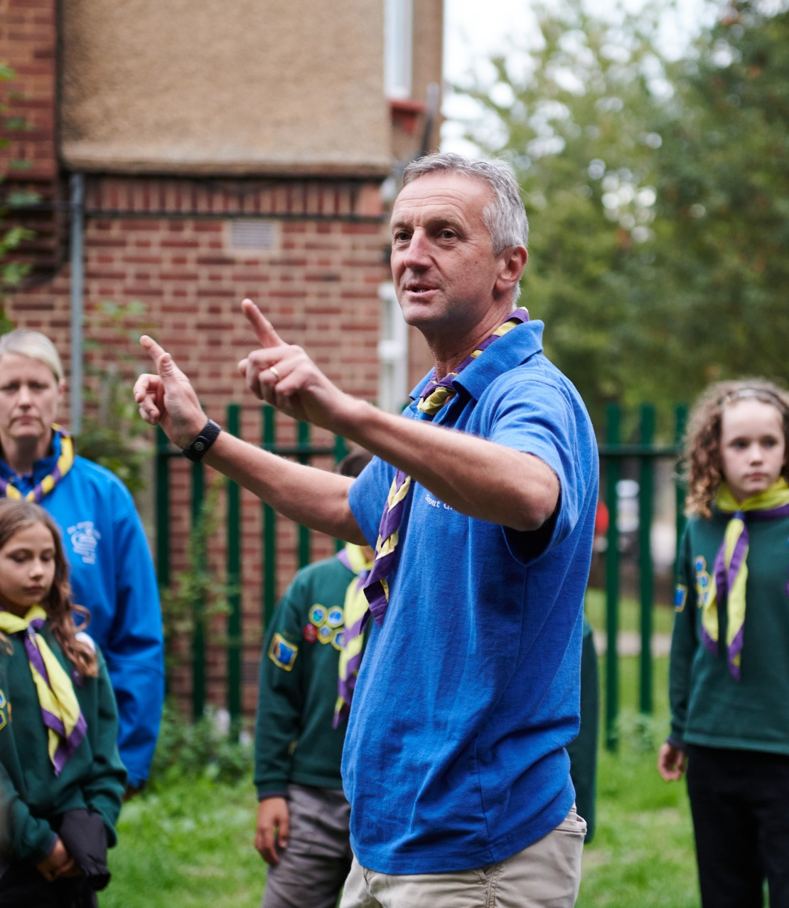
Who's on the call?
Craig Turpie, Deputy UK Chief Commissioner
Lara Burns, Chief Digital Officer
Jack Caine, UK Commissioner for People
Shaid Karim, Deputy UK Commissioner for People (Transformation)
Matthew Cobble, Deputy UK Commissioner for People (Operational)
Hamish Stout, Deputy UK Commissioner for People (Transformation)
Katie Miller, Head of Volunteering Experience
James Booker, Head of Portfolio Delivery & Change
Lauren Golding, Senior Communications Manager
Pete Jeffreys, Eleanor Coker, Bebbe Hron, Lucy Burrows-Smith Volunteer Journey Team
Kirsty Waugh, Susan Wallace, Elizabeth Stormfield, Change Team

Slide 3
What we’ve provided ahead of this call
What we’ll cover on this call
Friday, 31 March
Transformation Leads Newsletter
Change Planning workshop invites
Thursday, 13 April
Our Volunteering Culture webpages
Team-Based Volunteering webpages
Trustee Board webpages
Compass Guidance update
1. Changes & Support:
Our Volunteering Culture
Team-Based Volunteering
Trustee Boards
Compass Guidance
Change Support
2. Feedback:
Open Forum
Transformation Leads Survey
Early Adopters Progress
3. What's Coming in May

Slide 4
Roadmap for Change – A Reminder

Slide 5
April
What you’ll need to do
Our Volunteering Culture Resources
Our Volunteering Culture Statement
Video explaining Our Volunteering Culture and why it’s important
Activities and guidance to help review and implement Our Volunteering Culture
Team Resources
Team descriptions, including named role and accreditation descriptions
Role mapping from current roles to new teams
Supporting guidance for building new teams
Guidance for changing an Executive Committee into a Trustee Board
Change Resources
Video introducing cultural changes happening pre-digital transition
Webinar for District/County/Area/Region (Scotland) Commissioners to understand how these changes fit into the wider Volunteer Experience changes and the Skills for Life Strategy
POR
Trustee Board & Constitution updates

Slide 6
Our Volunteering Culture

Slide 7
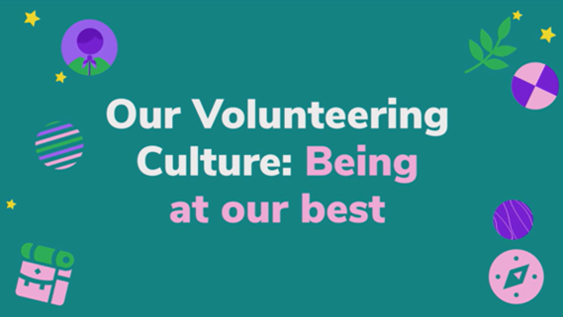
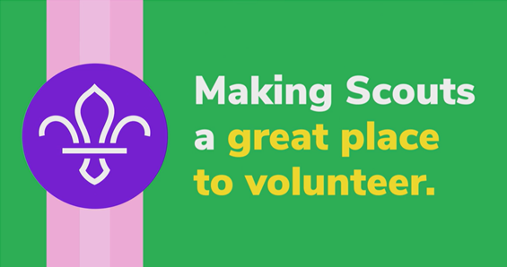
Our Volunteering Culture
Introducing Our Volunteering Culture
What we've created to support this
Actions to take now

Slide 8
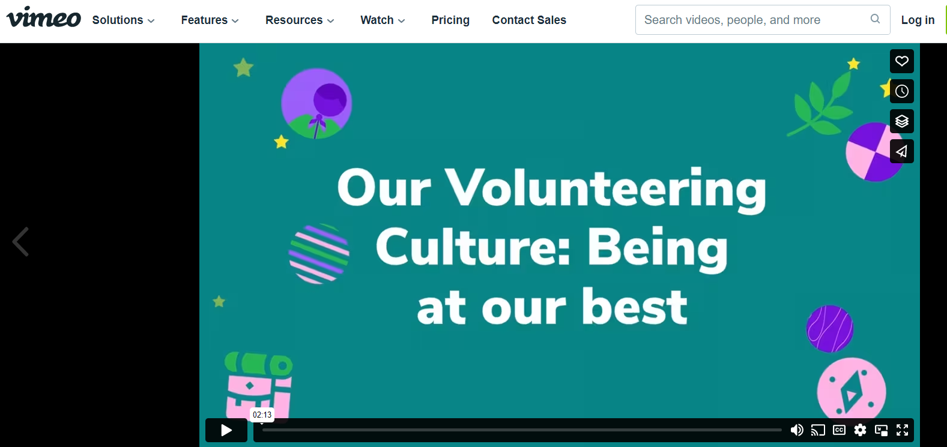
Our Volunteering Culture
Resources:
Our Volunteering Culture webpage guidance
Video
Activities

Slide 9
Our Volunteering Culture
Actions for now:
Take a look and share your feedback
Start talking to teams about this and using the activities to reflect and take action

Slide 10
Questions

Slide 11
Team-based Volunteering

Slide 12
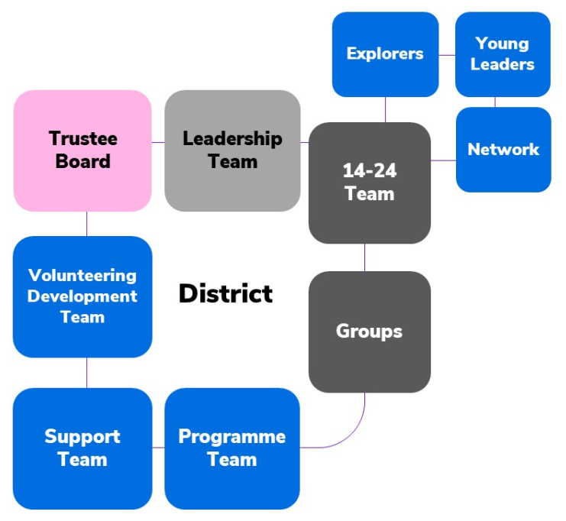
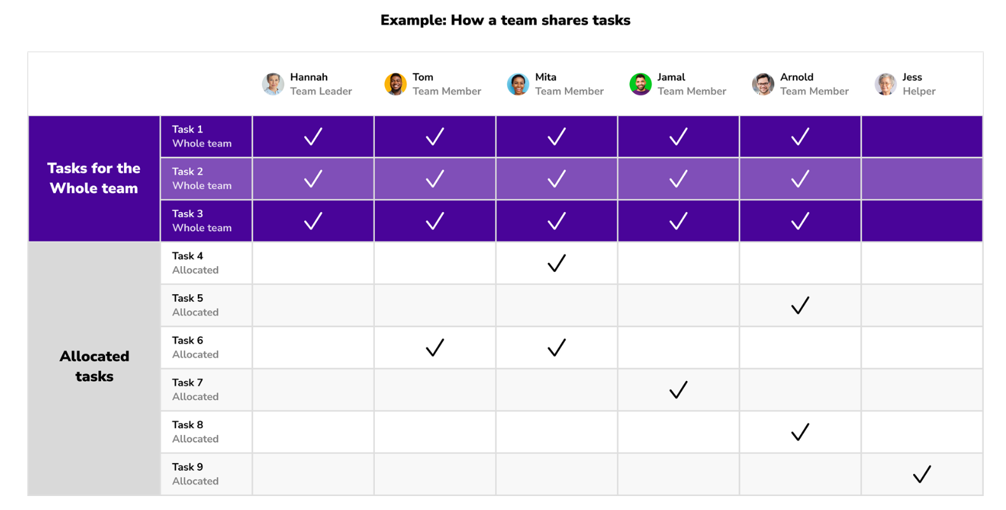
Team-based volunteering
Web page resources update: understanding the new teams approach and what it means for your current role and team
Moving from current roles to future teams: migration and role mapping
Actions to take now

Slide 13
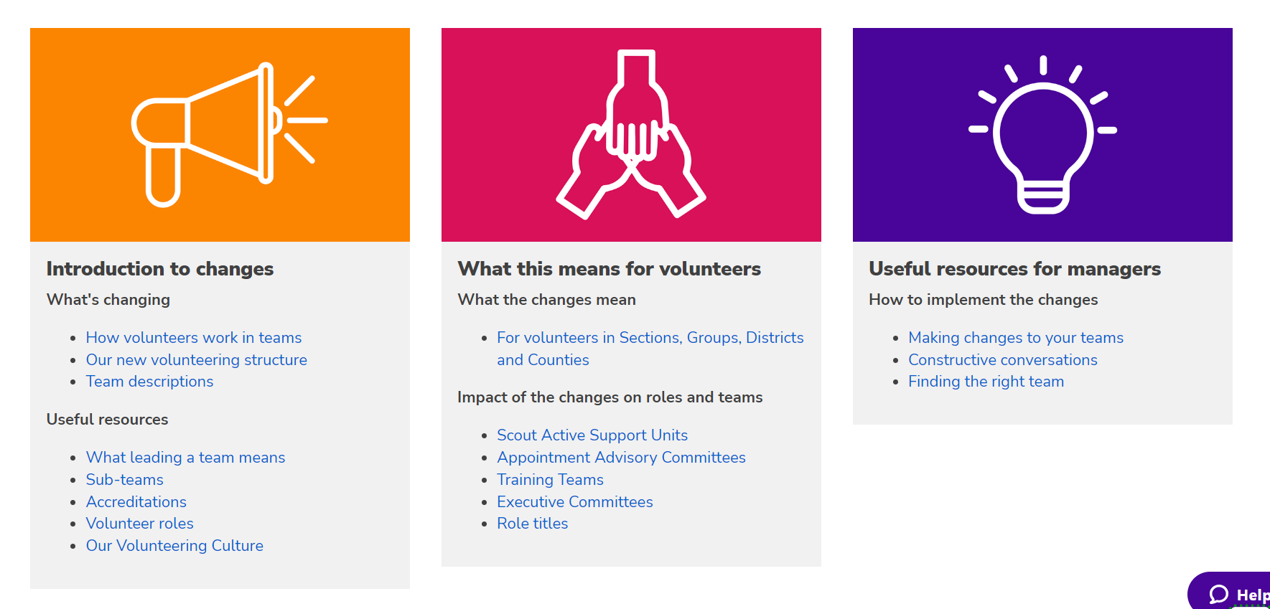
Team-based volunteering webpage resources

Slide 14
Moving from current roles to future teams: migration and role mapping
Data migration
Migration preparations are much wider to also include training, disclosures, awards, etc.
Preparations to “tidy up” data on Compass will assist with this
More information about data migration will come later in 2023
Role mapping
Make sure you design your new teams first
85% of current roles will change automatically
15% of roles either won’t exist, or are different enough that a local human conversation should be had
For an average-sized District or County team, this is 15-25 roles
Guidance for managers around “Making changes to your team,” “Finding the right team,” and “Constructive conversations” support this

Slide 15
Moving from current roles to future teams
Current | New
Section Leader | Section Team Leader
Assistant Section Leader Section Assistant | Section Team Member
Group Scout Leader | Group Lead Volunteer
Deputy Group Scout Leader Assistant Group Scout Leader | Group Leadership Team Member
District Commissioner | District Lead Volunteer
Executive Committee Member | Trustee
Chair | Chair
Deputy Chair | Deputy Chair
Treasurer | Treasurer
Secretary | Secretary
Occasional Helper | Non-member (disclosure only)
85% of current roles will change automatically Note: Correct at 18th April 2023.

Slide 16
Why it’s important to have conversations in your patch
Assistant District Commissioner (Section) – Beaver Scouts
They’re good at… They enjoy… We’d like them to… | They might go to…
Help volunteers with any programme changes, such as new badges and activities | Programme Team Leader Programme Team Member
Help volunteers connect across the District and beyond to learn, share best practices and overcome shared challenges | Volunteering Development Team Leader Volunteering Development Team Member
Look after joining enquiries across the District Work with Groups and other District teams to open Sections | Support Team Leader Support Team Member

Slide 17
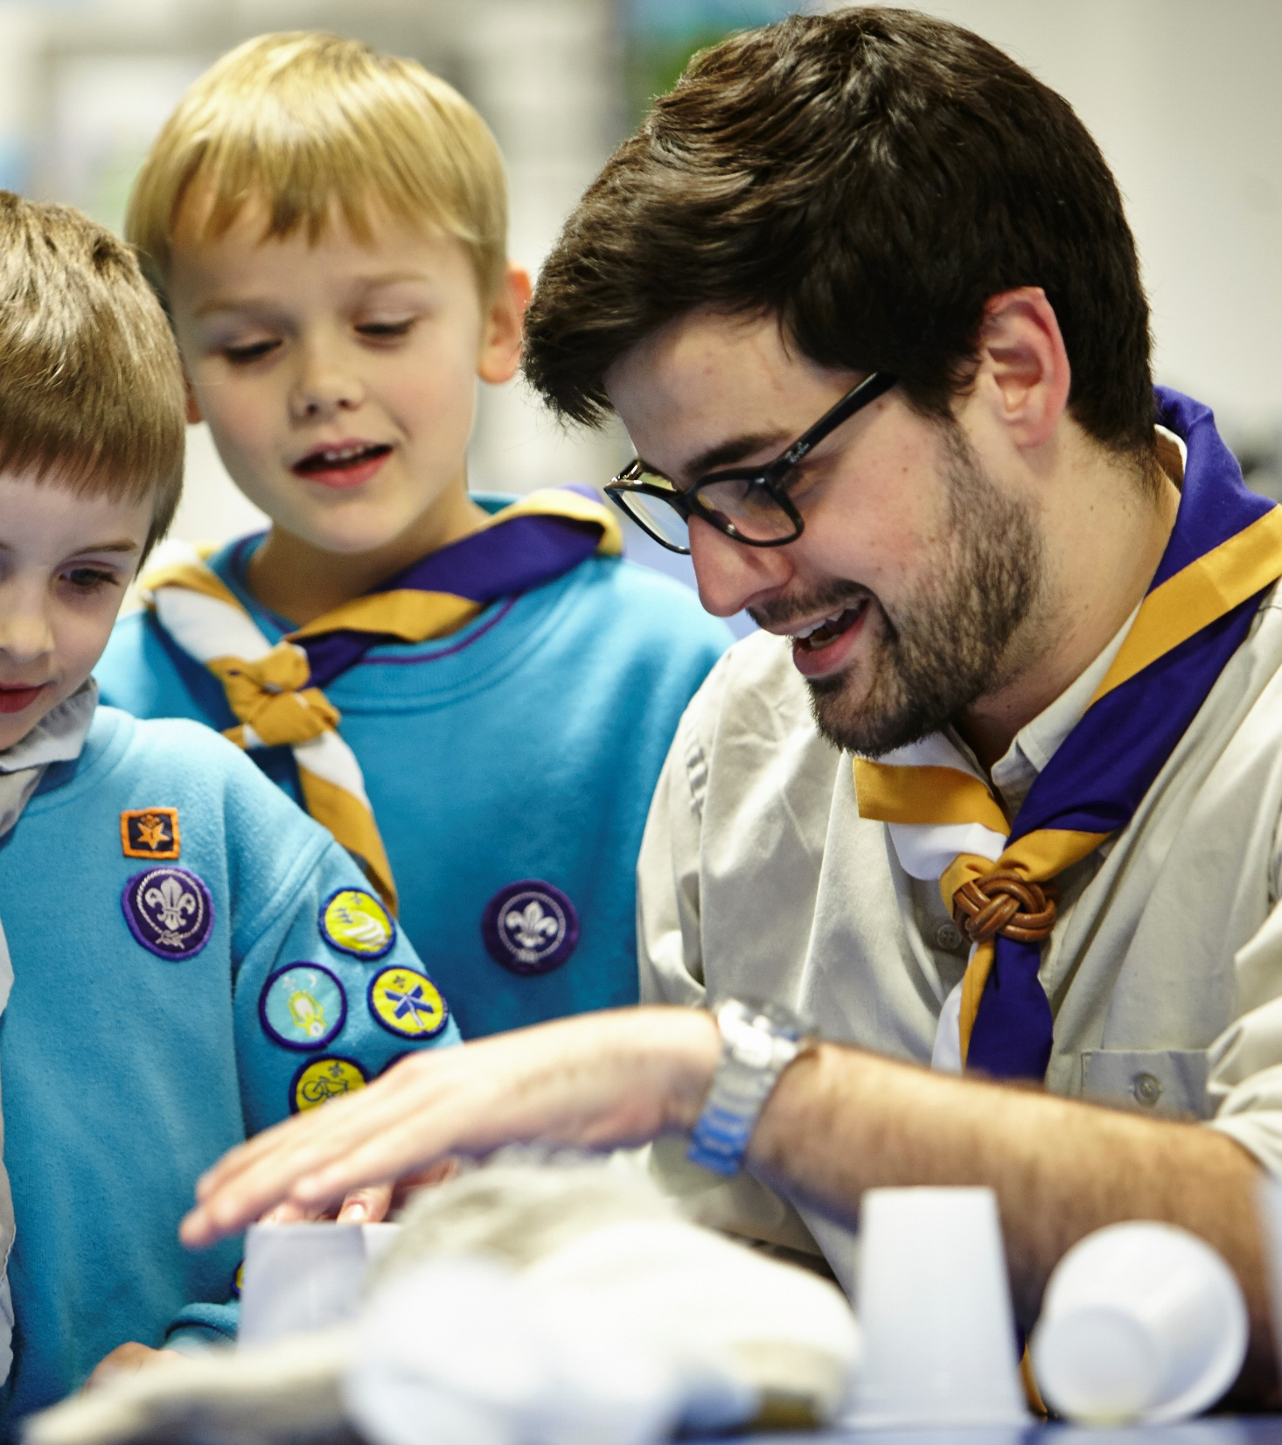
Team-based volunteering - Actions to take now
Work with Lead Volunteers to:
Speak to managers in your patch. For those who are ready, support them to start making changes to teams
Confirm everyone in your County has a way to find out about and understand the changes

Slide 18
Questions

Slide 19
Trustee Boards Update

Slide 20
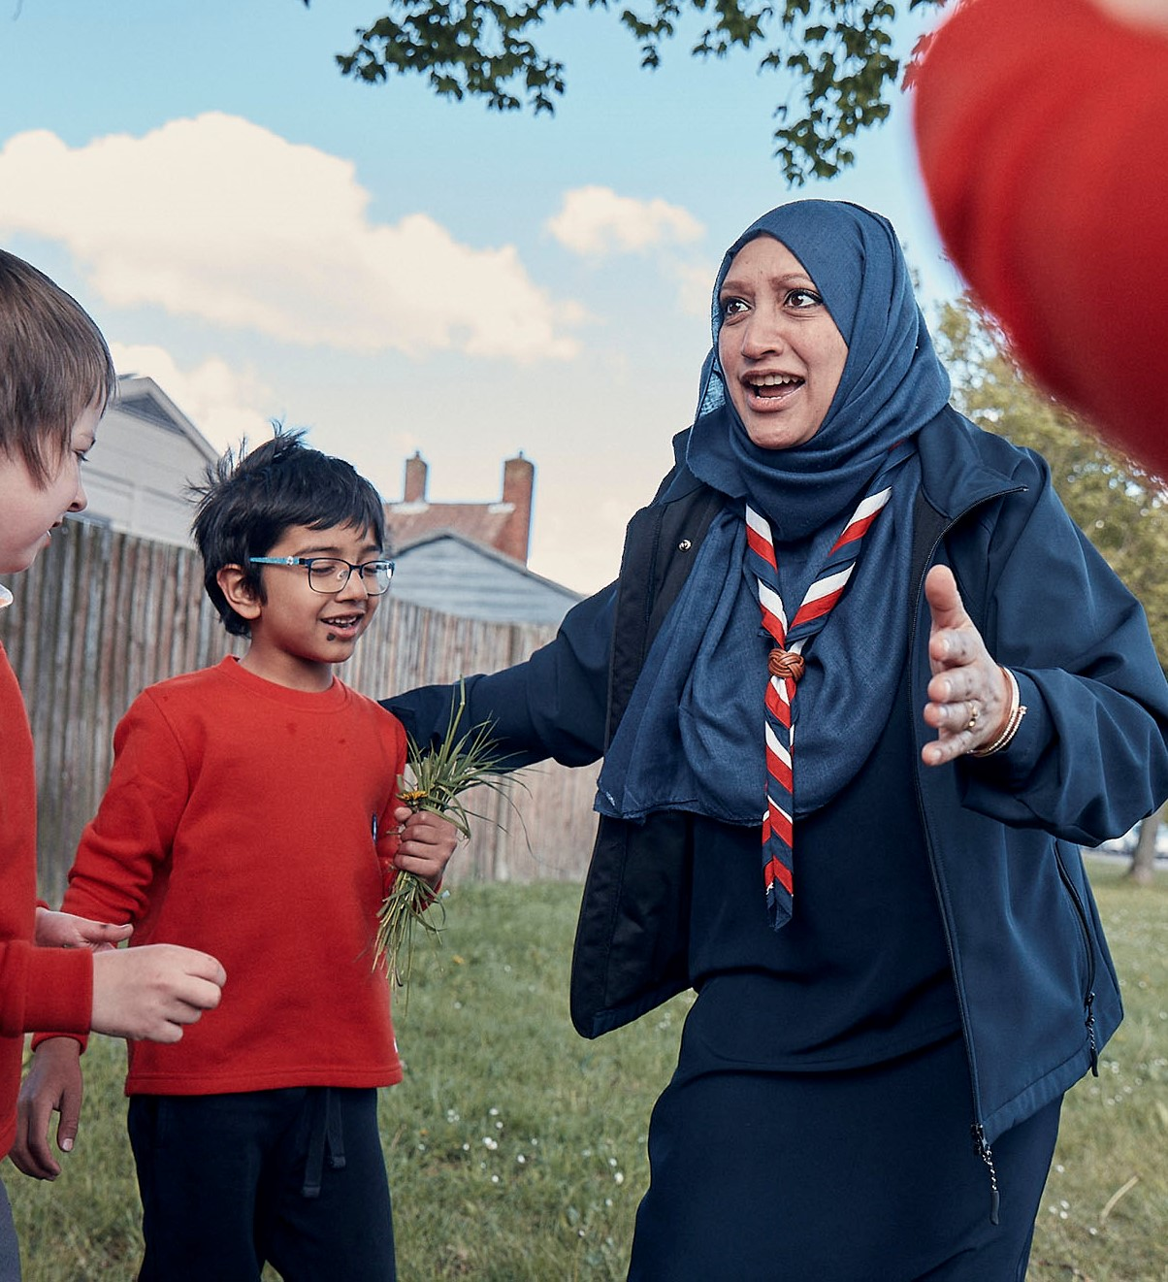
Actions
Ensure Trustee Board changes are cascaded to all Districts & Groups
Executive Committees retitle as Trustee Boards, effective from publication of April 2023 edition of POR. And Executive Committee Members as Trustees
All Groups/Districts/Counties to adopt (or re-adopt) the updated constitution from POR at their next AGM. [In Census 2023 only 48% said "yes, we have adopted the constitution". Target for Census 2024 is 100%.]
Trustee Boards to use the revised 'Purpose' statement within the constitution (5.4.4 in April POR) as the focus of their work
Use detail in the April 2023 edition of POR to support running local AGMs – and there is greater detail on the Moving to Trustee Boards webpage (link at the bottom to AGM agenda, planning timeline and script)

Slide 21
Transitioning to Trustee Boards
The purpose of Trustee Boards
Start Trustee Boards thinking about governance vs operational operationaloperational - examples
Example governance tasks – for which Trustees are collectively responsible | Example support tasks - undertaken through the Group Leadership Team or District/County Support Teams
Ensure that there are sufficient resources (funds, people, property and equipment) available to meet the planned work of the Group, including delivery of the high-quality programme | Fundraising Premises management and maintenance Grass cutting or service crew at camp site
Ensure that the charity’s finances are properly managed, including development and maintenance of appropriate budgets to support the charity’s work | Bookkeeping Payments of expenses and invoices Banking
Ensure that effective administration is in place to support the work of the Trustee Board | Distribution of agendas, minutes, etc. for Trustee Board Meetings and Annual General Meetings Managing agreed Trustee appointment processes prior to AGMs
Take responsibility for adherence to Data Protection Legislation recognising that, dependent on circumstances, it will at different times act as a Data Controller and as a Data Processor | Manage any web sites, email systems, documents stores used within/by the charity
Ensure that effective line management is in place for each employed staff member and that these are clearly established and communicated | Line manager, supporting staff in their work

Slide 22
Sharing the Changes

Slide 23
Roadmap for Change
Continue cleaning up Compass data
Continue informing your area about the upcoming changes through events, local emails and more, using the new videos and other resources to support this
Continue briefing District & Group Chairs on the Trustee Board Changes
April
Use the team resources to finalise the plan of what your new teams will look like
Start introducing Our Volunteering Culture to your volunteers
Start introducing use of teams in Groups, Districts, Counties
Start introducing the Trustee Board changes via AGMs for Groups/Districts/Counties/Regions/ Areas…

Slide 24
April and May Communication Moments
2 May: Role title change information shared with CC/DC/GSL via the All Members' Email
16 May: Volunteer Experience webpages shared with line managers via the All Managers' Email
6 June: Volunteer Experience webpages shared with everyone via the All Members' Email

Slide 25
Compass Guidance

Slide 26
Compass Update
Updating personal details, roles and training on Compass for each volunteer
This includes rationalising email addresses and telephone numbers so that they get correctly transferred during transition
Updating organisation records for sections/ASUs
Correcting "other" sections (we will send you the list)
The guidance contains a page that can be used as a guidance/information sheet for individual volunteers

Slide 27
Open Forum

Slide 28
Change Support

Slide 29
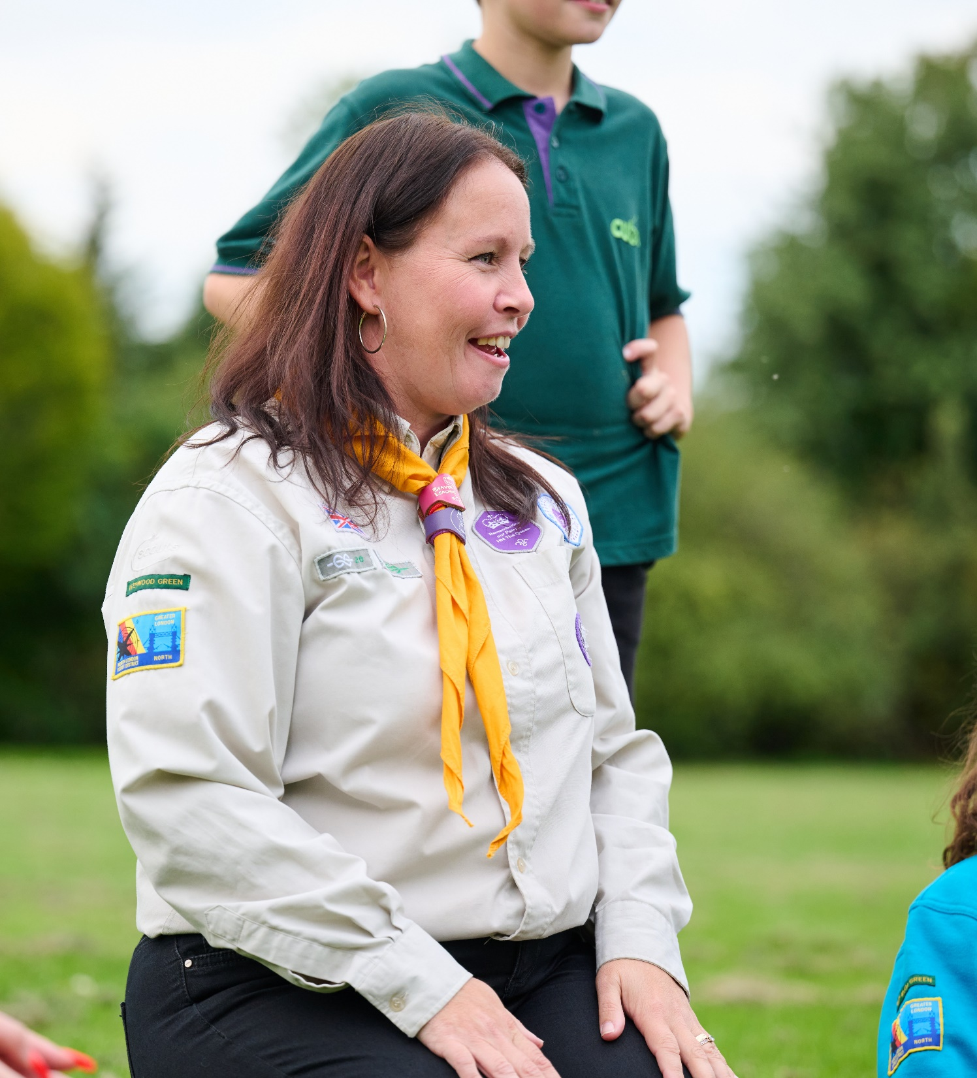
Change Support
Refreshed Transformation Leads Hub
3 new slide packs
Change Planning Workshop 27th April
More workshops to come (let us know what you'd like to see)

Slide 30
Survey

Slide 31
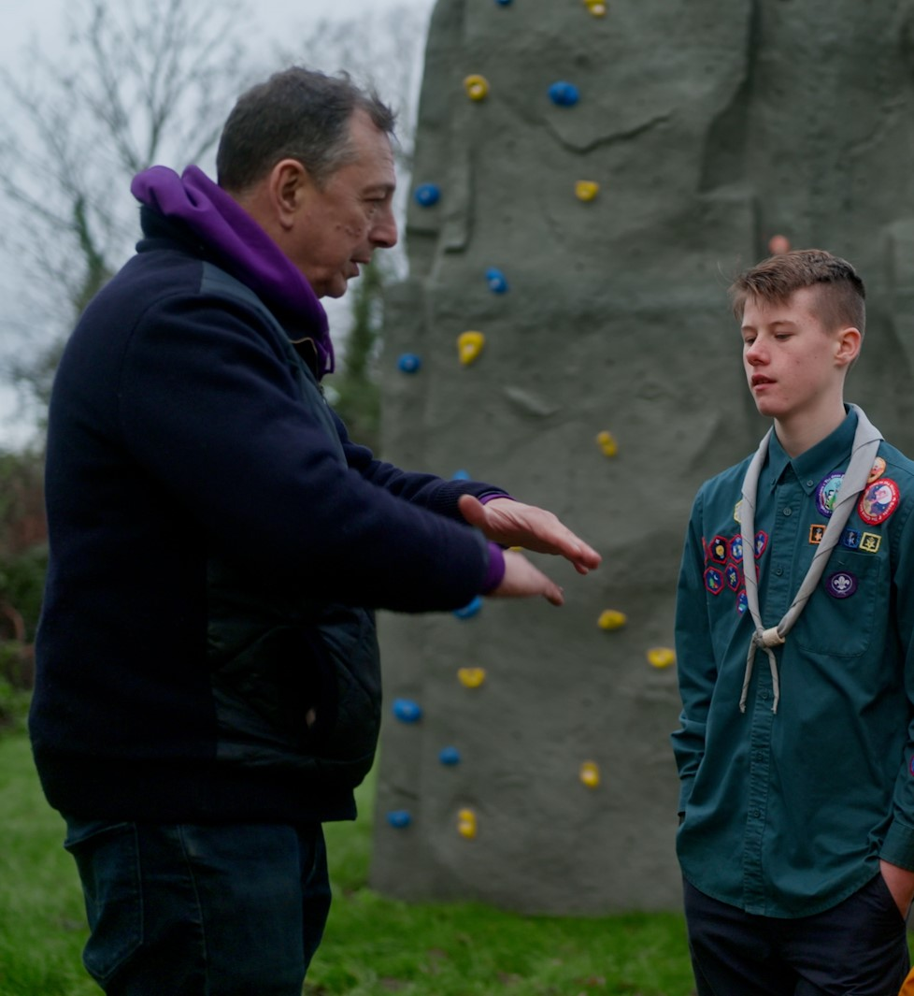
Transformation Leads Poll
I feel confident moving forward with progressing the changes in my area, now that the roadmap for change has been shared
How widely have you communicated the changes locally?
Who does your local delivery/change team include?

Slide 32
Transformation Leads Poll
RAG Rating
Green - Everything is going according to plan and meeting the expected timescales.
Amber - Most things are going according to plan but some things are taking longer or are more challenging than planned and this might affect the expected timescales.
Red - We've encountered an issue(s) that is more challenging or taking much longer than planned.
Have you started your local change plan?
What is your current RAG rating as a County/Area/Region (Scotland) or equivalent?

Slide 33
Early Adopter Cohort Progress

Slide 34
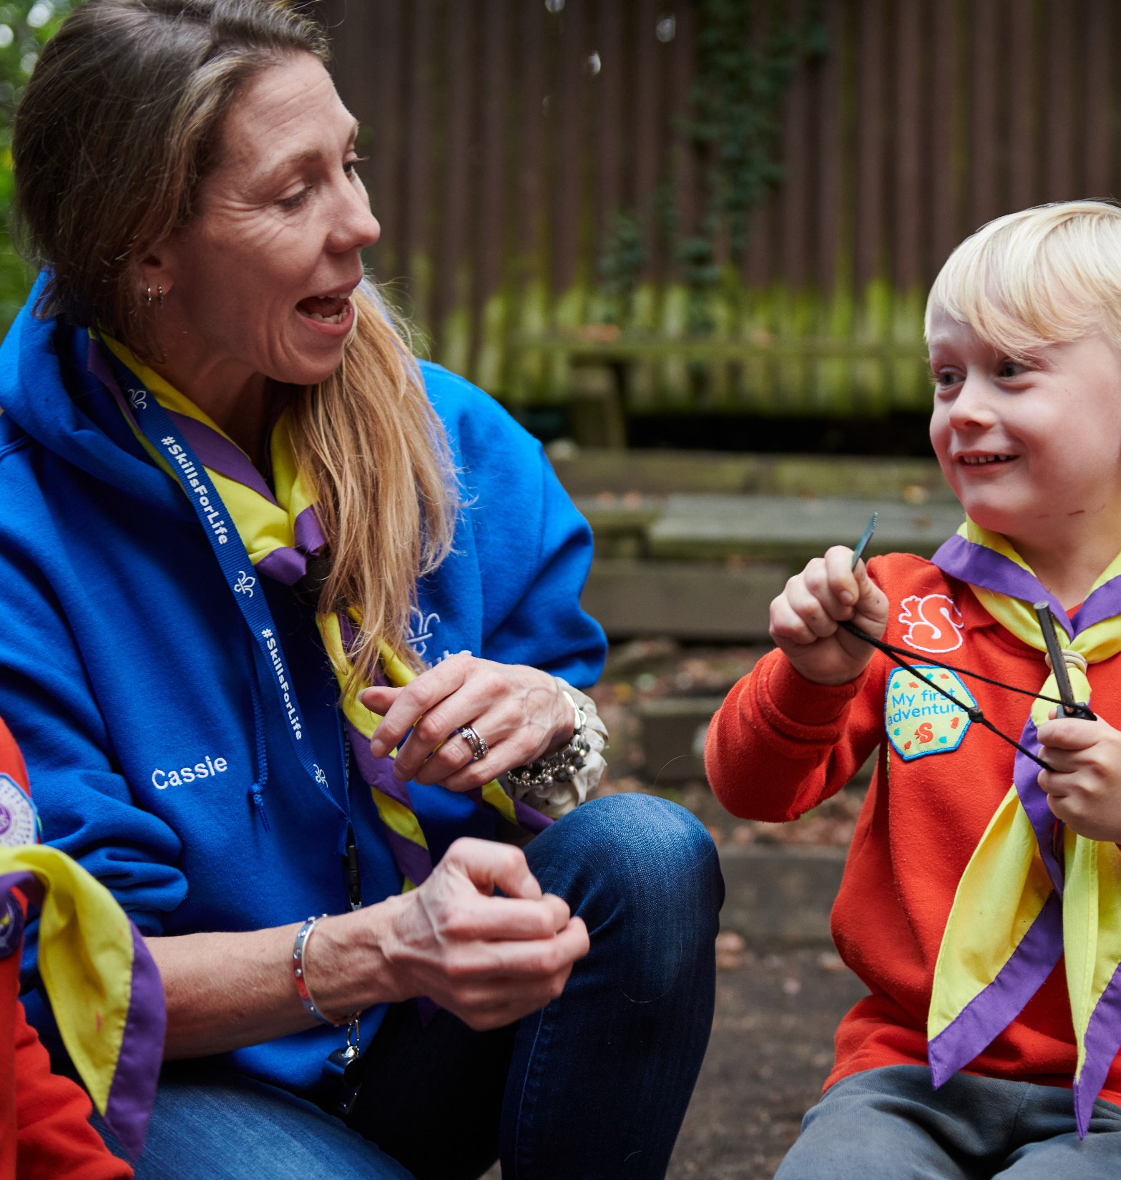
Early Adopter Progress
Creating Change Plans
Feedback Sessions on our teams and culture pages and upcoming learning and welcome resources to shape our work
Early testing of the Permits & Nights Away functionality of the membership system and upcoming testing of:
Profile page & References
Adding members, roles, disclosures

Slide 35
What's Coming in May

Slide 36
May
Mapping of current training modules to new Growing Roots base learning content (The learning every member will need to complete)
Digital Skills Tool Launch and supporting resources
Time to share how work is progressing in your areas and tips for success along with support for any challenges being faced
What you’ll need to do
Use mapping of current training to new learning to support your local planning and compliance
Ensure all local members are aware of upcoming changes and what they need to do
Get to know the Digital Skills Tool and plan how you will introduce this in your area
Continue cleaning up Compass data
Continue introducing Our Volunteering Culture
Continue introducing use of teams in Groups, Districts, Counties etc.
Continue encouraging constitution adoption via Group/Districts/County AGMs
Continue encouraging Trustee Boards to use the purpose statement in April 2023 POR

Slide 37
Thank You

