Slide 1
Transformation Leads Call

Slide 2
Who's on the call?
Craig Turpie, Deputy UK Chief Commissioner
Jack Caine, UK Commissioner for People
Andrew Sutherland, Deputy Programme Sponsor
Hamish Stout, Deputy UK Commissioner for People (Volunteer Journey)
Gordon Weston, Project Lead, Learning Content and Design
Anders Wulff, Volunteering Learning & Design Manager
Adam Ray, Communications Manager
James Booker, Head of Portfolio Delivery & Change
Robert Groves, Change Manager

Slide 3
What we’ve provided ahead of this call
What we’ll cover on this call
Monday 19th June
Communicating Change Video
Updated FAQs
Friday 26th May
4 new learning videos on testing hub:
Why is learning changing?
The Learning Tree
Growing Roots - The learning everyone needs
Growing Roots - The learning for your role or team
Learning
Moving from training to learning
Wood Badge
Branching Out
Feedback:
Open Forum
Transformation Leads Survey
Networking
What's coming in July

Slide 4
Roadmap for Change – A Reminder

Slide 5
June
Sharing with Transformation Leads draft plans on how Branching Out will look and work
Sharing with Transformation Leads draft plans for how the Wood Badge will change
What you’ll need to do
Continue cleaning up Compass data
Continue ensuring all local members are aware of upcoming changes and what they need to do
Continue introducing Our Volunteering Culture
Continue introducing use of teams in Groups, Districts, Counties
Continue introducing the Trustee Board changes via Group/Districts/County AGMs
Continue to introduce the Digital Skills Tool in your area and increase usage

Slide 6
Learning Update

Slide 7
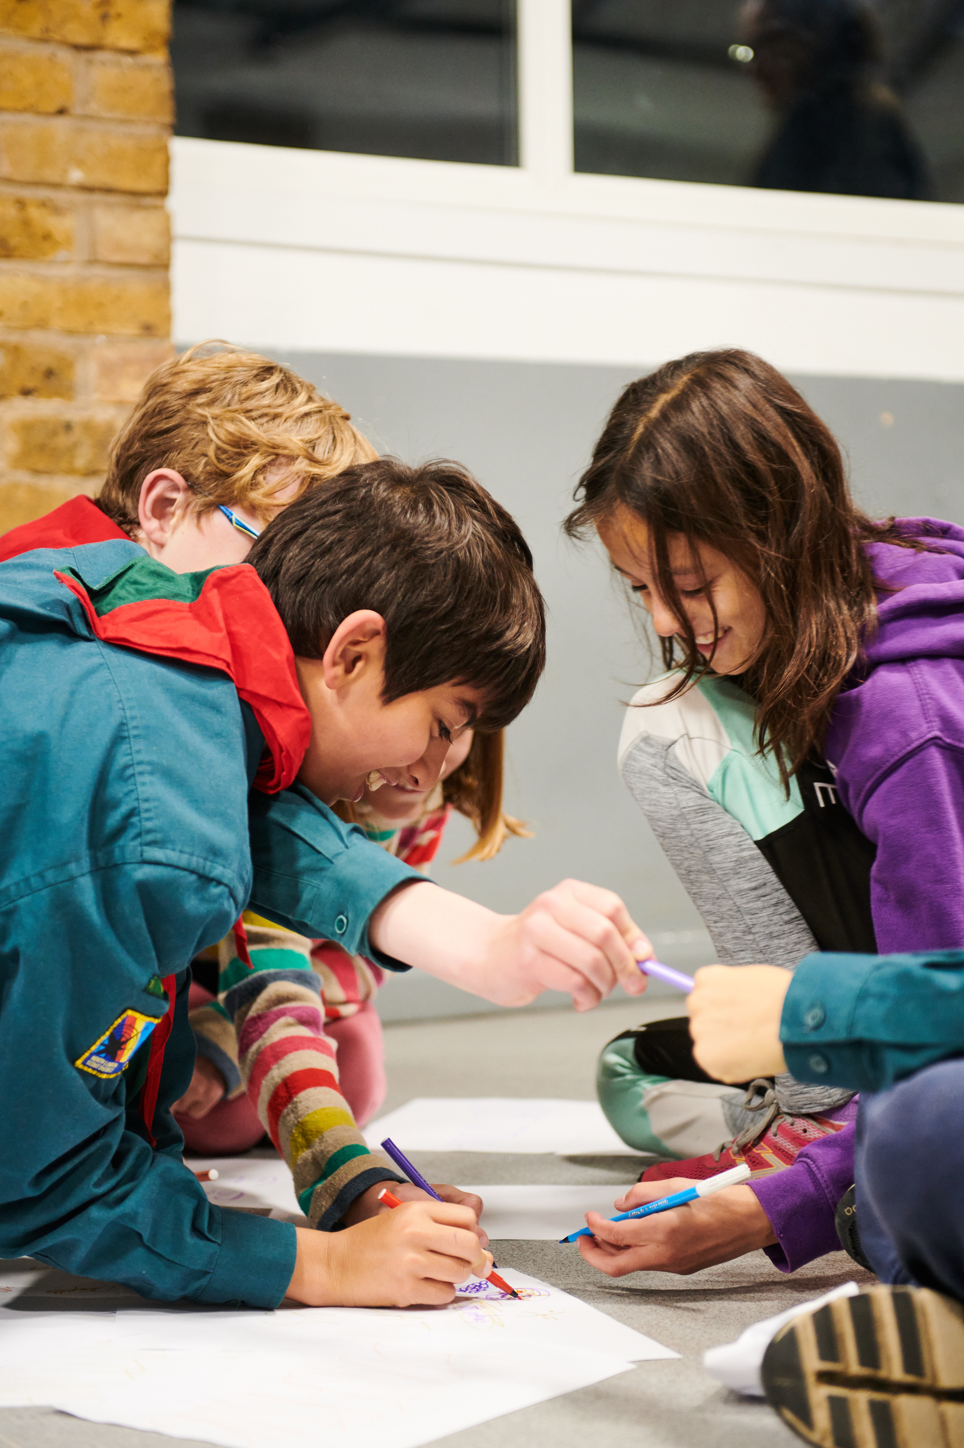
Current training
Externally our training is well regarded for its breadth and content
Volunteers value the Wood Badge when they achieve it
Internally difficult to navigate the training scheme
Modules are not always specific to a role and are often duplicated when changing roles
Volunteers are put off by having to repeat training or validation when moving role
Reliance on having many dedicated volunteers to:
Update PLPs & Compass
Deliver & validate training
Manage training compliance

Slide 8
From the Scout Experience Survey
Since 2018, volunteers have reported similar training experiences, with similarities in volunteers reporting training to be relevant, easy to access, simple, enjoyable and receiving training at the right time.
Sample sizes (2022)
Training was relevant: 6,974 adult volunteers
Training was easy to access: 6,976 adult volunteers
Training was simple to undertake: 6,976 adult volunteers
Training was enjoyable: 6,975 adult volunteers
Right training at the right time: 6,976 adult volunteers

Slide 9
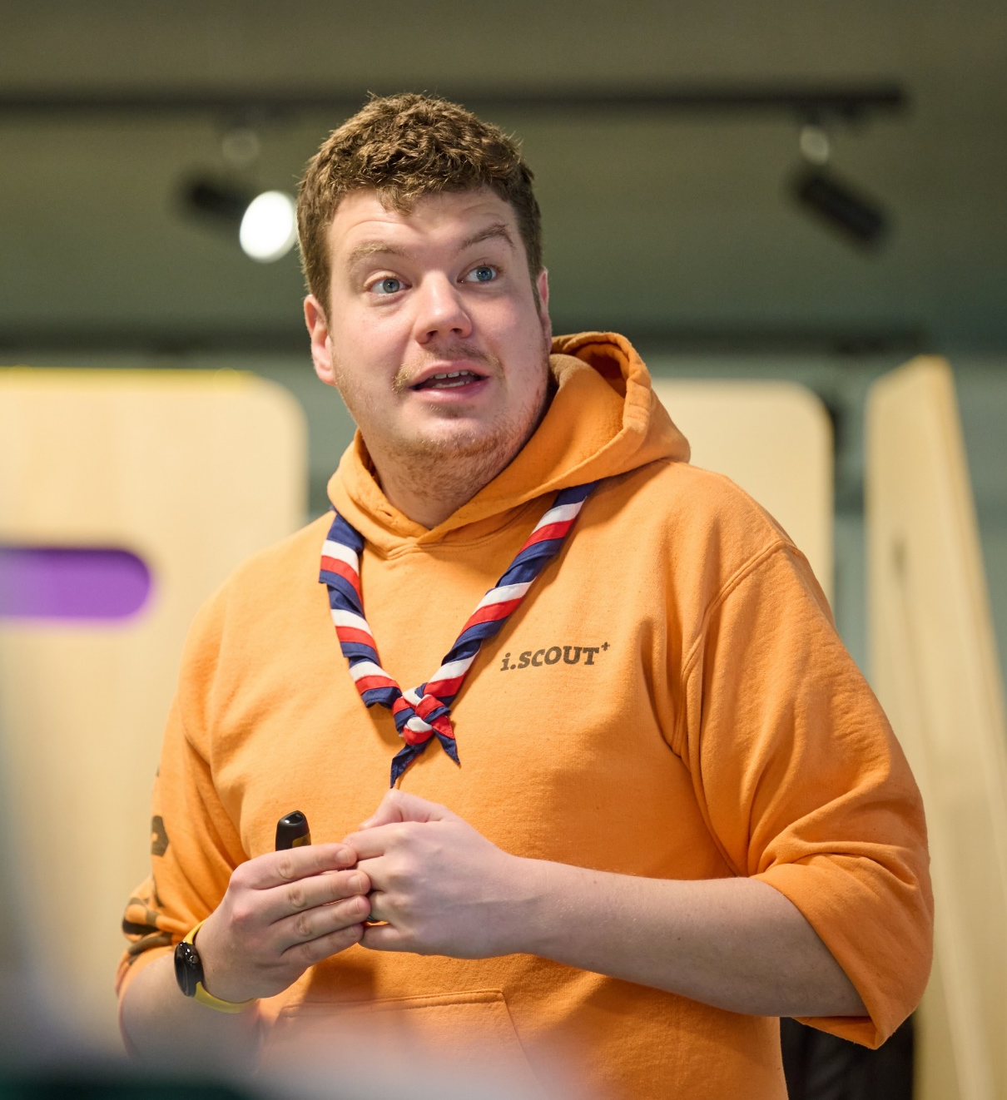
What will 2025 and beyond look like?
Volunteer focused – learning relevant for you!
Easy to understand learning journey for all
Additional optional learning designed to build and enhance a volunteer's skills
A Wood Badge is about helping the volunteer learn and develop as a person and leader
One platform to access and record all learning
Learning specific to a volunteer's role, without the need for duplication
Reduced administration and improved learning management through automated processes

Slide 10
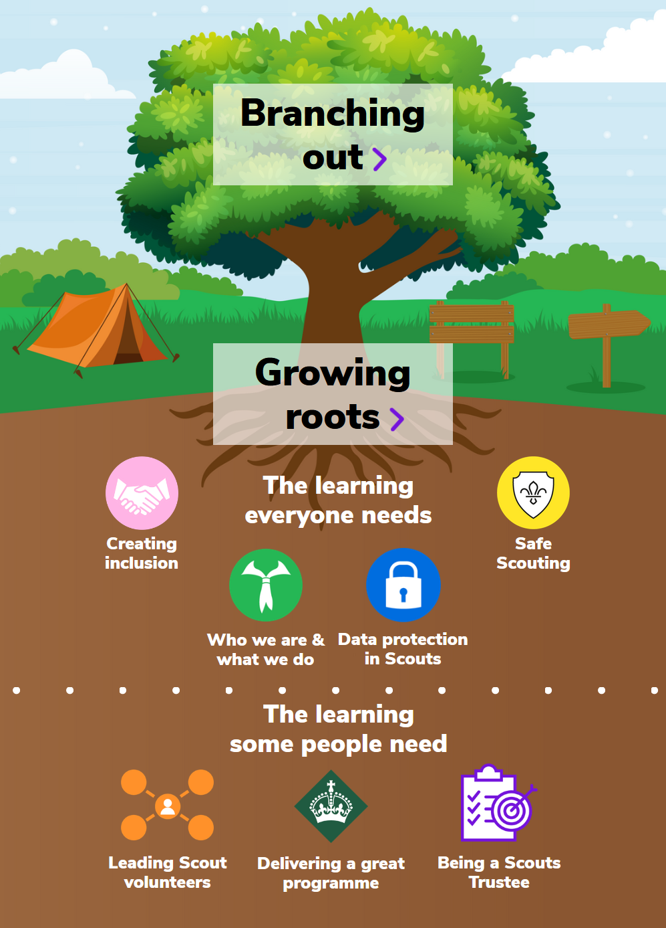
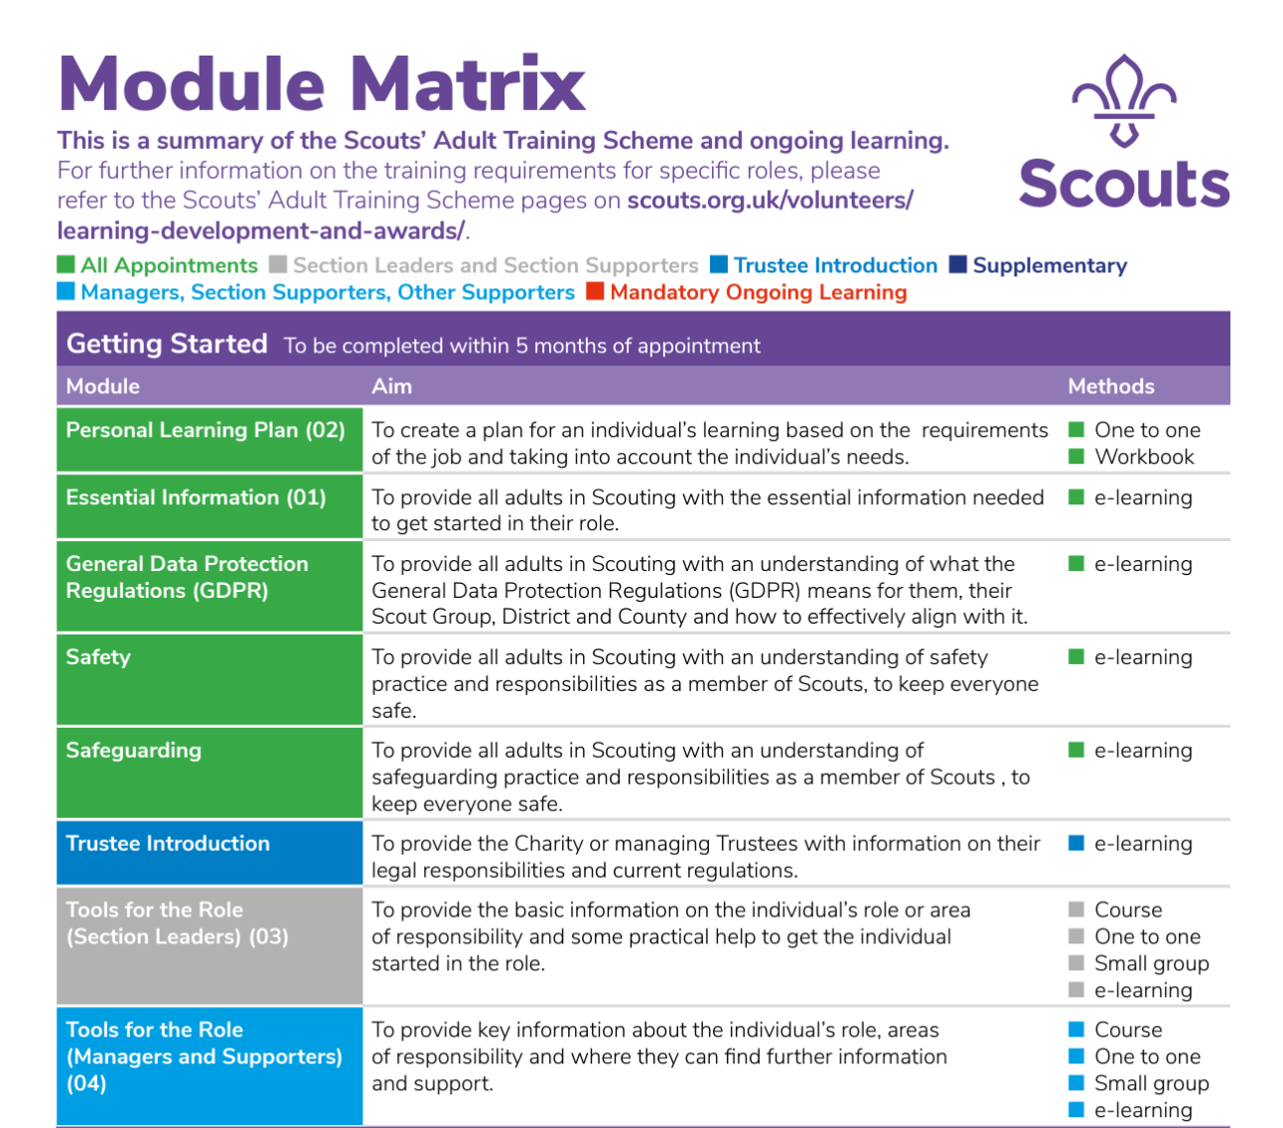
Moving from training to learning

Slide 11
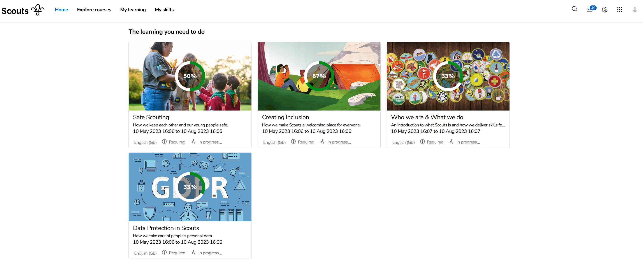

Slide 12
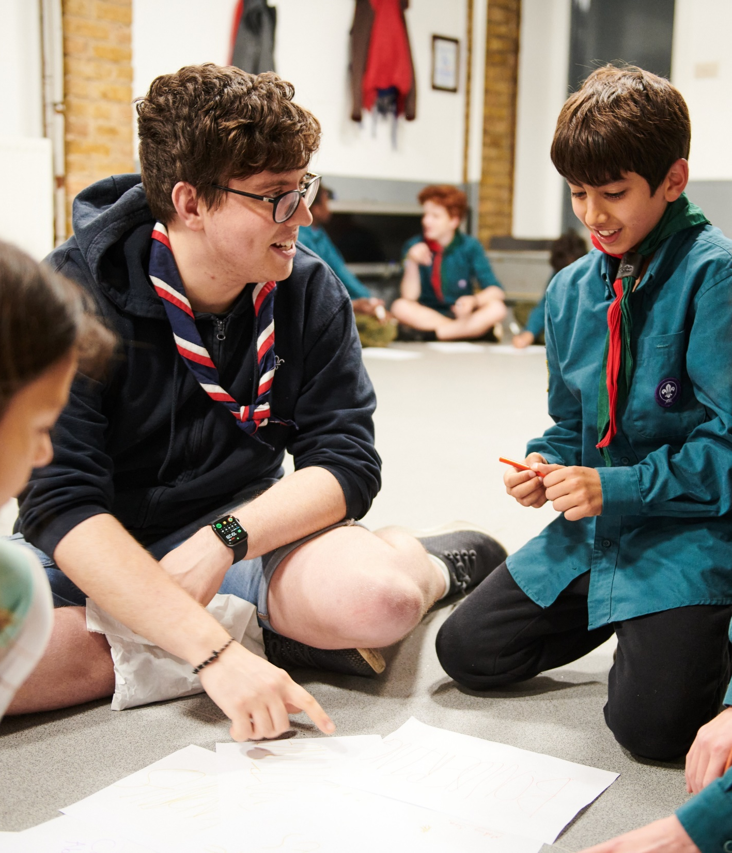
Continuing to deliver the Wood Badge into 2025
Volunteering Development Teams should ensure that all volunteers continue to have the opportunity to complete a Wood Badge
While new learning is developed the Wood Badge will continue to be delivered using current modules

Slide 13
Delivering the Wood Badge into 2025
Section Wood Badge
M&S Wood Badge
Growing Roots
Module 8 - Skills of leadership
Module 9 - Working with adults
Module 11 - Admin
Module 13 - Growing the section
Module 16 - Residential
Module 18 - Practical Skills
Module 19 - International
Module 10A & 10B - First Aid
Growing Roots
Module 11 - Admin
All current Manager & Supporter skills courses

Slide 14
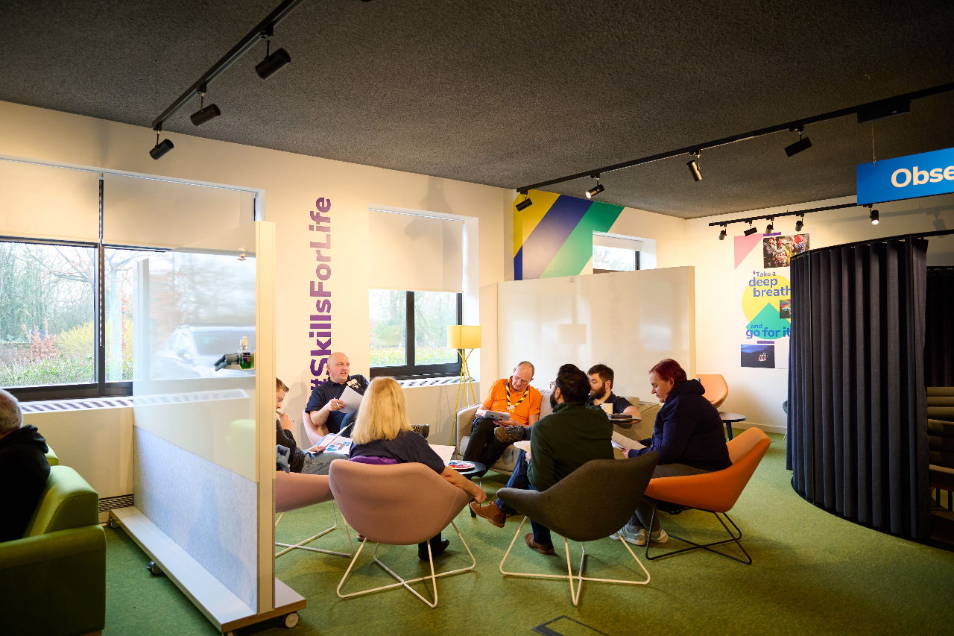
Volunteering Development Teams
Volunteering Development Teams will be responsible for delivering and validating modules until they are replaced over 2024 and 2025
First Aid & Permits should continue to be delivered the same as currently
As new branching out learning is developed Volunteering Development Teams will continue to be responsible for facilitating this
More detail around Volunteering Development Teams and their tasks, including those linked to the Warmer Welcome changes will be shared in the coming months

Slide 15
Modules to continue delivering locally
Module 8
Module 9
Module 11
Module 13
Module 16
Module 18
Module 19
Module 25
Module 27
Module 28
Module 29
Module 36
Module 38
Module 39
Manager & Supporter
Skills courses
Must continue to deliver:
Module 10A & 10B (First Aid)

Slide 16
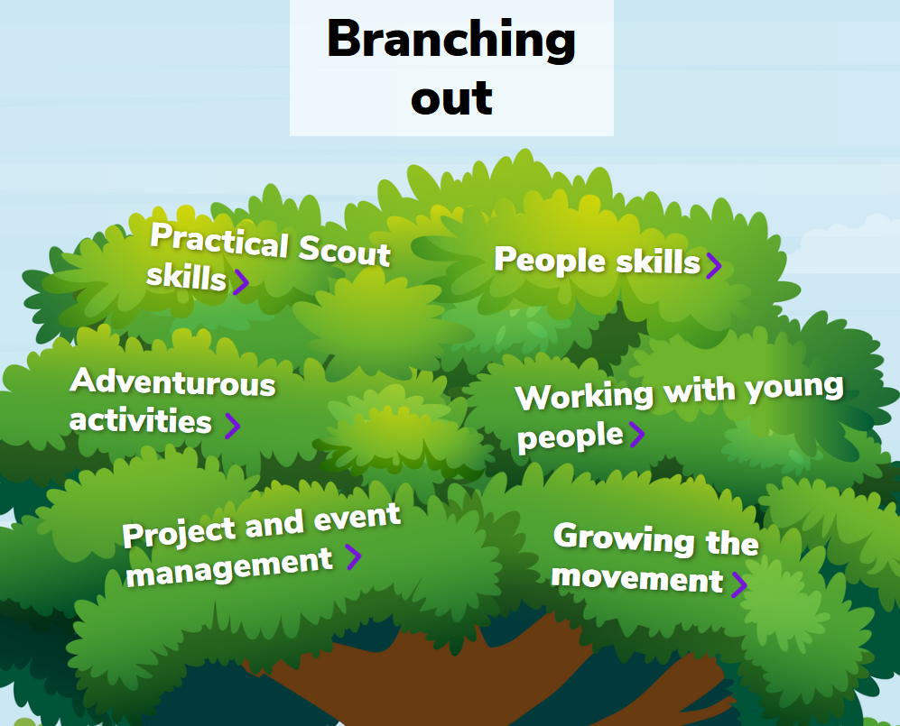
Branching Out
2023
2024
2025

Slide 17
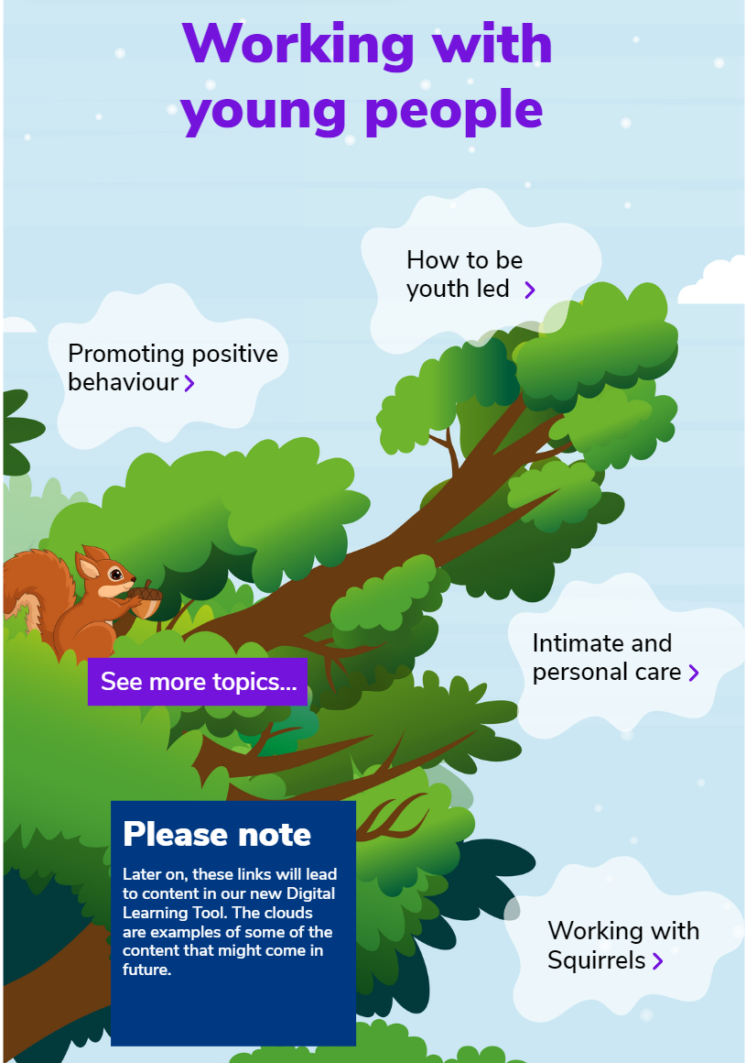
What will branching out look like?
From date of digital transition:
Continue to include existing permits and external qualifications
2024 into 2025:
Replace current modules with new learning
Learning will be broken into branches/topics - bitesize, variety of mediums e-learning, videos, in-person learning etc.
2025 onwards:
The new Wood Badge will be made up of learning within the new Branching Out content
Continue to add and update learning relevant to our volunteers

Slide 18
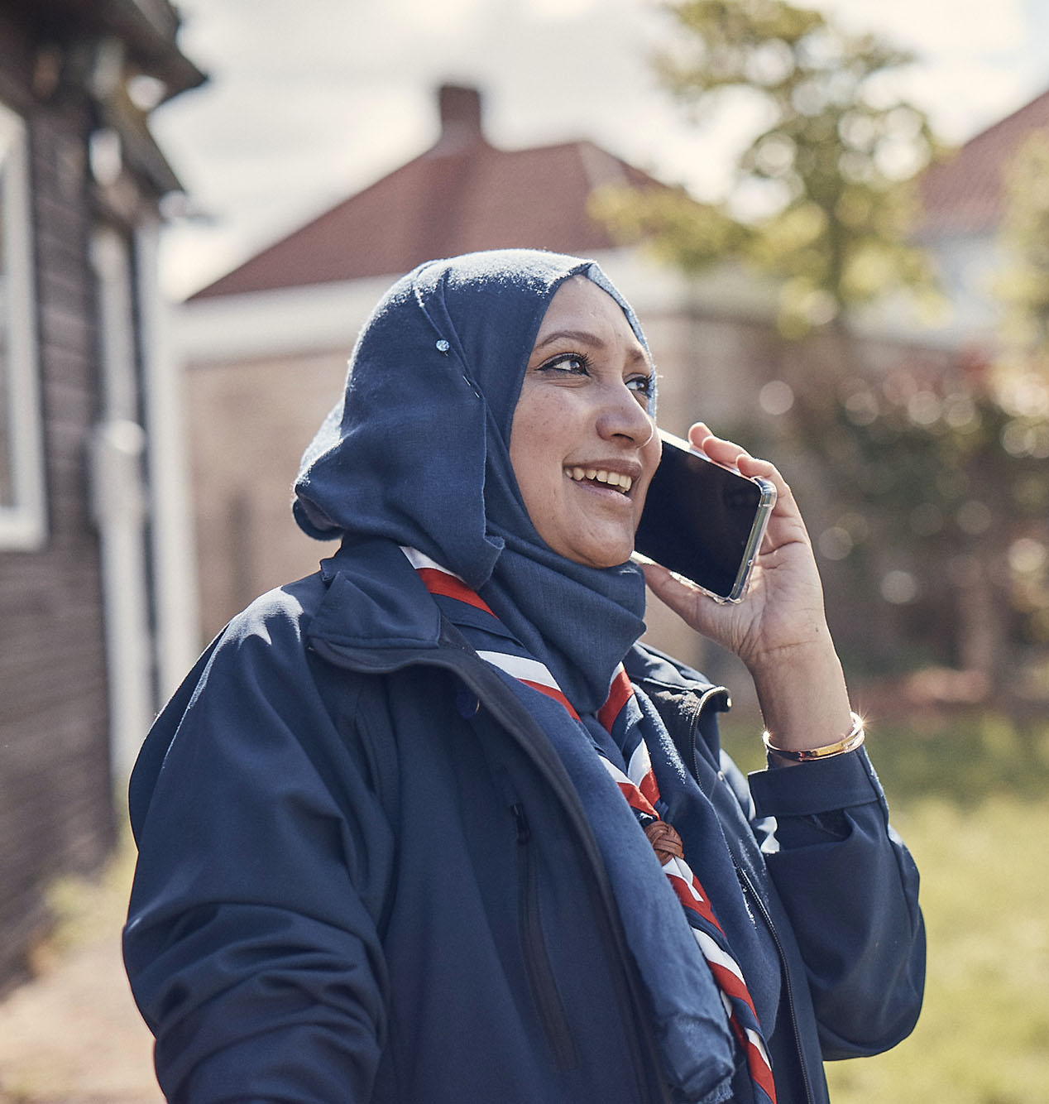
Digital first, not digital only
We’ll be taking an approach of digital first along with the rest of the volunteer experience changes
Face-to-face learning is still very important and remains the best way of delivering learning for several topics, this won’t change
We will have a way to access Growing Roots learning non-digitally. We’re refining exactly how this works, and will share this in a future update

Slide 19
Open Forum

Slide 20
Transformation Lead Survey

Slide 21
May Summary
Counties Responded
Counties Represented
42*
58**
May
April
11(-1)
12
11
Green - Everything is going according to plan and meeting the expected timescales.
Green - Everything is going according to plan and meeting the expected timescales.
28(+5)
23
Amber - Most things are going according to plan, but some things are taking longer or are more challenging than planned and this might affect the expected timescales.
5 (-3)
8
Red - We've encountered an issue(s) that is more challenging or taking much longer than planned
*24 Counties/equivalents did not complete poll, 9 of which left the call prior to poll
**18 Counties/equivalents had multiple attendees leading to duplicate responses. Where responses differ, the "lower" rating has been used
It's important to note that movement in RAG ratings are not always like for like as counties who submit data may differ each month

Slide 22
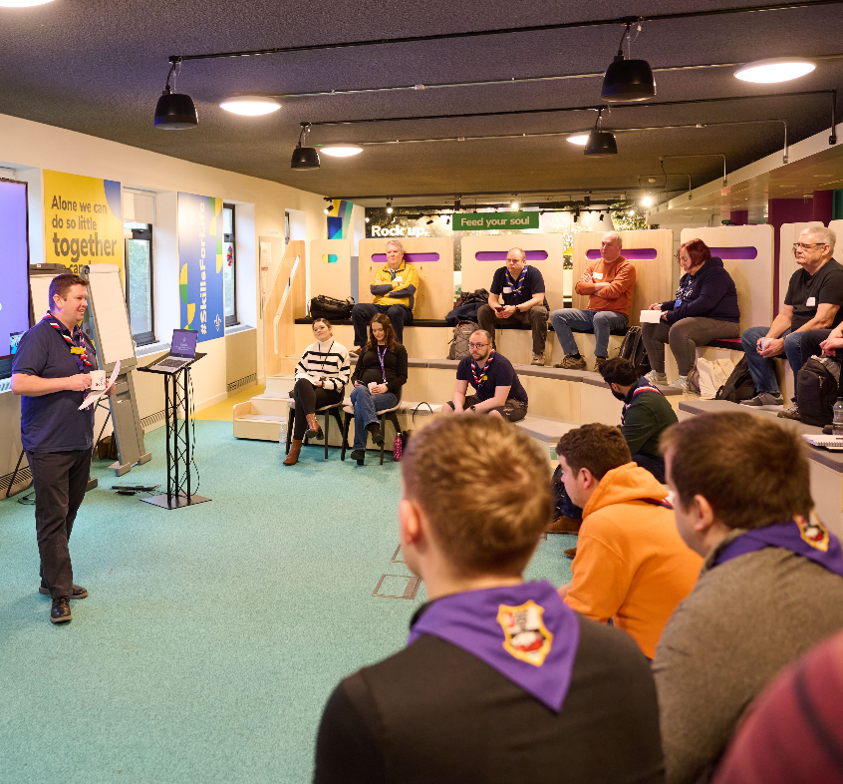
Survey
Zoom Polling
What is your role?
Have you made a local change plan?
Please indicate which of these changes you have communicated to all members in your area
For any volunteer experience changes not yet communicated to all members, when do you plan to do this?
What progress have you made on updating compass records?
What is the overall RAG rating for your County/Area/Region (Scotland)?

Slide 23
Networking Session

Slide 24
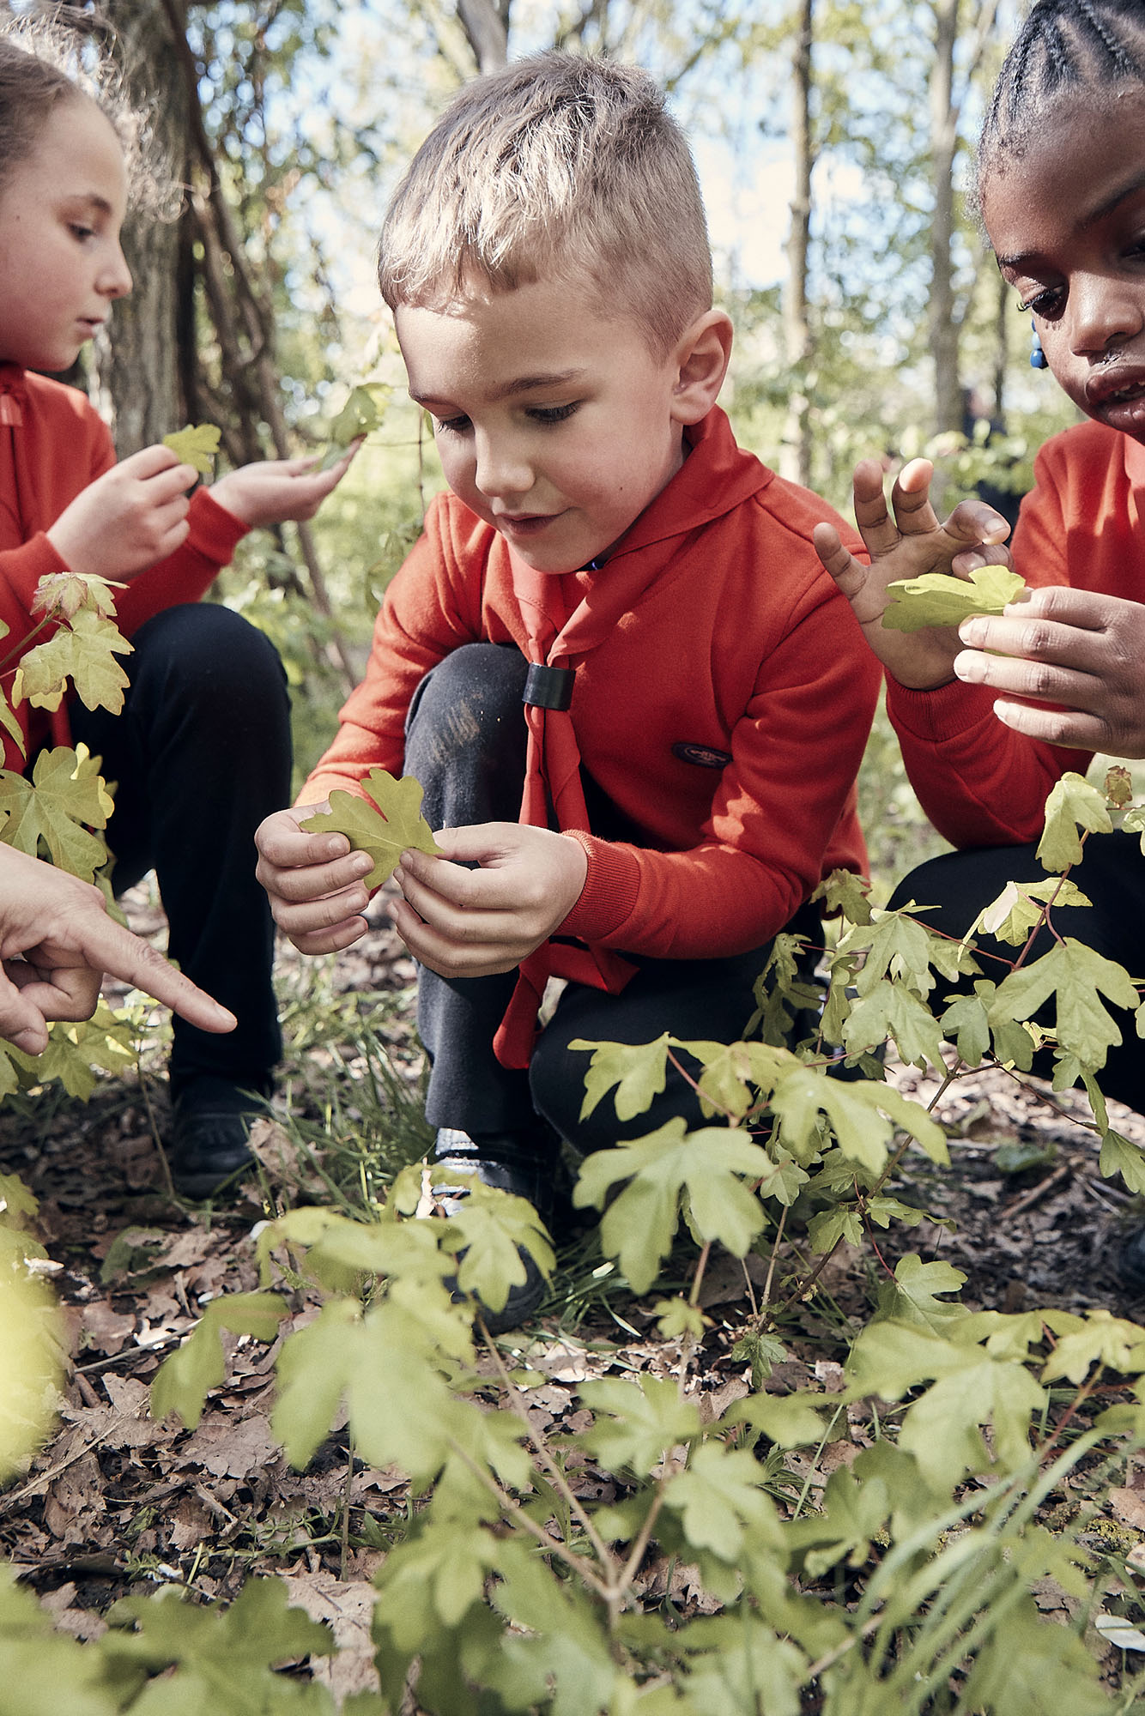
Networking Session
15 minutes in breakout rooms
Using Mural – please can at least one person per room ‘note take’
What communication methods have been working best in your area?
What challenges are you overcoming or continuing to face locally?

Slide 25
Early Adopter Update

Slide 26
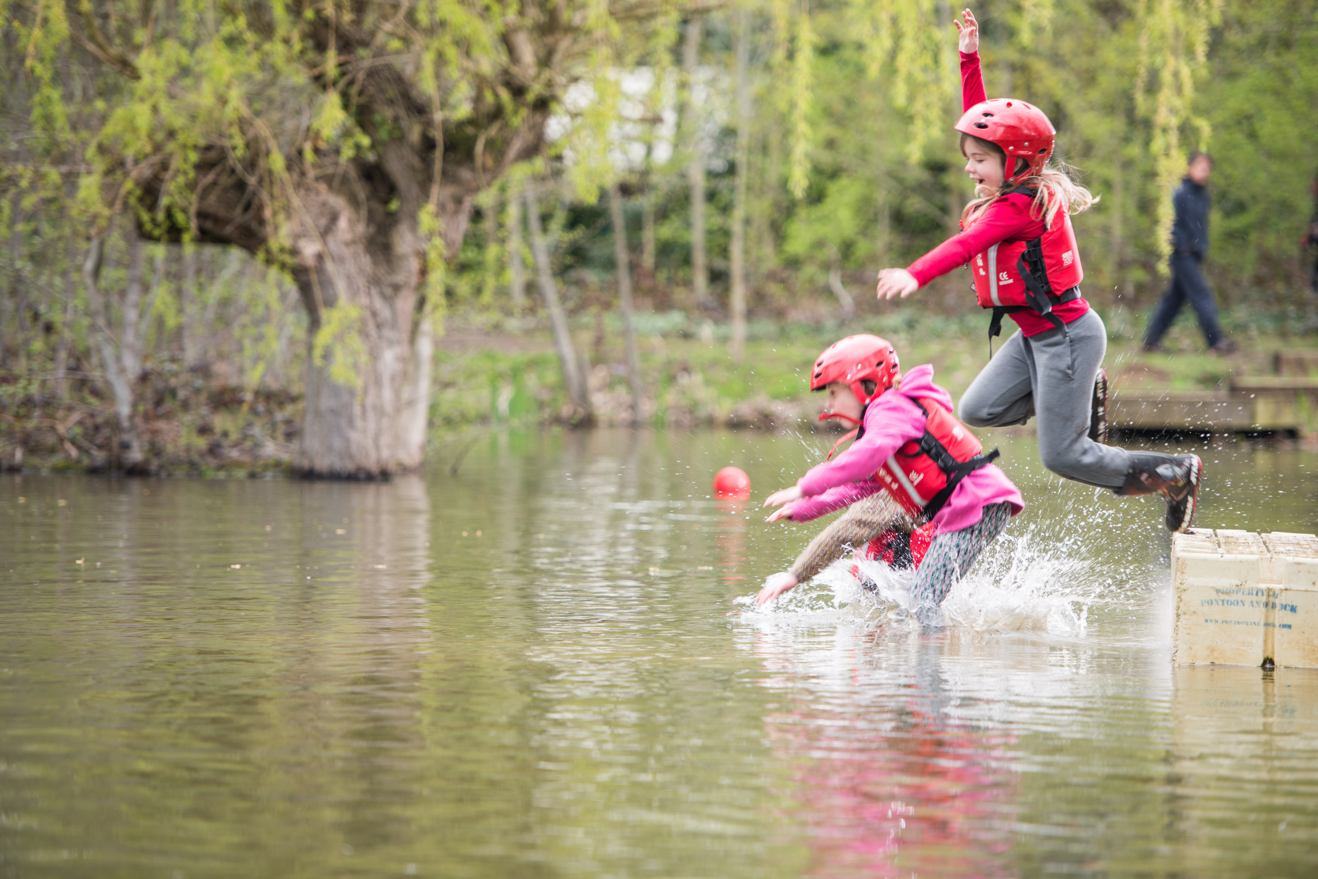
Early Adopter Update
Sharing updates on progress across the early adopter cohort
Clwyd taking over for Gwent as an early adopter area
Discussing what digital transition will look like for Early Adopters
Briefing those involved in testing for future Trustee Board membership changes

Slide 27
What's coming in July

Slide 28
July
Overview of the new Welcome Journey
Welcome system demonstration
Further details on learning transition
POR - This will be the final version of POR for Counties to use prior to their transition and will apply in every County until their transition to the new digital solutions
What you’ll need to do
Utilise additional mapping of current training to new learning to further support planning
Continue cleaning up Compass data
Continue introducing Our Volunteering Culture
Continue introducing use of teams in Groups, Districts, Counties
Continue introducing the Trustee Board changes via Group/Districts/County AGMs
Continue to introduce the Digital Skills Tool in your area and increase usage

Slide 29
Thank You

