Slide 1
Transformation Leads Call

Slide 2
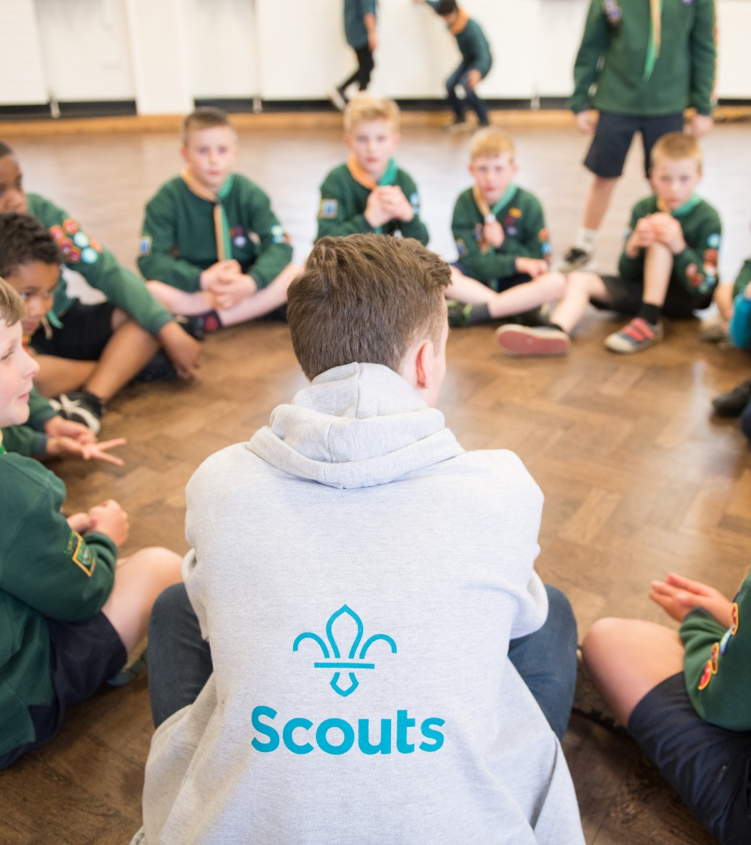
Who's on the call?
Craig Turpie, Deputy UK Chief Commissioner
Hamish Stout, Deputy UK Commissioner for People (Transformation)
Jack Caine, UK Commissioner for People
Rebecca Young, Head of Digital Delivery
Alison Fell, Heather Smith, & Davina McAuley, Welcome Project Team
Gordon Weston, Matt Cobble & Colin Davidson, Learning Project Team
Lauren Golding & Adam Ray, Communications Team
James Booker, Elizabeth Stormfield & Rob Groves, Change Team

Slide 3
Roadmap for Change

Slide 4
July
July
POR - This will be the final version of POR for Counties to use prior to their transition and will apply in every County until their transition to the new digital solutions in February
What you’ll need to do
Utilise additional mapping of current training to new learning to further support planning
Continue cleaning up Compass data
Continue introducing Our Volunteering Culture
Continue introducing use of teams in Groups, Districts, Counties
Continue introducing the Trustee Board changes via Group/Districts/County AGMs
Continue to introduce the Digital Skills Tool in your area and increase usage

Slide 5
What we’ve provided ahead of this call
What we’ll cover on this call
Transformation Lead Survey
Warmer Welcome:
Welcome journey overview
Welcome conversation resources
Learning Update:
Data Migration Update
First Aid
Transformation Information:
Change Support
Early Adopter Update
Aims for September
Thursday 20th July
Welcome webpages including resources
Coming this week
July 2023 POR
Notes:
Jack

Slide 6
Transformation Lead Survey

Slide 7
Survey
What is your role?
What challenges/barriers are you facing?
Would you be interested in a repeated change plan workshop over summer?
What is the overall RAG rating for your County/Area/Region (Scotland)?

Slide 8
Introduction to The Welcome Journey

Slide 9
Why are we improving the welcome journey?
We want to recruit 10K new volunteers so that we can offer Scouting to 50K more young people
Many of our existing volunteers are either former members or parents
To support attracting new volunteers we want to make joining easier and more transparent

Slide 10
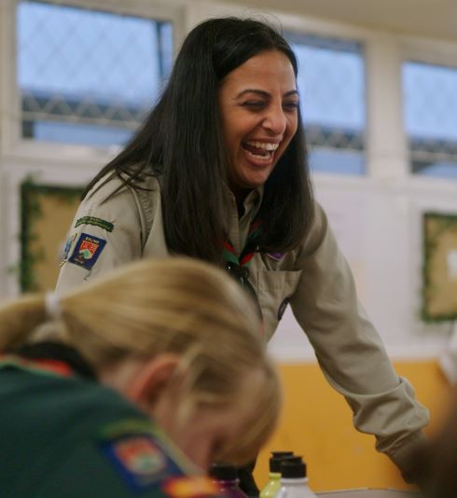
What did we learn from our research?
Joining us can feel daunting for new volunteers
New volunteers feel like our appointment panels are more like a job interview
The appointments process is time consuming and relies on inefficient tools and processes
We want more volunteers locally but need the support to make it happen
We’re often reliant on our existing networks to get new volunteers - parents, carers, friends, ex-members and current volunteers…

Slide 11
Welcome Journey – What's Changing
A new feature in the membership system to assist in attracting new volunteers and to make it easier for existing volunteers to identify other opportunities
A simple, consistent joining journey no matter where a new volunteer joins:
A more consistent, welcoming and easy way to complete the joining process, as a new volunteer and managed in the membership system
Reducing the administrative burden on our volunteers by automating references, internal checks of our systems and declarations (these were not automated on Compass)
Removing the Commissioner approval step and pre-provisional appointments status to simplify the joining process
Replacing meetings with an appointments panel at each change of role by a single 'Welcome Conversation' when a volunteer first joins Scouts
Growing Roots learning designed to provide volunteers with the information to do the basics for their role
Removal of Appointment Advisory Committees
Ensuring the new volunteer has the information necessary to feel supported through their induction with supporting resources and buddying opportunities

Slide 12
The Welcome Journey

Slide 13
Steps to becoming a member

Slide 14
Resources to support Welcome Journey

Slide 15
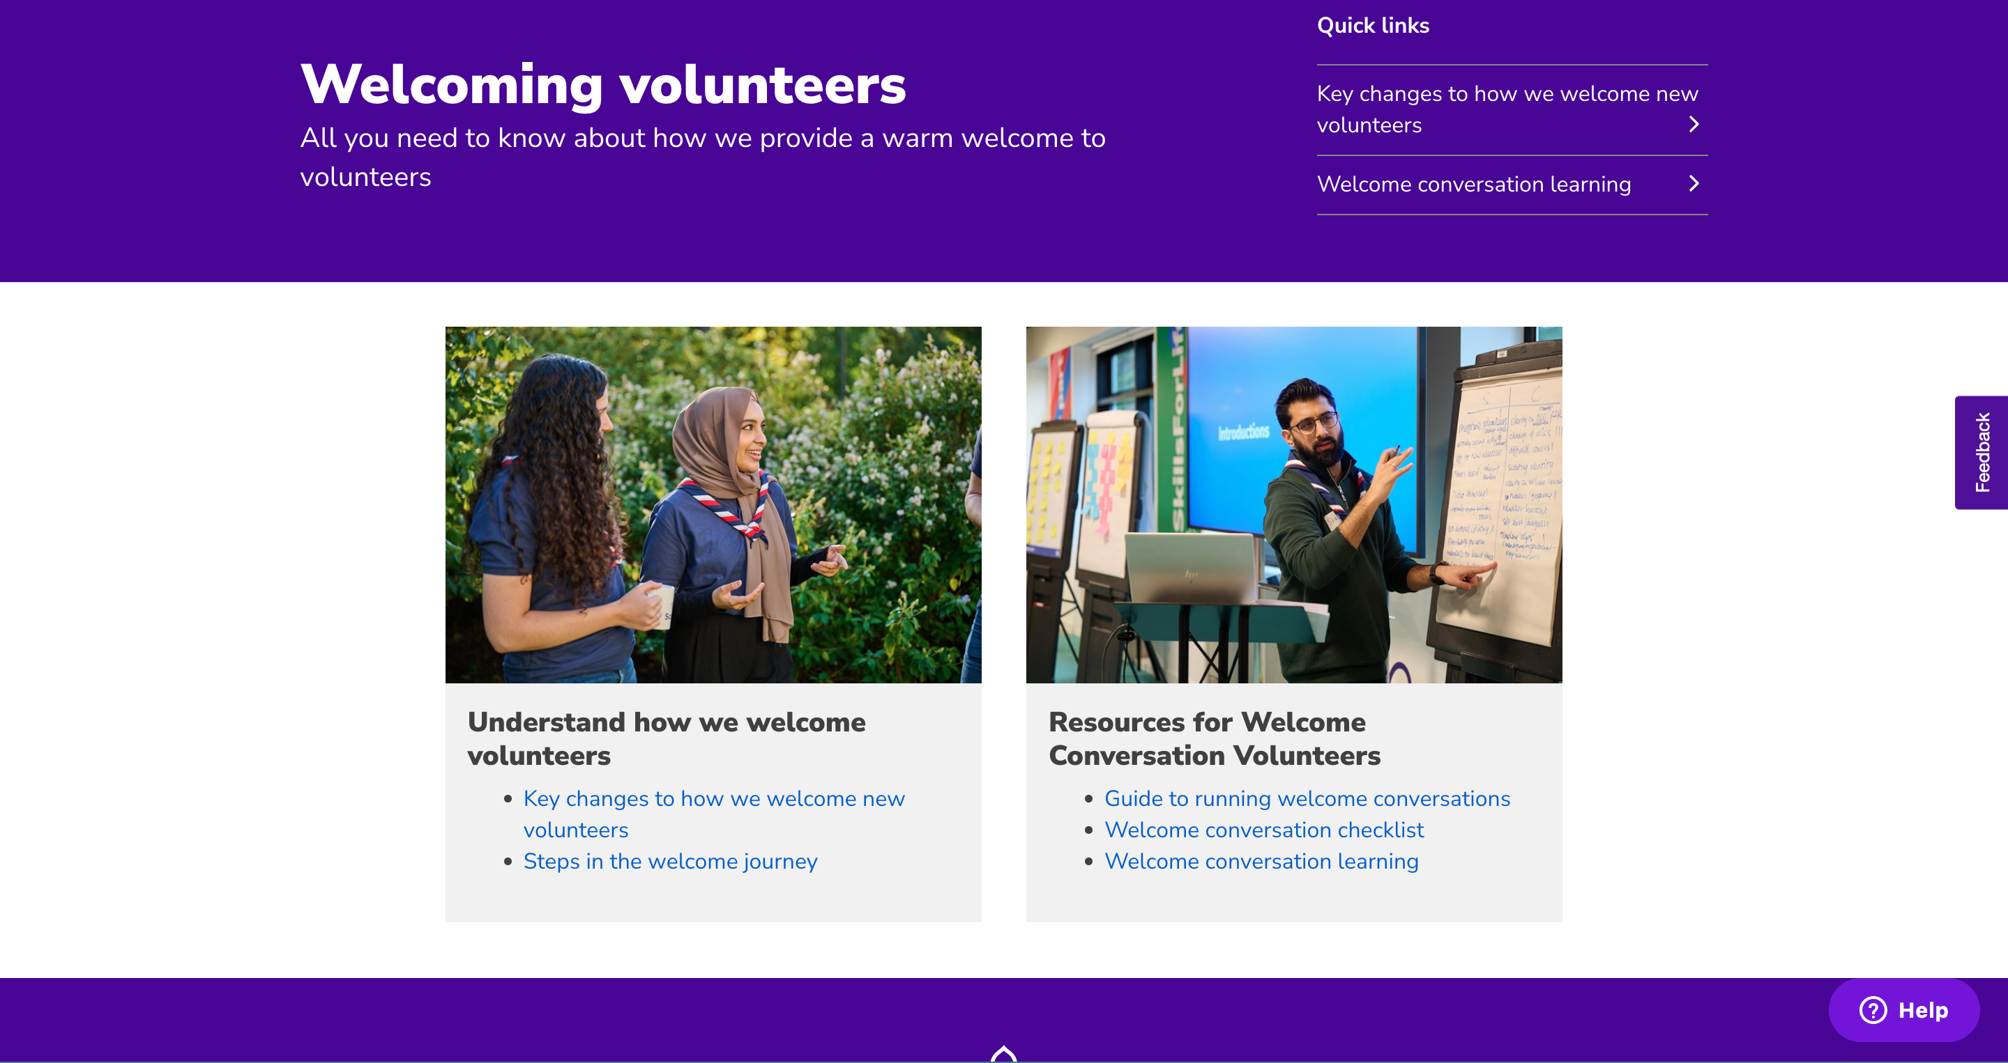
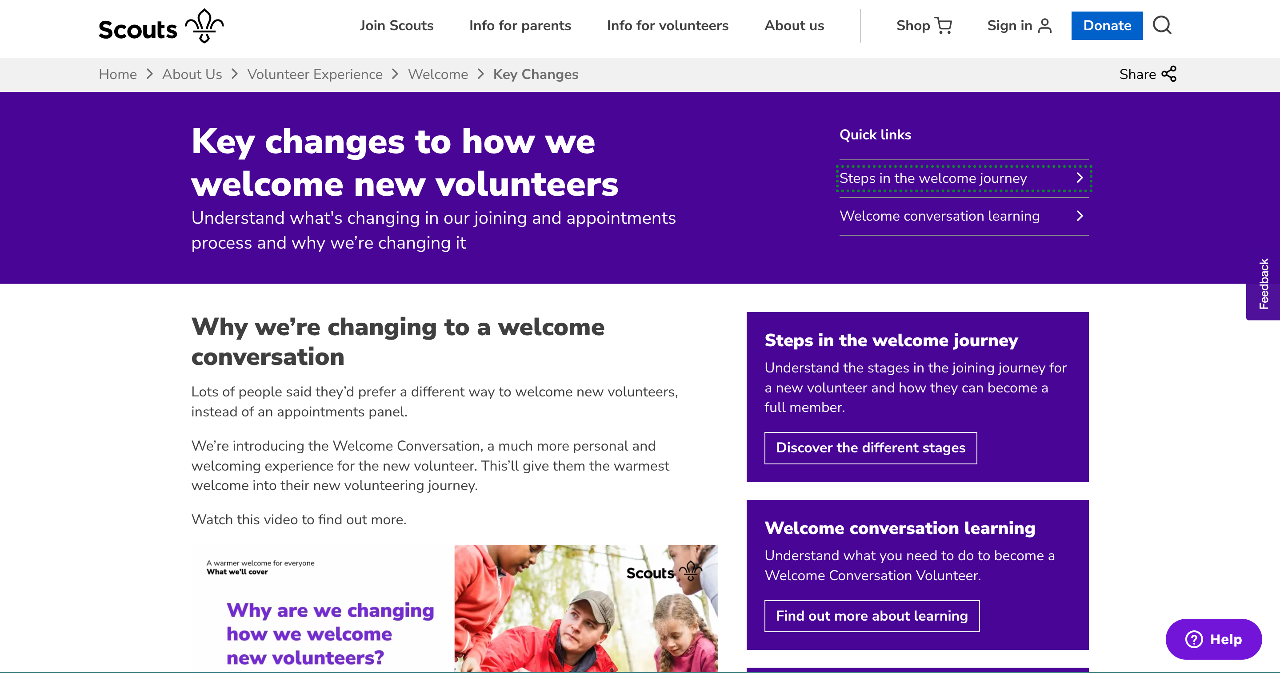
Welcome Resources
These webpages will become part of the Volunteer Experience section of the website
They are a collection of different resources for members to support the journey of a new volunteer. They include:
Checklists
Video to explain why we're changing from appointments panels to welcome conversations
Learning
Transparency on the steps involved in becoming a member of Scouts

Slide 16
Why have a welcome conversation?
How might this work in a District/County/Group?
Great first impression
New volunteers feel welcome, valued and supported
Helps them to be prepared at the start of their journey
Is Scouts right for them?
We need to make sure they understand and commit to our values and Promise, and how we keep young people safe.
Chance for them to ask questions
Currently:
Volunteers can hold their only role as a member of the AAC
Changes:
Must be an existing full member
Must have completed the welcome conversation learning and/or received the Welcome Conversation Volunteer accreditation
Having sufficient Welcome Conversation Volunteers is the responsibility of the Volunteering Development Team

Slide 17
Welcome Conversations – Who should carry them out?
What you’ll need to do
Two volunteers carry out the Welcome Conversation together:
The Lead Volunteer or Team Leader who is responsible for the new volunteer's recruitment. They must have completed the Welcome Conversation Learning and be someone that the new volunteer has met previously.
A second volunteer, who is not part of the same Group or Team, who has a Welcome Conversation Volunteer accreditation
To have a Welcome Conversation Volunteer accreditation, you’ll need to be an active member of a Group, District or County Team, who's completed the necessary learning, and agreed with the Volunteering Development Team Leader that you can take on these responsibilities
Can current members of the Appointment Advisory Committee carry out Welcome Conversations?
Yes, anyone who meets the above criteria can deliver welcome conversations as part of their role. Delivering welcome conversations cannot be a role in itself.
Do people carrying out Welcome Conversations need to complete any learning?
Yes. This consists of 3 videos which will include any necessary validation.

Slide 18
What does this mean in practice?
What you’ll need to do
Shivani has volunteered to become a member of the Beavers team at her local group. She has provided all the additional personal information on the Membership System. One of the next steps is to have her Welcome Conversation.
Zara, the Group Lead Volunteer, has already explained about the role and reaches out to the Volunteering Development Team to initiate a Welcome Conversation. They suggest Keenan, a Beavers Section Team Leader who has a Welcome Conversation accreditation, from the neighbouring Group.
Zara and Keenan arrange to meet and carry out a 30-minute Welcome Conversation before Beavers at the group meeting place. Both Zara and Keenan agree on the outcome. Zara records the outcome in the membership system, and it sends a notification to Keenan.
Shivani - Beaver Section Member
Zara - Group Lead Volunteer
Keenan - Beaver Section Team Leader

Slide 19
What does this mean in practice?
How does this make Shivani feel?
Why is this good practice?
Great!
She's completed her welcome conversation easily and it didn't feel daunting.
She's happy it was at a time that she's available and it was done in just 30 minutes.
She's motivated to volunteer, feels included in the decision and is clear on what happens next.
Shivani is getting to meet someone who is involved in the same section as her
Keenan is independent as he's from a neighbouring Group

Slide 20
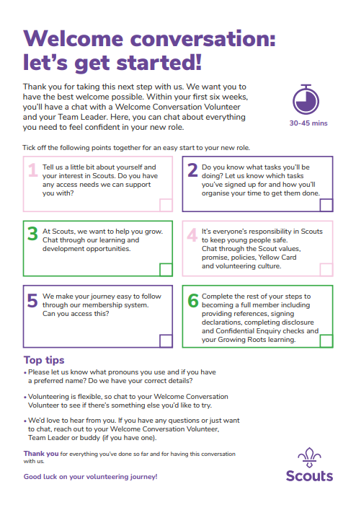
Welcome conversations
Website includes information on:
Learning required to be able to carry out Welcome Conversations
A checklist to act as a reminder of what needs to be covered when carrying out Welcome Conversations
More details around running Welcome Conversations

Slide 21
Welcome conversation learning videos
To carry out Welcome Conversations, volunteers will need to have a 'Welcome Conversation Volunteer' accreditation
There will be a series of videos to watch to support understanding of carrying out the welcome conversation
These have previously been shared with Early Adopter Transformation Leads to help iterate to the current point
There will be a new version before November based on feedback we have received

Slide 22
Next Steps
Ensure current Appointment Secretaries and members of the AAC who only hold that role, are aware of the changes and have had a conversation about what team they might join
Ensure that, where practical, any roles are at full status by 1st November (Early Adopters) or 1st February (All Counties/Areas/Regions)
Think about who will be involved in Welcome Conversations​ locally, ensuring there are volunteers with a variety of experiences & backgrounds
Don't just create a pool of people from your current Appointments panel to deliver Welcome Conversations locally

Slide 23
Open Forum

Slide 24
Learning update

Slide 25
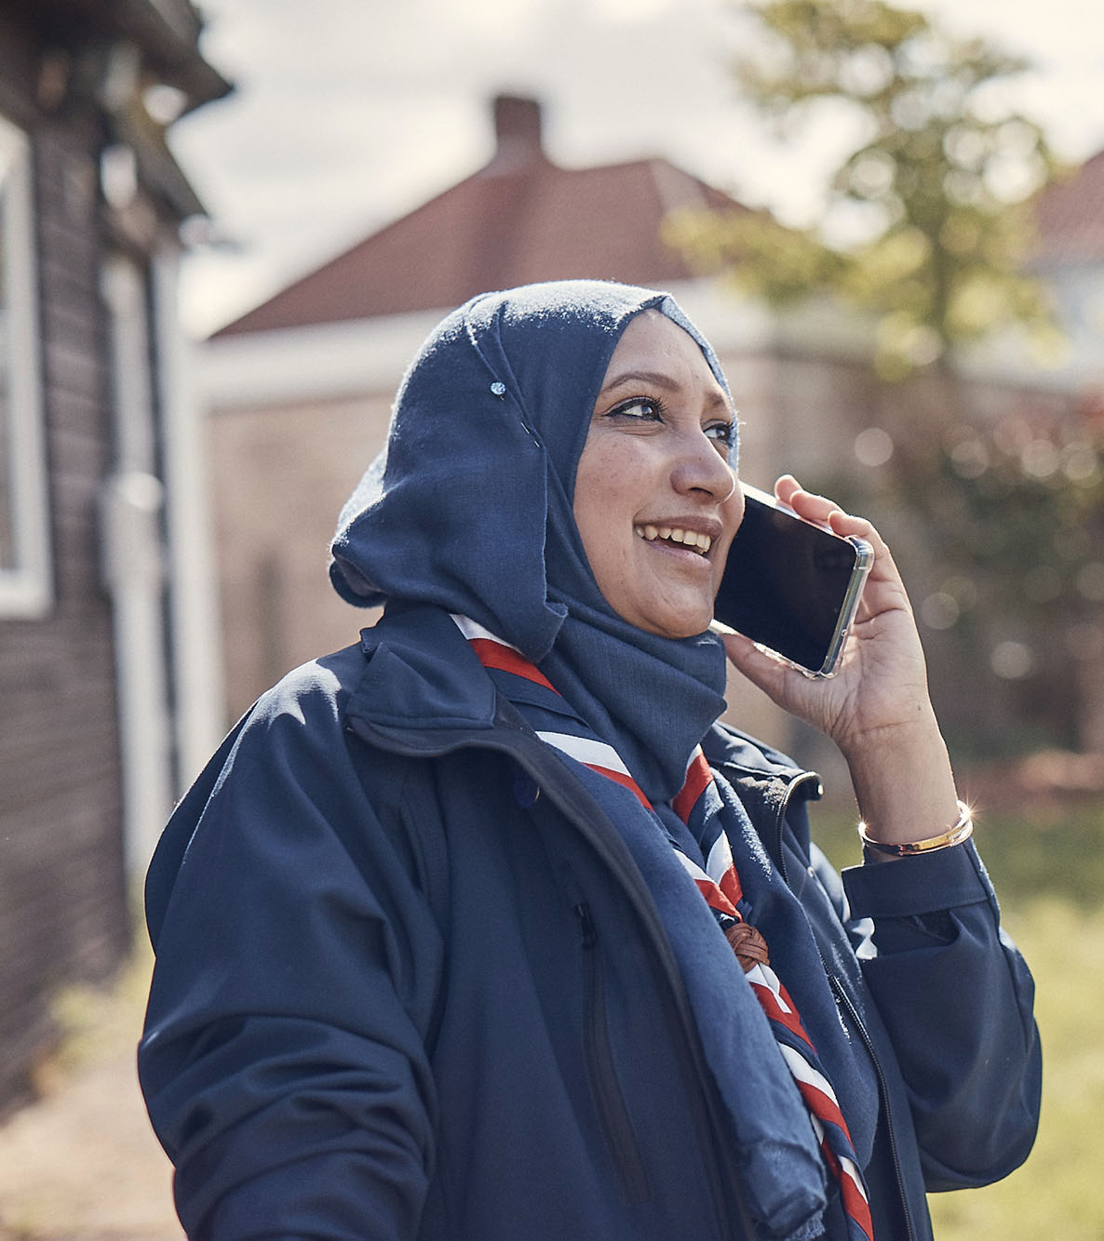
Learning Data Migration
All members will need to complete their Growing Roots learning
Members who have validated all their ‘Getting Started’ modules will be automatically signed off as having completed ‘Growing Roots’
Members who have validated some of their ‘Getting Started’ modules will be required to complete any outstanding learning through the new system
Ensure all completed training is validated by 1st February 2024. All unvalidated training will not be migrated.

Slide 26
Learning Data Migration
‘Getting Started’ modules validated
Relevant ‘Growing Roots’ complete
Some ‘Getting Started’ modules validated
Complete some of the new ‘Growing Roots’
Relevant ‘Growing Roots’ complete

Slide 27
Learning Data Migration
Validated ‘Getting Started’ modules will sign off Growing Roots learning as per this table:
Validated ‘Getting Started’ Training | Will sign off ‘Growing Roots’ Learning
GDPR Module | Data Protection in Scouts
Safety AND Safeguarding Modules | Safe Scouting
Module 1 – Essentials of Scouting | Who we are & What we do
Module 4 – Tools for the role (Managers & Supporters) | Leading Scout Volunteers
Module 3 – Tools for the role (Section Leaders) | Delivering a Great Programme
Trustee Introduction Module | Being a Trustee in Scouts
ALL getting started modules validated | Creating Inclusion

Slide 28
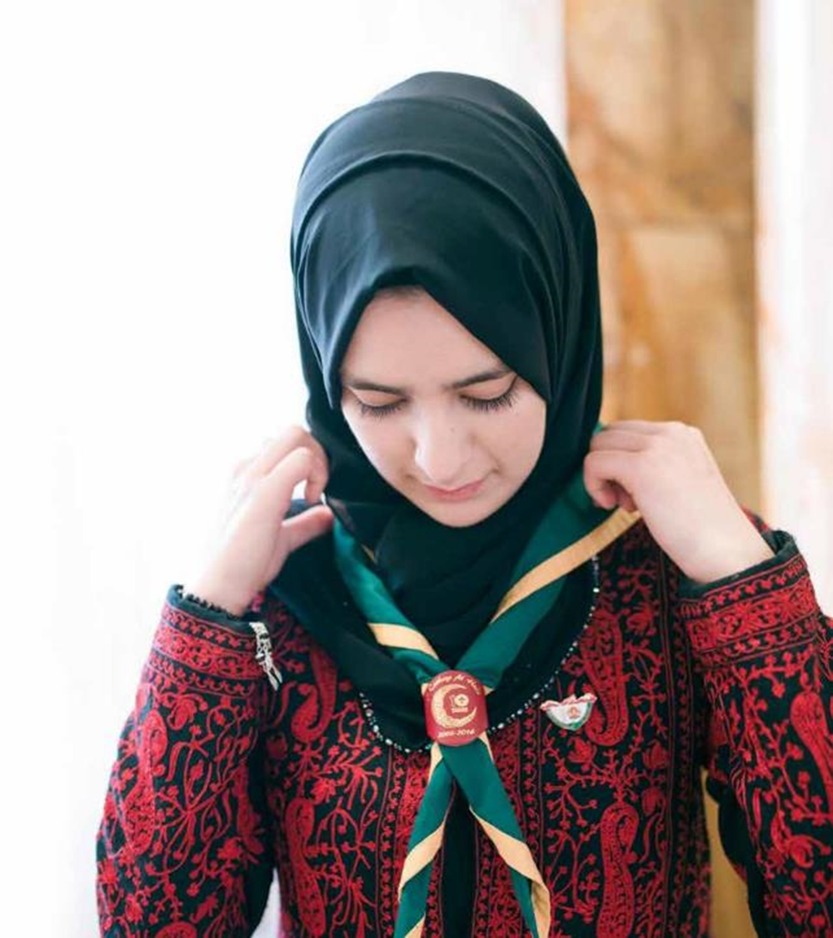
Recommended Learning
All members who have 'Growing Roots' signed off as part of the transition are recommended to complete the following new learning, though this is not compulsory
Creating Inclusion
Any role/team specific learning(once available)

Slide 29
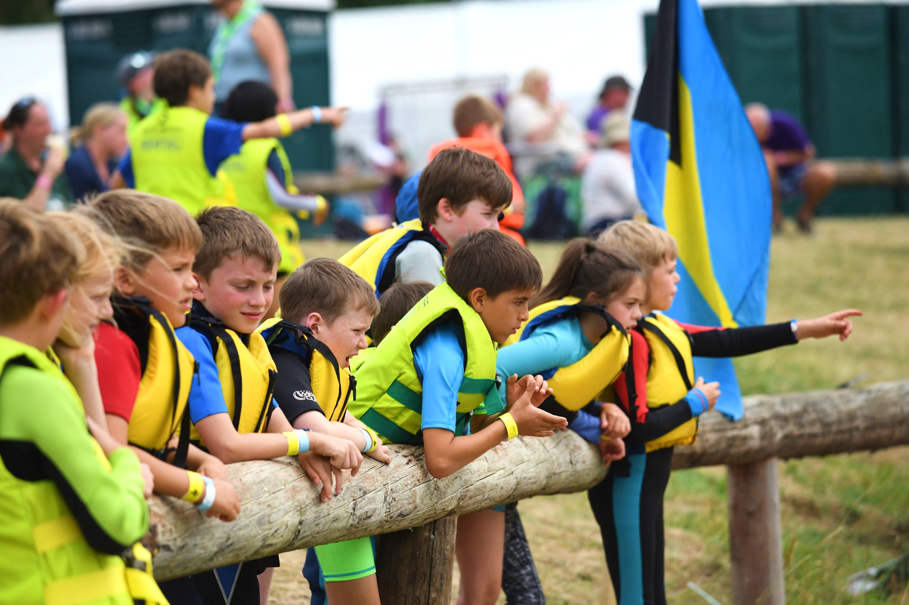
First Aid - Principles
As part of the move to the team-based approach, a review of who requires First Aid was undertaken and the following principles agreed:
Every young person should have direct access to first aid treatment when on Scout activities
Parents and carers should be confident that every adult leader, who is regularly and directly involved with their child’s Scouting, has completed, or is working towards completing, first aid training
No young person should ever miss out on a Scouts activity due to a lack of qualified adult first aid cover
Having a body of first aid trained volunteers has a positive impact on our communities

Slide 30
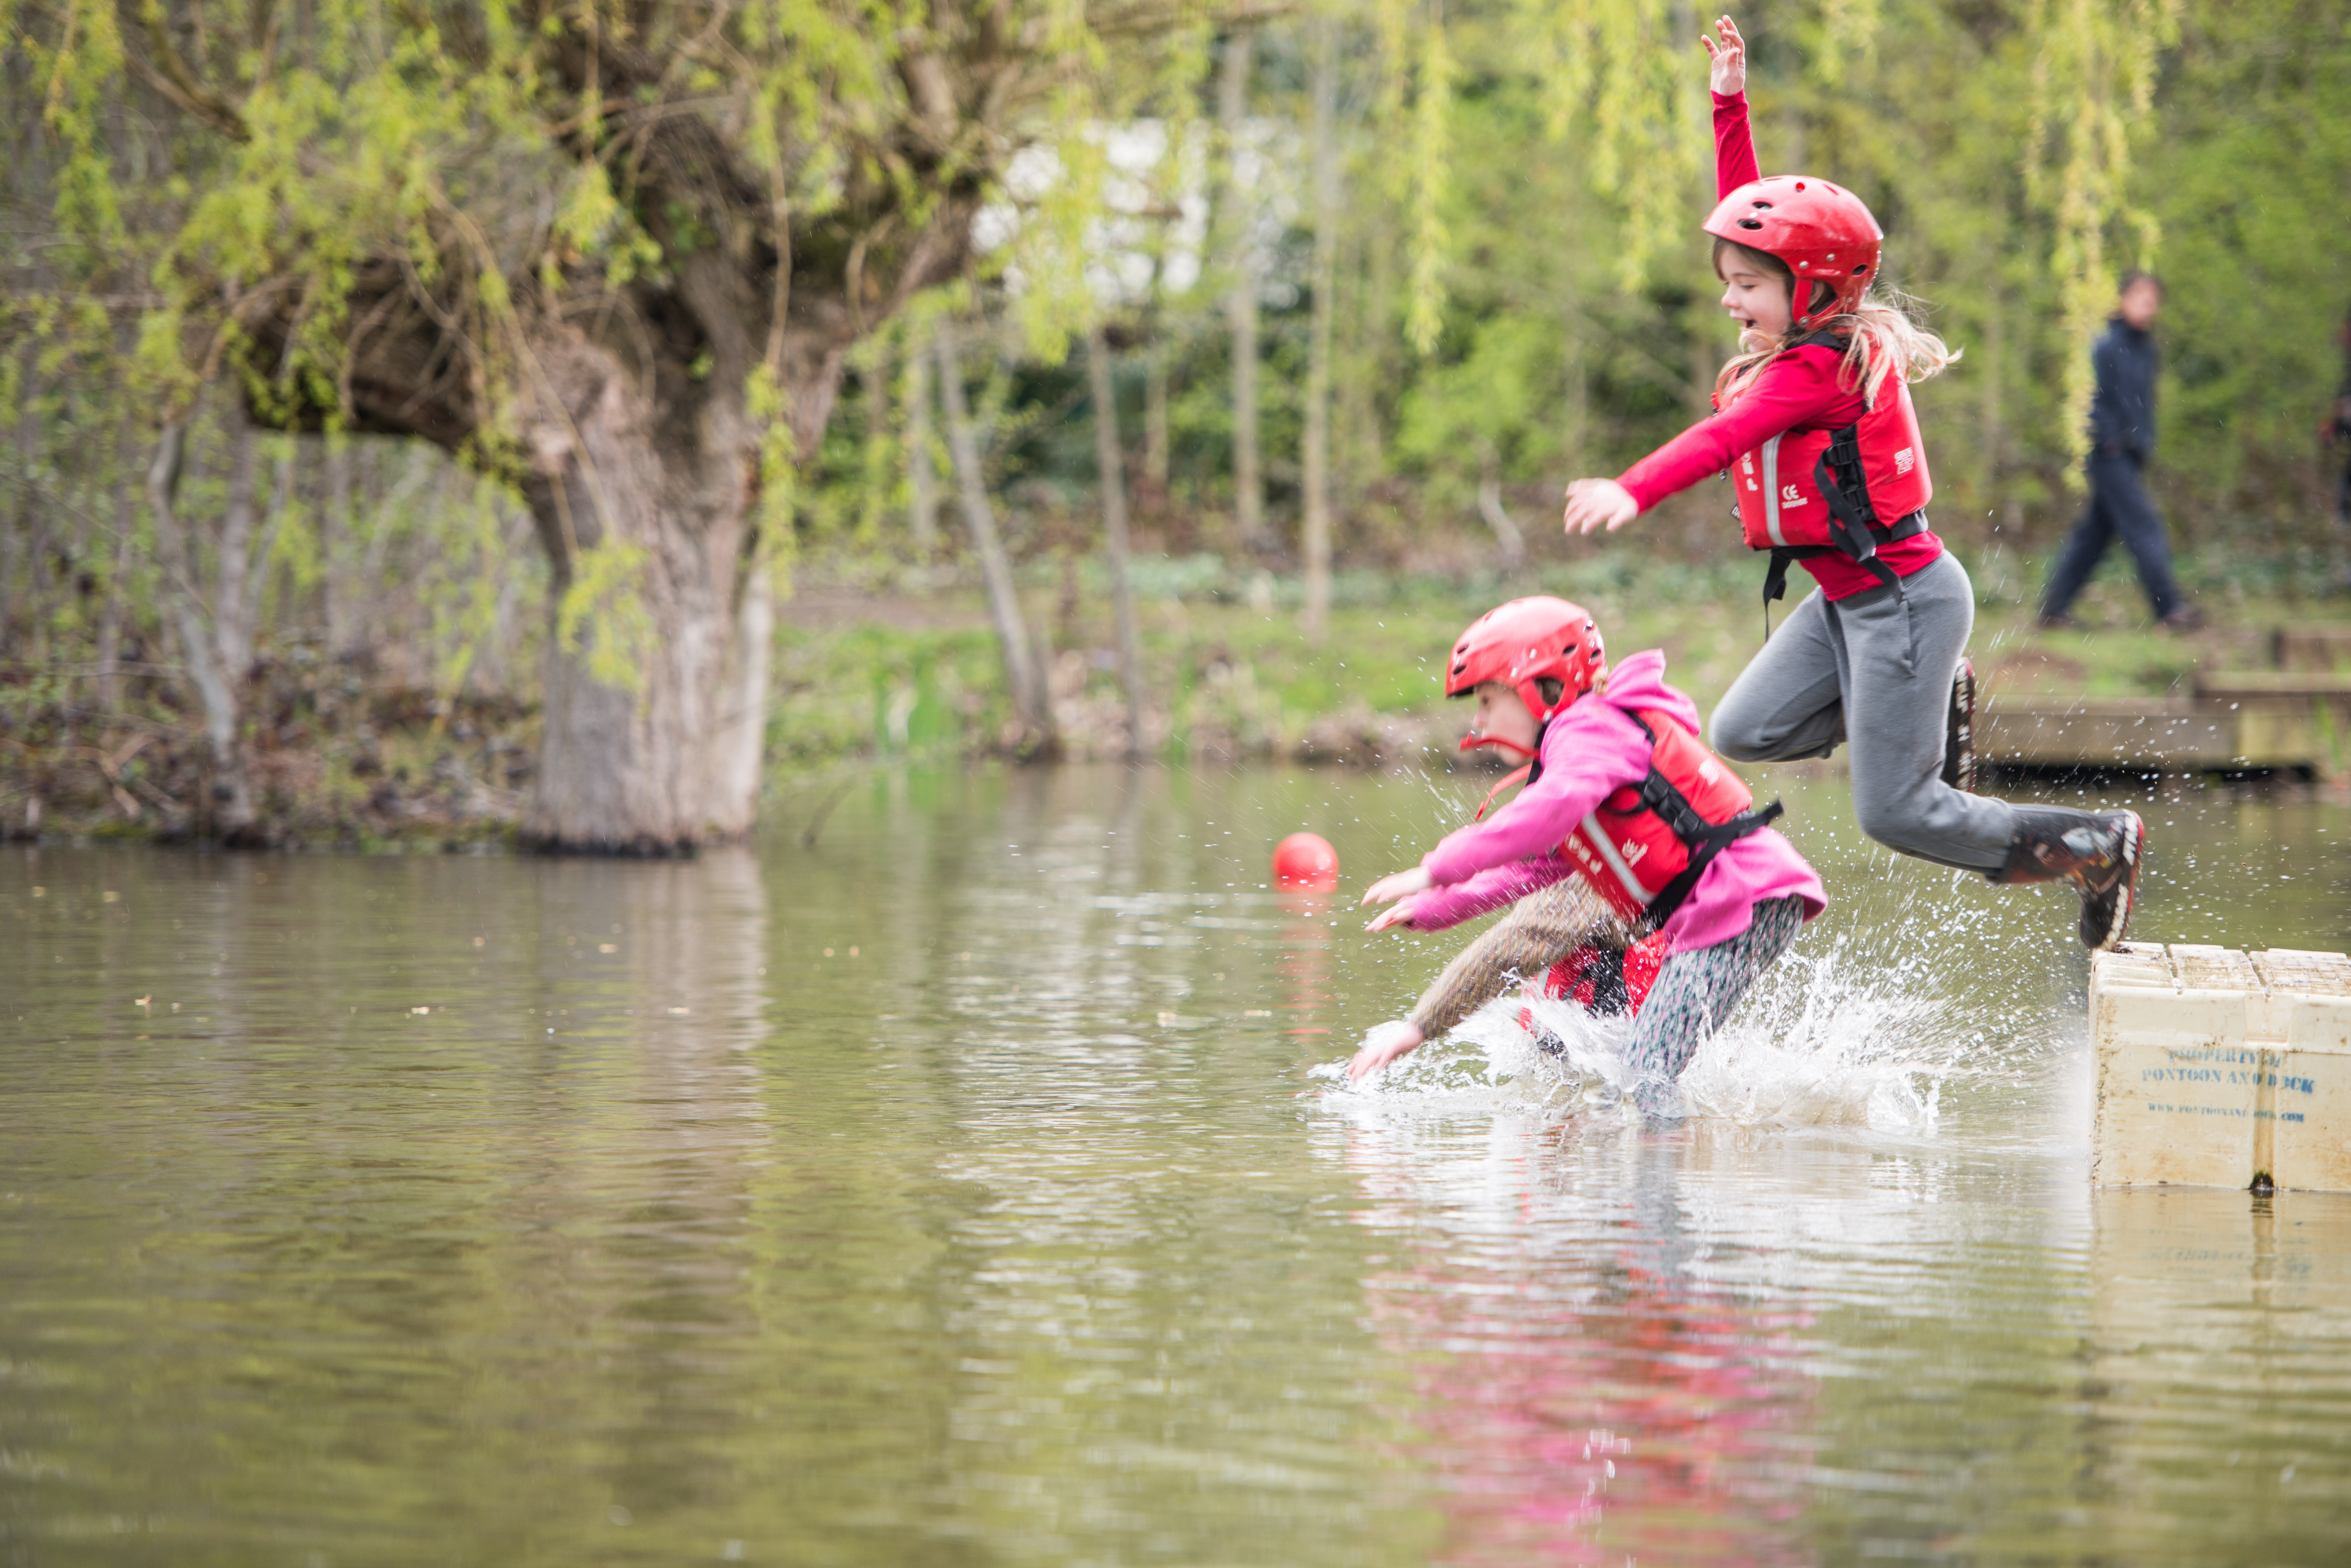
First Aid
This is the current proposal for First Aid
in the final stages of approval
First Aid is required for roles which:
Work directly with young people on a regular basis; or
Might reasonably be required to step in and work directly with young people
This includes the following roles:
All Section Team Leaders & Members (Squirrels, Beavers, Cubs, Scouts, Explorers)
Group Lead Volunteers
14-24 Team Leaders
This also means several leadership roles will no longer be required to have first aid

Slide 31
Timeframes
Any volunteers who transition into a role/team requiring first aid will have at least 2 years from transition to complete this (Exact timing TBC)
Any volunteers joining a team that requires first aid after the transition will have 1 year to complete this
More details on the transition timings for first aid will be shared after approval

Slide 32
First Response delivery models
Face to Face
Theory and Practical Demo
1 x 6-hour F2F session
OR
3 x 2-hour F2F sessions
Online
Theory
Practical Demo
3 x 2-hour online
trainer-led sessions
1 x 20-minute practical F2F
Blended
Theory
Practical Demo
1 x 2.5-hour
E-Learning
THEN
1 x 3-hour online trainer-led session
1 x 20-minute practical F2F

Slide 33
What Growing Roots learning will be available when?
November 23
Spring 24
Who we are and What we do
Delivering a Great Programme
Being a Trustee in Scouts
Data Protection in Scouts
Interim learning:
Being a Trustee in Scouts
Leading Scout Volunteers
Leading Scout Volunteers
Creating Inclusion
Safe Scouting

Slide 34
When will you need to complete your learning? (Post-transition)
 | Within the first 6-months | Within the first 6-months & every 3 years | Within the first year & every 3 years
 | Creating Inclusion | Safe Scouting | First Aid (If applicable)
 | Data Protection in Scouts
 | Who we are and What we do
As relevant to role/team | Delivering a great programme
 | Being a Trustee in Scouts
 | Leading Scout Volunteers

Slide 35
Completing the Wood Badge from transition to 2025
Section Wood Badge
M&S Wood Badge
Safe Scouting
Data Protection in Scouting
Who we are and What we do
Creating Inclusion*
Delivering a Great Programme*
Module 8 - Skills of leadership
Module 9 - Working with adults
Module 11 - Admin
Module 13 - Growing the section
Module 16 - Residential
Module 18 - Practical Skills
Module 19 - International
Safe Scouting
Data Protection in Scouting
Who we are and What we do
Creating Inclusion*
Leading Scout Volunteers*
Module 11 - Admin
All current Manager & Supporter skills courses
*Any volunteers who have been signed off during transition as having completed Growing Roots will be required to complete this new learning

Slide 36
Modules to continue delivering locally
Module 8 - Skills of leadership
Module 9 - Working with adults
Module 11 - Admin
Module 13 - Growing the section
Module 16 - Residential
Module 18 - Practical Skills
Module 19 - International
Module 25 - Assessing Learning
Module 27 - Instructing Practical Skills
Module 28 - Facilitating
Module 29 - Presenting
Module 36 - Adjustments to Scouts
Module 38 - Skills for Residential Experience
Module 39 - Mentoring and Coaching
Manager & Supporter Skills Courses
First Aid training
As new learning content is produced during 2024 and 2025 these modules will be retired

Slide 37
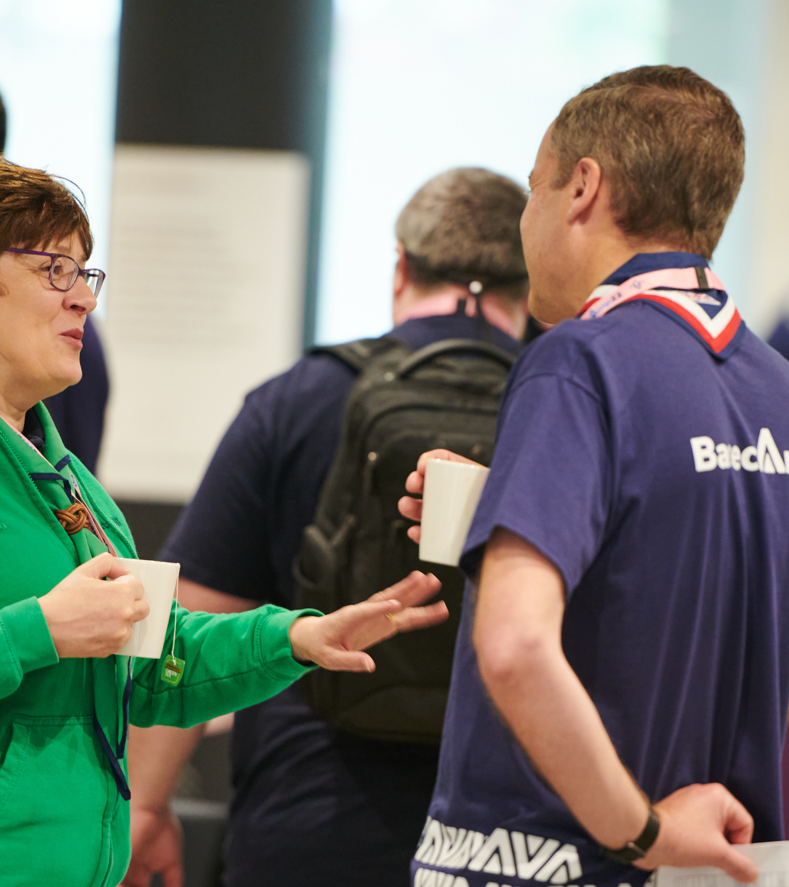
Steps to take now
Work with your current training team or Volunteering Development Team to review the capacity planning for First Aid / First Response courses
Ensure that relevant roles (specifically Section Assistants) are informed of the upcoming changes to who requires First Aid and work with them on the most convenient way to achieve the first aid requirements over the next two years

Slide 38
Steps to take now
Ensure all members have validated their ‘Getting Started’ training modules no later than 1st February 2024. Current training managers have access to the reports for this
Ensure that District Volunteering Development Teams can deliver and validate the remaining training modules after the new systems go-live
Support all volunteers to complete their Wood Badges by 1st February. This is particularly important for those who want to complete and record their Wood Badge against their current role
Please ensure all completed training is validated by 1st February 2024. All unvalidated training will not be migrated

Slide 39
Open Forum

Slide 40
Enable
Teamwork
Plan
Strategy
Success
Improve
Change Support
Engage

Slide 41
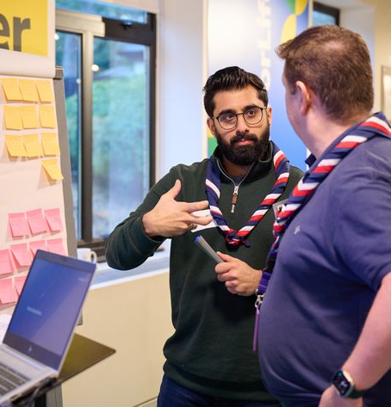
Change Support
Check that your Transformation Lead or CC role is in your top 5 roles showing on Compass - otherwise our mailing system might not pick up your email and you may be missed from the distribution list
Those who responded as having an amber RAG rating in last months' poll - please complete the survey by 28th July, this is important to help us provide further support
If you need any support; more information, answers to questions, help understanding parts of the changes or how to overcome a local barrier, please get in touch
transformation.leads@scouts.org.uk

Slide 42
Early Adopter Update
NOV 23

Slide 43
Early Adopter Update
Early Adopter Transformation Leads shared local updates on:
Successful implementation of Trustee Boards
Mapping team structures made easier by focusing on recruiting to tasks
Using a one-page document with all the relevant links in one place to make communications easier
Started to request feedback on how to implement Trustee Board membership changes
Provided development draft of October POR for feedback and to support their planning

Slide 44
Aims for September

Slide 45
Aims for September
Understood –
Your volunteers are aware of Our Volunteering Culture and the new team structures
Your volunteers understand Our Volunteering Culture; they understand how to set up the new District and County team structures, what tasks each team does, and the team responsibilities of Sections and Groups
Your Executive Committee members understand the purpose and tasks of Trustee Boards
Planned -
Your volunteers have planned how they are going to set up their new teams and what steps to take to implement Our Volunteering Culture
Your Executive Committees have planned how they will become Trustee Boards
Now Delivering -
Your volunteers are implementing Our Volunteering Culture, setting up the new District and County team structures (or be on the way to having this structure), and are operating in a team-based volunteering way
Your Executive Committees will have become Trustee Boards (or are on the way to), and are operating in this way
What you’ll need to do

Slide 46
August - September
July
POR - This will be the final version of POR for Counties to use prior to their transition and will apply in every County until their transition to the new digital solutions in February
August & September
Webpages providing more detail on accreditations and how to use them will be shared
More webpages around learning and welcome will be shared
What you’ll need to do
Use additional learning and welcome information to support building your teams
Continue cleaning up Compass data
Continue introducing Our Volunteering Culture
Continue introducing use of teams in Groups, Districts, Counties
Continue introducing the Trustee Board changes via Group/Districts/County AGMs
Continue to introduce the Digital Skills Tool in your area and increase usage

Slide 47
Thank You

