Slide 1
Transformation Lead Call

Slide 2
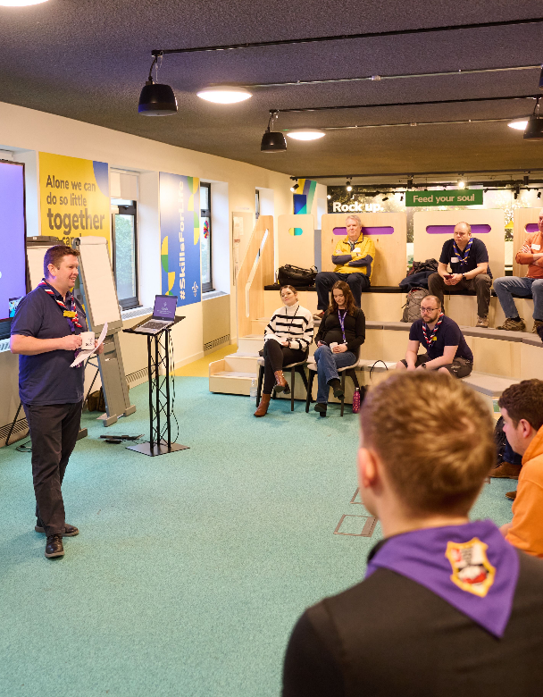
Who's on the call?
Craig Turpie, Deputy UK Chief Volunteer
Jack Caine, UK Lead Volunteer for People
Andrew Sutherland, Deputy Programme Sponsor
Katie Miller, Head of Volunteering Experience
Paul Fix, Project Sponsor - Volunteer Journey
Hamish Stout, UK People Team Member
Rob Groves, Elizabeth Stormfield, James Booker, Change Team
Adam Ray, Lauren Golding, Communications Team

Slide 3
What we’ll cover
Where are we now?
What to do now
Open Forum
West Yorkshire Showcase
Next steps & close

Slide 4
Where are we now?

Slide 5
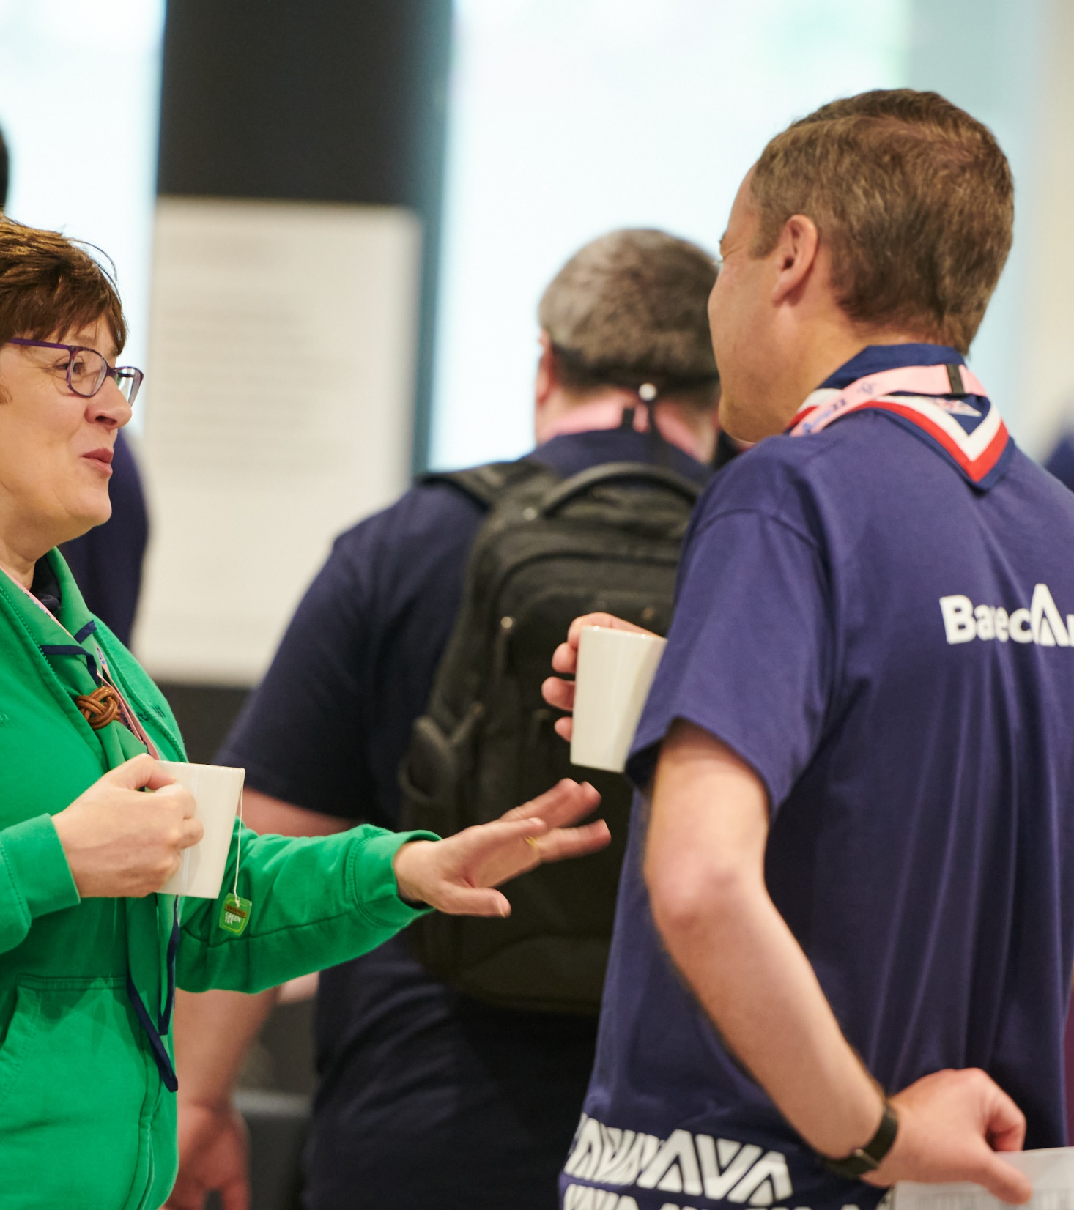
What we’ve been doing
Using feedback from yourselves along with HQ volunteers and staff and other stakeholders to explore options
Aligning practical actions that can be taken locally with wider implications of making changes including;
Safety, Safeguarding and data recording
Considering wider risks and external requirements
Impact on business-as-usual processes
Scoping next steps for delivering areas of change pre-digital
Agreeing this work through our governance structures, agreeing what is or isn't feasible and where we need to understand more

Slide 6
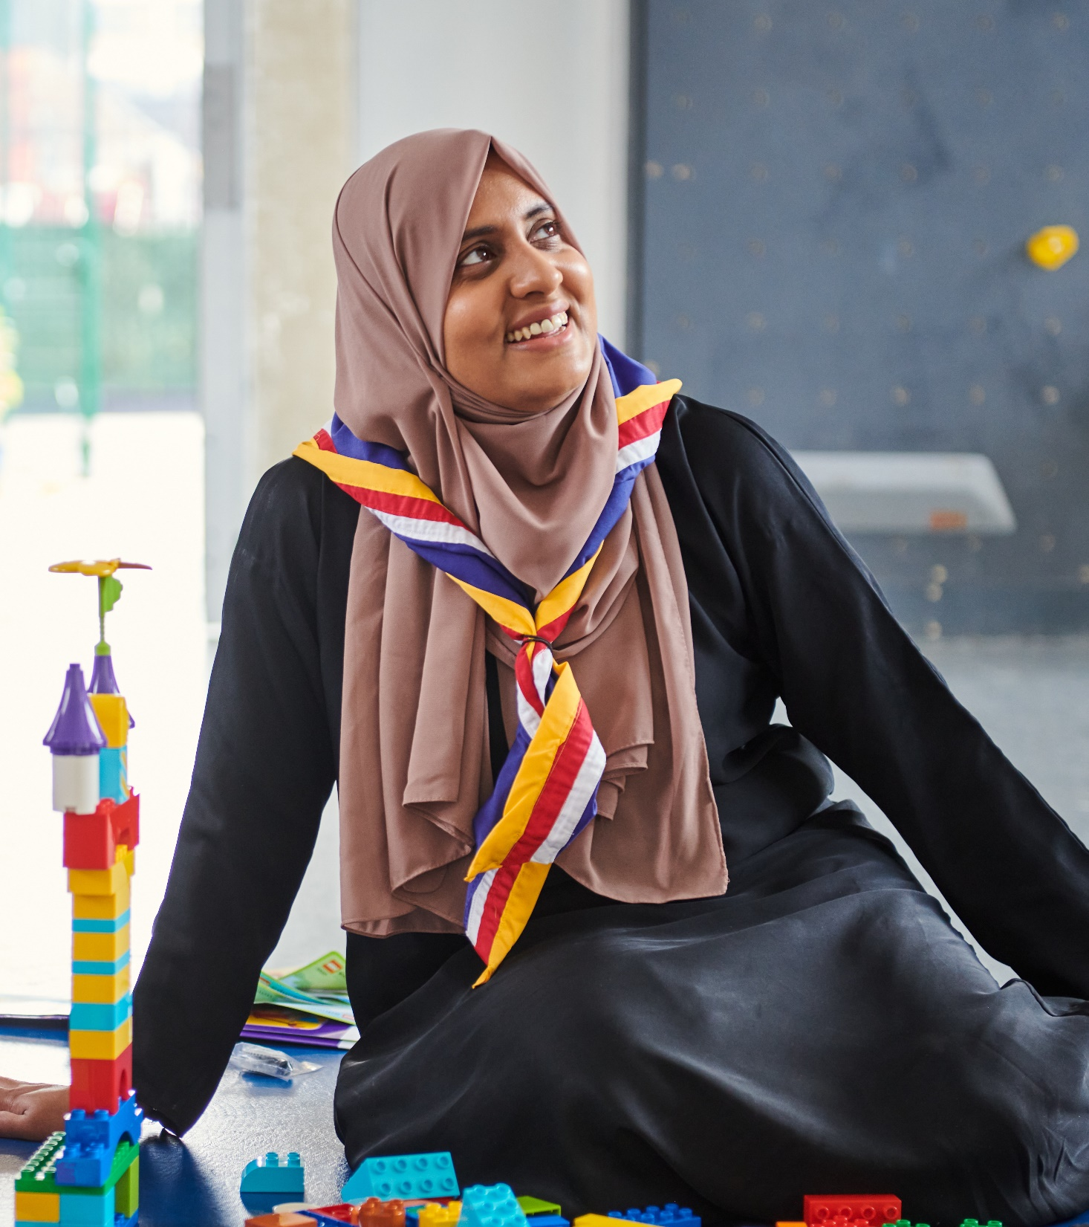
Changes that will launch before the digital system (Spring 2024)
Our Volunteering Culture
This is already live, but increased engagement with and use of Our Volunteering Culture as a tool to enable local discussion and changes to how we volunteer together at Scouts
We’ll be incorporating and highlighting this throughout our upcoming work

Slide 7
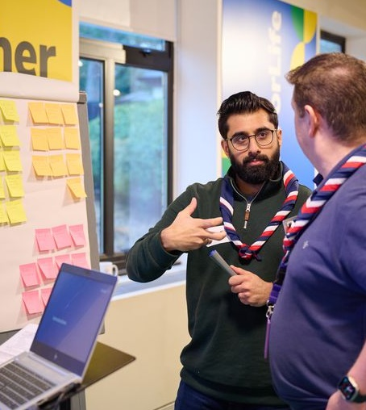
Changes that will launch before the digital system (Spring 2024)
Trustee Board changes
Membership changes to Trustee Boards will be adopted at the first Group/District/County AGM held after 1 April 2024.
Next POR edition will be shared in mid-March, will go 'live' from 1 April and will include the Trustee Board membership changes.
New support and tools to help Trustee Boards make these changes and support good local governance.

Slide 8
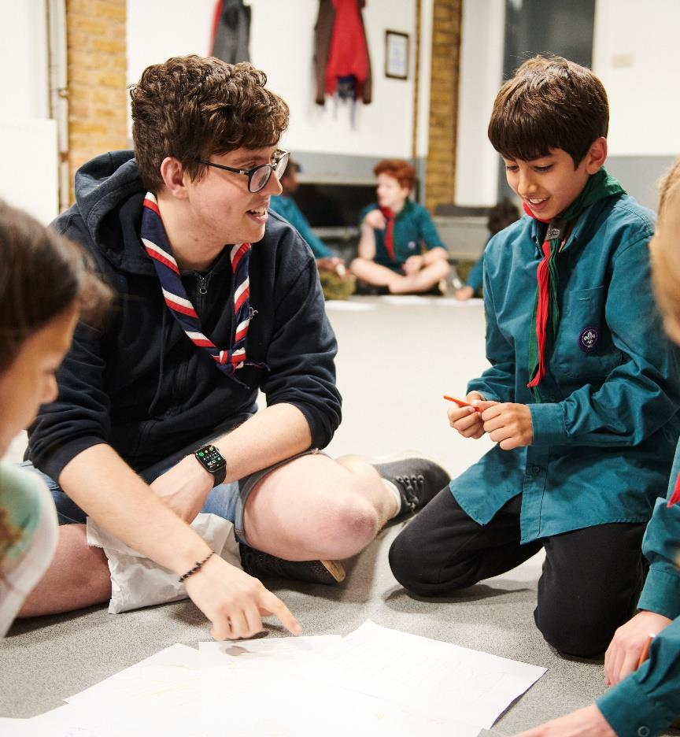
Changes that we are still working through
Formally moving to new teams and role titles - everyone operating in new teams and roles, supported by updated POR, aligning current processes under new teams, understood locally
Welcome Conversation - Implementing the new welcome conversation framework within our current rules and appointments process
Wood Badge – looking at whether we make the wood badge non-mandatory before the go live of new learning & systems

Slide 9
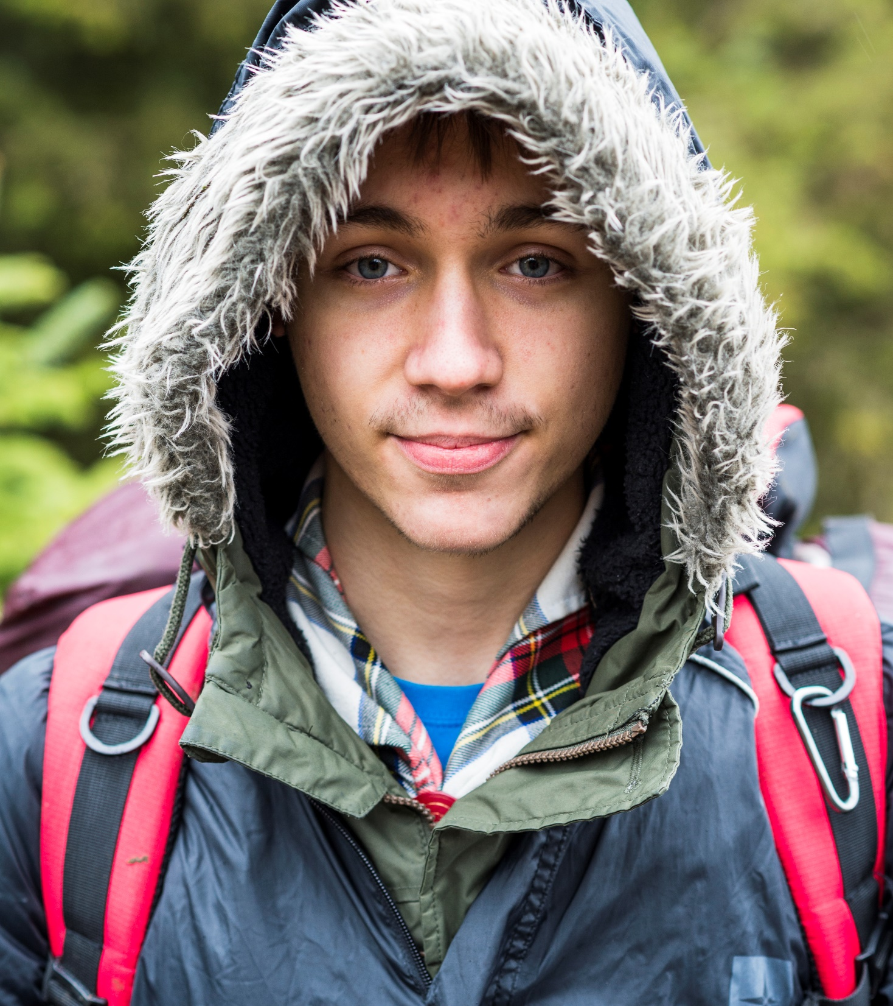
Changes that will launch with the digital system
Accreditations - Specific permissions to carry out tasks in the new digital system
Move to a learning culture - Tied to new course content and digital system
Growing Roots Learning - Tied to new course content and digital system
New Volunteer Joining Journey - Digital administration of the journey is tied to the digital system

Slide 10
What to do now

Slide 11
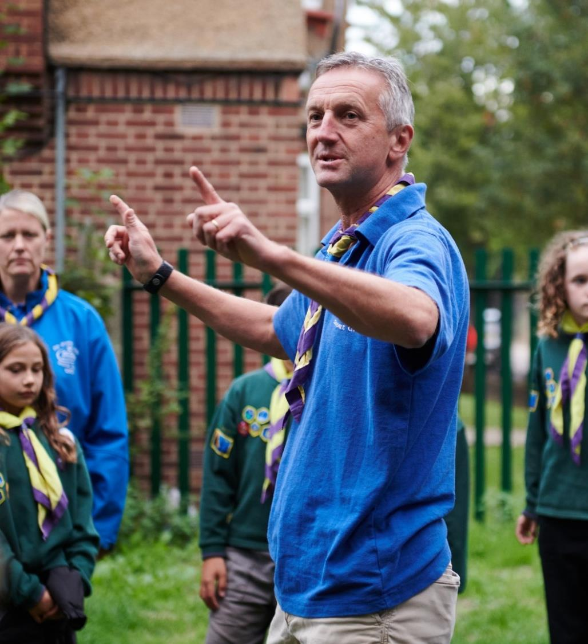
Build your teams
Having your teams at County, District and Group level built and informally in place
Draft the structure of the teams
Work out who could be part of the teams
Have conversations with existing volunteers
Start informally using new teams & titles
Agree who will be responsible for tasks
Work through the Our Volunteering Culture activities
Groups can fully move across

Slide 12
Embed Our Volunteering Culture
Each team at County, District & Group level should work through the Our Volunteering Culture activities
Each team should agree what they want to improve on over the next 6 - 12 months

Slide 13
Adopt Trustee Board membership changes
All County (and equivalent), District & Group Trustee Boards to be prepared and ready to adopt the Trustee Board membership changes at their next AGM after 1 April 2024
Steps to adopting membership changes:
Follow updated AGM agenda and script
Adopt constitution at AGM
Current Trustee Board to agree and implement local selection process
Discuss and agree with current Secretary the role they will take on from the AGM (Trustee or Administrator or both) and reflect this on Compass

Slide 14
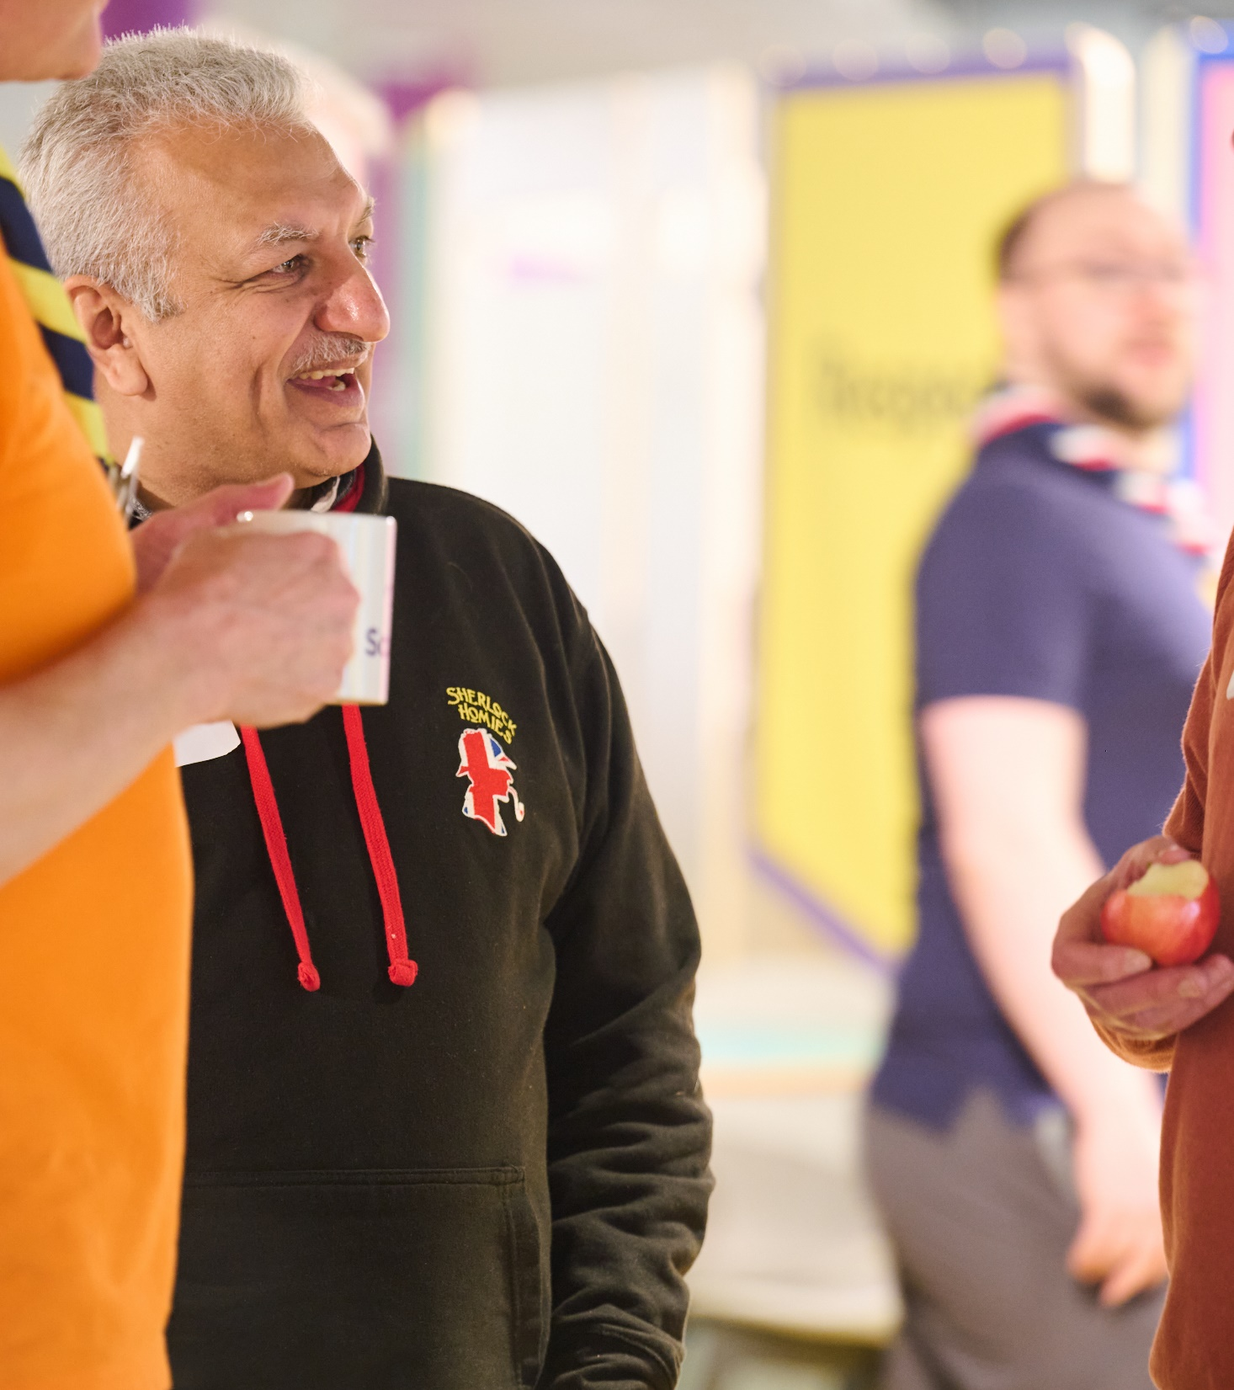
Make appointments panels more welcoming
Adopt the Appointments Meeting Conversation Guide
Meet the needs of new volunteers; use technology, agree times and places that work for new volunteers
Start identifying local Welcome Conversation Volunteers

Slide 15
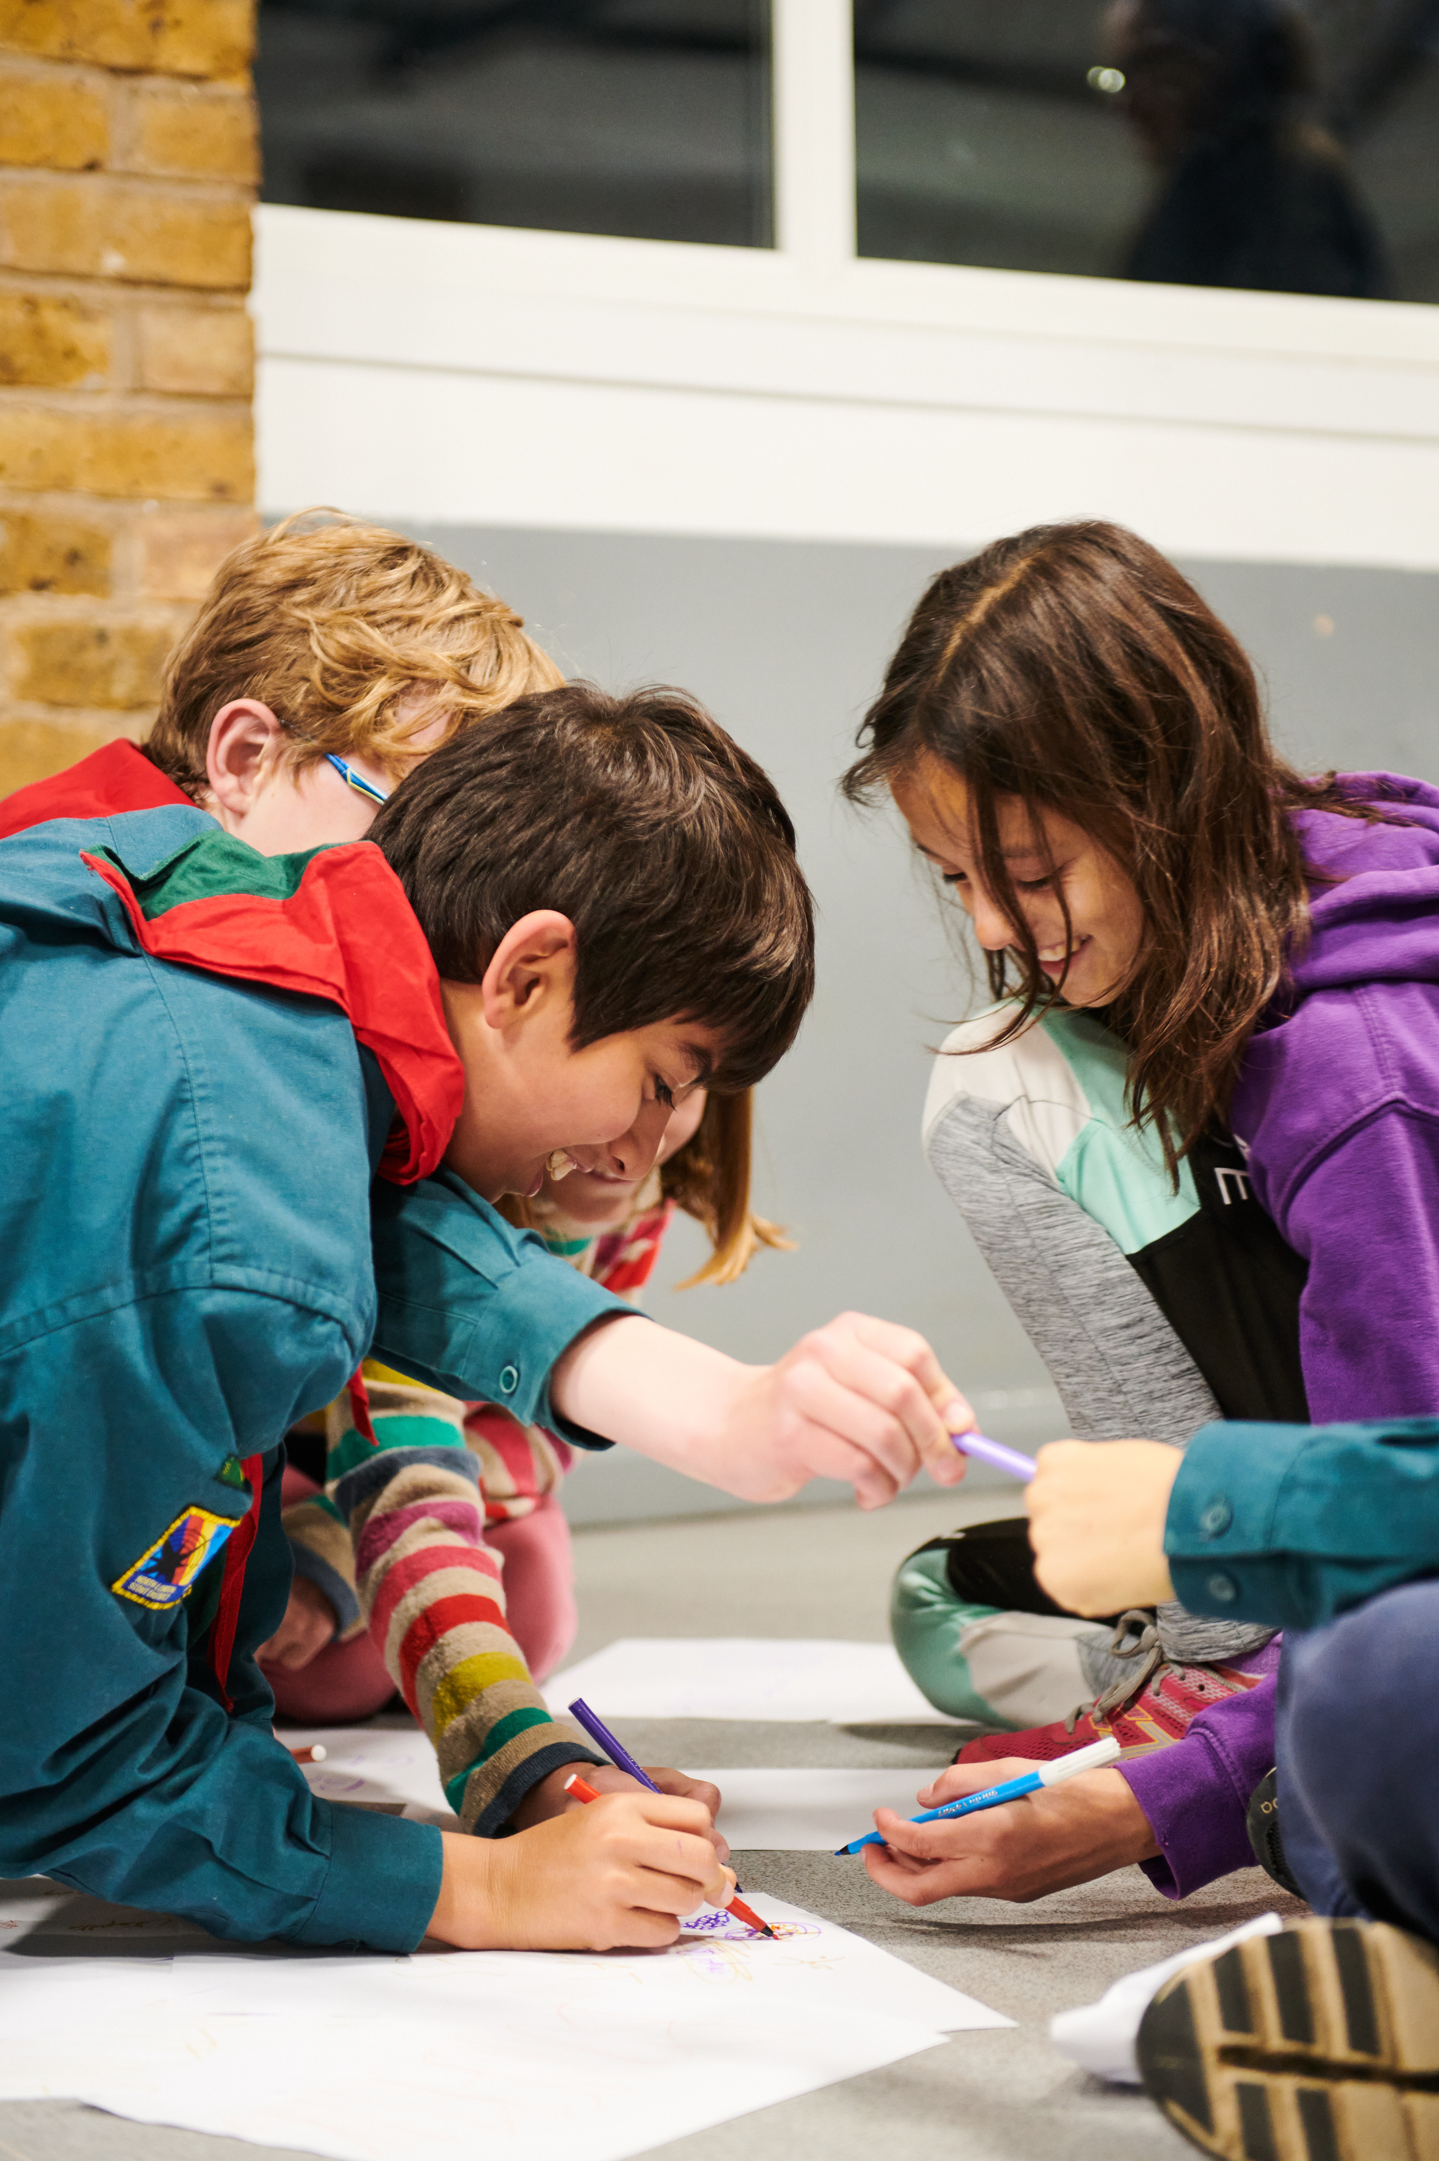
Ensure training provision
Ensure current training is planned and continuing to be delivered
Implement plans to ensure all those who will need First Aid are being trained:
Section Team Members (inc. current Section Assistants)
Section Team Leaders
Group Lead Volunteers
District Section Team Members
14-24 Team Leaders

Slide 16
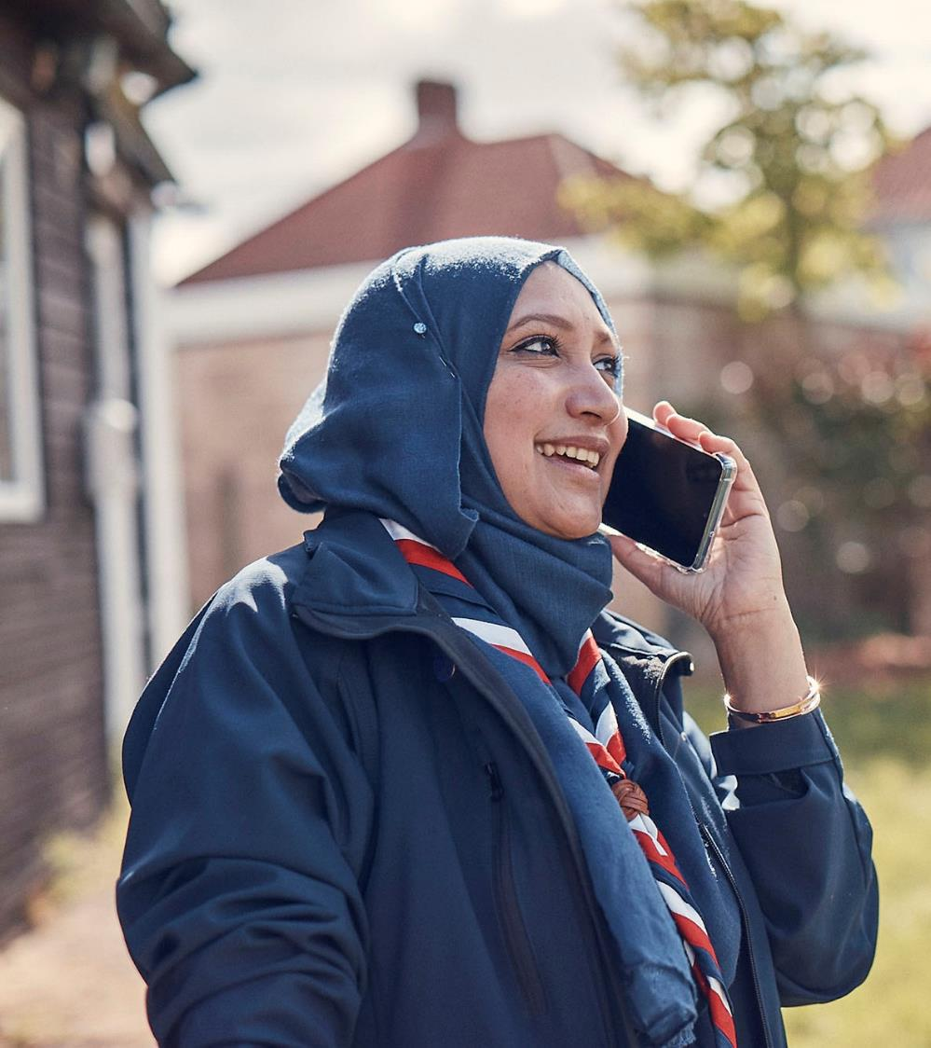
Supporting Resources
POR
Shared mid-March ready for 1 April go-live of Trustee Board changes for all
Resources
Risk Register & Yearly Planner already live
Updated AGM agenda & script shared by the end of February
4-Steps of Change webpages all live now
Updated setting up your team webpage and digital migration list shared in post-call email
Improving navigation and streamlining across Volunteer Experience webpages
And more to come

Slide 17
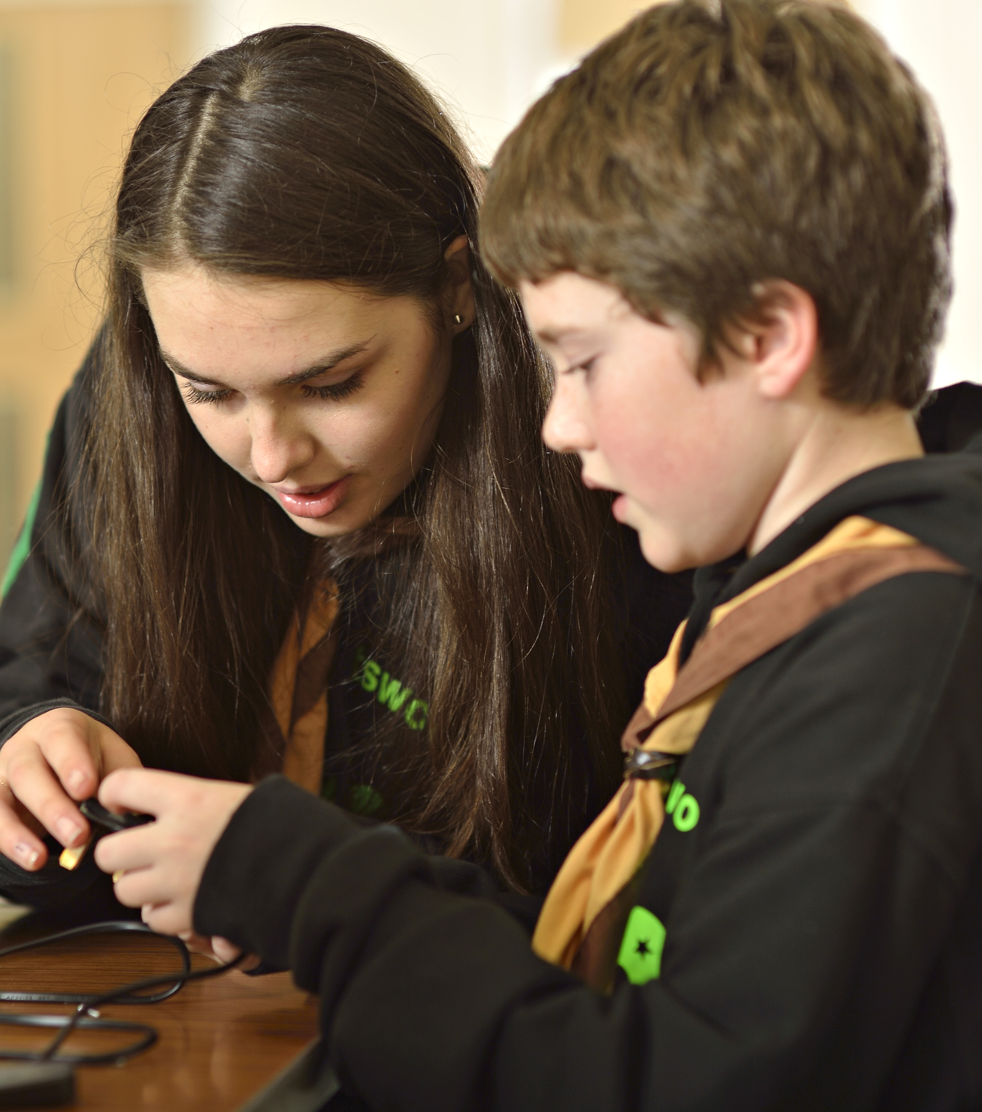
Upcoming Changes
These changes can be put into place now and not reliant on the digital system go-live
Next Transformation Lead call we will be able to share any additional changes you will be able to put into place before the digital system go-live and when these will come into effect

Slide 18
Open Forum

Slide 19
West Yorkshire Showcase
Ian Womersley - County Lead Volunteer
Gaz Pierce - County Transformation Lead
Helen Roy - District Lead Volunteer

Slide 20
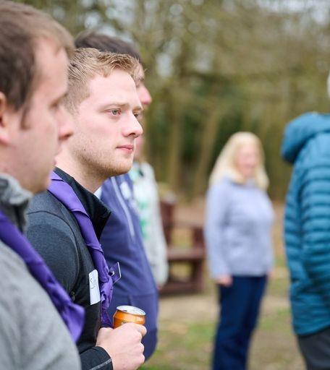
Engagement
Targeted comms
District engagement
District Commissioners
County Roadshows
Virtual meetings by topic

Slide 21
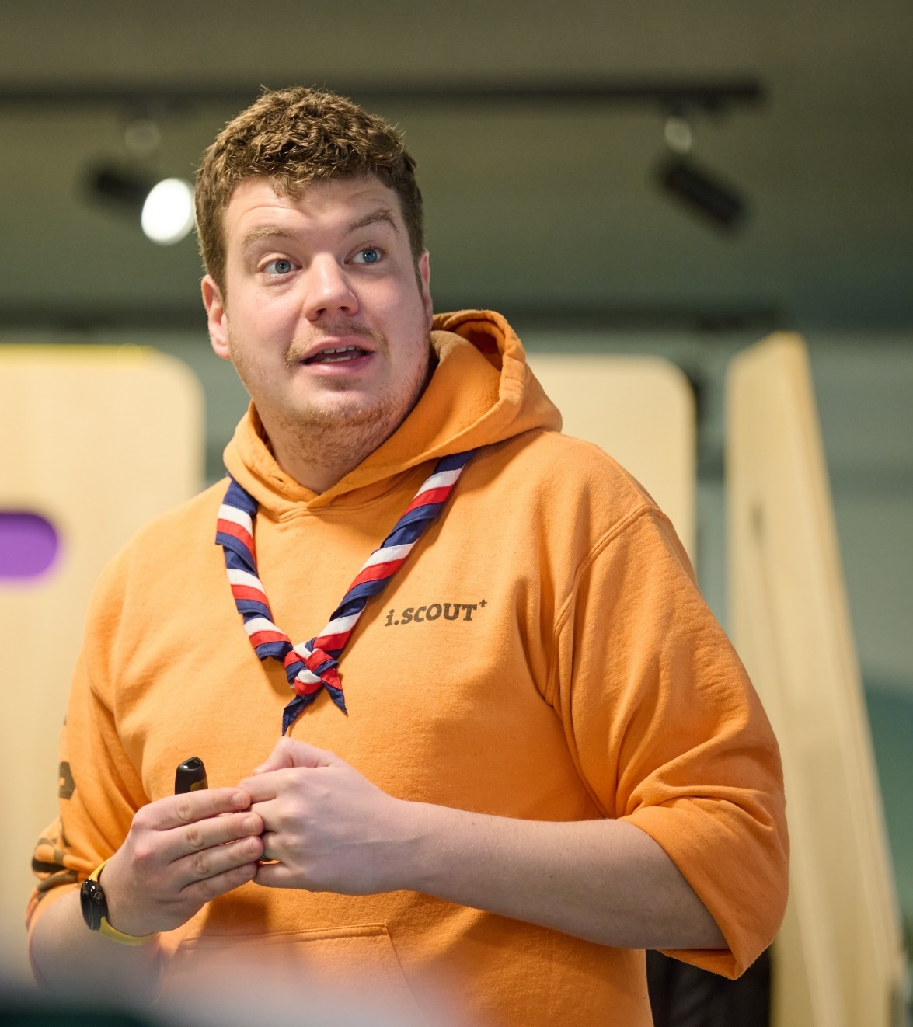
Building our County Teams
Different approaches
Bespoke support
County approach
Flexibility

Slide 22
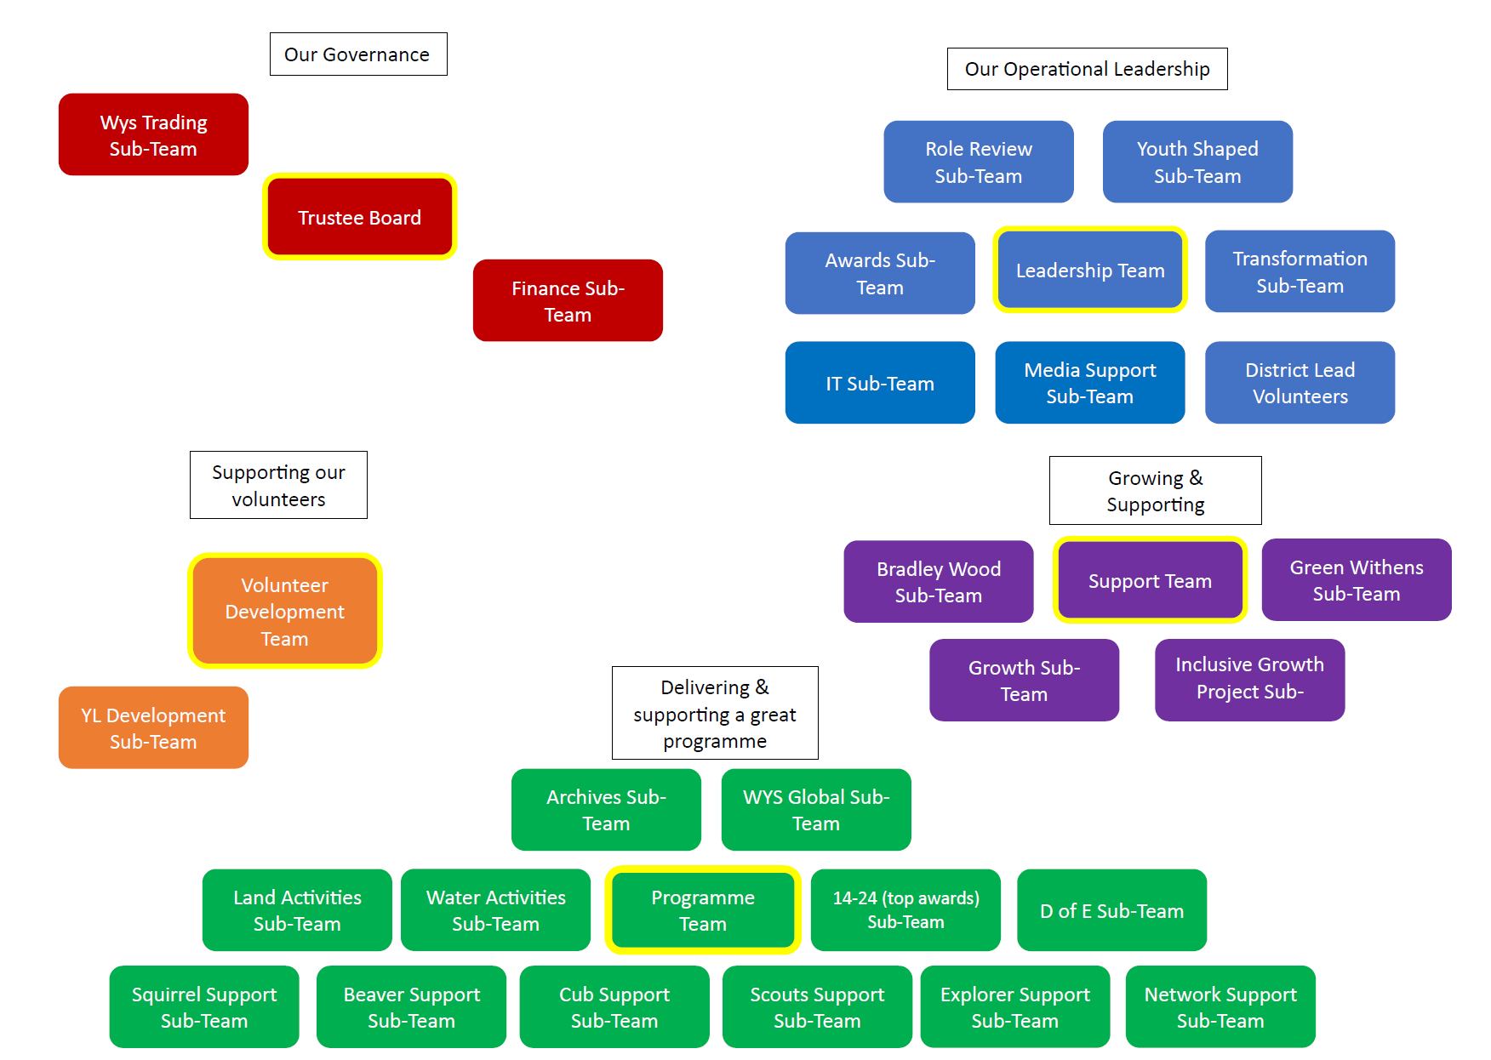
Our Structure

Slide 23
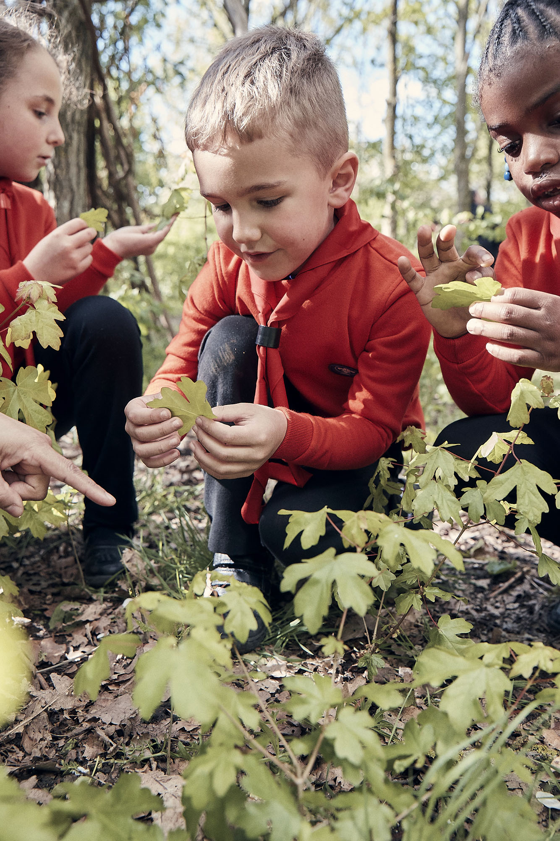
Huddersfield North -
My initial thoughts
Which things are sub-teams?
How will meetings actually work?
How do I lead the District through these changes?
Where do ADC Sections sit? It’s not just about Programme
Explorers feels isolated from the rest of the District
Is the Support team just everything left over? How will that work as a team?
Feels like lots of new roles – where are these volunteers coming from?
Where do NAN’s sit?
What am I actually doing as DC!?!

Slide 24
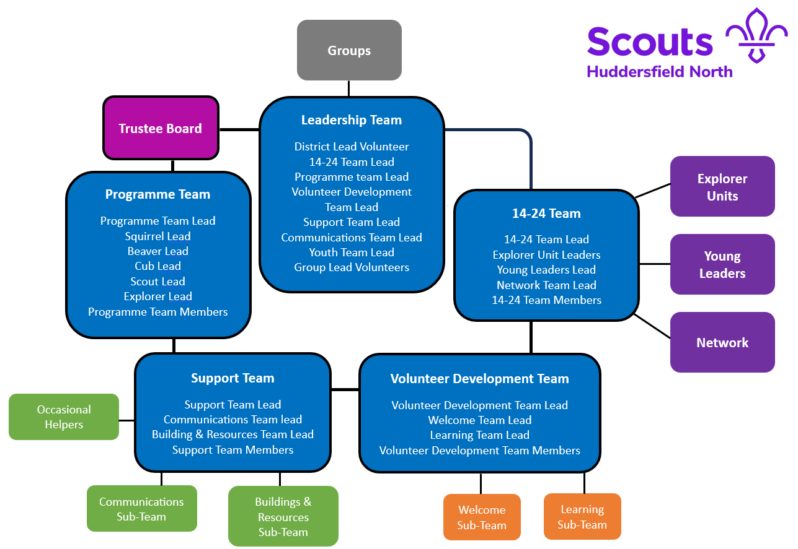
District Structure

Slide 25
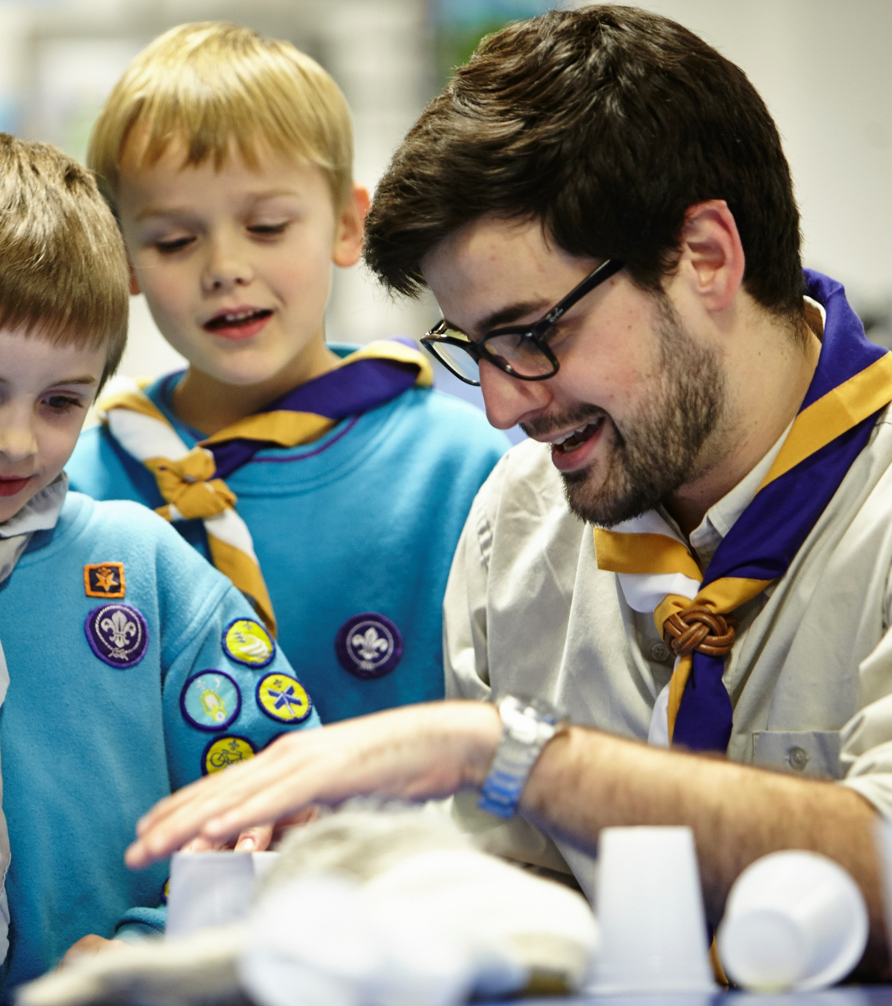
What I’ve learnt
Understanding the aims behind the changes
Making the changes that can be done
Accepting things will evolve
It works!

Slide 26
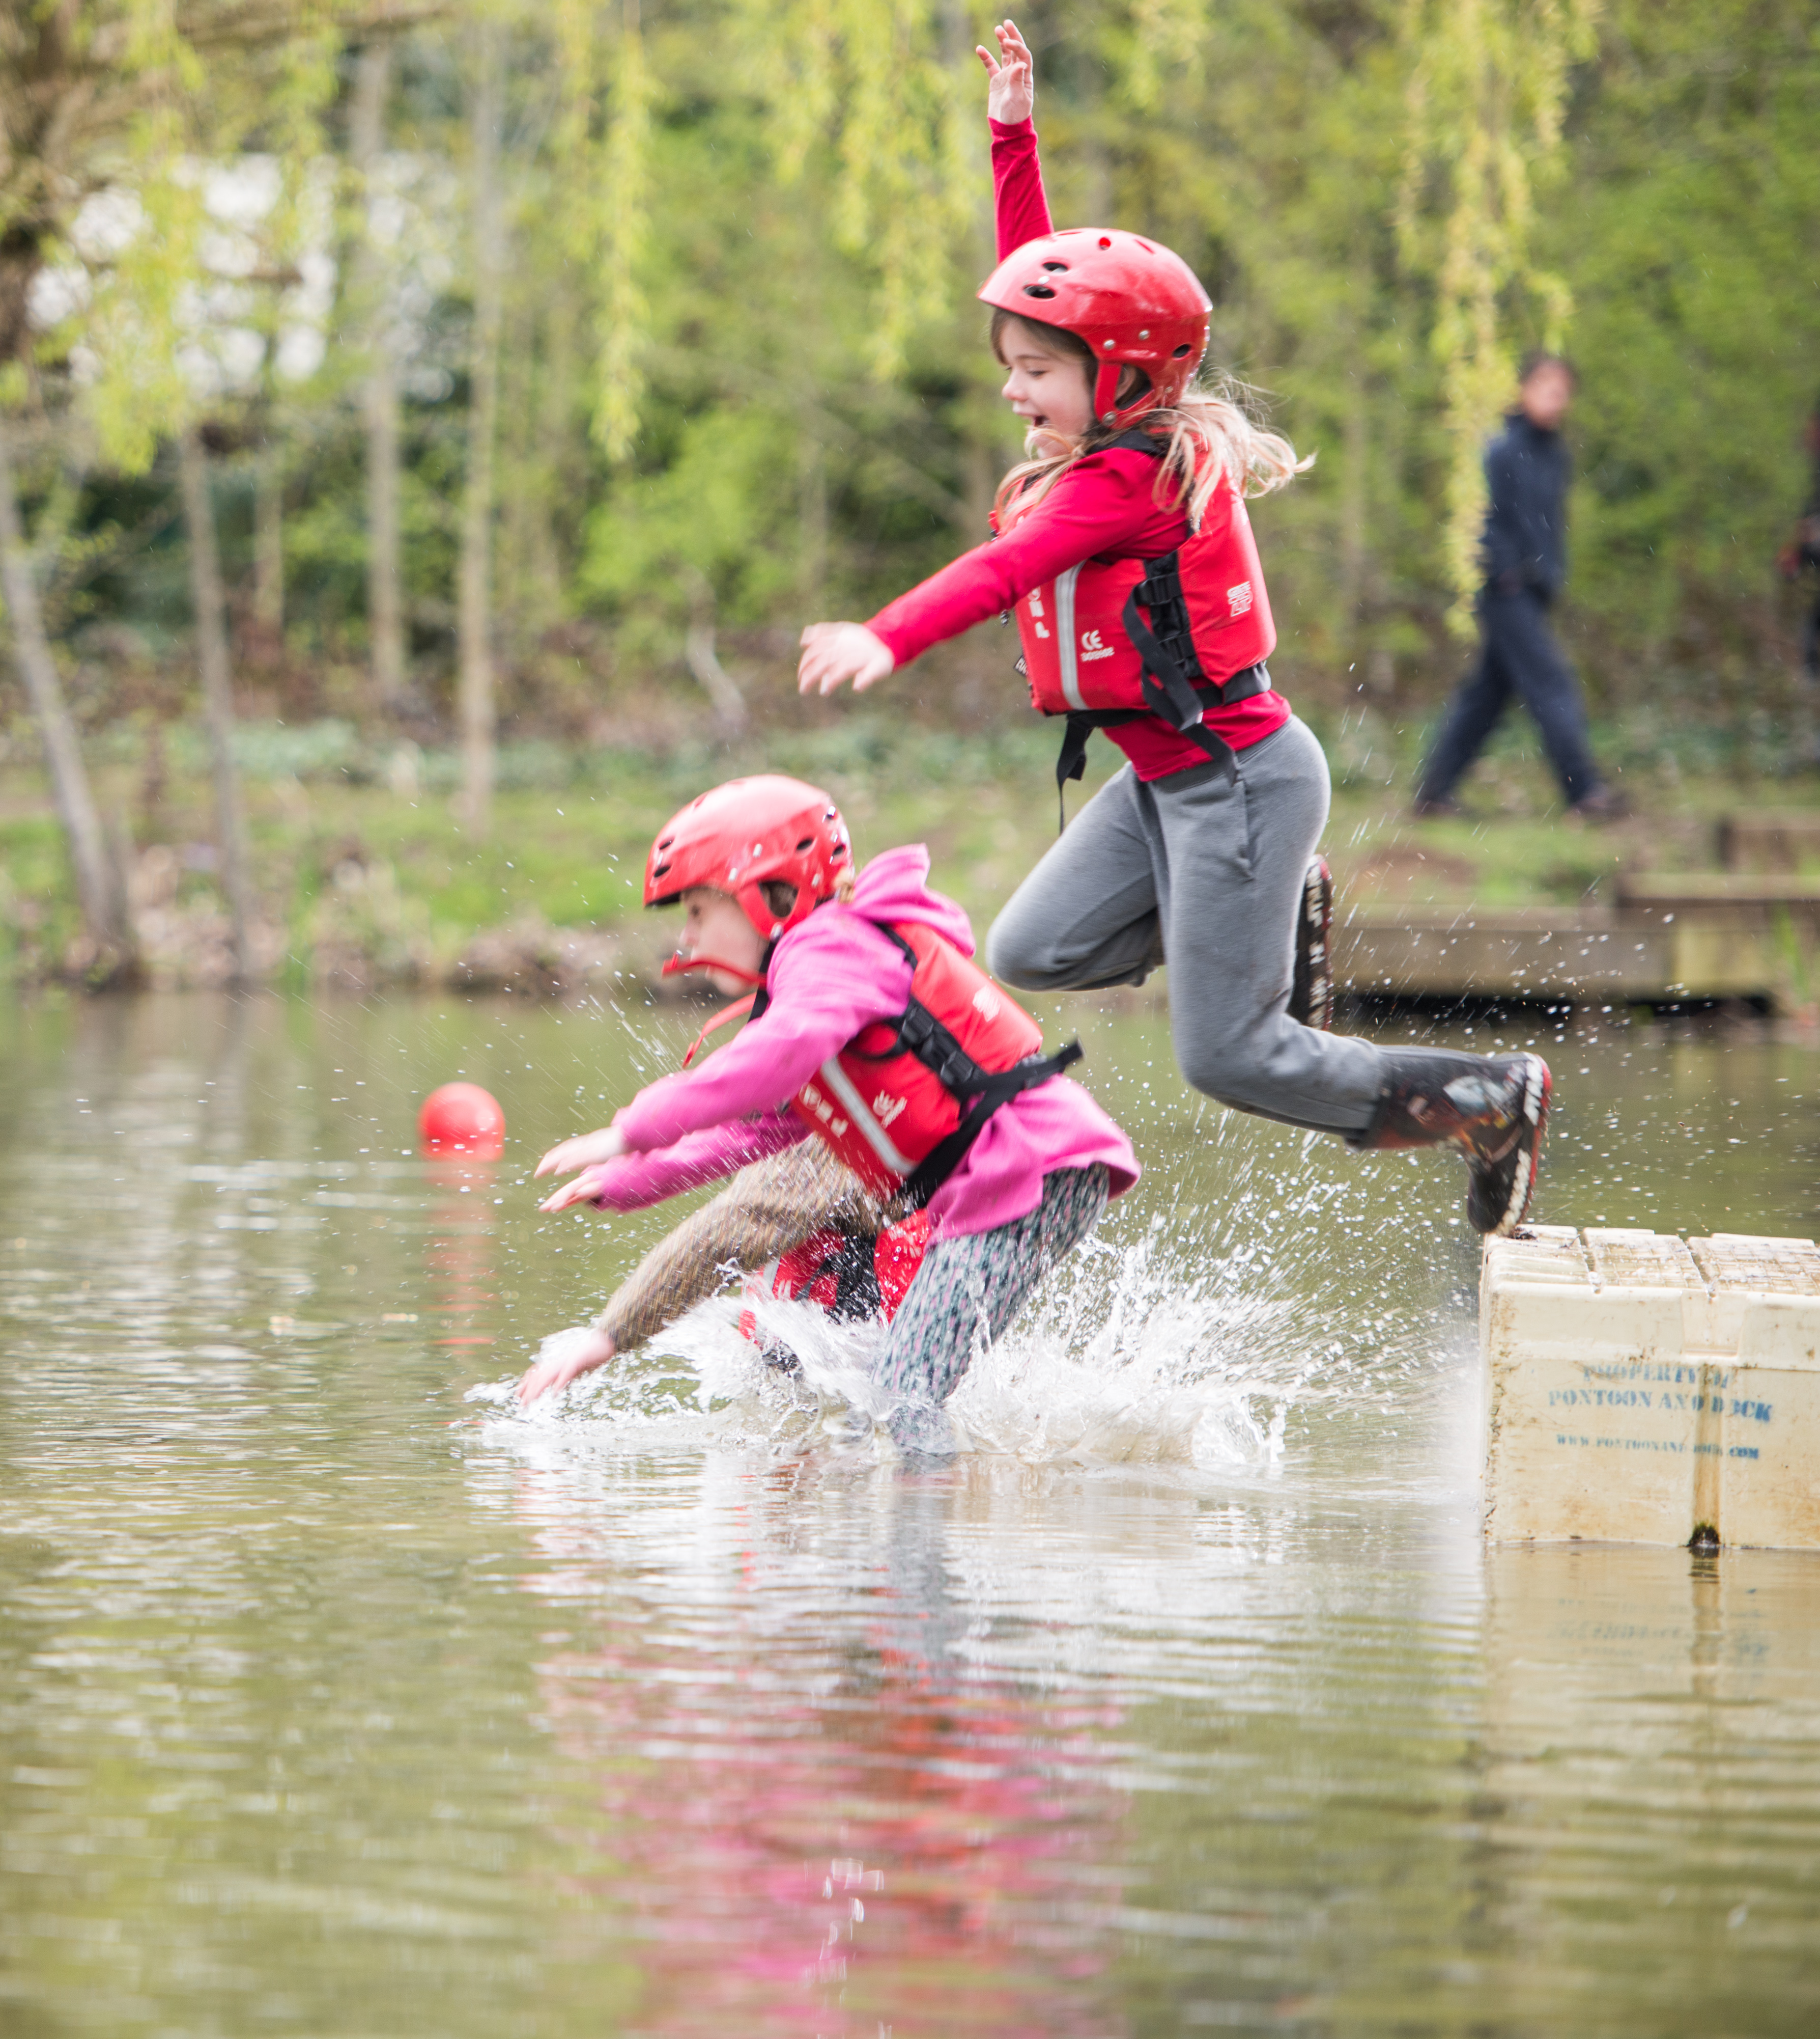
Trustee Board Changes
The focus on Trustee Boards purpose and constitution, has usefully brought several issues to the surface:
Scout and Guide Trustee Boards
Charities outside the federated structure
Sub-teams purpose and assurance

Slide 27
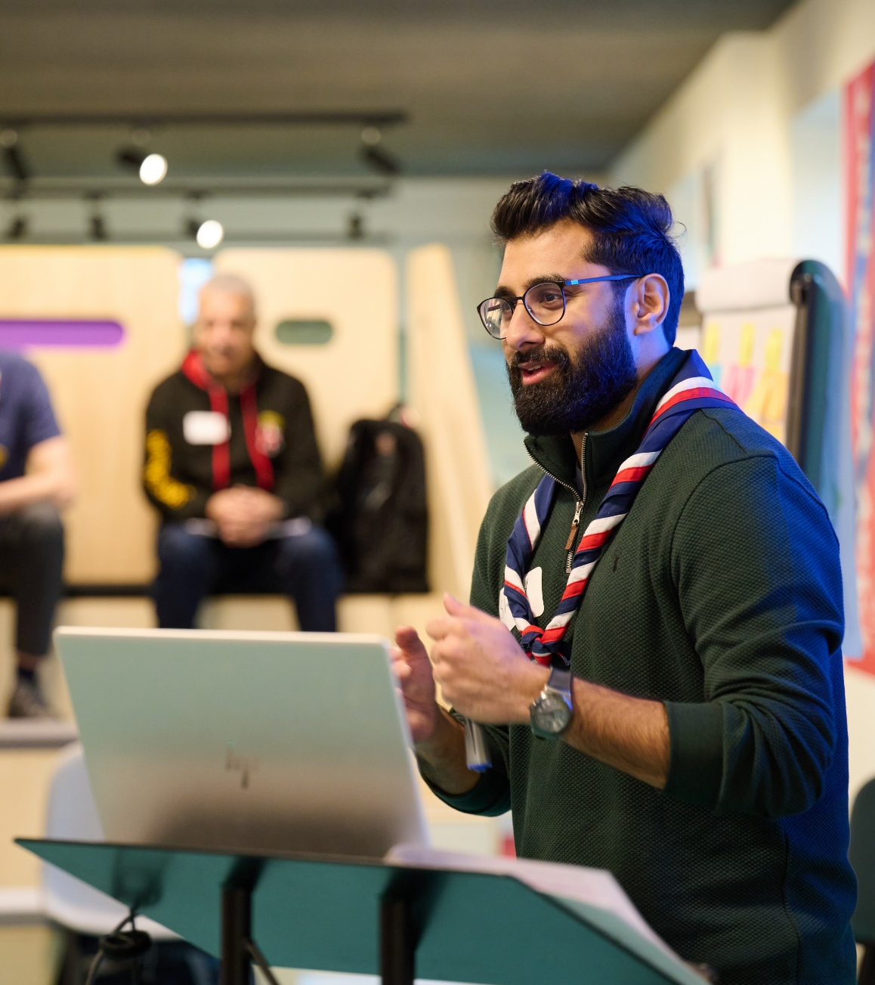
Welcome Changes
Successes:
County-wide consistency
Reduced waiting list for appointments
More personal touch
No second welcome

Slide 28
Open Forum

Slide 29
Next Steps

Slide 30
What we’re doing:
What you can do:
The next POR edition will be released mid-March to go live from 1 April with Trustee Board membership changes
Updated setting up your new teams and role mapping webpage shared in post-call email
Updated AGM Agenda & Script shared at the end of February
Once we have reviewed other elements of the programme and have further updates on the digital timeline we will share these
Continue implementing the parts of the Volunteer Experience changes already launched
Have a small team of volunteers who can support your patch through the changes

Slide 31
Thank You

