Slide 1
Transformation Lead Call

Slide 2
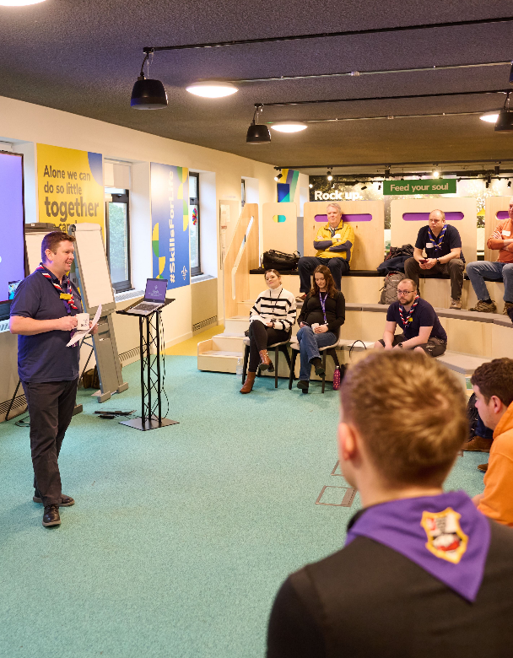
Who's on the call?
Craig Turpie, Deputy UK Chief Volunteer
Paul Fix, Programme Sponsor, Volunteer Experience
Jack Caine, UK Lead Volunteer for People
Andrew Sutherland, Deputy Programme Sponsor
Hamish Stout, Project Sponsor, Change and Infrastructure
Ben Powlesland, Membership Product Manager
Alison Fell, Welcome Product Lead
Frances Fawcett, Dorset Transformation Lead
Sanjay Chandarana, GLMW Transformation Lead
Rob Groves, Change Manager

Slide 3
What we’ll cover
Digital System Update
Change Readiness Update
Key actions and Feedback
Welcome Conversation Learning
Compass Freeze
Open Forum
Go-Live Support Teams
POR Update
TL Calls moving forwards
Next Steps

Slide 4
Digital System Update

Slide 5
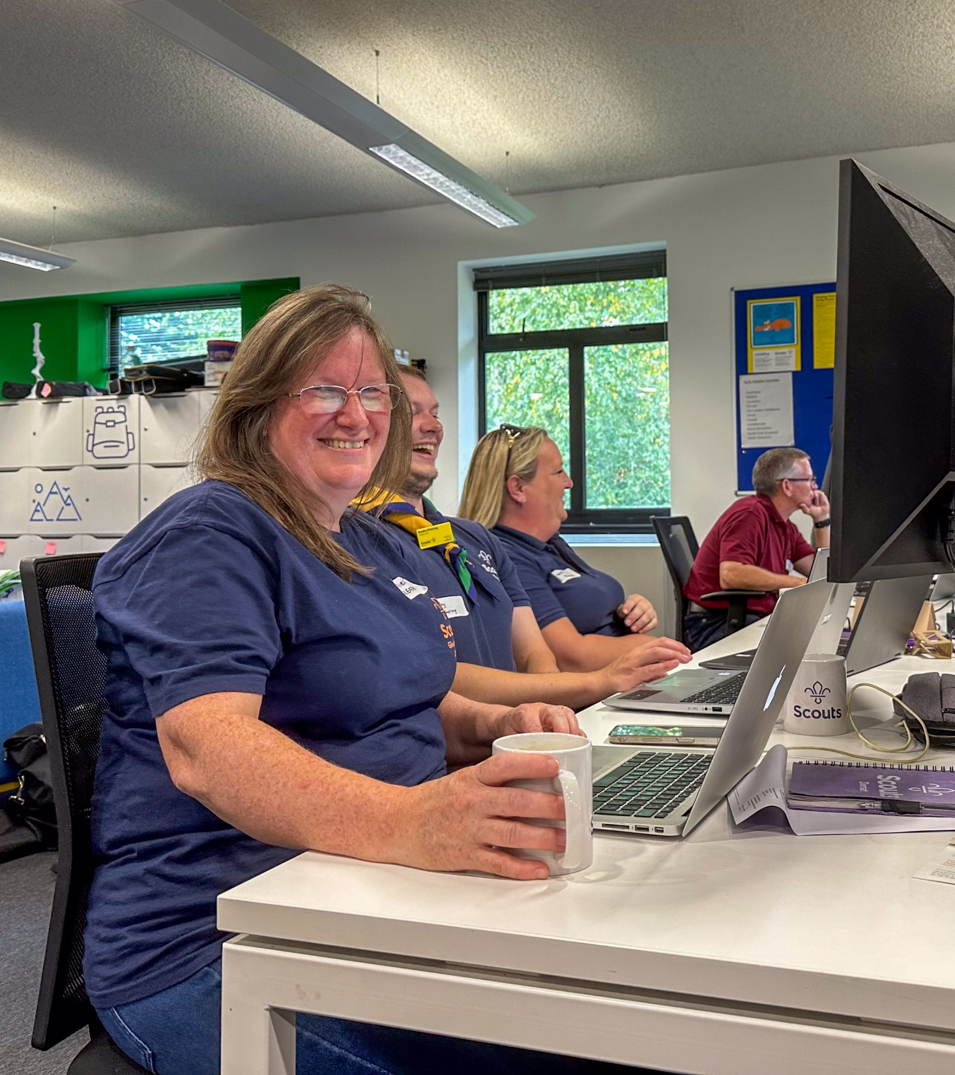
System Go-Live Dates
Current Progress:
Ongoing testing of the system
EA Counties testing day last weekend
Next Steps:
We have a review on 27 September to agree dates for Go-Live and Compass Freeze
Communicating a date:
During next week we will provide the Go-Live and Compass Freeze dates
County Lead Volunteers and Transformation Leads will get this information a day or two ahead of all members

Slide 6
Early Adopter Testing Day
‘I did not have to use the user guides at all. It is intuitive and works really well.’
‘I'm on my phone and I'm just getting stuff done … it's amazing.’
‘Compared to Compass, this is night and day.’
‘System looks clean and lovely.’
‘This far, far, far exceeded my expectations.’

Slide 7
Change Readiness overview

Slide 8
Change Readiness Overview
Overall RAG - Progress so far
Jan 24
June 24
Sept 24
Predicted RAG at Go-Live
Jan 24
June 24
Sept 24

Slide 9
Change Readiness Overview – Sept 24

Slide 10
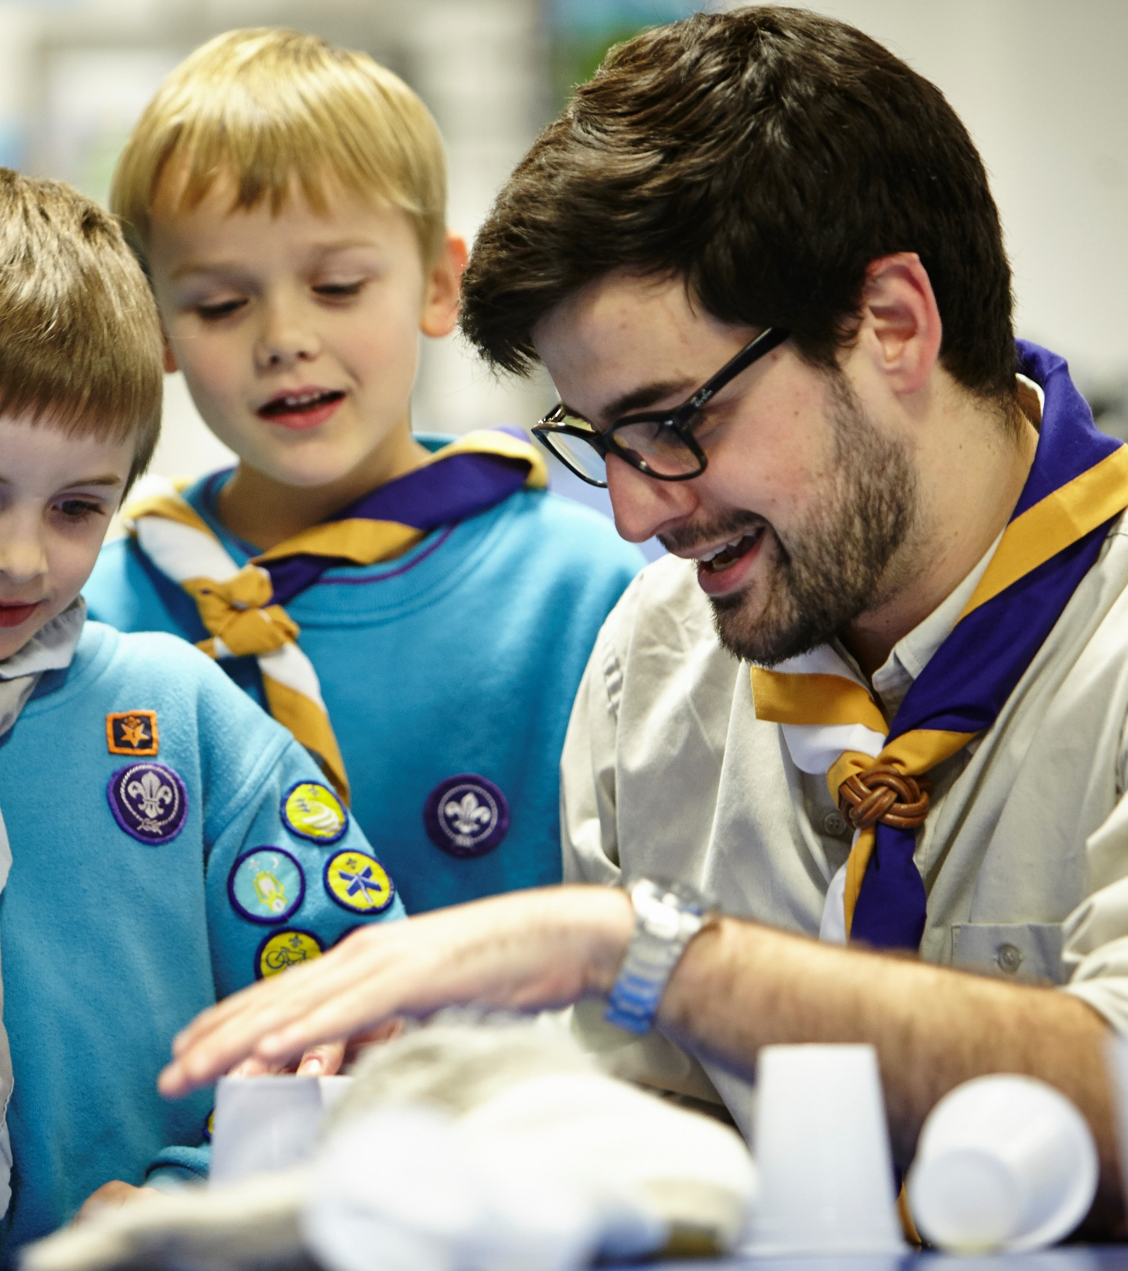
Key Themes
Communicating Change
More work needed to ensure Groups have been communicated with
Group Readiness
Great improvements over last 3 months, still lowest of the areas of readiness and engagement
Accreditations
Some uncertainty around how accreditations will work, likely as this is a new concept and heavily system based
District Readiness
District readiness has continued to improve but still impacted by vacancies and local leadership of the changes

Slide 11
Key Actions and Feedback

Slide 12
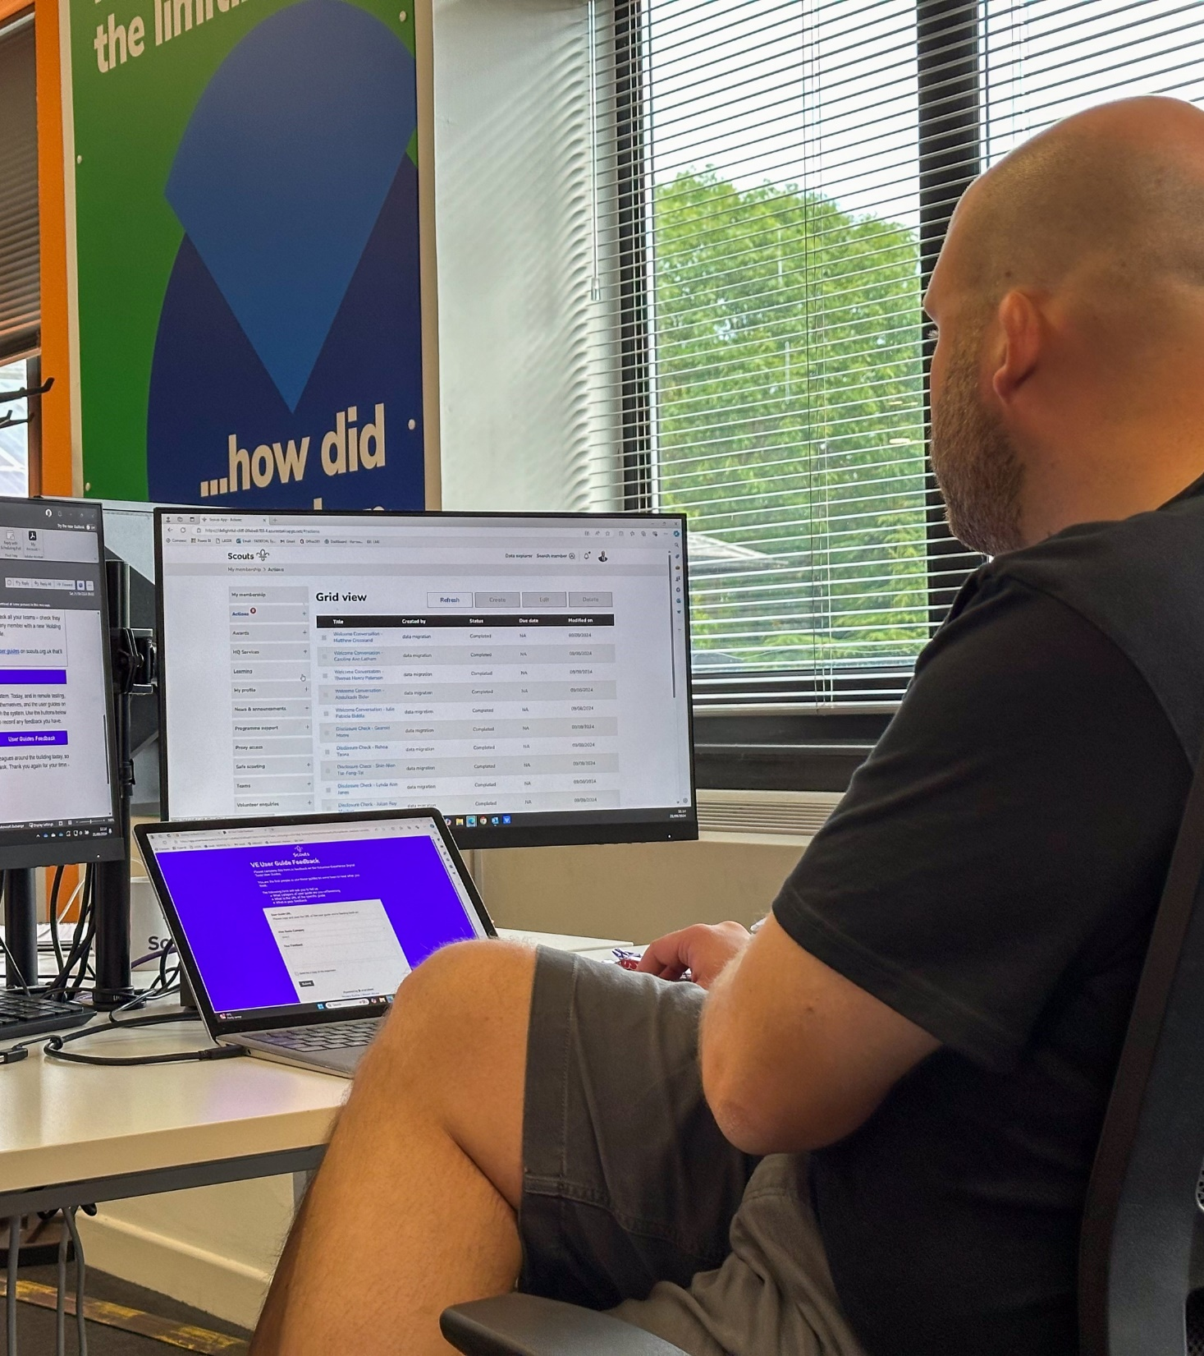
Essential Actions
Complete by 30 September
Make sure all volunteers have personal, unique and functioning email addresses
Validate and record all completed training
Complete by Compass Freeze
Finalise team structures at all levels
Go-Live Support Team in place
Ready for new ways of volunteering

Slide 13
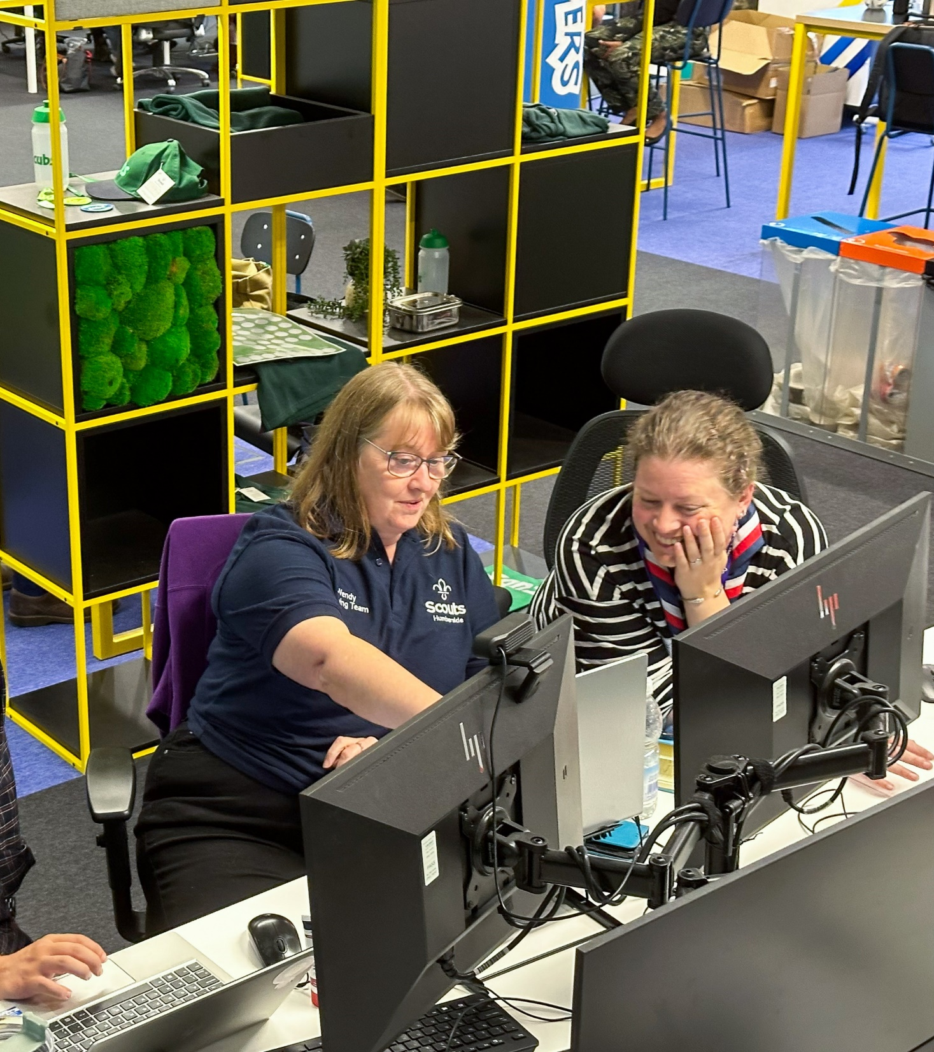
Encouraged Actions
These will be very beneficial to your local Go-Live experience
Complete by 30 September
Submit any Wood Badges & Awards to HQ
Submit any Grant applications
Complete by Compass Freeze
Support volunteers to renew their disclosures, permits and training which expire during the potential Compass Freeze window
Encourage early submission of all Nights Away Notifications
Complete additional Compass data readiness actions (available on the website)

Slide 14
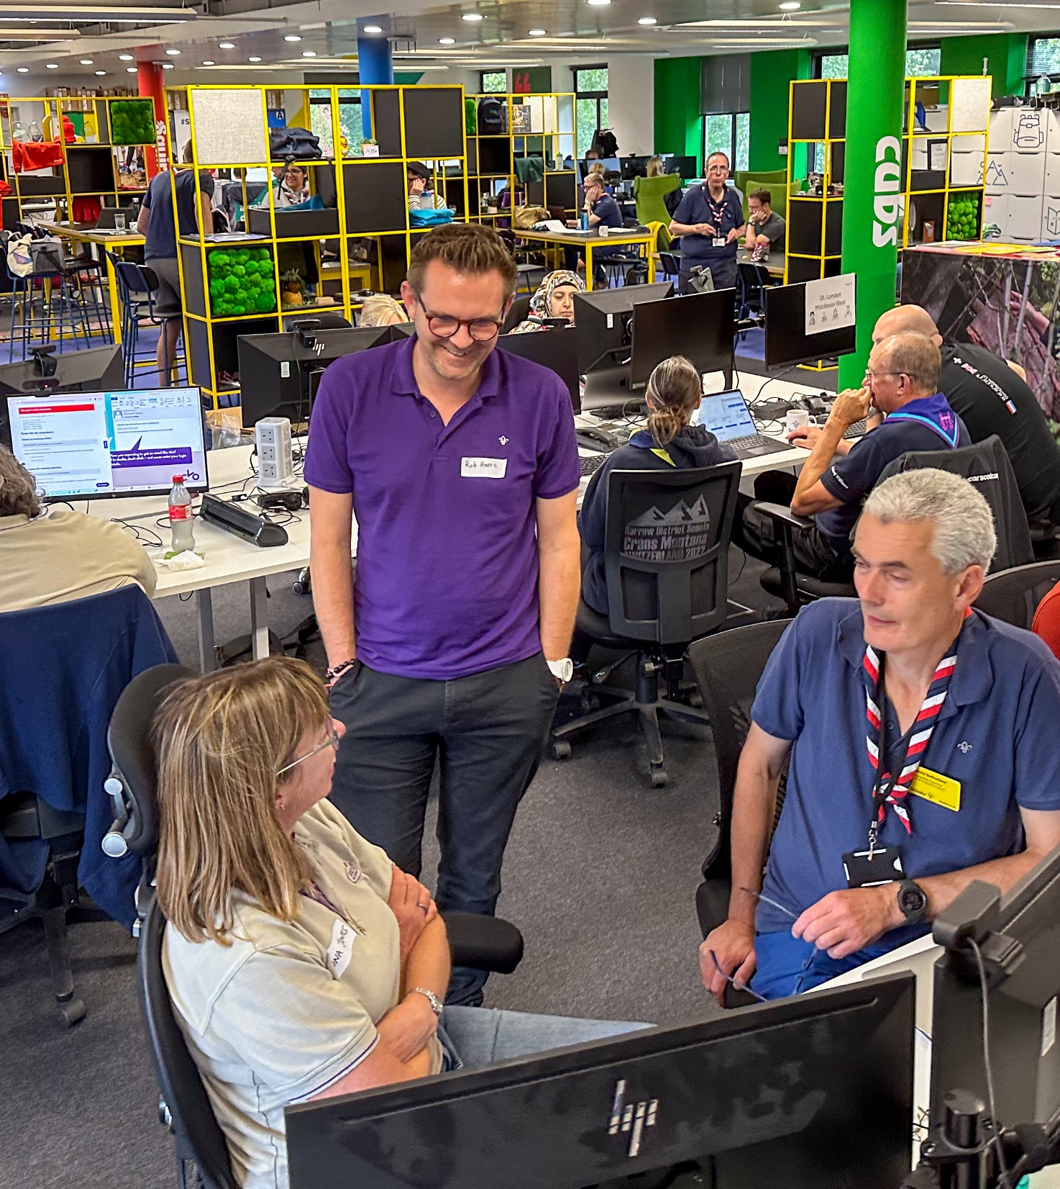
Post Go-Live Actions
Managing volunteers who didn’t get invited to the system
Putting volunteers into the right roles and teams, and issuing accreditations
Supporting Go-Live in your area
Support completion of outstanding tasks (Learning, Joining Journey steps etc.)
Embedding people and process changes

Slide 15
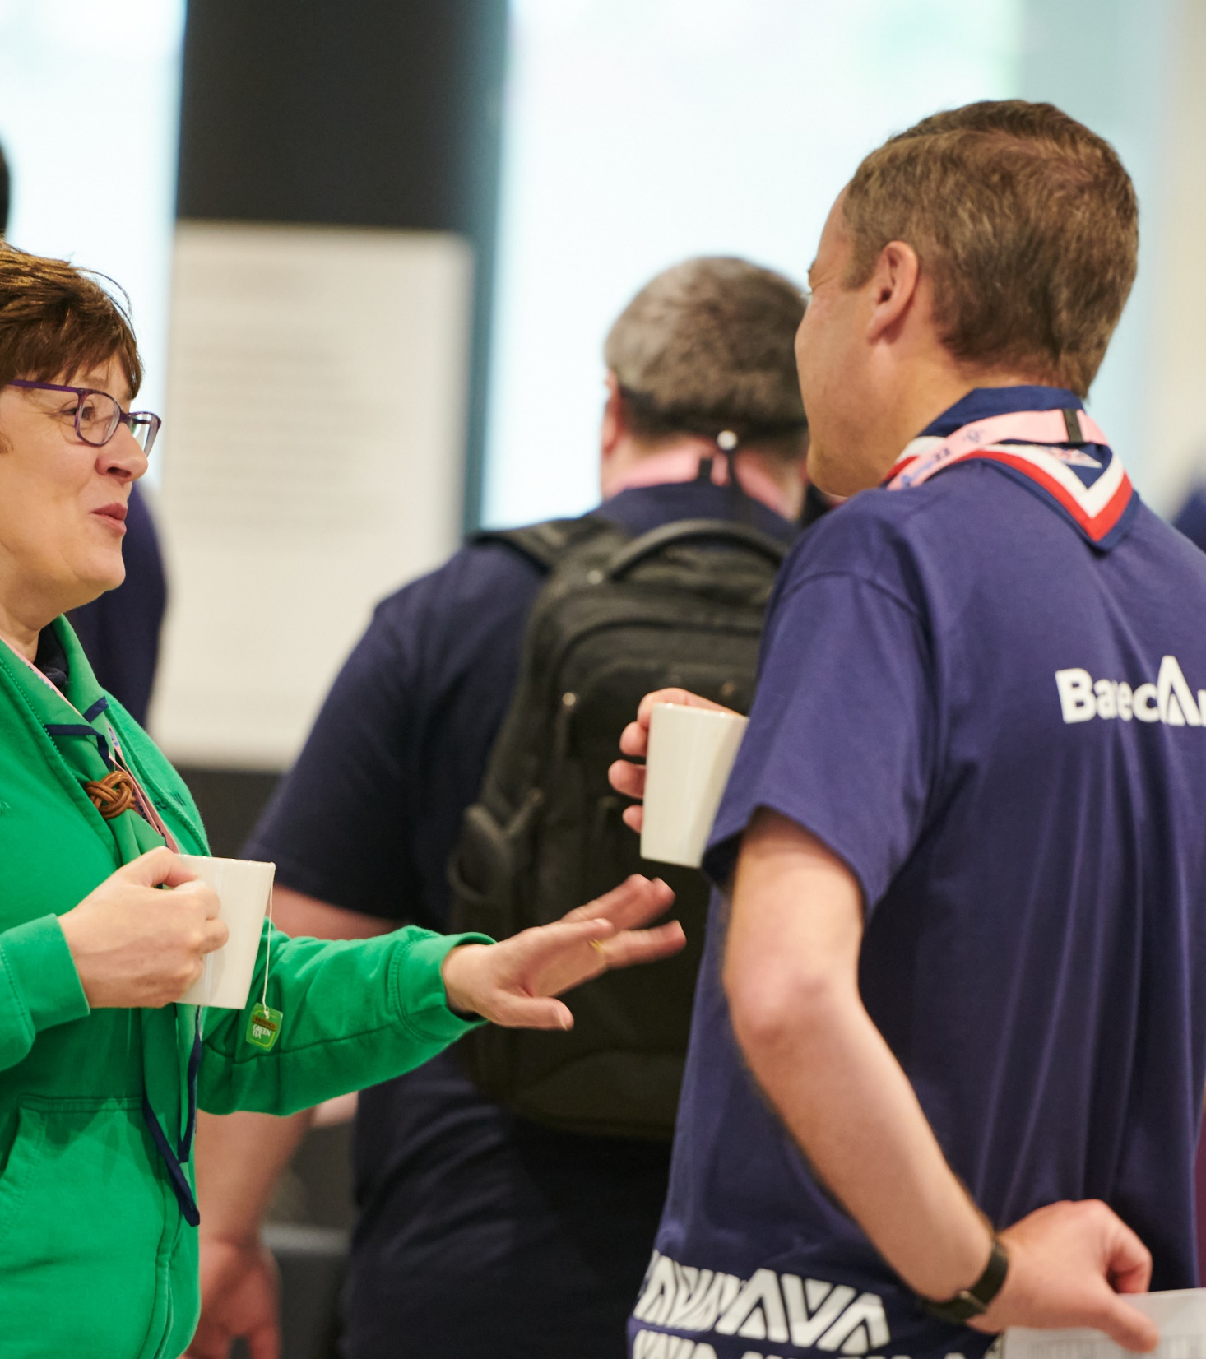
Feedback from movement
Groups - Group engagement has increased significantly but we are still getting reasonably regular feedback from Groups not being aware of any of the changes
Emails - Lots of great work done to support these, most questions across all Gearing up Go-Live calls were around emails
Compass Freeze - Queries around criminal record checks when Compass if offline

Slide 16
Email Addresses
Each volunteer will need an email address as their sign-in username to the new system. This must be:
Personal
Related to you as an individual, not your role as this may change
Unique
Not shared or duplicated with anyone else in the system
Functioning
Need to be able to access and use the email address
A proxy system is available for those unable to get an email address
Joe.Bloggs@ScoutGroup.org.uk
Jane.Doe@Gmail.com
Treasurer@ScoutGroup.org.uk
Joe & Jane - JoeandJanesmith@Hotmail.com

Slide 17
Welcome Conversation Learning

Slide 18
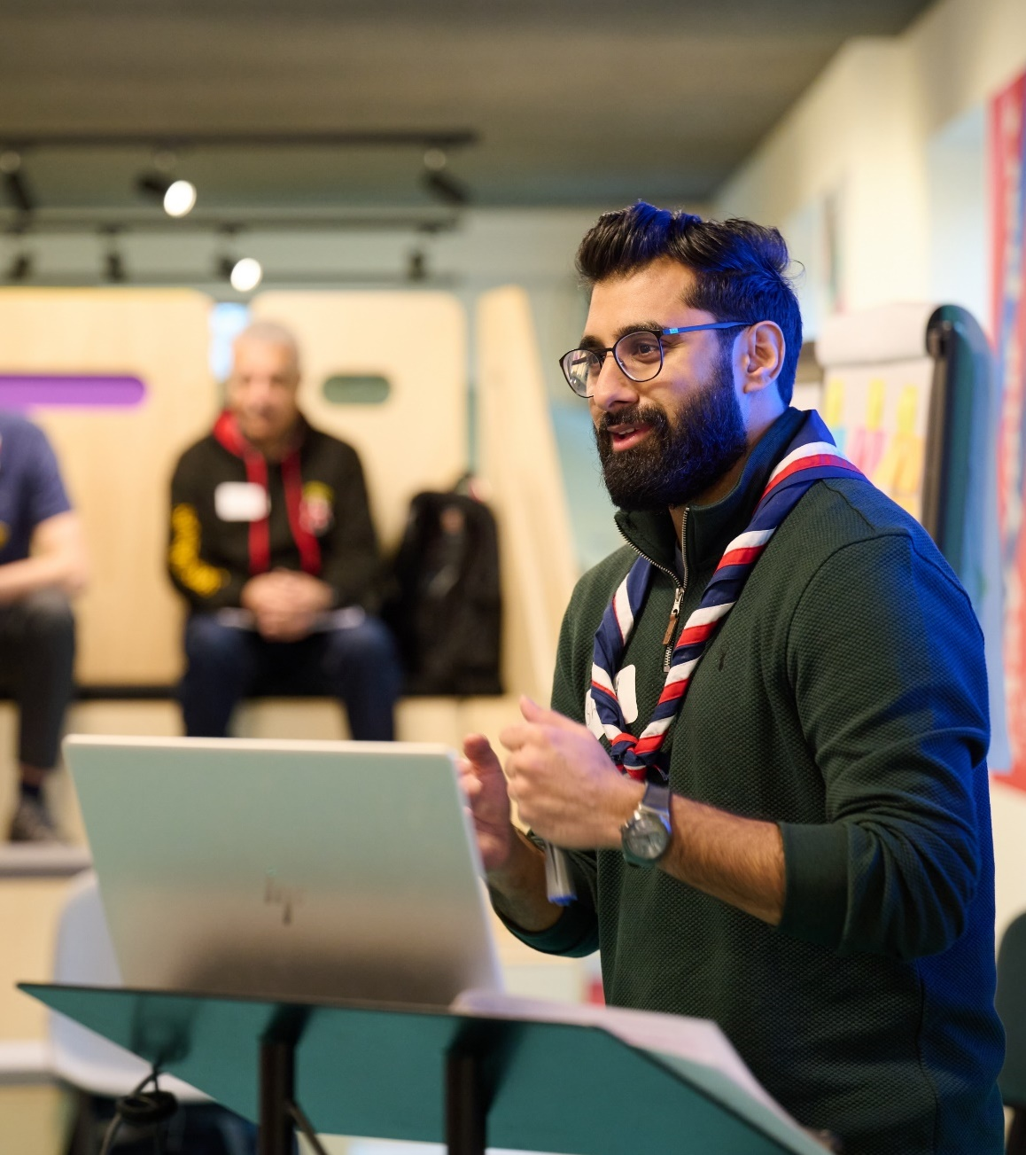
Welcome Conversation Learning
Welcome Conversation learning videos have been available online since last year
After launching this with Early Adopters earlier this year, the e-learning module is now available to all
A new module on Compass has been added titled ‘WCL : Welcome Conversation Learning’
When the e-learning has been completed this module can be added to their PLP and this will migrate across the new system
Encouraged Action: Get your Lead Volunteers, District/County Team Leaders and Welcome Conversation Volunteers trained and ready to deliver Welcome Conversations from Go-Live!

Slide 19
Compass Freeze

Slide 20
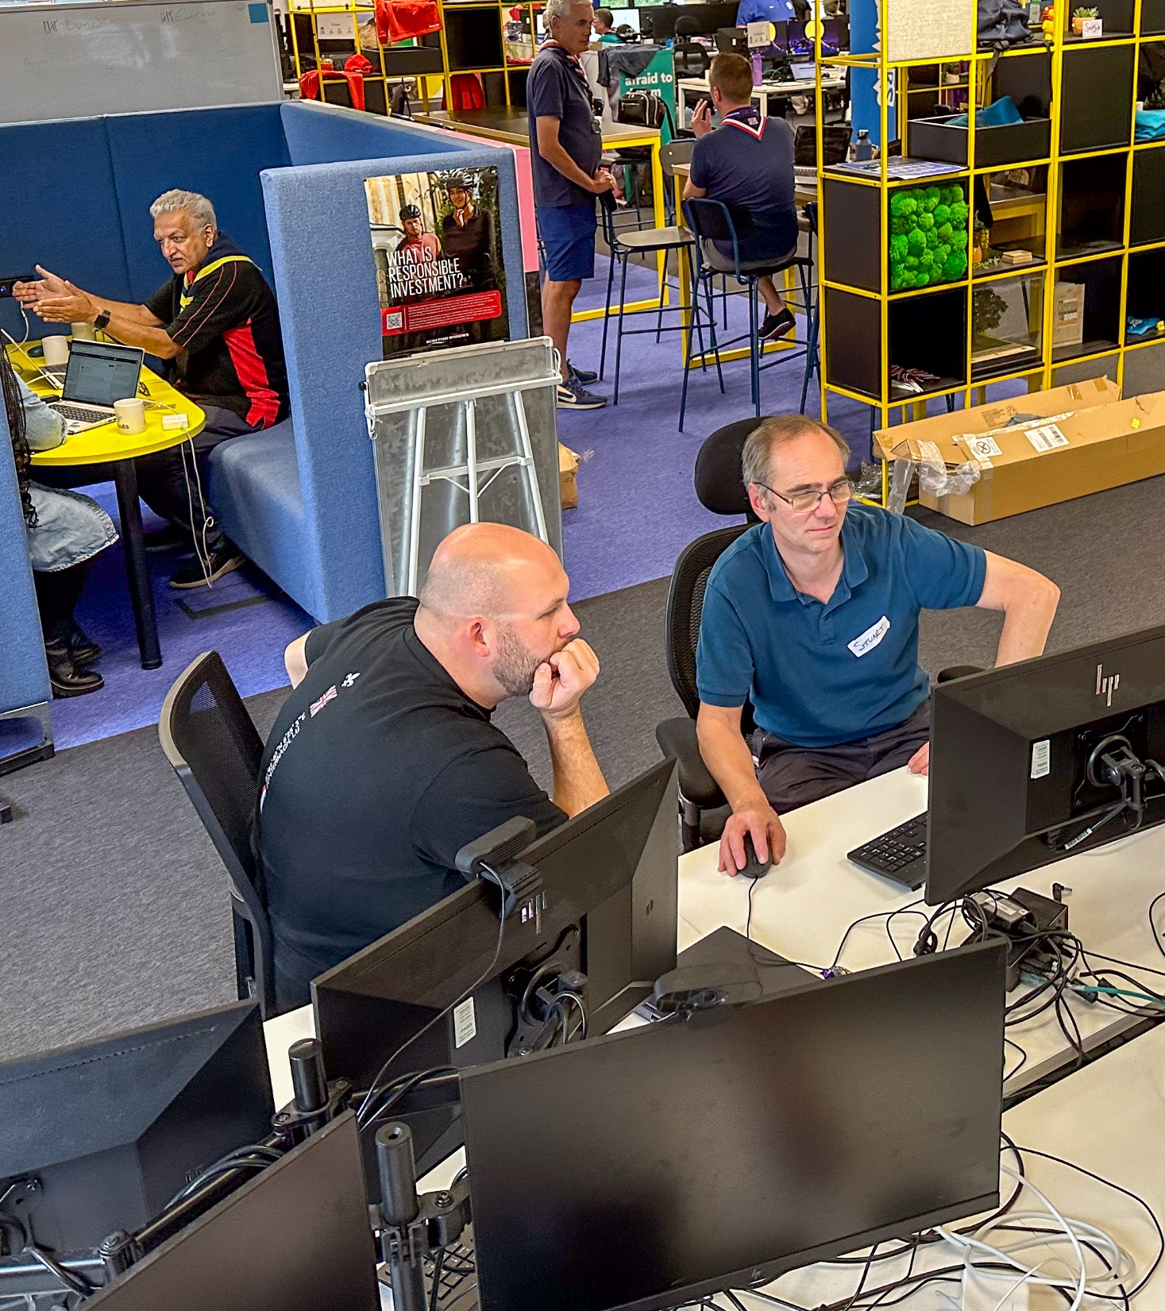
Compass Freeze
Starting 2-3 weeks prior to go-live
Compass Freeze will last 3 weeks in total
2 Weeks for Early Adopters
3 Weeks for All Other Counties
During Compass Freeze
Volunteers will have no access to live Compass records and will not be able to edit them
Some processes will stop, and others will change slightly
We will make sure you have the data you need during this period
Why it is needed
To accurately migrate the data out of Compass and into the new system

Slide 21
Compass Freeze Processes
Process | Up to 30 September | 30 Sept up to Compass Freeze | During Compass Freeze | From Go-Live
Awards | Must be submitted | Cannot be submitted | Cannot be submitted | Submitted through digital system
Grants | Must be submitted | Cannot be submitted | Cannot be submitted | Submitted through digital system
References | Should be completed | Must be completed (In-Progress will not migrate) | Cannot be completed | Completed through digital system
Member Management | Should be updated | No new roles or members 2-weeks before freeze | Cannot be updated | Updated through digital system
Scout Store | Continue as normal | Continue as normal | Unable to fulfil Decorated Awards orders | Return to normal

Slide 22
Compass Freeze Processes
Process | Up to 30 September | Up to Compass Freeze | During Compass Freeze | From Go-Live
Permits | Continue as normal | Continue as normal | Manual Process (Interim arrangement) | Permits applied for in digital system
 | Interim: Assessing and granting of permits can still be carried out if needed and recorded locally. Revoking of permits will be logged centrally
Nights Away Notifications | Early submission encouraged | Early submission encouraged | Manual checking required (Interim Arrangement) | Can submit through digital system or continue current local process
 | Interim: NAN Forms will need to be manually checked, strong recommendation for NANs to be submitted and approved prior to freeze
Learning | Should record validation | Must record validation (Unvalidated will not migrate) | Cannot be completed (Interim Arrangement) | Completed through digital system

Slide 23
Compass Freeze Processes
Process | Up to 30 September | Up to Compass Freeze | During Compass Freeze | From Go-Live
Suspensions | Continue as normal | Continue as normal | Manual submission form (Interim Arrangement) | Submitted through digital system
 | Interim: Suspensions can be applied as normal, but you'll need to submit an online form as you can't record the suspension on Compass.
Criminal Record Checks | Continue as normal, focus on expiring | No new submissions 2-weeks before freeze | Only checks returned before freeze are valid (Interim Arrangement) | Submitted through digital system
 | Interim: Only Disclosures which are showing as ‘Disclosure Issued’ on Compass prior to freeze are considered valid. All other volunteers must be treated as helpers without a disclosure*.
*They must be supervised with young people at all times, and will not be allowed to attend overnight activities unless otherwise advised by the UKHQ Safeguarding Team

Slide 24
Any Questions?

Slide 25
Go-Live Support Teams

Slide 26
Dorset Local Go-Live Support Team
Frances Fawcett

Slide 27
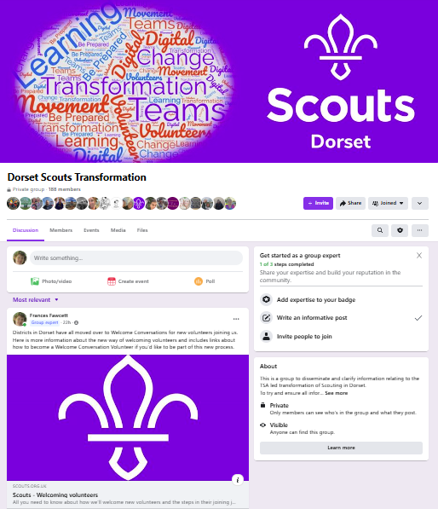
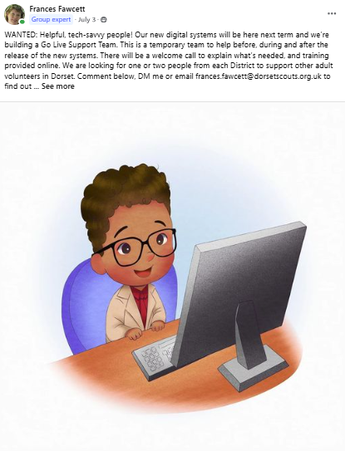
Dorset
How we built the team
Good amount of local awareness because we’ve been communicating for a while as an Early Adopter
Active (closed) Facebook Group for Transformation in Dorset
Asked DCs to identify one or two from their district
Posted a request for “helpful tech-savvy people”
We had too many!
How we’ll operate
Team Description, Welcome Call, Go-Live training
Central processes with representation from all Districts
Encourage self-support with links to online resources
Embrace the system – discourage local processes
Remember we are a temporary team

Slide 28
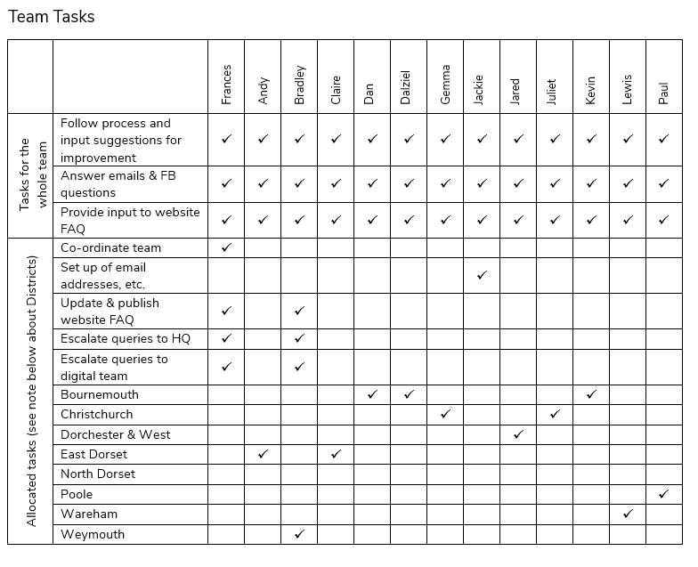
Dorset

Slide 29
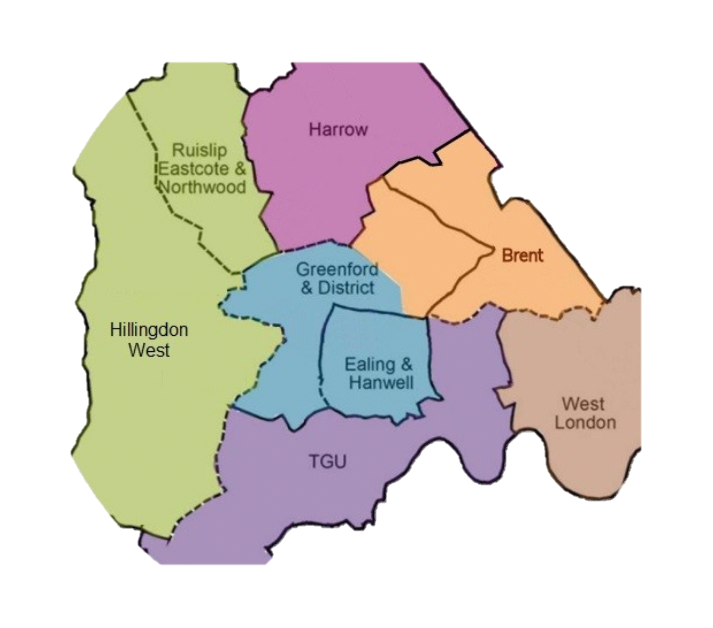
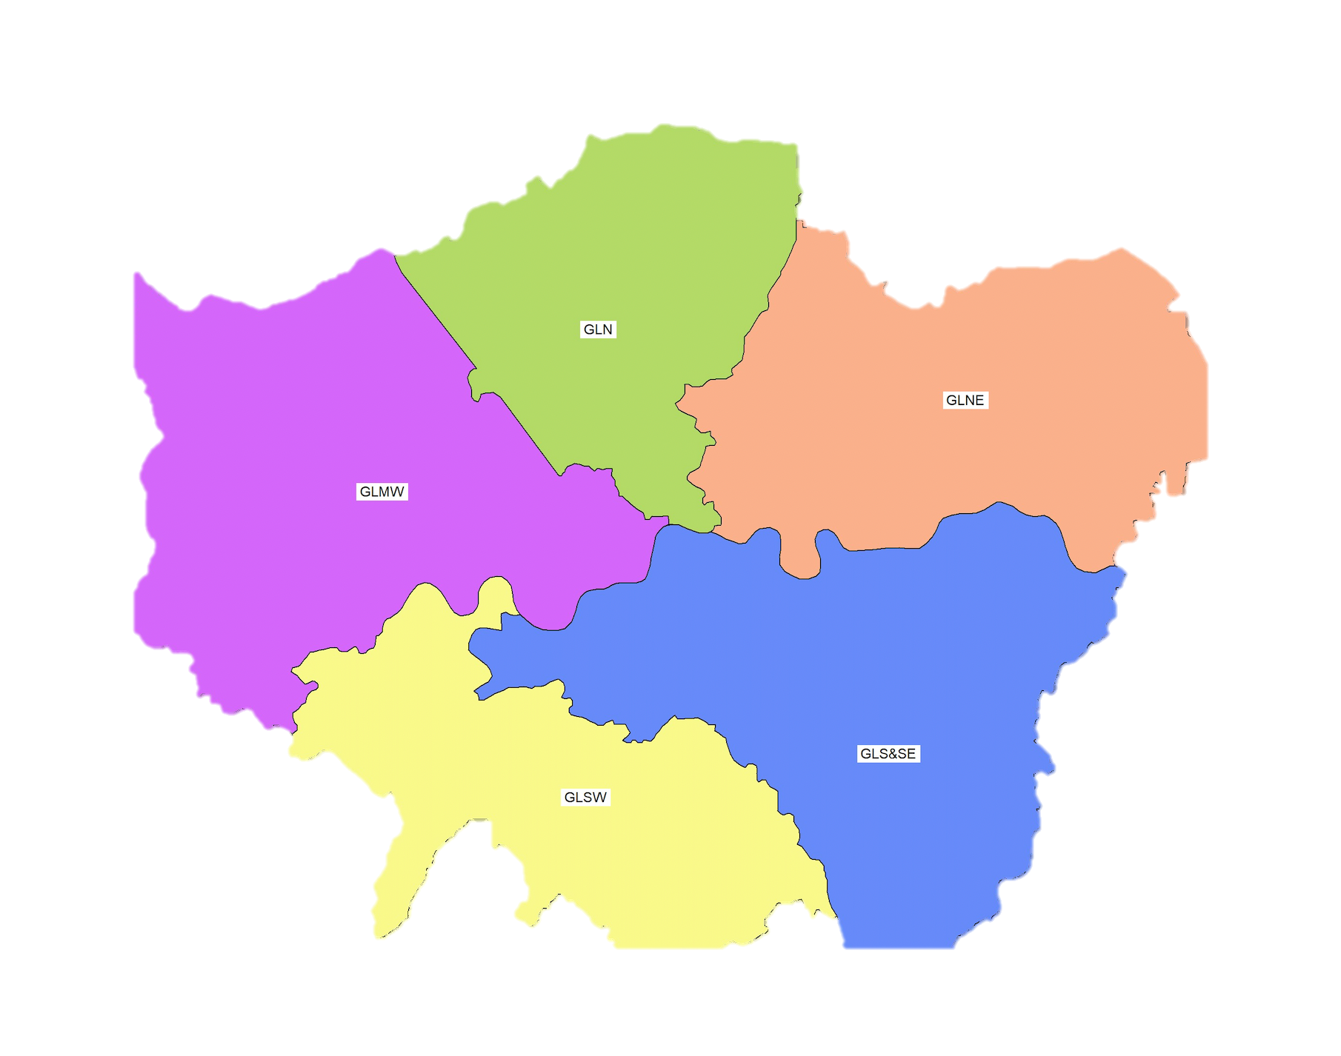
Local Go-Live Support Team
Sanjay Chandarana
Greater London Middlesex West (GLMW)
8 Districts - 2,500 Leaders and
around 2000 occasional helpers

Slide 30
GLMW Support Team
Structure : District Support teams + Core County support team
Incentive for Districts to nominate Support people;
Incentive to clean up data in advance;
More leaders with digital tools experience when we go live;
Key Responsibilities
Initial training on tools and processes; Provide day 1 support to help set up data on new systems (roles, teams, accreditations);
Ongoing local support;
Next Steps
Train up support team;
Set up communications - within support team (WhatsApp Group) - District support teams to County Support Teams to HQ Help Desk - leaders to their local support team; (District and County support team email addresses)

Slide 31
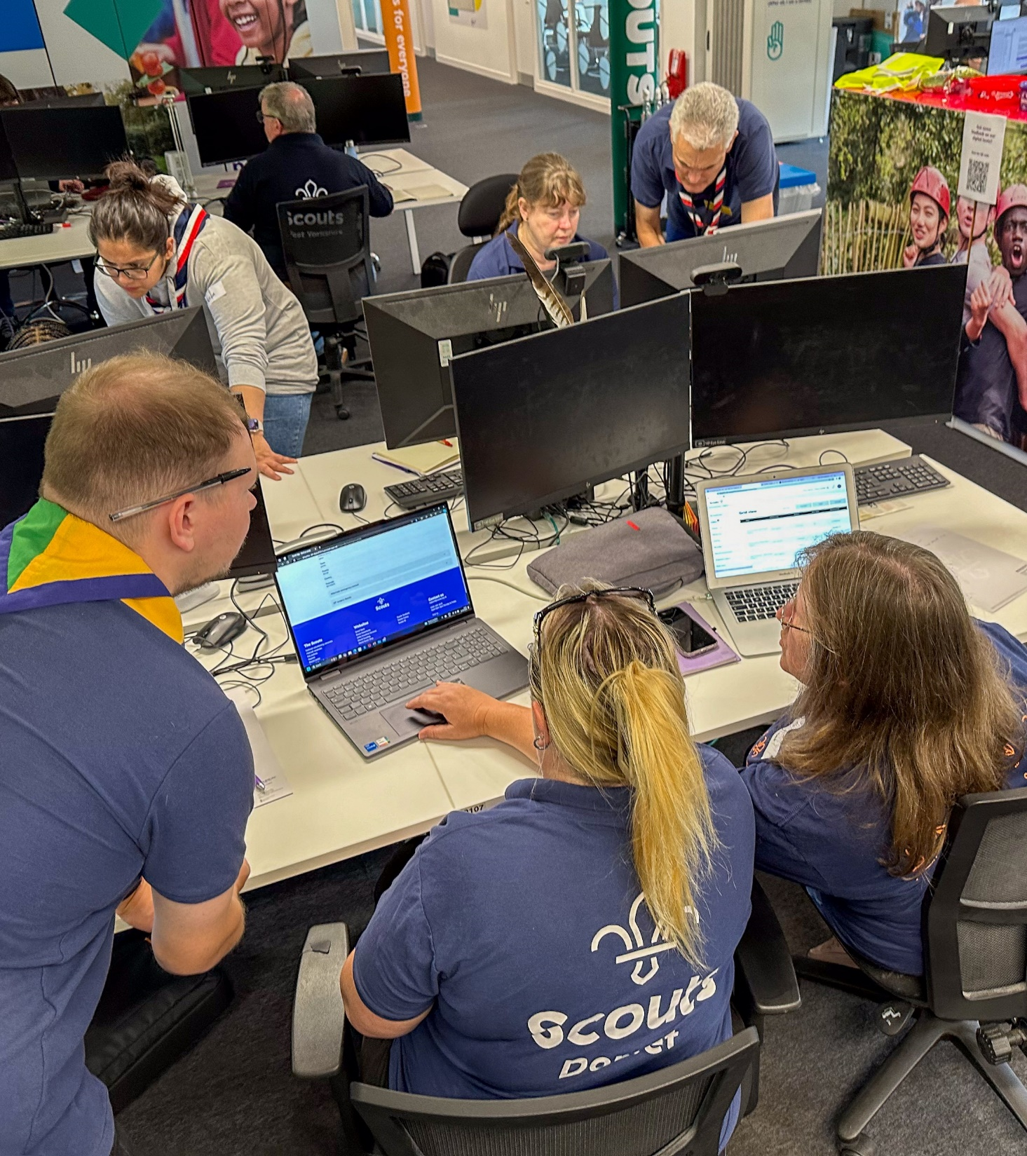
Go-Live Support Teams
When will we share training dates
After Go-Live date is agreed
What is needed next
Preparing your Go-Live Support Team
Go-Live Support Team attend Training
Share the single email address contact for your Local Go-Live Support Team
Plus … please start preparing to encourage all volunteers to attend their training

Slide 32
POR Update

Slide 33
POR timeline
Compass Freeze
Go-live EAs
VE timeline
Go-live 90%
In 2nd half of October PDF version of Autumn 2024 edition available on scouts.org.uk POR page for use in local planning
March 2024 (June 2024 update) edition
Autumn 2024 edition
Live POR – EAs
March 2024 (June 2024 update) edition
Autumn 2024 edition
Live POR – 90%
These timelines are not to scale!!

Slide 34
TL Calls Moving Forwards

Slide 35
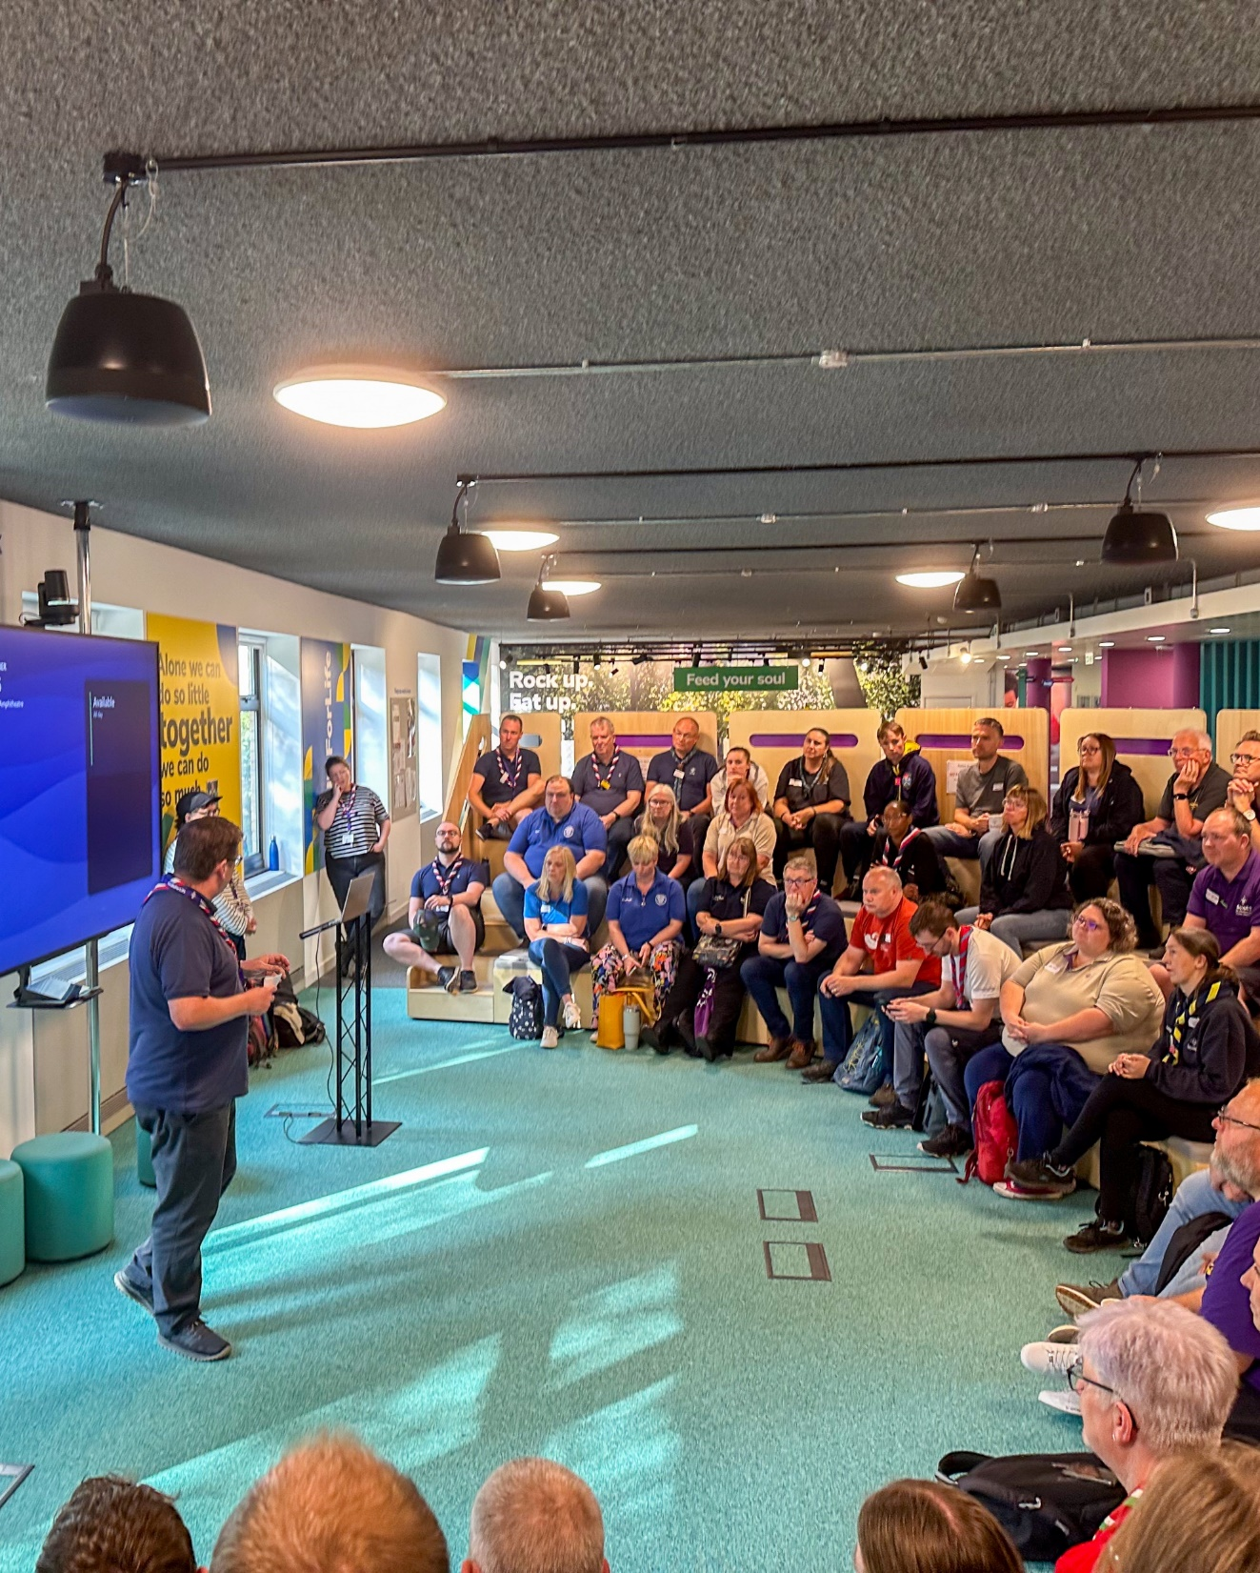
TL Calls
Currently we hold TL Calls towards the end of each month
Around Compass Freeze and Go-Live we have some options on what we can do:
Remain with the current schedule with no changes
An additional call shortly prior to Compass Freeze
An additional call shortly prior to Go-Live
An additional call shortly after Go-Live
This will be separate to any calls or support we arrange for the Local Go-Live Support Teams

Slide 36
Next Steps

Slide 37
What we’re doing:
What you can do:
Focus on all areas having completed essential actions and encouraged actions where possible
Start training those involved in delivering Welcome Conversations and adding this to Compass
Support Districts and particularly Groups to be ready for change
Share with us your primary contact email for your Go-Live Support Team
Carrying out volunteer end to end testing
Sharing webpage content for Compass Freeze
Training our HQ trainers
Sharing guidance for recording Welcome Conversation learning in post-call email

