Slide 1


The Listening Tool
Piloted as part of Scouts’ Approach to Discrimination Project
Notes:
In this presentation, we'll learn what the Listening Tool is, why it’s important and how to use it.

Slide 2
What is discrimination?
Notes:
Discrimination is ‘unfair treatment related to identity, such as age, gender, race or religion.’ Discrimination can look like lots of different things. For example, it could look like inappropriate language (slurs) or an old rule that’s always been there. Someone might say they’re “just having a laugh” or “it isn’t a big deal”.
But discrimination isn’t okay. It might make you feel angry, unsafe, powerless or scared. It’s motivated by stereotypes, prejudice or bias towards people’s identities, such as their gender, race or religion. It can be hard to talk about discrimination, especially if you’ve experienced it yourself or you know someone close to you who has. There’ll be people here today who’ve experienced discrimination, so we need to act in line with our Scout values and show care and respect for others.
Lots of discrimination goes unreported at Scouts. The Listening Tool is an anonymous reporting form anyone in our pilot locations can use to report:
• Discrimination or unfair treatment, linked to who someone is, such as their race, religion, or disability,
• Behaviour that makes someone feel left out, unwelcome, or like they don't belong at Scouts,
• Anything else that doesn't feel in line with our Scout values.
By helping Scouts understand what's happening across our movement, we can create a safer, more welcoming Scout experience for everyone.

Slide 3
What it is
What it isn’t
An anonymous reporting form
An opportunity to tell us what you're seeing, hearing and experiencing
A way to help make Scouts a safer, more welcoming place
A replacement for Safeguarding processes
A replacement for our Complaints process
A way to get support
Notes:
The Listening Tool is:
Anonymous.
An opportunity for you to tell us what you're seeing, hearing, and experiencing at Scouts.
A way to help Scouts learn how to make our movement safer and more welcoming.
It isn't:
A replacement for Safeguarding or Complaints processes. Safety of our members is our biggest priority; all volunteers must follow the existing process for Safeguarding concerns outlined in the Yellow Card.
A way to get support with something you’ve seen, heard or experienced at Scouts. No one will get in touch with you about a report you’ve made, but it may be passed over to the Safeguarding team if there is a safeguarding concern.
If you need support with something that’s happened at Scouts, speak to a local volunteer, Scouts’ Support Centre or follow our Complaints process.

Slide 4
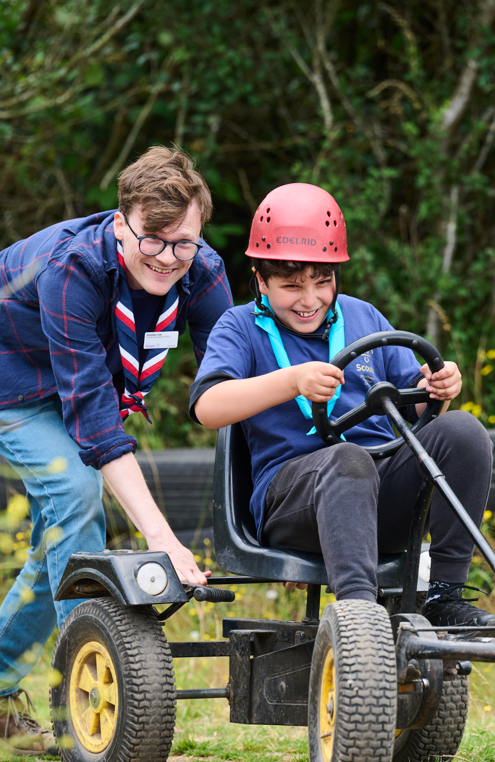
Why should you engage with the Listening Tool?
Help Scouts understand day to day experiences of parents, carers and family members by reporting what you see, hear and experience.
Help young people share their experiences through the Listening Tool.
Reports will shape guidance, resources and support for volunteers and leaders tackling discrimination.
Together, we can build a safer, more welcoming Scouts for all young people.
Notes:
Scouts need to know what people are seeing, hearing and experiencing, so we can design resources that are relevant, useful and evidence-based.
The more Scouts learn from this tool, the more tailored support for volunteers can be.
Parents, carers and family members may learn about discrimination from young people who need help to use the Listening Tool.
As parents, carers and family members, you may hear from your young people about discrimination or unfair treatment that has taken place at Scouts, or you may experience discrimination yourself. By reporting discrimination through the Listening Tool, your insights will help shape better guidance, resources and support for volunteers and leaders tackling discrimination. Together, we can build a safer, more welcoming Scouts for all our members.
Share what you see or hear to help us understand Parents' experiences across Scouts
Our younger members often share their experiences with their parents and carers, we need your help to understand their experiences.
Your insights will help shape better guidance, resources and support for volunteers and leaders tackling discrimination
Every report will contribute to the ways we collectively address discrimination and improve inclusion at Scouts
Together, we can build a safer, more welcoming Scouts for all young people

Slide 5

What we need from you
Report what you see, hear and experience
Make reports for our younger members (Squirrels, Beavers, Cubs)
Support others to make a report
Notes:
Anyone can make a report about something that’s happened at Scouts (or while travelling to or from Scout activities). You can report something that’s happened to you, something that you’ve seen or heard, or make a report for someone else. We will never ask you to share identifying information, such as names or Group. All reports are anonymous, and only data trends will be shared with volunteers.
As parents, caregivers and family members, young people may come home from Scouts and tell you about something they’ve seen, heard or experienced. Our younger Sections will need a trusted adult to make a report for them, and our young people aged 13 and older may ask for your help to report something.
The Listening Tool isn’t a way to get support with something that’s happened at Scouts. If you need support with something you or someone else has seen, heard or experienced at Scouts, speak to a local volunteer, our Support Centre or follow our Complaints process.
Here is an example of how parents, carers and family members can use the Listening Tool:
Kian has come home from Cubs upset because some of the other young people were making hurtful comments and jokes about his hearing aids. His parents ask what the volunteers did about this, but Kian doesn’t think the volunteers noticed what was happening, and he was too nervous to say anything to them. In this situation, Kian’s parents contact the volunteers immediately to let them know what has happened and arrange to speak with them about how this behaviour can be addressed. After this, Kian’s parents report the incident through the Listening Tool so Scouts can learn from the incident.

Slide 6

Making a report
Notes:
You can report:
You can report something you’ve seen, heard or experienced at Scouts (or while travelling to and from Scouts), even if you’re not sure it was discrimination. You don’t need to prove anything or use the ‘right’ words. If something didn’t feel right, you can report it.
You don’t need to be involved in the situation to make a report, and you don’t need permission to make a report about someone else.
You can report something no matter how long ago it happened, including incidents that happened over 10 years ago.
If you need support with something that’s happened at Scouts, you should speak to your District or County/Area/Region 14-24 Team, Scouts’ Support Centre or follow Scouts’ Complaints process.
You could also get support from external organisations, such as Childline (for under 19s), Young Minds, Mind (or SAMH in Scotland) or Chasing the Stigma. Discuss any local organisations that offer support too. You may want to signpost to specialised mental health organisations such as Switchboard (for LGBTQ+ people), Bayo (for Black people), or the Muslim Youth Helpline.

Slide 7
Accessing the Listening Tool online
Reports can only be made online. But if you don’t have easy access to the internet, you could:
Visit a library
Ask someone to make a report on your behalf
Ask someone if they can support you to make a report on their device
Top Tip: Save the link to the Listening Tool so you can return to it whenever you need to make a report.
Notes:
The Listening Tool is an online reporting form. This means reports can only be made with an internet connection. This slide has some ideas on how you could make a report if you don’t have easy access to the internet or don’t feel confident to use digital tools without support.
You can make a report at any time, so wait until you’re in a suitable location. You could write down what happened so you don’t forget, but make sure you don’t include any names or personal information.
Highlight the top tip, there’s a QR code on the final page so people can save the link then.

Slide 8
Walkthrough
https://vimeo.com/1206783931

Slide 9
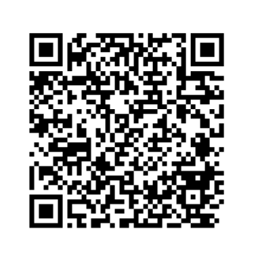
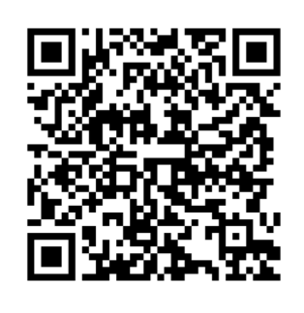
Any questions?
Visit our Listening Tool webpage
Make a report
Notes:
Prompt to save the link to the webpage so they can find it again in the future. The URL is scouts.org.uk/volunteers/equity-diversity-and-inclusion/listening-tool/.
Use the FAQ document to help you answer questions. If there’s anything you think should be added to the FAQ document, please speak to the key contact for the Listening Tool in your area.
The FAQ document covers:
I’m not sure if I’ve experienced discrimination or not, can I still report it through the Listening Tool?
Will volunteers in my pilot location be able to see my report?
Can I report something that happened a while ago?
Can I report something that doesn’t involve me?
Do I need to get permission to make a report about someone else?
Why does the form ask for the demographic details of the person making the report?
Why won’t someone get back to me about something I’ve reported through the Listening Tool?
Can I report something I’ve already reported to Safeguarding or made a formal complaint about?
I’m interested in helping Scouts develop their approach to tackling discrimination. Is there a way for me to learn more and get involved?
I’d like to provide feedback about the Listening Tool. Where can I do this?
How long will the Listening Tool be open for?
Can all of our young members make a report through the Listening Tool?
Is the Listening Tool available in languages other than English?
Who else is taking part in the Listening Tool pilot?
Who should I contact if I have a question or need support with the Listening Tool?

Slide 10


Pilot Locations across the UK
Birmingham County
Cardiff and Vale Area
East Belfast District
Greater London North-East County
Hertfordshire County
Kent County
Leicestershire County
Powys Region
South-East Scotland Region
Notes:
These are the nine pilot locations for the Listening Tool. This includes locations from England, Northern Ireland, Scotland and Wales.
Lead Volunteers from each of these Counties/Areas/Regions make up our working group for the approach to discrimination project, along with representation from the UK Inclusion Team and our Project Sponsor from our Race Equity Sub Team.

