Slide 1

National Lion Pilot
The Boy Scouts of America’s program
for Kindergarteners
Highlights and Updates

Slide 2
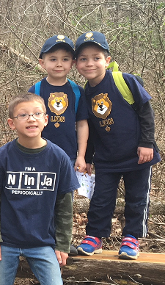
Lion Overview
Lion’s is designed as an introduction to Cub Scouting.
To join: A youth 5 years old or the year before first grade.
Dens of six to eight youth, plus adult partners
Families share leadership with Den Leader.
Two den meetings per month
  Den meeting--about 45 minutes
  Outings (Field trips) 2-3 pack meetings per year
Notes:
Your evaluation is needed to provide feedback for program continuation or expansion. To support the feedback, it is important to deliver the program as designed.
Reproduction or distribution without written consent is not authorized.

Slide 3
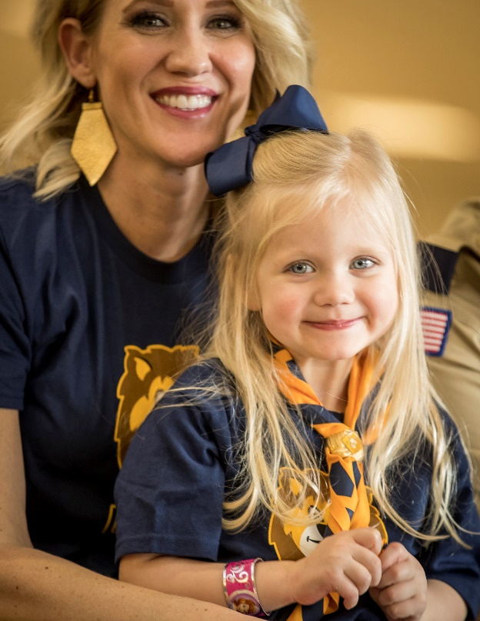
Board Approved—Historic Event!
Lions now move from Pilot to part of the official Cub Scouting Program.
Same curriculum & program.
Same intent to include more families at an earlier age.
Same desire to start slow and not overwhelm new families. Keep it simple.
Lions is now open to both Boy Dens or Girl Dens!

Slide 4
Adventures
Required Adventures | Elective Adventures
Lion’s Honor | I’ll Do It Myself
Fun on the Run | Pick My Path
Animal Kingdom | Gizmos and Gadgets
Mountain Lion | On Your Mark
King of the Jungle | Build It Up, Knock It Down
 | Rumble in the Jungle
 | Ready, Set, Grow
Lion Badge is earned by completing all 5 required adventures.

Slide 5
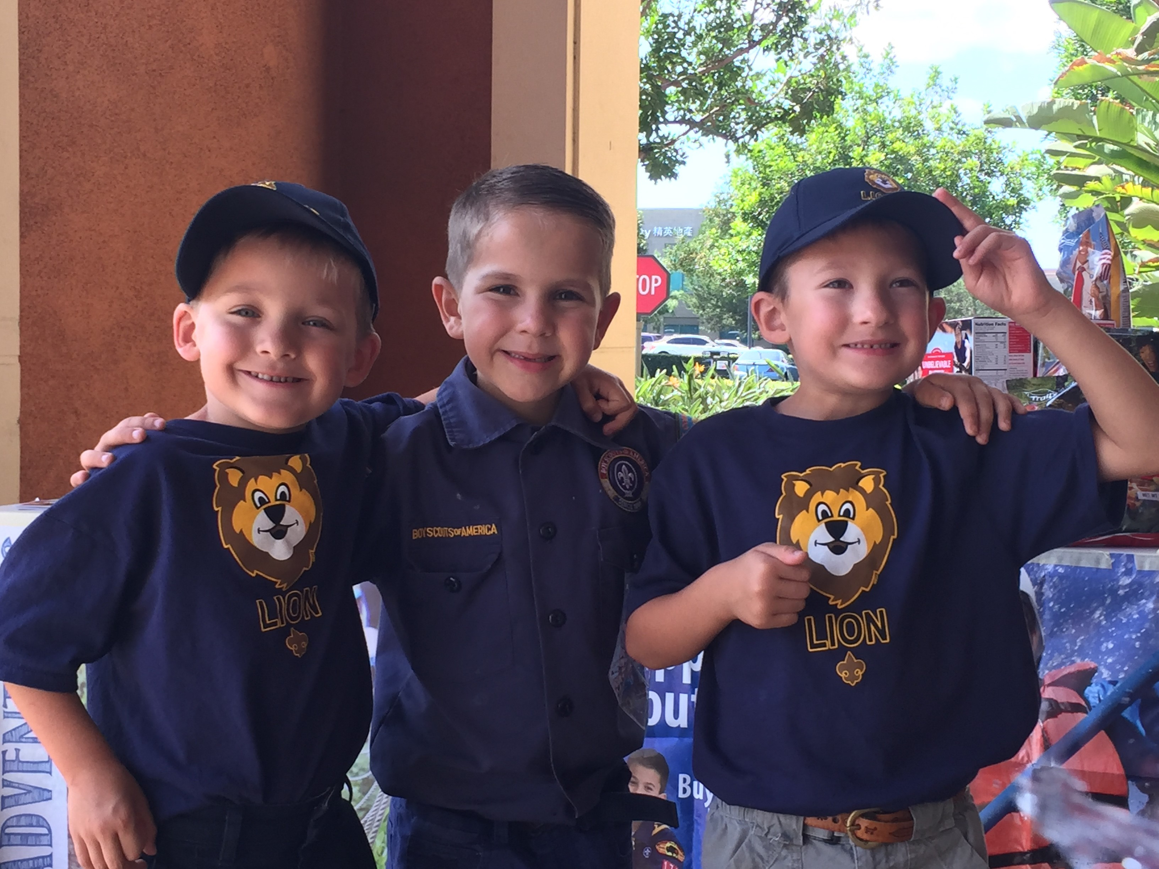
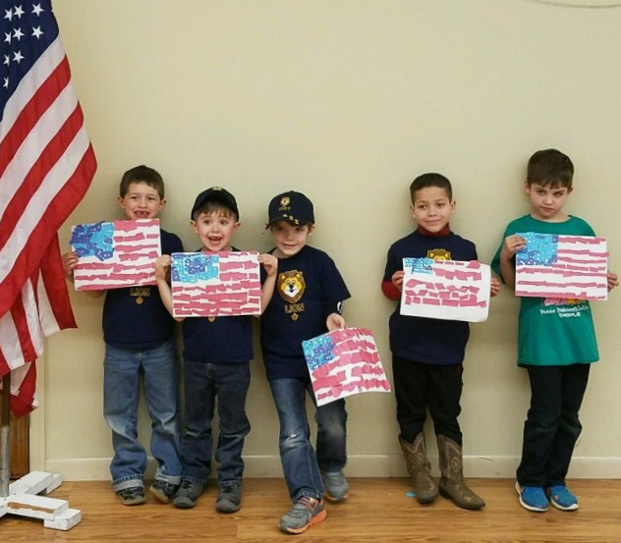
Lion Highlights
Parents say developing character is the #1 reason to join Scouting.
61% of Lion youth are new families to Scouting!

Slide 6
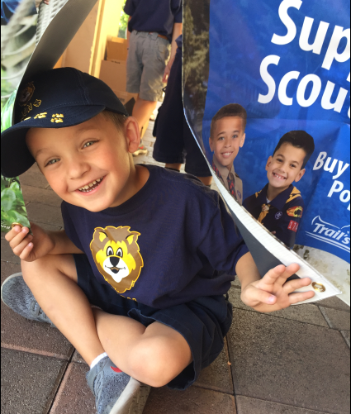
Lion Feedback
Feedback received from Parents, Leaders and Youth in Focus Groups & surveys
Feedback is all good!
Very few tweaks.
Loved T-shirt, stickers, and program.
Parents very happy with low cost of entry (T-shirt).
Wanted more bling/recognition at Pack meeting.

Slide 7
Membership
  54.4% growth the last 12 months
  91% of all councils involved in Lions
  Pilot Growth from 4 204 245 Councils
  Existing councils expanding their units
47,192
12/31/2017
30,618
12/31/2016

Slide 8
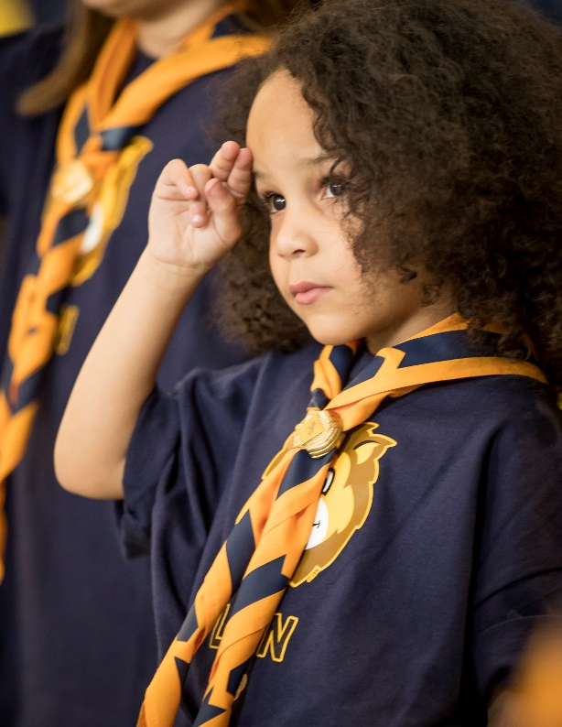
2017 Retention Rates
Region | 2016 Lions | 2017 Retained in BSA | 2017 % Retained in BSA
Central | 11,235 | 9,879 | 87.9%
Northeast | 8,616 | 7,797 | 90.5%
Southern | 5,587 | 4,147 | 74.2%
Western | 5,093 | 4,634 | 91.0%
87% Retention Rate

Slide 9
Market Opportunity
Region | Non-LDS Packs | Non-LDS Packs with Lions | % Non-LDS Packs with Lions
Central | 8,747 | 3,747 | 42.8%
Northeast | 5,979 | 2,871 | 48.0%
Southern | 8,586 | 2,411 | 28.1%
Western | 4,098 | 1,795 | 43.8%
27,410 packs offered Lions
that’s 40% -- 10,824 packs
= 60% great potential growth!

Slide 10
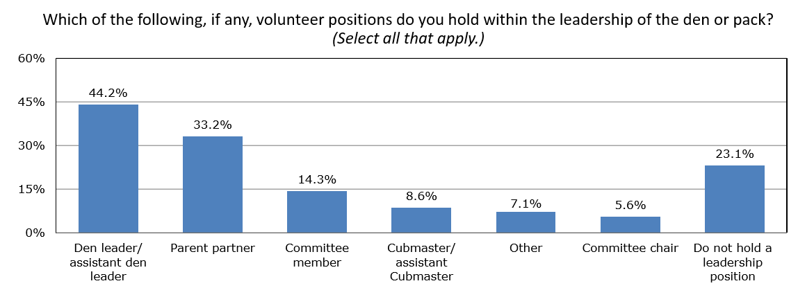
New Families Engaged
75% of parents take leadership roles!

Slide 11
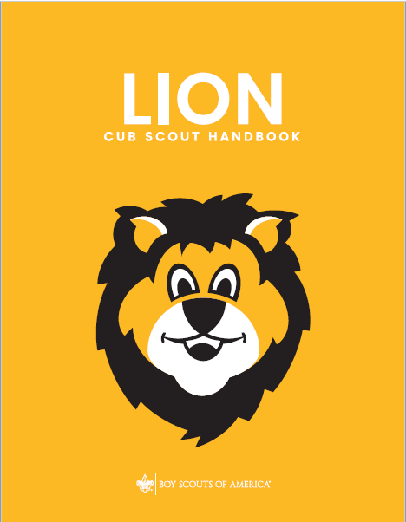
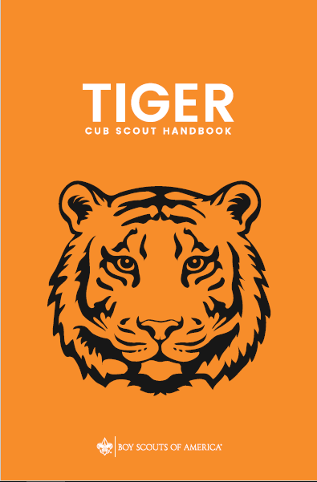
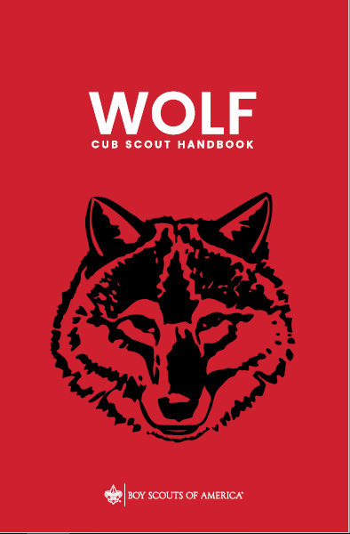
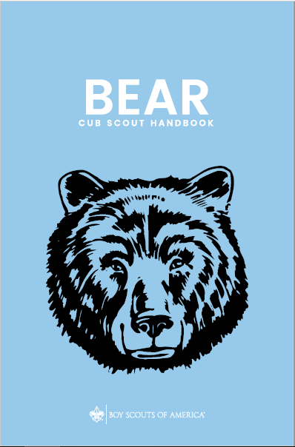
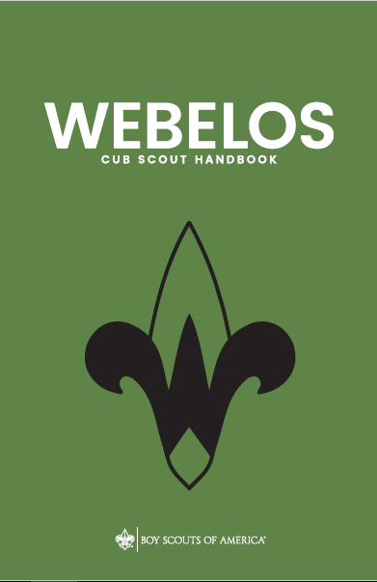
Cub Scouting
Program Handbooks
New
Notes:
Copies will be available for display at the National Annual Meeting
Shipped to Scout shops in early June 2018

Slide 12
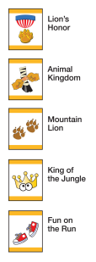

What’s New?
Added Pinewood Derby
Adding Adventure Loops and Advancement Chart
Changing rank patch to strip and adding rank cards
Updating materials to include family wording
Optional - Family Choice
  Fundraising
  Attending more Pack Meetings
  Adding optional neckerchief and slide

Slide 13

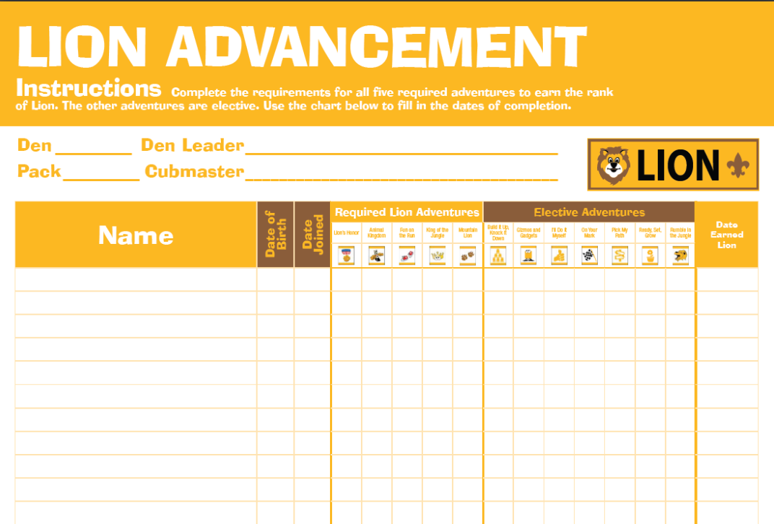

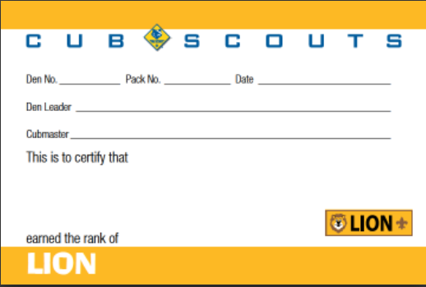
New Resources
New Cover
Added
Female Images
Rank Card

Slide 14
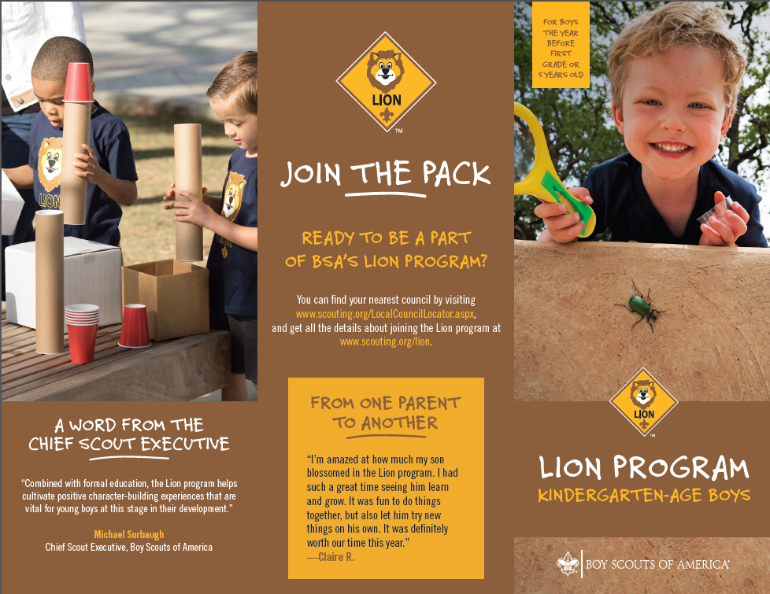

New Lion
Recruitment
Brochure(s)
Available at
www.scouting.org/lion
Versions
1) Original Boy Den
2) Interim Flier
3) New Girl Den
….coming soon

Slide 15
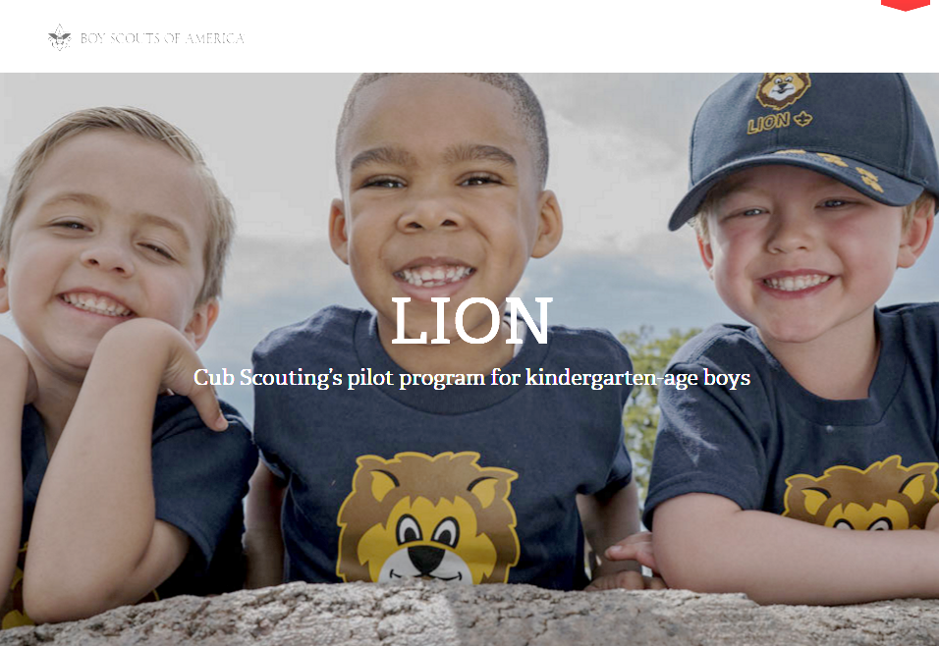
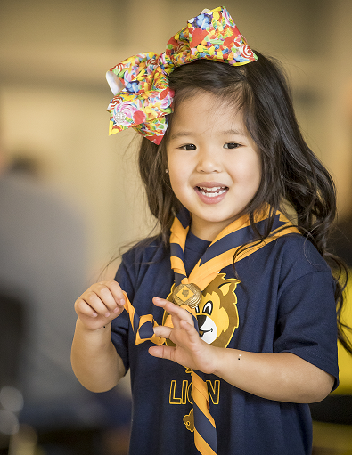
Online Resource
Lion web page:
www.scouting.org/lion
One-stop shop for resources--Councils, parents, leaders
  All program and orientation resources
  Recruiting materials—fliers, promotional video, etc.
  FAQs
Need help?
Contact Member Care 972-580-2489 or MyScouting@Scouting.org

Slide 16
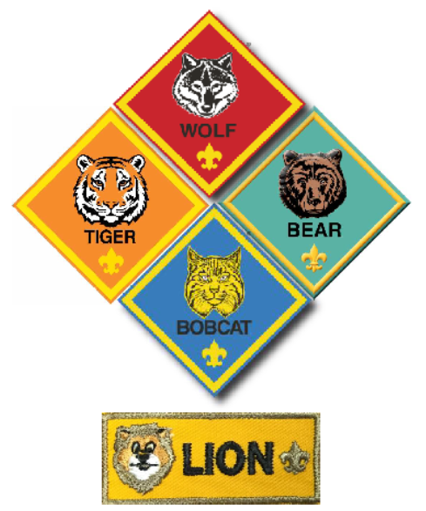
Cub Scout Ranks
Notes:
Left set is for Cub Scouting blue uniform
Right set is to be worn on the Webelos uniform.

Slide 17
Lion Panel
Bob D’Avignon
Director of Field Service
National Capital Area Council
Original Pilot—Western Mass
Ken Ruppel
Sr. Field Director
Crossroads of America Council
Michael De Los Santos
Scout Executive/CEO
Alamo Area Council
Daniel Tucker
Deputy Scout Executive
Orange County Council

