Slide 1
Welcome to the webinar about activities you can do virtually with Scouts and Explorers.
Please bear with us while we wait a couple minutes for members to join.

Slide 2
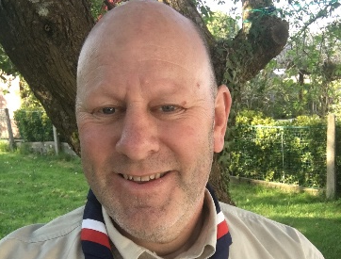
On tonight’s call
Dave Thompson, Explorer Scout Adviser and Volunteer Head of Active Support
Max Hemingway, Scout Leader
Humaairah Jama, Explorer Leader
Will Reynalds, Scout Adviser
Clint Marler,
Air Scout Adviser

Slide 3
Agenda
Welcome & intro
Activity ideas for Scouts
Activity ideas for Explorers
Expert opportunities
Top tips to adapt activities to deliver virtually
Q&A

Slide 4
Poll - Are you currently delivering activities online?

Slide 5
Activity ideas for Scouts
Max Hemingway, Scout Leader @ 4th Bramhall

Slide 6
Activity ideas
Paper Paddlecraft (Science Badge / Model Badge)
Talking Stick (Craft Badge)
Tin Can Bug House (Naturalist Activity Badge)
Dream Catchers (Craft Badge)
Parachutes (Science Badge)
Straw Rockets (Science Badge)
Toilet Roll Star Projector (Astronomer Badge)
Story Discs (Writer Activity Badge)

Slide 7
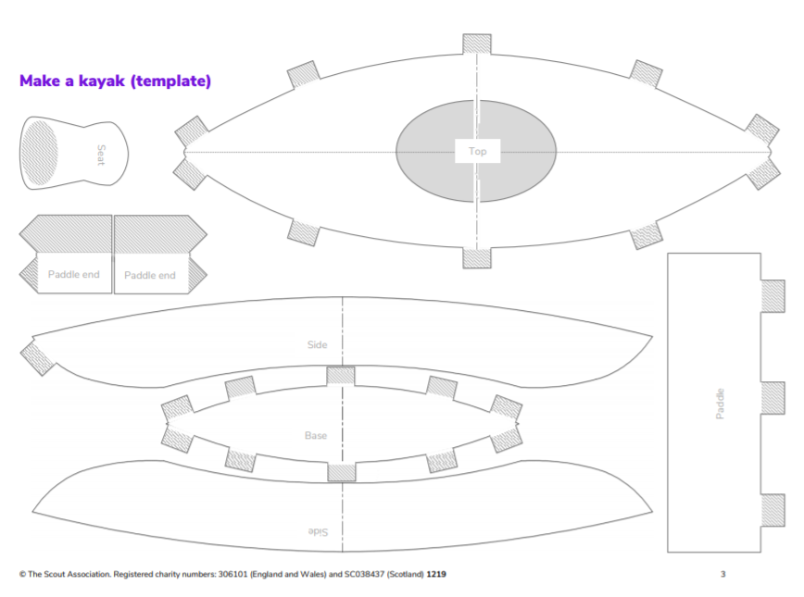
Paper paddlecraft
Science Badge / Model Badge
Instructions & Template
Talking stick
Craft badge
Watch the video here
Tin can bug house
Naturalist activity badge
Watch the video here

Slide 8
Dreamcatchers
Craft badge
Instructions & video
Parachutes
Craft badge
Watch the video here
Straw rockets
Science badge
Template & video
Toilet roll star projector
Astronomer badge
Watch the video here

Slide 9
Activity ideas for Explorers
Humaairah Jama, Explorer Leader @ 7th Goodmayes

Slide 10
Let Explorers take the lead. Ask them how often they want to have zoom sessions/how long they want them to be and what they want to do during them?
2-3 of them work together to plan and deliver the session for the rest of the unit.
Different Explorers lead each session.

Slide 11
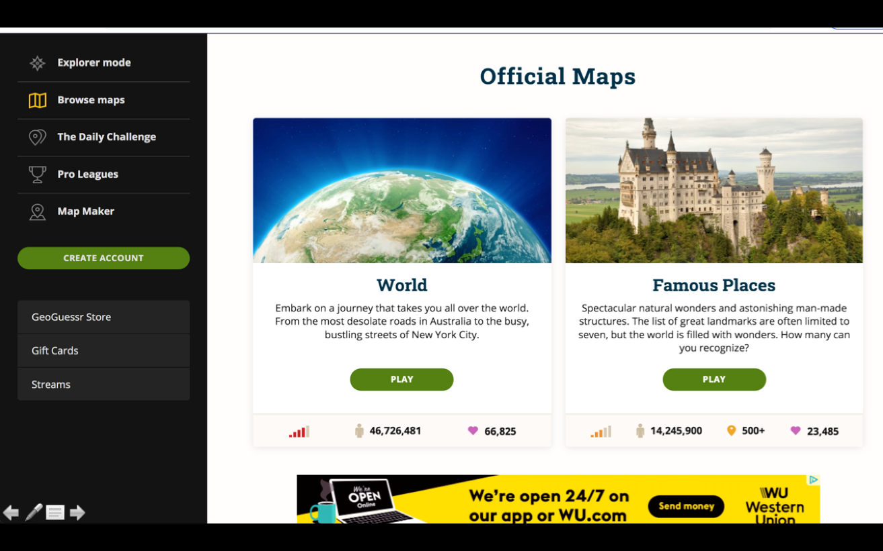
Session ideas
Debates
Teach/learn a skill
Taskmaster
Google street view scavenger hunt
GeoGuessr
Book club - choose a book accessible to everyone that they read in between sessions and discuss at the session.

Slide 12
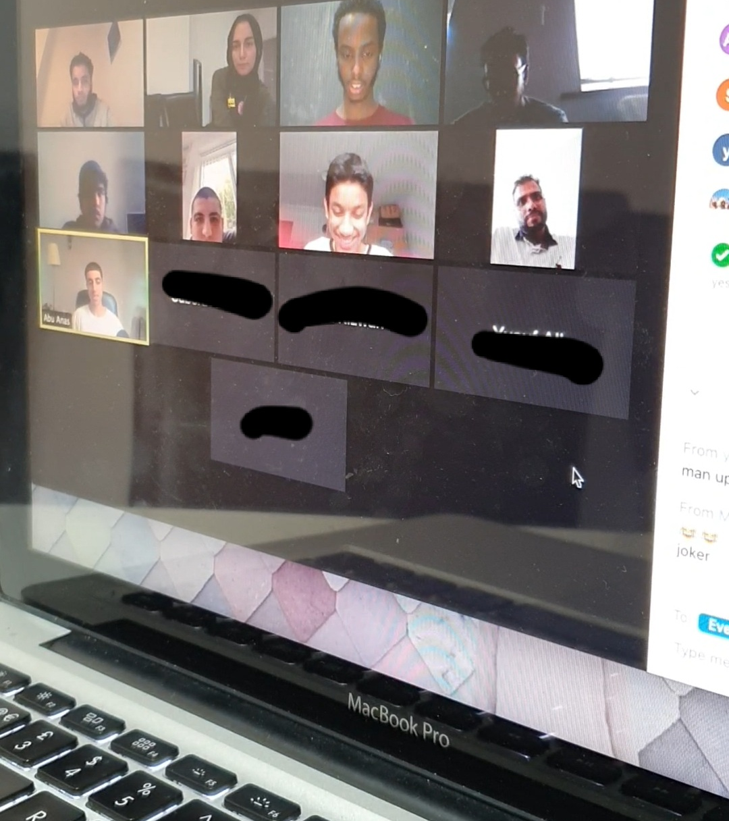
Badges
Cover over Zoom/at home
Chef activity badge
Creative arts activity badge
Global issues activity badge
International activity badge

Slide 13
Expert opportunities
Clint Marler, Air Scout Adviser
More opportunities to get celebrities and experts to join your Zoom meetings (compared to face-to-face)
For example:
Red Arrows & Aerobatic Pilot
Visited a Nuclear bunker talked with the Royal Navy outreach team
International with Finnish Air Scouts
RAF Chinook demonstration team

Slide 14
Top tips to adapt activities
to deliver virtually

Slide 15
Assets to use on your Zoom calls
Congratulations on achieving Chief Scout Awards - videos from section advisers
Ambassador videos
Branded backgrounds
Available in the Brand Centre
Or the Digital Platforms for Scouts webpage

Slide 16
For more activity ideas to do in The Great Indoors head to…
scouts.org.uk/the-great-indoors
1st Virtual Scout Group (filter by section in ‘popular topics’)
1st YouTube Scout Group (Facebook)
National SASU’s

Slide 17
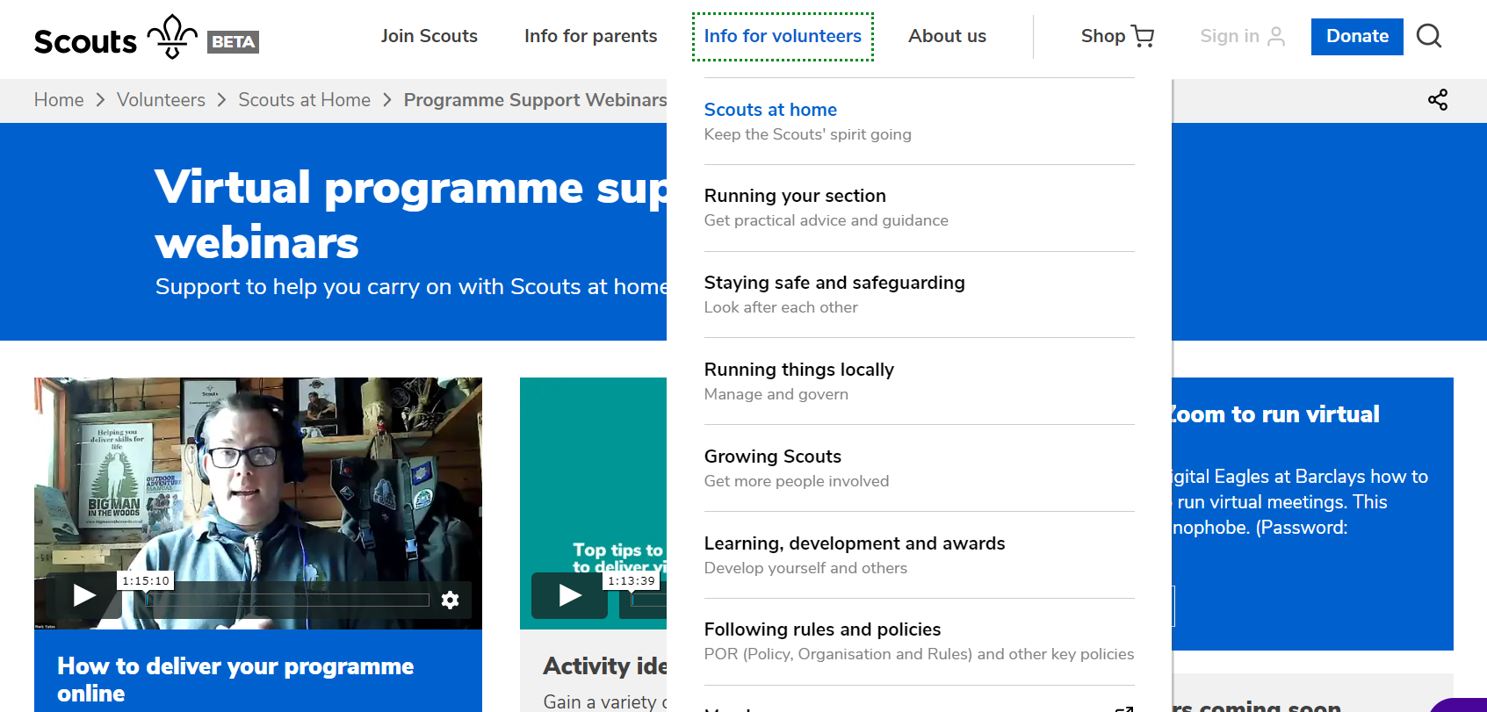
How to find the recording
www.scouts.org.uk/volunteers/scouts-at-home/programme-support-webinars/

Slide 18
Q&A

