Slide 1
New ways of working
Attracting new volunteers

Slide 2

Who's on the call?
  Hamish Stout, Change & Infrastructure Sponsor
  Katie Miller, Head of Volunteering Experience
  Katharine Paton-King, Growth & Communities Manager - South
  Alison Fell, Volunteer Product Lead - Welcome
  Pete Jeffreys, Volunteer Product Lead - Volunteer Journey
  Gordon Weston, Volunteer Sponsor - Learning
  Bebbe Hron, Volunteering Executive
  Adam Ray, Communications Team
  Rob Groves, Elizabeth Stormfield, Change Team

Slide 3

What we’ll cover
Volunteer Experience overview
Finding new volunteers today
New Volunteering Opportunities tool
Expressions of interest
Becoming a member
Questions
Next steps

Slide 4
Volunteer Experience Overview

Slide 5




Listening to our volunteers, young people and the public we’ve identified three key areas for change:
Providing a warmer welcome for everyone
Delivering a more engaging learning experience
Simplifying how we volunteer together
All of which will be supported by easy-to-use digital tools

Slide 6



Transforming our Volunteer Experience
A warmer welcome for everyone
Simplifying how we volunteer together
More engaging learning
Redesigning the appointments process
Introducing a welcome conversation
New volunteering opportunities tool
Improved self-service for new volunteers
Team-based approach allowing tasks to be shared
Clearer purpose and responsibilities of teams
More flexible volunteering
New digital tool for adult volunteers
Reviewing current training and moving to learning
New digital learning tool with engaging content
Learning produced in partnership with volunteers and external experts

Slide 7

Supporting Digital Tools
Scouts.org.uk Website
Easy to use and mobile-friendly
Single Sign On
Fewer steps and less administration
Specialist functionality
Digital first, but not digital only
Continuous improvement over time
Volunteering Opportunities
My Membership
My Learning
Better able to attract more volunteers through an improved advert and enquiry system
Clearer information upfront about roles, responsibilities and what to expect
Reduced administration (Including references & disclosures)
Improved visibility of information
Easier to manage processes e.g. Permits & Awards
More accessible, engaging and enjoyable learning
Easier reporting and management of learning

Slide 8




Steps to becoming a volunteer
Attraction
Joining
Appointment
Induction
I am attracted to volunteering with the Scouts, the information I need is readily available
I am clear on my roles & responsibilities, and I feel understood & valued
Becoming a volunteer with Scouts was a great experience, so easy and welcoming
I’ve been made to feel welcome, I understand what my role involves, I’ve received the key information for me to hit the ground running

Slide 9
Finding New Volunteers today
Katharine Paton-King
Growth & Communities Team

Slide 10

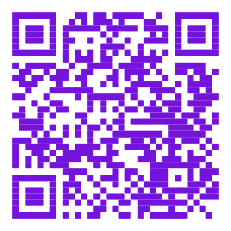
  Attraction
Methods and tools we already (and will continue to) use
Word of mouth
Social media
Posters and adverts
Open events / activity days
Focus on tasks rather than roles
Resources and Support available
Workshops
Brand Centre, templates
Web resources
Scan the code and explore the web resources...

Slide 11
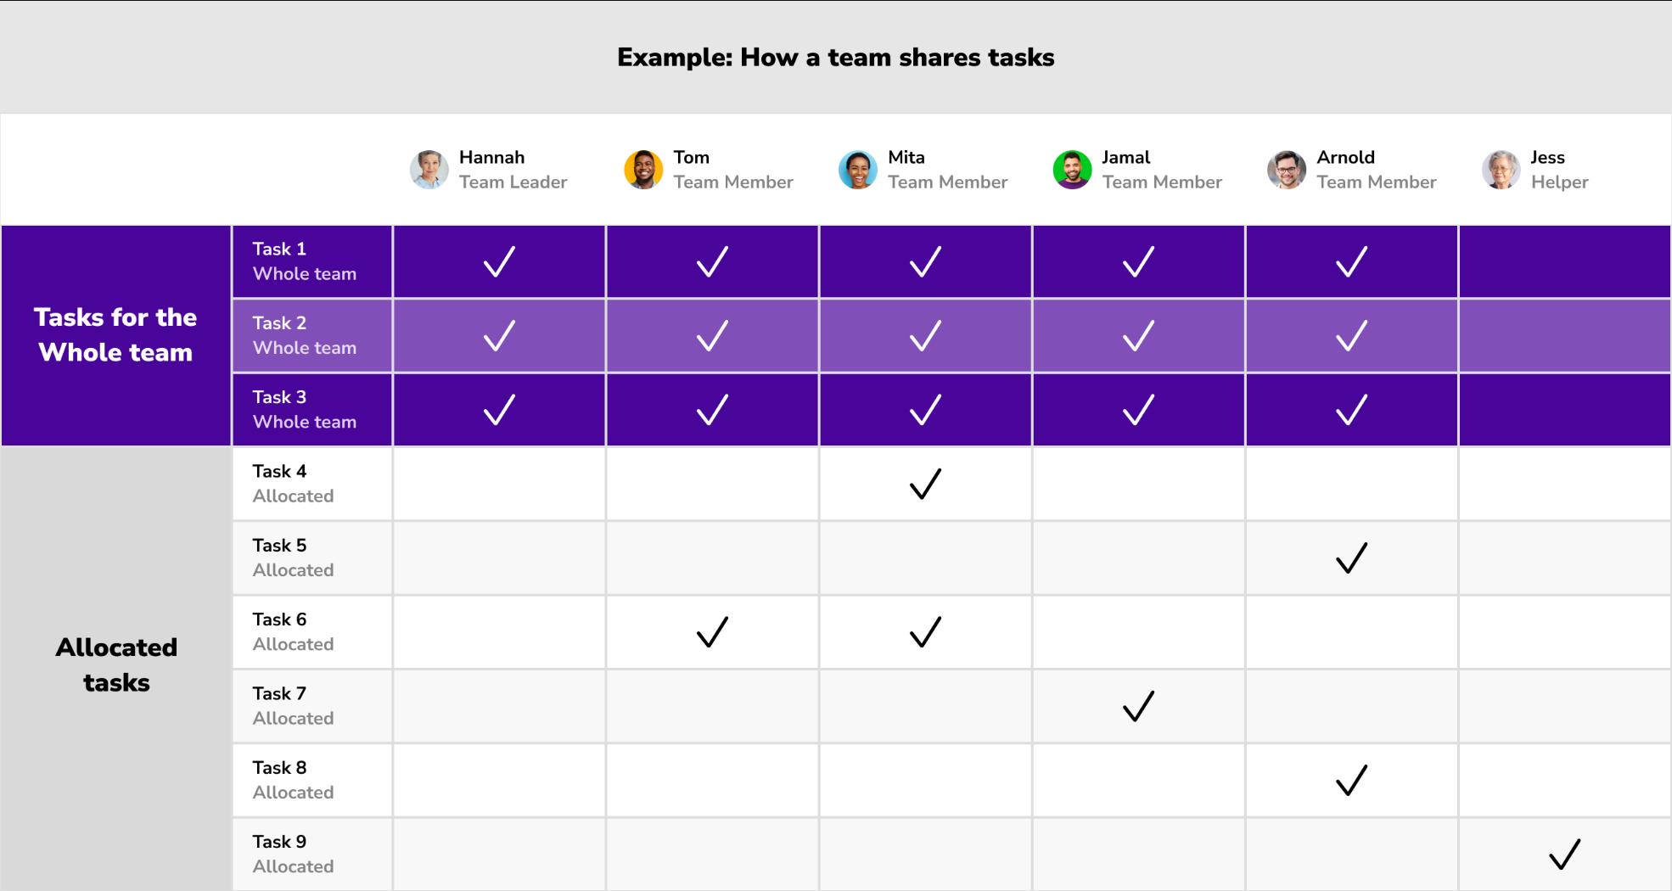

Slide 12
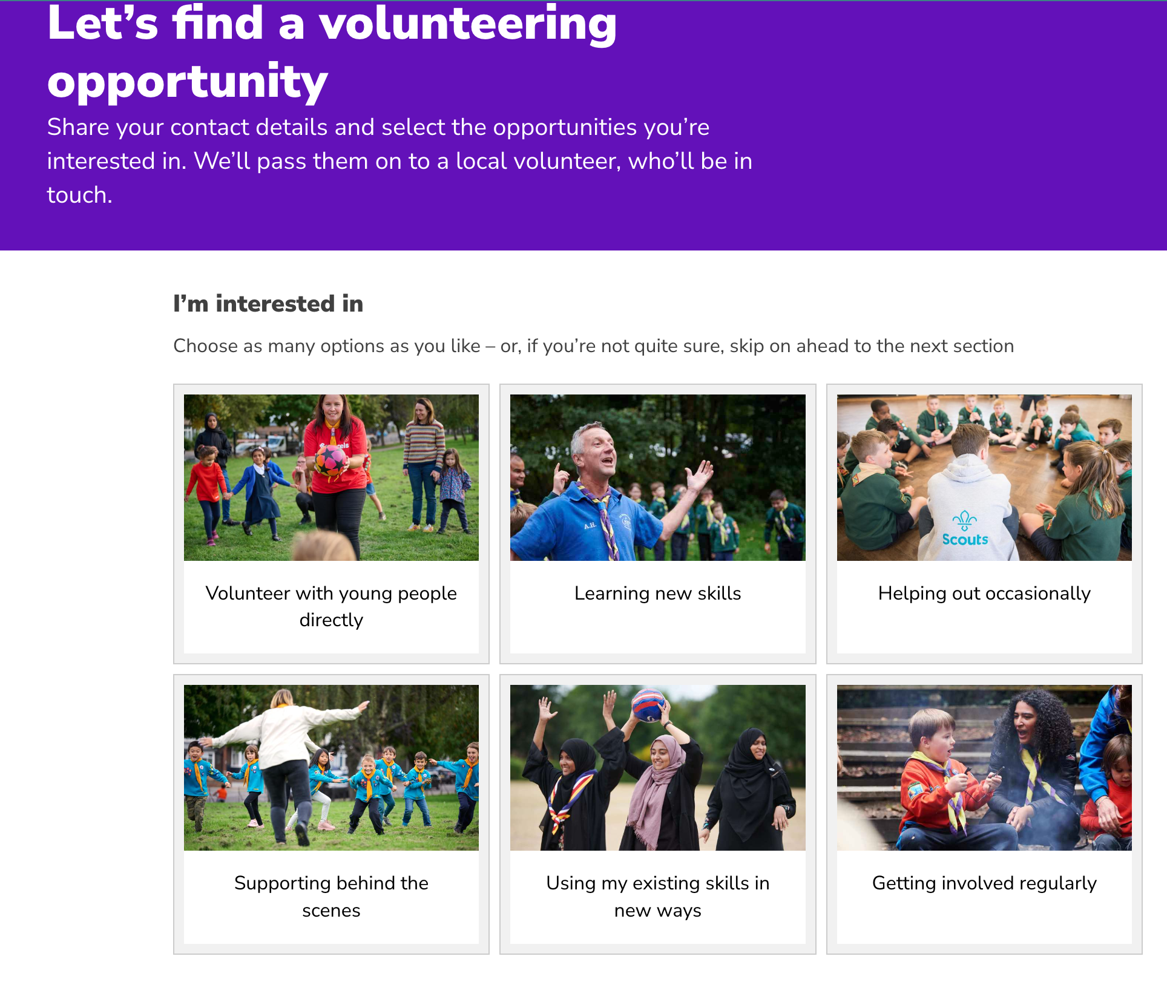
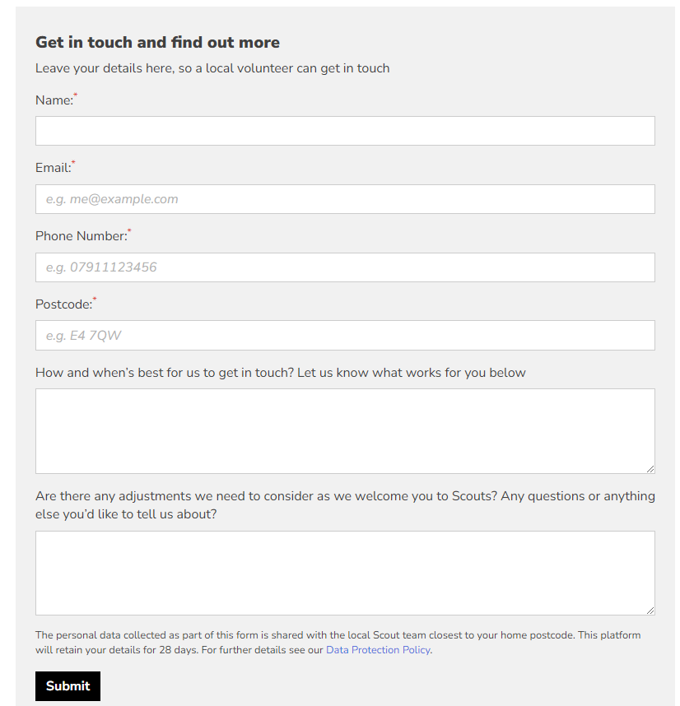
  Expressions of interest today

Slide 13
New Volunteering Opportunities tool

Slide 14

  Attracting volunteers
New digital system has many features to support both new volunteers and those recruiting them
Find and apply for a volunteering opportunity, or submit general expression of interest
New volunteers can track their joining journey progress
New digital features
  Update personal details
  Submit ID for criminal record check
  Existing volunteers access and manage new volunteer enquiries

Slide 15
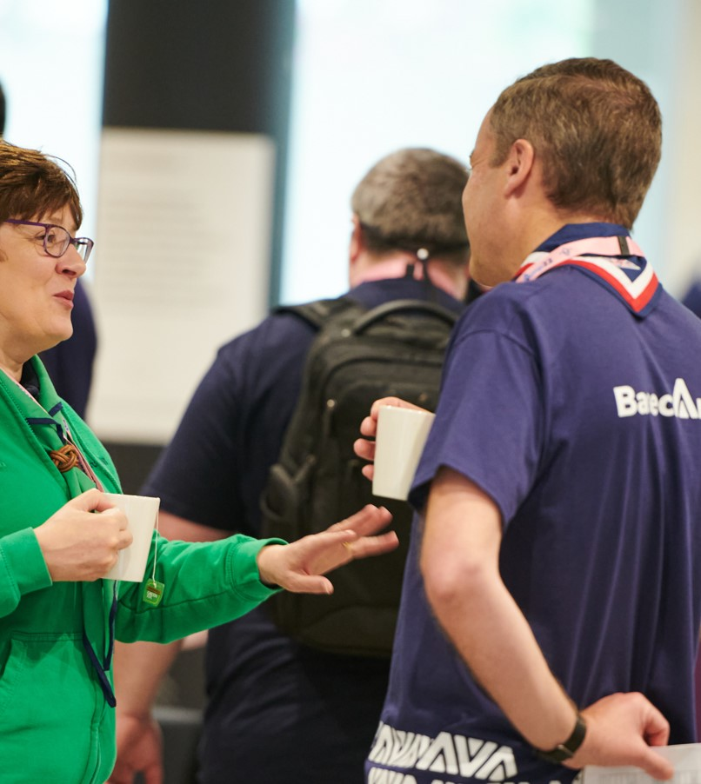
  System permissions
Default permissions to manage adverts and receive enquiries
  Section Team Leaders
  Programme, Volunteering Development, Support, 14-24 Team Leaders
  Lead Volunteers
  Trustee Board Chair
Systems permission can be shared with someone else using the Recruiter accreditation
Who can give or remove this accreditation:
  All Lead Volunteers
  All Volunteering Development Team Leaders
Remember: effective recruitment is for everyone in the team to be a part of.

Slide 16
New feature demo

Slide 17
  Demonstrating the tool
Over the next 10 minutes we're going to show you the tool and how:
To publish vacancies / adverts using templates
A new volunteer can register their interest in a role
To express interest in volunteering with Scouts
To manage expressions of interest
To add a new member
To share the direct link to an advert

Slide 18
Becoming a member

Slide 19
  I've added a new volunteer, what next?
Volunteer
Complete personal details, provide details for references and criminal record check information
Complete Safe Scouting learning within first 30 days
Work with your line manager to arrange Welcome Conversation
Other things within 6 months
Accept declarations
  Complete remaining Growing Roots learning
  Look at the induction & buddy information
Line Manager
Check no questions on joining journey
Validate ID for criminal record check
Arrange Welcome Conversation
Talk about buddies and induction
Monitor progress through digital tool
  Adventure and opportunity this way......

Slide 20



Questions

Slide 21
Listening to our volunteers, young people and the public we’ve identified three key areas for change:
Providing a warmer welcome for everyone
Delivering a more engaging learning experience
Simplifying how we volunteer together
All of which will be supported by easy-to-use digital tools

Slide 22



Making volunteering easier and more fun is how we reach our North star...
More young people gaining skills for life
Consistently and safely
deliver a great programme
Recruit more volunteers
and retain current ones

Slide 23
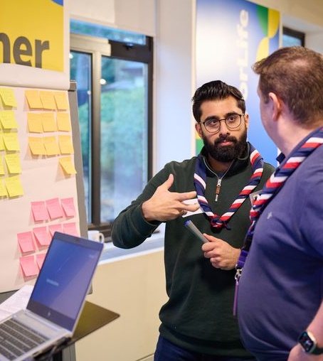
  Next Steps
We will send you…
These slides
A recording of the call
Links to all the resources we’ve mentioned
You might want to…
Talk with your teams about the “tasks not roles” approach to recruitment
Agree in your team who will lead on these recruitment tasks
Join a Go-Live Webinar
Group: 4th or 11th September
District / County: 2nd or 10th September

Slide 24
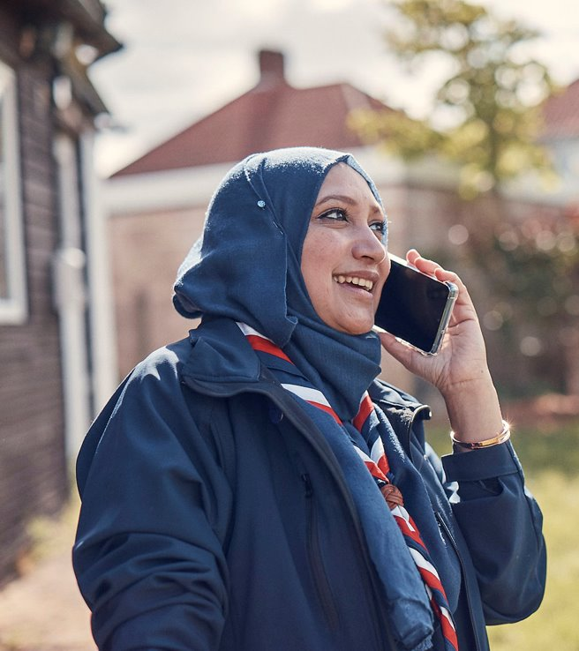
  Supporting Resources
Volunteer Experience overview www.scouts.org.uk/volunteers/volunteer-experience/
Change readiness checklists www.scouts.org.uk/volunteers/volunteer-experience/ready-for-change/
Growing Scouts including Recruitment Toolkit www.scouts.org.uk/volunteers/growing-scouts/
Volunteer Recruitment workshops www.scouts.org.uk/volunteers/growing-scouts/recruitment-toolkit/volunteer-recruitment-workshops/

