Slide 1
Transformation Leads Call

Slide 2
Who's on the call?
Craig Turpie, Deputy UK Chief Commissioner
Andrew Sutherland, Deputy Programme Sponsor
Hamish Stout, Deputy UK Commissioner for People (Transformation)
Lara Burns, Chief Digital Officer
Graham Phillips, Project Sponsor - Membership System
James Booker, Head of Portfolio Delivery & Change
Adam Ray, Communications Manager
Elizabeth Stormfield & Rob Groves, Change Team

Slide 3
What we’ll cover
System Processes
Migration Timeline
Go-Live Support
Tasks for 2023
Early Adopter Update
Next Steps

Slide 4
What we shared last month
Digital System Videos
Teams and Titles Webpage
Sub-teams Webpage
Helpers Webpage
Readiness Checklist
WhatsApp Community

Slide 5
System Processes

Slide 6
Overview
New system features will replace or amend several current Scouts processes
How you implement these processes locally will need to be built into your preparations
We’ll cover some processes today and the others in materials which will be shared during November

Slide 7
Process changes and enhancements
Attracting new volunteers | Managing volunteers (Inc. their teams & accreditations) | Activity & Nights Away Permits
The Joining Journey (Inc. Growing Roots) | Managing your local structures (Inc. teams & sub-teams) | Nights Away Notifications
Managing my personal details | Dashboards & Reporting | Good Service Awards
Learning | Appointment Reviews | Grant applications and tracking

Slide 8
Process Changes
Attracting new volunteers | Managing volunteers (Inc. their teams & accreditations) | Activity & Nights Away Permits
The Joining Journey (Inc. Growing Roots) | Managing your local structures (Inc. teams & sub-teams) | Nights Away Notifications
Managing my personal details | Dashboards & Reporting | Good Service Awards
Learning | Appointment Reviews | Grant applications and tracking

Slide 9
Activity & Nights Away Permits
Volunteer applies for permit through system, including selecting assessor, attaching supporting documentation
Selected assessor carries out technical assessment and confirms Scout rules knowledge
Technical assessment is recorded on system
Lead Volunteer or accredited person approves permit on system after confirming personal suitability
Progress of the permit application can be reviewed on the system at any time by Lead Volunteer or by applicant

Slide 10
Activity & Nights Away Permits
Volunteer applies for permit through system, including selecting assessor, attaching supporting documentation
Selected assessor carries out technical assessment and confirms Scout rules knowledge
Technical assessment is recorded on system
Lead Volunteer or accredited person approves permit on system after confirming personal suitability
Progress of the permit application can be reviewed on the system at any time by Lead Volunteer or by applicant

Slide 11
Good Service Awards
Through the system, any volunteer may submit a Good Service Award nomination, including supporting information, attachments and the citation
At the time of creating the submission, the system checks whether award criteria are met to allow for the creation of the nomination to proceed
Approved Good Service Award nomination sent to HQ by system
Awards sent out by HQ quarterly to the accredited Awards parcel recipient
On the system, the Lead Volunteer or Approver will then review (and edit if required) the nomination and approve or reject this

Slide 12
Good Service Awards
Through the system, any volunteer may submit a Good Service Award nomination, including supporting information, attachments and the citation
At the time of creating the submission, the system checks whether award criteria are met to allow for the creation of the nomination to proceed
Approved Good Service Award nomination sent to HQ by system
Awards sent out by HQ quarterly to the accredited Awards parcel recipient
On the system, the Lead Volunteer or Approver will then review (and edit if required) the nomination and approve or reject this

Slide 13
Nights Away authorisations
Volunteers submit their Nights Away Notifications (NAN), including risk assessment, through the system
System adds permit details, learning compliance and criminal records check status of all attending adult members
On the system, Lead Volunteer or accredited Nights Away Approver reviews the NAN form and attached supporting documents
On the system Lead Volunteer or Nights Away Approver approves or rejects the NAN
After approval, if there are changes made to the NAN it will reset and go round the approval route again

Slide 14
Nights Away authorisations
Volunteers submit their Nights Away Notifications (NAN), including risk assessment, through the system
System adds permit details, learning compliance and criminal records check status of all attending adult members
On the system, Lead Volunteer or accredited Nights Away Approver reviews the NAN form and attached supporting documents
On the system Lead Volunteer or Nights Away Approver approves or rejects the NAN
After approval, if there are changes made to the NAN it will reset and go round the approval route again

Slide 15
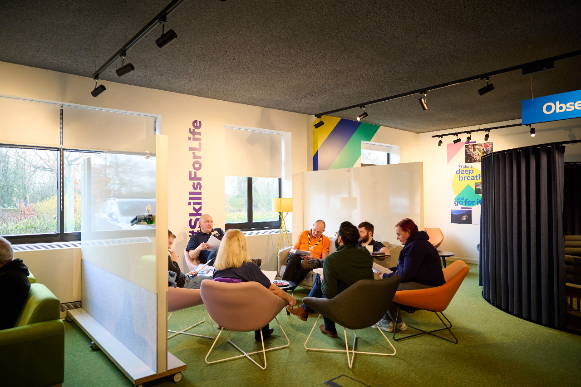
Things to consider
Discuss in your County how best to move to the new processes
Ensure those involved in your local processes:
Know what is changing
Know what they will need to do differently in future
Are given the appropriate accreditations
All volunteers will need to know about which processes are changing and how

Slide 16
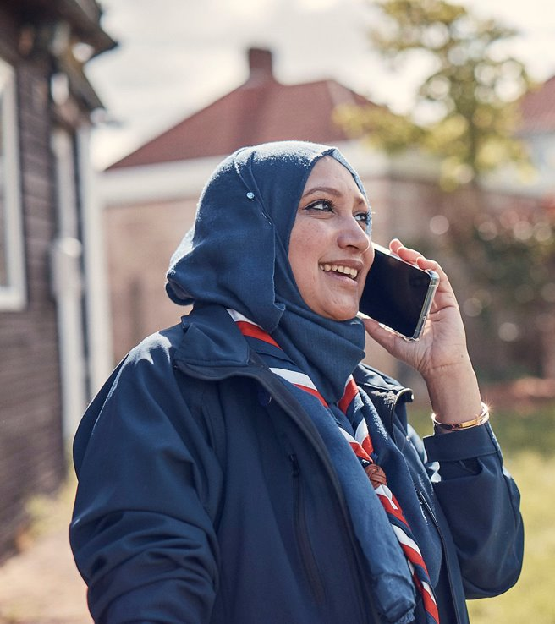
Understanding the new system
The system is designed to be intuitive and easily navigable
Guides and videos are being produced for the new systems and processes
These will be further improved using feedback from the EA go live
We’ll share more on this in January

Slide 17
Migration Timeline

Slide 18
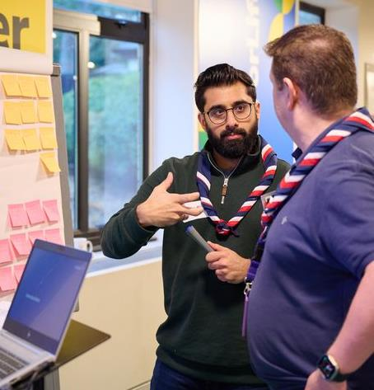
Current Status
System build complete
Internal testing currently in progress
Preparing for end-to-end testing with volunteers later this year
Beta testing learning content with volunteers
Agreeing exact dates of, and interim processes during the migration

Slide 19
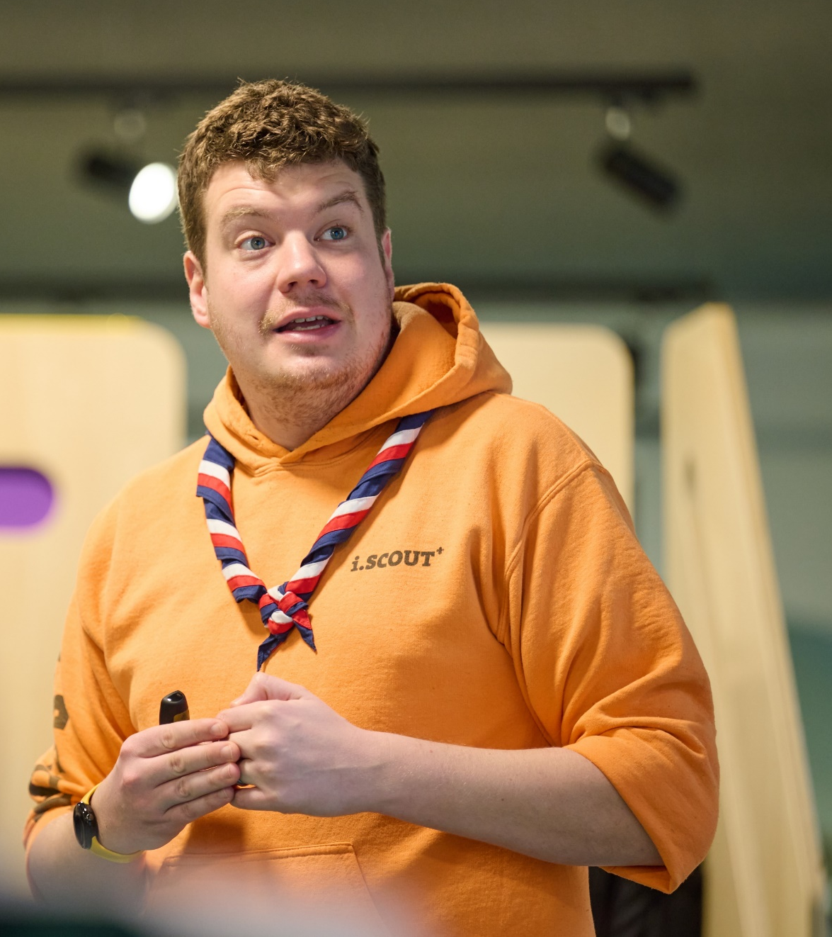
Go-Live Timeline
Early Adopters
Will start using the new digital tools, processes and structures from middle of February 2024
Counties must please update Compass information by 15 January (exact dates to be confirmed)
All Counties
Will start using the new digital tools, processes and structures from end of April 2024
Counties must please update Compass information by 31 March (exact dates to be confirmed)

Slide 20
Communications
Friday 13 October: Transformation Leads Newsletter
Thursday 19 October: County and District Commissioner and Chairs Call
Tuesday 31 October: Transformation Leads Call
Tuesday 7 November: All Member Email

Slide 21
Questions

Slide 22
Go-Live Support

Slide 23
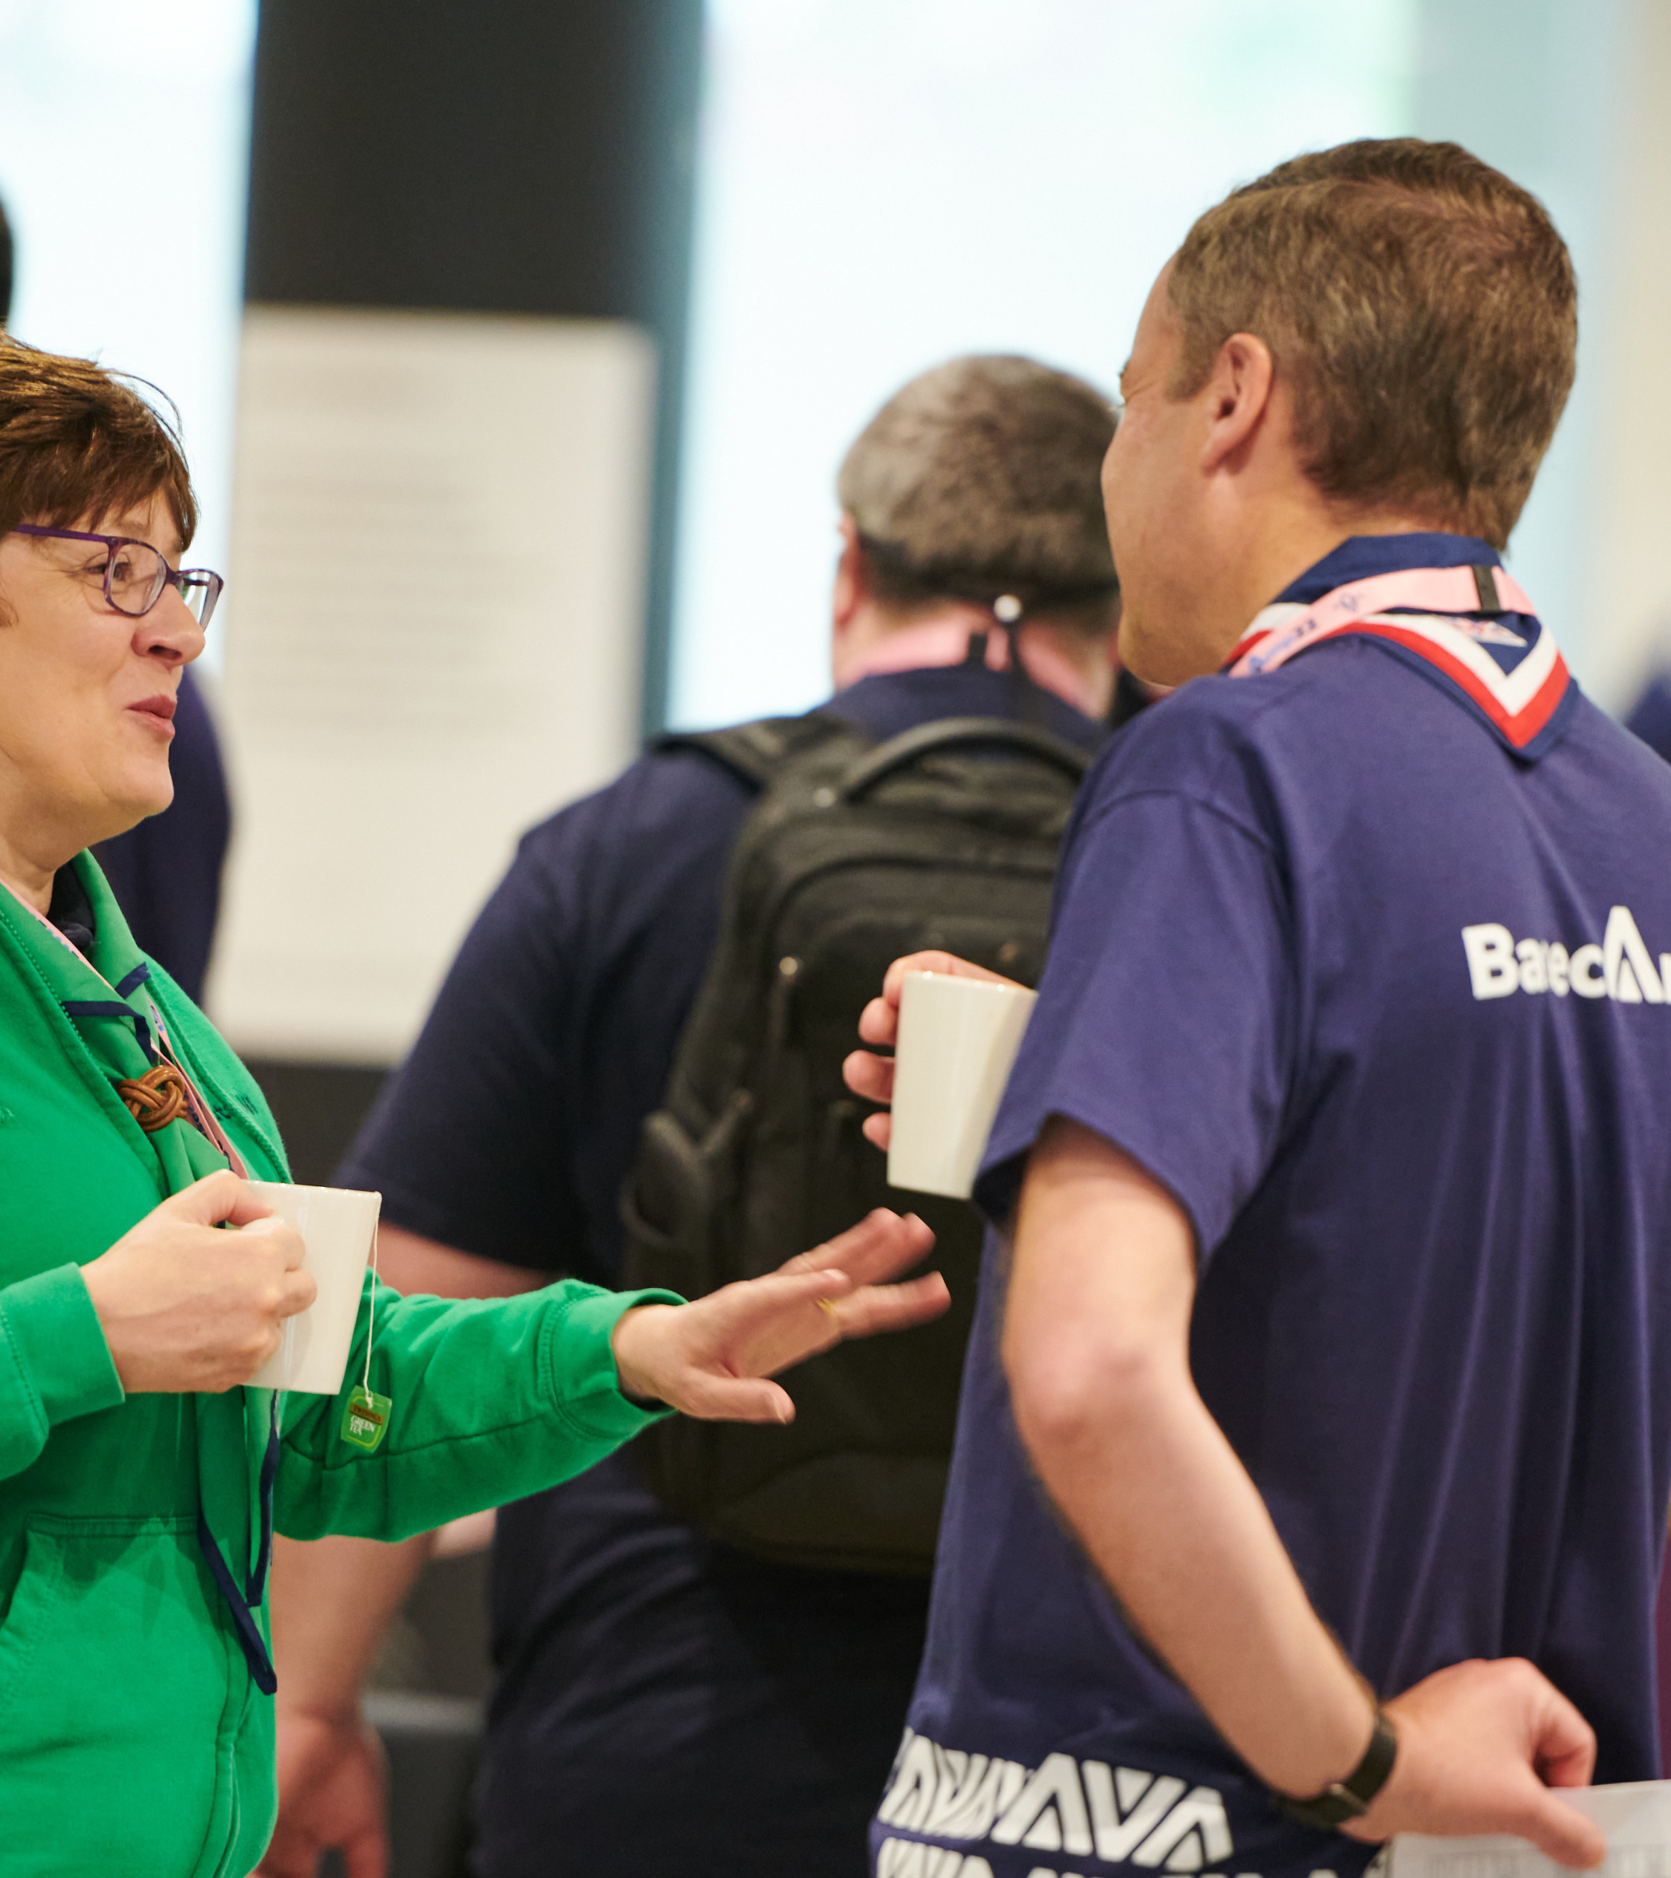
Support Model
Support for volunteers will be needed during the weeks before and after go-live
An HQ support model will be in-place, through the Support Centre, for volunteers
An additional layer of support will be needed locally too, particularly for queries which can only be answered locally about:
County/District Structures
Changes to local Scouts processes

Slide 24
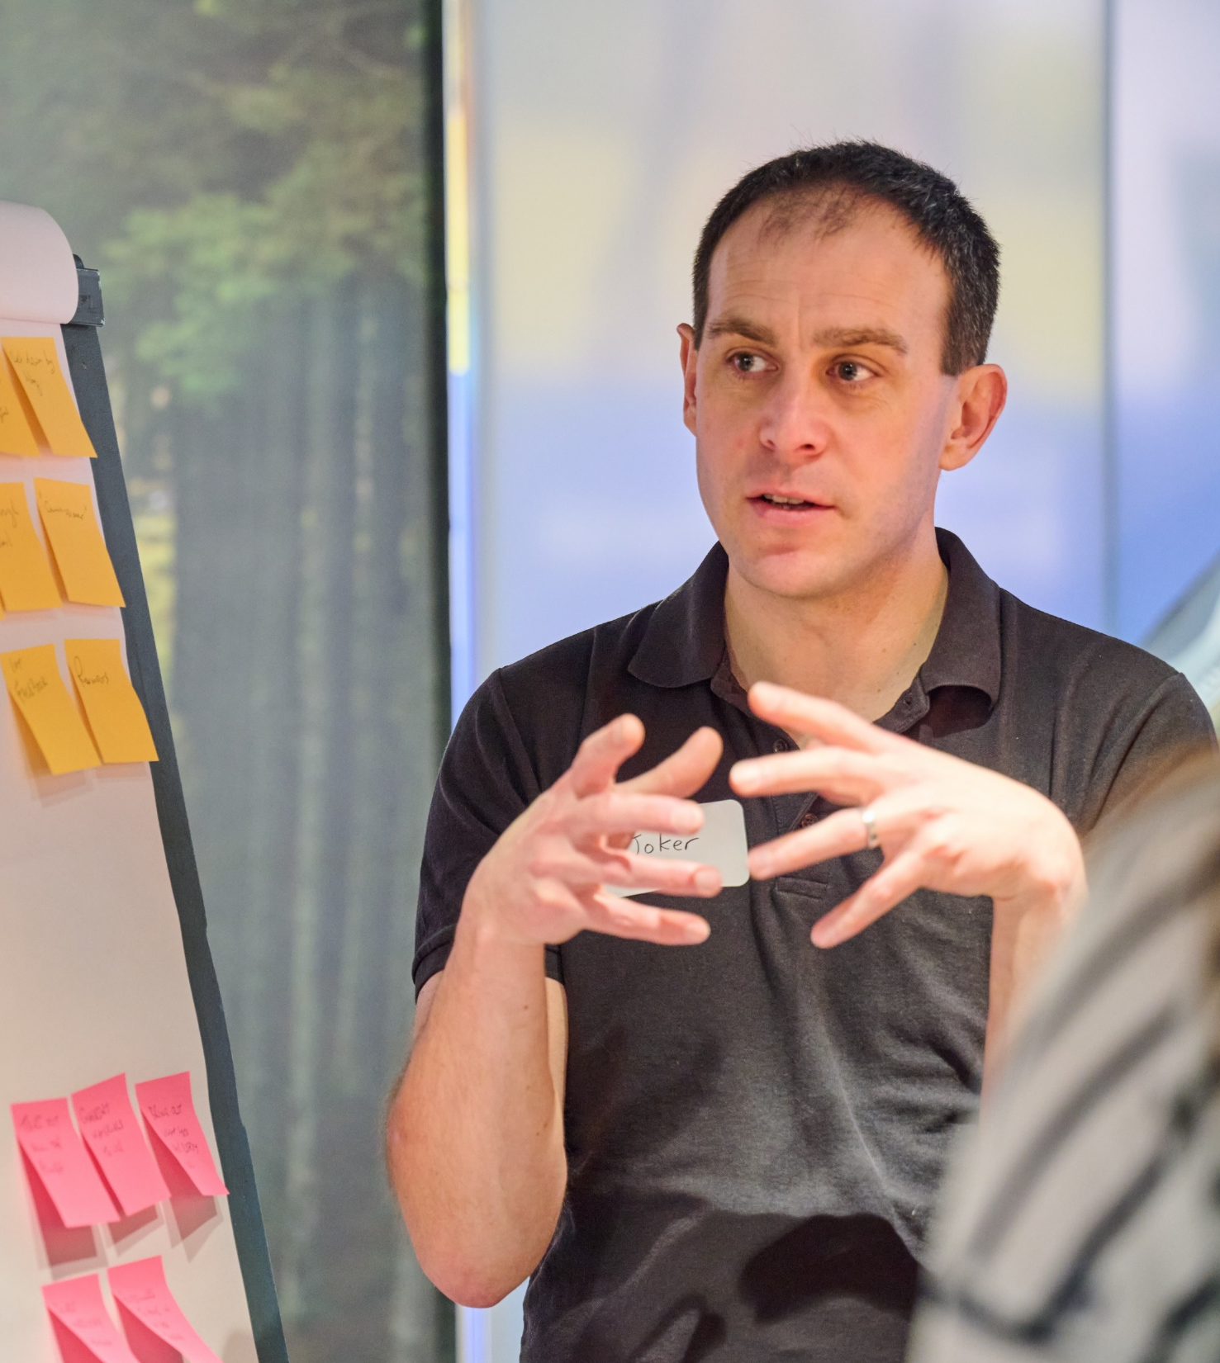
Local Support Needed
System Advice
Where do I find X, Y or Z on the new system?
How do I add/change something on my record?, and so on.
Local Scouting Changes
Who do I talk to about / How are we handling X, Y or Z?
Are we using the new NAN process?
Signposting
The Digital Skills Tool can also provide support for those with wider digital questions or support needs

Slide 25
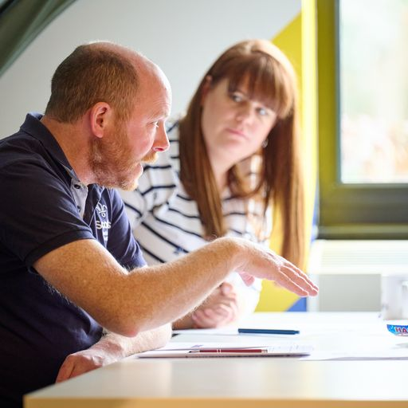
Local Support Model
Somewhere for people to get their questions answered locally
Build this how it works best in your area:
Central inbox
WhatsApp/Facebook Groups
Using existing teams/structures
This could be made up of people such as:
Transformation team
Digital system testers
Digital Champions already in your area
Trainers

Slide 26
Central Support Model
Local Support
Self-Service
Support Centre
Technical Support
Internal technology team and our 3rd party system providers
Resolve bugs and technical problems with system functionality
Webpages, User Guides, FAQs on website, local colleagues
Support for changes to scouting processes, basic troubleshooting, admin support etc.
District/County Support
Technical issues or bugs in digital systems
Queries from volunteers that aren’t answered via local support
Project/Programme team or Change team
Escalations from Support Centre
Escalation

Slide 27
POR Update

Slide 28
POR
The October edition will now be published in mid-January 2024
In mid-November an ‘almost-final-draft’ of the January 2024 edition will be circulated to all CCs and TLs

Slide 29
Tasks for 2023

Slide 30
Tasks to complete in 2023
All volunteers provided with relevant information for them
County & District team structures agreed
Use accreditations to plan how you’ll share tasks in your new structures
Reviewing your local processes
Compass records up to date
Full appointments encouraged

Slide 31
Questions

Slide 32
Early Adopter Update

Slide 33
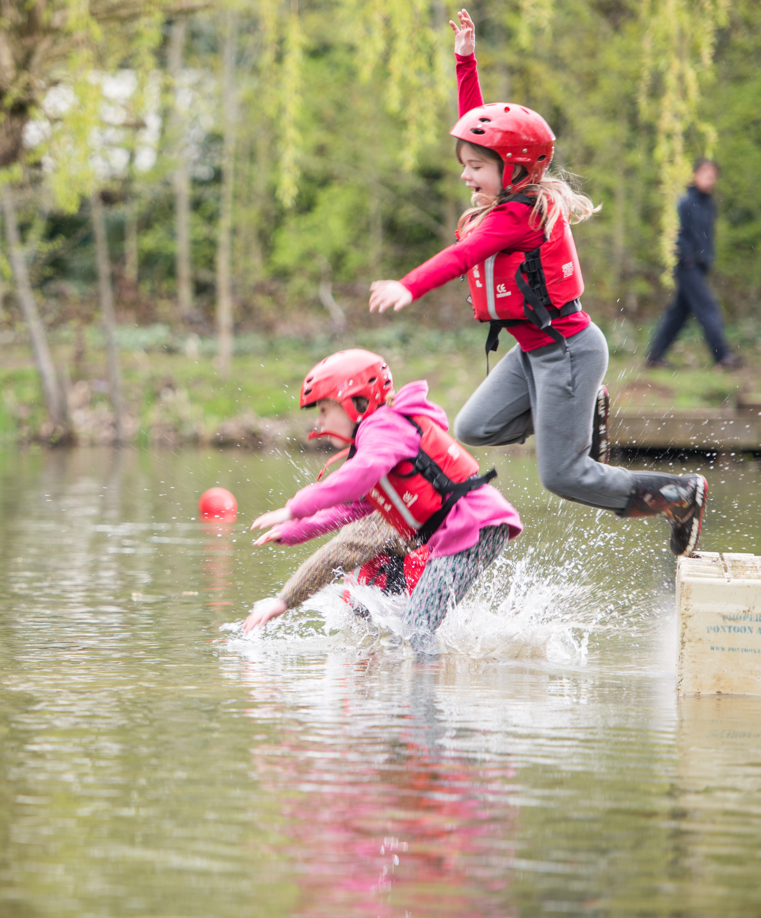
Early Adopter Update
Early Adopters going live in February 2024
EA event in January 2024
Exploring how best to deliver guides and videos for the new systems

Slide 34
Next Steps

Slide 35
What we’re doing:
What you can do:
Dates for Trustee webinars (for all Chairs & Lead Volunteers)
20 November
23 November
Developing Trustee resources ready for sharing at the end of November
Developing resources for building Volunteering Development Teams
Sharing confirmed first aid and learning changes information with CTMs and equivalents - 9 November
Utilise the readiness checklist in your area
Review your local processes
Build your local support model
Sign up to support building new resources for Volunteering Development Teams
Respond to the Change Readiness Survey

Slide 36
Thank You

