Slide 1


The Listening Tool
Piloted as part of Scouts’ Approach to Discrimination Project
Notes:
We know discrimination happens at Scouts, but most people don’t report it. The Listening Tool is a way for Scouts to learn more about discrimination happening at Scouts so we can create resources to support our volunteers who’re tackling discrimination.

Slide 2
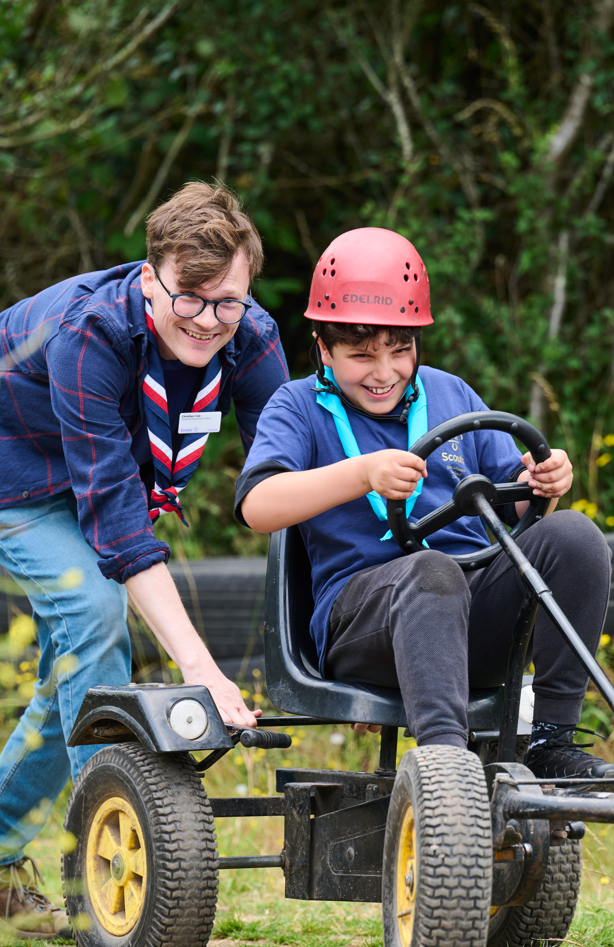
Scouts is all about...
Having fun
Trying new things
Belonging somewhere
Notes:
We want Scouts to be a place where everyone feels they belong. A place where you can have fun, try new things and hang out with your friends.
Think about some of the things you've done at Scouts.
Encourage everyone to share something fun or new they've done at Scouts.
No one at Scouts should feel unsafe, as though they don't matter, unwelcome, powerless or intimidated. But we know that some situations may cause some members to feel this way at Scouts. As a result they may feel as though they do not belong or matter at Scouts.
We need your help to understand what our members may be experiencing, so we can build the right guidance, help and support.

Slide 3
What is discrimination?
Notes:
Discrimination is ‘unfair treatment related to identity, such as age, gender, race or religion.’ Discrimination can look like lots of different things. For example, it could look like inappropriate language (slurs) or an old rule that’s always been there. Someone might say they’re “just having a laugh” or “it isn’t a big deal”.
But discrimination isn’t okay. It might make you feel angry, unsafe, powerless or scared. It’s motivated by stereotypes, prejudice or bias towards people’s identities, such as their gender, race or religion. It can be hard to talk about discrimination, especially if you’ve experienced it yourself or you know someone close to you who has. There will be people in this room who’ve experienced discrimination, so it’s important to be kind and respectful to each other when we talk about discrimination.
As Scouts, we believe in our Scouts values, Promise and Law and we expect all our members to act in line with these.
That means we:
Care about others (Care)
Work together to problem solve (Cooperation)
Take responsibility for our words, actions and mistakes (Integrity)
And are courageous even when it feels hard. (A Scout has courage in all difficulties.)
People who are excluding others, treating them unfairly or discriminating against others aren’t living by our values. If Scouts know how people aren't following our values, they can create resources to help those people learn and do better.

Slide 4
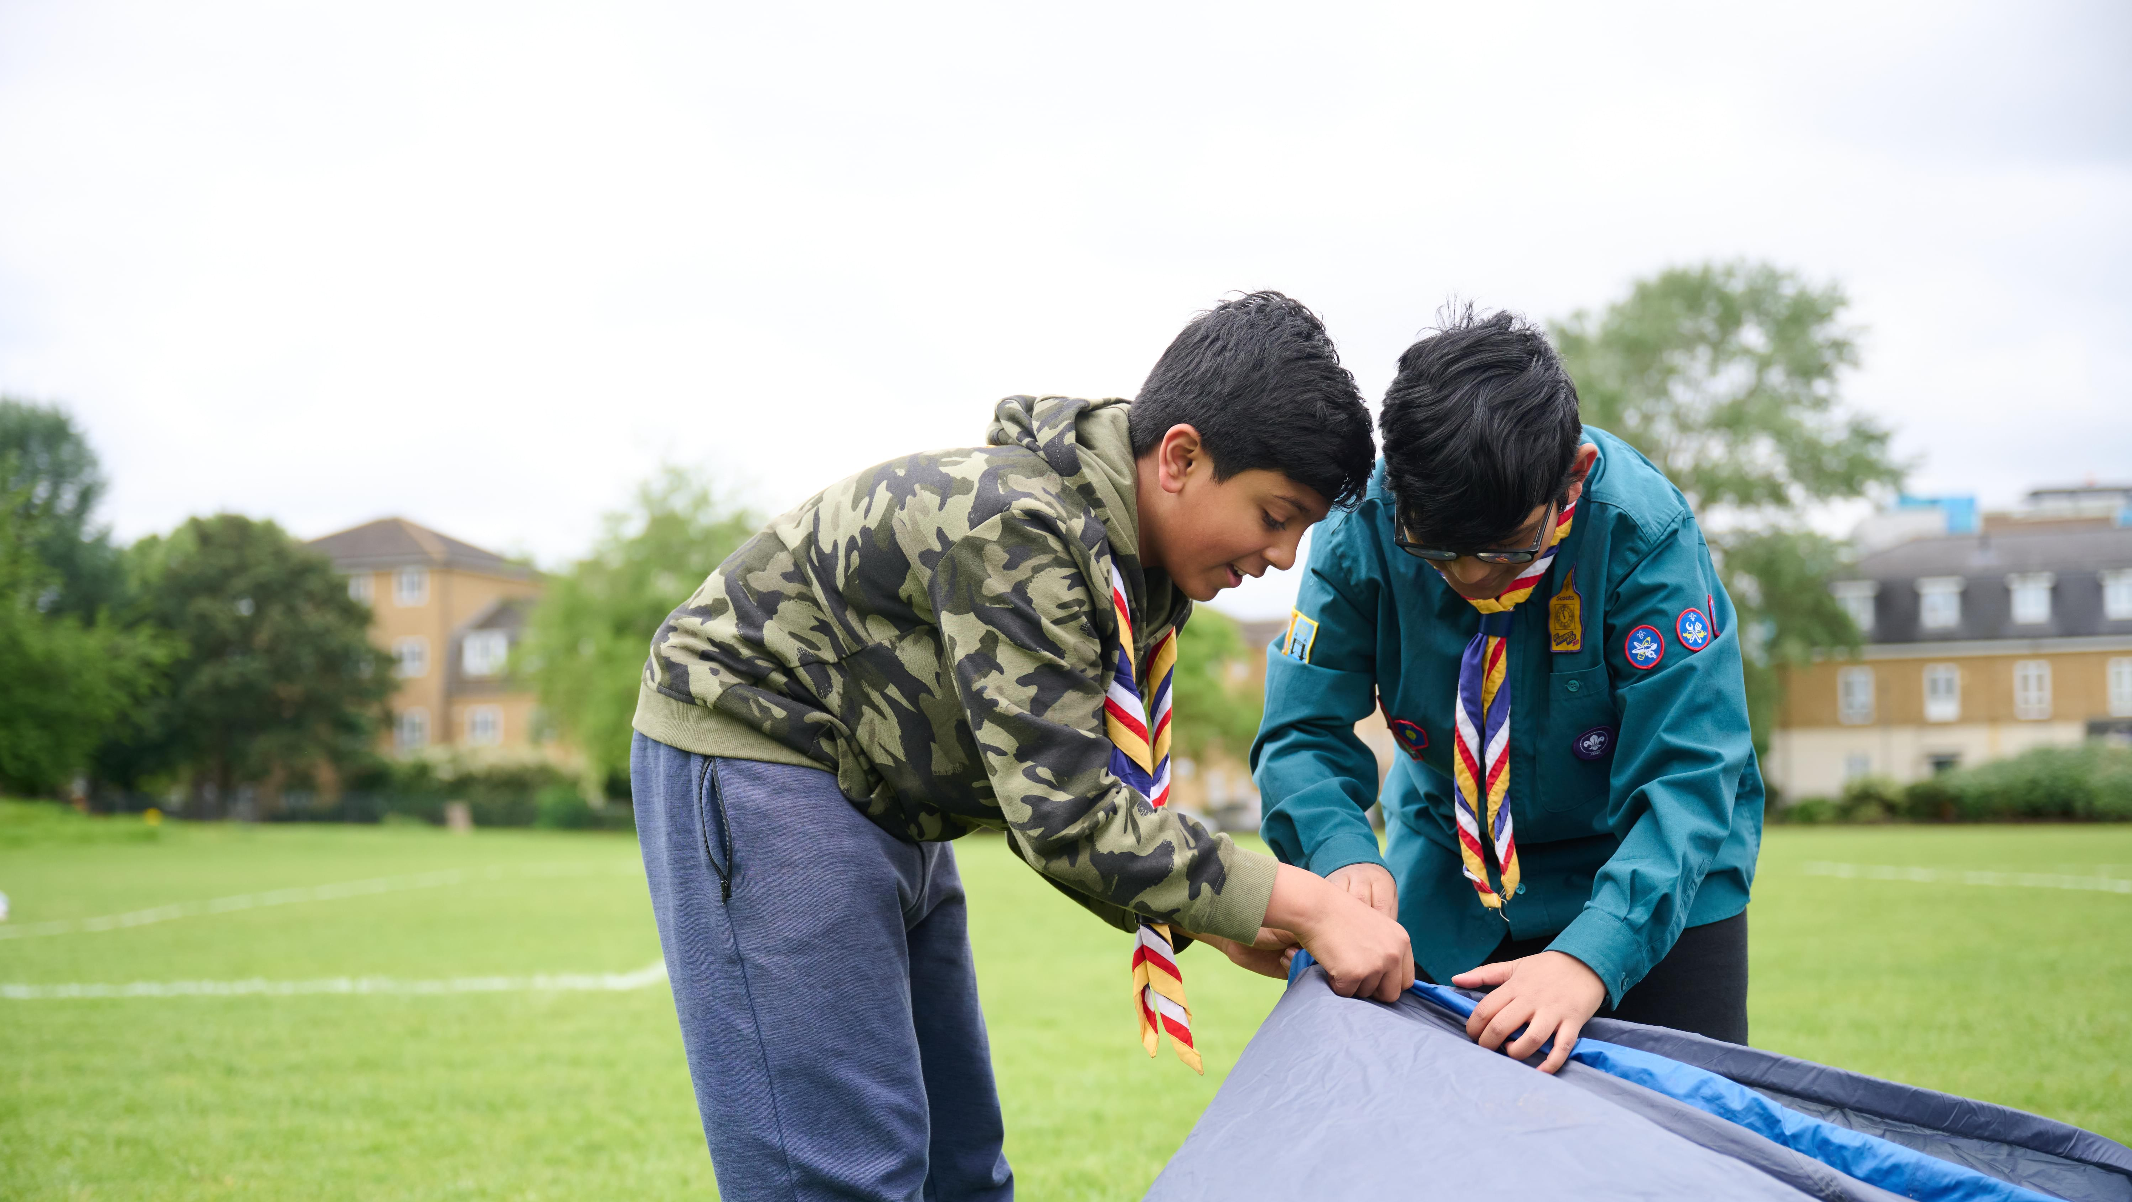
What is the Listening Tool?
Notes:
The Listening Tool is a way for you to tell Scouts about:
• Discrimination or unfair treatment, linked to who someone is, such as their race, religion, or disability,
• Behaviour that makes someone feel left out, unwelcome, or like they don't belong at Scouts,
• Anything else that doesn't feel in line with our Scout values.
The Listening Tool is anonymous. No one will know that you’ve made a report, and you won’t be asked to share your name, Group or contact details. If Scouts think there is a safeguarding concern, they’ll pass this on to the Safeguarding team.
HQ will use what you tell them to create new resources for volunteers to help them address discrimination when it happens.
The Listening Tool isn’t:
A way to get support with something you’ve seen, heard or experienced at Scouts.
A replacement for Safeguarding concerns. Follow the Yellow Card (and Orange Card for Young Leaders) to report any Safeguarding concerns.
Let’s have a think about what you might report through the Listening Tool. Discuss discrimination that could be reported through the Listening Tool. Give young people a way to opt out of this discussion without question. For example, by setting up a juice and biscuits table at the other end of the room. You may want to have another leader available who can check in with them.
You could read out the following statements and ask if they think this could be reported through the tool (these could all be reported through the tool):
A Scout leader knows Emma has complained to the GLV about him making sexist jokes, so he replaces Emma as Patrol Leader and refuses to tell her why.
The Scout leaders let everyone vote for what activity they would run on the last night of term. All of the options were Christmas-themed, but Ahmed doesn’t celebrate Christmas and feels left out.
A leader tells Ruby she isn’t allowed to help chop wood for the fire because it’s too dangerous, but later she sees him showing some younger boys how to chop wood.
Michal and Joseph are following Cam around, whispering inappropriate things about his sexuality in his ear because he wore nail polish to Explorers last week.

Slide 5
What we need from you?
Report your experiences
Support those around you to report their experiences
Talk about the Listening Tool with other Groups, Sections and Units
Notes:
There’s three big things we need you to do to help us tackle discrimination at Scouts.
We need you to:
Tell us about your own experiences
Help your friends report their experiences
Spread the word with other Sections, Groups and Units. This could count towards the Scout Personal Challenge Award, or contribute to the ‘Values’ section of Chief Scout Platinum and Diamond Awards when ran alongside activities exploring our values.

Slide 6

Making a report
Notes:
Anyone can make a report using the Listening Tool. If you're under 13, you should ask a trusted adult to make a report for you.
You can report something you’ve seen, heard or experienced at Scouts (or while travelling to and from Scouts), even if you’re not sure it was discrimination. You don’t need to prove anything or use the ‘right’ words. If something didn’t feel right, you can report it.
You don’t need to be involved in the situation to make a report, and you don’t need permission to make a report about someone else.
If you’ve experienced discrimination at Scouts, you should talk to a trusted adult. You could also speak to Scouts’ Support Centre or follow Scouts’ Complaints process. Encourage everyone to think about who their trusted adults are, give examples (a Section volunteer, family member, teacher), but don’t push anyone to share.
Discrimination can impact your mental health, and you might feel sad, alone or angry. There are lots of organisations that support people with their mental health, such as Childline, Young Minds or Chasing the Stigma. Discuss any local organisations that offer support too. You may want to signpost to specialised mental health organisations such as Switchboard (for LGBTQ+ people), Bayo (for Black people), or the Muslim Youth Helpline.

Slide 7
Accessing the Listening Tool online
Reports can only be made online. But you could if you don’t have easy access to the internet:
Visit a library
Ask someone to make a report on your behalf
Ask someone if they can support you to make a report on their device
Top Tip: Save the link to the Listening Tool so you can return to it whenever you need to make a report.
Notes:
The Listening Tool is an online reporting form. This means reports can only be made with an internet connection. This slide has some ideas on how you could make a report if you don’t have easy access to the internet or don’t feel confident using digital tools without support.
You can make a report at any time, so wait until you’re in a suitable location. You could write down what happened so you don’t forget, but make sure you don’t include any names or personal information.
Discuss any rules around phone/internet usage during Scout activities
Highlight the top tip, there’s a QR code on the final page so people can save the link then.

Slide 8
Walkthrough
https://vimeo.com/1206783931

Slide 9
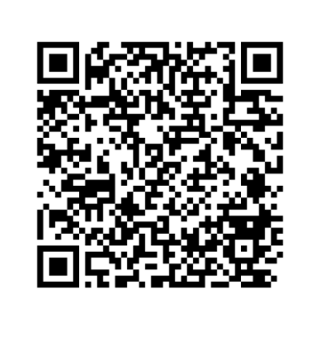
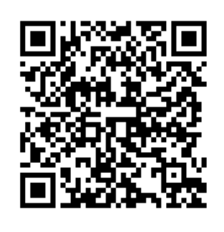
Any questions?
Visit our Listening Tool webpage
Make a report
Notes:
Prompt to save the link to the webpage so they can find it again in the future. The URL is scouts.org.uk/volunteers/equity-diversity-and-inclusion/listening-tool/.
Use the FAQ document to help you answer questions. If there’s anything you think should be added to the FAQ document, please speak to the key contact for the Listening Tool in your area.
The FAQ document covers:
I’m not sure if I’ve experienced discrimination or not, can I still report it through the Listening Tool?
Will volunteers in my pilot location be able to see my report?
Can I report something that happened a while ago?
Can I report something that doesn’t involve me?
Do I need to get permission to make a report about someone else?
Why does the form ask for the demographic details of the person making the report?
Why won’t someone get back to me about something I’ve reported through the Listening Tool?
Can I report something I’ve already reported to Safeguarding or made a formal complaint about?
I’m interested in helping Scouts develop their approach to tackling discrimination. Is there a way for me to learn more and get involved?
I’d like to provide feedback about the Listening Tool. Where can I do this?
How long will the Listening Tool be open for?
Can all of our young members make a report through the Listening Tool?
Is the Listening Tool available in languages other than English?
Who else is taking part in the Listening Tool pilot?
Who should I contact if I have a question or need support with the Listening Tool?

