Slide 1
Transformation Leads Call
16 January 2024

Slide 2
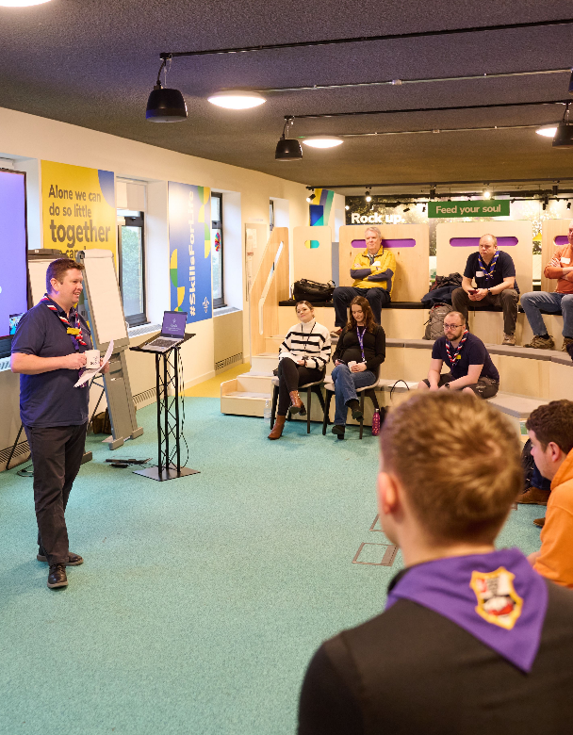
Who's on the call?
Craig Turpie, Deputy UK Chief Volunteer
Andrew Sutherland, Deputy Programme Sponsor
Jack Caine, UK Lead Volunteer for People
Lara Burns, Chief Digital Officer
Paul Fix, Project Sponsor, Volunteer Journey
Lucy Burrows-Smith, Volunteering Executive
Hamish Stout, UK People Team Member
Gemma Norman, Rob Groves, Change Team
Adam Ray, Communications Manager

Slide 3
What we’ll cover
Timeline update
Open Forum
Change Readiness
Ensuring Readiness for Migration
County & District Structures & Teams
Accreditations
Open Forum
Next steps & close

Slide 4
Timeline update

Slide 5
Open Forum

Slide 6
Change Readiness

Slide 7
Change Readiness Overview
Overall RAG - Progress so far
Nov 23
Jan 24
Predicted RAG at Go-Live
Nov 23
Jan 24

Slide 8
Change Readiness Overview – Nov 23

Slide 9
Change Readiness Overview – Jan 24

Slide 10
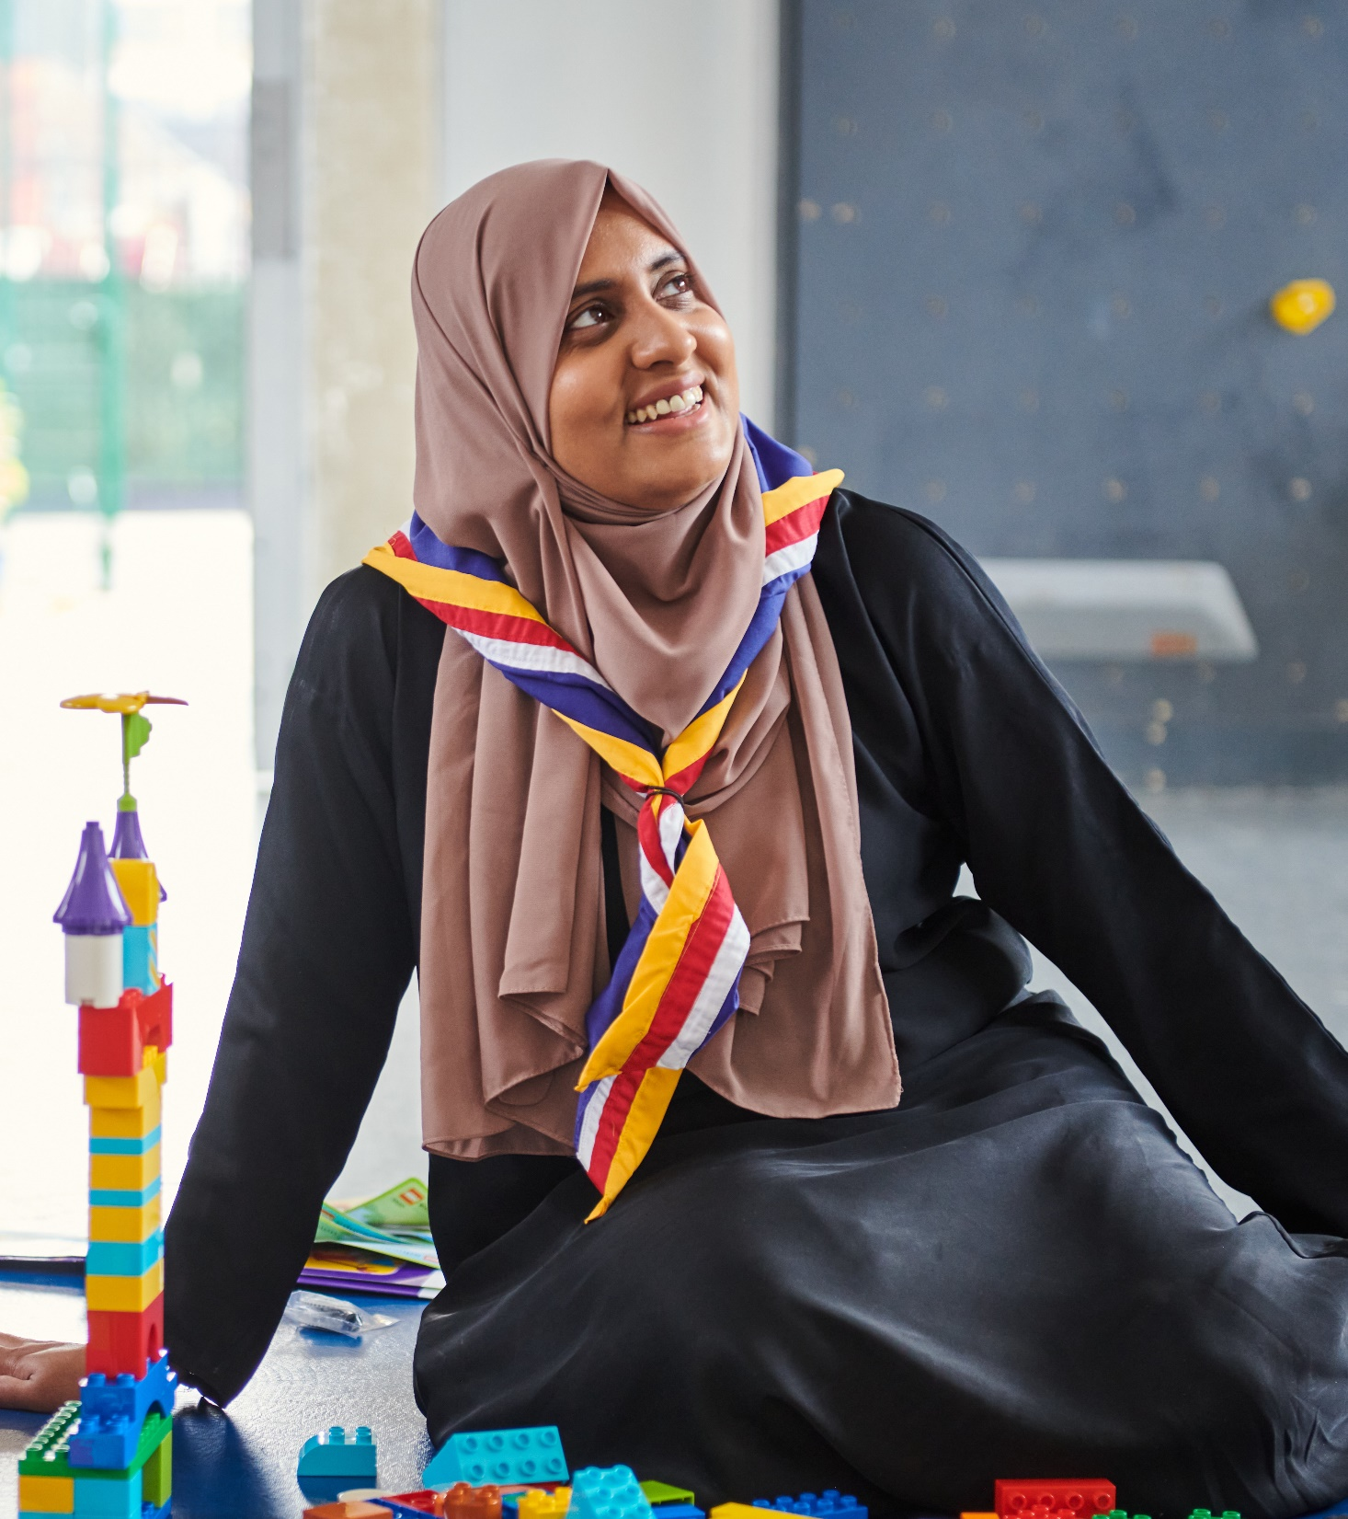
Key Themes
Communicating Locally
Some areas haven’t yet spoken to their Districts and Groups
Local Engagement
Engagement at District and Group level is challenging
Building Teams
Understanding how to move from current role to new teams, role mapping, sub-teams
Trustee Board Purpose & Readiness
Getting Groups & Districts up to date with Trustee Board changes

Slide 11
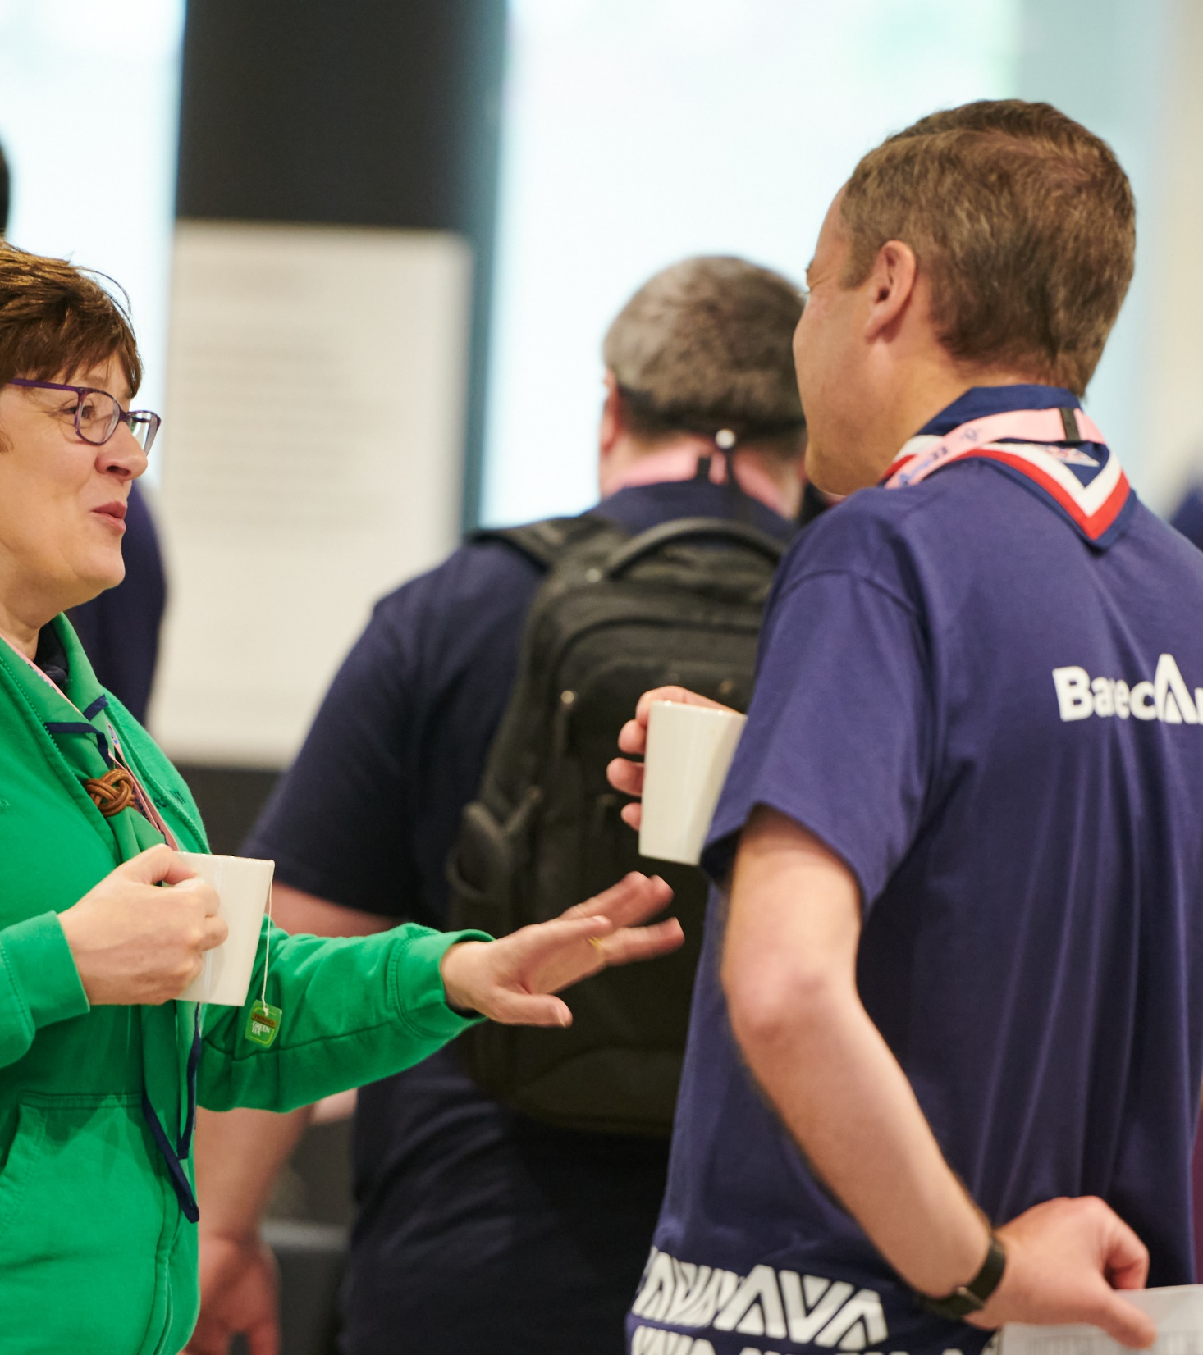
Tonight, we’ll focus on three key elements of the survey ….
Making sure everyone is ready for migration
County, District and Group structures
Accreditations
Note that focussing on these will also address the ‘role title conversations’ element of the survey.

Slide 12
a) Making sure everyone is ready for migration

Slide 13
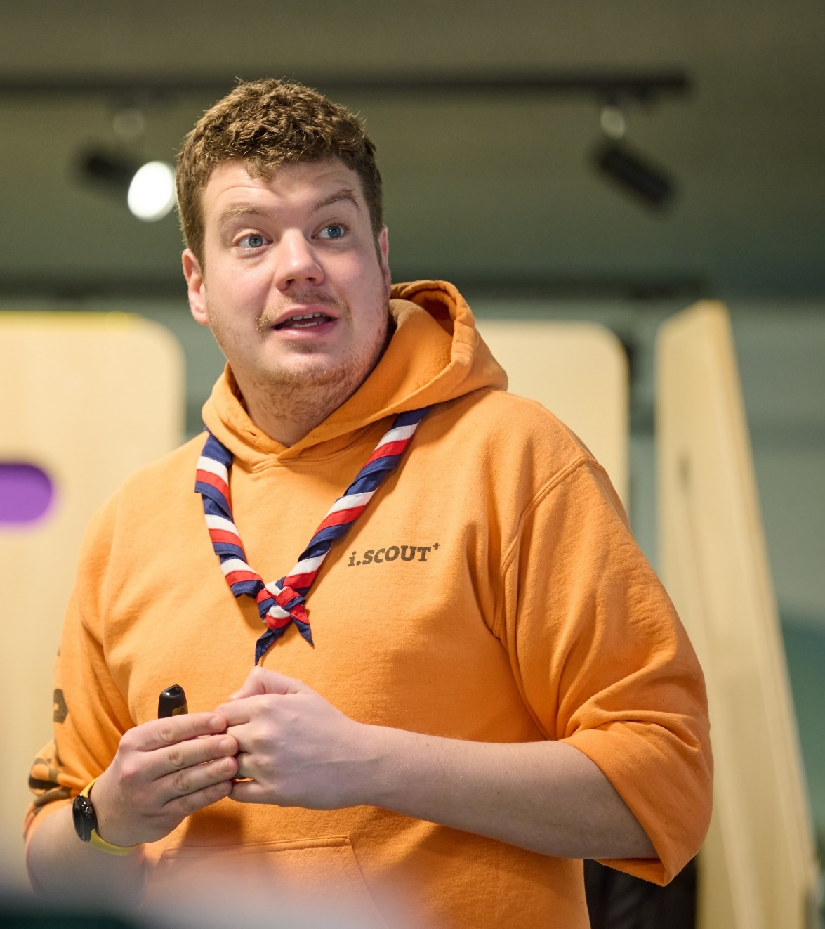
Ensuring migration readiness
Your key local challenges to manage are:
Volunteer personal details should match the volunteer’s expectations when they first log on, for example:
Correct email addresses
Accurate / no missing roles (note: both multiple variants and no variants; Group Sectional Assistants)
Their learning records are not missing any items
Their awards are correctly listed
Communications
Making sure that everybody in your County knows what they need to know and do (and why)
Making sure there is accurate communication – no invention of local rules

Slide 14
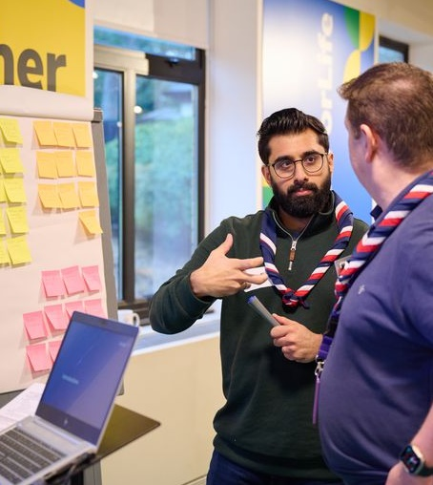
Ensuring everyone is ready to exploit our new ways of working
Making sure our new ways of working will be used / exploited
Examples of possible challenges:
Members who are unwilling to change, so work around the new systems rather than using them to give them more Scouting time and/or less volunteering time
People saying they do work in teams, but not actually embracing the new ways of team working
Local processes not being adjusted to the new ways of working
Training teams continuing unchanged (‘hiding’ in the Volunteering Development Team)
AACs continuing unchanged (‘hiding’ in the Volunteering Development Team)
Section Teams continuing unchanged in their operation
County-wide readiness
The challenge is to be sure that everybody in every Group and District will be at ‘green’ for at least the “Important” parts of the readiness checklist

Slide 15
b) County, District & Group Structures and Teams

Slide 16
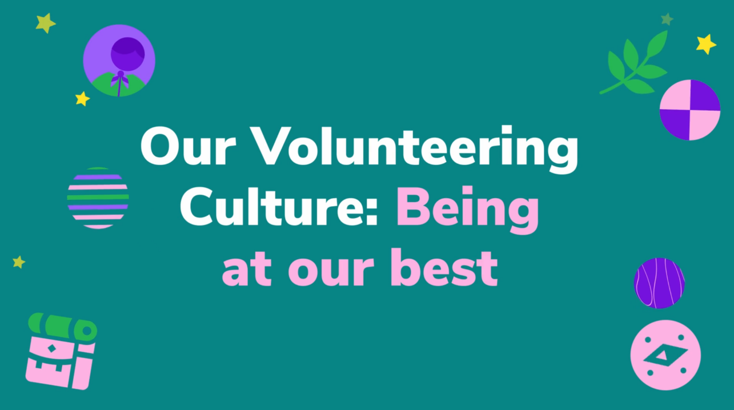
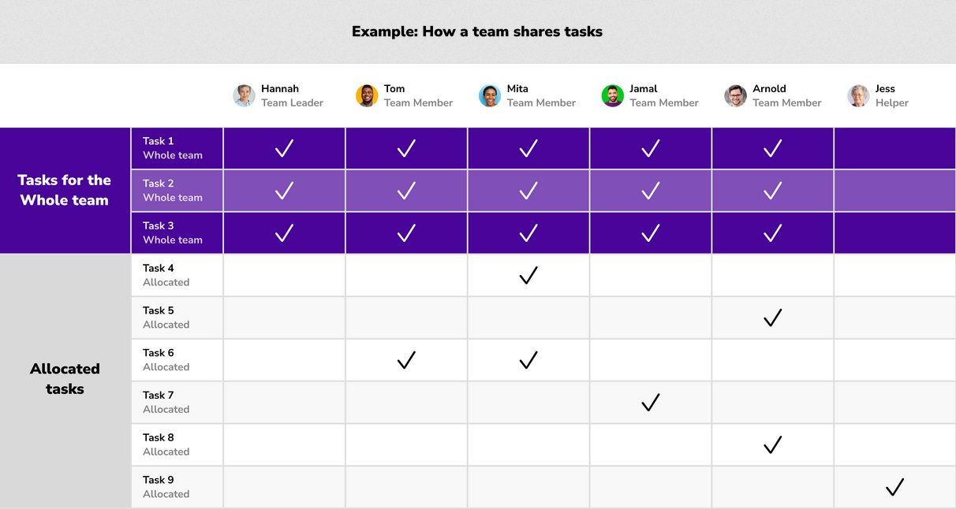
Teams - core principles
Key action: Make sure that for each County, District, Group and team...
Programme is at the core of everything that we do
Each Lead Volunteer is clear that only the teams listed in the organisation diagrams & POR may exist. Teams (except Section Teams) may have sub-teams if appropriate to their operation.
Each team member understands the core principles of working in teams - see Volunteering Together and Our Volunteering Culture
Each team must meet their Team Description, but can organise themselves to achieve that, so that each team member is clear about their role in the team - see How volunteers work in teams

Slide 17
Team leadership
Key action: Creating clear understanding and effective leadership of each team by…
Making sure each team (County, District and Group) has someone that leads the team (Team Leader, or Lead Volunteer for the Leadership Team, and Chair for Trustee Board)
The people leading the team are clear about their role - facilitating the team so that they collectively achieve its purpose (from the team description)
Volunteers leading a team will be:
Creating a positive team environment
Helping their team members to find what they need
Attracting and welcoming new volunteers
Reflecting and reviewing the team
More detail at Leading a Team

Slide 18
Inclusion
It’s embedded in Our Volunteering Culture
Inclusion is built in, not bolt on
It's fundamental to everyone's role and team

Slide 19
Inclusion in teams in practice
What are some likely ways in which this will work in practice?
Leadership Teams - if you, or the people leading inclusion where you volunteer, have a breadth of impact – supporting inclusion across volunteers, young people and programme, new provision, wider teams, etc.
Inclusion Team – sub-team of Leadership Team - if you've got a group of inclusion volunteers already or want to grow or focus in this way.
Specific teams - if you, or the people leading inclusion where you volunteer, have a more specific focus:
Programme Team. For example, doing parent carer frameworks, assisting with reasonable adjustment requests, advising on delivering inclusive camps.
Volunteering Development Team. For example, embedding inclusive practise through inductions, helping volunteers learn and share best practise around inclusion
Support Team. For example, looking after relationships with other organisations that support inclusive growth.
It’s flexible!

Slide 20
Inclusion - moving to our new approach
Role titles will be clearer, more inclusive, and understandable to everyone
Formally recorded on scouts.org.uk. For example, Team Member, Team Leader or Lead Volunteer
Flexible about how you continue to describe yourself. For example, ‘I help make sure Scouts is inclusive and accessible for all’ or ‘I'm the Inclusion Lead’
Important to have conversations
With inclusion volunteers about what team they'll be in
With wider teams about how they'll embed inclusion

Slide 21
Actions: Local structures
Each County, District, and Group should aim to:
Have discussions with all current (and new or potential) team members
Appoint Team Leaders and Team Members for each of the teams (and any sub-teams where relevant)
Allocate tasks within the team. Consider who will have accreditations relating to the team (these largely relate to County and District teams, but may be given to volunteers in Groups and Sections)
Start to informally work in new team structures
More detail on Becoming part of a new team | Scouts (and opportunity to join session on Tuesday 23rd January – see link in post-call email)

Slide 22
c) Accreditations

Slide 23
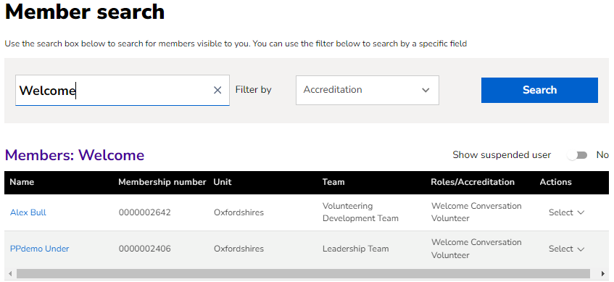
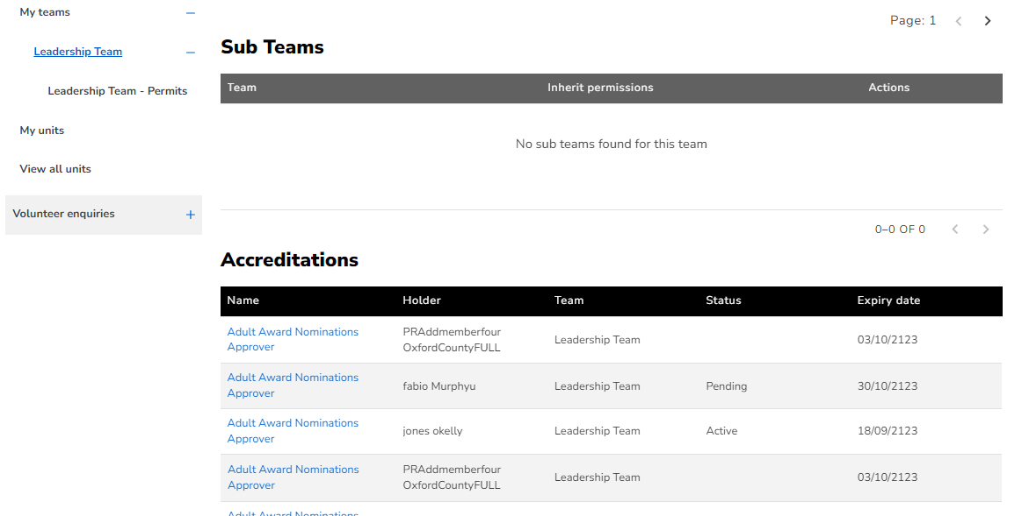
Accreditations
Why are accreditations introduced? What problem are we solving?
Rather than allocating tasks to a team, we sometimes need to allocate a task to one or more specific people
A key benefit of this is that some bite-sized tasks can be shared with people who have their primary role in another team, rather than them taking on the full responsibility of an additional team
They also benefit a team so that the team can focus on its core purpose
An important benefit is that some roles become more attractive and achievable, without distracting too much from the volunteer’s primary role
It also enables Lead Volunteers to share some responsibilities and draw on volunteers' expertise and experience in key areas, for example safeguarding.

Slide 24
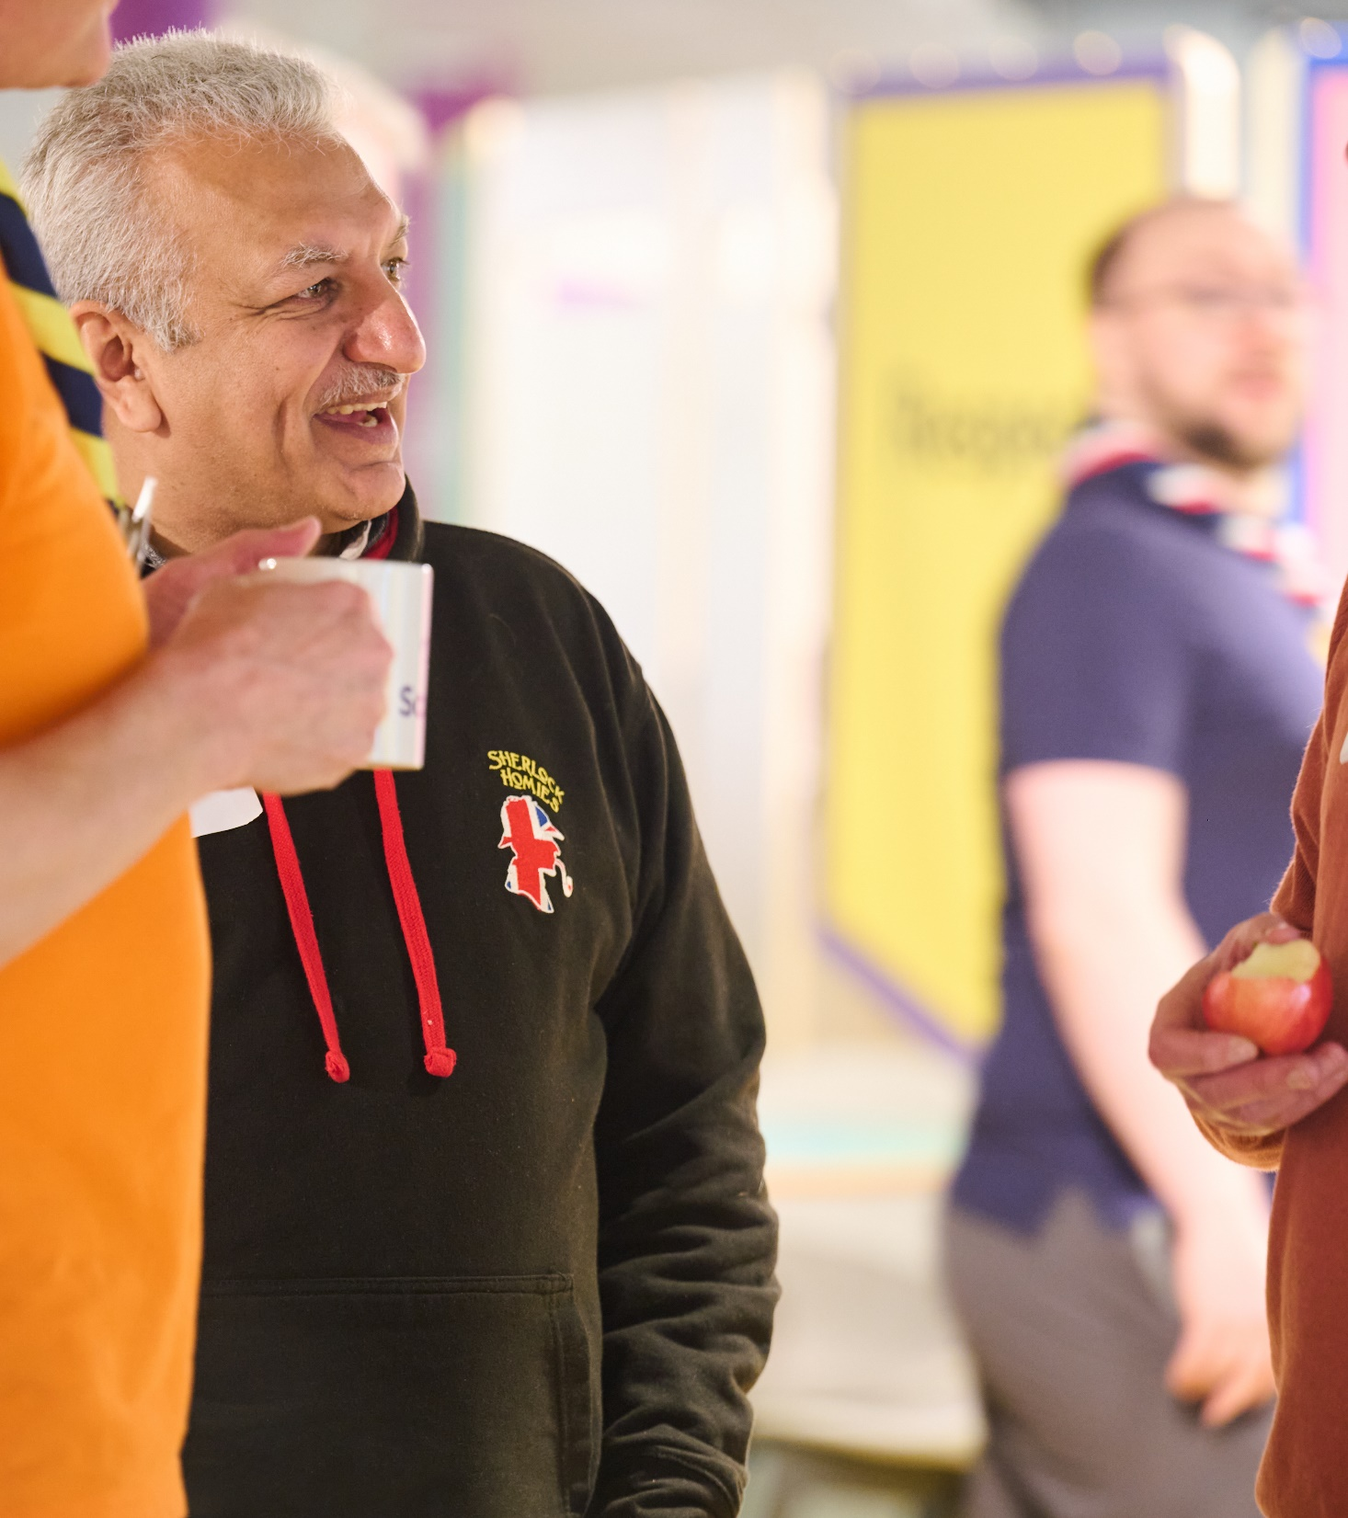
Accreditations - core principles
Accreditations are a way of sharing tasks and responsibilities, where a volunteer needs to be given certain permissions to take these on
Available accreditations are listed in the Accreditations Table in POR; no others can exist
Accreditations are not ‘roles’ - they're permission to do a specific task
Accreditations can only be given to volunteers who are already full members
Accreditations are usually given by the Team Leader of that team or a Lead Volunteer

Slide 25
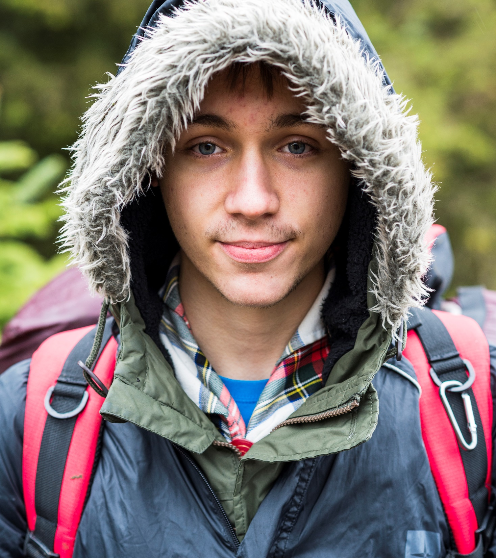
Key facts about accreditations
Accreditations will reflect:
For some topics, the need to have a person with particular (usually specialised) skills
In other cases, the sharing of responsibilities so that one individual (e.g. a Lead Volunteer) does not get overloaded
Or, the need for UKHQ to know who to contact to about a particular topic (for example who to send Awards to within a County or District)
Accreditations are not a team membership
An accreditation does not create a membership of a specific team. However, the task is affiliated to a team.
For example, a Cub Section Team Member who is an excellent kayaker could have an appropriate “Kayak Assessor” accreditation. They would be affiliated to, but not be a member of, the County Programme Team.

Slide 26
The Accreditations Table
Most accreditations have pre-requisite(s) that must be verified before the accreditation can be given
The accreditations table shows, for each accreditation:
Accreditation title
The team responsible for the accreditation (creating, where necessary, an informal network of affiliated people who have that accreditation)
Who (role) can give or remove the accreditation
About the person who can hold the accreditation
whether they are in a role that undertakes regulated activity
what learning must the person have already completed, and what other qualifications must already be held
if an internal check is needed for the accreditation
Maximum time that the accreditation can be held for before review
If no accreditation is given, who do the related responsibilities and tasks sit with by default

Slide 27
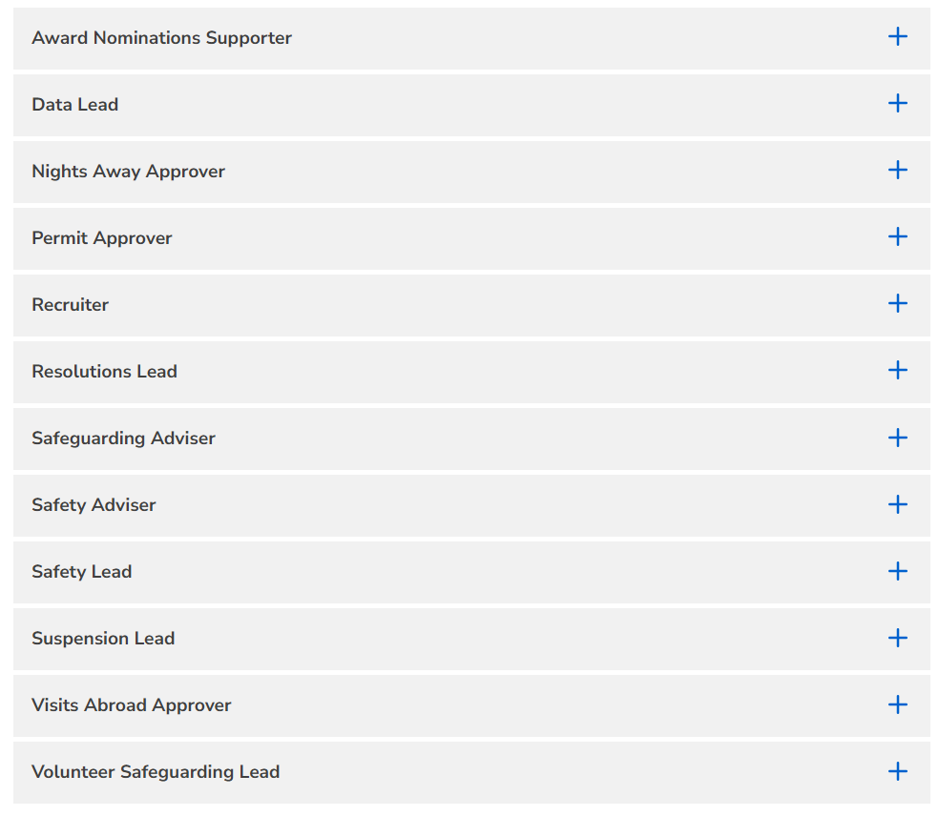
Useful resources - accreditations
Accreditations | Scouts
Leadership Team Accreditations | Scouts
Programme Team Accreditations | Scouts
Volunteering Development Team Accreditations | Scouts
UKHQ Accreditations | Scouts

Slide 28
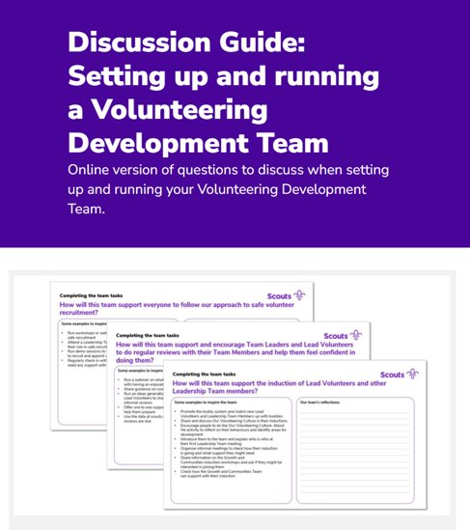
Useful resources - teams
Tools to support Volunteering Development Teams | Scouts
Questions to help you reflect on how you volunteer together include:
Doing tasks as one team
Sharing and coordinating accreditations
Collaborating with other teams

Slide 29
Open Forum

Slide 30
Next Steps

Slide 31
What we’re doing:
What you can do:
Re-planning POR release date
Working to provide an updated timeline as soon as possible
Updating page design and resources for role mapping
Planning out upcoming webinars focussing on specific teams
Sharing our updated Trustee resources including:
Trustee Board Annual Planner
Risk Register Webpage
Appointing Trustees Guidance
Look at how you can build inclusivity into your Teams, Sub-teams and local processes
Continue working on County, District & Group Team Structures
Look out for invites to support with some new web resources and layout
Watch and share the Welcome Workshop recording within your County
Explore and share the new Welcome & Learning webpages

Slide 32
Thank You

