Slide 1
Transformation Lead Call
May 24

Slide 2
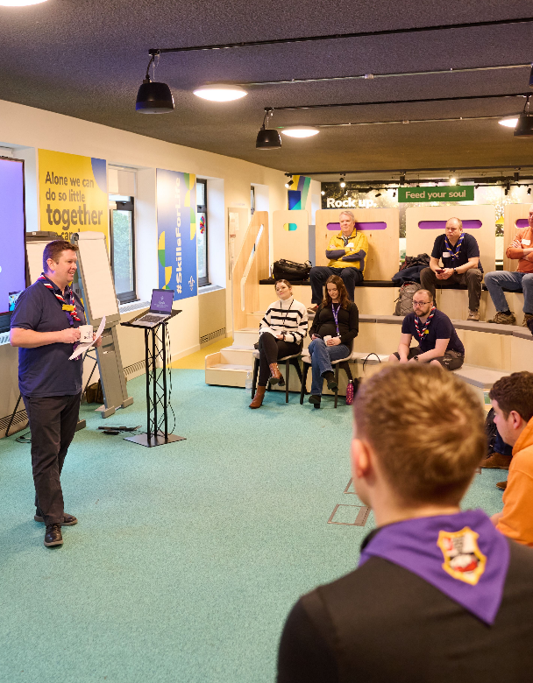
Who's on the call?
Craig Turpie, Deputy UK Chief Volunteer
Jack Caine, UK Lead Volunteer for People
Andrew Sutherland, Deputy Programme Sponsor
Hamish Stout, Project Sponsor, Change and Infrastructure
Elizabeth Stormfield, Gemma Norman, Rob Groves, Change Team
Adam Ray, Communications Manager
Breakouts
Matt Cobble, Graham Phillips, Lucy Burrows-Smith, Anders Wulff, Paul Fix, Stephen Mallet, Heather Smith, Alison Fell, Ben Powlesland, Vanessa Slawson

Slide 3
What we’ll cover
PFD Response Update
Digital System Update
Volunteer Experience - Roadmap for Change (Phases 3 & 4)
Open Forum
Breakout Discussion Rooms

Slide 4
PFD Response Update

Slide 5
Breakout Rooms Poll

Slide 6
Digital System Update

Slide 7
Volunteer Experience - Roadmap for Change

Slide 8
Delivery Phases
Introducing and embedding culture changes*
Now - Summer ‘24
Circa. 60 days prior to Compass freeze
After Summer ‘24
After move to digital tools
Introducing new ways of working
Preparing for the digital tools & processes
Moving to digital tools & processes
Embedding our new ways of working
Compass Freeze
Go-Live Support
*Introducing and embedding culture changes includes:
Our Volunteering Culture
Learning Culture
Welcome Culture
New ways of working

Slide 9
Moving to digital tools and processes - After Summer ‘24
Introducing and embedding culture changes*
Now - Summer ‘24
Circa. 60 days prior to Compass freeze
After Summer ‘24
After move to digital tools
Introducing new ways of working
Preparing for the digital tools & processes
Moving to digital tools & processes
Embedding our new ways of working
Compass Freeze
Go-Live Support

Slide 10
Moving to digital tools and processes - After Summer ‘24
What’s happening during this phase?
Compass Freeze
Interim processes in place
Continuing training for new digital tools
Lead Volunteer preparations
Go-Live Support
Encouragement to use digital tools
Support for Counties with go-live of new processes

Slide 11
Compass Freeze
Interim Processes
Compass will be unavailable during this period, Support Centre will have access to information if needed
Interim process will be live during the Compass freeze, until the go-live of the digital system
During this period, all volunteers will need to make sure they are aware of and following these processes
Training for new digital tools and processes
Training sessions will continue to be run during this time
Volunteers should be encouraged to attend

Slide 12
Soft Launch - Preparation Week
In the first week of go-live we’ll be encouraging Lead Volunteers and their teams to get everything set up and for other volunteers to use the system if needed only
This means they can:
Move volunteers into the right teams and give them the accreditations they need
Explore the live system to support their teams
We’ll be communicating directly with Lead Volunteers during this time to support them to do this

Slide 13
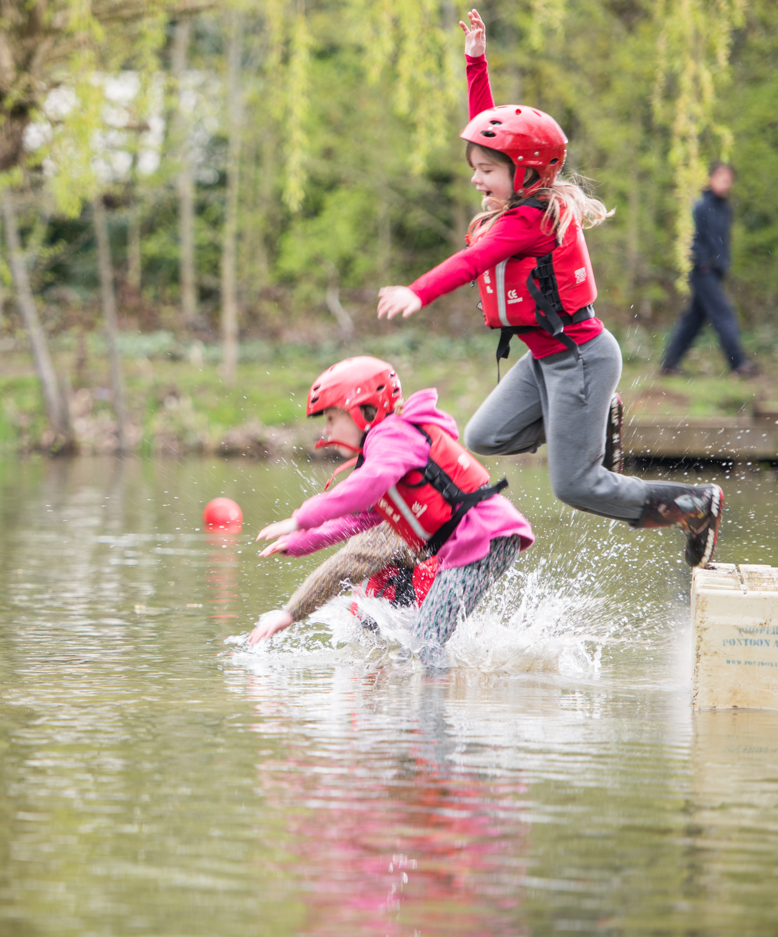
Using the new digital system
At go-live:
Volunteers with a migrated email
Receive an email directing them to login to the new system and set up their password
Volunteers with a missing or duplicated email
Will need to contact the Support Centre to get a login email added
Volunteers without an email
Will need their line manager to set up the proxy details

Slide 14
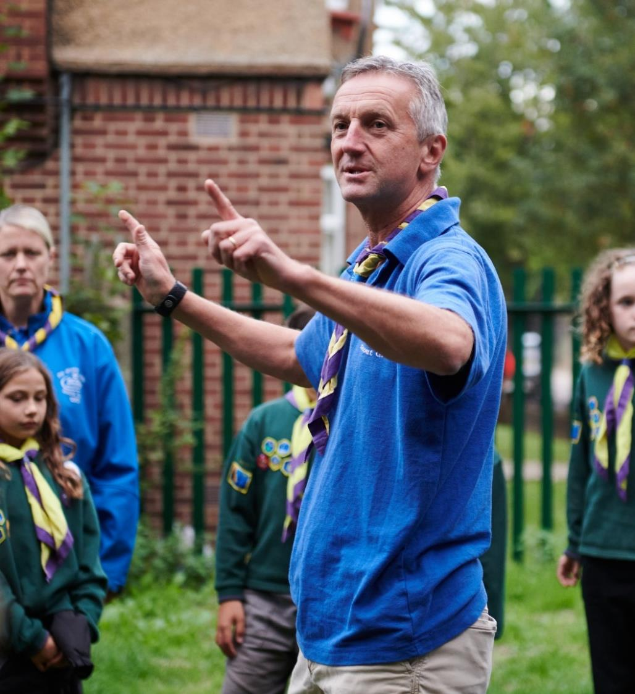
Go-Live
Supporting use of digital tools
All members will go-live with the new system approx. 2-3 weeks after Compass freeze
We’ll be regularly communicating with volunteers, highlighting different functions of the digital tools they can try out
We’ll also continue to deliver training sessions during the first week of go-live
Local Support
For around 6-weeks after go-live, your County go-live support teams should be helping with local queries

Slide 15
Moving to digital tools and processes - After Summer ‘24
What tasks need to be completed in your County/Area/Region (Scotland) during this period?
You must:
Make sure all volunteers are aware of and carrying out interim processes during Compass freeze
Have your County go-live support team operating
Encourage volunteers to attend training webinars
Make sure all volunteers are aware of and carrying out processes that will change when the digital tools go-live
Formally adopt new teams and titles locally, along with new ways of working
Make sure volunteers with outstanding learning are completing this through the learning tool

Slide 16
Any Questions?

Slide 17
Embedding our new ways of working - After move to new digital tools
Introducing and embedding culture changes*
Now - Summer ‘24
Circa. 60 days prior to Compass freeze
After Summer ‘24
After move to digital tools
Introducing new ways of working
Preparing for the digital tools & processes
Moving to digital tools & processes
Embedding our new ways of working
Compass Freeze
Go-Live Support

Slide 18
Embedding our new ways of working - After move to new digital tools
What’s happening during this phase?
Success stories
Website transition to business as usual
Feedback on future improvement
Embedding culture change

Slide 19
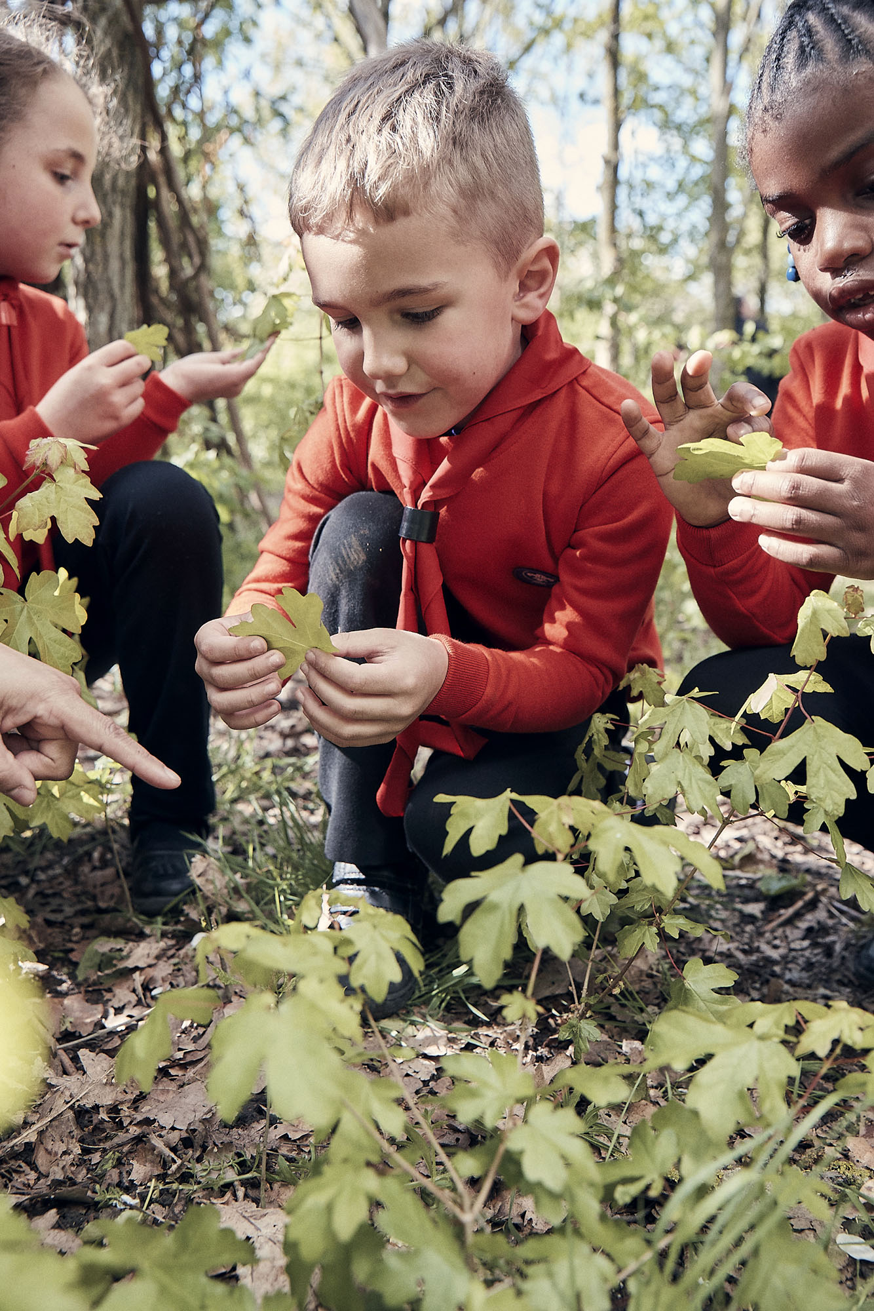
Success Stories
We’ll be sharing blogs/videos of success stories from across the movement
We’ll be reaching out to all Transformation Leads to share stories from their County or a District or Group

Slide 20
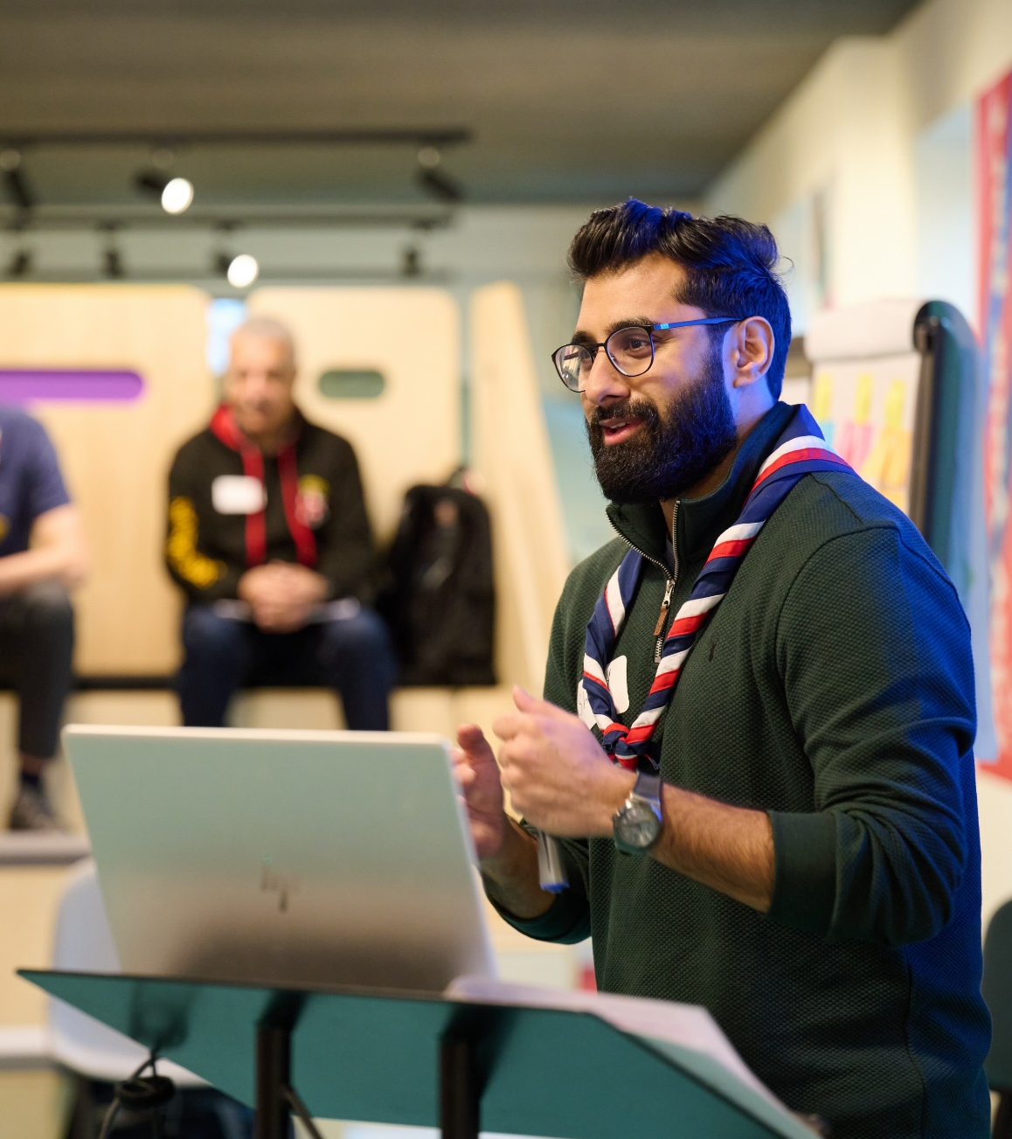
Website Transition
Ongoing work will take place just before go-live and over the following months to update content across the website
This will focus on moving current transition content into its business-as-usual pages and improving the way volunteers can navigate through the website easily to find the information they need

Slide 21
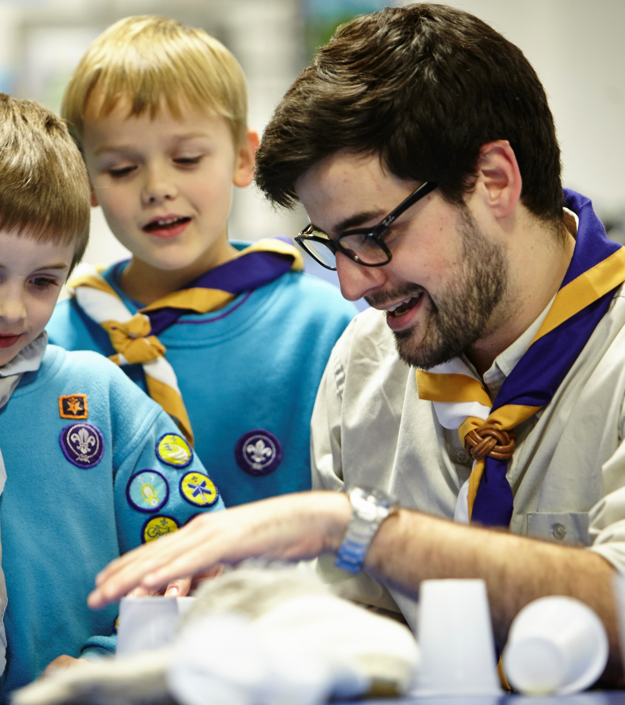
New Ways of Working and Feedback
New ways of working, supported by the digital tools, will need to continue to embedded into everyday practice
There will be a central process to share feedback on what additional features should be considered in future updates to the digital tools

Slide 22
“A shared understanding for what we do and say as volunteers in Scouts, supporting each other, following our values and being at our best, while acting as role models for young people.”
Embedding Culture Change
It’s important that we remember the core of the volunteer experience transformation is about culture change
Across the movement we must continue to embed, and role model this culture change
This includes:
Our Volunteering Culture
New ways of working, including learning and welcome

Slide 23
Embedding our new ways of working - After move to new digital tools
What tasks need to be completed in your County/Area/Region (Scotland) during this period?
You must:
Continue to embed culture changes across teams
Support volunteers to embed changes into their business as usual
You should:
Share feedback for future improvements to digital tools and new ways of working
Share success stories from your patch

Slide 24
Any Questions?

Slide 25
Breakout Rooms

Slide 26
Breakout Options
Two 15-min breakout rooms:
Trustee Changes
Building a Team
Running a Team
Volunteer Joining Journey
Learning Data Migration
Growing Roots & Branching Out
Data Migration (Not Learning)
Engaging with people resistant to change
Our Volunteering Culture

Slide 27
Next Steps

Slide 28
What we’re doing:
What you can do:
Respond to readiness survey by 20th June
Make sure all Trustee Boards have, or are ready to, adopt the membership changes at their next AGM
Make sure training provision is maintained for all current and new volunteers
Make sure team structures and their members are defined at County, District & Group level
Continue embedding Our Volunteering Culture in new teams
Make sure current appointments panels are as welcoming as possible
Releasing updated readiness webpage content
Working to support full introduction of Welcome Conversations in Early Adopter Counties
Delivering webinar content for targeted audiences
Producing new videos to support understanding of Volunteer Experience changes

