Slide 1
Transformation Lead Call

Slide 2
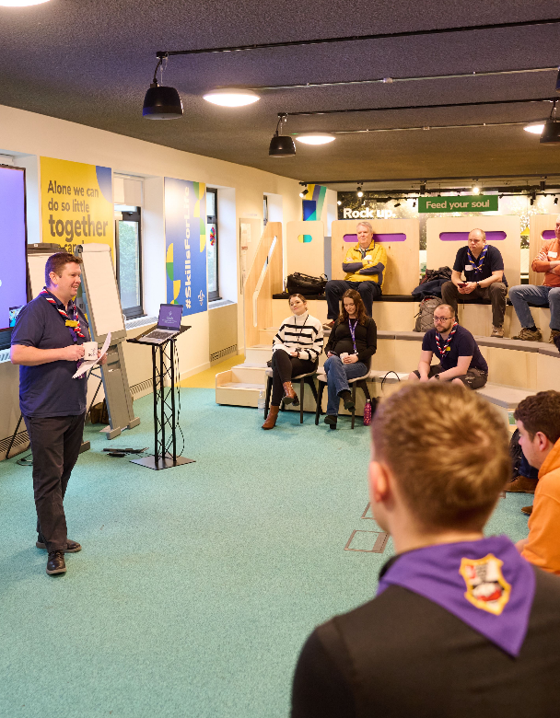
Who's on the call?
Jack Caine, UK Lead Volunteer for People
Andrew Sutherland, Deputy Programme Sponsor
Ben Powlesland, Membership Product Manager
Graham Phillips, Membership Project Sponsor
Paul Fix, Project Sponsor - Volunteer Journey
Hamish Stout, UK People Team Member
Elizabeth Stormfield, Gemma Norman, James Booker, Change Team
Adam Ray, Lauren Golding, Communications Team

Slide 3
What we’ll cover
What is happening before the digital tools release?
Digital Tools demo

Slide 4
What is happening before the digital tools release?

Slide 5
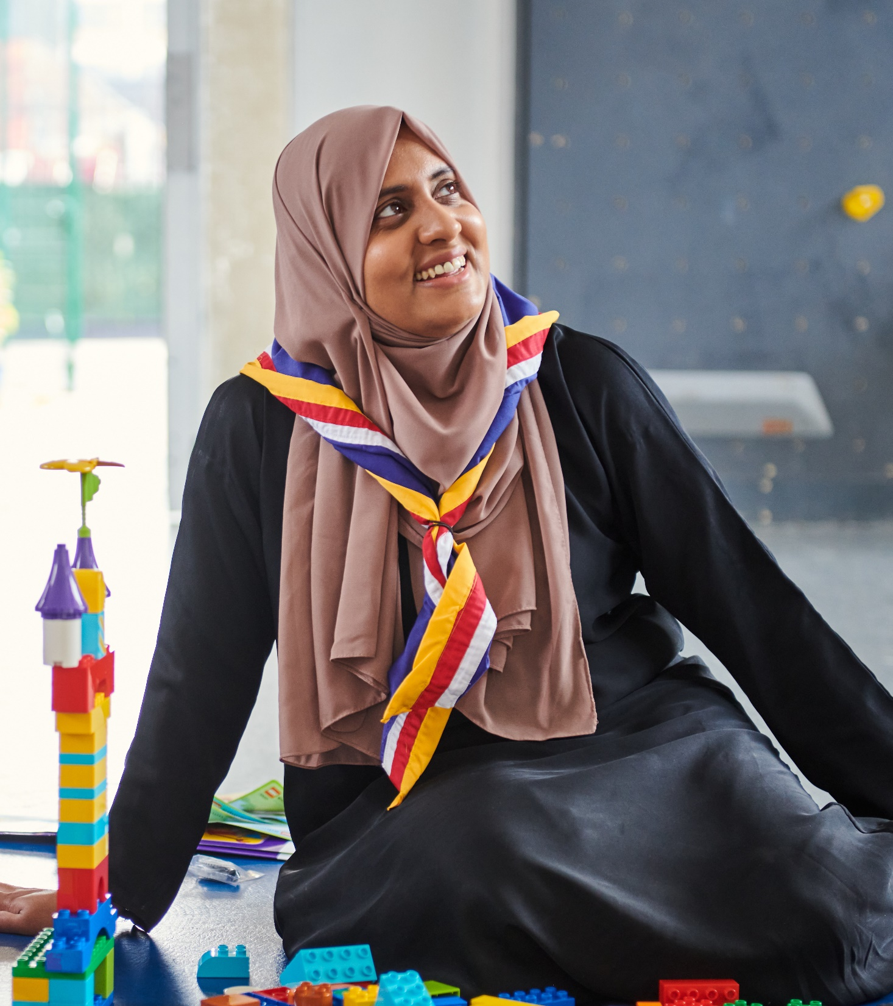
What is continuing?
Our Volunteering Culture (Ongoing)
Increasing engagement with and use of Our Volunteering Culture
Teams & Titles (Ongoing)
Encouraging adoption of the team-based approach and titles informally.
We will not formally adopt the new Teams & Titles (in POR or compass) before the digital tools go-live but will increase their informal use

Slide 6
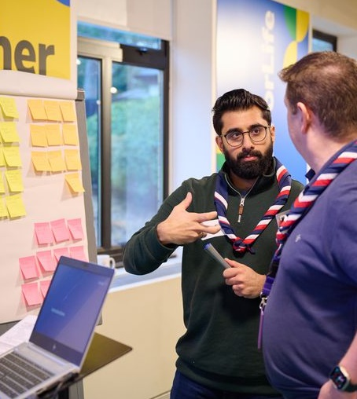
What will happen with March 2024 POR?
Trustee Board Membership Changes
Membership changes to Trustee Boards will be adopted at the first Group/District/County AGM held after 1 April 2024
Awards
Commissioner's Commendation Award will be re-named Commendation Award from March 2024 POR

Slide 7
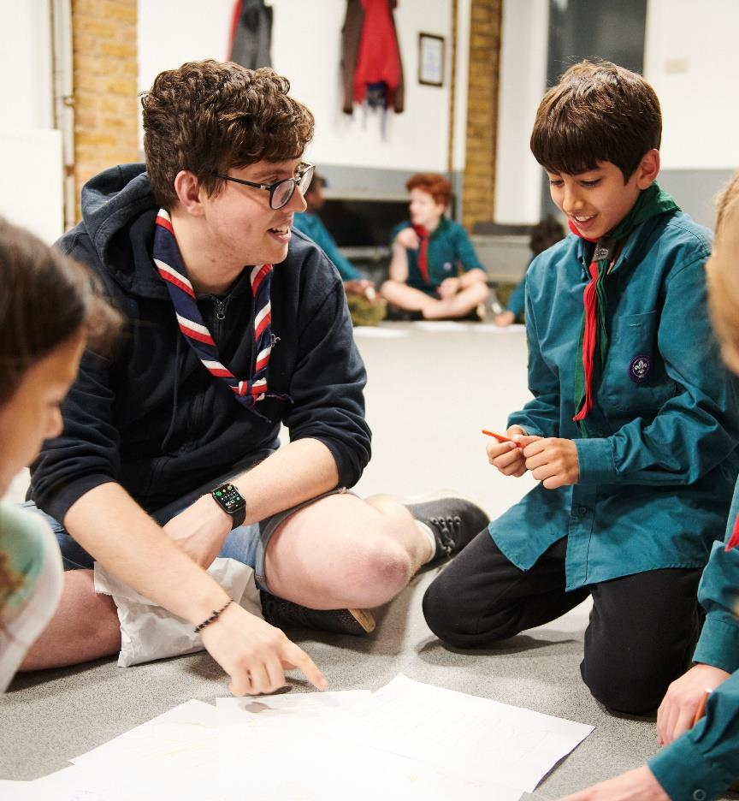
What will happen before the digital tools release (Timing TBC)
Welcome Conversation & Culture
Introduction of Welcome Conversations within the current adult appointments process and the culture of a warmer welcome
This will first go-live with Early Adopters and before being rolled out to everyone else
We are working to agree a timescale for this now along with support materials

Slide 8
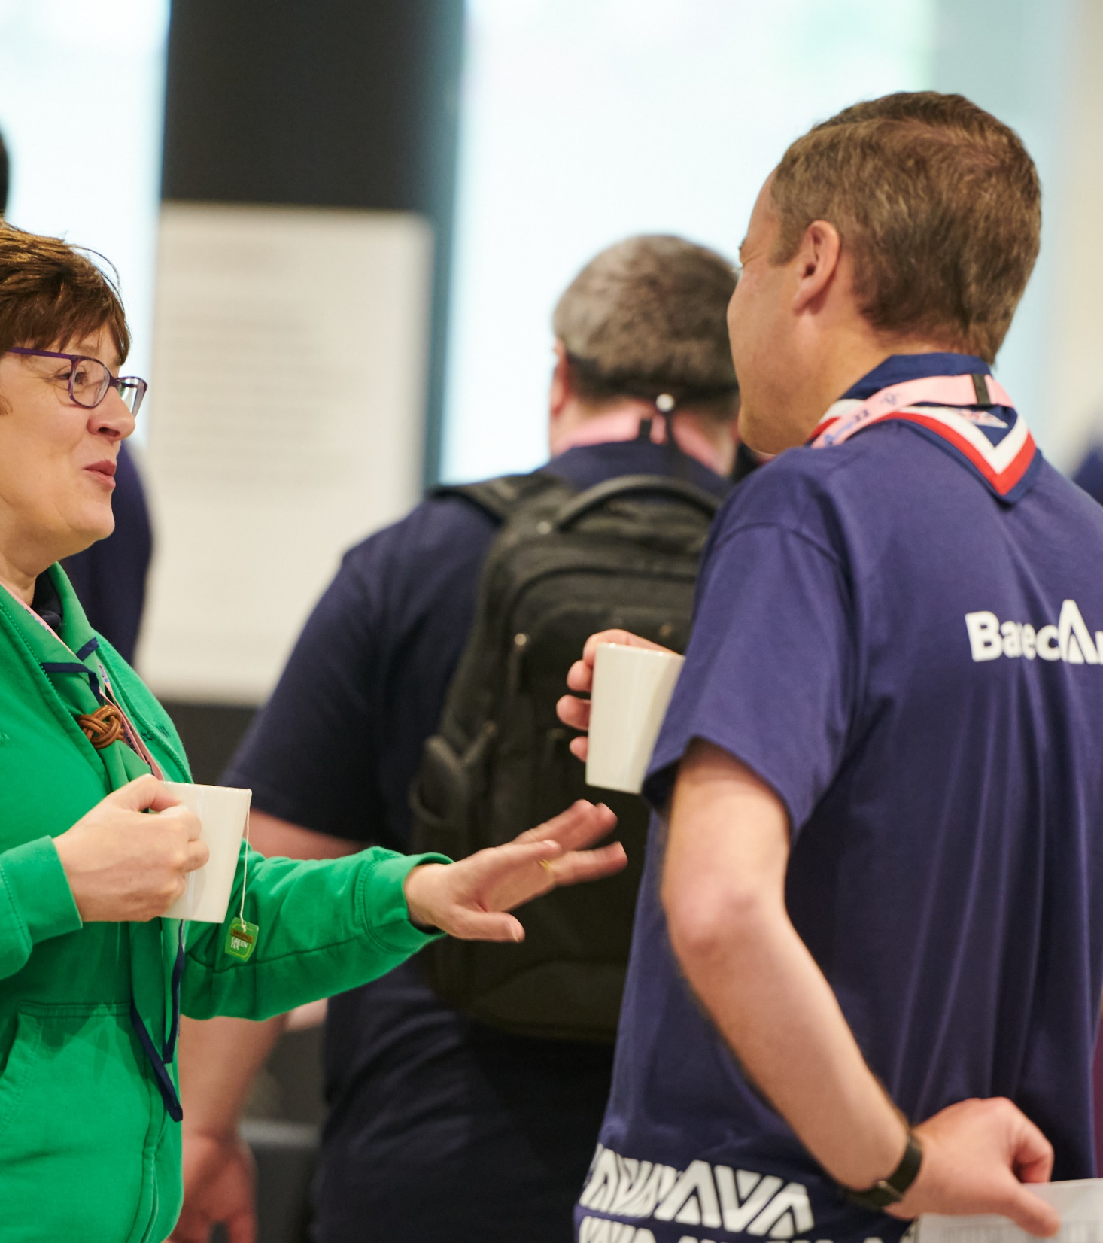
What will happen with the release of the digital tools?
Accreditations - Specific permissions to carry out tasks in the new digital system
Move to a learning culture - Tied to new course content and digital system
Growing Roots Learning - Tied to new course content and digital system
New Volunteer Joining Journey - Digital administration of the journey is tied to the digital system
Teams & Titles formal adoption - Formally moving to the new teams and titles

Slide 9
What happens next?
Continue implementing the parts of the Volunteer Experience changes already launched
POR will be released this week
At next month's TL Call we will be able to share an updated roadmap for change with more detail on:
When pre-digital changes will come into effect
What supporting resources will be shared and when
What additional targeted engagement activities will be delivered and when

Slide 10
Open Forum

Slide 11
Digital Tools Demo

Slide 12
Next Steps

Slide 13
What we’re doing:
What you can do:
New Teams pages being shared tomorrow!
The March POR edition will be released this week
Developing an updated Roadmap for Change for all Counties/Areas/Regions (Scotland)
Improving readiness resources to align with the updated roadmap for change
Shaping engagement activity with wider audiences at County, District & Group level
Continue implementing the parts of the Volunteer Experience changes already launched
Have a small team of volunteers who can support your patch through the changes

Slide 14
Thank You

