Slide 1
Transformation Leads Call

Slide 2
Who's on the call?
Craig Turpie, Deputy UK Chief Commissioner
Jack Caine, UK Commissioner for People
Andrew Sutherland, Deputy Programme Sponsor
Alison Fell, Project Delivery Team Product Lead - Welcome
Anders Wulff, Volunteering Learning & Development Manager
Gordon Weston, Project Lead, Learning Content and Design
Colin Davidson, Assistant UK Commissioner People (Learning)
Hamish Stout, Deputy UK Commissioner for People (Transformation)
Adam Ray, Communications Manager
Kirsty Waugh, Gemma Norman & Rob Groves, Change Team

Slide 3
What we’ll cover
Our New Ways of Working
Volunteer Joining Journeys
Learning
First Aid re-cap
Change Readiness Survey Results
Looking Back
Horizon Scanning
Early Adopter Update
Next Steps

Slide 4
Our New Ways of Working

Slide 5
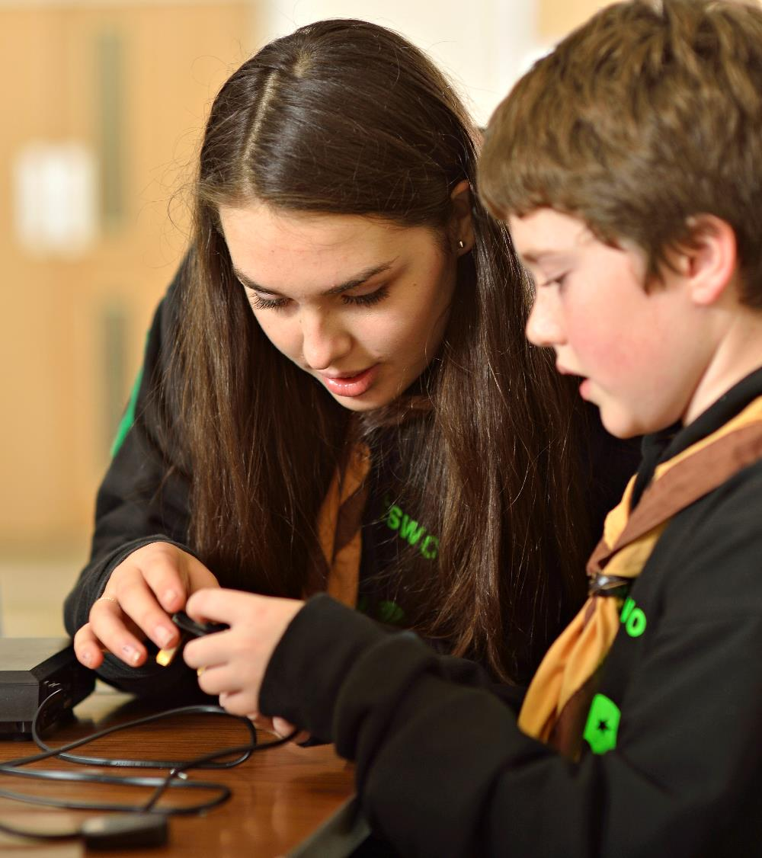
Overview
The people, culture and digital changes coming in will mean new ways of working across Scouts
Several existing Scouts processes will be replaced or amended
How you implement these processes locally will need to be built into your preparations

Slide 6
The Volunteer Joining Journey

Slide 7
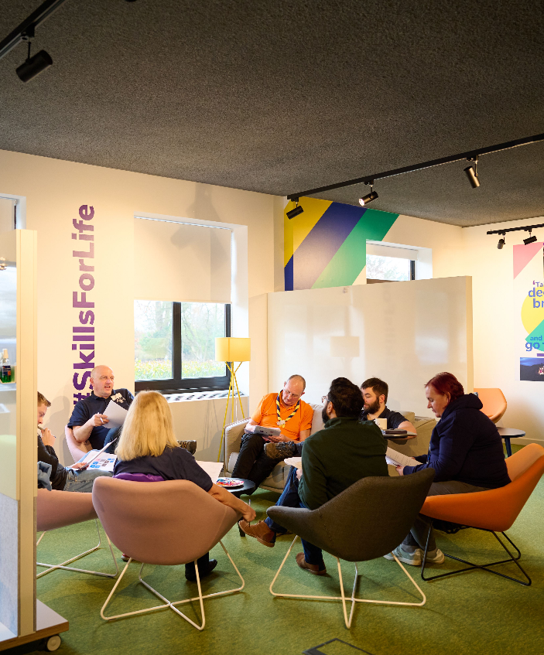
The Volunteer Joining Journey
This journey applies to all new volunteers, and volunteers returning more than 30-days after leaving Scouts
Includes any young people joining as an adult volunteer
Once a new volunteer has been added to the system, the volunteer joining journey steps can be completed in any order

Slide 8
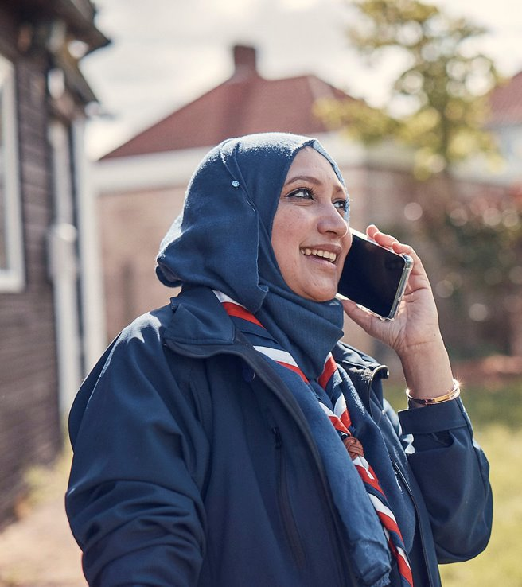
Recruitment
When you recruit a new volunteer locally, you’ll:
Add them to scouts.org.uk using their basic personal details
Add a role to their profile
The new volunteer will receive an email with their login details
The new volunteer will then fill in all their additional personal details and start working towards a full role

Slide 9
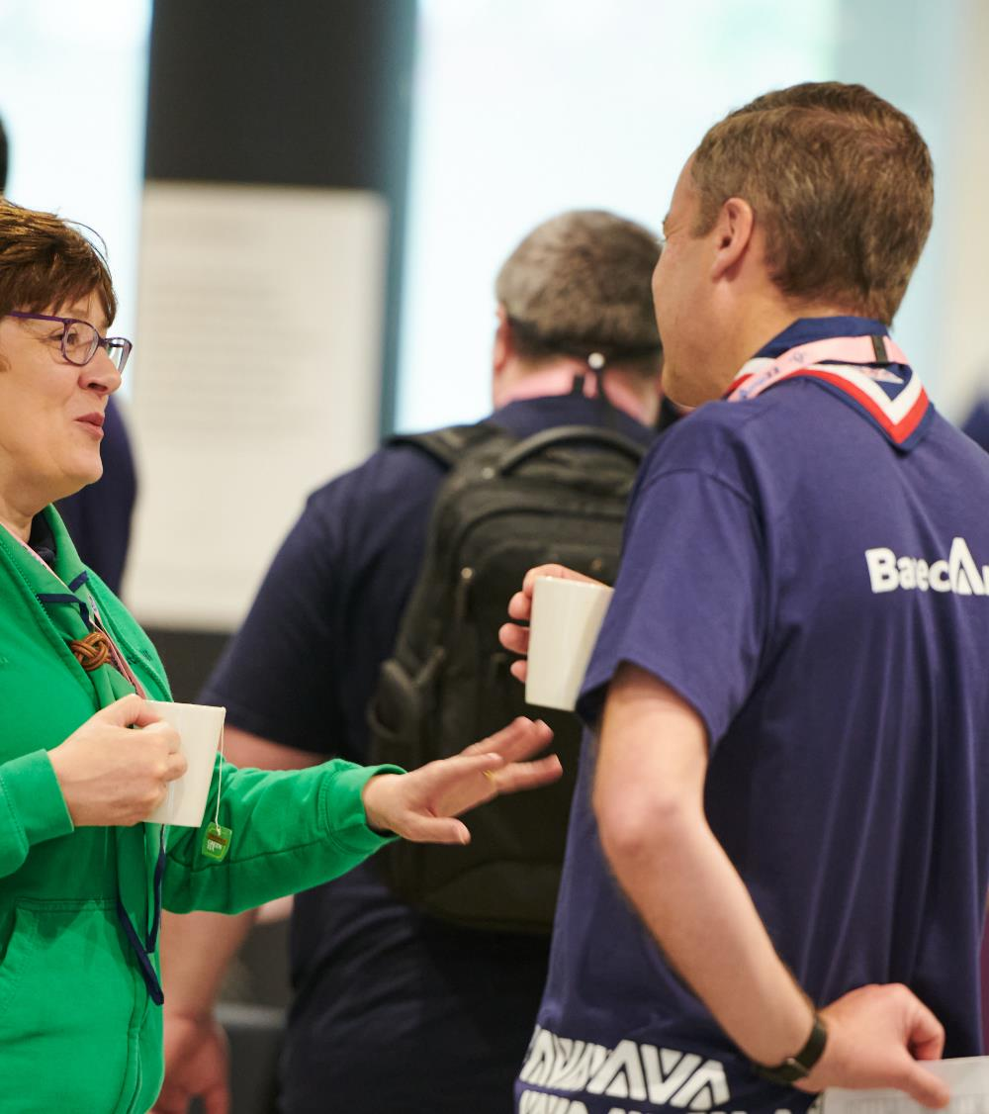
Declarations
The current declarations have been updated. Volunteers declare they commit to:
Accepting Scout values and policies and Our Volunteering Culture
Agreeing to complete the learning required
When logging in for the first time, new volunteers will have declarations to complete (this will also be true for all those logging into the system for the first time)
This includes a Trustee declaration if the volunteer’s role includes Trustee responsibilities

Slide 10
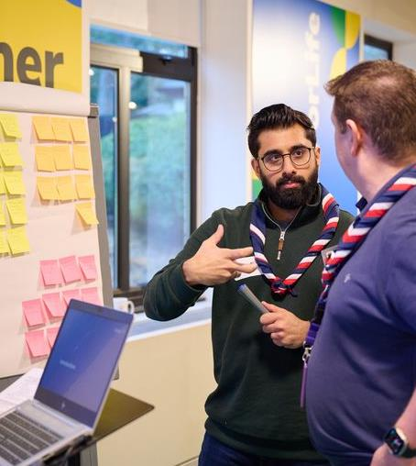
Trustee Eligibility Checks
Trustee eligibility checks have always been required to confirm they are not disqualified by law from being a Trustee
This will now be built into the volunteer joining journey
The Trustee Board Chair will need to undertake the regulator-prescribed checks to confirm the volunteer is not prohibited from being a charity trustee
On the system they will need to confirm that these have been carried out and the volunteer is eligible
If the volunteer is not eligible, they will not be able to become a Trustee or any role which may have Trustee responsibilities

Slide 11
Internal Check
A new volunteer's details are checked against the Scouts’ internal records
This is automatically initiated by the system when the volunteer has completed their self-service personal details
Should a flag be raised, HQ Safeguarding will direct this towards the District / County Lead Volunteer or the relevant person with the Volunteer Safeguarding Lead accreditation
The details will be visible to the volunteer and their Team Leader/Lead Volunteer

Slide 12
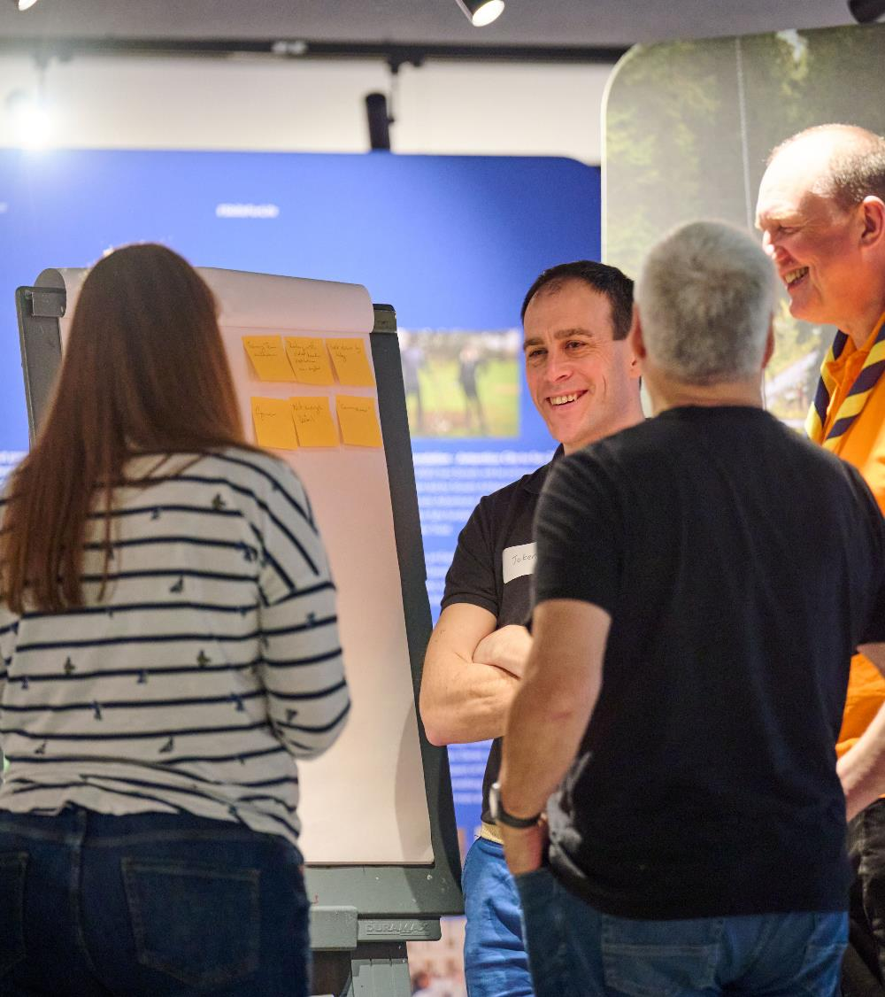
Welcome Conversation
The Lead Volunteer or Team Leader will arrange the Welcome Conversation with themselves and one other independent person (who must be accredited for Welcome Conversations)
Both adults must have completed the Welcome Conversation Volunteer learning
This can be done in several ways
Reach out to the Volunteering Development Team, who suggest one or more suitable people
Arrange the independent person locally and inform the Volunteering Development Team of this
And more!
Reminder:
These are not Appointment Panels
The independent person should be in a similar role or have other similar characteristics

Slide 13
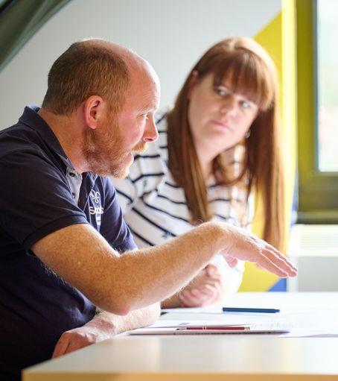
Welcome Conversations
The Lead Volunteer will record the outcome in the digital system, and it will send a notification to the independent person to confirm this
Where the two people disagree it will be referred to the District or County Lead Volunteer

Slide 14
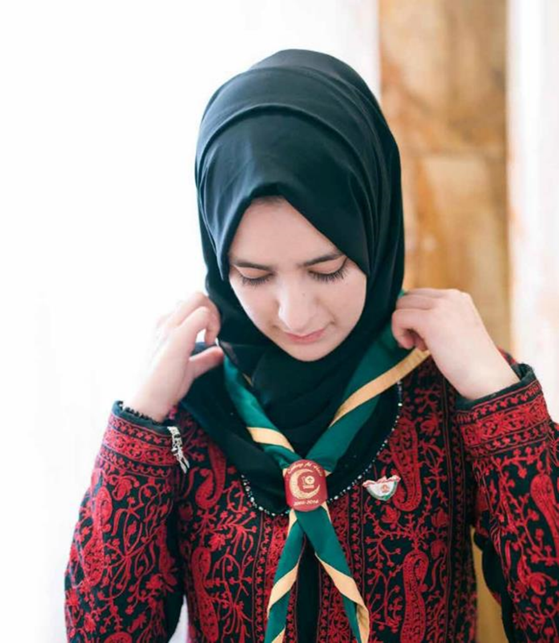
Criminal Record Check
The volunteer can start their criminal record check once their personal details have been added
For England & Wales - Atlantic Data is built into the digital system
For Scotland - Provide information through the system and then get sent a link for PVG
Northern Ireland - Carry out NI process first, then complete details in the system
An ID Check will still need to be carried out as currently and recorded
Should a flag be raised, the same process as is currently in place will be followed, this will now include the relevant person with the Volunteer Safeguarding Lead accreditation

Slide 15
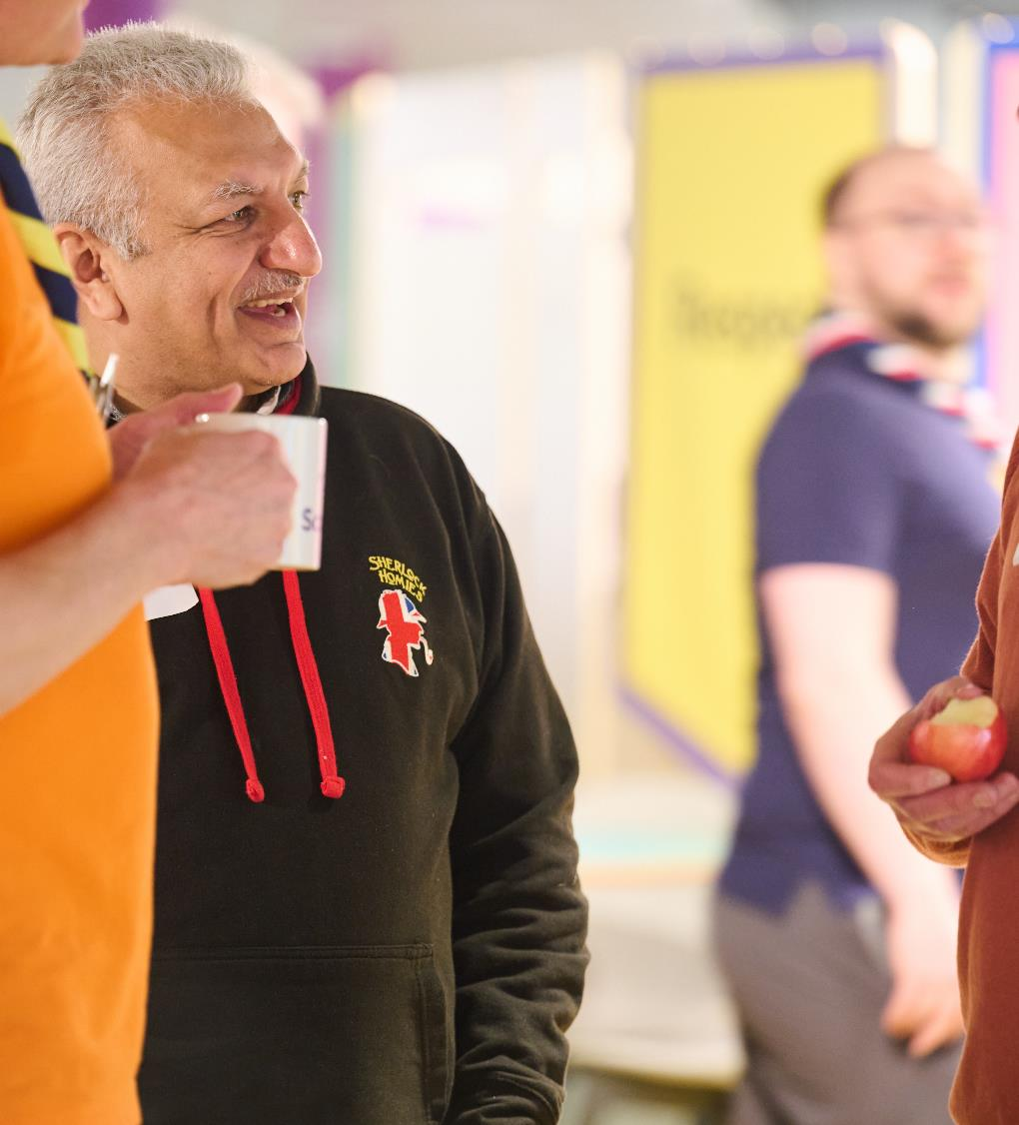
References
The new volunteer can start their references once they have provided their personal details
Up to four referees can be added
The system will assess the first two responses received (however, should an unsatisfactory reference come back from the others this will be reviewed)
Unsatisfactory references will be referred to District or County Lead Volunteer or accredited Volunteering Safeguarding Lead
Overdue references (30 days) will be referred to the volunteer for action (including nominating new referees)

Slide 16
Growing Roots
From setting up their account in the digital system, volunteers will have access to the learning tool
The learning tool will show them the Growing Roots learning they need to complete, including the learning specific for their role
This can be completed in stages and volunteers can come back to learning still in progress
Volunteers will have 6 months to complete this
Note that First Aid isn’t part of Growing Roots (but see slides later in this presentation)

Slide 17
Volunteer Role Change Journey

Slide 18
The Volunteer Role Change Journey
This journey applies to any volunteer adding or changing their role. Examples include:
Moving from a Trustee to a Team Member
Moving from Team Member to Team Leader or Lead Volunteer
Taking on a role in a District/County Team

Slide 19
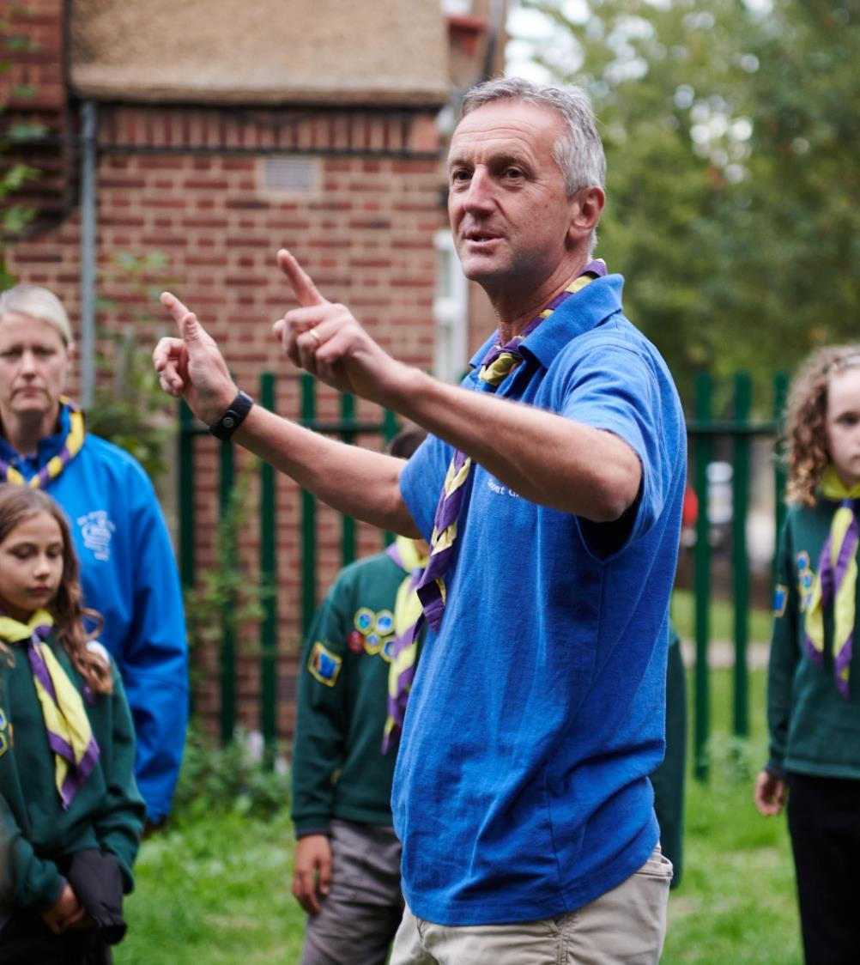
For every change of role
Meet with your new team leader
Re-sign declarations
Internal check
Criminal Record Check
Renewed every five years if in a role that requires a criminal record check.
Growing Roots
If any additional learning is required for the new role e.g. Leading Scout Volunteers, this will show on the learning section of My Learning
Trustee eligibility check
If the new role has trustee responsibilities

Slide 20
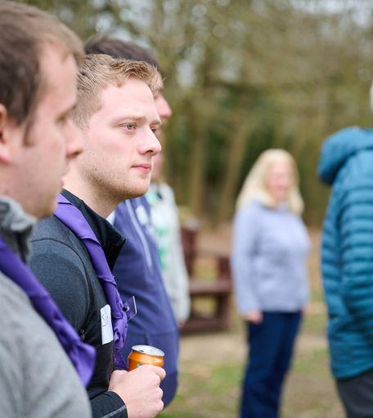
If not previously completed
References
If references haven’t been previously taken, they will be prompted in the system as required
Welcome Conversation
If no Welcome Conversation previously recorded, then a Welcome Conversation must be held

Slide 21
Learning

Slide 22
Learning Renewals
The digital system will remind volunteers when learning must be renewed
Volunteer undertakes the learning. Completion is automatically recorded by the digital system on the volunteer’s record or manually by a training assessor (e.g. First Aid)
Volunteering Development Teams and Lead Volunteers can track compliance via the dashboards
Learning to be renewed = Safe Scouting and First Aid. The requirements for these, by role, are shown in the Teams Table The Safe Scouting learning includes both safeguarding and safety (as separate elements within the learning module)

Slide 23
Branching Out
Volunteers will be able to select from a range of additional learning opportunities.
Some of these will provide skills for their specific role within their team. Others will be optional learnings of interest to volunteers.
As the volunteer completes their learning, this is recorded on the digital system by a learning assessor / Volunteering Development Team (this will be automatic in the case of digital learning modules)
This additional learning may, if the volunteer wishes, lead to the award of the Wood Badge
Our continuing training modules will be on the learning tool and will be replaced by new Branching out content over the next 2 years
Where a volunteer opts to complete the Wood Badge, only one Wood Badge is awarded (there is no Wood Badge for each role)

Slide 24
First Aid Update

Slide 25
The principles of First Aid at Scouts
Young people always have direct access to first aid when at Scouts
Parents and carers are confident about adult leaders' first aid skills
No young person should miss out on Scouts because of a lack of first aid cover
Having our leaders trained in first aid has a positive community impact

Slide 26
Roles requiring first aid
We encourage all adults in Scouts to have first aid training
First Response required for these roles:
Section Team Members (inc. current Section Assistants)
Section Team Leaders
Group Lead Volunteers
District Section Team Members
14-24 Team Leaders
Out of scope:
Managers and supporters (non-sectional)
Adults meeting for non-adventurous activities

Slide 27
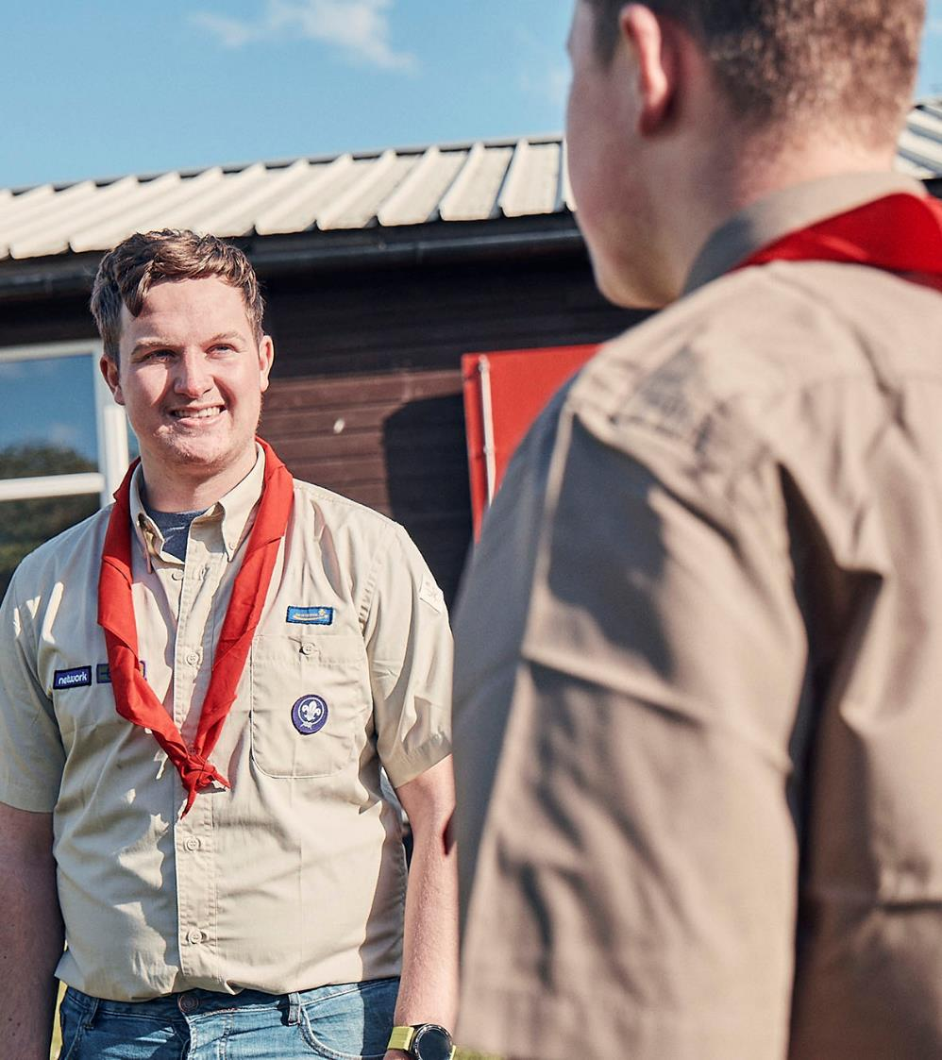
First aid rules
First aid rules for activities remain
Activity plans and risk assessments still determine the number of first aiders required for specific activities

Slide 28
Timescales for completion
Completion of both 10A & 10B within:
I’m a new member
12 months from starting in role
I’m a Section Assistant
migrating to a Section Team
24 months from transition
I’m in a Wood Badge role
continuing to be Section facing
Current remaining time
(up to 24 months)
Renewal remains - 3 years
Taken from completion of 10A

Slide 29
Resources

Slide 30
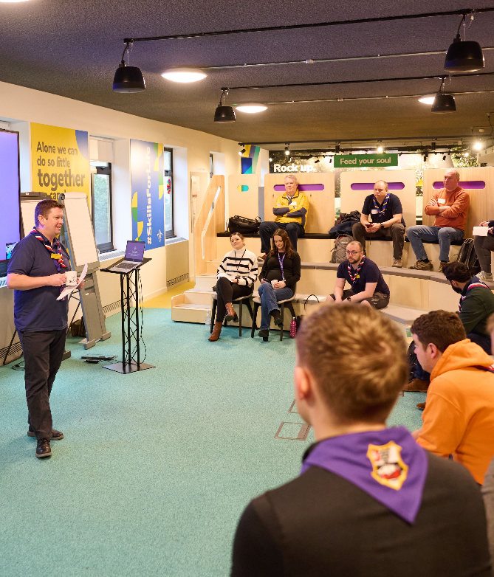
Resources
Learning Webpages:
Shared in draft in last TL Newsletter
Finalised for next TL Newsletter
Welcome Webpages:
Shared in next TL Newsletter, inc. welcome conversation learning videos
First Aid:
Webinar recording available on Vimeo
New Ways of Working overview:
Shared in next TL Newsletter

Slide 31
Questions

Slide 32
Change Readiness Survey

Slide 33
Change Readiness Overview
Overall RAG - Progress so far
Predicted RAG at Go-Live

Slide 34
Change Readiness Overview

Slide 35
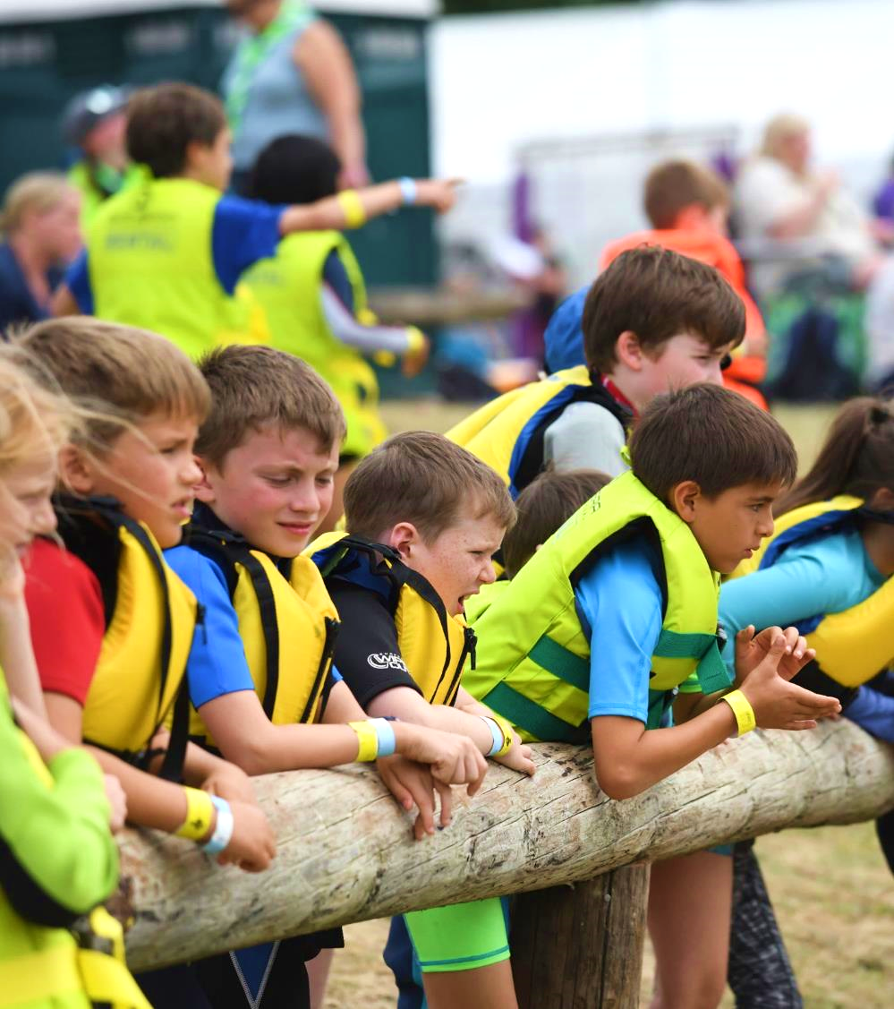
Change Readiness Survey
Same survey repeated every 6 weeks, one response per County/Area/Region
Next survey will come out on 11 December, to be completed by 8 January
Shared with Region & Nation Commissioners to support locally
Reviewing how resources and HQ comms can support locally
Targeted support being provided where indicated

Slide 36
Looking Forward

Slide 37
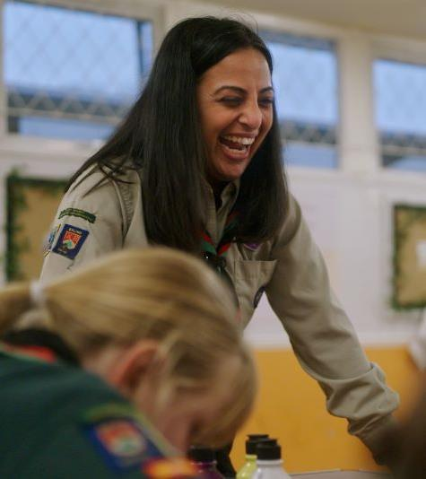
Priority tasks for 2023
Ensure all volunteers are provided with information relevant for them
Agree your County team structures and membership
Use accreditations to plan how you’ll share tasks in your new structures
Review your local processes
Build your local support structure for go-live
Volunteers are at full appointment wherever possible

Slide 38
Looking Back

Slide 39
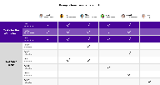
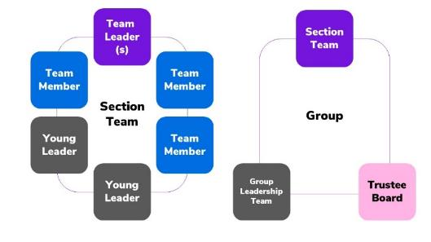
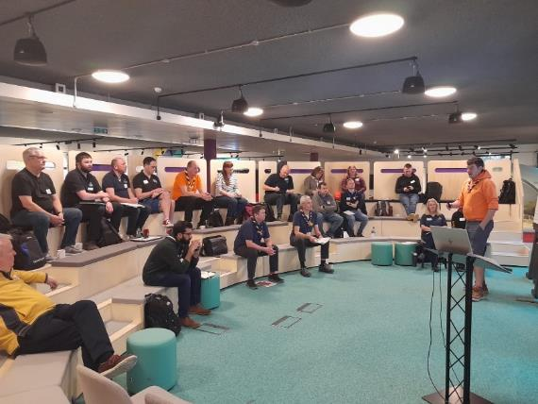
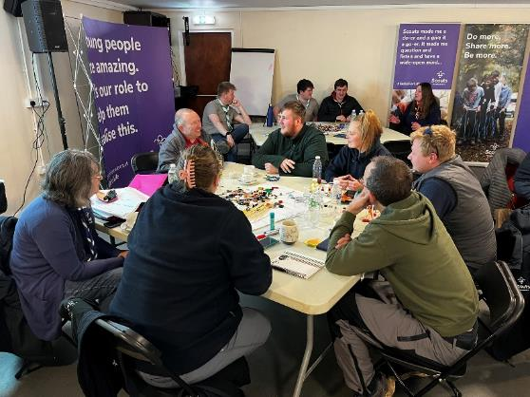
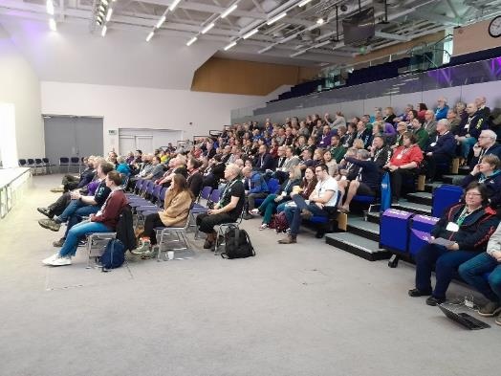
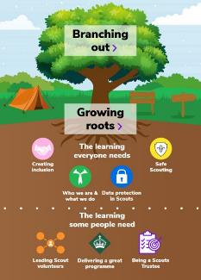
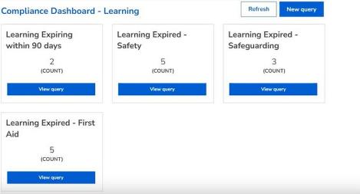
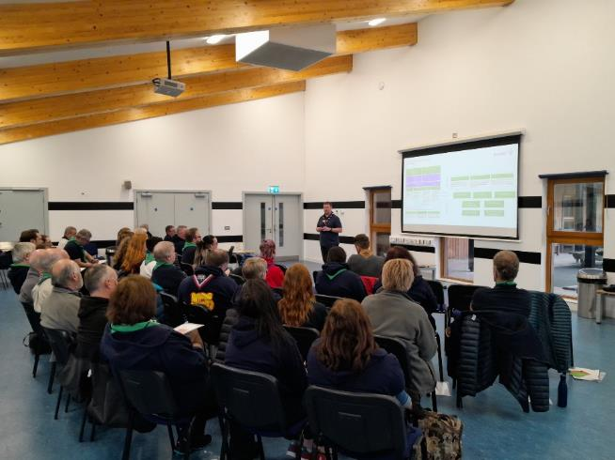
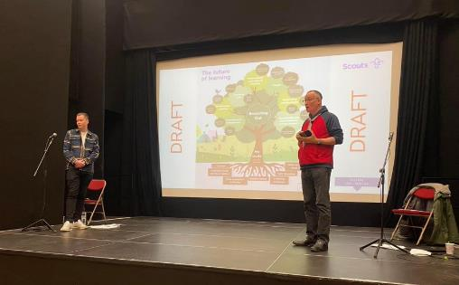
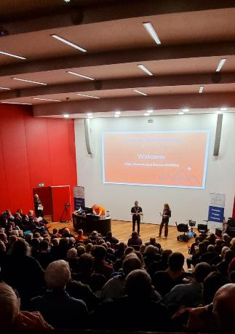
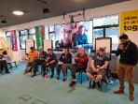
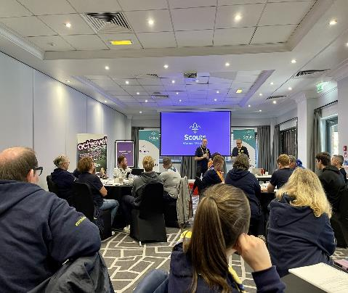
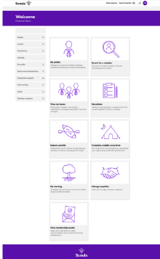
You’ve achieved so much already
127,000 views of live VE web pages
94 Transformation Leads across Scouts
Facebook Group 224 posts
995 comments
1,427 reactions
450+ members of VE Group involved in testing
All digital systems are built and ready for testing
Transformation events held around the country with over 30 supported by HQ

Slide 40
Early Adopter Update

Slide 41
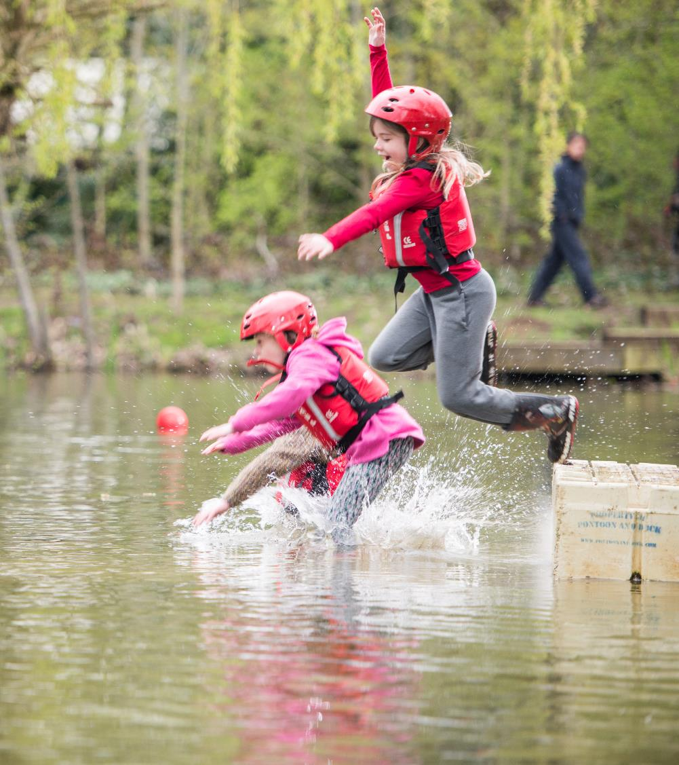
Early Adopter Update
Early Adopter event in January 2024
Exploring how best to deliver guides and videos for the new systems
Sharing processes overview for feedback
Shared latest Change Guide updates for feedback
Talking through what migration looks like and key tasks during this time

Slide 42
Next Steps

Slide 43
What we’re doing:
What you can do:
Sharing resources on building your local Volunteering Development Teams
Developing resources for building Volunteering Development Teams
Looking at how we manage Scouts processes when on two systems
Finalising learning and welcome webpages to share in December TL Newsletter
‘Almost-final-draft’ of January POR will be shared tomorrow
Use the readiness checklist in your area
Confirm your local team structures
Review your local processes
Build your local support model
Any POR feedback to be received by mid-December

