Slide 1


The Listening Tool
Piloted as part of Scouts’ Approach to Discrimination Project
Notes:
In this presentation, we'll learn what the Listening Tool is, why we’d need you to share and promote it in your local areas, and how to use it yourselves. We’ll also quickly go through the resources available to help you promote the Listening Tool in your local area.

Slide 2
What is discrimination?
Notes:
Discrimination is ‘unfair treatment related to identity, such as age, gender, race or religion.’ Discrimination can look like lots of different things. For example, it could look like inappropriate language (slurs) or an old rule that’s always been there. Someone might say they’re “just having a laugh” or “it isn’t a big deal”.
But discrimination isn’t okay. It might make you feel angry, unsafe, powerless or scared. It’s motivated by stereotypes, prejudice or bias towards people’s identities, such as their gender, race or religion. It can be hard to talk about discrimination, especially if you’ve experienced it yourself or you know someone close to you who has. There’ll be people here today who’ve experienced discrimination, so we need to act in line with our Scout values and show care and respect for others.
Lots of discrimination goes unreported at Scouts. The Listening Tool is an anonymous reporting form anyone in our pilot locations can use to report:
• Discrimination or unfair treatment, linked to who someone is, such as their race, religion, or disability,
• Behaviour that makes someone feel left out, unwelcome, or like they don't belong at Scouts,
• Anything else that doesn't feel in line with our Scout values.
By helping Scouts understand what's happening across our movement, we can create a safer, more welcoming Scout experience for everyone.

Slide 3
What it is
What it isn’t
An anonymous reporting tool
An opportunity to tell us what you're seeing, hearing and experiencing
A way to help make Scouts a safer, more welcoming place
A replacement for Safeguarding processes
A replacement for our Complaint process
A way to get support
Notes:
The Listening Tool is
Anonymous. We won’t ask you to share names of people, Groups or any other identifiable information.
An opportunity for you to tell us what you're seeing, hearing, and experiencing at Scouts.
A way to help Scouts learn how to make our movement safer and more welcoming.
It isn't:
A replacement for Safeguarding processes. You must follow existing Safeguarding processes outlined in the Yellow Card.
A replacement for the Complaints process.
A way to get support with something you’ve seen, heard or experienced at Scouts. No one will get in touch with you about a report you’ve made, but it may be passed over to the Safeguarding team if there’s safeguarding concerns.
If you need support with something that’s happened at Scouts, speak to your Line Manager, Scouts' Support Centre, or a Mental Health First Aider. Some external support services are signposted on our Listening Tool webpage.

Slide 4

Engaging with the Listening Tool will…
Help us, help you tackle discrimination
Help us all live by our Scout values
Themes from the Listening Tool will help us build a safer and more inclusive Scouts
Notes:
Our volunteers have told us that they need more support tackling discrimination in their Sections, Groups and teams. Themes from the Listening Tool will be used to develop resources for volunteers that are relevant, useful and evidence-based. The more Scouts can learn from the Listening Tool, the more tailored support will be.
The Listening Tool is closely aligned with our Scout Values. Together, we can continue to build a movement where we:
Show respect and care for other (care&respect)
Work together to problem solve (cooperation)
Take responsibility for our words, actions and mistakes (integrity)
Using the Listening Tool will help us make Scouts a safer and more inclusive place for all our members, including you.

Slide 5
So, what we need from you…
Report your own experiences
Support young people to make reports
Use our pre-made resources to share the Listening Tool with:
  Volunteers
  Parents, carers and family members
  Young people
Notes:
Use the Listening Tool to report what you’ve seen, heard or experienced.
Support others, especially our young people, to report discrimination.
Anyone in our pilot locations can use the Listening Tool, including young people and family members. That’s why we need you to spread the word about the Listening Tool. Tell other volunteers about the Listening Tool and encourage them to share it with volunteers, families and young people so everyone can report discrimination when it happens. You can use our pre-made resources to help you.

Slide 6
Spreading the word
Encourage other volunteers to use the tool:
  Speak to them about how it will 'help us, help them'
Encourage parents/carers to report their experiences and their young person’s experiences
Talk to young people:
  Share it as part of your programme
  Young people over 13 can use the tool themselves
Notes:
Consider what key volunteers may be able to share information in your area. This could include Youth Leads, Inclusion Leads, Communication teams, District and Group Lead Volunteers, and Section/Unit volunteers. We need information about the Listening Tool to reach everyone in our pilot locations, and you play a role in this.
Parents, caregivers, and family members need to know about the Listening Tool, as they’re likely to make a report on behalf of our young people. They need to know why the tool exists, when they should use it, and how to do so. They are likely to hear about discrimination from young people before it’s been resolved, so you should include the Listening Tool with any other resources and support you offer parents, carers and family members when resolving incidents, even if you aren’t sure it’s relevant.
Young people aged 13 and over can make a report independently through the Listening Tool, while those under 13 need support from a trusted adult. You can introduce the Listening Tool as part of your Programme, alongside activities around treating everyone fairly, identifying your trusted adults, and what to do if you feel unsafe, scared or bullied at Scouts. Explorer and Network members can get involved in sharing the Listening Tool in their Districts (and County/Area/Region) as part of their Top Awards (as part of the ‘Values’ section).
Encouraging volunteers, families and young people around you in Scouts to use the Listening Tool will help Scouts understand the full picture of what’s going on across our movement.

Slide 7

Key Details you need to know about making a report
Notes:
You can report discrimination:
Happening in any Scout setting, including online.
Involving any of our members, families or members of the public.
No matter when it happened, including if it happened over 10 years ago.
You don’t need to prove anything or use the ‘right’ words. If something didn’t feel right, you can report it.
You don’t need to be involved in the situation to make a report, and you don’t need permission to make a report about someone else.
As volunteers, you may be approached to make a report for someone else. In these circumstances, you should:
Treat any information shared with you as confidential and follow our Data Protection Policy.
Report any Safeguarding concerns in line with our Yellow Card.
Signpost to mental health support services, such as Mind (or SAMH in Scotland) and Chasing the Stigma.
Your County/Region/Area may have trained mental health first aiders who can offer support in the immediate aftermath of discrimination. However, they shouldn’t be relied on for long-term support.
You may also want to use our guidance on reporting and responding to racism to help you resolve incidents of discrimination. This guidance focuses on racism but can be applied more broadly. As part of this project, we will be bolstering this guidance and advice.

Slide 8
Accessing the Listening Tool online
Reports can only be made online. But you could if you don’t have easy access to the internet:
Visit a library
Ask someone to make a report on your behalf
Ask someone if they can support you to make a report on their device
Top Tip: Save the link to the Listening Tool so you can return to it whenever you need to make a report.
Notes:
The Listening Tool is an online form. This means reports can only be made with an internet connection. This slide has some ideas on how you or someone else could make a report if you don’t have easy access to the internet or don’t feel confident using digital tools without support.
You can make a report at any time, so wait until you’re in a suitable location. You could write down what happened so you don’t forget, but make sure you don’t include any names or personal information.
Highlight the top tip, there is a QR code on an upcoming slide where they can open and save the link to the tool and webpage.

Slide 9
Walkthrough
https://vimeo.com/1206783931
Notes:
Let’s watch this quick demonstration of how to report something through the Listening Tool.

Slide 10






Available resources
Notes:
Scouts have created a collection of pre-made resources you can use to share information about the Listening Tool with volunteers, families and young people. This includes template messages for WhatsApp groups and OSM, social media posts, newsletter and email text and printable posters to display in your usual meeting place.
If you want to deliver a PowerPoint presentation to introduce the Listening Tool, we have specific PowerPoint decks for:
Volunteers (this slide deck)
Parents, carers and family members
Scouts and Explorers
Network members
We also have Word documents with key points for talking to different audiences and top tips to help you. These documents centre on:
- Talking to volunteers
Talking to young people
Talking to parents, carers and family members.
Our young person document contains suggested activities to run alongside introducing the Listening Tool.
We also have an FAQ document you can use to answer questions.

Slide 11
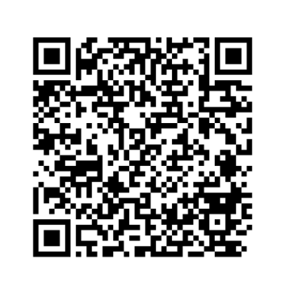
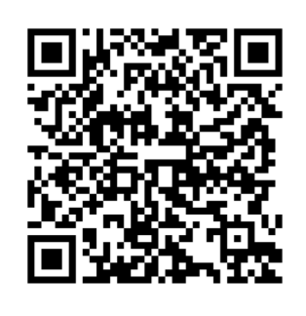
Any questions?
Visit our Listening Tool webpage
Make a report
Notes:
Prompt to save the link to the webpage so they can find it again in the future. The URL is scouts.org.uk/volunteers/equity-diversity-and-inclusion/listening-tool/.
Use the FAQ document to help you answer questions. If there’s anything you think should be added to the FAQ document, please speak to the key contact for the Listening Tool in your area.
The FAQ document covers:
I’m not sure if I’ve experienced discrimination or not, can I still report it through the Listening Tool?
Will volunteers in my pilot location be able to see my report?
Can I report something that happened a while ago?
Can I report something that doesn’t involve me?
Do I need to get permission to make a report about someone else?
Why does the form ask for the demographic details of the person making the report?
Why won’t someone get back to me about something I’ve reported through the Listening Tool?
Can I report something I’ve already reported to Safeguarding or made a formal complaint about?
I’m interested in helping Scouts develop their approach to tackling discrimination. Is there a way for me to learn more and get involved?
I’d like to provide feedback about the Listening Tool. Where can I do this?
How long will the Listening Tool be open for?
Can all of our young members make a report through the Listening Tool?
Is the Listening Tool available in languages other than English?
Who else is taking part in the Listening Tool pilot?
Who should I contact if I have a question or need support with the Listening Tool?

Slide 12
Additional slides you might like to use

Slide 13


Pilot Locations across the UK
Birmingham County
Cardiff and Vale Area
East Belfast District
Greater London North-East County
Hertfordshire County
Kent County
Leicestershire County
Powys Region
South-East Scotland Region
Notes:
These are the nine pilot locations for the Listening Tool. This includes locations from England, Northern Ireland, Scotland and Wales.
Lead Volunteers from each of these Counties/Areas/Regions make up our working group for the approach to discrimination project, along with representation from the UK Inclusion Team and our Project Sponsor from our Race Equity Sub Team.

Slide 14
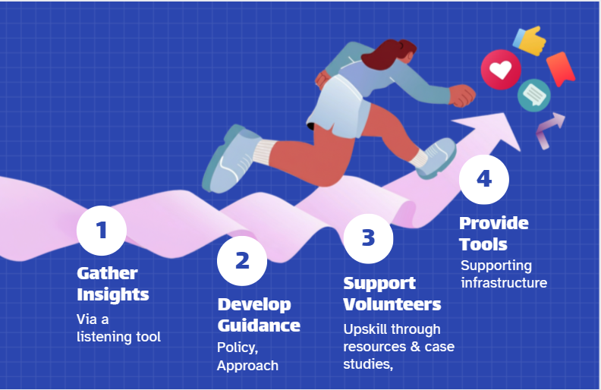
Our proposed approach
Notes:
If people are interested in learning more about the approach to discrimination project, use this slide to help you.
The Approach to Discrimination Project is made up of four key steps.
The first step is the Listening Tool. Volunteers, young people and families across the nine pilot locations can report discrimination they've seen, heard or experienced at Scouts.
Using information shared through the Listening Tool and pre-existing knowledge, the project working group (LVs from the pilot counties) will support Scouts to develop our approach to tackling discrimination.
From conversations we've had so far, this will likely focus on support, growth and learning opportunities.
Step two aims to develop anti-discrimination policies that are fair, proportionate and in line with our values and embed this approach within our existing policies.
Once the approach is decided, Scouts will build resources to support volunteers, so they know what to do when discrimination happens. This may include new EDI learning for volunteers around microaggressions, race equity and proactive inclusion.
Step four is all about creating the infrastructure to ensure a consistent application of the approach we decide upon. For example, recording forms, ways of logging, and determining where members have been educated or upskilled.

