Slide 1
Transitioning to Trustee Boards

Slide 2
Who's on the call?
Hamish Stout, Deputy UK Commissioner for People
Pete Jeffreys, Volunteer Journey Delivery Team Product Lead
Stuart Imrie, Scotland Commissioner (Governance Support)
Terry Kingham, Assistant UK Commissioner for People (Local Governance)
Rob Groves, Change Manager

Slide 3
What we’ll cover
Moving to a team-based approach
For Trustee Boards, what has already changed?
For Trustee Boards, what else will change?
Resources
Next steps
Follow up

Slide 4
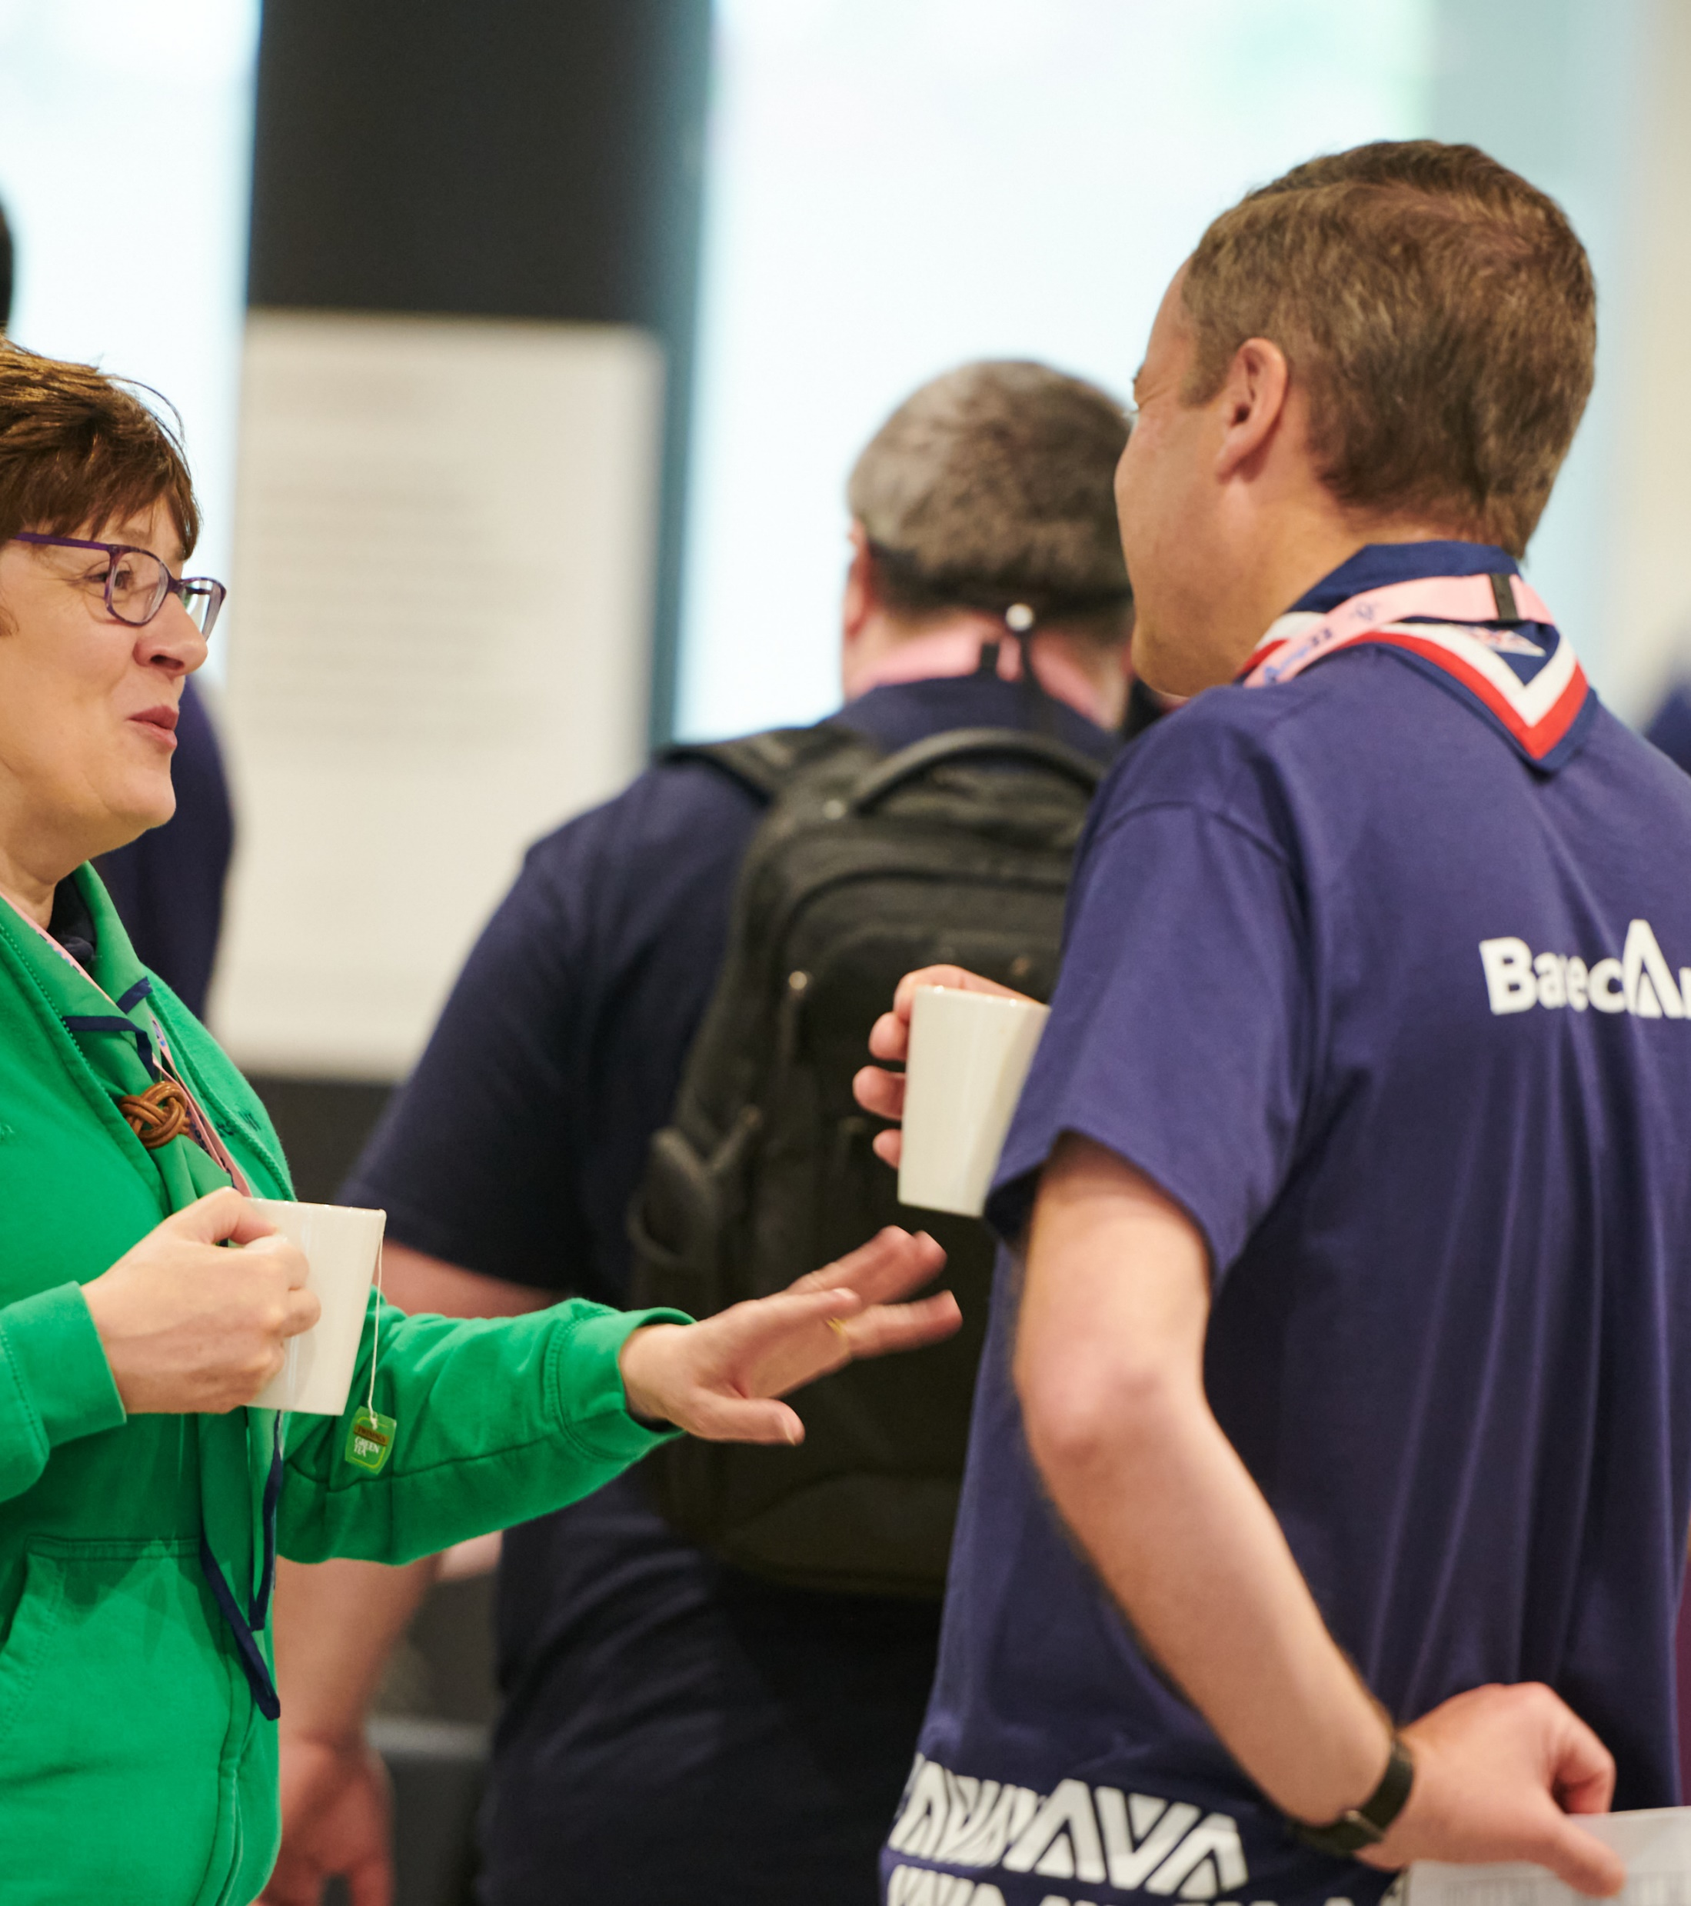
Introduction
As part of the work to transform the volunteer experience within Scouts there are changes to Executive Committees and how they function
These changes are informed by:
The evolution of good practice guidance from charity regulators
Our move to a teams-based approach
These cultural and procedural changes to how Executive Committees currently operate will support our Skills for Life strategy, our ‘North Star’ and the overall aims of the volunteer experience transformation

Slide 5
Making volunteering easier and more fun is how we reach our North star...
More young people gaining skills for life
Consistently and safely
deliver a great programme
Recruit more volunteers
and retain current ones

Slide 6
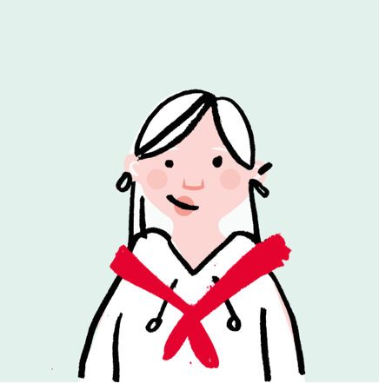
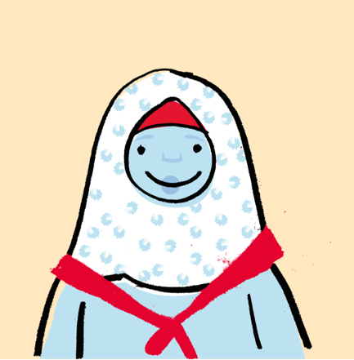
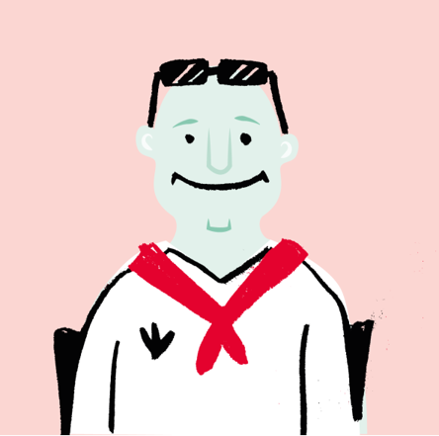
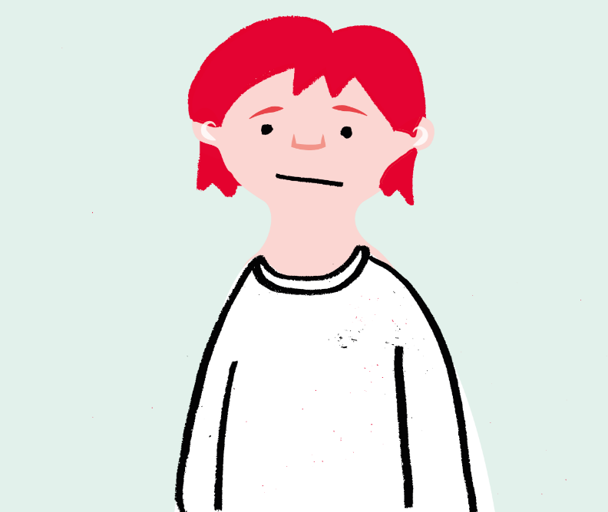
We want to make volunteering with Scouts easier and more fun…
…so that we can attract more volunteers and our current volunteers want to stay

Slide 7
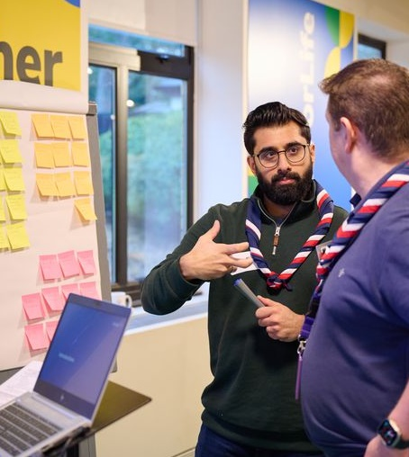
Setting up for success
Good governance is fundamental to a charity's success, enabling and supporting the charity to:
Meet the charity’s objectives
Comply with the law and relevant regulations
Good practice for charities is set by the charity regulators, and there have been some significant changes over the past few years.
Note that these changes apply whether or not your charity is registered with a charity regulator. They apply to all Groups, Districts and Counties or equivalent.

Slide 8
Moving to a team-based approach

Slide 9
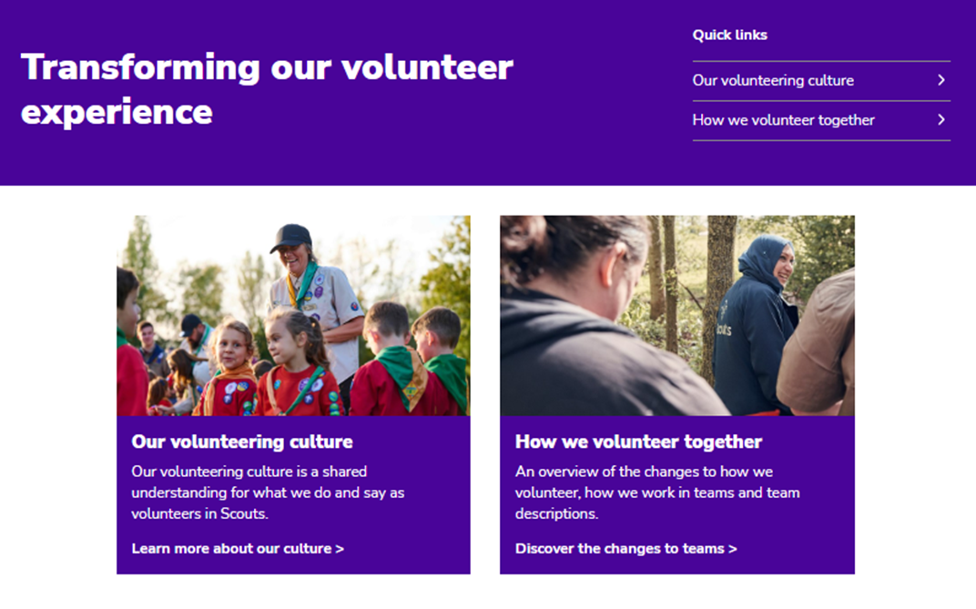
Moving to a team-based approach
The key principles for these teams are to:
Allow for flexible volunteering that suits people’s skills, interests, and time
Provide clear purpose and responsibilities
Have tasks that will be shared among a team
Be led by a Team Leader or Lead Volunteer
Have a team description that describes the purpose, and the tasks that they need to achieve

Slide 10
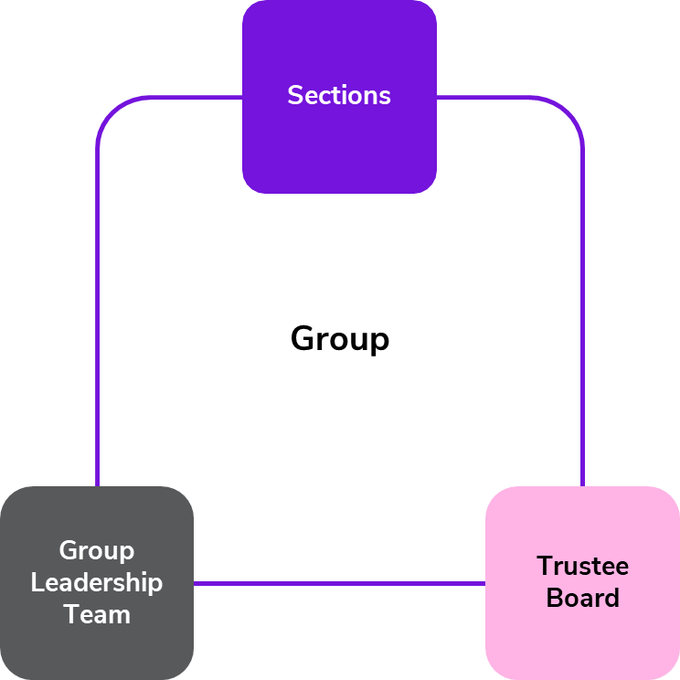
Group Structure
Section Team Leader
Section Team Members
Group Lead Volunteer
Group Leadership Team Members
Section Team Leaders
Chair
Secretary
Trustees
Group Lead Volunteer

Slide 11
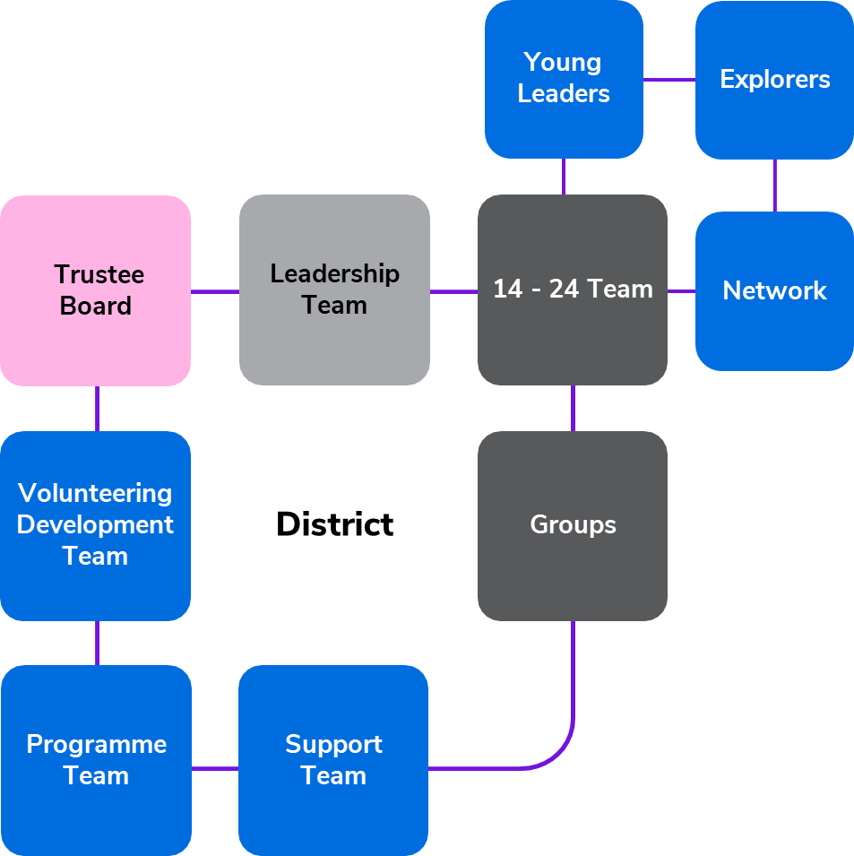
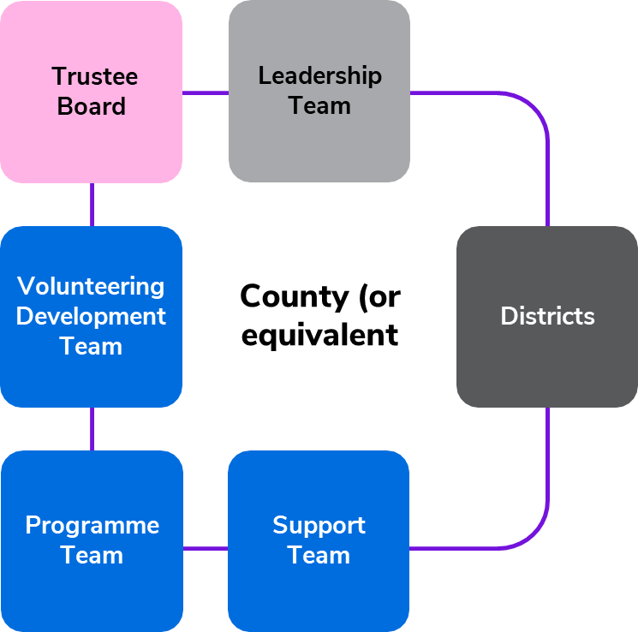
District & County Structure

Slide 12
For Trustee Boards, what has changed already?

Slide 13
What’s changed already?
Name
Purpose
To bring us in line with the good practice guidance set out by the charity regulators two key areas changed in the April 2023 edition of POR for England, Wales & Northern Ireland and in July 2023 for Scotland:
Name - Executive Committees are now Trustee Boards and Executive Committee Members are now Trustees
Purpose - Trustee Boards focus on governance of the charity rather than operation of the charity

Slide 14
Renaming as Trustee Boards
Executive Committees have been renamed as Trustee Boards, members of which are renamed as Trustees
Why this change?
To align with good practice guidance from the charity regulators
To help reinforce the purpose of Trustee Boards and focus on the role and responsibilities of being a charity Trustee

Slide 15
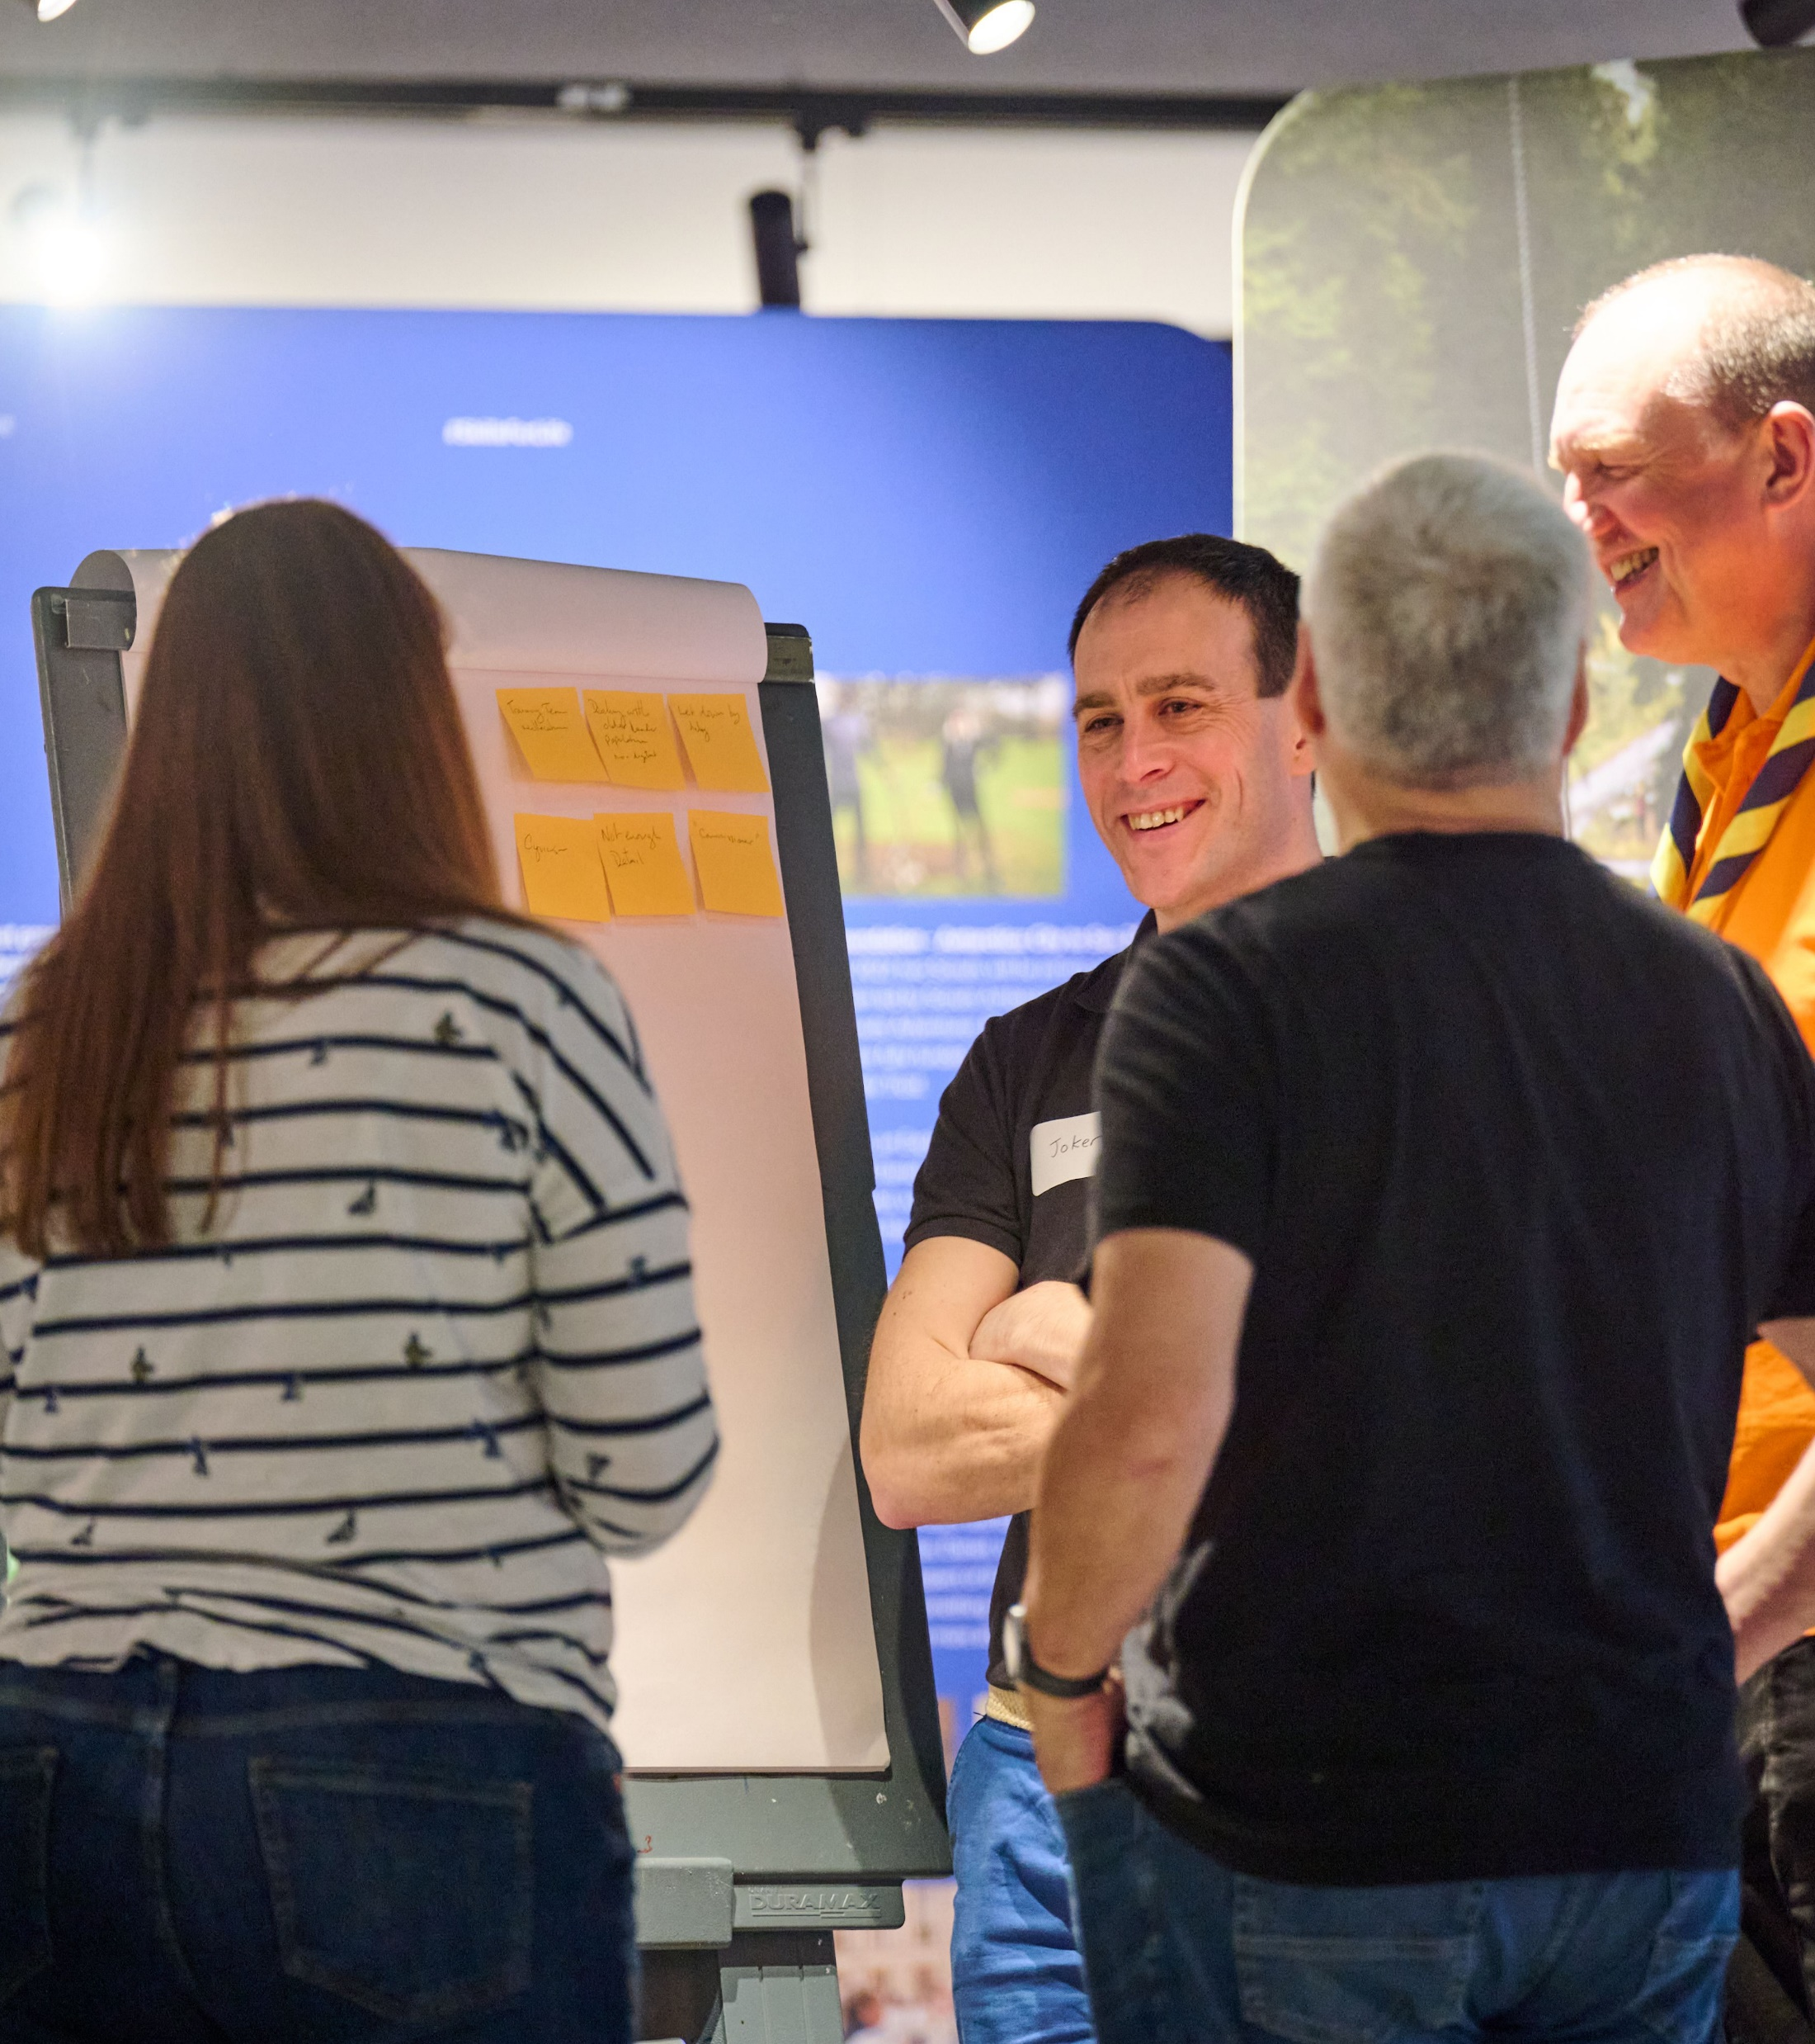
Trustee Board - Purpose
Trustee Boards need to focus on governance and now have a clearer purpose statement in POR to reflect this.
Why this change?
To align with good practice guidance from charity regulators
To focus on ensuring effective governance as the core responsibility of any charity Trustee Board and to ensure that the charity focusses on meeting its objectives

Slide 16
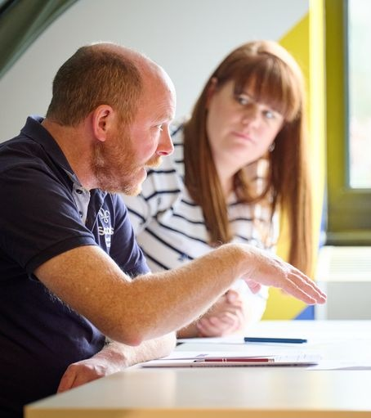
Trustee Board - Purpose
Elements of the purpose of a Trustee Board include:
Being confident that:
Young people are meaningfully involved in decision making at all levels
There are sufficient resources available to meet any planned work
Scouts has a positive image in their local community
Managing risk:
Developing and maintaining a risk register, including the appropriate mitigations
Ensuring that:
The charity’s finances are properly managed and appropriately budgeted
Effective administration is in place to support the work of the Trustee Board

Slide 17
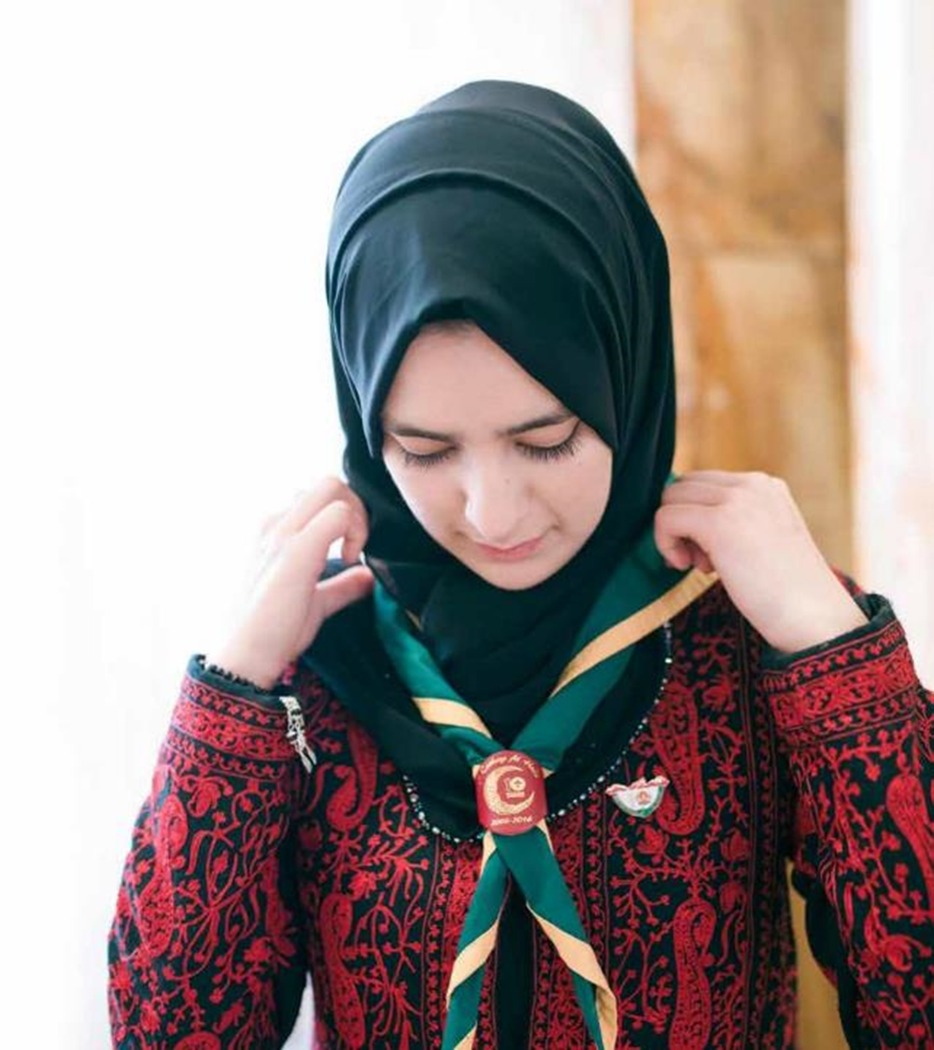
What this looks like in practice
Some areas are for trustees to be confident that they are being done.
Some areas, the core governance tasks, are for trustees themselves collectively to do.
Operational tasks such as repairing the hut, cutting grass, fundraising and similar are still really important.
These will be managed through the Group Leadership Team, or the Support Team in a District or County (or equivalent).
These tasks can still be carried out by people who are Trustees, however, they will be managed under the relevant operational team rather than in their Trustee role.

Slide 18
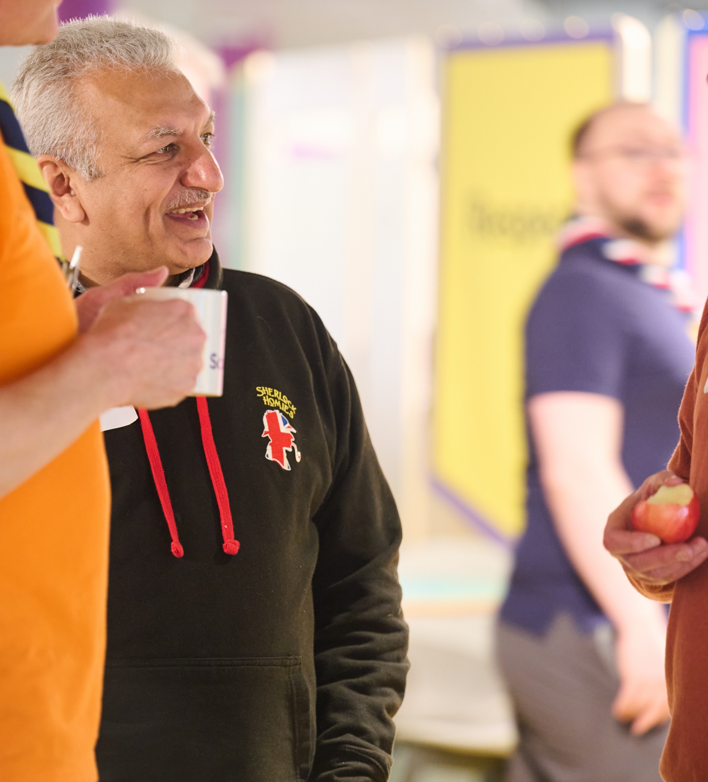
Your Constitution
All Trustee Boards must ensure they have adopted a constitution as their governing document.
This could be:
The constitution as set out in POR
An adapted version of the constitution as set out in POR, or Scottish variations
When should this be done?
If you haven’t already adopted a constitution this should be done formally at your next AGM
It’s good practice to re-adopt your constitution at every AGM

Slide 19
For Trustee Boards, what else will change?

Slide 20
Changes to Trustee Board membership
To bring our governance up-to-date with current charity sector good practice we need to ensure that Trustee Boards are the right size and have the appropriate membership to deliver their purpose
The membership changes will be detailed in full in the next edition of POR and should be used to prepare for your next AGM, following migration to the new digital system
At your next AGM, your next Trustee Board will be appointed using these new rules and the updated constitution to reflect these new rules must be adopted.
Name
Membership
Purpose

Slide 21
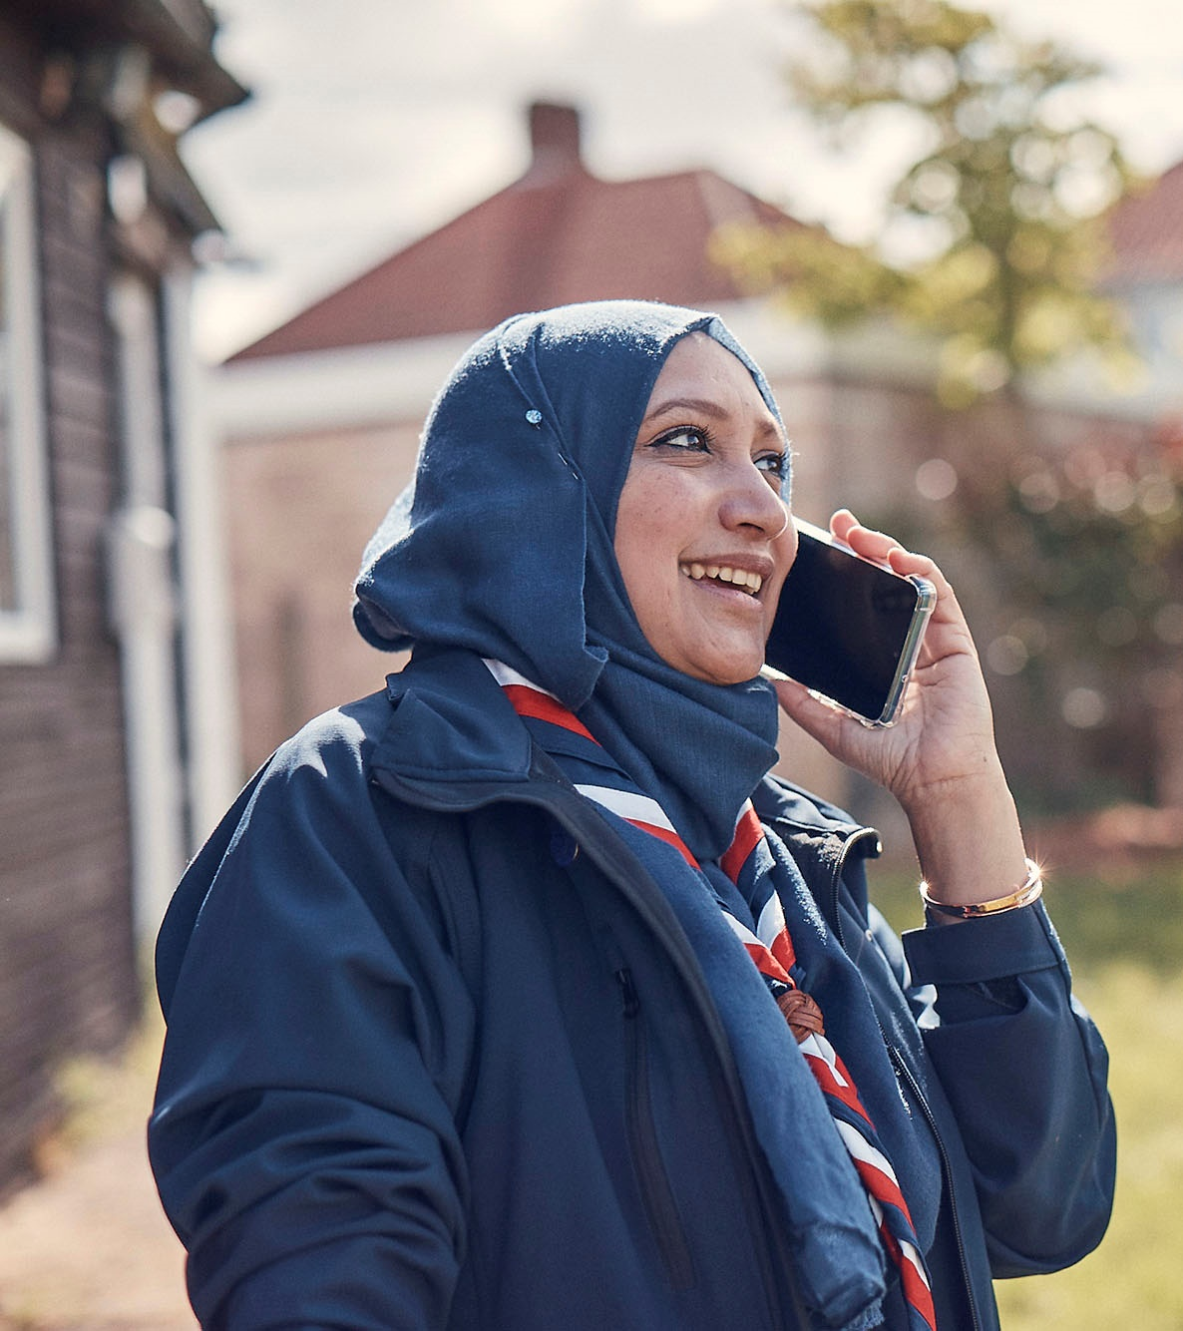
Trustee Board - Membership
What is changing?
As a continuation of the work to align Scouts with good practice guidance from charity regulators (in all nations):
Trustee Board Size - Having enough people to have a range of views, without making decisions difficult
Membership Periods - Ensuring Trustee Boards are progressively refreshed and continue to have objectivity
Administration - To ensure Trustees can play a full role in board discussions and decisions, but underpinned by excellent administration

Slide 22
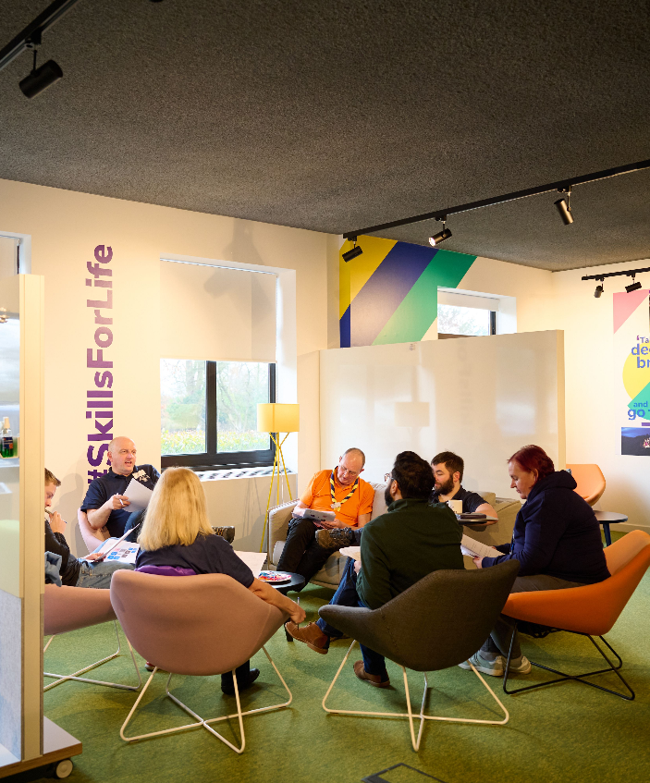
Trustee Board Size
In line with charity sector good practice, Trustee Boards, should be:
Size of between 5 and 12 Trustees
Supported by excellent administration
and will comprise:
Chair
Treasurer
Lead Volunteer - ex-officio
Youth Lead - ex-officio (District and County; except Scotland))
Additional appointed Trustees
Co-opted Trustees (where appropriate)

Slide 23
Trustee Board membership Ex-officio Trustees
Group - Group Lead Volunteer
Removed: Deputy Group Scout Leader, Section Leaders, Sponsoring authority, Secretary
District - District Lead Volunteer and District Youth Lead
Removed: DESC, DSNC, Secretary
County - County Lead Volunteer and County Youth Lead
Removed: Secretary
Shared ex-officio roles must all be eligible to be Trustees and complete Trustee learning, but only one will use the ex-officio position
Note: In Scotland, ex-officio is only the District/County Lead Volunteer

Slide 24
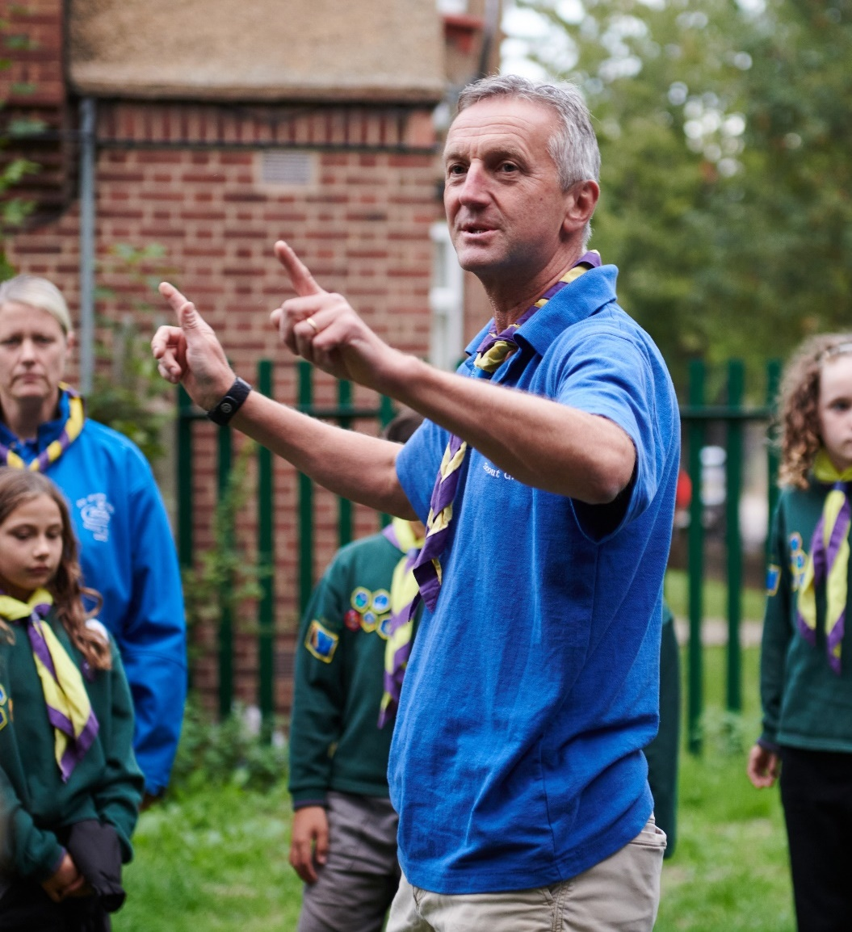
Trustee Board membership Appointed & Co-opted Trustees
‘Appointed’ Trustees replace ‘Nominated’ and ‘Elected’ Trustees
Good practice is to have a formal, rigorous and transparent procedure to appoint new trustees to the board, which includes advertising vacancies widely
Trustee Boards will agree what the open selection process is for all appointed Trustees, who will then be appointed at the AGM based on the outcome of this selection process
Co-opting of Trustees will continue, these are included in the 5 -12 membership size, with the number of co-opted Trustees not exceeding the number of appointed Trustees, excluding the Chair & Treasurer

Slide 25
Trustee Board membership Excellent administration
Trustee Boards need good administration and are collectively responsible for ensuring that this is in place
Administration is important but is not, of itself, the responsibility of a Trustee. It will be part of the responsibility of the Group Leadership or District/County Support Team
Current Secretaries will be automatically moved into a Trustee role when migrating to the new system and the role itself will be discontinued
Administration can be organised to suit individual Trustee Boards. For example, the current Secretary becoming a member of the Group Leadership or District/County Support Team and carrying out any admin tasks

Slide 26
Membership Periods
Appointed Trustees are initially appointed at the AGM for up to 3 years
Co-opted Trustees are initially appointed by the Trustee Board for a period of one year, and would normally become Appointed Trustees at the next AGM
All Trustee appointments (including Chair and Treasurer) can be extended by the Scout Council at the AGM in steps of up to 3 years
A Trustee can be a member of a Trustee Board for a maximum of 9 years, in any role
Membership periods will start from 2024 AGMs and do not include previous service as Trustees
Ex-officio roles are not subject to membership periods as a Trustee (though their role may have a term limit)

Slide 27
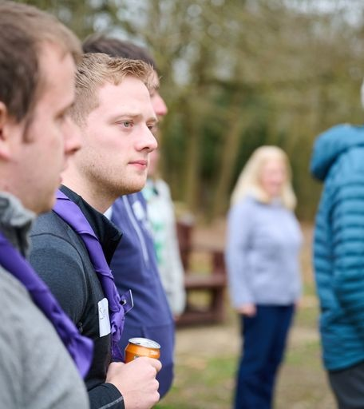
Additional Changes
The Trustee Board must confirm, through processes set out by the regulators, that all Trustees are eligible
Where possible, Trustee Boards should have two members aged 18 to 25
Anyone invited, or with the right to, may attend a Trustee Board, but would not have a formal vote.
This includes under 18’s - views of young people should always be considered
The quorum for a Trustee Board meeting will be ‘one third of members, plus one’
Scout Councils continue to set the quorum for their meetings (Scout Councils normally just meet for their AGM)

Slide 28
Examples - Governance vs. Operational

Slide 29
Persona Examples
Linda – 1st Anytown Scout Group
Exec Committee Member
Look after buildings and property
Helps to organise and run fundraising activities
Maintains Group equipment
Linda – 1st Anytown Scout Group
As Group Trustee
Takes full part in Trustee Board meetings as a Trustee, including oversight of buildings and property and budgeting
As Member of Group Leadership Team (or in Support Sub-Team)
Helps to manage/maintain Group property
Helps to organise and run fundraising activities
Helps to maintain Group equipment

Slide 30
Persona Examples
Daniel – Anytown District
District Support Team Member
Records minutes and actions of Exec Meetings
Prepares meeting agendas
Co-ordinates preparations for AGM
Daniel – Anytown District
District Exec Secretary
Records minutes and actions of Exec Meetings
Prepares meeting agendas
Co-ordinates preparations for AGM
Daniel – Anytown District
As District Trustee
Takes full part in Trustee Board meetings as a Trustee
As District Support Team Member
Ensures minutes and actions of Exec Meetings are recorded
Prepares meeting agendas
Co-ordinates preparations for AGM
OR

Slide 31
Persona Examples
Wilma – 1st Anytown Scout Group
Group Exec Treasurer
Provides finance advice and reporting to Trustee Board
With Trustee Board ensures appropriate insurances are in place
Prepares annual accounts and ensures their timely ‘audit’
Pays invoices and expenses
Manages banking and other financial transactions
Keeps appropriate ‘books’ and copies of relevant support documentation
Wilma – 1st Anytown Scout Group
As Group Trustee Board Treasurer
Provides finance advice and reporting to Trustee Board
With Trustee Board ensures appropriate insurances are in place
Prepares annual accounts and ensures their timely ‘audit’
As Member of Group Leadership Team (Support Sub-Team)
Pays invoices and expenses
Manages banking and other financial transactions
Keeps appropriate ‘books’ and copies of relevant support documentation

Slide 32
Resources

Slide 33
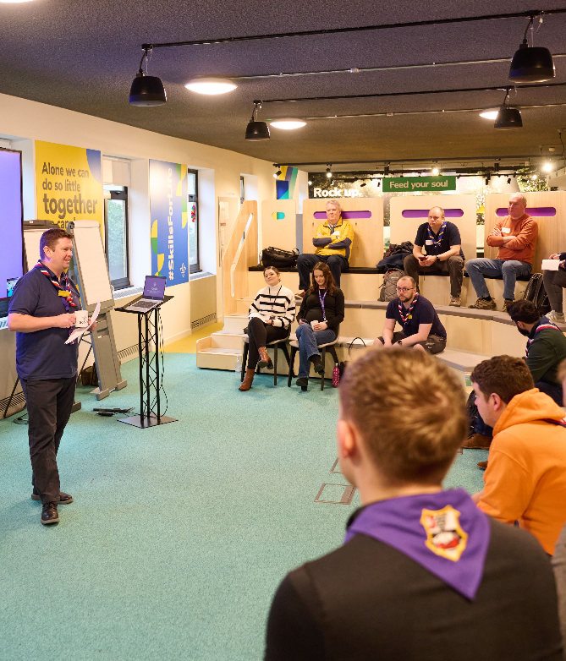
Resources
Available now:
Updated the Moving to Trustee Boards webpage
Current AGM templates and script
Available by the end of the year:
Webpage providing guidance and examples for an open selection process for appointing Trustees
Available in early 2024 (aligned with POR release):
POR Chapter 5 for post-migration
Risk Register guidance and template
Trustee Board yearly meeting planner tool
Updated AGM template and script
Updated webpage on accounting and reporting

Slide 34
Questions

Slide 35
Next Steps

Slide 36
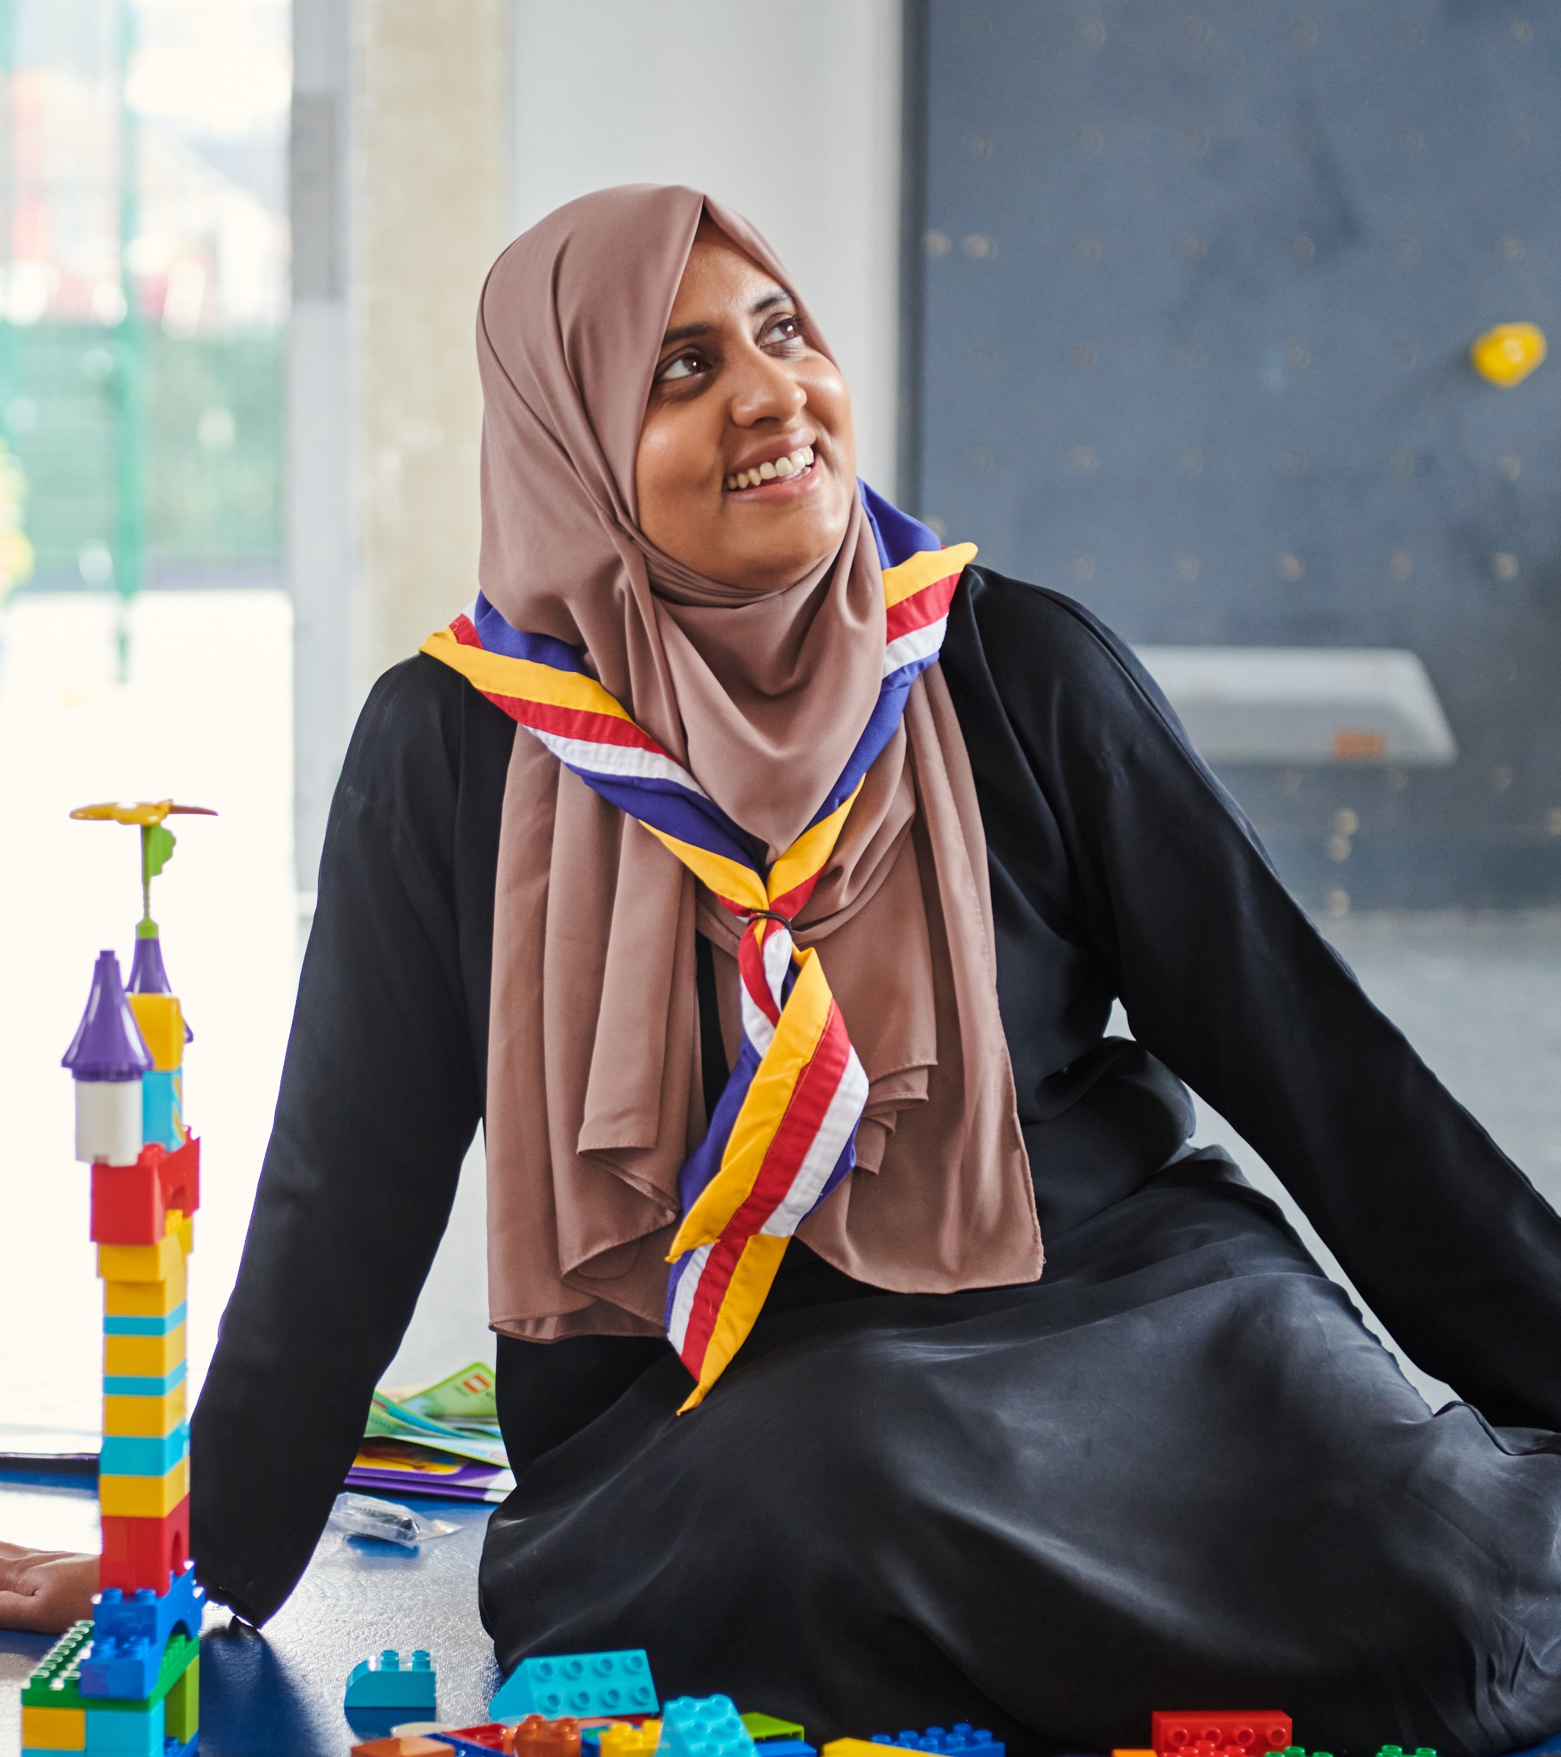
Next Steps
Any Groups, Districts, Counties (or equivalents) still using the terms Executive Committees and Executive Committee Members must update these
All Trustee Boards must actively work towards embedding the updated purpose statement in what they do and your Trustee Board agenda planning
Use the updated AGM template and script in your AGM planning
All Trustee Boards to use the membership changes information to plan and begin implementing changes ready for their next AGM following migration to the new digital system

Slide 37
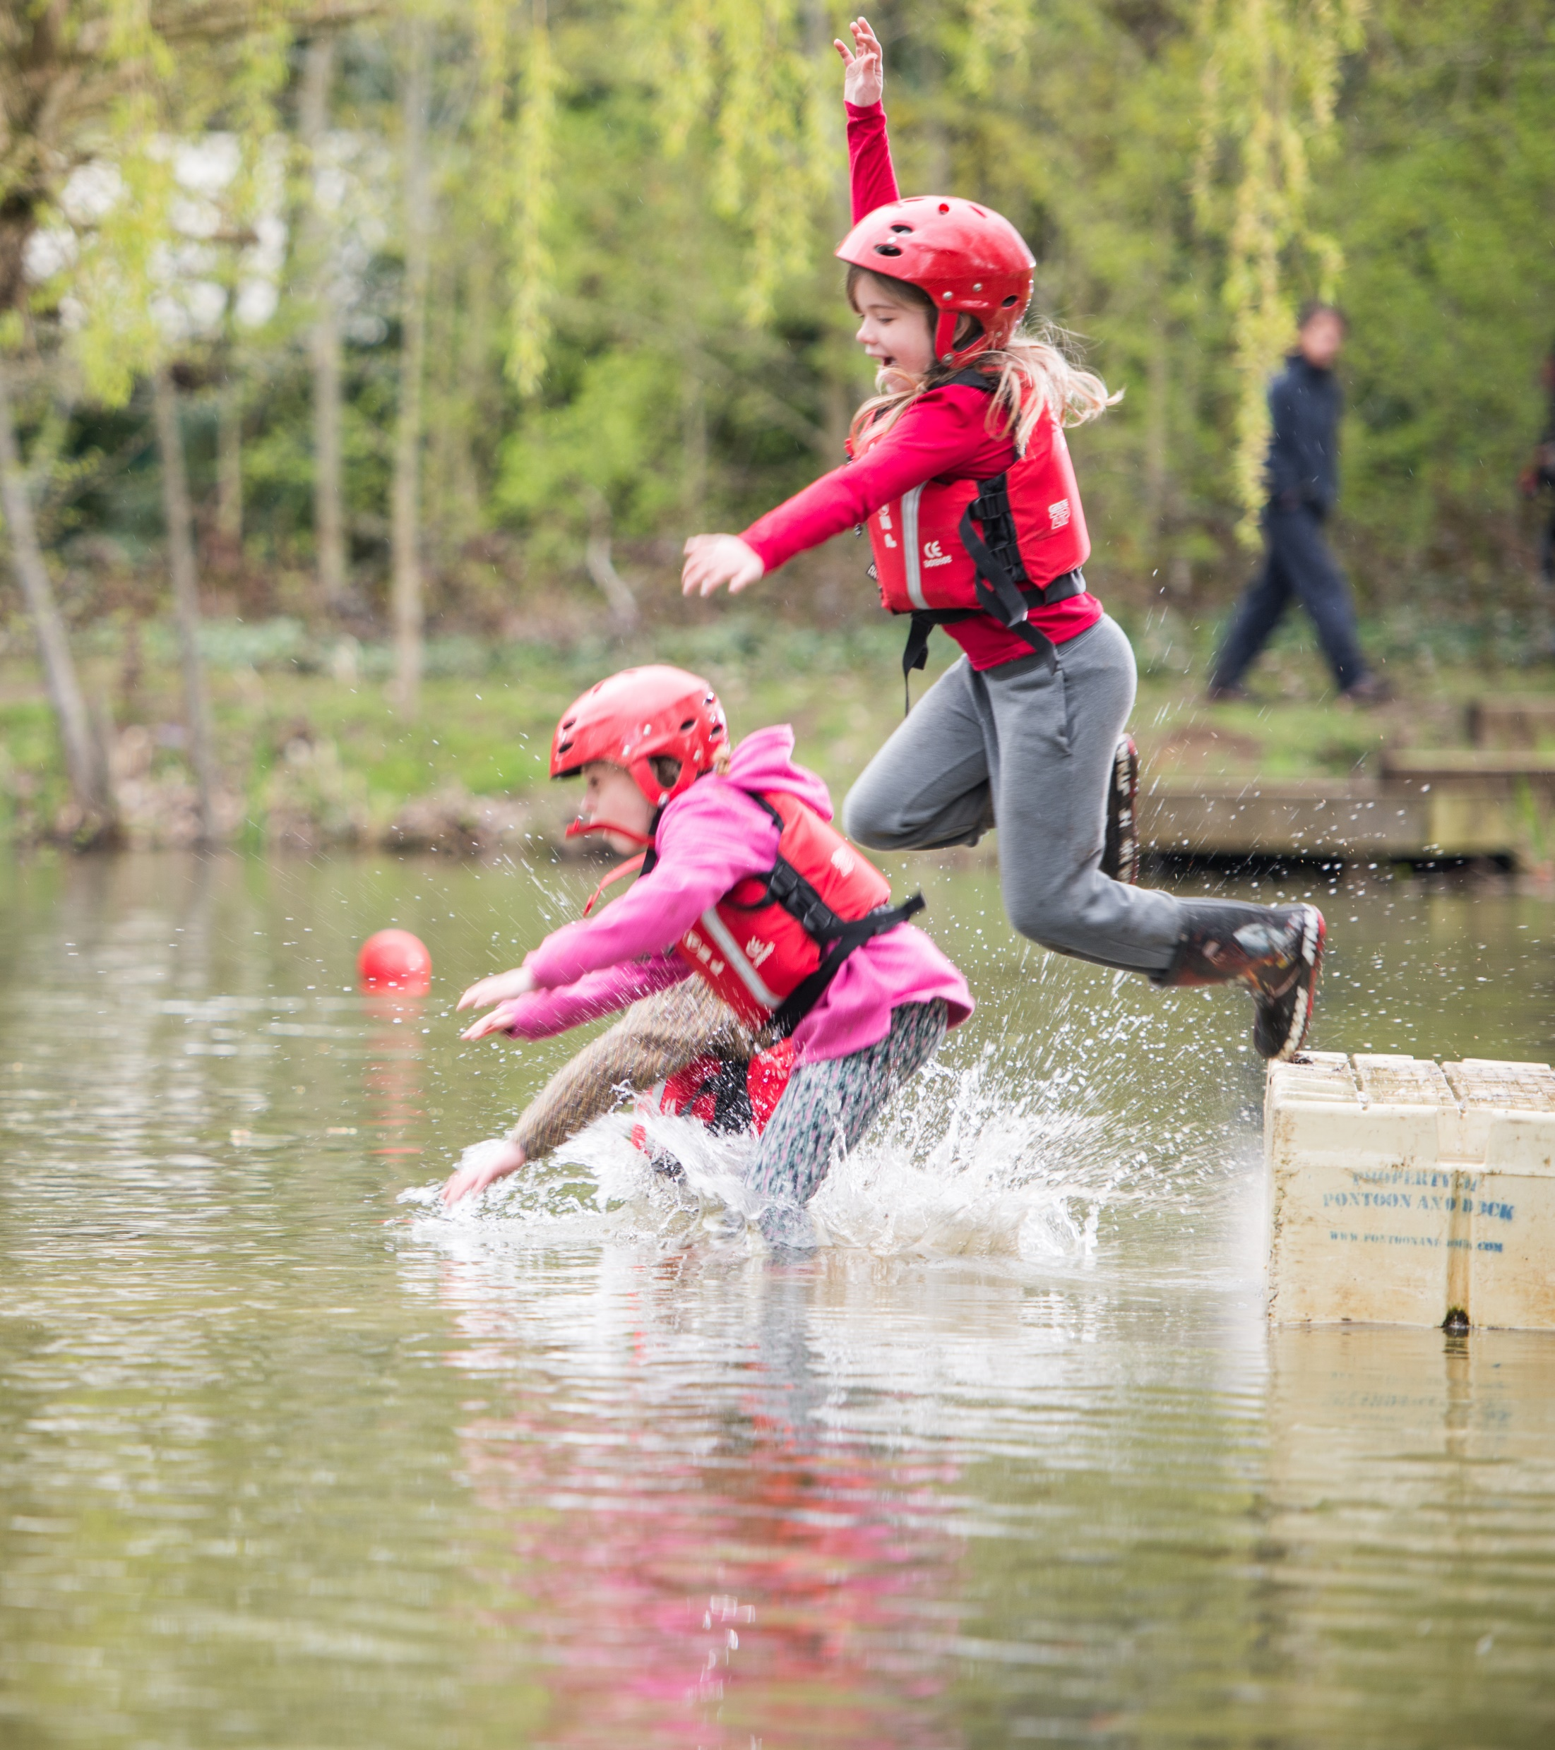
Follow Up
If you have any follow up questions, or any questions we didn’t get around to please get in contact via the Support Centre

