Slide 1
Transformation Leads Call

Slide 2
Who's on the call?
Craig Turpie, Deputy UK Chief Commissioner
Jack Caine, UK Commissioner for People
Andrew Sutherland, Deputy Programme Sponsor
Hamish Stout, Deputy UK Commissioner for People (Transformation)
Paul Fix, Volunteer Journey Volunteer Sponsor
Pete Jeffreys, Volunteer Journey Delivery Team Product Lead
Lara Burns, Chief Digital Officer
James Booker, Head of Portfolio Delivery & Change
Lauren Golding & Adam Ray, Communications Team
Kirsty Waugh, Gemma Norman & Rob Groves, Change Team

Slide 3
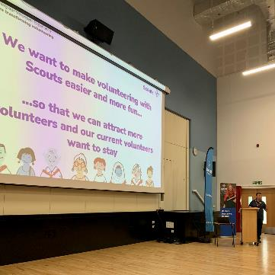
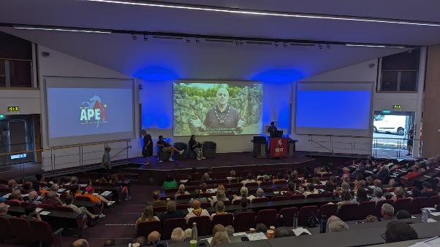
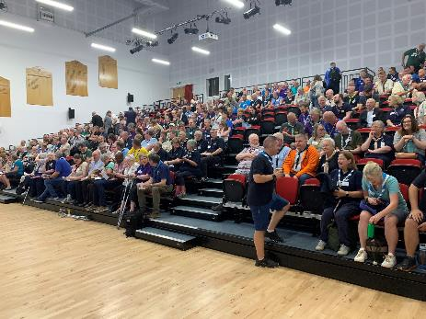
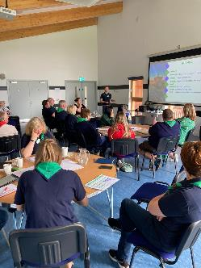
Transformation Events
Northern Ireland
Gilwell Reunion
Kent
Scotland
And many more!

Slide 4
What we’ll cover
Timeline
Trustee Board Membership Changes
County/Area/Region(Scotland) Readiness
What can we be doing now?
Readiness Checklists
Transformation Lead Poll
Transformation Information
Early Adopter Update
Next Steps

Slide 5
Go Live Timeline Update

Slide 6
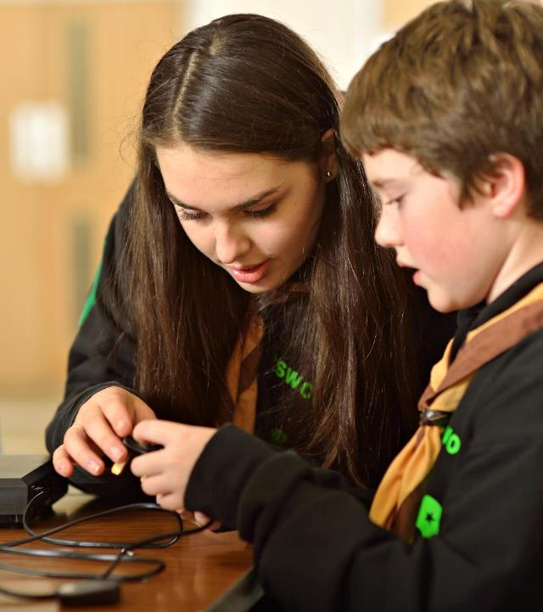
Completed Digital Features
Self-service management of your membership profile
Greater visibility of other members and sections
Automated process for References
Nights away notifications
Automated compliance checking for awards, permits and nights away
An integrated Learning System
New interactive, engaging learning content
Single sign on for Atlantic Data - no smart sheets/paper for Nations
Permit applications online and assessors visible
Self-service reporting and dashboards

Slide 7
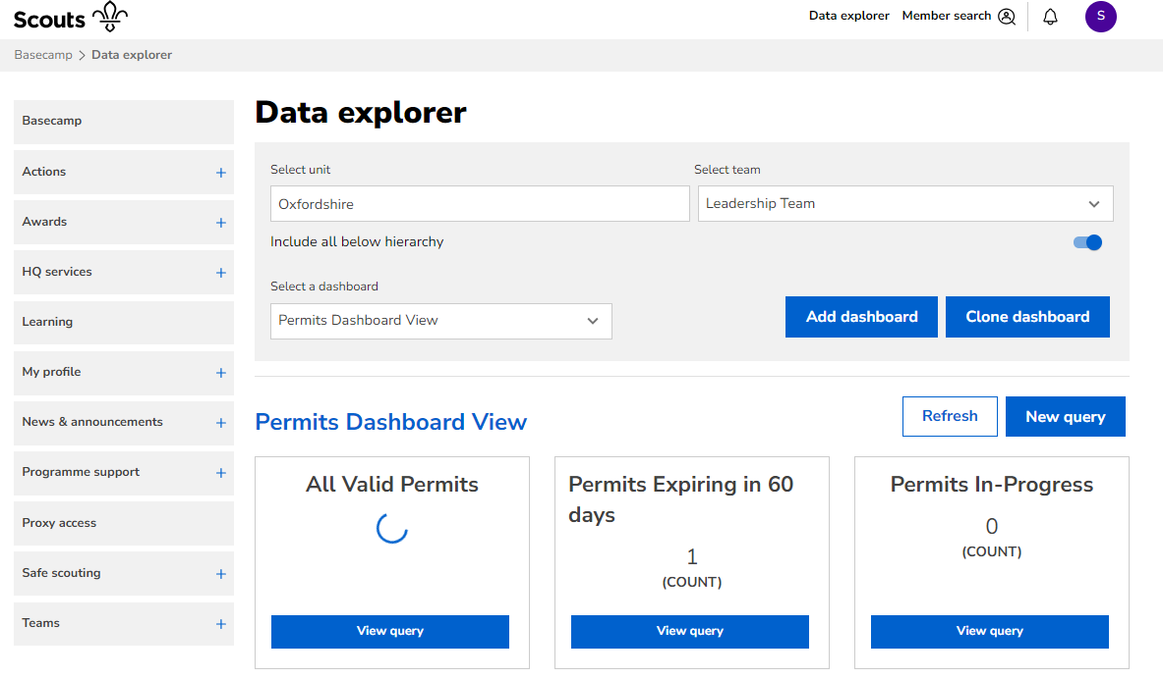

Slide 8
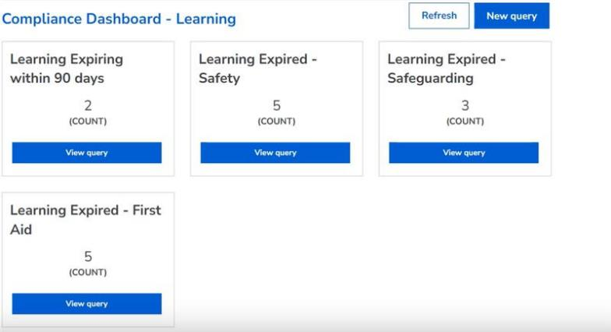
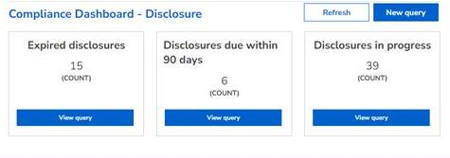
Note: Our new digital systems are in the final stages of development, therefore things you see on these slides may still change, including the words used, the layout and the design. ​

Slide 9
Timeline to Early Adopter Go Live
Membership Build
Bugs sorting
Project Team
Volunteers
Membership Business Acceptance Testing
HQ
Welcome collaboration sprints
Welcome Pre Production
Supplier
Pre-Prod
Prod
Data Migration
Testing weekend
Data Migration
Volunteer End to End testing
Factors that will impact timeline
TSA Pre-Prod Prep
TSA Prod /Welcome Pre Production Prep
Joint System Integration Testing
Compass Freeze
Volunteer Usability Testing
Christmas
Accessibility Audit
Accessibility Testing
Early Adopter
Go Live
Census
HQ Training and Testing
EA Training
Welcome Testing
Learning Content Beta Testing
Security Test
PEN Test 2
Perf Test 2

Slide 10
Timeline to all Counties Go Live
Project Team
Draft/refine user stories
Development Sprint
Bug fixing & QA
Volunteers
Review and triage bugs
HQ
Support & settle
Re-test & settle
Supplier
Test Data Migration
Data Migration
Compass Freeze
Volunteer Training
EA
Go Live
All Counties
Go Live
Feedback, review and continuous improvement
Adapting content and/or training material

Slide 11
Questions

Slide 12
Trustee Board Membership Changes

Slide 13
Trustee Boards Changes
Name
Membership
Purpose
Name - Executive Committees are now Trustee Boards and Executive Committee Members are now Trustees
Purpose - Trustee Boards focus on governance rather than operations
Membership - Trustee Boards are the right size and of the appropriate membership to deliver their purpose
This work has been supported by testing with Early Adopter areas who have provided feedback on supporting resources

Slide 14
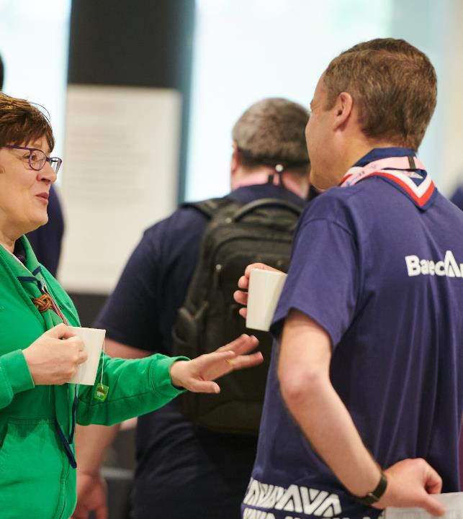
Trustee Board - Purpose (Re-cap)
Elements of the purpose of a Trustee Board include:
Being confident that:
Young people are meaningfully involved in decision making at all levels
There are sufficient resources available to meet any planned work
Scouts has a positive image in their local community
Managing risk:
Developing and maintaining a risk register, including the appropriate mitigations
Ensuring that:
The charity’s finances are properly managed and appropriately budgeted
Effective administration is in place to support the work of the Trustee Board

Slide 15
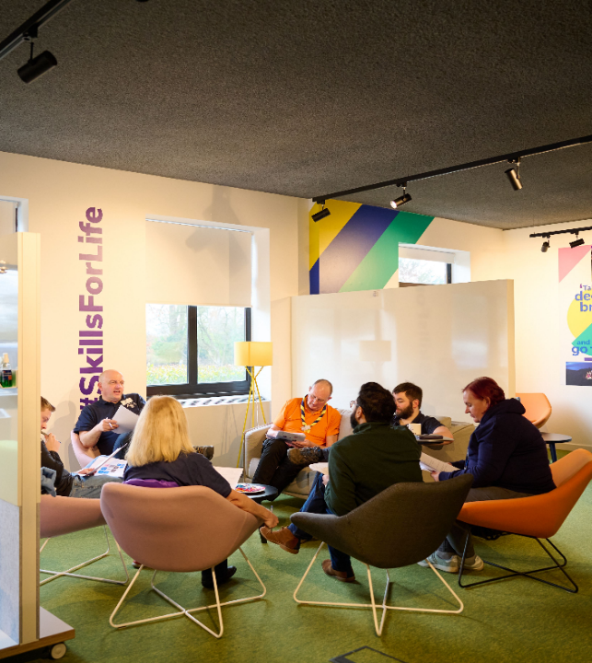
Trustee Board - Membership
Trustee Boards, in line with best practice, will be:
Chair
Treasurer
Lead Volunteer - ex-officio
Youth Lead - ex-officio (Where appropriate)
Additional appointed Trustees
Co-opted Trustees
A total size between 5 and 12 Trustees
Supported by excellent administration

Slide 16
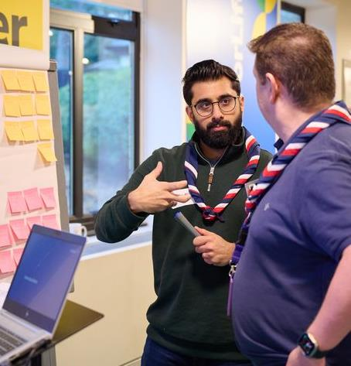
Trustee Board - Membership
Why?
A continuation of the work to align Scouts with good practice guidance from the charity sector (in all nations)
Board Size - Having enough people to have a range of views, without making decisions difficult
Membership Periods - Ensuring Boards are progressively refreshed and continue to have objectivity
Administration - To ensure Trustees can play a full role in board discussions and decisions
From when?
These changes should take place from 2024 AGMs

Slide 17
Ex-officio Changes
Group - Group Lead Volunteer
Removed: Deputy Group Scout Leader, Section Leaders, Sponsoring authority, Secretary
District - District Lead Volunteer and District Youth Lead
Removed: DESC, DSNC, Secretary
County - County Lead Volunteer and County Youth Lead
Removed: Secretary
Shared ex-officio roles must all be eligible to be Trustees and complete Trustee learning, but only one will use the ex-officio position

Slide 18
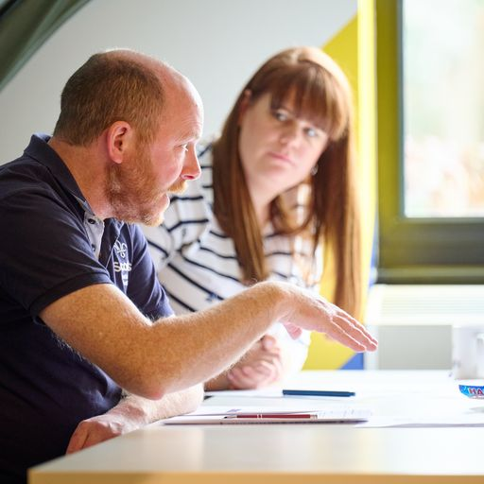
Appointed & Co-opted Trustees
‘Nominated’ and ‘Elected’ will be replaced with ‘Appointed’
Trustee Boards will agree what the open selection process is for all appointed Trustees, ensuring its rigour
The Chair, Treasurer and Trustees will be appointed at the AGM based on the outcome of this selection process
Co-opting Trustees will continue, these are included in the 5 -12 membership size
The number of co-opted Trustees may not exceed the number of appointed Trustees, excluding the Chair & Treasurer

Slide 19
Membership Periods
Appointed and co-opted Trustees are initially appointed for up to 3 years
Trustees can be extended by the Scout Council at the AGM to a maximum of 9 years, including the Chair & Treasurer
Membership periods will start from 2024 AGMs and do not include previous service as Trustees
Ex-officio roles are not subject to membership periods as a Trustee (though their role may have a term limit)

Slide 20
Additional Changes
All Trustees must have reached their 18th Birthday before appointment
Where possible, Trustee Boards should have 2 members aged 18 to 25
Views of young people should always be considered. Under 18s may attend a Trustee Board, but would not have a formal vote
Quorum for a Trustee Board meeting will be ‘one third of members, plus one’
Scout Councils continue to set their own quorum

Slide 21
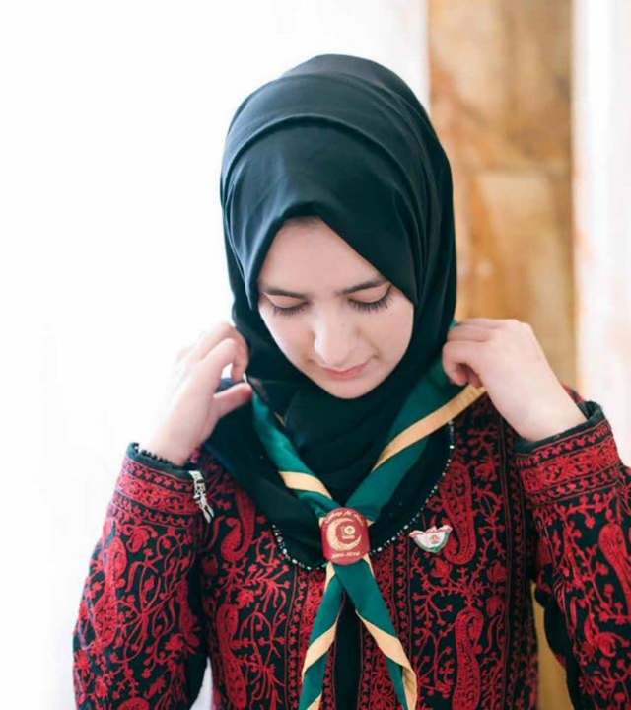
Resources
Updated ‘Transitioning to Trustee Boards’ slide deck
Trustee Board webpages updated with membership changes details
Updated guidance / template for carrying out 2024 AGM
Template annual planner for Trustee Boards
Resources / templates including:
Annual accounts
Assessing & managing risk
Resources will be shared once available, before the end of this year

Slide 22
County/Area/Region(Scotland) Readiness

Slide 23
Readiness
There are lots of tasks that can be carried out in preparation for migration to the new systems
Some have already started this work, some are just getting started
The system go-live is not dependent on readiness
Having good local readiness prior to migration will make this much smoother and reduce the workload locally

Slide 24
Readiness Checklists
To support local readiness, we are producing County/Area/Region(Scotland), District and Group readiness checklists
These can be used by Lead Volunteers and Transformation Leads to:
See what tasks need to be completed locally and their importance
Rate local progress on these tasks using a RAG rating system
Help Counties gain a better understanding of readiness across their area and where support might be needed
We’ll be sharing the checklists in the October Transformation Lead Newsletter with support on how you can use these

Slide 25
Structure
Three sections:
Migration readiness
Scouting processes readiness
Governance readiness
In each section:
Important vs Useful
For each task:
Detail of the task (stated as an outcome)
Suggested RAG rating
Supporting webpage notes

Slide 26
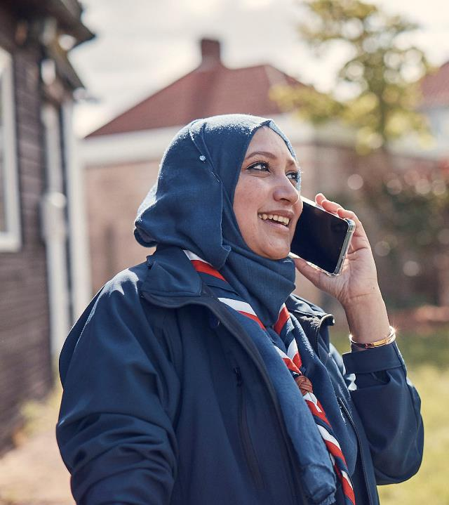
Key Tasks
Updating Compass
Email addresses & personal details
Training validated (especially Getting Started)
Full appointments
Up to date roles, including Occasional Helper/PVG-Only
Organisation records
Building your teams
Agree County, District & Group team and sub-team structures
Ensure conversations are held with those who won’t directly migrate

Slide 27
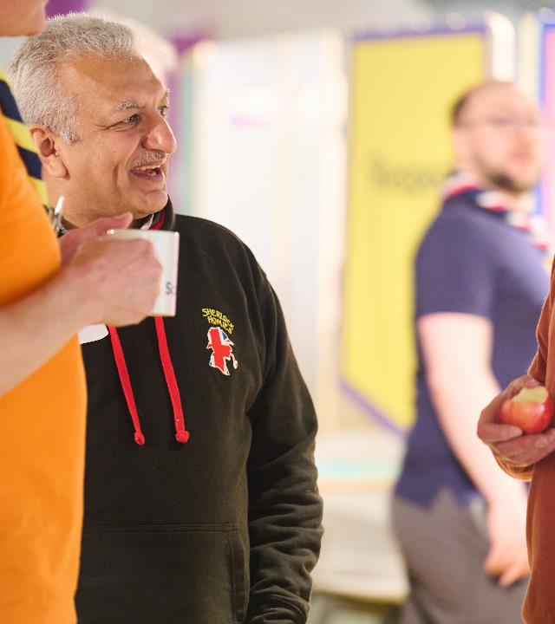
Key Tasks
Team readiness:
All new teams ready for migration and to meet their team descriptions
E.G. Volunteering Development Team ready to support appointments and learning
Trustee Boards:
Support Trustee Boards at all levels to be working within their new purpose, including charity risk management
Ensure Chairs are aware of membership changes coming from 2024 AGMs

Slide 28
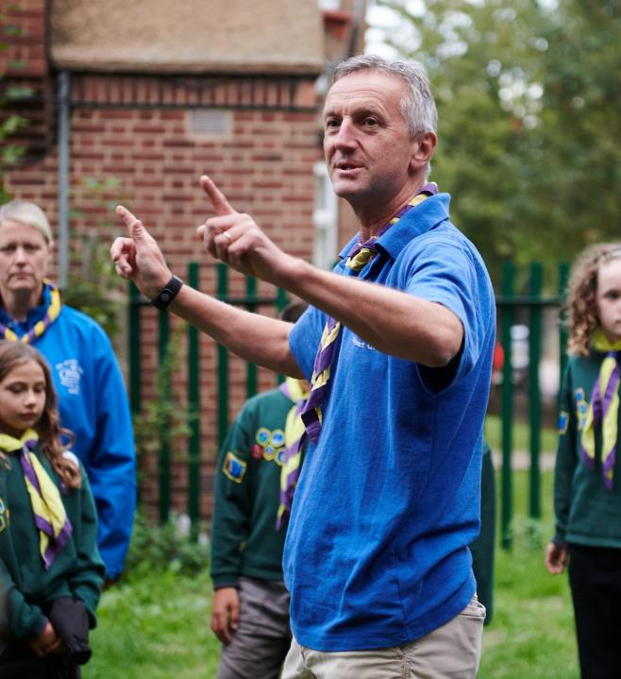
Key Tasks
Local Process Changes:
Consider how local processes might change with the new digital system such as, awards, permits, NANs etc.
Consider what changes to County/District/Group websites or email addresses might be needed
Local Support:
Ensure those who would benefit from improved digital skills can be supported locally and signposted to the Digital Skills Tool
Ensure there is a way for volunteers to reach out for support locally around how local processes might be changing or how

Slide 29
Open Forum

Slide 30
Transformation Lead Poll

Slide 31
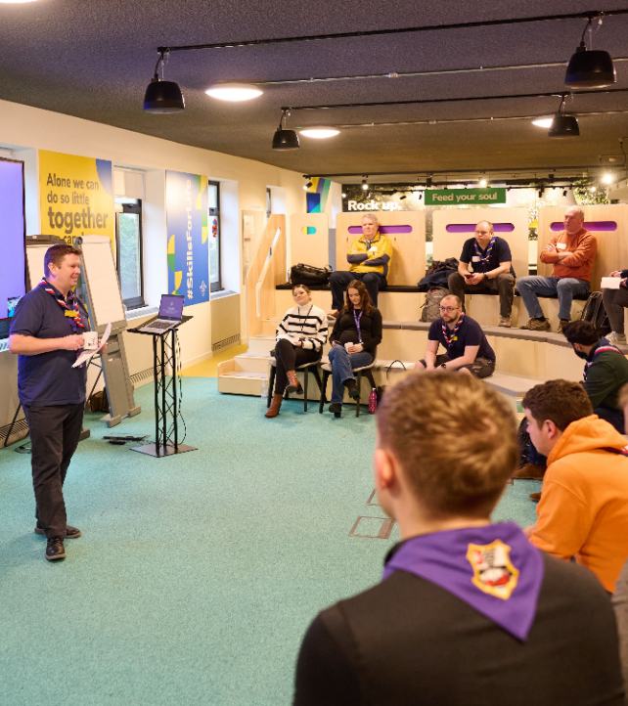
Transformation Lead Poll
What is your role?
What changes have you communicated to all members?
For any changes you haven’t communicated to all, when do you plan to do this?
What is the overall RAG rating for your County/Area/Region (Scotland)?
Would you be interested in having a ‘Broadcast’ Transformation Lead WhatsApp Group for central information sharing?

Slide 32
Early Adopter Update

Slide 33
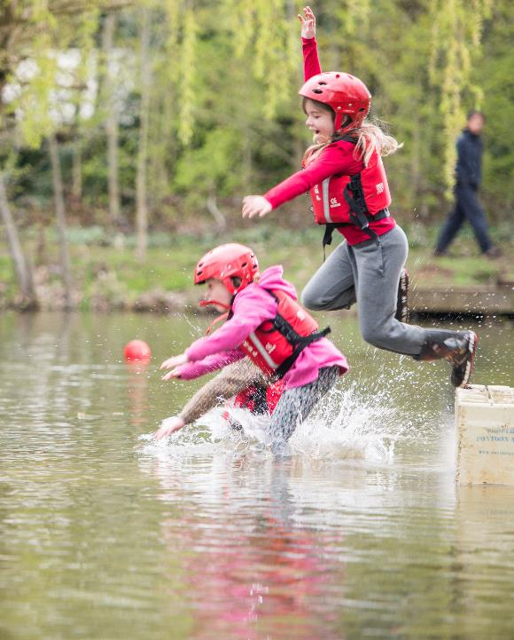
Early Adopter Update
Early Adopters were informed of migration timeline changes
Using EA feedback to:
Shape and refine the readiness checklists ready for sharing with all
Get feedback on the resources needed to support the Trustee Board membership changes
Develop the approach to how we’ll support volunteers to learn how the new digital systems work
Develop the approach to supporting volunteers once the new systems go live

Slide 34
Next Steps

Slide 35
What we’re doing:
What you can do:
Arranging webinars for County & District Chairs on Trustee Board membership changes
Sharing information with CTMs and equivalents on learning changes
Developing an updated Roadmap for Change
Continue getting your patch ready for migration
Lookout for new resources in the October newsletter:
Readiness Checklists
Updated webpage resources for helpers
Respond to Transformation Lead survey coming in the October newsletter

Slide 36
Thank You

