Slide 1
Welcome Workshop

Slide 2
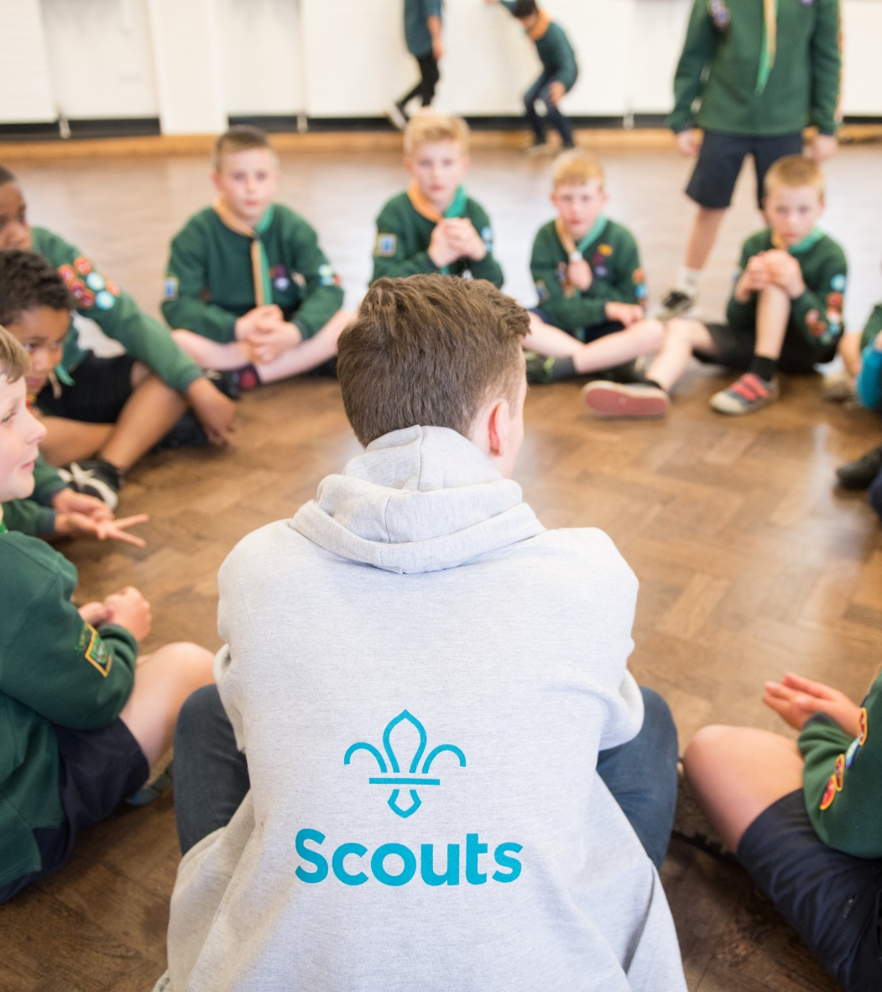
Who's on the call?
Kester Sharpe, Project Sponsor, Welcome
Paul Fix, Project Sponsor, Volunteer Journey
Heather Smith, Volunteering Executive
Alison Fell, Project Delivery Team Product Lead – Welcome
Matt Cobble, UK People Team Member
Rebecca Young, Head of Digital Delivery/ Welcome SRO
Lucy Burrows-Smith, Volunteering Executive
Adam Ray, Lauren Golding, Communications Team
Rob Groves, Elizabeth Stormfield, Change Team

Slide 3
Why we’re transforming volunteering

Slide 4
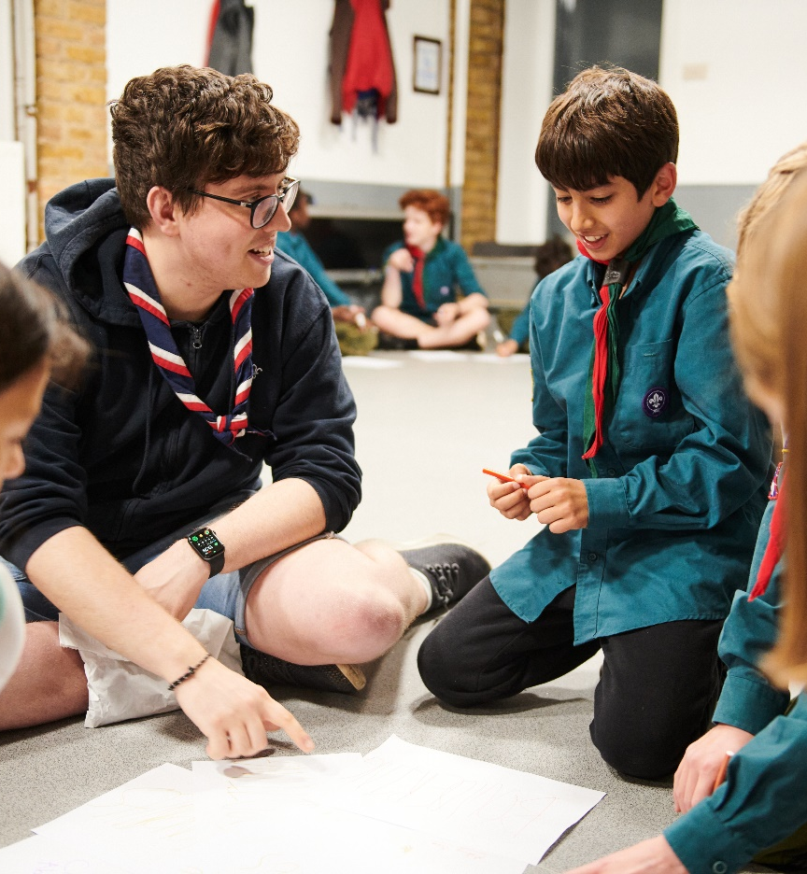
Why we’re transforming volunteering
Our Skills for Life strategy
To provide more young people, and the ones we already have, with skills for life, we need more volunteers
Every volunteer deserves to feel valued during their time with Scouts
The world is changing, and volunteers want more flexibility in the time they give
Ultimately…..

Slide 5
We want to make volunteering with Scouts easier and more fun…
…so that we can attract more volunteers and our current volunteers want to stay

Slide 6
Making volunteering easier and more fun is how we reach our North star...
More young people gaining skills for life
Consistently and safely
deliver a great programme
Recruit more volunteers
and retain current ones

Slide 7
What is changing?

Slide 8
Listening to our volunteers, young people and the public we’ve identified three key areas for change:
Providing a warmer welcome for everyone
Delivering a more engaging learning experience
Simplifying how we volunteer together
All of which will be supported by easy-to-use digital tools

Slide 9
Supporting Digital Tools
Scouts.org.uk Website
Easy to use and mobile-friendly
Single Sign On
Fewer steps and less administration
Specialist functionality
Digital first, but not digital only
Continuous improvement over time
Welcome Tool
Membership Tool
Learning Tool
Improved attraction
More transparency for new volunteers
Improved enquiry management
Reduced administration
Increased self-service
Easier and improved management of teams, permits, awards and more
More accessible learning
More engaging and enjoyable learning
Easier reporting and management of learning

Slide 10
What we’ll cover
The Volunteer Joining Journey
Welcome Conversations
Q&A
Growing Roots
Induction & Buddying
Next Steps
Q&A

Slide 11
Why are we changing?

Slide 12
What new volunteers will see
A new volunteer joining journey to make sure all volunteers have a warm welcome into Scouts
To help us extend our reach
New volunteers need to be able to keep track of their joining journey and be in control of their own progression
New volunteers
"My journey made me feel welcome as an individual at Scouts" - Shivani
Shivani is a new volunteer who was previously a youth worker and wants to stay involved with her local community. Her motivations are helping young people, making a positive impact and personal growth.
Shivani’s schedule is mostly flexible, but she’s often unable to take on regular volunteering opportunities. She also sometimes feels unwelcome and excluded in new spaces.
At Scouts, she’s looking forward to being welcomed by her new team and building connections with other volunteers.
What you’ll see
A 'self-service' recruitment process through the digital system
Removed the pre-provisional appointment to make it simpler
Removed the Commissioner approval step
One Welcome conversation when someone joins Scouting
Automated references
Simplified Criminal Record check processes where we can in nations

Slide 13
The Volunteer Joining Journey

Slide 14
Notes:
https://www.scouts.org.uk/volunteers/volunteer-experience/welcome/joining-journey/

Slide 15
Supporting the Volunteer Journey & Our Volunteering Culture
Everyone should have a shared understanding for what we do and say as volunteers in Scouts:
supporting each other,
following our values and being at our best,
while acting as role models for young people.
It's also there to help our new volunteers thrive from the moment they join, giving them clear expectations and a shared understanding of what it really means to be a volunteer in Scouts.
It's for all of us.
All Lead Volunteers and all Team Leaders have an additional role to play, embedding and championing Our Volunteering Culture in the teams they recruit volunteers too.

Slide 16
Volunteering Development Teams and the Volunteer Joining Journey
Champion Our Volunteering Culture and encourage teams to follow it
Attract and welcome new volunteers to County/Area/Region (Scotland) teams
Make sure volunteers are well-supported
Help volunteers in County/Area/Region (Scotland) teams with learning
Recognise volunteers
Volunteering Development Team Leaders
“I help make sure all volunteers find it easy to join, that they feel welcome when they do, and that their volunteer experience just keeps getting better and better.” - Kris
Kris has a lot of experience volunteering with Scouts, and they’ve recently dedicated their time to becoming their County’s new Volunteering Development Team Leader. Their role focusses on making sure all volunteers in County teams have a fantastic volunteering experience. By doing so, they make it easy for people to join and learn new skills.
They don’t do this alone, though. Kris is responsible for making sure their team is attracting and supporting new volunteers. As a Team Leader, they also are their team’s first point of contact, responsible for making sure that their volunteering experience is a positive one, too.
Kris is motivated by helping volunteers be the best they can be, and by building relationships and networks.
Notes:
https://www.scouts.org.uk/volunteers/volunteer-experience/our-volunteering-culture/

Slide 17
Recruitment
What the change is
When you recruit a new volunteer locally, you’ll:
Add them to scouts.org.uk using their basic personal details
Add a role to their profile
The new volunteer will receive an email with their login details
The new volunteer will then fill in all their additional personal details and start working towards a full role
Examples of how the Volunteering Development Team might support
Make sure Lead Volunteers know how to add new volunteers
Support different methods of recruitment within their areas, making use of tools such as social media, the brand centre, and working with Growth & Communities
Answer volunteer enquiries and help new volunteers find the best opportunity for them.
Notes:
https://www.scouts.org.uk/volunteers/volunteer-experience/volunteering-together/team-descriptions/
https://www.scouts.org.uk/volunteers/volunteer-experience/volunteering-together/team-descriptions/tools-to-support-volunteering-development-teams/

Slide 18
The Volunteer Joining Journey
What the change is
This journey applies to all new volunteers, and volunteers returning more than 30-days after leaving Scouts
Includes any young people joining as an adult volunteer
Once a new volunteer has been added to the system, all seven volunteer joining journey steps can be completed in any order
Examples of how the Volunteering Development Team might support:
Lead Volunteers and Team Leaders will be responsible for supporting new volunteers, however, this will be supported by:
Support Counties/Districts/Groups to understand the volunteer joining journey
Identify volunteers who will help give a warm welcome to new volunteers, and support others to
Remove barriers to people completing their joining journey, and support others to
Manage any local 'welcoming volunteers' resources and processes e.g. team get togethers, WhatsApp groups

Slide 19
References
What the change is
The new volunteer can start their references once they have provided their personal details
Up to four referees can be added
The system will assess the first two responses received (however, should an unsatisfactory reference come back from the others this will be reviewed)
Unsatisfactory references will be referred to District or County Lead Volunteer or accredited Volunteering Safeguarding Lead
Overdue references (30 days) will be referred to the volunteer for action (including nominating new referees)
Examples of how the Volunteering Development Team might support:
Monitor dashboards at Scouts.org.uk to make sure references are being completed in a timely manner
Understand guidance on who referees need to be and the process - to answer questions from Lead Volunteers supporting new volunteers

Slide 20
Criminal Record Check
What the change is
The volunteer can start their criminal record check once their personal details have been added
An ID Check will still need to be carried out as currently and recorded
Should a flag be raised, the same process as is currently in place will be followed, this will now include the relevant person with the Volunteer Safeguarding Lead accreditation
Examples of how the Volunteering Development Team might support:
Offer support to Team Leaders and Group Lead Volunteers with completing criminal record checks (There is a Disclosure Support Volunteer accreditation that can support with this)
Offering support with Volunteer Safeguarding process when necessary
Use the dashboards at scouts.org.uk to monitor progress around completing checks and identify if any are 'stuck' or delayed

Slide 21
Other steps in the joining journey
What the change is
Internal check
A new volunteer's details are checked against the Scouts’ internal records
This is automatically initiated by the system when self-service personal details are completed
Declarations
The current declarations have been updated. Volunteers declare they commit to:
Accepting Scout values, policies and Our Volunteering Culture and Promise
Agreeing to complete the learning required
Volunteering Development Teams are not responsible for overseeing completion of:
Internal checks
Declarations
Trustee Eligibility Checks
These should be carried out by the applicable Trustee Board

Slide 22
Welcome Conversations

Slide 23
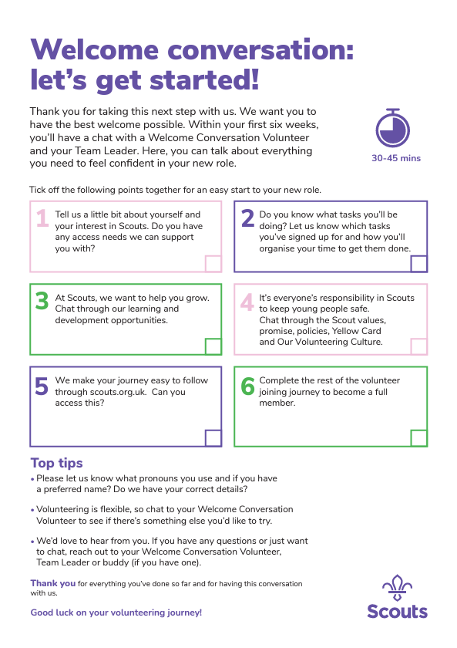
Welcome Conversation
The Lead Volunteer or Team Leader will arrange the welcome conversation with themselves and one other independent person (who must have the Welcome Conversation Accreditation)
This can be done in several ways
Reach out to the Volunteering Development Team, who suggest one or more suitable people
Arrange the independent person locally and inform the Volunteering Development Team of this
More resources available on scouts.org.uk (Conversation guide, checklist, learning)
Notes:
https://www.scouts.org.uk/volunteers/volunteer-experience/welcome/conversation-guide/ https://www.scouts.org.uk/volunteers/volunteer-experience/welcome/checklist/

Slide 24
Welcome Conversation Volunteers will:
Have an active role in Scouts which should be similar to the role the new volunteer is taking on.
Preferably have a relatable joining experience
Complete Welcome Conversation learning and gain the accreditation
AAC Members don't automatically gain the Welcome Conversation Volunteer accreditation at transition- be conscious that many current AAC members won't meet the above criteria
Welcome Conversation Volunteers
"Having a role in the welcome conversation means I can help someone like someone helped me 6 months ago" - Alex
Alex is a Beavers Section Team Member who wants to get the Welcome Conversation Volunteer accreditation. He already has experience with helping new volunteers into his section, plus the new Squirrels section that was recently set up in his Group. Alex didn't feel like he had the greatest welcome into Scouts, so he wants to take on this accreditation to make sure he can offer full support to new volunteers joining Scouts.
Alex believes he can make a difference because a positive welcome experience can set the tone for a volunteer’s entire time at Scouts. He also likes to meet new people and wants to expand his network in Scouts.

Slide 25
Welcome Conversation
The Volunteering Development Team might support by: ​
Regularly reviewing the number and geographical spread of Welcome Conversation Volunteers across the County/District.
Encouraging Team Leaders and Lead Volunteers to keep a “look out” for people who’d make great Welcome Conversation Volunteers. ​
Having a separate WhatsApp group with volunteers in County/Area/District Teams who have the Welcome Conversation Volunteer accreditation.​​

Slide 26
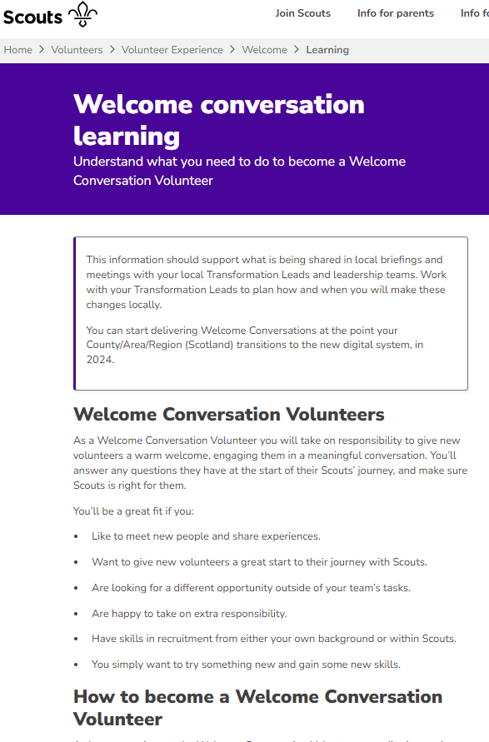
Welcome Conversation Learning
What the learning is:
Three videos
Purpose
How to prepare
How to have the welcome conversation
Videos are all on Scouts.org.uk now to view and will be on the new learning platform
This learning will also be built into the Leading Scouts Volunteers learning
Once the new system goes live you can complete a short quiz and the Volunteering Development Team can then give the accreditation
Notes:
https://www.scouts.org.uk/volunteers/volunteer-experience/welcome/learning/

Slide 27
Welcome Conversations
 | Can they do welcome conversations as default (in terms of digital system permissions)? | What learning is required before carrying out a welcome conversation? | Do they need to be given an accreditation?
Team Leaders & Lead Volunteers | Yes | Welcome conversation learning as part of Leading Scouts Volunteers | No, as the system will allow them to do it as default
Sub-Team Leaders | Yes | Welcome conversation learning (they can do the individual learning module, or if they choose to complete Leading Scouts Volunteers they will do the learning as part of this) | No, as the system will allow them to do it as default
All other volunteers - eg. Team Members | No | Welcome conversation learning | Yes

Slide 28
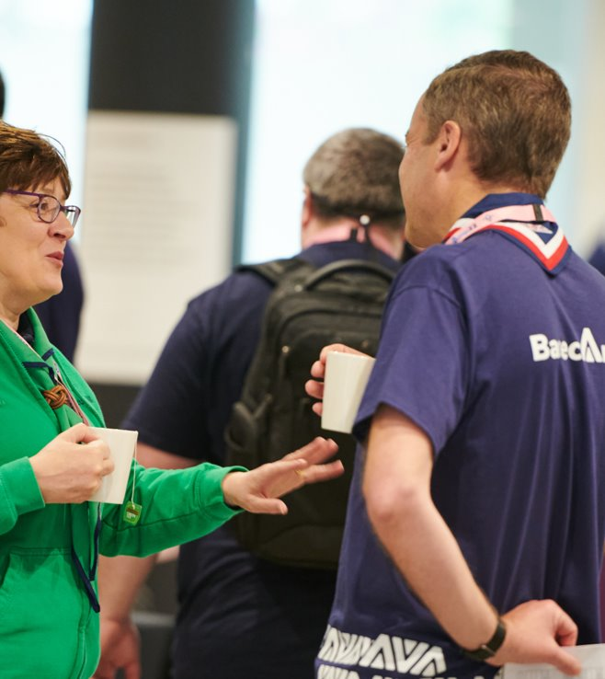
Supporting Welcome Conversations
Volunteering Development Team providing ‘oversight’ ​
Ensuring that Welcome Conversations being held locally are fair and consistent
Providing support where the two people disagree on the outcome of the conversation- it will be referred to the District or County Lead Volunteer
Building your pool of local Welcome Conversation Volunteers ​
Finding the people ​
Supporting with learning for accreditation

Slide 29
Questions

Slide 30
Growing Roots

Slide 31
Growing Roots
From setting up their account in the digital system, volunteers will have access to the learning tool
The learning tool will show them the Growing Roots learning they need to complete, including the learning specific for their role
This can be completed in stages and volunteers can come back to learning still in progress
Volunteers will have 6 months to complete this
Note - First Aid should be completed within 12 months where required
Notes:
https://www.scouts.org.uk/volunteers/volunteer-experience/learning/growing-roots

Slide 32
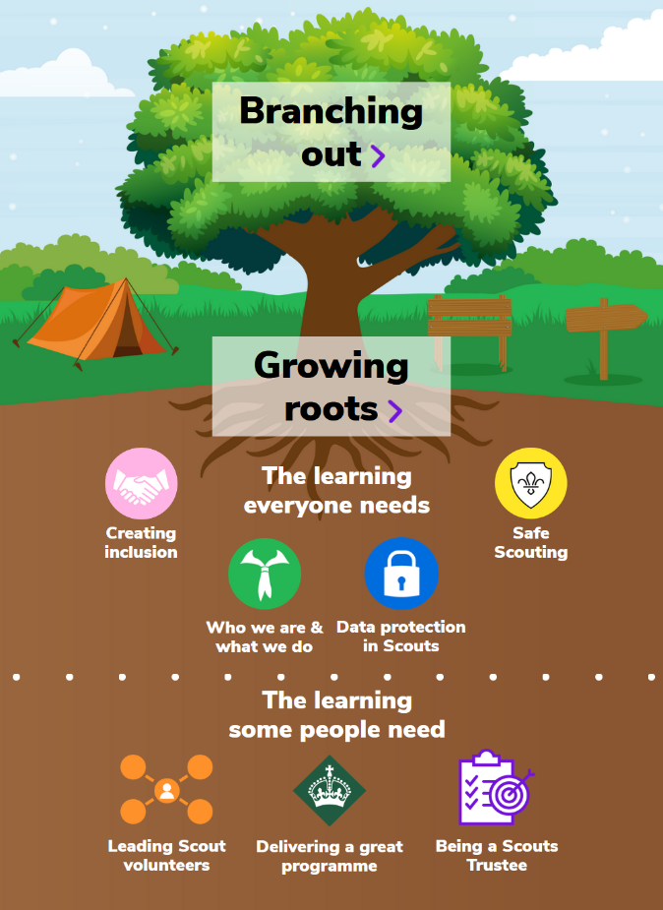
Growing Roots
Let's have a quick tour of the Learning Tree

Slide 33
Growing Roots
What the change is
Current mandatory training modules are replaced by new e-learning content – Getting Started is replaced with Growing Roots
Progress is automatically tracked and recorded
Growing Roots is done within your first 6 months
You don't have to redo learning for new roles
How the Volunteering Development Team might support:
Support new volunteers with accessing the learning and how the new Learning Tree works, where required
Help new volunteers find support if they struggle with digital access or ability
Help volunteers understand what additional learning they can engage in beyond Growing Roots

Slide 34
Induction
Notes:
https://www.scouts.org.uk/volunteers/volunteer-experience/welcome/induction/

Slide 35
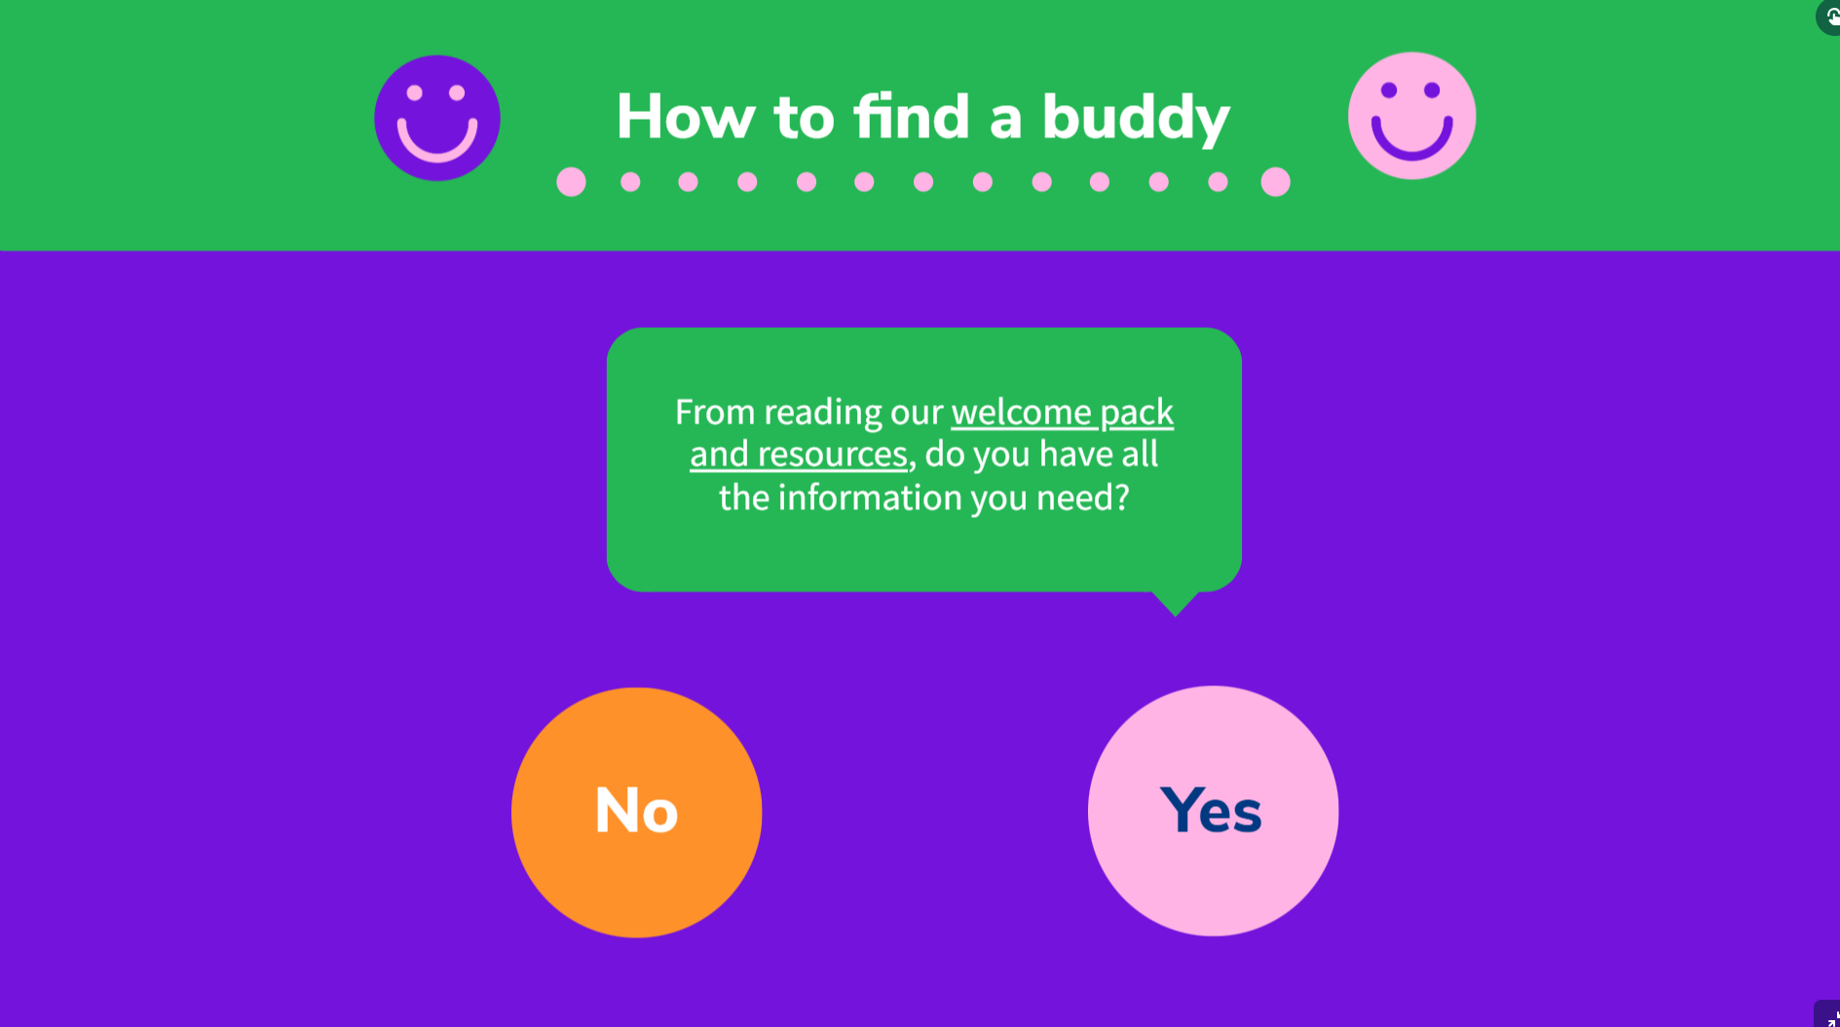
Buddying
The Volunteering Development Team might:
Help to find buddies for new volunteers. (Buddies are not essential, but recommended)
Promote use of resources for a new volunteer- can be self-service but need to know where to find them
New buddy webpage
New buddy flowchart - online and print versions
Encourage these to be used alongside other local induction resources
Notes:
https://www.scouts.org.uk/volunteers/volunteer-experience/welcome/buddies/

Slide 36
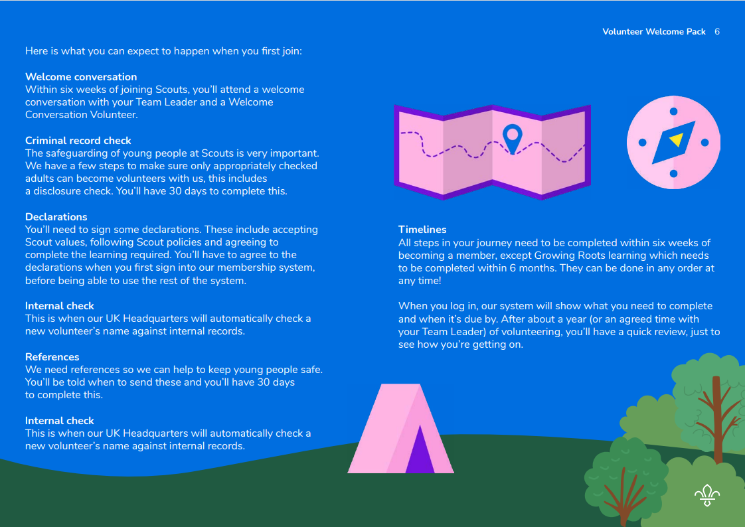
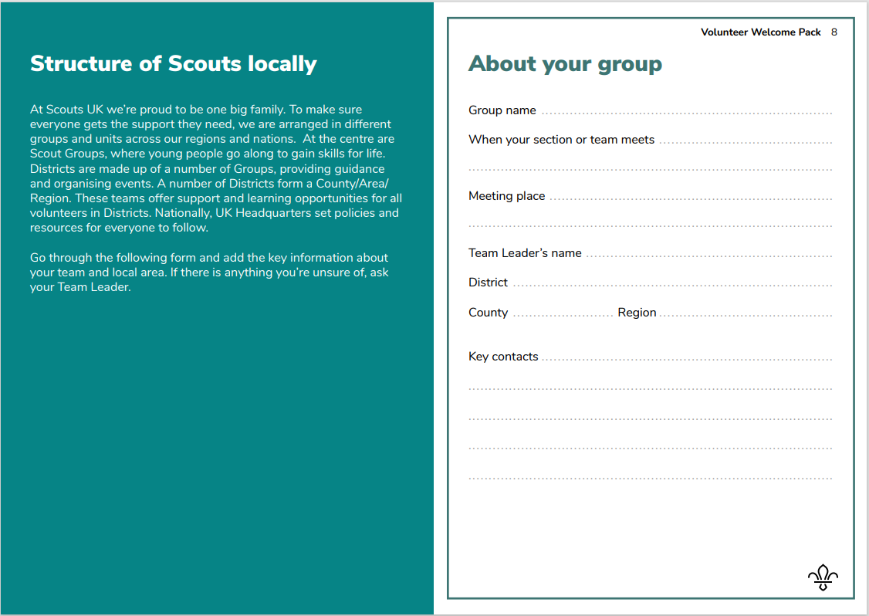
Welcome pack
For new volunteers, shared through introductory email
To be sent to new adults to help them understand their own joining journey
Useful information for them about Scouts as a movement
Should be used alongside any local information to be given around Group/ District/County/Area/Region (Scotland)
Will be available on website soon

Slide 37
Volunteer Role Change Journey

Slide 38
The Volunteer Role Change Journey
This journey applies to any volunteer adding or changing their role. Examples include:
Moving from a Trustee to a Team Member
Moving from Team Member to Team Leader or Lead Volunteer
Taking on a role in a District/County Team

Slide 39
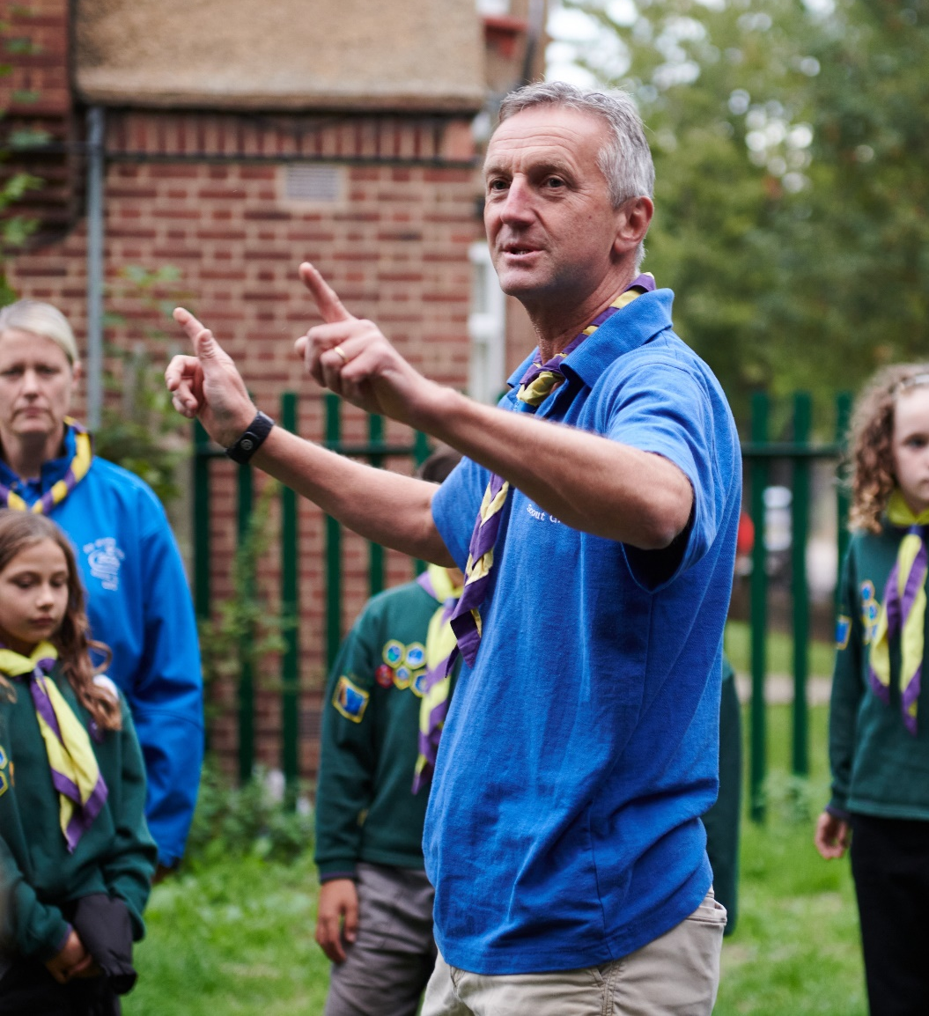
For every change of role
Meet with your new team leader
Re-sign declarations
Internal check
Criminal record check- Renewed every five years if in a role that requires a criminal record check.
Growing Roots- If any additional learning is required for the new role e.g. Leading Scout Volunteers, this will show on the learning section of My Learning
Trustee eligibility check- If the new role has trustee responsibilities
If not previously required:
References
Welcome Conversation

Slide 40
Next Steps

Slide 41
What we’re doing:
What you can do:
Sending welcome webpages through cascade
Providing learning videos up front for familiarisation - will still need to complete learning from day 1
Embedding Our Volunteering Culture within new processes
Look at welcome and Volunteering Development Team webpages
Read the team descriptions
Support people to get to full appointment where possible
Key messages communicated to AAC members
Begin to identify Welcome Conversation Volunteers
Familiarise yourselves with the learning

Slide 42
Questions

