Slide 1
Transformation Lead Call

Slide 2
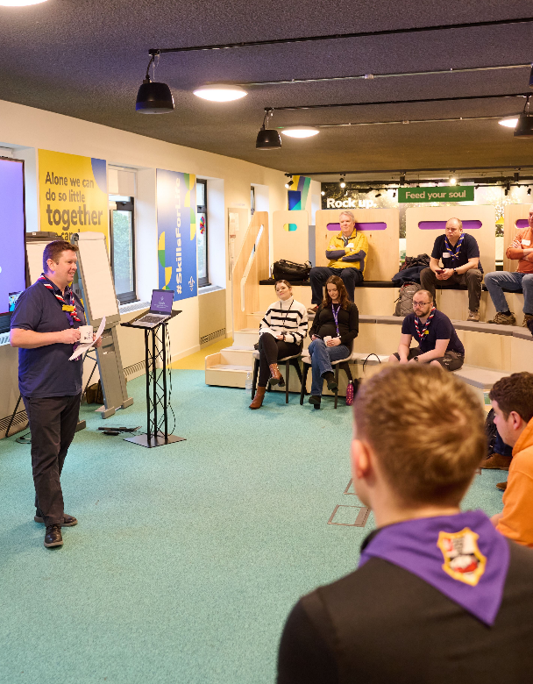
Who's on the call?
Craig Turpie, Deputy UK Chief Volunteer
Jack Caine, UK Lead Volunteer for People
Andrew Sutherland, Deputy Programme Sponsor
Hamish Stout, Project Sponsor, Change and Infrastructure
Emma Gage, Senior Change Manager
Elizabeth Stormfield & Rob Groves, Change Managers
Adam Ray, Communications Manager
Breakouts
Bebbe Hron, Alison Fell, Ben Powlesland, Graham Phillips, Matt Cobble, Gordon Weston

Slide 3
What we’ll cover
Digital System Update
Engaging and Supporting Groups
Leading Change
Open Forum
Breakout Rooms
Next Steps

Slide 4
Digital System Update

Slide 5
Engaging and Supporting Groups

Slide 6
Engaging Groups
Groups are key to the success of the Volunteer Experience changes
Around 7,000 Groups plus Explorers in 760 Districts, across the movement where most of our people volunteer and where most of our new volunteers join the movement
Adopting the Volunteer Experience changes is critical to make sure we achieve our aim:
We want to make volunteering with Scouts easier and more fun…
…so that we can attract more volunteers and our current volunteers want to stay

Slide 7
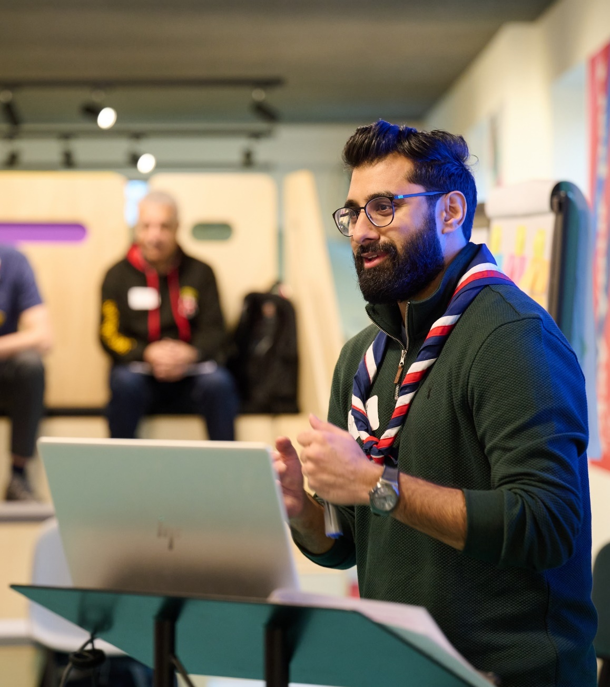
Challenges
Time
Volunteers
Capacity
What’s in it for me?

Slide 8
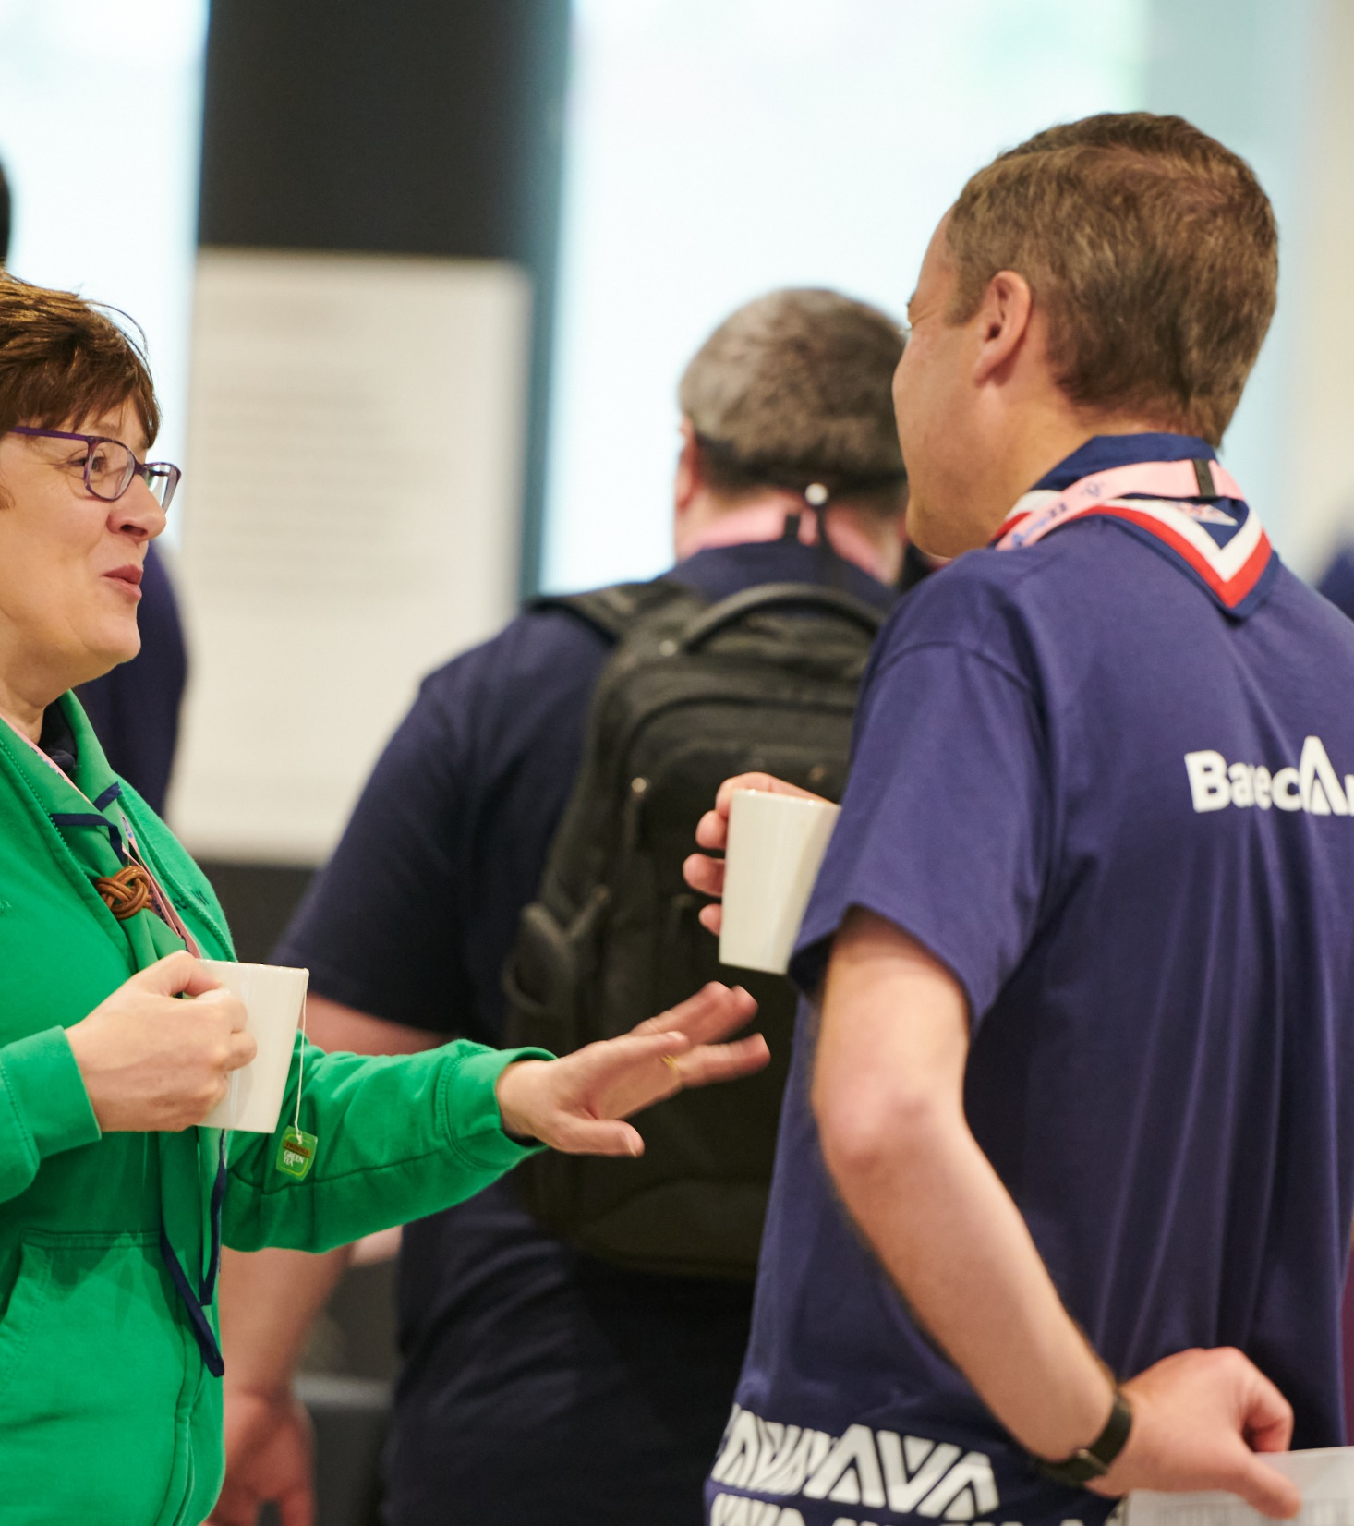
What can we do?
Awareness - Why are we doing this?
Waiting lists, difficulty bringing in new volunteers, volunteers aren’t staying as long
Desire - What’s in it for me?
Simpler structures, better systems and processes, easier to recruit and better retention
Knowledge - What do I need to know?
Make sure information is focused and relevant for them
Ability - What do I need to do?
Key actions, ready for change webpages
Reinforcement - Keeping things going
A system going live isn’t the end!

Slide 9
Suggestions & Tips
Hearing about change from HQ is great… Hearing about change from their local leadership team is better!
Group volunteers engage more with local comms
Create time for discussion on what this means and what to do next
Focus on the important tasks and the benefits of this with the opportunity to learn more
Personal messages have higher engagement than ‘forwarded’ messages

Slide 10
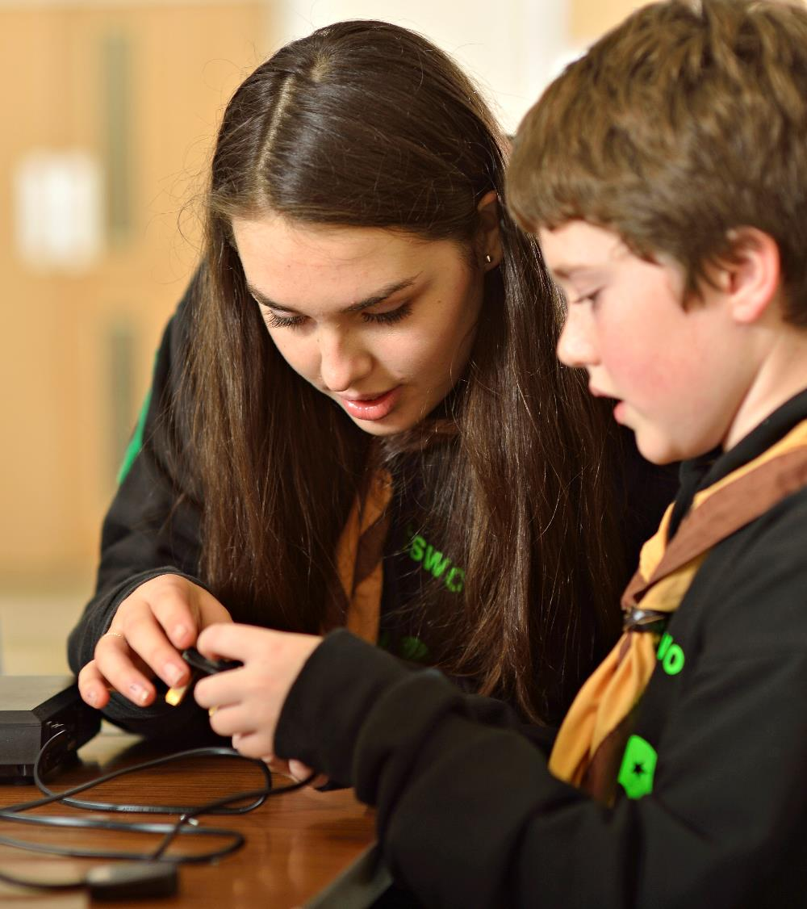
Examples
How some areas have gone about this:
County or District led -
Dedicated online or in-person sessions
Drop-in online or in-person sessions
In-person event for all Group Lead Volunteers
Utilising planned meetings -
Adding agenda item to planned District meeting with Group Lead Volunteers
Meeting Groups at their meeting places
Mailing -
Sharing key links, making actions and deadlines clear (End of September)
Short Videos

Slide 11
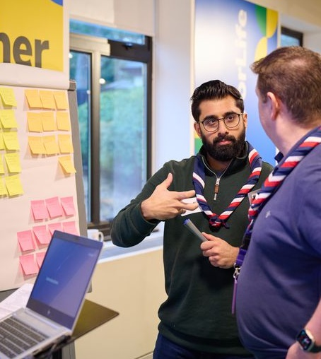
Useful Resources
Videos & Recordings:
Group Leadership Team webinar
Group Lead Volunteer interview video
Group recruitment video
Webpages:
Ready for change
Preparing your Group’s data

Slide 12
Leading Change

Slide 13
In times of change people want to hear key messages from:
Senior Leaders
Line manager or team leader
Why we’re doing this? Why now? Risk of not changing
What’s in it for me? Why should I bother?

Slide 14
Actively and visibly participate throughout the project
Visible support and enthusiasm from beginning to end
Build a coalition of support with peers and direct reports
Get mid-level managers aligned around the change
You are who people want to hear the “why” from
Communicate support for the change with staff and volunteers
It’s not just about cascading information

Slide 15
Resistance or Change Reaction? Emotion Disengagement Acting out Work impact Negativity Avoidance Building barriers Controlling

Slide 16
Leading change for Transformation Leads
Tactics for managing resistance
Listen and understand

Slide 17
Leading change for Transformation Leads
Tactics for managing resistance
Personal appeals

Slide 18
Leading change for Transformation Leads
Tactics for managing resistance
Convert the strongest dissenters

Slide 19
Leading change for Transformation Leads
Tactics for managing resistance
Remove barriers

Slide 20
Leading change for Transformation Leads
Tactics for managing resistance
Create hope

Slide 21
Leading change for Transformation Leads
Tactics for managing resistance
Demonstrate the benefits in a real and tangible way

Slide 22
Any Questions… or examples?

Slide 23
Breakout Rooms

Slide 24
Breakout Options
Two 15-min breakout rooms:
Welcome
Building your teams
Data Migration
Learning
Our Volunteering Culture
Digital System Functions

Slide 25
Next Steps

Slide 26
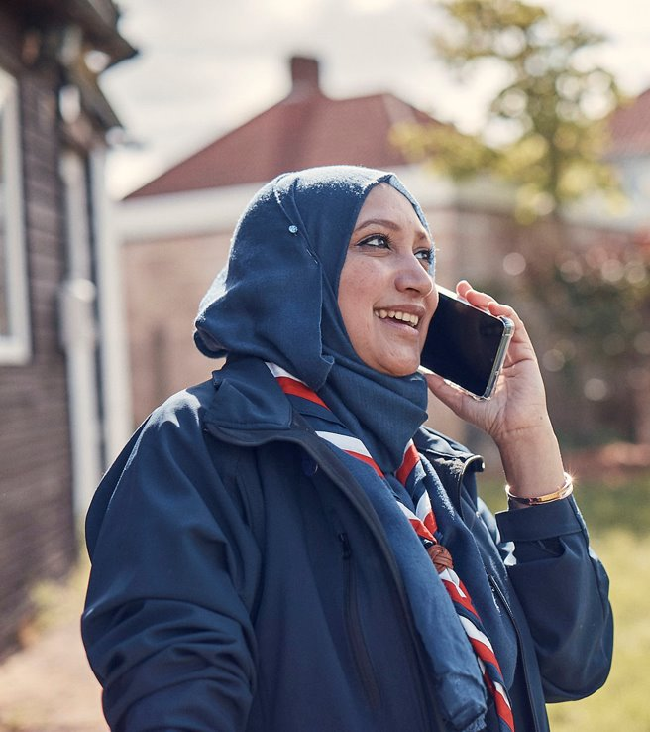
POR Update
The Volunteer Experience changes will be included in the autumn edition of POR which will be published shortly before the new system goes live.
The VE changes affect almost all POR chapters. Particularly chapters 4, 16 and the new Teams and Accreditations Tables.
The autumn edition of POR will not be ‘live’ until the new system is live – until then you will continue to use the current edition.
In the All-Member Email on 6 August, we will circulate a draft version of the autumn POR edition to some roles for pre-publication feedback about the clarity of the autumn edition.
Requests for pre-publication feedback will go to CCs, TLs, County Chairs, ACCs (Activities). You can pass on more widely if you know particular people who would welcome the opportunity to review.
August is holiday season but any/all feedback received by the late August Bank Holiday will be particularly useful. Feedback will be via a Smartsheet form.

Slide 27
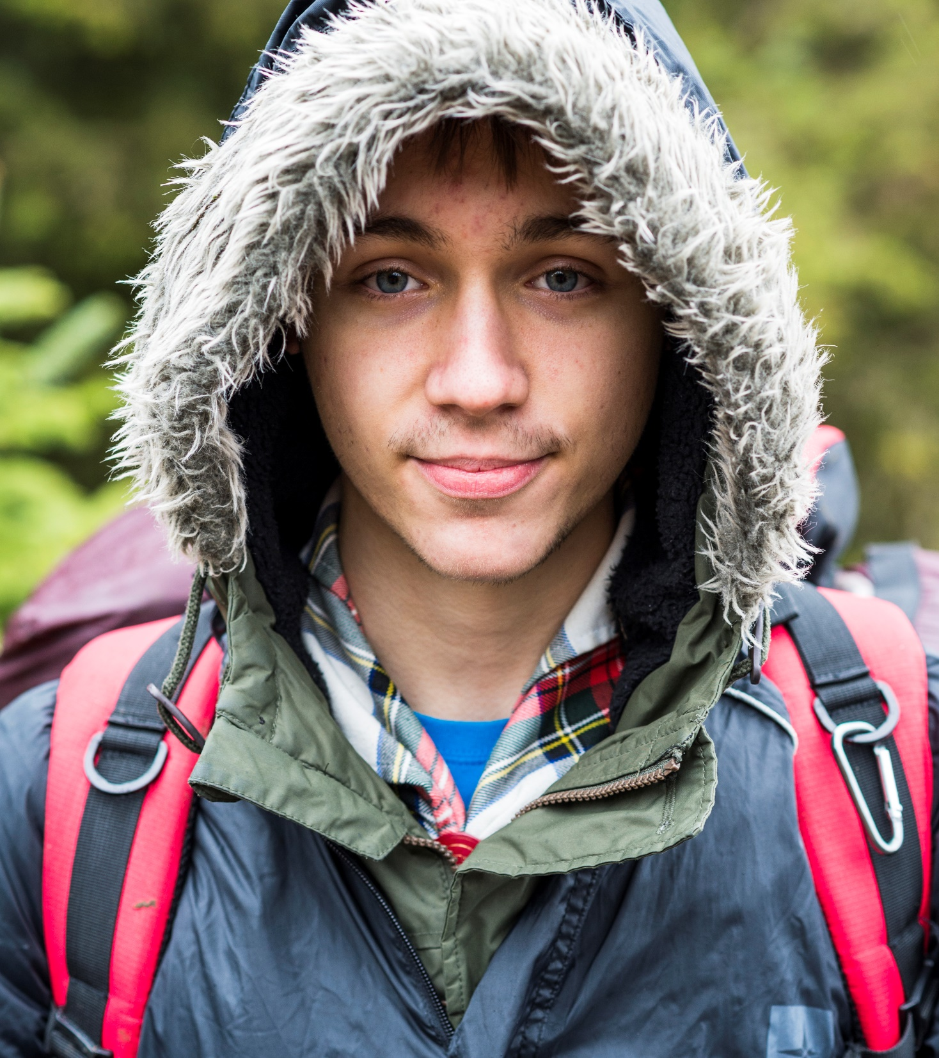
Welcome & Attraction Tool
We’ll be talking more about the attraction tool within our digital system and how this will help with great recruitment locally
Expect some further information and webinar invites over the next couple of weeks
Volunteer Joining Journey Webinar
Late Aug - Open to all involved in the Joining Journey
Walk through from start to finish, providing any final preparation tips and examples

Slide 28
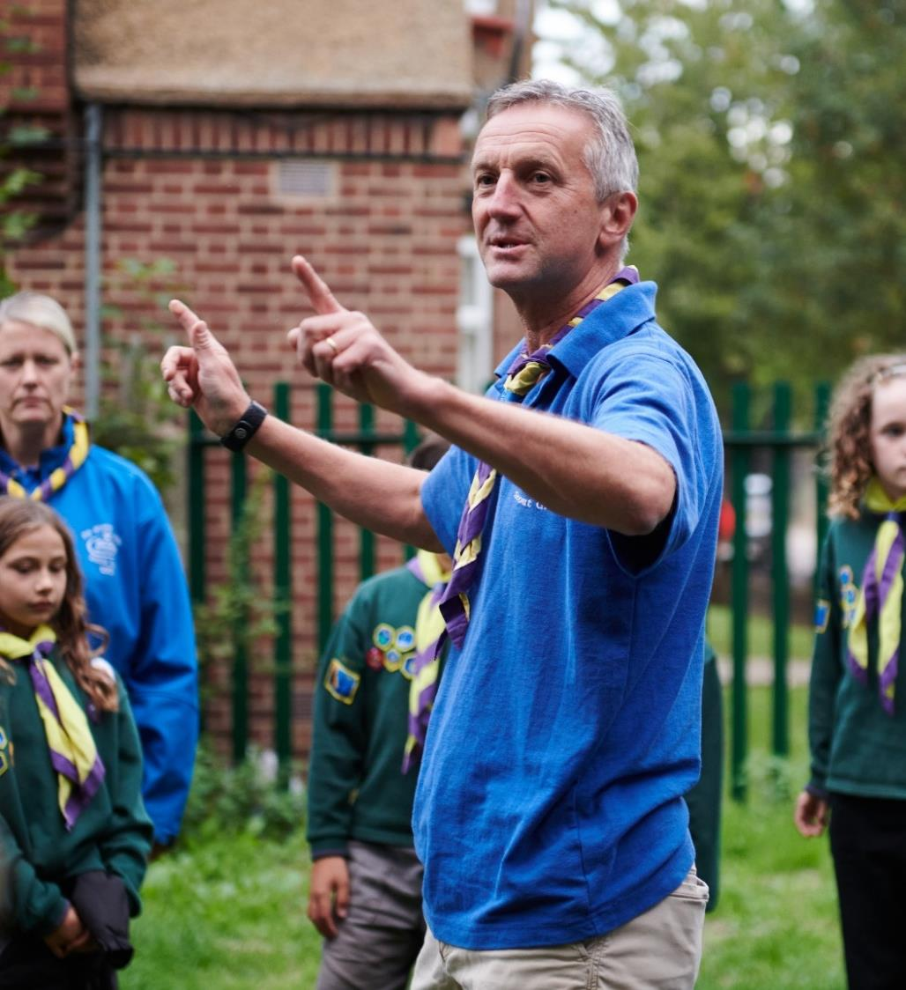
Volunteer Team Changes
Programme Sponsor
Paul Fix has stepped into the role of Programme Sponsor
Learning Project Sponsor
Gordon Weston has stepped into the role of Learning Project Sponsor
Volunteer Journey Project Sponsor
A recruitment campaign for this role will be going live soon
People Leadership Team
Matt Cobble and Paul Fix will be joining the People Leadership Team

Slide 29
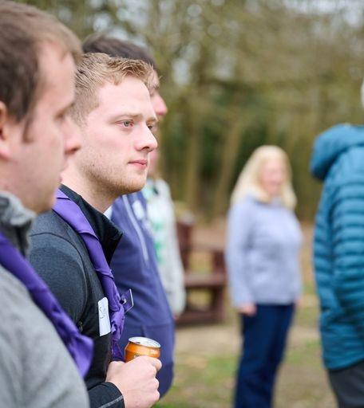
Gearing up for Go-live
A huge thank you for everything you and your teams are doing
We’re now in the final stretch of getting ready for go-live before the end of 2024
Lots of activity from September onwards, the more ready you are locally the easier go-live will be
Gearing up for go-live Webinar
Early Sept - TLs, County/District Lead Volunteers & Group Lead Volunteers (Separate session)
Walk through from early September to post go-live, what is happening when, what will compass freeze look like etc.

Slide 30
What we’re doing:
What you can do:
Testing all Counties data migration & preparing for volunteer testing
Defining HQ process for managing unsubscribed emails
Preparing for Go-Live Support Team induction
Testing roll out plans with our Early Adopters
Sharing webinar invites later in the year
Support Districts and particularly Groups to be ready for change
All essential tasks to be ready for the new system should be complete by 30 September
Share with us the members of your Go-Live Support Team, forward on the induction invite to any new joiners

