Slide 1
Transformation Lead Call

Slide 2
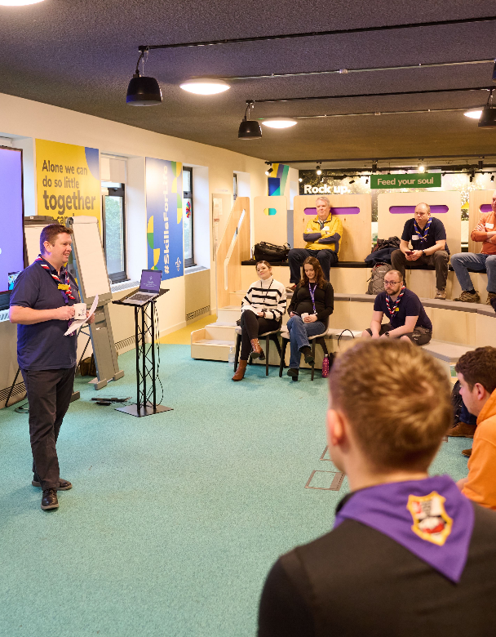
Who's on the call?
Craig Turpie, Deputy UK Chief Volunteer
Andrew Sutherland, Deputy Programme Sponsor
Hamish Stout, Project Sponsor, Change and Infrastructure
Ben Powlesland, Membership Product Manager
Rob Groves, Change Manager
Adam Ray, Communications Manager

Slide 3
What we’ll cover
Actions before Compass goes offline
Feedback from testing and training
Local Go-Live Support Teams
Safety Training from PFD
Going Live!
Next Steps

Slide 4
Actions before Compass goes offline

Slide 5
County Actions Reminder
Essential
Encouraged
Make sure all your volunteers have personal, unique and functioning email addresses
Validate and record all completed training
Finalise team structures at all levels
Go-Live Support Team in place
Ready for new ways of volunteering
Support volunteers to renew their permits and training which expire while Compass is offline
Encourage early submission of all Nights Away Notifications
Start training those involved in delivering Welcome Conversations and adding this to Compass
Complete additional Compass data readiness actions (available on the website)

Slide 6
Wood Badges
Will all migrate over to the new system
All modules validated on Compass prior to freeze will migrate
If you have validated all modules for a Wood Badge in Compass after 30 September
The Wood Badge must be recommended through a Support Centre request after Go-Live
The Wood Badge will be added as a historic Wood Badge into My Membership
The Wood Badge will be included in the next Awards mailout

Slide 7
Testing Feedback

Slide 8
Testing Feedback
‘I like the layout and think that once all data is on and correct, with the training it will be an easy system to navigate’
‘Overall, I think the new system is looking good’
‘Much better than Compass, fairly easy to use + navigate so far’
‘Feeling really positive about the new system!
‘Worked through all the requested test functions, the menus are easy to follow and the system seems great to use’

Slide 9
Testing overview and next steps
Thank you! - we know it wasn't easy
It was a really useful process
We have used it to improve the tools and our Go-Live Support
It reinforces the importance of communicating our changing ways of working as well as the system functionality
Next steps:
Test access closed today, this won’t reopen
All system breaking issues will be resolved for Go-Live
There will be some upcoming improvements, we’ll share a list of these
Post Go-Live releases will be in the New Year
1,157 Testers
Learning Content Testing
1,072 Go-Live Support Team Members
Face-to-Face Usability Testing
Security Testing
Performance Testing
Mobile Phone Testing
900+ Tickets Raised

Slide 10
Local Go-Live Support Teams

Slide 11
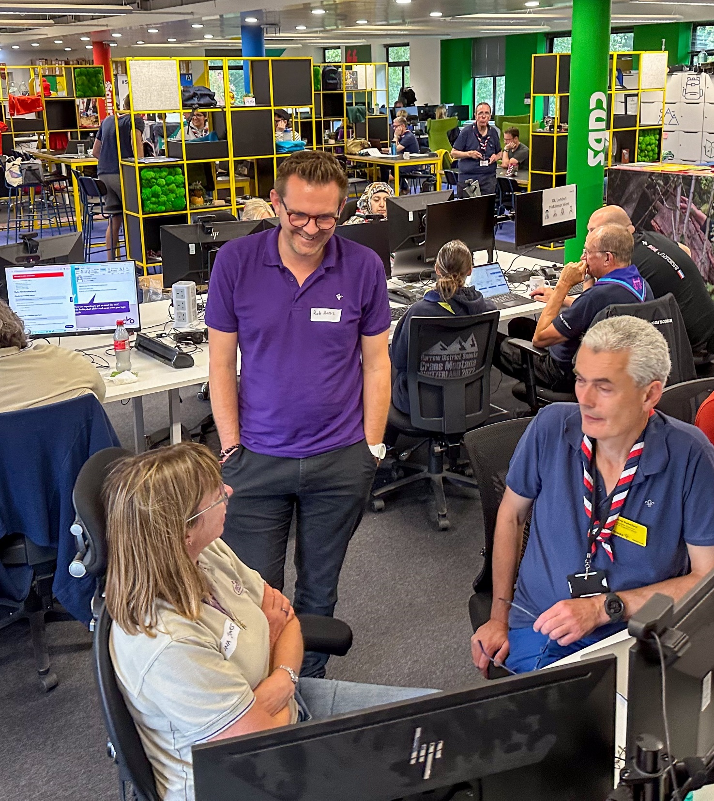
Adding to your Team
We’ll use the Smartsheet mailing list up to Go-Live to reach out with any important information and invites
You must add people via the Smartsheet Form, so we know they are on the team
Please forward the two recorded training webinars to anyone you add from now on
If you remove people, we also need to know this
After Go-Live we’ll be using the accreditation list

Slide 12
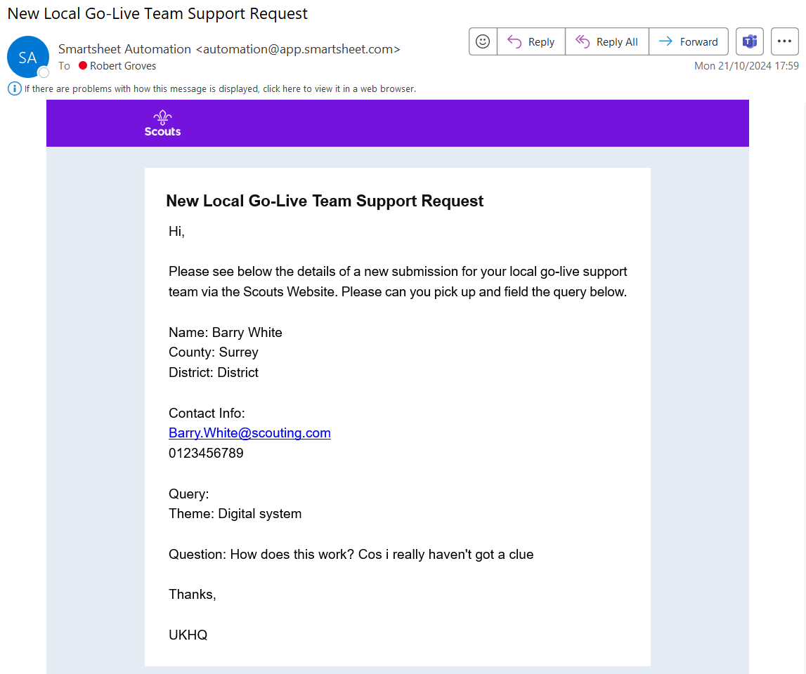
Managing queries
Contacting Go-Live Support Teams Centrally
We’ll have a central form that can be completed which will automatically mail out to Local Teams
Forwarding Support Centre Queries
Queries coming direct to the Support Centre asking simple process questions will be directed back to Local Teams
Action - We must get a single email address we can send these queries to so they can be managed locally. Without this we will send these to the Transformation Lead and County Lead Volunteer

Slide 13
Support available
Self Service
Guides, webinar recording and videos to support all volunteers
Go-Live Support Team
First point of contact for local volunteers to get additional support about process changes, or digital queries
HQ Support
Local Go-Live Support Teams will be supported by HQ (Support Centre)
Support Centre will have extended hours ('til 8pm) and weekend cover (10am to 4pm)
Escalation will be managed via Ops Room operating through Go-Live
Local Support
Step 1
Step 2
Self-Service
'How do I reset my password?’
‘How do I nominate someone for an award?'
'How do I apply for a permit?'
Local Go-Live Support Teams
Support users with digital tools
Answer basic questions about changes (roles, teams, process) Answer queries on people and process changes

Slide 14
Additional Safety Learing

Slide 15
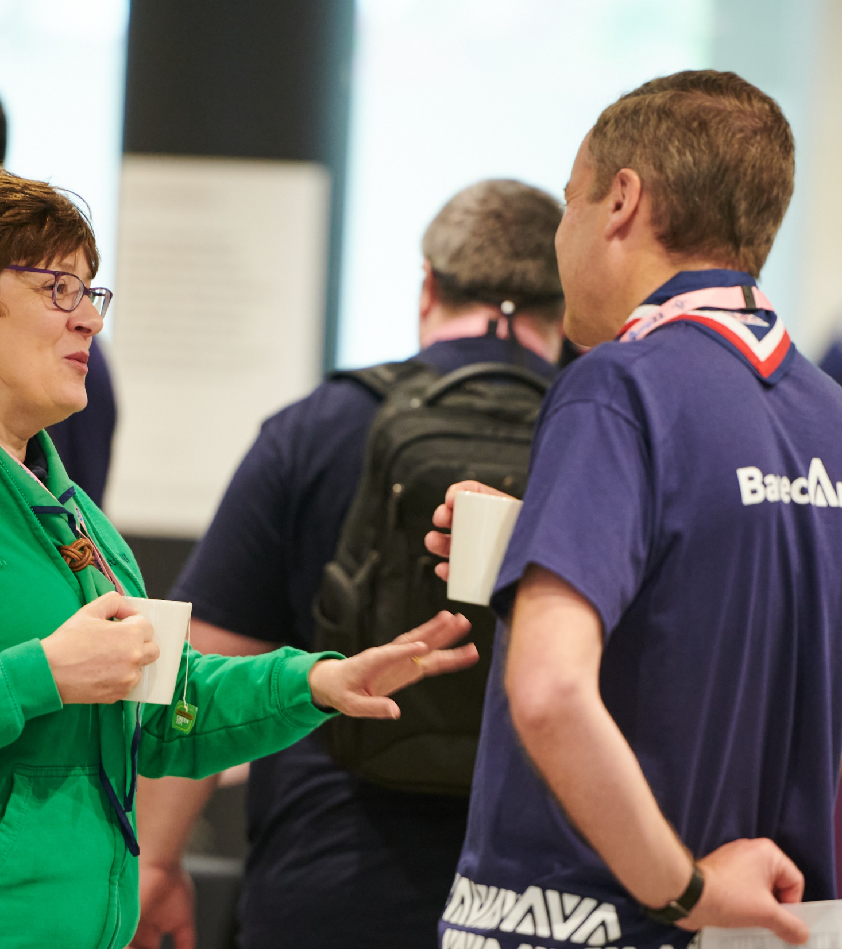
Additional Safety Learning
In response to the Prevention of Future Deaths (PFD) report, all members will be required to complete the updated Safety Learning
This will need to be completed by July 2025, and expiry dates will be updated during the data migration.

Slide 16
Any Questions?

Slide 17
Go-Live Plan

Slide 18
Go-Live Timings
Thurs 21 Nov Early Adopter County and District Lead Volunteer Invites
Mon 25 Nov Early Adopter All Invite
Sun 1 Dec All Counties Group Lead Volunteer Invites
All Counties County and District Lead Volunteer Invites Thurs 28 Nov
Early Adopter Group Lead Volunteer Invites Sun 24 Nov
All Counties All Invite Mon 2 Dec

Slide 19
Who gets access when?
Nov 21st (EA day 1) | Early Adopter County/Area/Region Lead Volunteer Early Adopter Transformation Leads All Early Adopter Go-live support team members (TBC) Early Adopter District Lead Volunteers Nations HQ staff Nations Team volunteers (including England team) All UKLT volunteers (Not all UK HQ volunteers) Volunteer Experience Programme volunteers All UK HQ staff
Nov 24th | Each Group Lead Volunteer in each EA County
Nov 25th | All other volunteers and staff in early Adopter County/Area/Region(s) All other UK HQ volunteers not included above
Nov 28th (90% day 1) | All other County/Area/Region Lead Volunteers All other Transformation Lead(s) All other Go-live support team members (TBC) All other District Lead Volunteers
Dec 1st | Al other Group Lead Volunteer
Dec 2nd | All other volunteers and local staff
Day One
District/County/Area/Region Lead Volunteers
County/Area/Region Transformation Leads
District Lead Volunteers
Nations Team Volunteers and Staff
UK HQ Staff
Go-Live Support Team Members - TBC

Slide 20
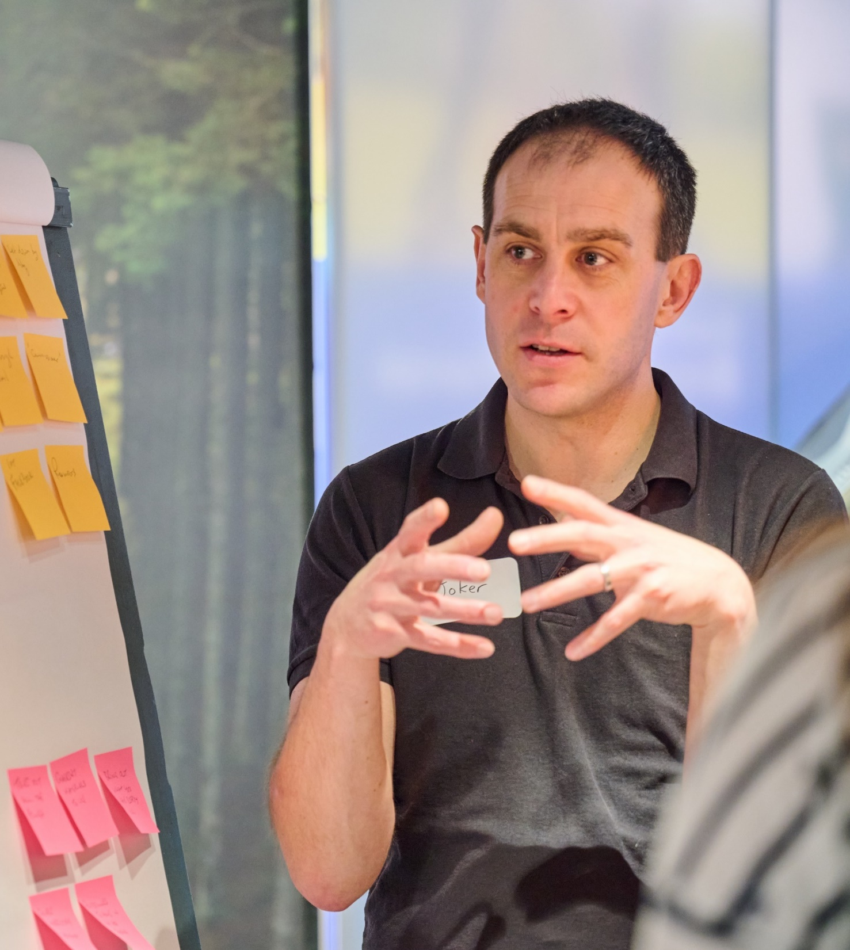
What do I need to do locally?
We’re going to walk through this as an ‘imaginary’ County, showing what each person/team needs to do in what order
Whilst the time is limited, it’s really important that these actions are taken from day one
Where someone isn’t available at Go-Live, pre-plan what your workaround for this is going to be
If possible, we recommend that the County Team and each District Team get together virtually or in-person to carry out some of the initial actions

Slide 21
Anywhere County
District One
District Two (No Lead Volunteer)
District Three
Group One
Group Two
Group Three
(No Lead Volunteer)

Slide 22
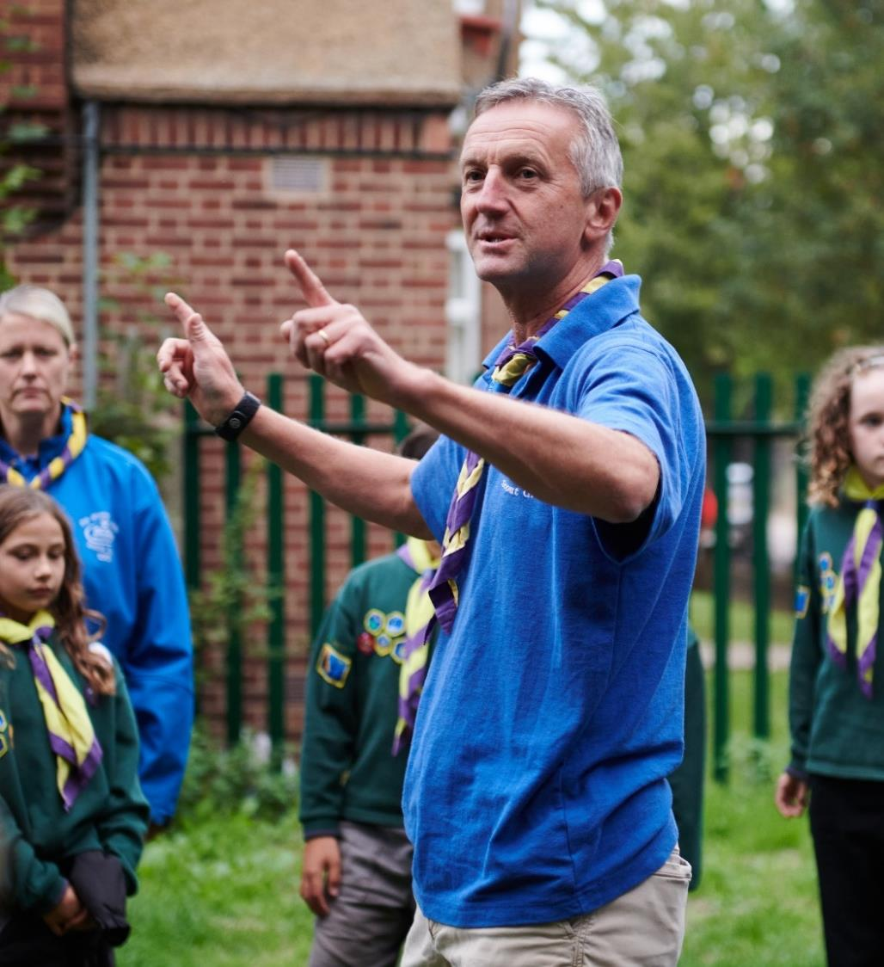
Actions prior to Go-Live
From 7 Nov
Anywhere County plan their Go-Live actions
Anywhere County directly, supported by District messaging, advertise out to all volunteers how to contact the Go-Live Support Team
County arrange call with District Leadership Teams to walk through their go-live plans and support model
District arrange call with Group Leadership Teams to walk through their go-live plans and support model

Slide 23
Anywhere County
By end of Day Three (Saturday)
County Leadership Team
Programme Team Leader(s)
Volunteering Development Team Leader(s)
Support Team Leader(s)
What we’re building:
Anywhere County Leadership Team choose to meet online
County Lead Volunteer
Sign-in: Receive email and reset password
Set up profile: Declaration, personal details, check teams and roles
Set up your structure: Create any agreed sub-teams in Leadership Team

Slide 24
Anywhere County
By end of Day Three (Saturday)
County Leadership Team
Programme Team Leader(s)
Volunteering Development Team Leader(s)
Support Team Leader(s)
What we’re building:
Set up your team: Where required, assign the County Leadership Team Member and County Team Leader roles
Invite them in: You’ll have a template email you can share with just those people to give them the information they need to sign-in

Slide 25
Anywhere County
By end of Day Three (Saturday)
County Leadership Team
Programme Team
Volunteering Development Team
Support Team
What we’re building:
Leadership Team Members
Sign-in: Receive email from County Lead Volunteer, reset password
Set up profile: Declaration, personal details, check teams and roles
County Team Leaders
Set up your structure: Create any agreed sub-teams in your team
Set up your team: Add roles to your team members
Once everyone has their role set up and can see what they are expecting, the online meeting ends

Slide 26
Anywhere County
By end of Day Three (Saturday)
County Leadership Team
Programme Team
Volunteering Development Team
Support Team
Trustee Board
What we’re building:
Additional Actions:
Give each District Lead Volunteer the ‘Recruiter’ accreditation
Set up Go-Live Support Team: Add accreditations, invite them to sign-in
Check Trustee Board Team, invite them to sign-in where required
Invite any required County Team Members to sign-in
Add any County Team Accreditations
Close Holding roles after roles are allocated
Record any actions carried out while Compass was offline, for example, Permit status changes

Slide 27
District One
By end of Day Three (Saturday)
District Leadership Team
Programme Team Leader(s)
Volunteering Development Team Leader(s)
Support Team Leader (s)
14 -24 Team Leader(s)
What we’re building:
Step One
District One Leadership Team choose to meet online
District Lead Volunteer
Sign-in, Set up profile, Set up structure, Set up team, Invite them in
Leadership Team Members
Sign-in, Set up profile
District Team Leaders
Set up structure, Set up team
14-24 Team - check Sections set up correctly
District Leadership Team
Programme Team
Volunteering Development Team
Support Team
Trustee Board
14-24 Team
Explorer, Young Leader & Network Sections
Step Two & Three

Slide 28
District One
By end of Day Three (Saturday)
District Leadership Team
Programme Team
Volunteering Development Team
Support Team
Trustee Board
14-24 Team
What we’re building:
Additional Actions:
Check Trustee Board Team, invite them to sign-in if required
Invite any District Team Members to sign-in as required
Add any District Team Accreditations
Close Holding roles after roles are allocated
Record any actions carried out while Compass was offline, for example, Permit status changes

Slide 29
District Two (No District Lead Volunteer)
By end of Day Three (Saturday)
District Leadership Team
Programme Team Leader(s)
Volunteering Development Team Leader(s)
Support Team Leader (s)
14 -24 Team Leader(s)
What we’re building:
Step One
County Lead Volunteer/Leadership Team Member
Set up structure, Set up team, Invite them in
District Leadership Team Members
Sign-in, Set up profile
District Team Leaders
Set up structure, Set up team
All
Complete additional actions
District Leadership Team
Programme Team
Volunteering Development Team
Support Team
Trustee Board
14-24 Team
Step Two to Four

Slide 30
District Three
By end of Day Three (Saturday)
District Leadership Team
Programme Team Leader(s)
Volunteering Development Team Leader(s)
Support Team Leader (s)
14 -24 Team Leader(s)
What we’re building:
Step One
District Lead Volunteer
Set up structure, Set up team, Invite them in
District Leadership Team Members
Sign-in, Set up profile
District Team Leaders
Set up structure, Set up team
All
Complete additional actions
District Leadership Team
Programme Team
Volunteering Development Team
Support Team
Trustee Board
14-24 Team
Step Two to Four

Slide 31
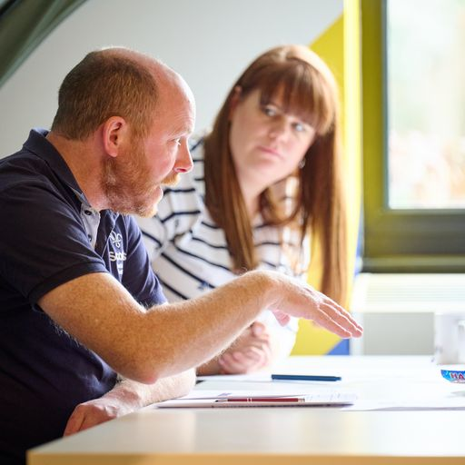
Anywhere County
By end of Day Three (Saturday)
Additional Actions:
Set up a check in with all Districts on day three to confirm all actions completed
Meet with Go-Live Support Team to be prepared for Go-Live

Slide 32
Group One
By end of Day Four
(Sunday)
Group Leadership Team
Squirrel Section
Beaver Section
Cub Section
Scout Section
Trustee Board
What we’re building:
Group Lead Volunteer
Sign-in, Set up profile
Set up Leadership Team and Trustee structure, add additional Leadership Team Members
Check Section teams and Trustee Board
Notes:
Most, if not all, Section Teams will already be set up via migration

Slide 33
Group Two
By end of Day Four
(Sunday)
Group Leadership Team
Squirrel Section
Beaver Section
Cub Section
Scout Section
Trustee Board
What we’re building:
Group Lead Volunteer
Sign-in, Set up profile
Add Leadership Team Member
Invite Leadership Team Member and Chair to system
Group Leadership Team Member/Chair
Set up Leadership Team and Trustee Structure, add additional Leadership Team Members
Check Section teams and Trustee Board

Slide 34
Group Three (No Group Lead Volunteer)
By end of Day Four
(Sunday)
Group Leadership Team
Squirrel Section
Beaver Section
Cub Section
Scout Section
Trustee Board
What we’re building:
District Lead Volunteer/Leadership Team Member
Set up Leadership Team Structure, add additional Leadership Team Members
Check Section teams and Trustee Board
OR
District Lead Volunteer/Leadership Team Member
Set up Leadership Team member
Invite Leadership Team Member and Chair to system
Group Leadership Team Member
Set up Leadership Team and Trustee Structure, add additional Leadership Team Members
Check Section Teams and Trustee Board

Slide 35
All Volunteers
From Day Five (Monday)
All Volunteers
Sign-in: Receive email and set password
Set up profile: Declaration, personal details, check teams and roles
If applicable - apply for any Permits issued while Compass was offline
Complete any outstanding learning, including Safety learning
Get familiar with the new system

Slide 36
Timeline
CLV/DLV Access
GLV Access
All Access
Day One
Day Two
Day Three
Day Four
Day Five
Day Six Onwards
Set up Team structures
Add roles and accreditations for County/District Teams
Invite County/District Team to system
Set up Go-Live Support Team
Start recording any actions taken whilst Compass was offline
Set up Group Leadership Team
Add roles and accreditations for Group Leadership Team
Check Sections and Trustee Board
Login and setup profile
Start using the system
Complete outstanding learning
Formally operate in new teams
Support Volunteers to use new systems via Go-Live Support Team
Continue to embed new ways of volunteering

Slide 37
Any Questions?

Slide 38
Next Steps

Slide 39
What we’re doing:
What you can do:
Providing all member training
POR for go-live
Building Go-Live Checklist webpages
Final preparations to update website content when Compass goes offline and at Go-Live
Setting up our Ops Room from Compass going offline
Preparing significant updates to Knowledge Base
Focus on all areas having completed essential actions and encouraged actions where possible
Share with us your primary contact email for your Go-Live Support Team
Prepare for Compass going offline
Start working with the County and Districts to create their Go-Live Plans
Promote your Go-Live Support Team

