Slide 1
Local Go-Live Support Team induction
August 24

Slide 2
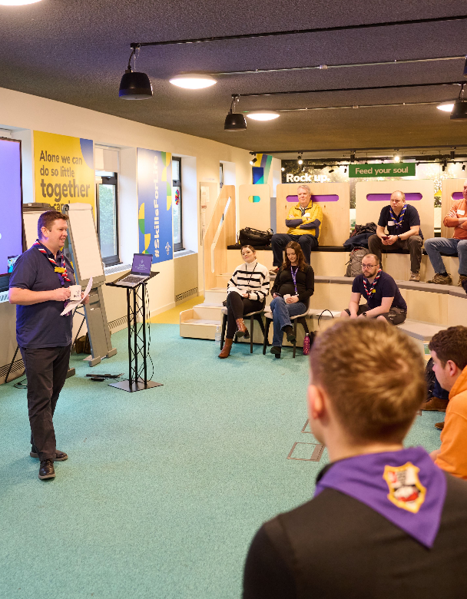
Who's on the call?
Hamish Stout, Project Sponsor, Change and Infrastructure
Paul Fix, Programme Sponsor, Volunteer Experience
Liz Cash, Training Manager
Dan Venting, Support Centre Manager
Prerna Carroll, (Digital) Delivery Manager
Elizabeth Stormfield, Rob Groves, Change Team
Adam Ray, Communications Manager

Slide 3
What we’ll cover
Overview of the Volunteer Experience Changes
Your role and your team
Timeline
Training
Next steps

Slide 4
Overview of Volunteer Experience changes

Slide 5
Making volunteering easier and more fun is how we reach our North star...
More young people gaining skills for life
Consistently and safely
deliver a great programme
Recruit more volunteers
and retain current ones

Slide 6
Where are we now?
We support over 140,000 incredible volunteers to deliver skills for life to over 430,000 young people
However, the landscape is changing:
70% of volunteers don’t want to give a weekly commitment
We lose 13% of our volunteers every year, many complaining of burnout and overload
100,000 young people on waiting lists across the UK
Increasing amounts of time spent on administrative tasks
Several current processes and structures don’t support our volunteers or easier recruitment

Slide 7
We cannot grow to meet our ambitions for young people, from section level to the whole of the UK, without making some fundamental changes

Slide 8
We want to make volunteering with Scouts easier and more fun…
…so that we can attract more volunteers and our current volunteers want to stay

Slide 9
Transforming our Volunteer Experience
A warmer welcome for everyone
Simplifying how we volunteer together
More engaging learning
Redesigning the appointments process
Introducing a welcome conversation
New digital recruitment tool
Improved self-service for new volunteers
Team-based approach allowing tasks to be shared
Clearer purpose and responsibilities of teams
More flexible volunteering
New digital tool for adult volunteers
Reviewing current training and moving to learning
New digital learning tool with personal and engaging content
Includes new co-designed Safeguarding learning

Slide 10
Supporting Digital Tools
Scouts.org.uk Website
Easy to use and mobile-friendly
Single Sign On
Fewer steps and less administration
Specialist functionality
Digital first, but not digital only
Continuous improvement over time
Volunteering Opportunities
My Membership
My Learning
Better able to attract more volunteers through a wide range of channels
Clearer information upfront about roles, responsibilities and what to expect
Reduced administration (Including references & disclosures)
Improved visibility of information
Easier to manage processes e.g. Permits & Awards
More accessible, engaging and enjoyable learning
Easier reporting and management of learning

Slide 11
“A shared understanding for what we do and say as volunteers in Scouts, supporting each other, following our values and being at our best, while acting as role models for young people.”
Embedding Culture Change
It’s important we remember the core of the volunteer experience transformation is about culture change
Across the movement we must continue to embed, and role model this culture change
This includes:
Our Volunteering Culture
New ways of working, including learning and welcome

Slide 12
Where will we be?
Digital tools which reduce administration for volunteers and automate several processes
Volunteers feeling welcomed and valued from day one
More accessible and engaging learning all in one place
Clearer structures and responsibilities for teams
More flexible volunteering to accommodate our changing landscape

Slide 13
Your role and your team

Slide 14
Team tasks
Tasks the team needs to undertake individually or collectively:
Provide the first line of support for local volunteers to get advice to resolve ‘how to’ queries using knowledge to support both the local processes used by our volunteers, and questions about the new digital tools that support those local processes.
Signposting volunteers to pages on scouts.org.uk or to the Digital Skills Tool and Digital Champions to provide support
Enabling people to use the new digital system and understand the changes in local processes
Identifying issues raised within the County that need referring to the HQ Support Centre
Receive and manage local referrals from the Support Centre

Slide 15
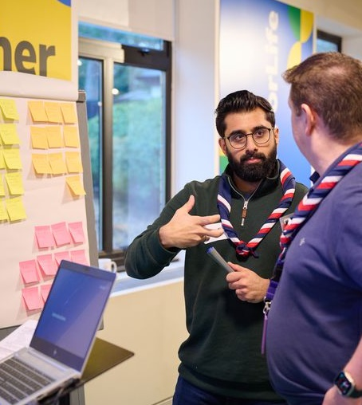
Team structure
The appropriate structure will vary from County to County, so build this to best support your volunteers.
Incorporating this into your County’s pre-existing teams and support channels
A central inbox for volunteers to send queries to
Setting up WhatsApp/Facebook Groups
Page(s) on the County/District website which signpost to support available
Ideally the team would be made up of people with a mix of local process and system knowledge such as your local transformation team, those who have helped test the system, any digital champions you have in your area and others.

Slide 16
Central Support Model
Tier 0
Tier 1
Tier 2
Tier 3
End Users
'How do I reset my password'
'Why is my role now X?'
'How do I apply for a permit?'
Local Go-Live Support Teams
Support users with digital tools
Answer basic questions about changes (roles, teams, process) Answer queries on cultural changes
Support Centre and HQ staff
'My data isn't right'
'I can't access something I need to'
'Something isn't working'
Feedback on changes and system
IT Support and HQ Staff
Service issues
System admin (role, process configuration)
HQ roles and access
Major cultural/ process issues

Slide 17
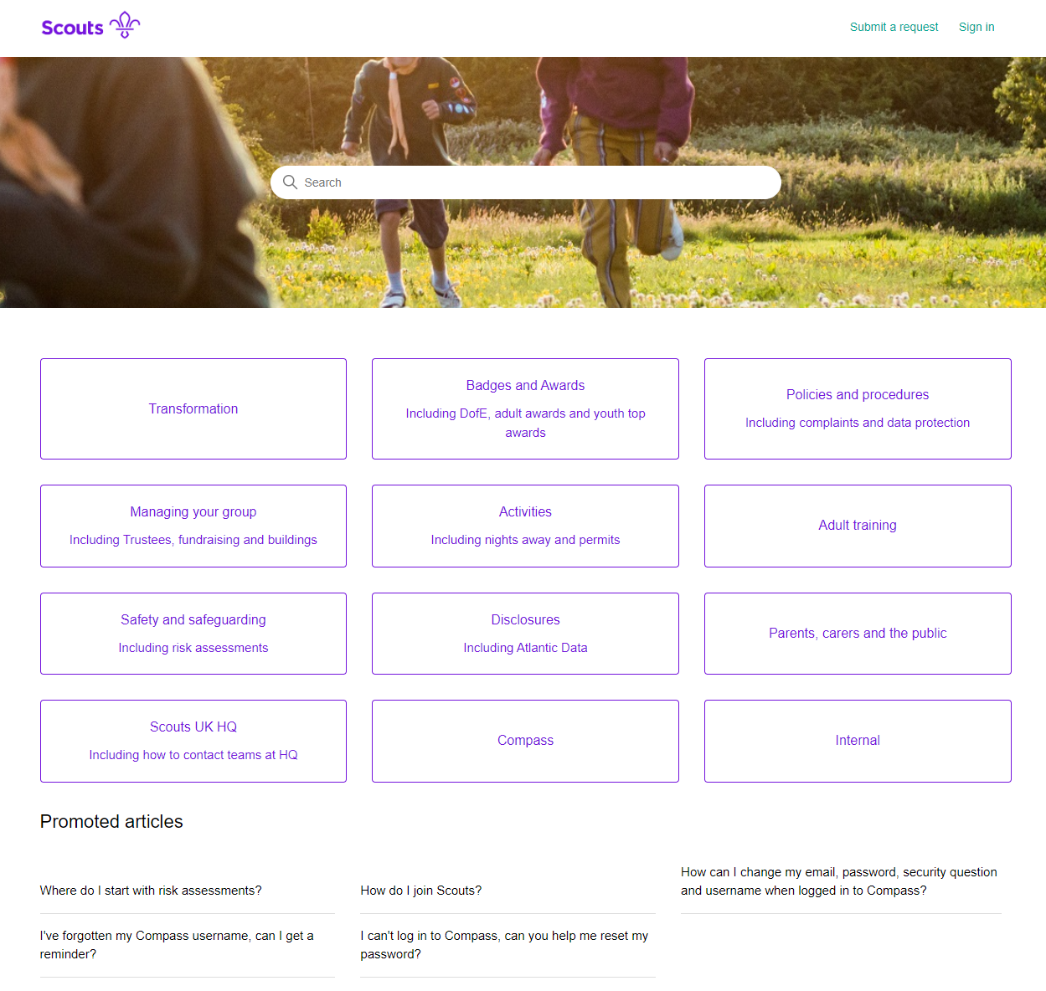
Knowledge Base
This is something the Support Centre own and manage, filled with helpful articles that they use to support their work answering queries
You will have access to this space and we will be adding articles to support your work locally
There will be articles covering the FAQs we have had so far in relation to the transformation
Where we see large numbers of questions coming in during the go-live phase we will update these articles to meet that need

Slide 18
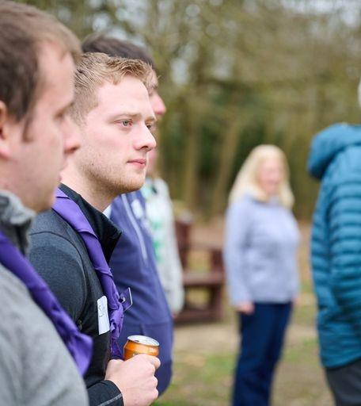
Things to do now
Now is the time to make sure you know how volunteers can get in contact with your team and have set up and communicated that information locally – County webpages or newsletters etc.
Understand what knowledge and expertise you have in your team to support Go-Live and if you have any gaps you might be able to fill
Plan how you will escalate issues to the Support Centre or digital team
Plan how you will manage the expectations of local volunteers?
Will you have a rota so that you can be available across the week?
Think about your response time in relation to your team capacity, will you aim to respond within 24/48 hours?
How will you let volunteers know you are working on their query? Maybe an automatic response or holding message?

Slide 19
The timeline

Slide 20
Delivery Phases
Introducing and embedding culture changes*
Now - Summer ‘24
September Onwards
Before end of 2024
After move to digital tools
Introducing new ways of working and data readiness
Finish preparations for the digital tools & processes
Moving to digital tools & processes
Embedding our new ways of working
Compass Freeze
Go-Live Support
*Introducing and embedding culture changes includes:
Our Volunteering Culture
Learning Culture
Welcome Culture
New ways of working

Slide 21
Preparing for new and updated processes
Managing your local structures
Managing our volunteers
Permits
(Activity, Nights Away)
Good Service Awards
Managing my personal details
Learning
Notifications
Dashboards & Reporting
Volunteer Joining Journey
Volunteer Role Change process
Reporting
Suspensions (Adults)
Appointment Reviews
Grant applications
Nights Away Notifications (NAN)
Minibus Permits
Attracting new volunteers
Actions
Qualifications
Process changes from day one
Process available from day one

Slide 22
Training

Slide 23
Local Go-Live Support
Local Go-Live support
Session(s) to clarify how Local Go-Live Support will work and introduction to training programme
Local Go-Live Support Teams provide support to members including answering questions, directing queries to online information, and where appropriate refer query to Support Centre
Training Objectives
Ensure Local Go-Live Support Teams are well versed in the process changes, and how they are supported by the new digital functionality
Knowledge of how to use the digital system sufficient to identify which Tier the help request belongs to
Knowledge of where to locate online help
Knowledge of Go-Live Support
Go Live
Identify Local Go-Live Support Teams
Training sessions delivered to Local Go-Live Support Teams introducing new processes/cultural changes and digital system
Resources provided
Recordings of training sessions
How to guides for processes
Access to knowledge base for responses to frequently asked questions

Slide 24
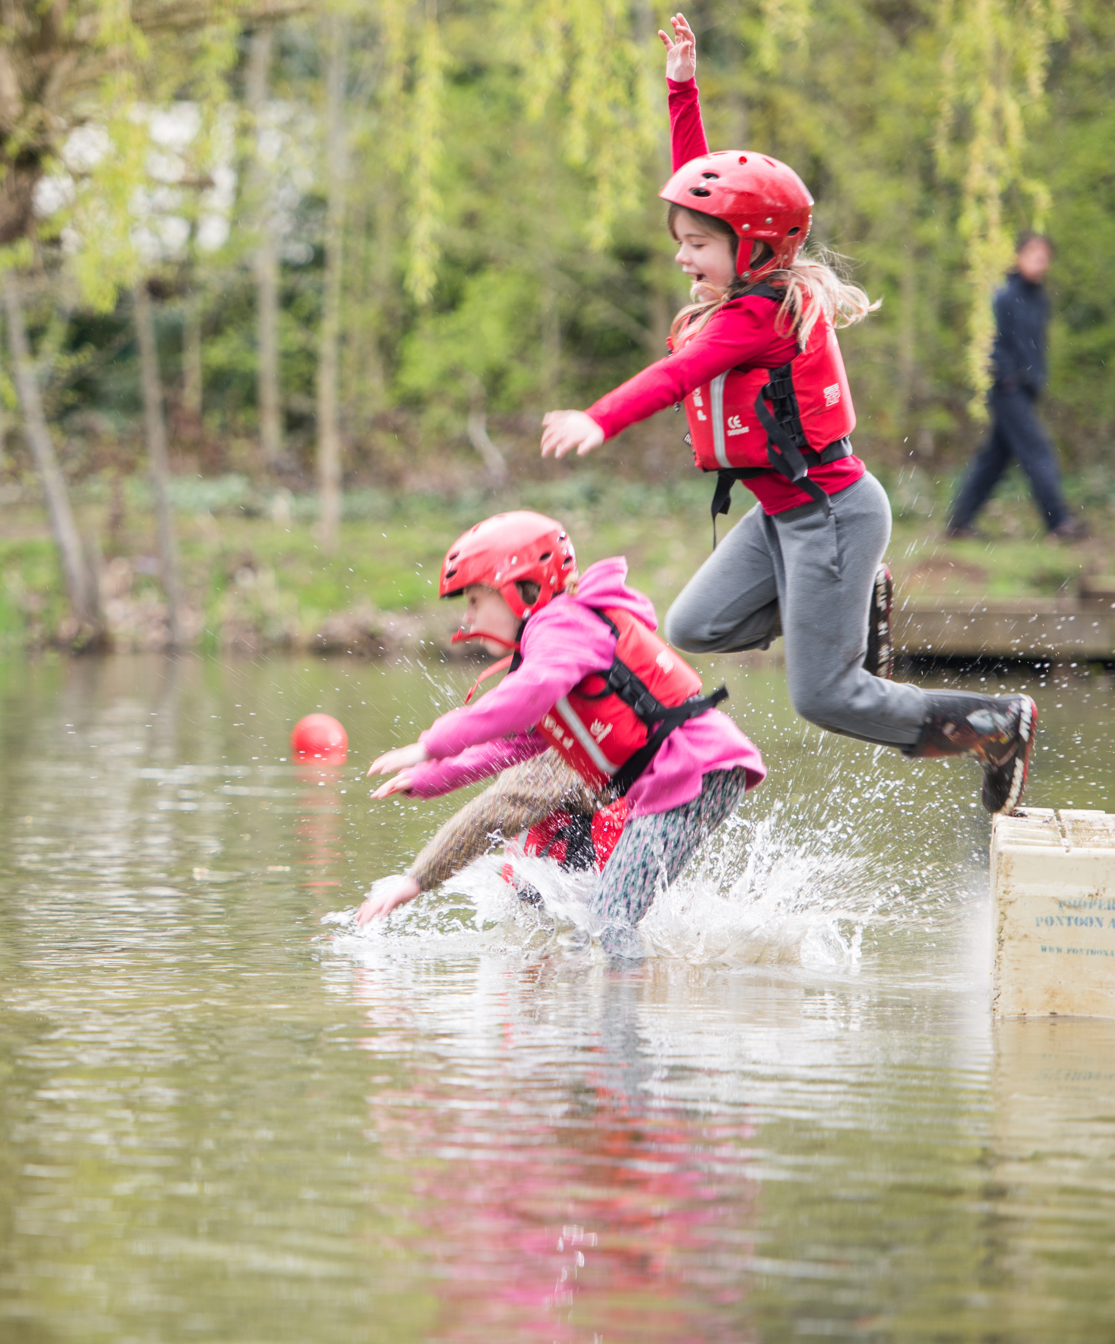
New system and process training for Volunteers
Training webinars for all volunteers will start a few weeks prior to go-live of the new system, just before Compass Freeze
We will deliver:
All Member sessions - walking through steps of new processes and system functions
Targeted sessions – leader (manager) specific sessions covering approvals, suspensions and other processes they will need detail on
These live sessions will be recorded and shared

Slide 25
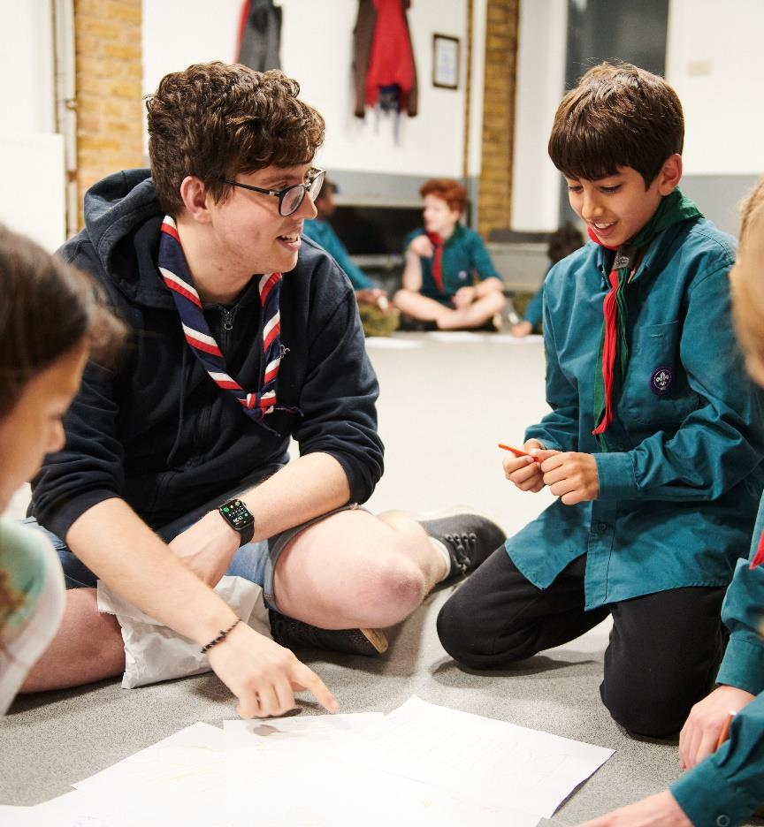
New system and process training for Volunteers
Alongside the live sessions, we’ll also have a suite of guides on the website
Step by step written guides and videos for all the functions within the digital tools will be produced and available online

Slide 26
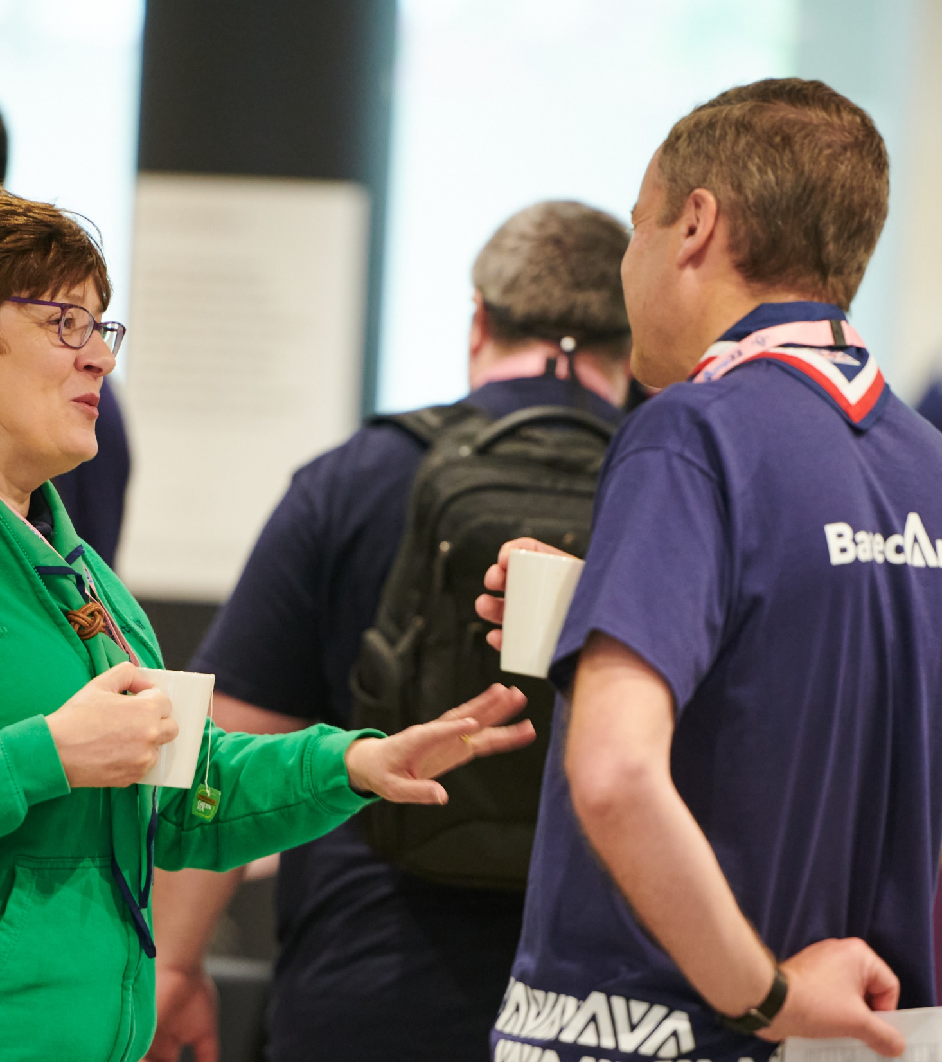
Training for Tier 1 Support
Training Sessions will begin at the start of September, so you have the time to familiarise yourself with the digital tools prior to go-live
Several sessions will be held across two weeks
Access to a digital tools training environment will be given after training

Slide 27
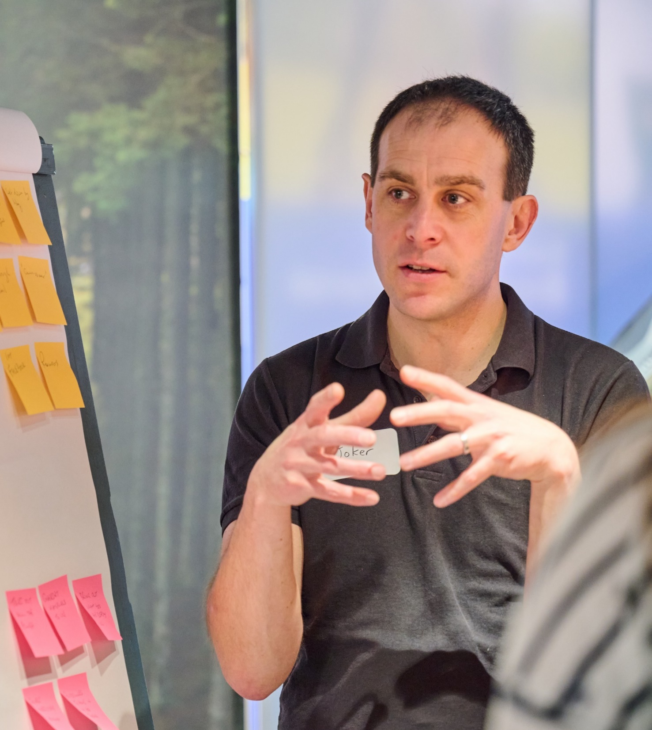
Training content – Tier 1 Support
We will be covering both the changes to local processes and the digital systems.
This includes:
Joining Journey
First steps – signing in, checking and editing personal details
Viewing and working with Teams
Activity and Nights Away Permits
Awards
Reviews
Grants
Accreditations
My Learning

Slide 28
Next Steps

Slide 29
Webinars and training
Volunteer Joining Journey
27 August 7-8pm
Gear Up for Go-Live County/District level
2 Sept 7-8pm
Gear Up for Go-Live
Group level
4 Sept 7-8pm
Local Go-Live Support team training
Weeks commencing 2nd and 9th September – times TBC and explored in the poll
How to be a great Trustee Board
18 Sept 7-8pm

Slide 30
Any Questions?

Slide 31
What we’re doing:
What you can do:
Make sure you know who is in your team
Think about how you will manage the questions you'll get locally; will you have a shared mailbox for example?
Make sure everyone in the team has had their name added to the register so we can make sure they get invited to the training and can access the testing area
Attend the Gear up for Go-Live webinars as these will have essential information about the process and timeline
Refresh your knowledge about the changes by watching previous webinars and exploring the website. We will send helpful links along with these slides after the call.
Arranging training for you and your team
Creating and arranging systems training for all local volunteers
Writing and updating Knowledge Base articles
Setting up access for you to test the systems ahead of go-live

Slide 33
Preparing for digital tools and processes - Circa. 60 days before Compass freeze
Introducing and embedding culture changes*
Now - Summer ‘24
Circa. 60 days prior to Compass freeze
After Summer ‘24
After move to digital tools
Introducing new ways of working
Preparing for the digital tools & processes
Moving to digital tools & processes
Embedding our new ways of working
Compass Freeze
Go-Live Support

Slide 34
Preparing for digital tools and processes - Circa. 60 days before Compass freeze*
What’s happening during this phase?
Making sure all data is up to date on Compass
Preparing locally for new ways of working
Implementing local go-live support teams
Preparing for interim measures during Compass freeze
Start training for new digital tools and processes
POR for post-migration
*Compass freeze will be at different times for Early Adopter Counties and all other Counties

Slide 35
Making sure data is up to date
From around 60-days before Compass freeze there will be targeted comms for all members to make sure their data is updated on Compass ready for migration. This includes:
Personal details
Criminal record checks
Permits
Appointment steps
Getting Started training
Training validation
Anything not completed before Compass freeze cannot migrate across to the new digital system

Slide 36
Preparing for digital tools and processes - For circa. 60 days before Compass freeze
Tasks to complete in your County/Area/Region (Scotland)
What must happen:
All Compass records ready for migration
Your Go-Live Support Team is ready to start
Volunteers are aware of the interim processes during Compass freeze and the coming new ways of working
What should happen:
Remaining Counties, Districts & Groups informally adopts new teams and titles locally
What must not happen:
Volunteers working outside of current rules in POR (E.G. App. Panels, Role training requirements)

Slide 37
Moving to digital tools and processes - After Summer ‘24
Introducing and embedding culture changes*
Now - Summer ‘24
Circa. 60 days prior to Compass freeze
After Summer ‘24
After move to digital tools
Introducing new ways of working
Preparing for the digital tools & processes
Moving to digital tools & processes
Embedding our new ways of working
Compass Freeze
Go-Live Support

Slide 38
Moving to digital tools and processes - After Summer ‘24
What’s happening during this phase?
Compass Freeze
Interim processes in place
Continuing training for new digital tools
Lead Volunteer preparations
Go-Live Support
Encouragement to use digital tools
Support for Counties with go-live of new processes

Slide 39
Compass Freeze
Interim Processes
Compass will be unavailable during this period, Support Centre will have access to information if needed
Interim process will be live during the Compass freeze, until the go-live of the digital system
During this period, all volunteers will need to make sure they are aware of and following these processes
Training for new digital tools and processes
Training sessions will continue to be run during this time
Volunteers should be encouraged to attend

Slide 40
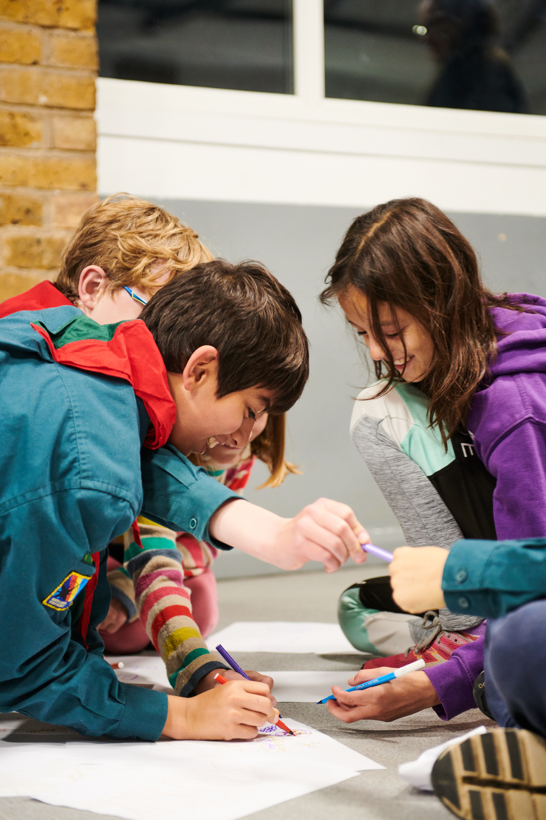
Soft Launch - Preparation Week
In the first week of go-live we’ll be encouraging Lead Volunteers and their teams to get everything set up and for other volunteers to use the system if needed only
This means they can:
Move volunteers into the right teams and give them the accreditations they need
Explore the live system to support their teams
We’ll be communicating directly with Lead Volunteers during this time to support them to do this

Slide 41
Using the new digital system
At go-live:
Volunteers with a migrated email
Receive an email directing them to login to the new system and set up their password
Volunteers with a missing or duplicated email
Will need to contact the Support Centre to get a login email added
Volunteers without an email
Will need their line manager to set up the proxy details

Slide 42
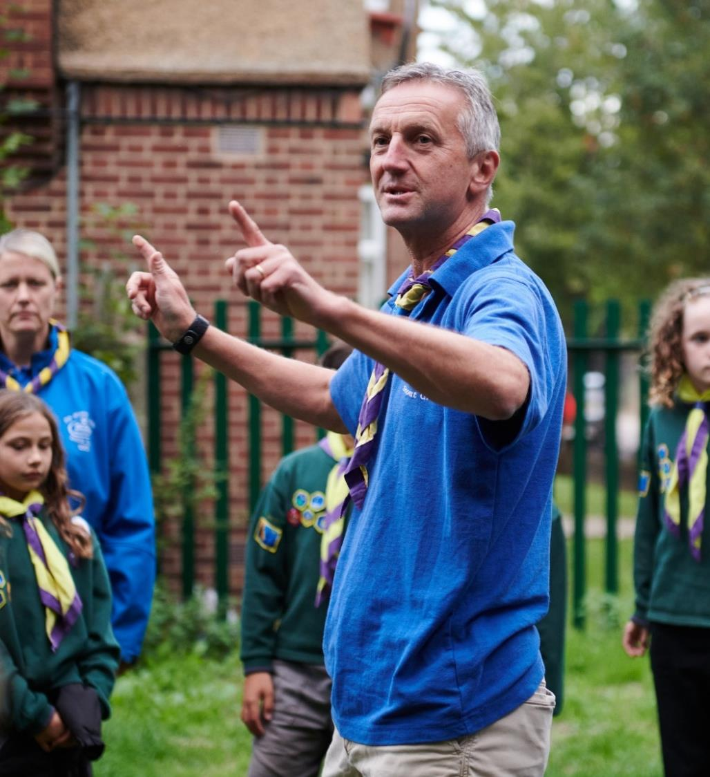
Go-Live
Supporting use of digital tools
All members will go-live with the new system approx. 2-3 weeks after Compass freeze
We’ll be regularly communicating with volunteers, highlighting different functions of the digital tools they can try out
We’ll also continue to deliver training sessions during the first week of go-live
Local Support
County go-live support teams should be helping with local queries for around 6-weeks after go-live

Slide 43
Moving to digital tools and processes - After Summer ‘24
What tasks need to be completed in your County/Area/Region (Scotland) during this period?
You must:
Make sure all volunteers are aware of and carrying out interim processes during Compass freeze
Have your County go-live support team operating
Encourage volunteers to attend training webinars
Make sure all volunteers are aware of and carrying out processes that will change when the digital tools go-live
Formally adopt new teams and titles locally, along with new ways of working
Make sure volunteers with outstanding learning are completing this through the learning tool

Slide 44
Embedding our new ways of working - After move to new digital tools
Introducing and embedding culture changes*
Now - Summer ‘24
Circa. 60 days prior to Compass freeze
After Summer ‘24
After move to digital tools
Introducing new ways of working
Preparing for the digital tools & processes
Moving to digital tools & processes
Embedding our new ways of working
Compass Freeze
Go-Live Support

Slide 45
Embedding our new ways of working - After move to new digital tools
What’s happening during this phase?
Success stories
Website transition to business as usual
Feedback on future improvement
Embedding culture change

Slide 46
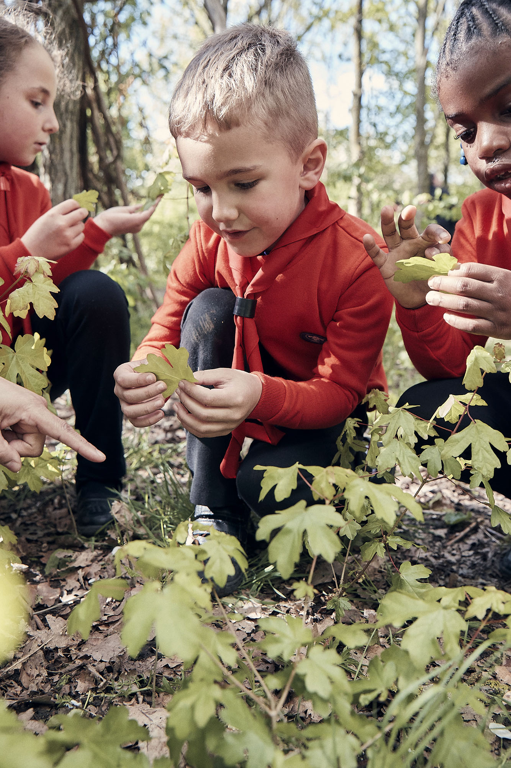
Success Stories
We’ll be sharing blogs/videos of success stories from across the movement
We’ll be reaching out to all Transformation Leads to share stories from their County or a District or Group

Slide 47
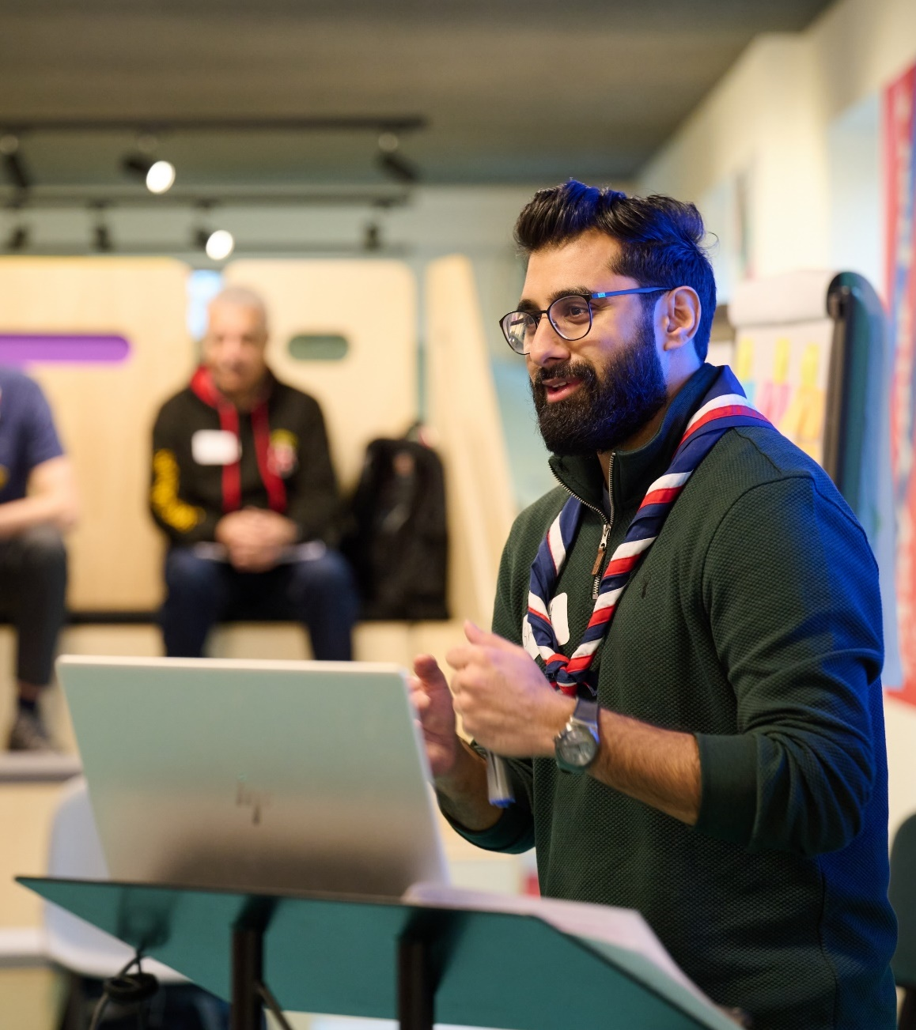
Website Transition
Ongoing work will take place just before go-live and over the following months to update content across the website
This will focus on moving current transition content into its business-as-usual pages and improving the way volunteers can navigate through the website easily to find the information they need

Slide 48
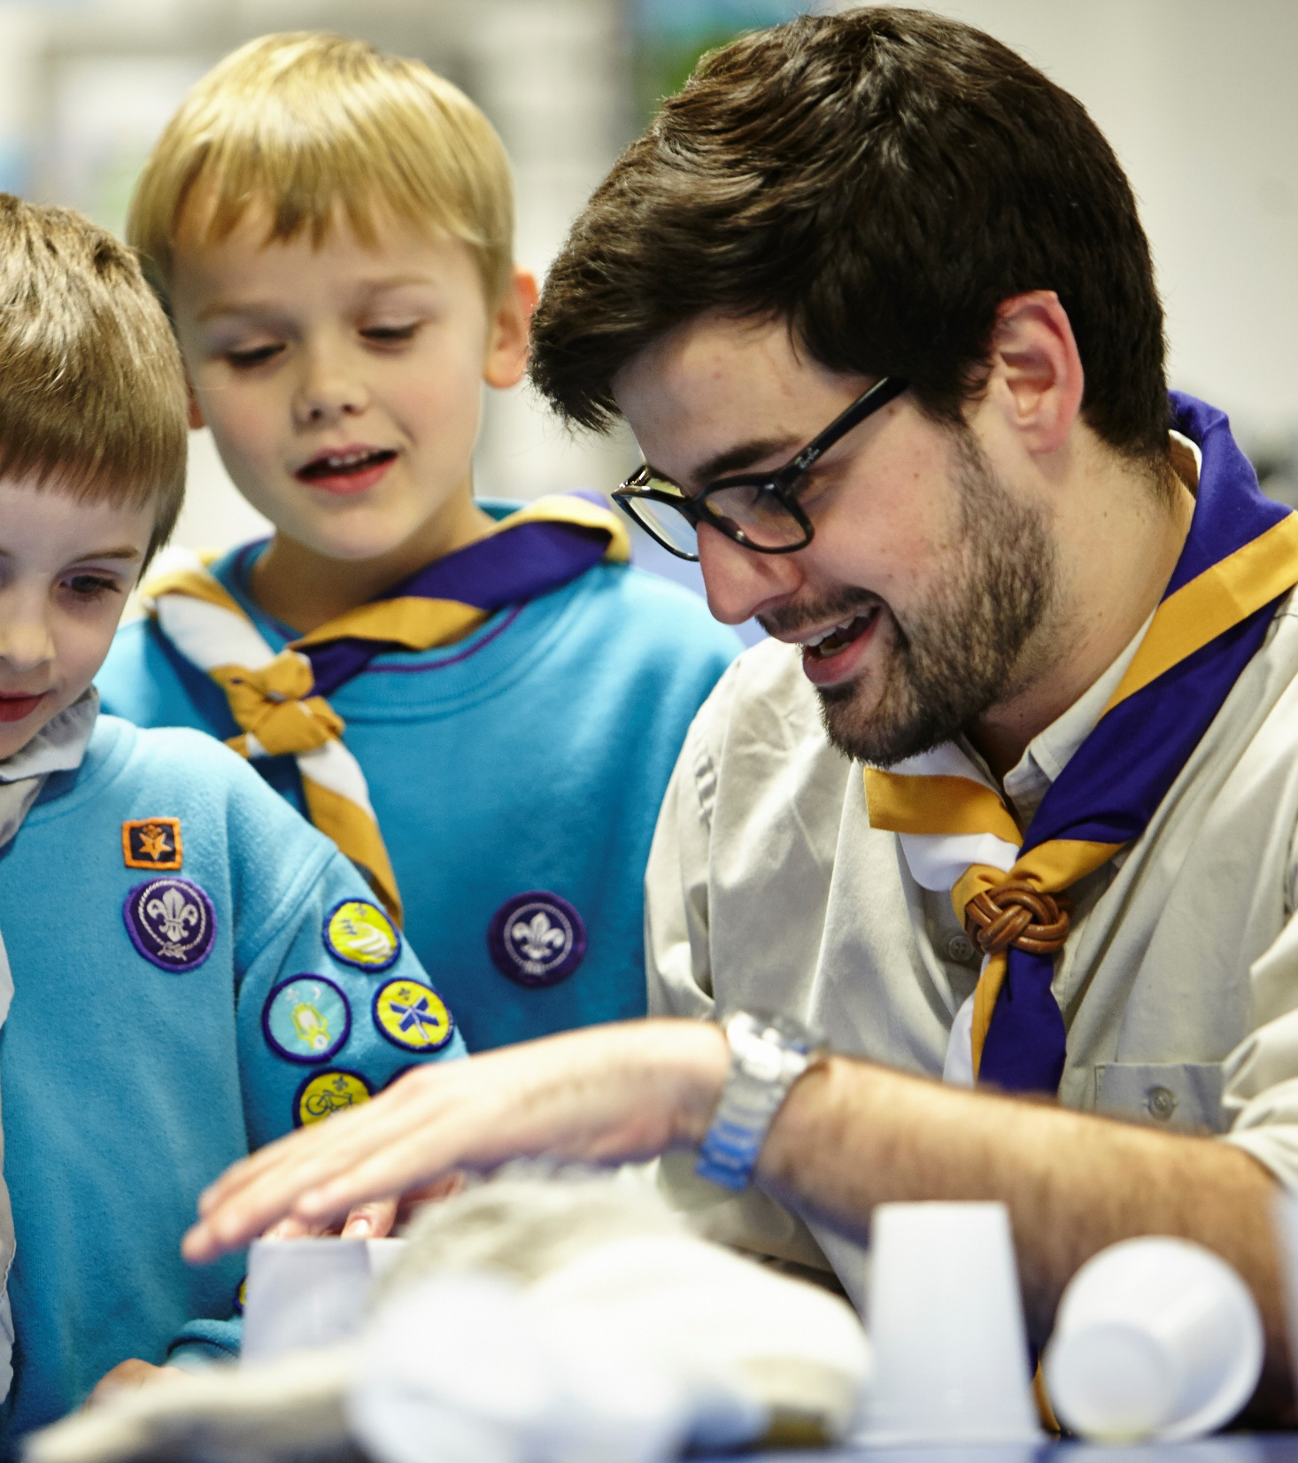
New Ways of Working and Feedback
New ways of working, supported by the digital tools, will need to continue to embedded into everyday practice
There will be a central process to share feedback on what additional features should be considered in future updates to the digital tools

Slide 49
“A shared understanding for what we do and say as volunteers in Scouts, supporting each other, following our values and being at our best, while acting as role models for young people.”
Embedding Culture Change
It’s important that we remember the core of the volunteer experience transformation is about culture change
Across the movement we must continue to embed, and role model this culture change
This includes:
Our Volunteering Culture
New ways of working, including learning and welcome

Slide 50
Embedding our new ways of working - After move to new digital tools
What tasks need to be completed in your County/Area/Region (Scotland) during this period?
You must:
Continue to embed culture changes across teams
Support volunteers to embed changes into their business as usual
You should:
Share feedback for future improvements to digital tools and new ways of working
Share success stories from your patch

Slide 51
Introducing new ways of working - Now into Summer ‘24
Introducing and embedding culture changes*
Now - Summer ‘24
Circa. 60 days prior to Compass freeze
After Summer ‘24
After move to digital tools
Introducing new ways of working
Preparing for the digital tools & processes
Moving to digital tools & processes
Embedding our new ways of working
Compass Freeze
Go-Live Support

Slide 52
Introducing new ways of working - Now into Summer ‘24
What’s happening during this phase?
Targeted webinars & support
Showcasing digital tools
Sharing success stories
Readiness resources and surveys
Welcome Conversations for Early Adopters

Slide 53
Other resources and support
Additional videos helping to explain and explore areas of the Volunteer Experience Programme, including:
Learning migration
Team structures
The digital system
Updated presentation resources targeted at District and Group level
Exploring options for providing targeted support to smaller audiences
Ongoing support for County events

Slide 54
Readiness Webpages
We’ll be releasing updated readiness webpages during May that cover:
What every volunteer needs to do
What Groups need to do
What Districts & Counties need to do
There'll be a small number of tasks that direct you to relevant pages on scouts.org.uk for more information
We'll update the readiness checklists to reflect this and help you review what needs to be done in finer detail
We’ll be restarting the short 10-minute readiness surveys for Counties during May

Slide 55
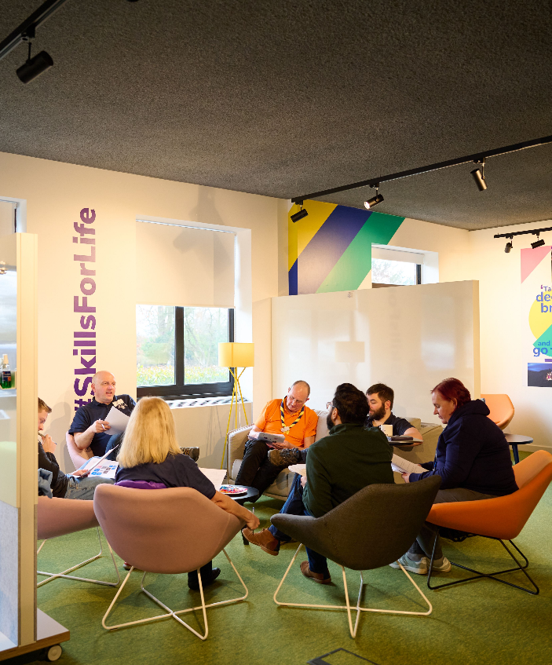
Sharing Success Stories
We’re looking to share short quotes, blogs and videos of success stories from implementing the Volunteer Experience changes
We have a handful from our Early Adopters and that we've picked up anecdotally at events already, but are looking for more!
If you have a particular story from your County, a District or a Group you think would be good to share with the movement, please get in touch

Slide 56
Welcome Conversations for Early Adopters
We’re supporting the full introduction of Welcome Conversations in Early Adopter Counties from 1st June onwards
The feedback from this will help us to improve the introduction of Welcome Conversations in all Counties
Other than in Early Adopter Counties, there are no actions required now and the current appointment process should remain as per POR
We will share actions for everyone else when appropriate

Slide 57
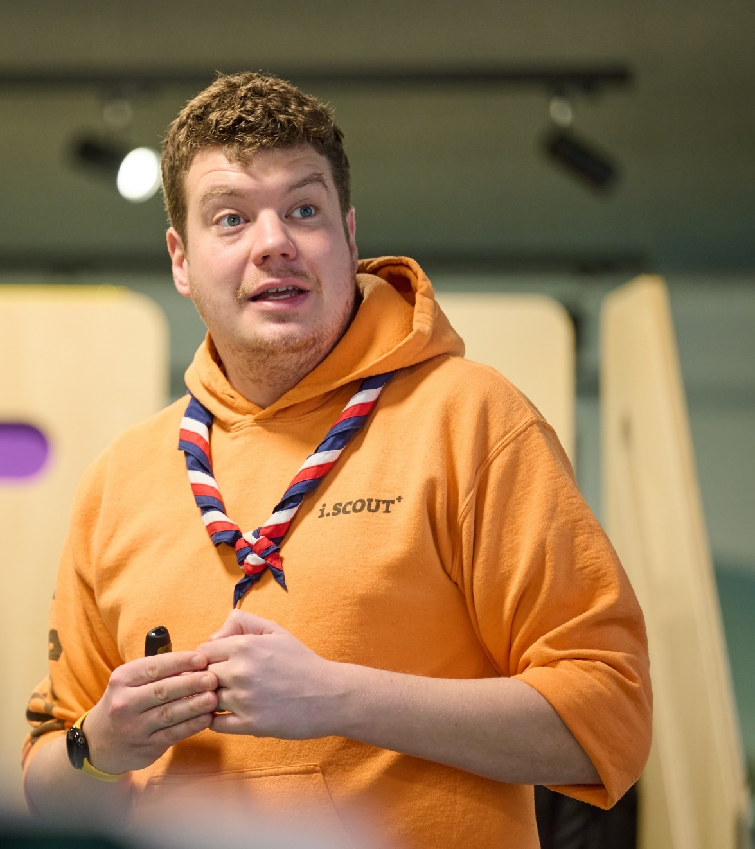
Setting up your Go-Live Support Team
Support for volunteers will be needed during the 4-8 weeks around go-live
A local support team will be needed to answer queries about:
County/District/Group Structures
Changes to local Scouts processes
Queries during Compass freeze
Simple digital system questions
To support the local go-live support teams, an HQ support model will be in place, through the Support Centre

Slide 58
Setting up your Go-Live Support Team
To help you form your team, in May we’ll share some tasks for a group of local volunteers to temporarily take on during go-live
There will be an onboarding session in early-summer for those interested locally to discuss what is involved and the training they will receive
We’ll share more detail about how this aligns with the HQ support model during summer

Slide 59
Introducing new ways of working - Now into Summer ‘24
Tasks to complete in your County/Area/Region (Scotland)
What must happen:
Make sure every Trustee Board have, or are ready to, adopt the membership changes at their next AGM
Make sure every County, District & Group team has defined its structure and members
Start forming your Go-Live Support Team
Maintain training provision and current welcome processes for all current and new volunteers
What should happen:
Each County, District & Group informally adopts new teams and titles locally
What must not happen:
Volunteers working outside of current rules in POR (E.G. Appt. Panels, Role training requirements)

Slide 60
Any Questions?

Slide 61
Data Migration
Almost all data will be migrated across to the new system including;
Wood Badges
Validated training modules including mandatory ongoing learning
Previous roles
Personal details
Permits
And more
Some data will not migrate, including free text and preferences options: Ongoing Learning, Employment, Hobbies & Interests, Visibility Settings, Qualifications & Skills

Slide 62
How learning data will map to Growing Roots
We have been working to make sure our learning provides the quality, safety and skills needed to deliver skills for life for young people. The outcome of the inquest has further reinforced the need for this
As part of this we have reviewed how our current modules will map across to our new Growing Roots learning and made some key changes to this to ensure all volunteers have received a consistent standard of training

Slide 63
How current learning data will map to Growing Roots
A volunteer will need to have the below modules validated when they are mapped to be marked as having completed the related learning in Growing Roots
Current module(s) | Growing Roots Learning
GDPR | Data Protection in Scouts
Module 7 - Scouting for All* | Creating Inclusion
Module 1 - Essential Information | Who we are & What we do
Safety | Safe Scouting (Safety)
Safeguarding | Safe Scouting (Safeguarding)
Module 3 - Tools for the Role (Section Leaders) Module 12A - Delivering a Quality Programme* Module 12B - Programme Planning* Module 17 - Running Safe Activities* All four modules must be validated for the new learning skill to be signed off* | Delivering a Great Programme
Full Manager & Supporter Wood Badge required* | Leading Scout Volunteers
Trustee Introduction | Being a Trustee in Scouts
*These are changed from the previous role mapping we shared

Slide 64
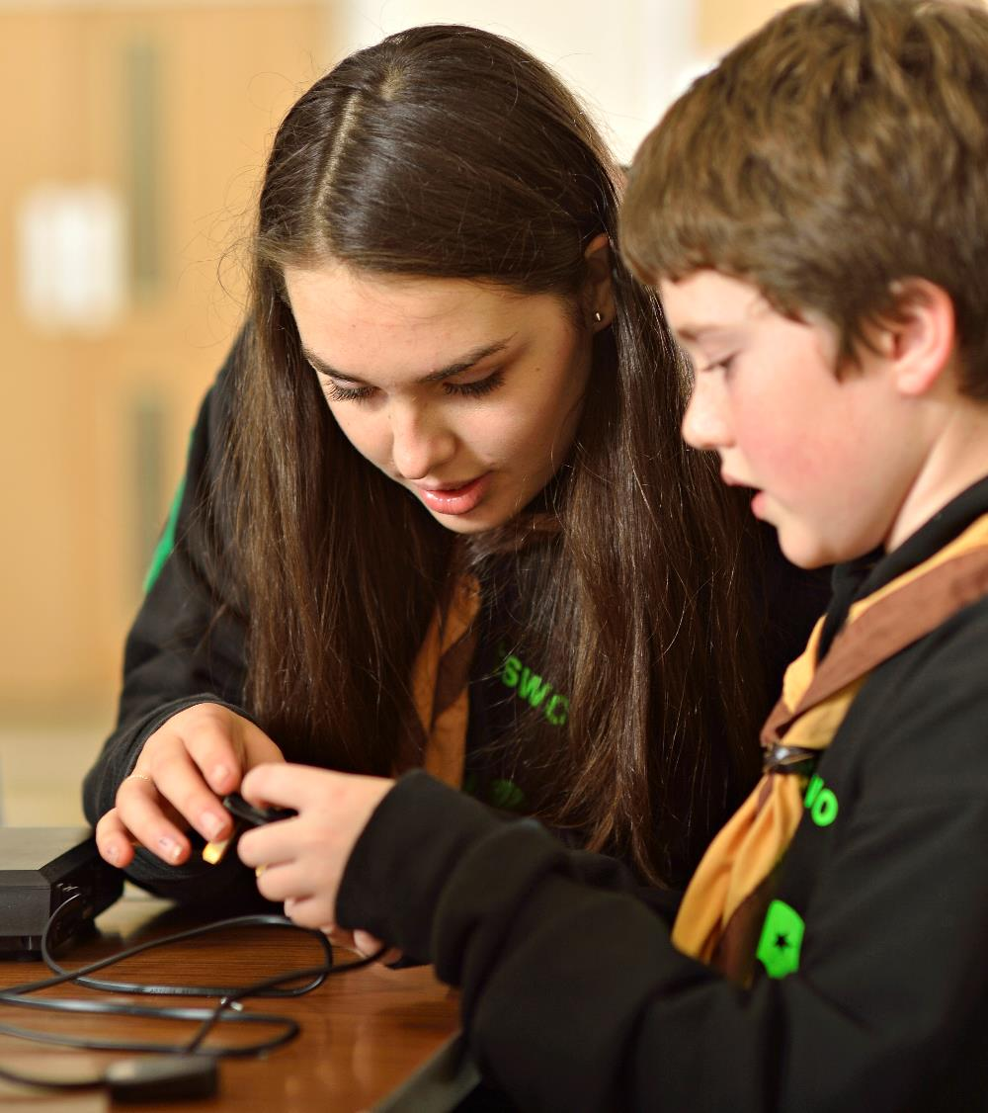
What does this mean in practice?
Section Assistants and any Lead Volunteers without a Managers & Supporter Wood Badge, will have learning to complete when they migrate
Section Assistants should continue to make sure they have completed all relevant modules
All Wood Badge roles should continue to work towards achieving their Wood Badge
Recommendation: Any additional learning is completed in the new learning tool
The current mapped modules could also be validated prior to migration by completing the module or, where applicable, prior experience

Slide 65
Compliance
Volunteers will need to complete any outstanding Growing Roots learning, which hasn’t been credited through their migrated modules, once live on the digital tools:
Safe Scouting & Data Protection
Volunteers who haven’t completed this learning will have six months from their previous role start date to complete this learning
All other Growing Roots learning
Volunteers who haven’t completed any other Growing Roots learning will have six months from go-live of the digital tools to complete this learning

Slide 66
First Aid Reminder
First Response required for these roles:
Section Team Members (inc. Section Assistants)
Group Lead Volunteers
District Section Team Members
14-24 Team Leaders
Completion of both 10A & 10B within:
I’m a new member
12 months from starting in role
I’m a Section Assistant
migrating to a Section Team
24 months from transition
I’m in a Wood Badge role
continuing in a Section
Current remaining time
(up to 24 months)
Renewal remains - 3 years
Taken from completion of 10A

Slide 67
Persona Examples
Volunteer | Situation | Actions needed
Bryony Was a Section Assistant Now a Section Team Member | Didn’t have a full role on Compass Has validated Module 1 on Compass | Migrated to a provisional role Awarded the skill for Who We Are and What We Do Enrolled on Data Protection in Scouts and Safe Scouting, to be completed within six months of her Section Assistant role start date Enrolled on Delivering a Great Programme, and Creating Inclusion, to be completed within 6 months of go-live Complete First Aid within 2-years of go-live
Thomas Was a Section Assistant Now a Section Team Member | Had a full role on Compass Therefore, has validated all Getting Started modules for his Section Assistant role Has validated Module 7 and 10a & 10b (First Response) | Migrated to a full role Awarded the skills for Data Protection in Scouts, Who We Are and What We Do Enrolled on Delivering a Great Programme and Creating Inclusion to be completed within 6 months of go-live Will need to renew Safety, Safeguarding and First Aid by the expiry date migrated from Compass

Slide 68
Persona Examples
Volunteer | Situation | Actions needed
Kirsty Was a Section Leader Now a Section Team Leader | Has a full role on Compass Therefore, has validated all Getting Started for her Section Leader role Has validated Modules 12A, 12B, and 17 Has not completed 10a & 10b (First Response) | Migrated to a full role Awarded the skills for Data Protection in Scouts, Who We Are and What We Do, Safe Scouting, and Delivering a Great Programme Enrolled on Creating Inclusion, to be completed within 6 months of go-live Will need to renew Safety and Safeguarding by the expiry date migrated from Compass Complete First Aid by the expiry date migrated from Compass (Up to 2-years)
Peter Was a Group Scout Leader Now a Group Lead Volunteer | Has a full role on Compass Has validated all Getting Started modules for his GSL role but not completed any other modules | Migrated to a full role Awarded the skills for Data Protection in Scouts, Who We Are and What We Do, and Safe Scouting (Safety and Safeguarding) Enrolled on Creating Inclusion and Leading Scout Volunteers, to be completed within 6 months of go-live Complete First Aid by the expiry date migrated from Compass (Up to 2-years) Will need to renew Safety and Safeguarding by the expiry date migrated from Compass

Slide 69
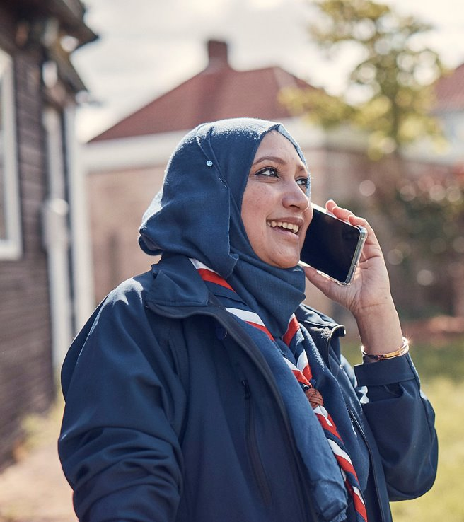
Preparing for new and updated processes
All volunteers must be aware of the processes that will be supported by the new digital systems
All new teams should agree their local processes and responsibilities within these
For example:
How Group Lead Volunteers source the independent person to support each Welcome Conversation
Ensuring a smooth switchover to NAN authorisations
Ensuring a smooth start to the Volunteer Joining Journey

Slide 70
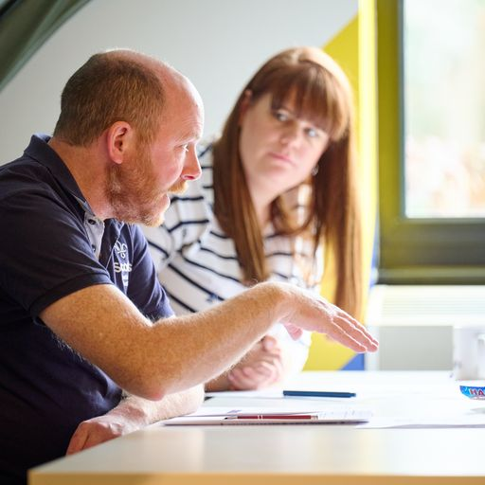
Interim Processes
Some current processes can’t be done during this period and others will need a temporary process put in place
We’ll be sharing the detail of what the impacts are, and any process changes closer to go-live
Any temporary processes are designed to be as simple as possible
We will be producing webpages walking through any changes to processes

Slide 71
POR for Post-Migration
POR will be updated, taking effect from go-live of the digital tools, although the wording will be available prior to go-live.
In addition to role title changes, this will primarily mean changes to:
Chapter 4
Chapter 16
Roles Table replaced by Teams and Accreditations tables
A supplement to the current POR will be issued for use by Early Adopter Counties. We will use feedback from this to generate a final ‘full’ POR edition to apply everywhere from the main ‘go-live’.

Slide 72
What we’re doing:
What you can do:
Sharing webinar dates and building content
Producing new videos to support understanding of Volunteer Experience changes
Sharing Go-Live Support Team tasks
Sharing new readiness webpages
Preparing to walk through the next two phases at next month’s TL Call
Make sure every Trustee Board have, or are ready to, adopt the membership changes at their next AGM
Make sure every County, District & Group team has defined its structure and members
Start forming your Go-Live Support Team
Maintain training provision and current welcome processes for all current and new volunteers
Each County, District & Group informally adopt new teams and titles locally, where possible

Slide 73
Transformation Lead Call
May 24

Slide 74
Who's on the call?
Craig Turpie, Deputy UK Chief Volunteer
Jack Caine, UK Lead Volunteer for People
Andrew Sutherland, Deputy Programme Sponsor
Hamish Stout, Project Sponsor, Change and Infrastructure
Elizabeth Stormfield, Gemma Norman, Rob Groves, Change Team
Adam Ray, Communications Manager
Breakouts
Matt Cobble, Graham Phillips, Lucy Burrows-Smith, Anders Wulff, Paul Fix, Stephen Mallet, Heather Smith, Alison Fell, Ben Powlesland, Vanessa Slawson

Slide 75
What we’ll cover
PFD Response Update
Digital System Update
Volunteer Experience - Roadmap for Change (Phases 3 & 4)
Open Forum
Breakout Discussion Rooms

Slide 76
PFD Response Update

Slide 77
Breakout Rooms Poll

Slide 78
Digital System Update

Slide 79
Volunteer Experience - Roadmap for Change

Slide 80
Delivery Phases
Introducing and embedding culture changes*
Now - Summer ‘24
Circa. 60 days prior to Compass freeze
After Summer ‘24
After move to digital tools
Introducing new ways of working
Preparing for the digital tools & processes
Moving to digital tools & processes
Embedding our new ways of working
Compass Freeze
Go-Live Support
*Introducing and embedding culture changes includes:
Our Volunteering Culture
Learning Culture
Welcome Culture
New ways of working

Slide 81
Any Questions?

Slide 82
Breakout Rooms

Slide 83
Breakout Options
Two 15-min breakout rooms:
Trustee Changes
Building a Team
Running a Team
Volunteer Joining Journey
Learning Data Migration
Growing Roots & Branching Out
Data Migration (Not Learning)
Engaging with people resistant to change
Our Volunteering Culture

