Slide 1


The Listening Tool
Piloted as part of Scouts’ Approach to Discrimination Project
Notes:
In this presentation, we'll learn what the Listening Tool is, why it’s important, how to use it, and how you can get involved in the Approach to Tackling Discrimination project at a local and national level.

Slide 2
What is discrimination?
Notes:
Discrimination is ‘unfair treatment related to identity, such as age, gender, race or religion.’ Discrimination can look like lots of different things. For example, it could look like inappropriate language (slurs) or an old rule that’s always been there. Someone might say they’re “just having a laugh” or “it isn’t a big deal”.
But discrimination isn’t okay. It might make you feel angry, unsafe, powerless or scared. It’s motivated by stereotypes, prejudice or bias towards people’s identities, such as their gender, race or religion. It can be hard to talk about discrimination, especially if you’ve experienced it yourself or you know someone close to you who has. There’ll be people here today who’ve experienced discrimination, so we need to act in line with our Scout values and show care and respect for others.
Lots of discrimination goes unreported at Scouts. The Listening Tool is an anonymous reporting form anyone in our pilot locations can use to report:
• Discrimination or unfair treatment, linked to who someone is, such as their race, religion, or disability,
• Behaviour that makes someone feel left out, unwelcome, or like they don't belong at Scouts,
• Anything else that doesn't feel in line with our Scout values.
By helping Scouts understand what's happening across our movement, we can create a safer, more welcoming Scout experience for everyone.

Slide 3
What it is
What it isn’t
An anonymous reporting tool
An opportunity to tell us what you're seeing, hearing and experiencing
A way to help make Scouts a safer, more welcoming place
A replacement for Safeguarding processes
A replacement for our Complaint process
A way to get support
Notes:
The Listening Tool is
Anonymous. We won’t ask you to share names of people, Groups or any other identifiable information.
An opportunity for you to tell us what you're seeing, hearing, and experiencing at Scouts.
A way to help Scouts learn how to make our movement safer and more welcoming.
It isn't:
A replacement for Safeguarding or Complaints processes. You must follow existing processes for Safeguarding concerns outlined in the Yellow Card.
A way to get support with something you’ve seen, heard or experienced at Scouts.
No one will get in touch with you about a report you’ve made, but it may be passed over to the Safeguarding team if there is a safeguarding concern.
If you need support with something that’s happened at Scouts, speak to a member of your District or County/Area/Region 14-24 Team, Scouts' Support Centre, or a Mental Health First Aider.

Slide 4

Why should you engage with the Listening Tool?
Making Scouts safer for yourself and others
Living by our Scout Values
Notes:
Scouts need your help to tackle discrimination across our movement.
Our volunteers have told us that they need more support tackling discrimination in their Sections, Groups and teams. Themes from the Listening Tool will be used to develop resources for volunteers that are relevant, useful and evidence-based. The more Scouts can learn from the Listening Tool, the more tailored support will be.
Using the Listening Tool will help us make Scouts a safer and more inclusive place for all our members, including you.
As Scouts, we believe in our Scout Promise, Law and Values. We try to leave the world better than we found it. Using the Listening Tool is another way we can live by our Scouts values. It’s a way for us to care for each other, work together to problem-solve and take responsibility for our words, actions and mistakes.

Slide 5
What we need from you?
Report your experiences
Support those around you to report their experiences
Support your Group and District to share information about the Listening Tool
Notes:
There’s three big things we need you to do to help us tackle discrimination at Scouts.
We need you to:
Tell us about your own experiences
Help others report their experiences – if they need help using the tool
Spread the word with other Sections, Groups and Units. This could contribute to the ‘Values’ section of Chief Scout Platinum and Diamond Awards when ran alongside activities exploring our values.

Slide 6

Making a report
Notes:
You can report something you’ve seen, heard or experienced at Scouts (or while travelling to and from Scouts), even if you’re not sure it was discrimination. You don’t need to prove anything or use the ‘right’ words. If something didn’t feel right, you can report it.
You don’t need to be involved in the situation to make a report, and you don’t need permission to make a report about someone else.
You can report something no matter how long ago it happened, including incidents that happened over 10 years ago.
If you need support with something that’s happened at Scouts, you should speak to your District or County/Area/Region 14-24 Team, Scouts’ Support Centre or follow Scouts’ Complaints process.
You could also get support from external organisations, such as Childline (for under 19s), Young Minds, Mind (or SAMH in Scotland) or Chasing the Stigma. Discuss any local organisations that offer support too. You may want to signpost to specialised mental health organisations such as Switchboard (for LGBTQ+ people), Bayo (for Black people), or the Muslim Youth Helpline.

Slide 7
Accessing the Listening Tool online
Reports can only be made online. But you could if you don’t have easy access to the internet:
Visit a library
Ask someone to make a report on your behalf
Ask someone if they can support you to make a report on their device
Top Tip: Save the link to the Listening Tool so you can return to it whenever you need to make a report.
Notes:
The Listening Tool is an online reporting form. This means reports can only be made with an internet connection. This slide has some ideas on how you could make a report if you don’t have easy access to the internet or don’t feel confident to use digital tools without support.
You can make a report at any time, so wait until you’re in a suitable location. You could write down what happened so you don’t forget, but make sure you don’t include any names or personal information.
If you are asked to support or make report on someone’s behalf, you must treat any information shared as confidential and adhere to our Data Protection Policy.
Highlight the top tip, there’s a QR code on the final page so people can save the link then.

Slide 8
Walkthrough
https://vimeo.com/1206783931

Slide 9
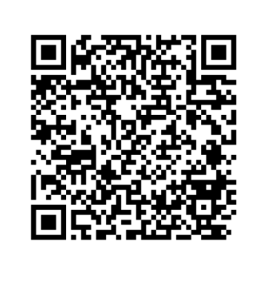
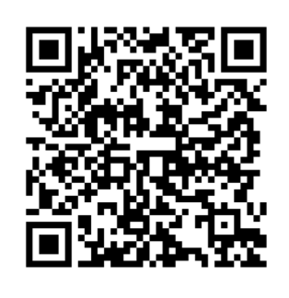
Any questions?
Visit our Listening Tool webpage
Make a report
Notes:
Prompt to save the link to the webpage so they can find it again in the future. The URL is scouts.org.uk/volunteers/equity-diversity-and-inclusion/listening-tool/.
Use the FAQ document to help you answer questions. If there’s anything you think should be added to the FAQ document, please speak to the key contact for the Listening Tool in your area.
The FAQ document covers:
I’m not sure if I’ve experienced discrimination or not, can I still report it through the Listening Tool?
Will volunteers in my pilot location be able to see my report?
Can I report something that happened a while ago?
Can I report something that doesn’t involve me?
Do I need to get permission to make a report about someone else?
Why does the form ask for the demographic details of the person making the report?
Why won’t someone get back to me about something I’ve reported through the Listening Tool?
Can I report something I’ve already reported to Safeguarding or made a formal complaint about?
I’m interested in helping Scouts develop their approach to tackling discrimination. Is there a way for me to learn more and get involved?
I’d like to provide feedback about the Listening Tool. Where can I do this?
How long will the Listening Tool be open for?
Can all of our young members make a report through the Listening Tool?
Is the Listening Tool available in languages other than English?
Who else is taking part in the Listening Tool pilot?
Who should I contact if I have a question or need support with the Listening Tool?

Slide 10
Additional slides you might like to use

Slide 11


Pilot Counties/Regions/Areas across the UK
Birmingham County
Cardiff and Vale Area
East Belfast District
Greater London North-East County
Hertfordshire County
Kent County
Leicestershire County
Powys Region
South-East Scotland Region
Notes:
These are the nine pilot locations for the Listening Tool. This includes locations from England, Northern Ireland, Scotland and Wales.
Lead Volunteers from each of these Counties/Areas/Regions make up our working group for the approach to discrimination project, along with representation from the UK Inclusion Team and our Project Sponsor from our Race Equity Sub Team.

Slide 12
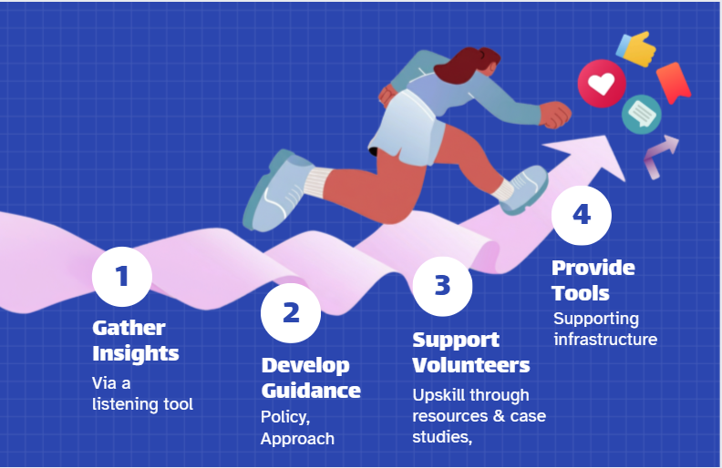
Our proposed approach
Notes:
The Approach to Discrimination Project is made up of four key steps.
The first step is the Listening Tool. Volunteers, young people and families across the nine pilot locations can share with Scouts incidents of discrimination they've seen, heard or experienced.
Using information shared through Listening Tool and pre-existing knowledge, the project working group (LVs from the pilot counties) will support Scouts to develop our approach to discrimination.
From conversations we've had so far, this will likely focus on support, growth and learning opportunities. Step two aims to develop anti-discrimination policies that are fair, proportionate and in line with our values and embed this approach within our existing policies.
Once the approach is decided, Scouts will build resources to support volunteers, so they know what to do when discrimination happens. This may include new EDI learning for volunteers around microaggressions, race equity and proactive inclusion.
Step four is all about creating the infrastructure to ensure a consistent application of the approach we decide upon. For example, recording forms, ways of logging, and determining where members have been educated or upskilled.

Slide 13

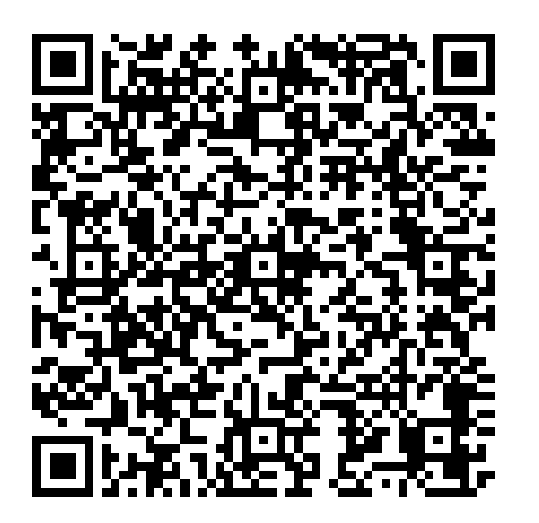


Want to do more?
Get involved in the Approach to Discrimination project
Notes:
The Listening Tool is closely aligned with our Scout values. It’s a way for us to care for each other, work together to problem solve, and take responsibility for our words, actions, and mistakes. Helping to spread the word about the Listening Tool to other Sections, Groups and teams could contribute to the ‘Values’ section of Chief Scout Platinum and Diamond Awards when ran alongside activities exploring our values.
You can also register your interest in helping Scouts develop our national approach to tackling discrimination.

