Slide 1
Transformation Lead Call
April 24

Slide 2
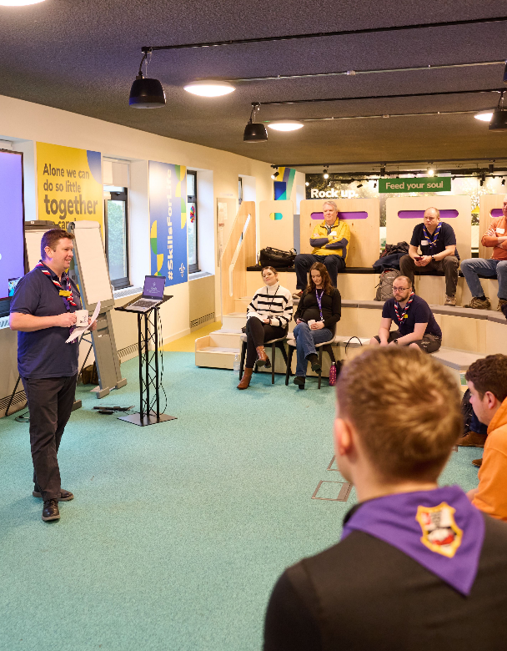
Who's on the call?
Craig Turpie, Deputy UK Chief Volunteer
Jack Caine, UK Lead Volunteer for People
Andrew Sutherland, Deputy Programme Sponsor
Hamish Stout, Project Sponsor, Change and Infrastructure
Liz Cash, Training Manager
Matt Cobble, Project Sponsor, Learning
James Booker, Head of Portfolio Delivery & Change
Elizabeth Stormfield, Gemma Norman, Rob Groves, Change Team
Adam Ray, Lauren Golding, Communications Team

Slide 3
What we’ll cover
Volunteer Experience - Roadmap for Change (Phases 1 & 2)

Slide 4
Volunteer Experience - Roadmap for Change

Slide 5
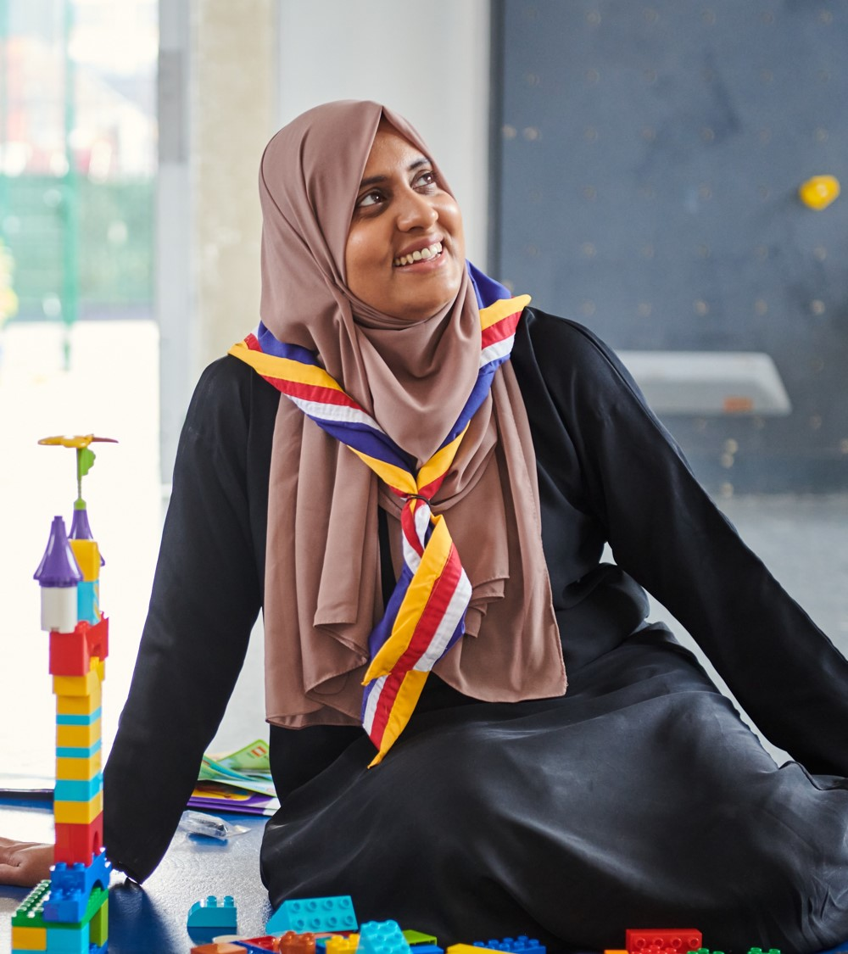
Key Principles
Setting out key milestones over 2024 for delivering the Volunteer Experience transformation
We are still working to confirm the date for the release of the digital tools
Locally, the more you do now to move to the new ways of working will make moving to using the new digital tools easier

Slide 6
Delivery Phases
Introducing and embedding culture changes*
Now - Summer ‘24
Circa. 60 days prior to Compass freeze
After Summer ‘24
After move to digital tools
Introducing new ways of working
Preparing for the digital tools & processes
Moving to digital tools & processes
Embedding our new ways of working
Compass Freeze
Go-Live Support
*Introducing and embedding culture changes includes:
Our Volunteering Culture
Learning Culture
Welcome Culture
New ways of working

Slide 7
Introducing new ways of working - Now into Summer ‘24
Introducing and embedding culture changes*
Now - Summer ‘24
Circa. 60 days prior to Compass freeze
After Summer ‘24
After move to digital tools
Introducing new ways of working
Preparing for the digital tools & processes
Moving to digital tools & processes
Embedding our new ways of working
Compass Freeze
Go-Live Support

Slide 8
Introducing new ways of working - Now into Summer ‘24
What’s happening during this phase?
Targeted webinars & support
Showcasing digital tools
Sharing success stories
Readiness resources and surveys
Welcome Conversations for Early Adopters

Slide 9
Targeted Webinars
Running your AGM
8 May 7-8pm
Digital System Demo
Mid-May
How to be a great Trustee Board
28 May 7-8pm
County & District Leadership Team Webinar
Early June
Group Leadership Team Webinar
Mid-June
Running your AGM
17 June 7-8pm
Digital System Demo
Early July
Running your AGM
17 July 7-8pm
How to be a great Trustee Board
18 Sept 7-8pm

Slide 10
Other resources and support
Additional videos helping to explain and explore areas of the Volunteer Experience Programme, including:
Learning migration
Team structures
The digital system
Updated presentation resources targeted at District and Group level
Exploring options for providing targeted support to smaller audiences
Ongoing support for County events

Slide 11
Readiness Webpages
We’ll be releasing updated readiness webpages during May that cover:
What every volunteer needs to do
What Groups need to do
What Districts & Counties need to do
There'll be a small number of tasks that direct you to relevant pages on scouts.org.uk for more information
We'll update the readiness checklists to reflect this and help you review what needs to be done in finer detail
We’ll be restarting the short 10-minute readiness surveys for Counties during May

Slide 12
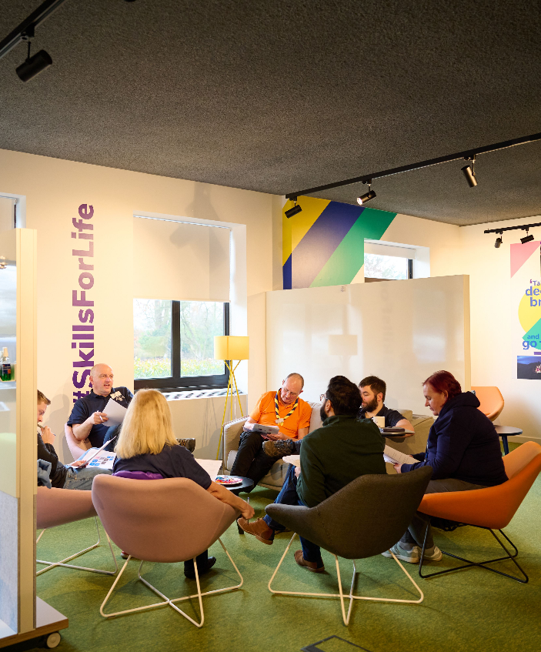
Sharing Success Stories
We’re looking to share short quotes, blogs and videos of success stories from implementing the Volunteer Experience changes
We have a handful from our Early Adopters and that we've picked up anecdotally at events already, but are looking for more!
If you have a particular story from your County, a District or a Group you think would be good to share with the movement, please get in touch

Slide 13
Welcome Conversations for Early Adopters
We’re supporting the full introduction of Welcome Conversations in Early Adopter Counties from 1st June onwards
The feedback from this will help us to improve the introduction of Welcome Conversations in all Counties
Other than in Early Adopter Counties, there are no actions required now
We will share actions for everyone else when appropriate

Slide 14
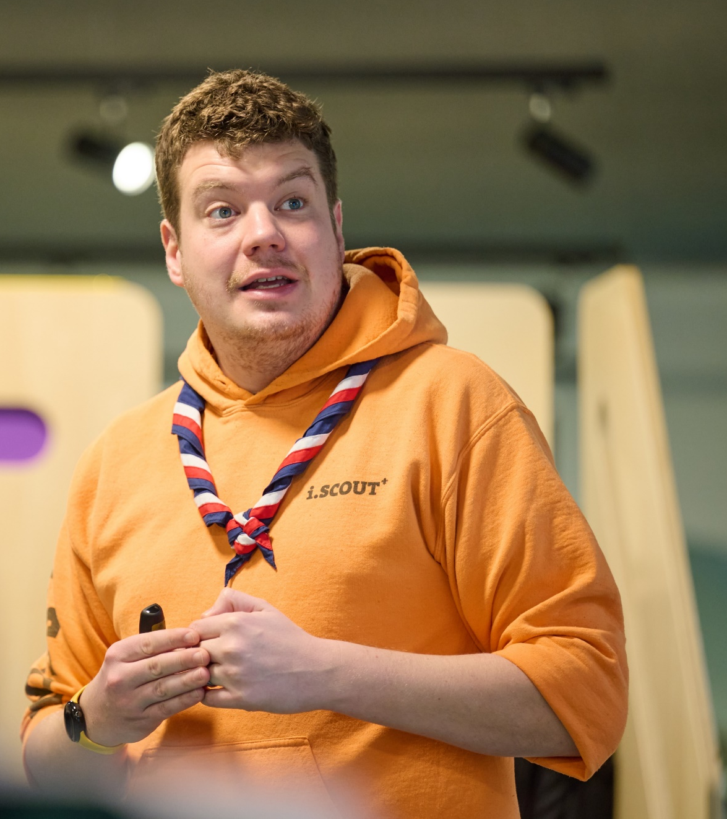
Setting up your Go-Live Support Team
Support for volunteers will be needed during the 4-8 weeks around go-live
A local support team will be needed to answer queries about:
County/District/Group Structures
Changes to local Scouts processes
Queries during Compass freeze
Simple digital system questions
To support the local go-live support teams, an HQ support model will be in place, through the Support Centre

Slide 15
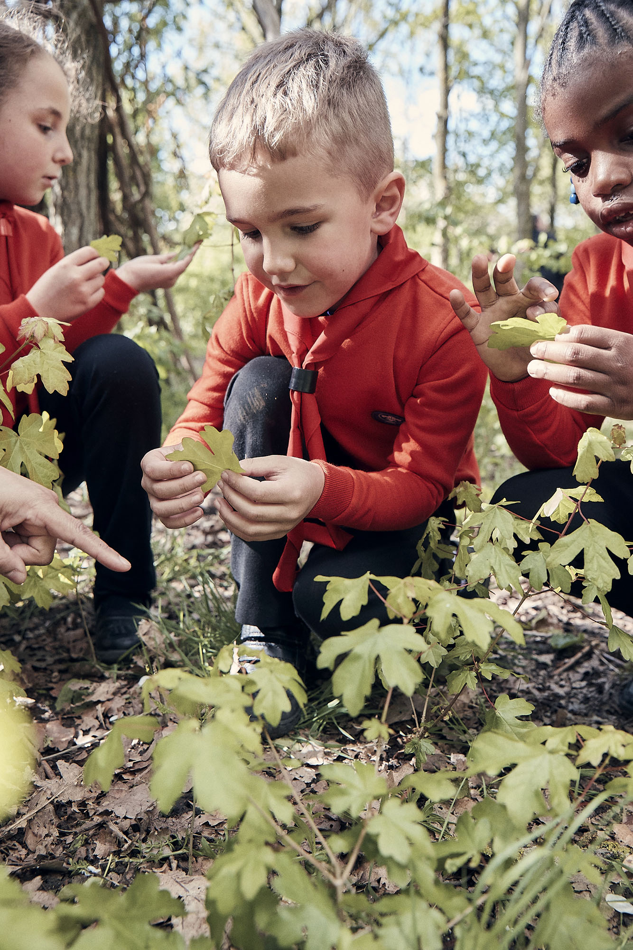
Setting up your Go-Live Support Team
To help you form your team, in May we’ll share some tasks for a group of local volunteers to temporarily take on during go-live
There will be an onboarding session in early-summer for those interested locally to discuss what is involved and the training they will receive
We’ll share more detail about how this aligns with the HQ support model during summer

Slide 16
Introducing new ways of working - Now into Summer ‘24
Tasks to complete in your County/Area/Region (Scotland)
What must happen:
Make sure every Trustee Board have, or are ready to, adopt the membership changes at their next AGM
Make sure every County, District & Group team has defined its structure and members
Start forming your Go-Live Support Team
Maintain training provision and current welcome processes for all current and new volunteers
What should happen:
Each County, District & Group informally adopts new teams and titles locally
What must not happen:
Volunteers working outside of current rules in POR (E.G. Appt. Panels, Role training requirements)

Slide 17
Any Questions?

Slide 18
Preparing for digital tools and processes - Circa. 60 days before Compass freeze
Introducing and embedding culture changes*
Now - Summer ‘24
Circa. 60 days prior to Compass freeze
After Summer ‘24
After move to digital tools
Introducing new ways of working
Preparing for the digital tools & processes
Moving to digital tools & processes
Embedding our new ways of working
Compass Freeze
Go-Live Support

Slide 19
Preparing for digital tools and processes - Circa. 60 days before Compass freeze*
What’s happening during this phase?
Making sure all data is up to date on Compass
Preparing locally for new ways of working
Implementing local go-live support teams
Preparing for interim measures during Compass freeze
Start training for new digital tools and processes
POR for post-migration
*Compass freeze will be at different times for Early Adopter Counties and all other Counties

Slide 20
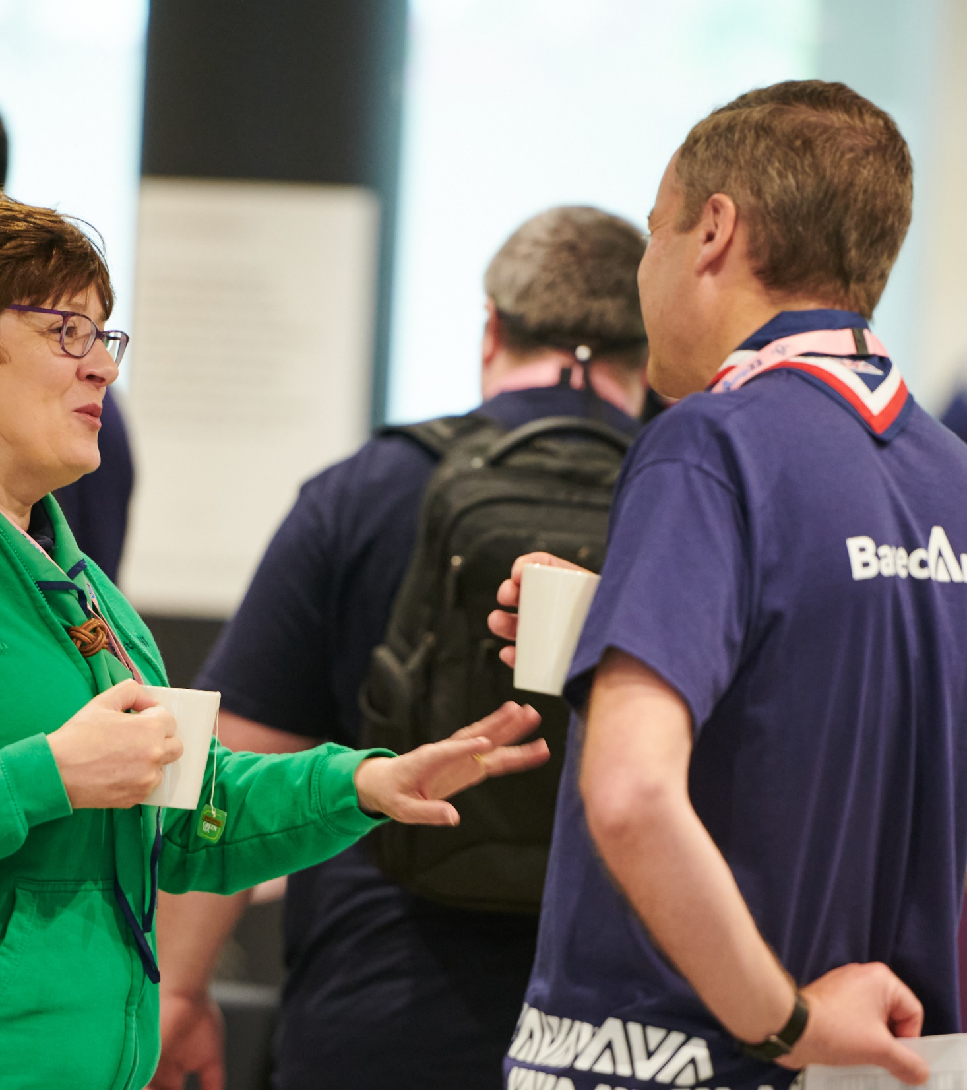
Making sure data is up to date
From around 60-days before Compass freeze there will be targeted comms for all members to make sure their data is updated on Compass ready for migration. This includes:
Personal details
Criminal record checks
Permits
Appointment steps
Getting Started training
Training validation
Anything not completed before Compass freeze cannot migrate across to the new digital system

Slide 21
Data Migration
Almost all data will be migrated across to the new system including;
Wood Badges
Validated training modules including mandatory ongoing learning
Previous roles
Personal details
Permits
And more
Some data will not migrate, including free text and preferences options: Ongoing Learning, Employment, Hobbies & Interests, Visibility Settings, Qualifications & Skills

Slide 22
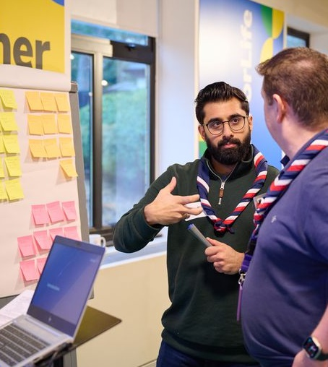
How learning data will map to Growing Roots
We have been working to make sure our learning provides the quality, safety and skills needed to deliver skills for life for young people. The outcome of the inquest has further reinforced the need for this
As part of this we have reviewed how our current modules will map across to our new Growing Roots learning and made some key changes to this to ensure all volunteers have received a consistent standard of training

Slide 23
How current learning data will map to Growing Roots
A volunteer will need to have the below modules validated when they are mapped to be marked as having completed the related learning in Growing Roots
Current module(s) | Growing Roots Learning
GDPR | Data Protection in Scouts
Module 7 - Scouting for All* | Creating Inclusion
Module 1 - Essential Information | Who we are & What we do
Safety | Safe Scouting (Safety)
Safeguarding | Safe Scouting (Safeguarding)
Module 3 - Tools for the Role (Section Leaders) Module 12A - Delivering a Quality Programme* Module 12B - Programme Planning* Module 17 - Running Safe Activities* All four modules must be validated for the new learning skill to be signed off* | Delivering a Great Programme
Full Manager & Supporter Wood Badge required* | Leading Scout Volunteers
Trustee Introduction | Being a Trustee in Scouts
*These are changed from the previous role mapping we shared

Slide 24
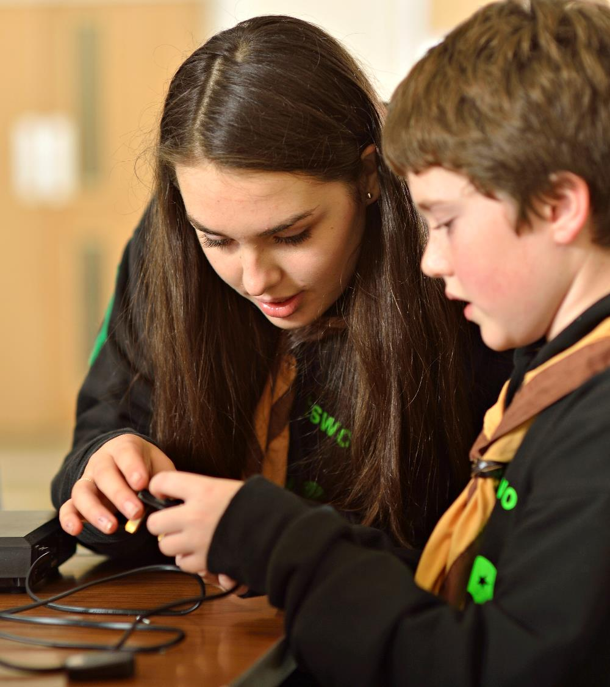
What does this mean in practice?
Section Assistants and any Lead Volunteers without a Managers & Supporter Wood Badge, will have learning to complete when they migrate
Section Assistants should continue to make sure they have completed all relevant modules
All Wood Badge roles should continue to work towards achieving their Wood Badge
Recommendation: Any additional learning is completed in the new learning tool
The current mapped modules could also be validated prior to migration by completing the module or, where applicable, prior experience

Slide 25
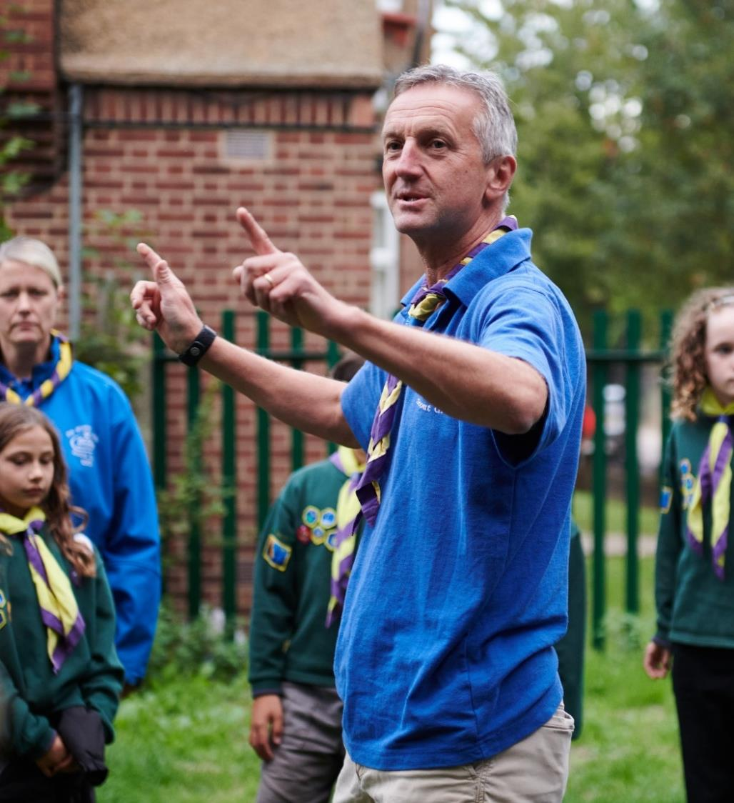
Compliance
Volunteers will need to complete any outstanding Growing Roots learning, which hasn’t been credited through their migrated modules, once live on the digital tools:
Safe Scouting & Data Protection
Volunteers who haven’t completed this learning will have six months from their previous role start date to complete this learning
All other Growing Roots learning
Volunteers who haven’t completed any other Growing Roots learning will have six months from go-live of the digital tools to complete this learning

Slide 26
First Aid Reminder
First Response required for these roles:
Section Team Members (inc. Section Assistants)
Group Lead Volunteers
District Section Team Members
14-24 Team Leaders
Completion of both 10A & 10B within:
I’m a new member
12 months from starting in role
I’m a Section Assistant
migrating to a Section Team
24 months from transition
I’m in a Wood Badge role
continuing in a Section
Current remaining time
(up to 24 months)
Renewal remains - 3 years
Taken from completion of 10A

Slide 27
Persona Examples
Volunteer | Situation | Actions needed
Bryony Was a Section Assistant Now a Section Team Member | Didn’t have a full role on Compass Has validated Module 1 on Compass | Migrated to a provisional role Awarded the skill for Who We Are and What We Do Enrolled on Data Protection in Scouts and Safe Scouting, to be completed within six months of her Section Assistant role start date Enrolled on Delivering a Great Programme, and Creating Inclusion, to be completed within 6 months of go-live Complete First Aid within 2-years of go-live
Thomas Was a Section Assistant Now a Section Team Member | Had a full role on Compass Therefore, has validated all Getting Started modules for his Section Assistant role Has validated Module 7 and 10a & 10b (First Response) | Migrated to a full role Awarded the skills for Data Protection in Scouts, Who We Are and What We Do, and Creating Inclusion Enrolled on Delivering a Great Programme, to be completed within 6 months of go-live Will need to renew Safety, Safeguarding and First Aid by the expiry date migrated from Compass

Slide 28
Persona Examples
Volunteer | Situation | Actions needed
Kirsty Was a Section Leader Now a Section Team Leader | Has a full role on Compass Therefore, has validated all Getting Started for her Section Leader role Has validated Modules 12A, 12B, and 17 Has not completed 10a & 10b (First Response) | Migrated to a full role Awarded the skills for Data Protection in Scouts, Who We Are and What We Do, Safe Scouting, and Delivering a Great Programme Enrolled on Creating Inclusion, to be completed within 6 months of go-live Will need to renew Safety and Safeguarding by the expiry date migrated from Compass Complete First Aid by the expiry date migrated from Compass (Up to 2-years)
Peter Was a Group Scout Leader Now a Group Lead Volunteer | Has a full role on Compass Has validated all Getting Started modules for his GSL role but not completed any other modules | Migrated to a full role Awarded the skills for Data Protection in Scouts, Who We Are and What We Do, and Safe Scouting (Safety and Safeguarding) Enrolled on Creating Inclusion and Leading Scout Volunteers, to be completed within 6 months of go-live Complete First Aid by the expiry date migrated from Compass (Up to 2-years) Will need to renew Safety and Safeguarding by the expiry date migrated from Compass

Slide 29
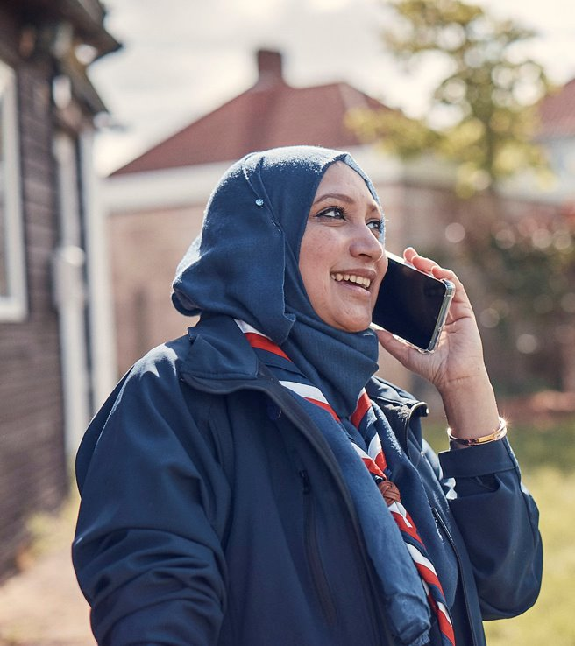
Preparing for new and updated processes
All volunteers must be aware of the processes that will be supported by the new digital systems
All new teams should agree their local processes and responsibilities within these
For example:
How Group Lead Volunteers source the independent person to support each Welcome Conversation
Ensuring a smooth switchover to NAN authorisations
Ensuring a smooth start to the Volunteer Joining Journey

Slide 30
Preparing for new and updated processes
Managing your local structures
Managing our volunteers
Permits
(Activity, Nights Away)
Good Service Awards
Managing my personal details
Learning
Notifications
Dashboards & Reporting
Volunteer Joining Journey
Volunteer Role Change process
Reporting
Suspensions (Adults)
Appointment Reviews
Attracting new volunteers
Grant applications
Nights Away Notifications (NAN)
Minibus Permits
Actions
Qualifications
Process changes from day one
Process available from day one

Slide 31
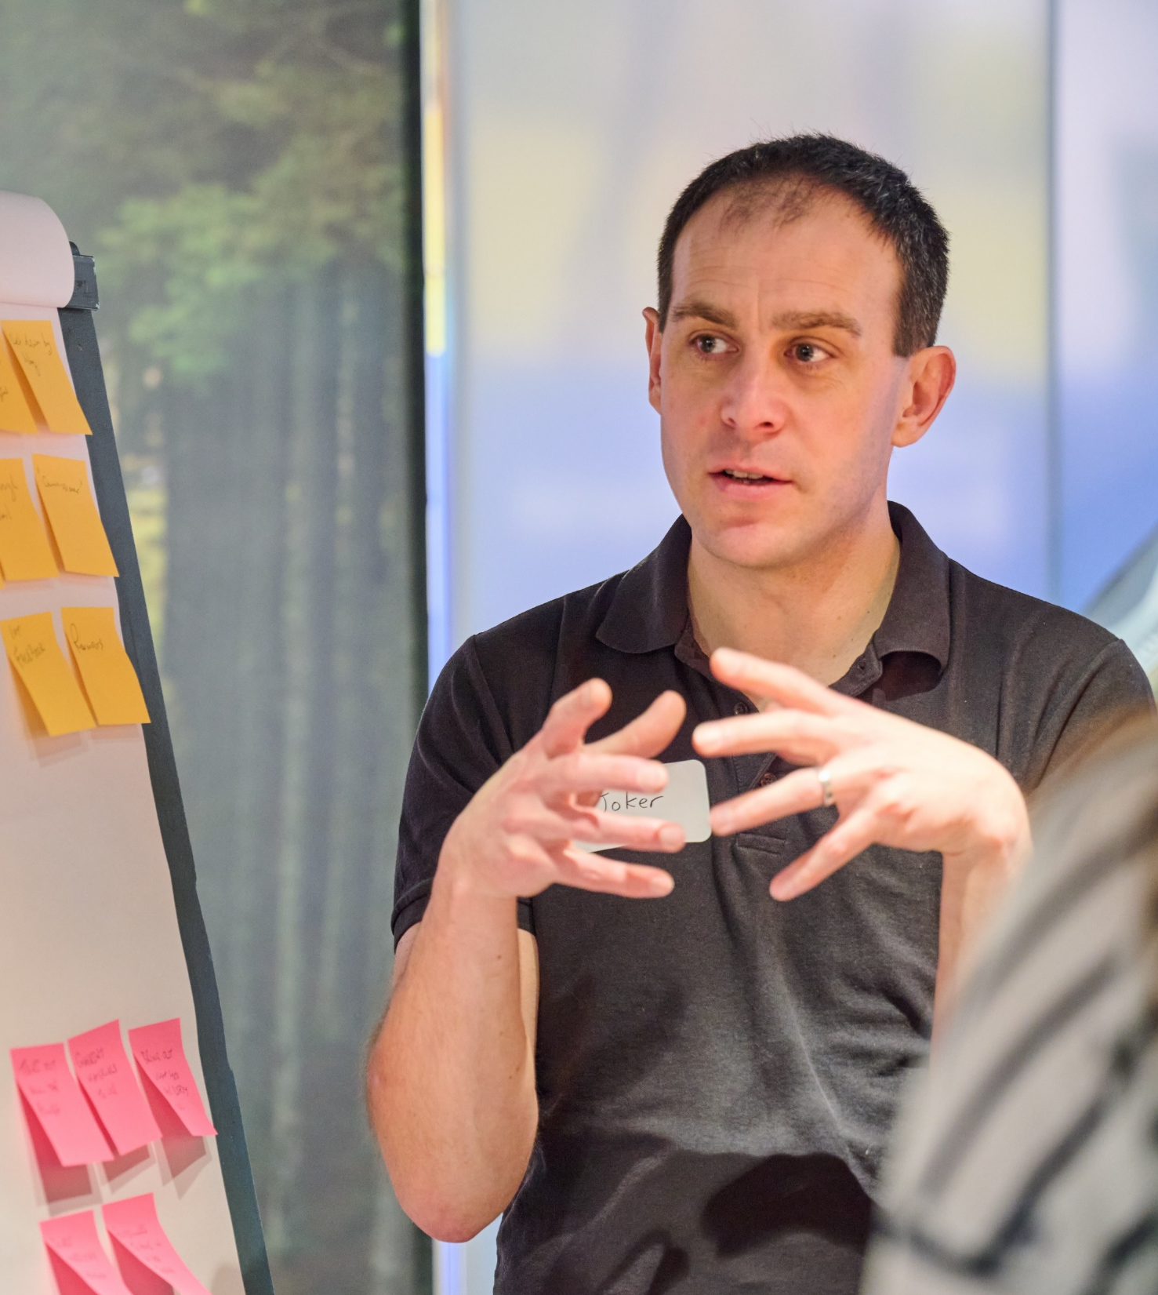
Interim Processes
While Compass is frozen, several processes will be impacted. This includes:
Awards
Criminal record checks
Internal checks
References
Suspensions
Training
Permits
Nights Away Notifications
Member & Role management
Any process changes will only need to be in place for the 2-3 weeks where Compass is frozen
Some processes will also change while we are operating on two systems, such as permits.

Slide 32
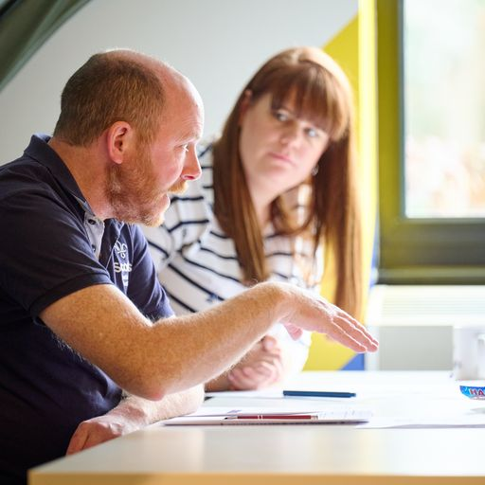
Interim Processes
Some current processes can’t be done during this period and others will need a temporary process put in place
We’ll be sharing the detail of what the impacts are, and any process changes closer to go-live
Any temporary processes are designed to be as simple as possible
We will be producing webpages walking through any changes to processes

Slide 33
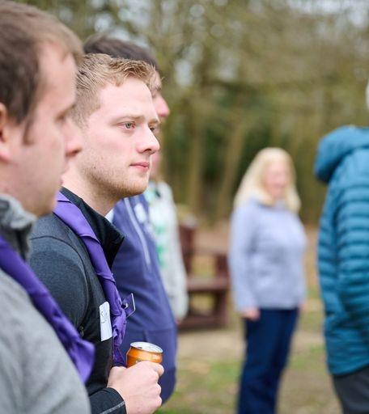
Go-Live Support Teams
Your Go-Live Support Teams will receive the training in systems and processes they need
Locally you’ll need to make sure your volunteers are aware of how to access this
Just before Compass freeze, you’ll want to get this team in place

Slide 34
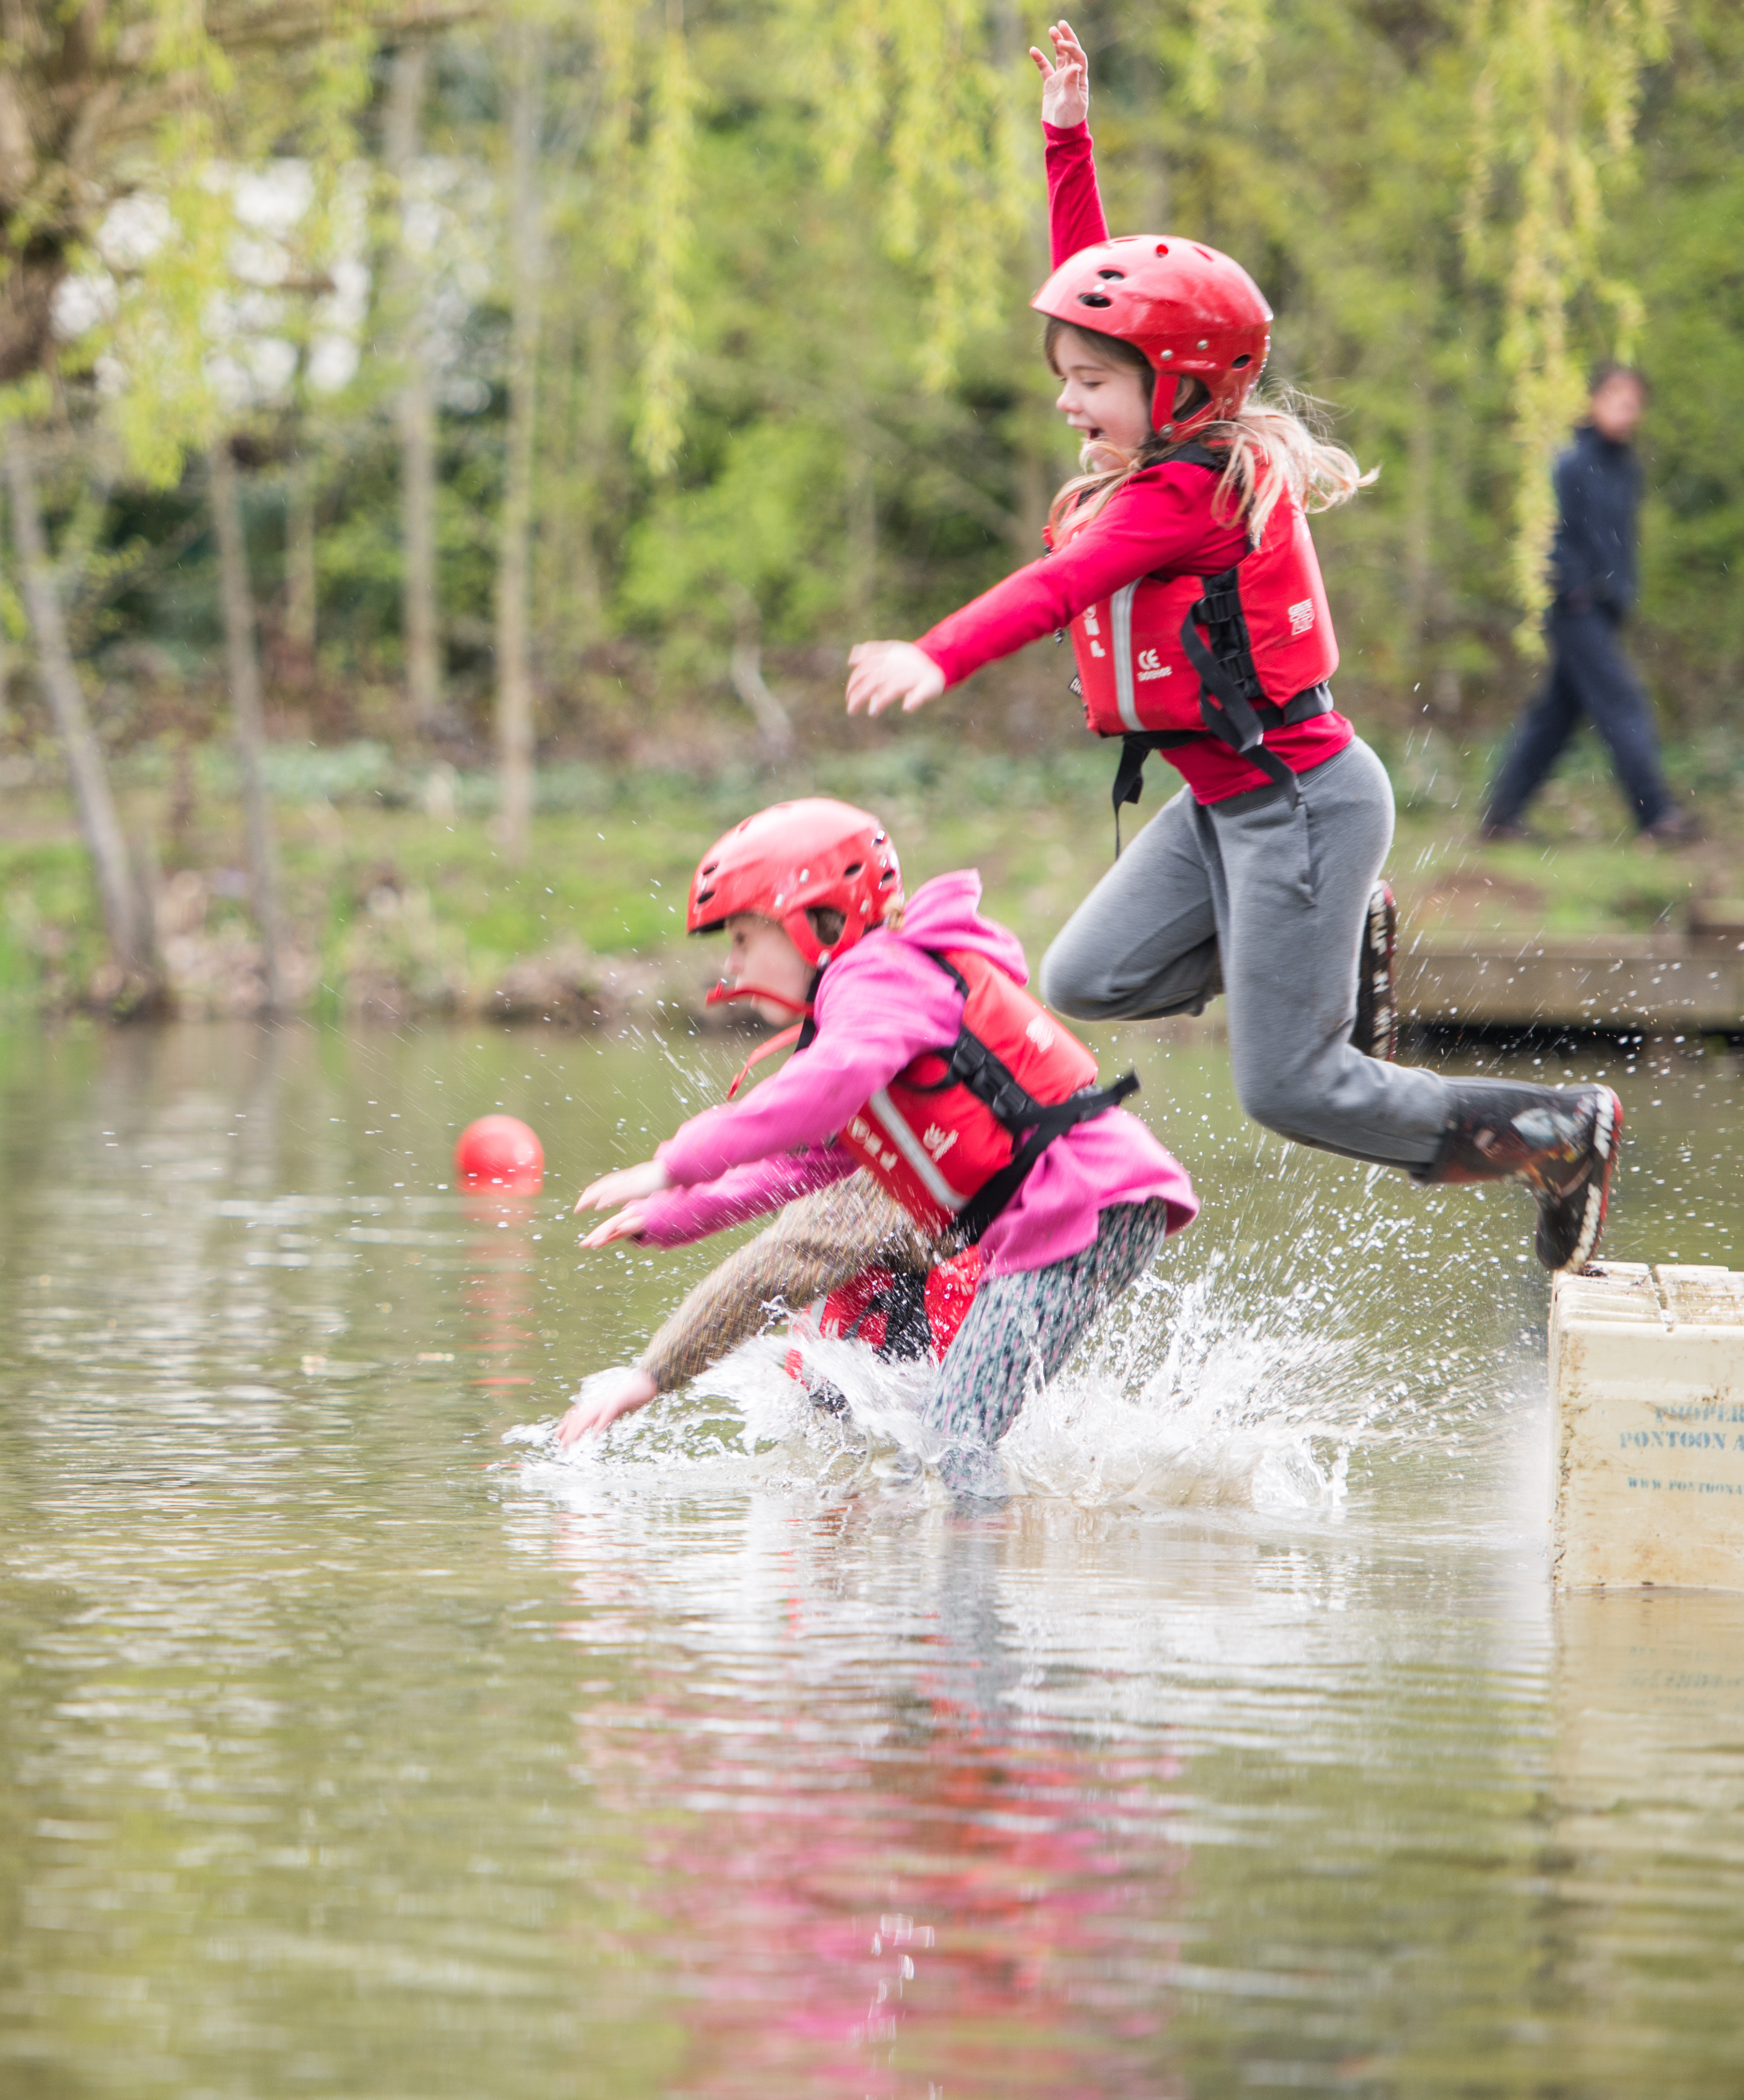
New system and process training
Training webinars will start a few weeks prior to go-live of the new system, just before Compass freeze
We will deliver:
All Member sessions - walking through steps of new processes and system functions
Targeted sessions - role specific sessions such as for Assessors, Nights Away Approvers, Learning Facilitators etc.
These live sessions will be recorded and shared

Slide 35
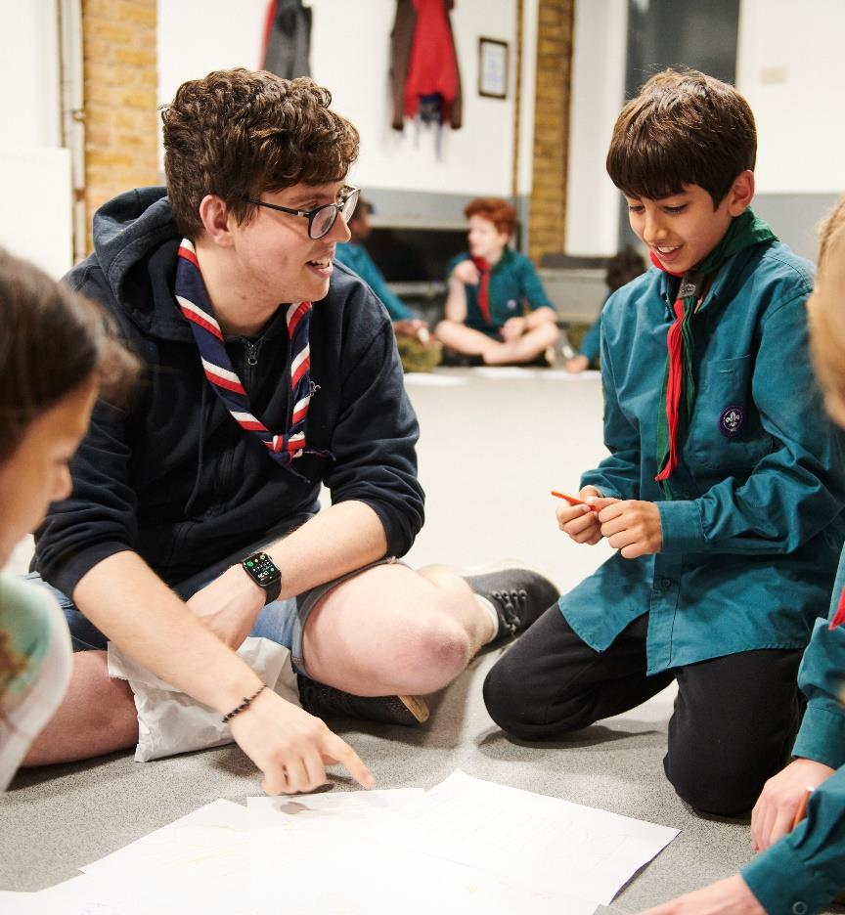
New system and process training
Alongside the live sessions, we’ll also have a suite of guides on the website
Step by step written guides and videos for all the functions within the digital tools will be produced and available online

Slide 36
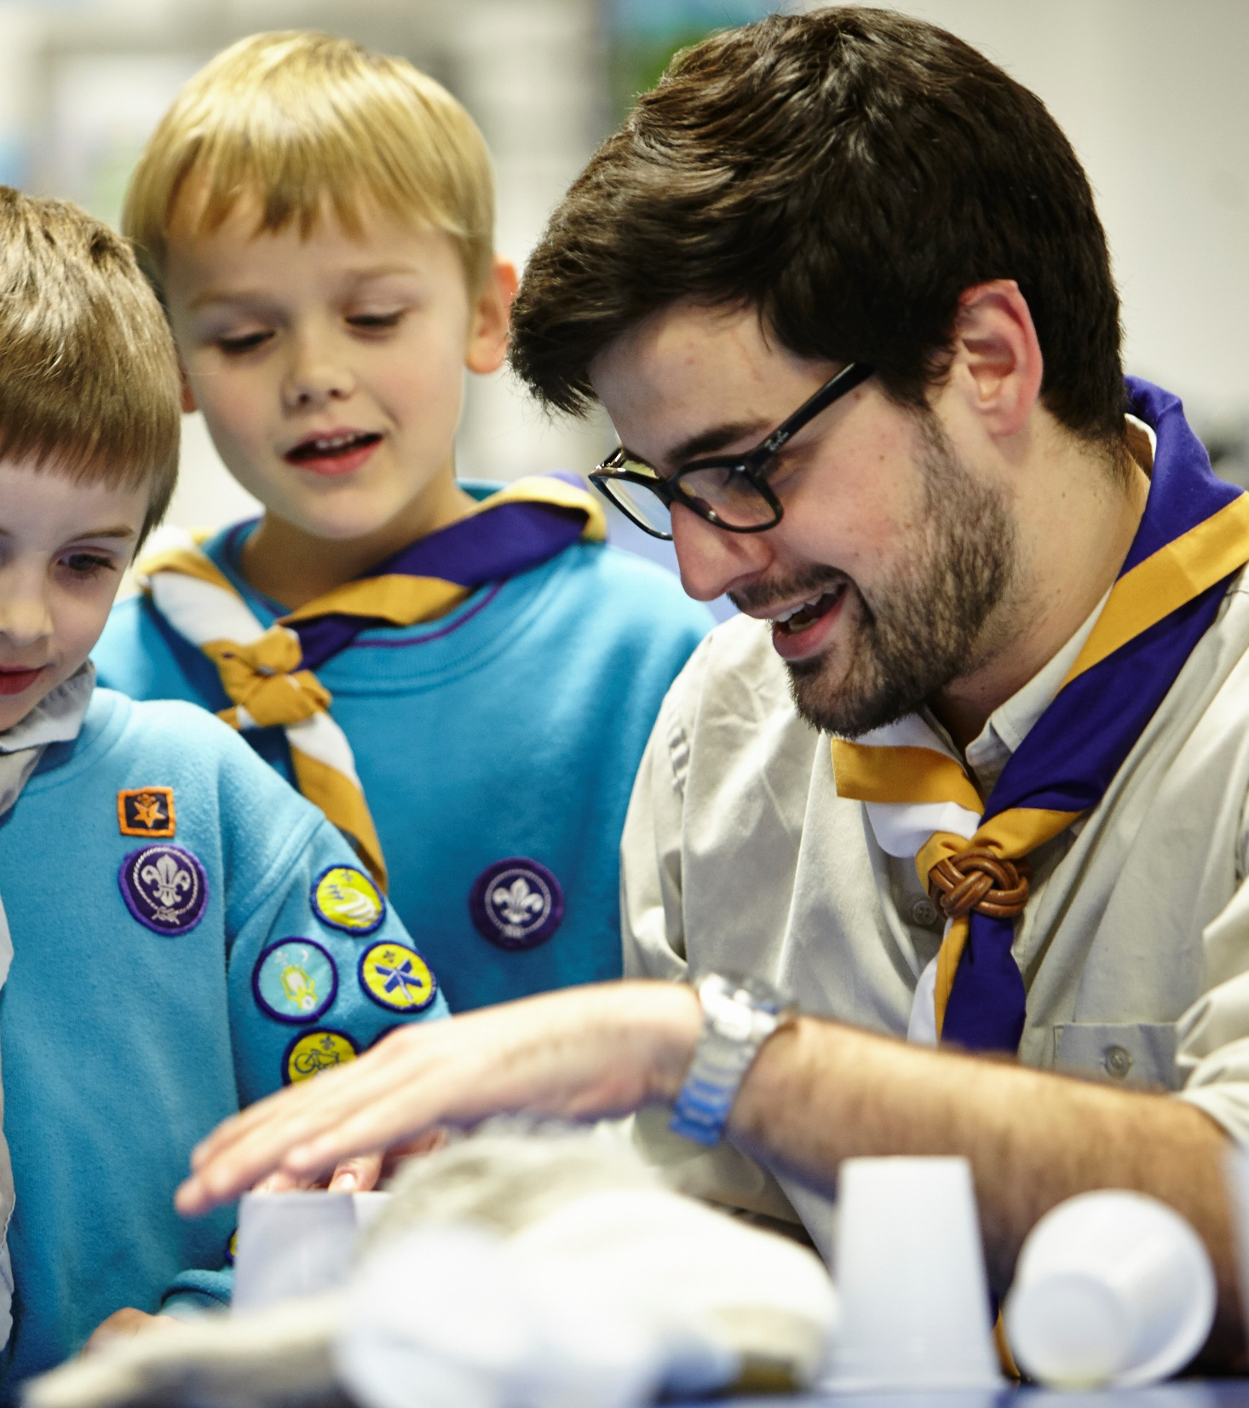
POR for Post-Migration
POR will be updated, taking effect from go-live of the digital tools, although the wording will be available prior to go-live.
In addition to role title changes, this will primarily mean changes to:
Chapter 4
Chapter 16
Roles Table replaced by Teams and Accreditations tables
A supplement to the current POR will be issued for use by Early Adopter Counties. We will use feedback from this to generate a final ‘full’ POR edition to apply everywhere from the main ‘go-live’.

Slide 37
Preparing for digital tools and processes - For circa. 60 days before Compass freeze
Tasks to complete in your County/Area/Region (Scotland)
What must happen:
All Compass records ready for migration
Your Go-Live Support Team is ready to start
Volunteers are aware of the interim processes during Compass freeze and the coming new ways of working
What should happen:
Remaining Counties, Districts & Groups informally adopts new teams and titles locally
What must not happen:
Volunteers working outside of current rules in POR (E.G. App. Panels, Role training requirements)

Slide 38
Any Questions?

Slide 39
Next Steps

Slide 40
What we’re doing:
What you can do:
Sharing webinar dates and building content
Producing new videos to support understanding of Volunteer Experience changes
Sharing Go-Live Support Team tasks
Sharing new readiness webpages
Preparing to walk through the next two phases at next month’s TL Call
Make sure every Trustee Board have, or are ready to, adopt the membership changes at their next AGM
Make sure every County, District & Group team has defined its structure and members
Start forming your Go-Live Support Team
Maintain training provision and current welcome processes for all current and new volunteers
Each County, District & Group informally adopt new teams and titles locally, where possible

Slide 41
“A shared understanding for what we do and say as volunteers in Scouts, supporting each other, following our values and being at our best, while acting as role models for young people.”
Embedding Culture Change
It’s important that we remember the core of the volunteer experience transformation is about culture change
Across the movement we must continue to embed, and role model this culture change
This includes:
Our Volunteering Culture
New ways of working, including learning and welcome

