Slide 2
Notes:
Here are Mo and Jaz. They love watching videos online.

Slide 3
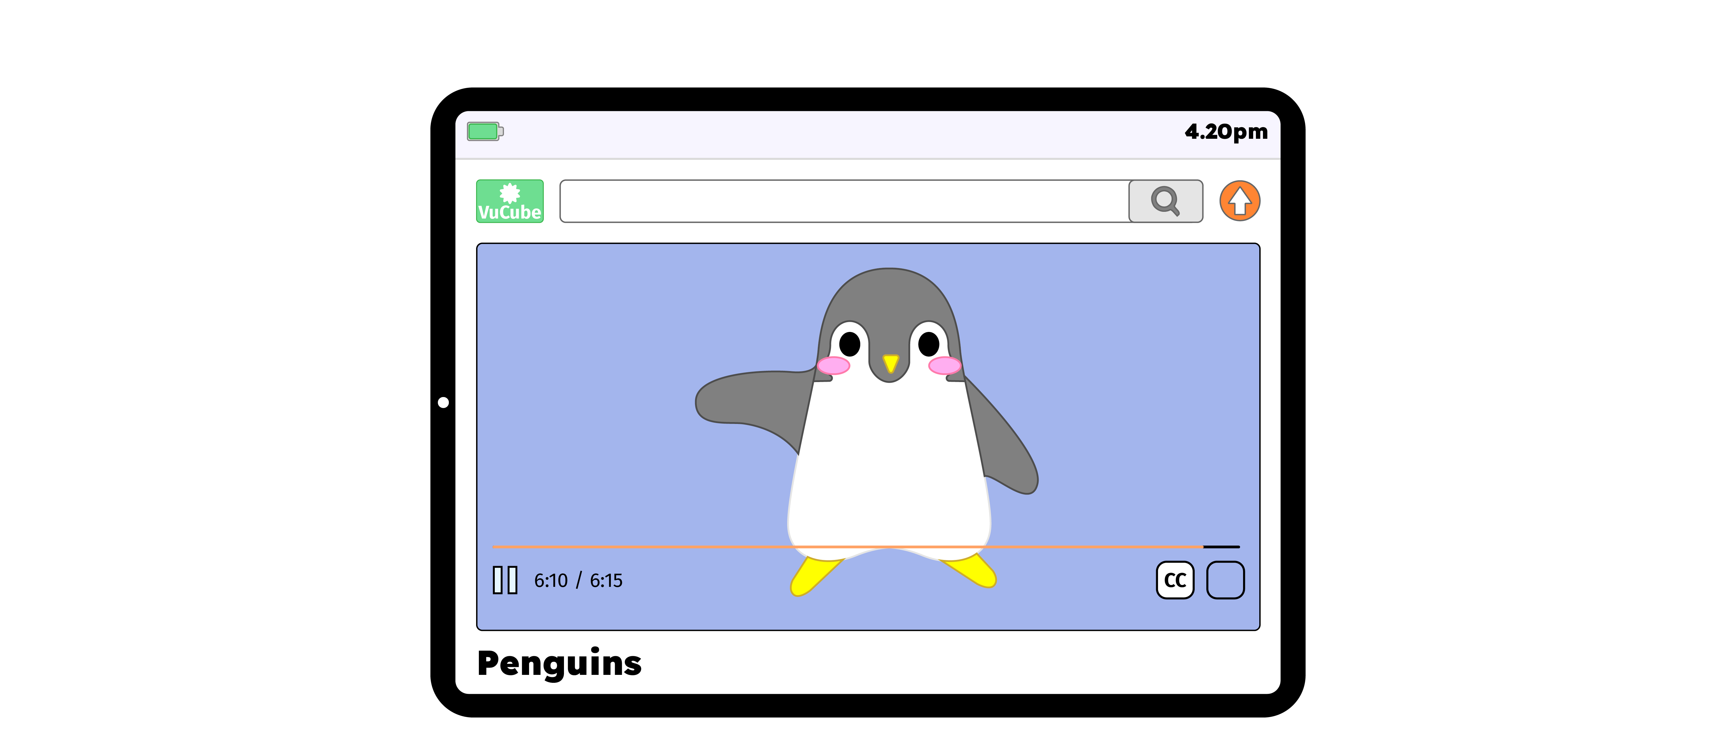
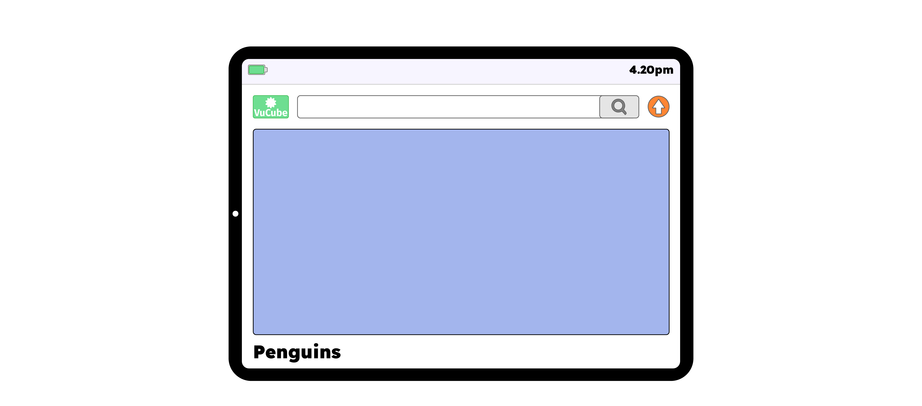
Notes:
They are watching one of their favourite videos about penguins.

Slide 4
Notes:
But at the end, the video changes and a new one starts playing.

Slide 5
Notes:
This one is not about penguins, it is scary.

Slide 6
Notes:
“I don’t like this video,” says Mo. “I feel worried.”
“I have a funny feeling in my tummy,” says Jaz. “I don’t like it either.”

Slide 7
Notes:
Questions
How are Mo and Jaz feeling?
What should Mo and Jaz do next?

Slide 8
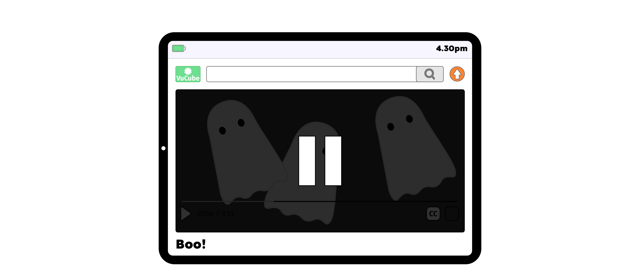
Notes:
Mo and Jaz stop watching the video and go to find Dad.

Slide 9
Notes:
“Dad, there’s something scary on the tablet and we don’t want to watch it,” says Jaz.

Slide 10
Notes:
“Thank you for coming to tell me,” replies Dad. “I’m sorry you saw something that made you feel worried. Asking for help was the right thing to do.”

Slide 11
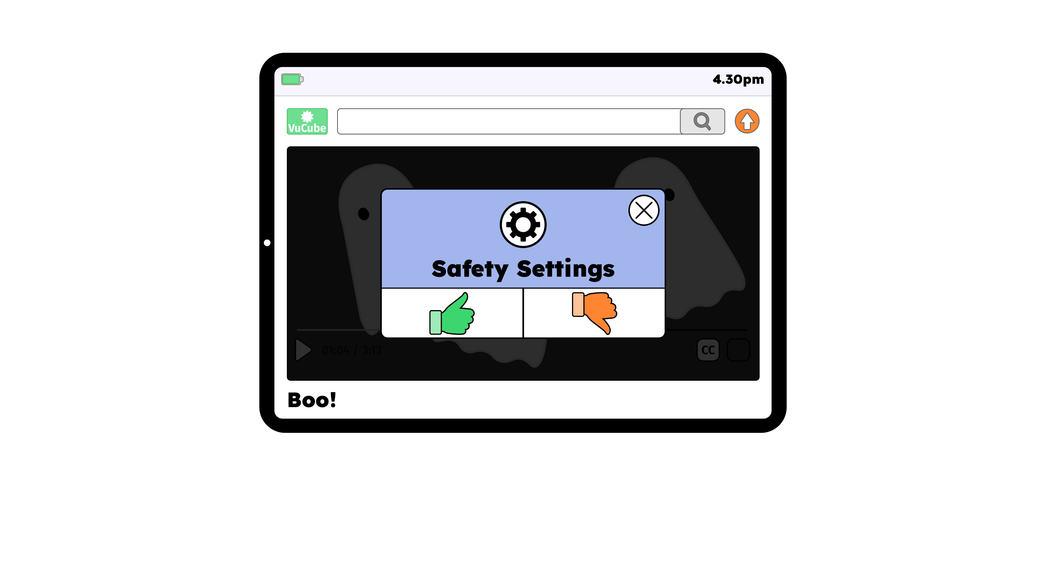
Notes:
Dad checks the safety settings on the tablet and puts the tablet away. “Shall we go outside to play?” he asks.

Slide 12
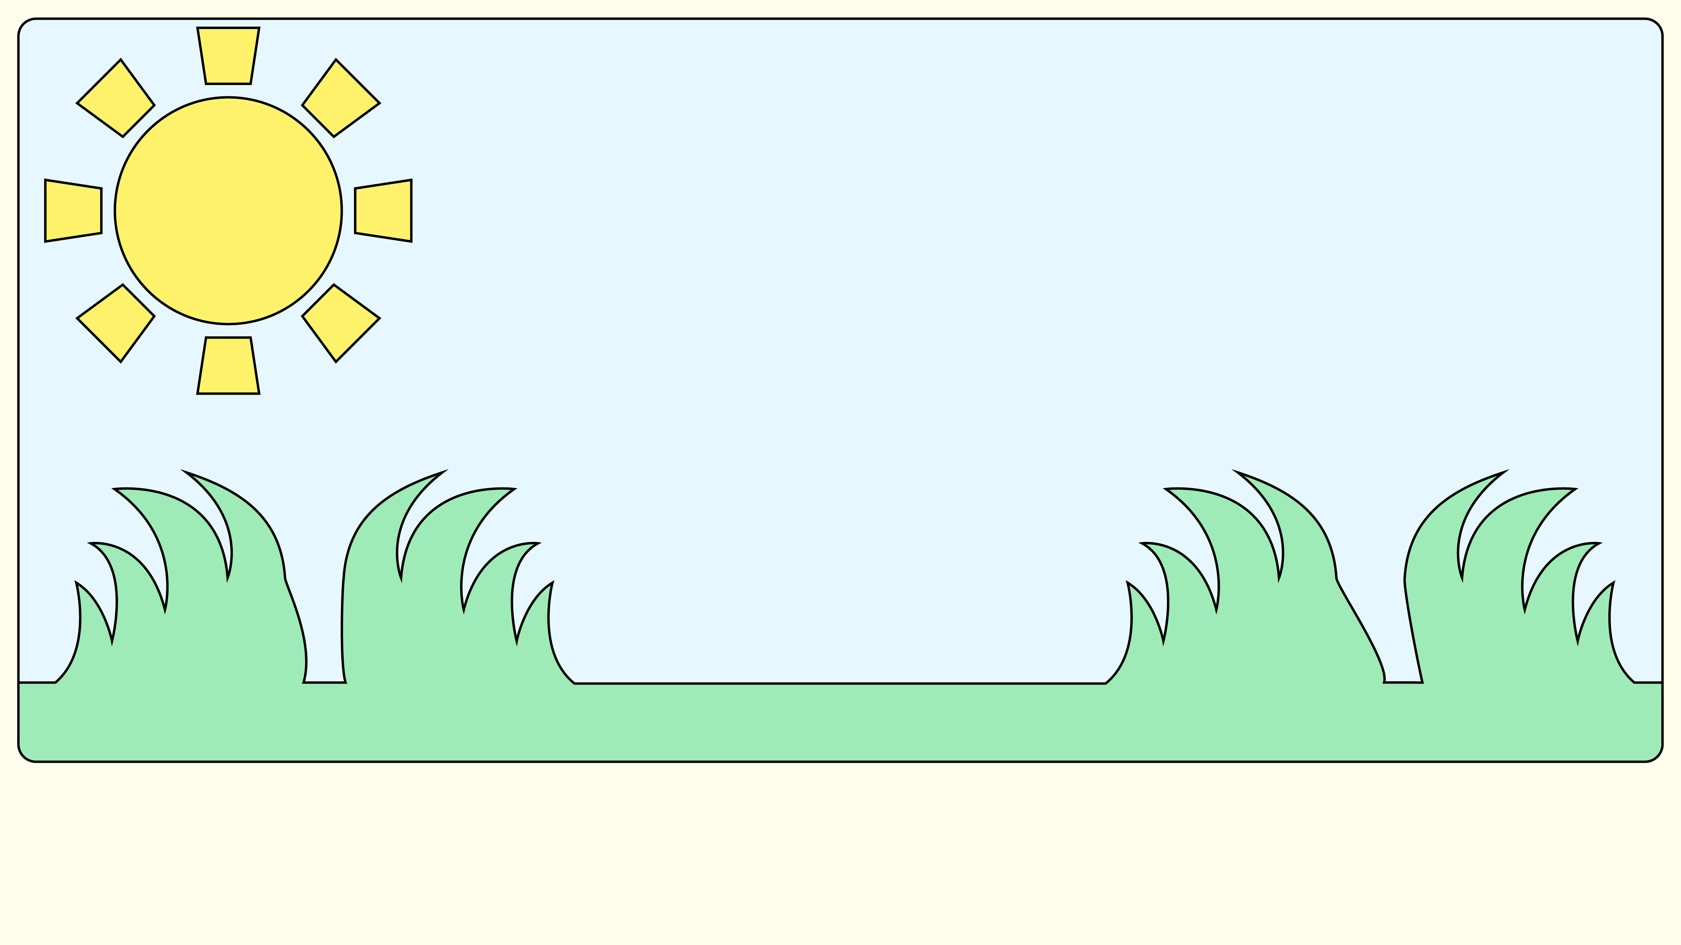
Notes:
Mo and Jaz feel much better. Remember, if you see something online that makes you feel worried or upset, you don’t have to carry on looking at it.

Slide 13
Notes:
Always tell a grown-up if something changes online that makes you feel worried or upset.

Slide 14
Notes:
Questions
Mo and Jaz enjoy watching videos online, what is your favourite thing to do online?
How did Mo and Jaz feel when they saw the video?

Slide 15
Notes:
Mo and Jaz’s message to you
We are very lucky to live with Dad, he helps us with whatever we need.
Who are the grown-ups in your life that you can go to for help?

